Slide 1
Genetic variants and risk of lung cancer in never smokers
Tumor conference
2010.4.19
R4 Sone Yee Kim
Division of Pulmonology,
Department of Internal Medicine,
Yonsei University College of Medicine

Slide 2
Introduction
Tobacco smoking remains the principal cause of lung cancer
However
  15% of men, 53% women (25 % of all cases)
  10-15 % in Europe & North America
  30-40% in Asian countries
  → never smoker
  J clin Pathol 2007

Slide 3
Introduction
Lung cancer in never smoker(NCINS)
-hot issue
  Higher response rate with EGFR-TKI
  J Natl Cancer Inst 2005
  Activating mutations in the EGFR-TK domain more frequently
  Echinoderm microtubule-associated protein-like 4 anaplastic lymphoma kinase(EML4-ALK) fusion gene –two pathways involving EML4 and ALK dominant in 40-50% in NCINS Nature 2007
  Women, NSCLC (mostly adenocarcinoma)
  Better natural history and prognosis with therapy

Slide 4
Introduction
Many studies
  Etiology, clinical characteristics, prognosis of lung cancer in never smokers are different
  Lung cancer in never smokers is increasingly recognised as a distinct disease entity

Slide 5
Introduction
Causes of Lung cancer in never smokers
  -are poorly understood
  -established risk factor is second-hand smoking
  -other : environmental factors, hormones, viral infections
  -individual susceptibility to lung cancer has been studied (inherited genetic & acquired somatic changes)
  The specific genetic mechanisms remains to be elucidated

Slide 6
Genetic variants and risk
Familial aggregation
-familiy history of lung cancer → increase lung cancer in never smokers

Slide 7
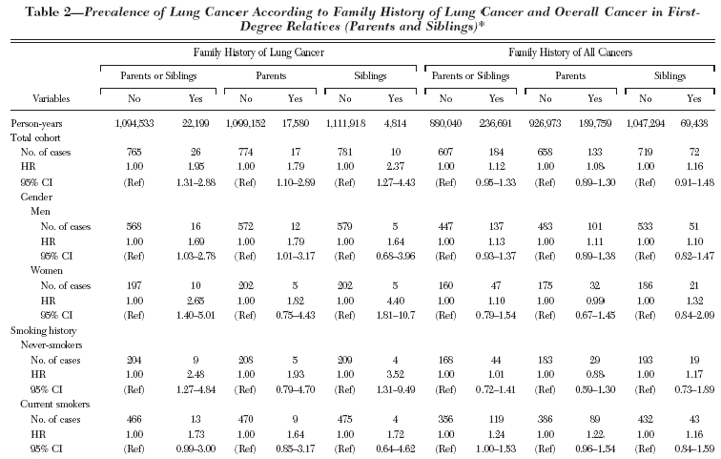
The JPHC study, CHEST 2006

Slide 8
Linkage studies
-family aggregation → possibility of one or more susceptibility gene for lung cancer
6q 23-25 (146cM to 164 cM) – lung cancer (even in never smokers)
  :familial lung cancer
Am J Hum Genet 2004

Slide 9
Candidate gene association studies
Genome- wide association studies

Slide 10
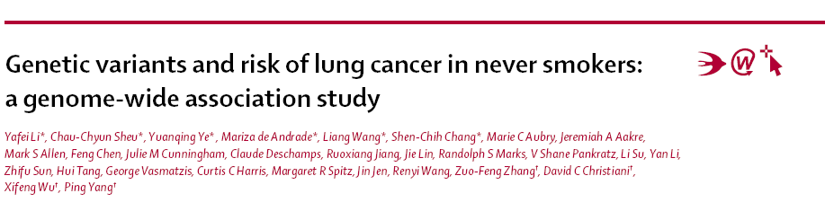
March, 2010, Lancet oncology

Slide 11
Introduction
Genome –wide association studies
  Identified several candidate genes and genomic loci that have a moderate effect on the risk of lung cancer
  But no studies in never smokers alone
AIMS of THIS STUDY
  -To identify genetic loci and candidate genes that increase the risk of lung cancer in never smokers by genome-wide association study
Genome –wide association (GWA) studies : assay hundred of thousands of single-nucleotide polymorphisms(SNPs) and relate them to clinical conditions and measurable traits.
JAMA , 2008
SNP: single-nucleotide polymorphism is a DNA sequence variation occuring when a single nucleotide – A,T,C,G – in the genome differes between members of a species ,
Journal of molecular biology, 2005

Slide 12
Methods -Patients
Patients
  Never smokers: < 100 cigarettes during their lifetime
  Written informed consent
  Protocol approved by
  - Mayo Clinic (Rohester, MN, USA)
  - MD Anderson Cancer Center (MDACC)
  - Kelsey-seybold Clinic(Houston, TX,USA)
  - Harvard School of Public Health and Massachusetts General Hospital (Boston, MA, USA)
  - University of California in Los Angeles (CA, USA)

Slide 13
Methods -Patients
Mayo GWA studies
Cases
Patients with lung cancer
Controls
Community residents
Classed as never smokers
Between January ,1997 , and September, 2008
Never smokers
Matched to patients according to age, sex, ethinic background

Slide 14
Methods -Patients
Detailed information (cases and controls)
  -structured questionnaire and medical records
  -family history of cancer, exposure to second- hand smoke
  -source of the exposure (spouses,parents, and co-workers-social setting/ chidhood,adulthood,lifetime), amount (number of packs), duration of exposure(years),history of COPD

Slide 15
Methods-patients
MDACC study
Cases
Patients with lung cancer
Controls
Healthy individuals
Recruited from the Kelsey-Seybold Clinic, which is the largest multispecialty physician group practic in the grater Houston area
Newly diagnosed, histologic confirmed
Recruited from MDACC

Slide 16
Methods-patients
Detailed information
  -face to face interview datas and medical records
  -on demographic data

Slide 17
Methods-patients
Harvard study
Cases
Patients with primary lung cancer
Controls
Healthy non-blood-related family members and friends of patients with cancer or patients with cardiothoracic conditions undergoing surgery
Newly diagnosed, histologic confirmed

Slide 18
Methods-patients
Detailed information
  -interviewer-administered questionanaire
  -on demographic , occupatioinal exposures, detailed smoking histories

Slide 19
Methods-patients
UCLA study
Cases
Patients with lung cancer
Controls
Population without hisotry of lung or aerodigestive tract cancers
Histologic confirmed
Identified through the Los angels Country Cancer Registry administered by the cancer surveillance program at the University of southern California (Los Angeles, CA, USA)
Matched according to sex and age
Selected by use of an algorithm to identify eligible controls froma census of each case’s neighbourhood

Slide 20
Procedures
CEPH (Centre du Etude Polymorphisme Humain) has organized the collaborators to produce genetic maps with the combined datasets for all the human chromosomes
Mayo GWA study
  -Illumina HumanHap 370k and 610k BeadChips(Illumina, San Diego, CA, USA): contain 373397 and 592532 tag SNPs
  -CEPH DNA samples ( a family trio) were included to monitor genotyping calling in this study. → concordance between the replicates was above 99.5%

Slide 21
Methods-Procedures
SNP quality control
-exclude
  5% of samples that failed(n=33549)
  Minor allele frequencies (MAF) less than 0.005 (n= 7878)
  Genotype distributions that were not in Hardy-Weinberg equilibrium (p<1*10⁻⁷ , n=52)
Sample quality control
-exclude
  Genotyping call rates <95% (n=3)
  Inconsistencies between genotype and self-reported sex data (n=1)
=➔ 331918 SNPs of 377 case-control pairs

Slide 22
Methods-Procedures
Population stratification :
  ten eigenvectors
  no significant between cases and controls
  in further SNP-association analyses, the population stratification was not adjusted.
Top 44 SNPs were obtained

Slide 23
Methods-Procedures
MDACC
  -Illumina HumanHap 660k and 610k Beadchips
  -after qulity control → 735 never smokers(328 cases and 407 controls)
  -All 44 SNPs call rate >95%
  -samples in this study genotyping call rates >95%

Slide 24
Methods-Procedures
Harvard study
  -Illumina Human610-Quad BeadChip
  -after quality control → 253 never smokers (92 cases and 161 controls)
  All 44 SNPs call rate >95%
  samples in this study genotyping call rates >95%

Slide 25
Methods-Procedures
MDACC/Harvard → two top SNPs
(rs 2352028 and rs2352029)
rs 2352028 and rs2352029
  -complete linkage disequilibrium in the control data from Mayo,MDACC, Harvard, CEU HapMap
  → Only rs 2352028 was genotyped in the UCLA study
CEU HapMap: sample consists of "Utah residents with ancestry from northern and western Europe".

Slide 26
Methods-Procedures
rs 2352028 was genotyped in the UCLA study
  -by use of the TaqMan allelic discrimination method on the TaqMan ABI 7900 HT sequence detection system platform
  -10% of the samples were randomly selected and repeated for quaity control
  -no GWA study data, popuation stratification was not done
Genome microarray analysis with the Illumina Human WG D ASL array (Illumin, Inc,SanDiego, CA, USA)
  -143 pairs of normal and tumor samples from never smoking cases , of which 70 overlapped with the Mayo genome-wide association study

Slide 27
Methods-statistical analysis
Mayo study
  -variable: COPD,exposure to second-hand smoke in adulthood/childhood,lifetime exposure to second-hand smoke, family history of lung cancer, family hisotry of any other cancer
  -association between SNPs and lung-cancer risk by conditional logistic regression model.
MDACC and Harvard study
  -OR (95% CI), p-value
UCLA
  -OR, p-value

Slide 28
Methods-statistical analysis
meta analysis : combined estimates of risk for replicated SNPs from the Mayo genome-wide association study and the three replication studies
Linear regression model : correlation between genotypes and gene transcrip exprssion levels (eQTL) in 70 samples of normal lung tissue
Paired t-test: identify genes that were exprssed differently in tumor samples and samples of adjacent normal tissue

Slide 29
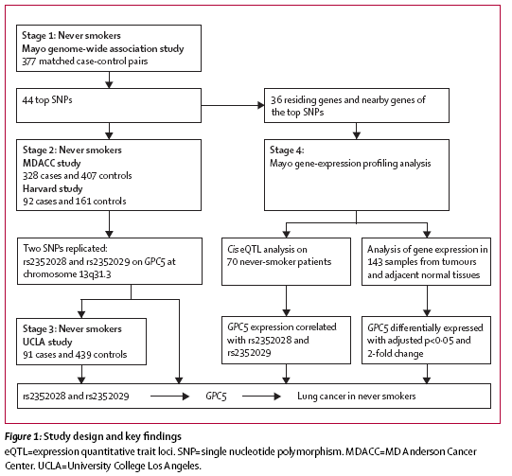
Results

Slide 30
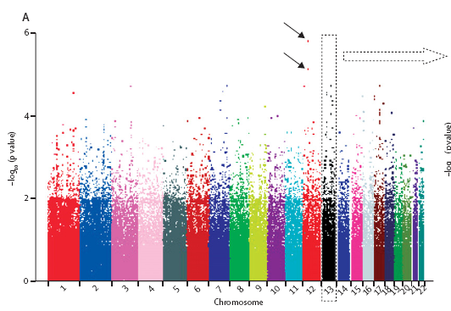
Results
Stage I
  -analysis 331917 SNP in 377 case-control pairs matched according to age, sex, ethnic origin
  -strongest association was detected at two SNPs on chromosome 12, rs 11183940 (p= 1.5 * 10 ⁻⁶) and rs 10880785(p= 7.1 * 10 ⁻⁶)
  -44 most significant SNP by considering confounders (p < 0.001)

Slide 32
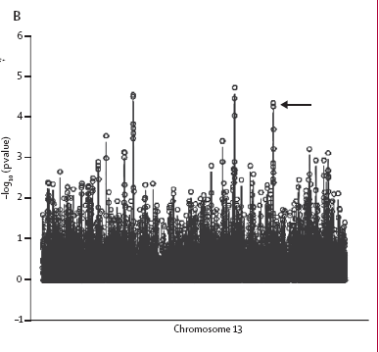
Results
Stage II
  -tested the 44 top SNPs in datasets from the MDACC and Harvard studies
  -MDACC study
  rs 2352028 & rs 2352029 at chromosome 13q31.3 were replicated & rs 2352028 & rs 2352029 were strongly associated with expression levels of GPC ( p= 1.96 * 10 -4) by eQTL analysis
  →not replicated in Harvard study
  But significant in the combination data (Mayo, MDACC, Harvard)
eQTL ( expression quantitative trait loci) analysis - SNPs in regulatory elements can affect expression levels of the target genes

Slide 34
Results
Stage III
  -rs 2352028 and rs 2352029 : complete linkage disequilibrium
  Tested rs 2352028 in the UCLA study
  Significantly associated with risk for lung cancer in the dominant model

Slide 35
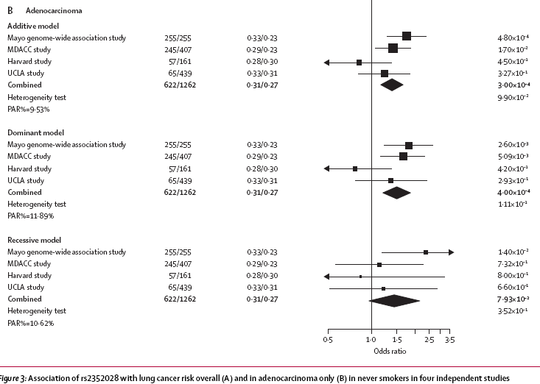

Slide 36
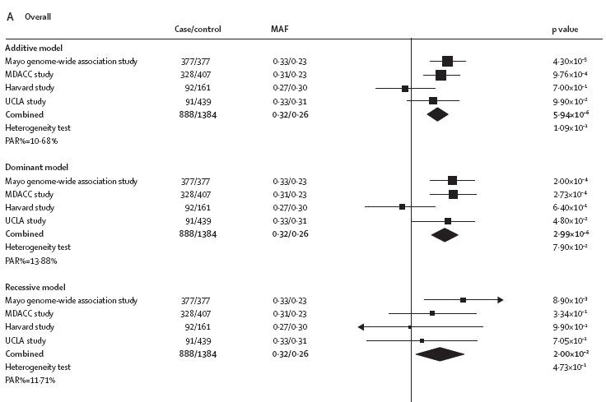
PAR=10.68 %→ More than 10% of cases of lung cancer in never smokers could be attributed to genetic variation of the SNP rs 2352028

Slide 38
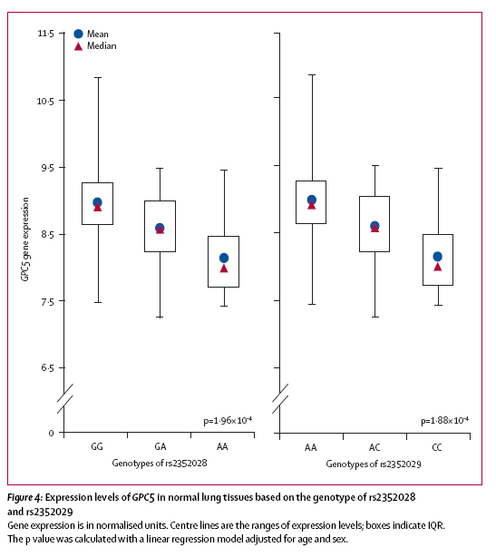
Results
Among all residing and nearby genes of the 44 SNPs → identifed 36 genes
in normal lung tissue
  Genotypes of the top 44 SNPs and the gene-exprssion levels
  GPC5 expression level : Individuals with
  the high-risk allele(A at rs 2352028) <common allele (G)
  GPC5 expression level : Individuals with the
  high-risk allele(C at rs 2352029) <common allele (A)
No other candidate SNPs were significantly correlated with their residing or nearby genes’ expression levels

Slide 39
Results
Whole-genome transcription levels in tumour and adjacent normal lung tissue
  36 genes were compared in all histological tumour and matched normal tissue
GPC5 expression levels were 50% lower in adenocarcinoma than in matched normal lung tissue (p=6.75 * 10 ⁻¹¹): consistent with eQTL
No correlation in other histology
Other genes show correlation , but incosistent with eQTL

Slide 40
Discussion
Four stage of GWA
  44 candidate SNPs
  Rs 2352028, rs 2352029
    -Replicated in stage 2
    -located at intron 5 of GPC
  Rs 2352028
    -replicated in stage 3
    -associated with risk of lung cancer in never smokers through their regulation of GPC expression (eQTL)

Slide 41
Discussion
  →GPC expression is lower in adenocarcinoma
    ( no significance in other histology)
  To confirm this result , we assess the Oncomin microarray databases
    Lung cancer (9), adenocarcinoma (7)
    GPC downregulation in adenocarcinoma(2)
    GPC –adenocarcinoma
    (limitation: sample size, different etiology of adenocarcinoma)

Slide 42
Discussion
Former smoker (quitting duration >10yrs) in Harvard
  →two replicated SNPs were associated with lung cancer
  → Long term quitters might share common genetic mechanisms in developing lung cancers

Slide 43
Discussion
GPC 5
  -glypican gene family
    -glypican: important in reulating cell proliferation and division, development processes, oncogenesis
  -amplification at 13q31-32 in several tumors
  -deletion at 13q31.3 in lung cancer
  -13q partial deletion in lung hypoplasia
  → Lung development

Slide 44
Discussion
Small sample size , but multilevel anaylysis → statistical reliability, biological plausibility
Potential heterogeneity(cf Harvard)
Other SNPs validation : small sample size, other study is needed

Slide 45
Summary
We have identified a genetic locus at 13q 31.3 that regulates the expression of GPCs, which might contribute to the development of lung cancer in never smokers
Further studies are needed to investigate the regulatory effect of these SNPs and the functional role of GPC5 in lung tumorigenesis

Slide 46
Closing
More research is needed about lung cancer in never smoker
→Improve understanding of lung cancer generally
cause, therapy

