Slide 1
Smoking-related interstitial lung disease
S. H. Lee,
Division of Pulmonology
Department Of internal medicine
Yonsei University College of Medicine
Notes:
안녕하세요. 호흡기 내과 강사 이상훈 입니다. Pleural effusion 에 대해서 review 를 준비하였습니다.

Slide 2
Smoking-related interstitial lung disease
complex mixture of more than 6,000 compounds and causes a variety of pulmonary and systemic effects in humans
An estimated 10 to 15% of all smokers develop clinically significant airflow obstruction
Uncommon
Overlab
Notes:
Lung cancer, COPD
ILD
Smoking 자체만으로 respiratory bronchiolitis가 있으며, emphysema 가 있고, abnormal 한 PFT, cough, sputum

Slide 3
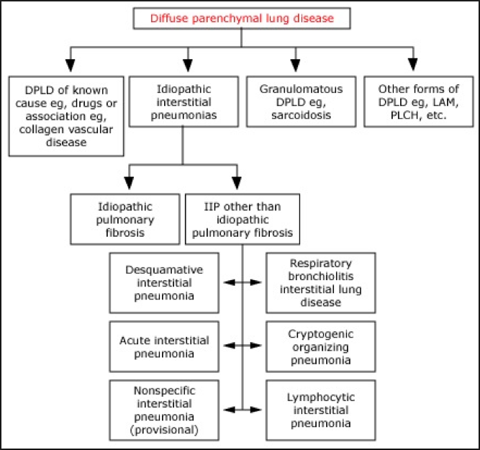
Smoking-related interstitial lung disease
Notes:
Diffuse parenchymal lung diseases consist of disorders of known causes (rheumatic disease, environmental or drug related
The interstitial pneumonias are further categorized as chronic fibrosing, acute or subacute fibrosing, or smoking related.

Slide 4
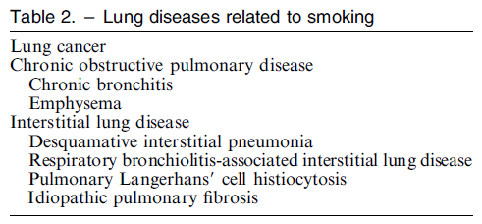

Slide 6
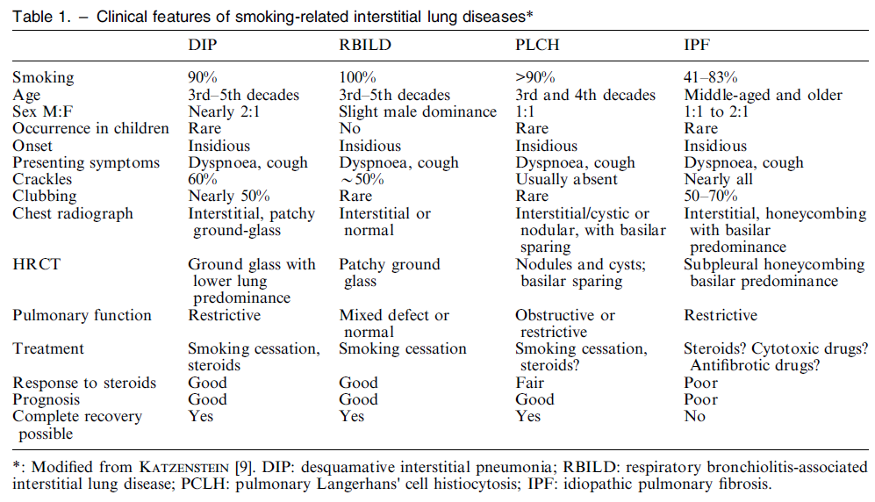

Slide 7
RB-ILD
Respiratory bronchiolitis (RB) is a well-recognized pathological lesion found in the lungs of many cigarette smokers that is generally not associated with respiratory symptoms.
The key features of RB are the pathologic findings of tan-pigmented macrophages (also known as smokers’ macrophages) in the respiratory bronchioles, a patchy submucosal and peribronchiolar infiltrate of lymphocytes and histiocytes, and peribronchiolar fibrosis that extends into contiguous alveolar walls.

Slide 8
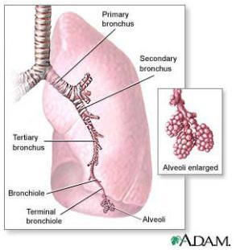
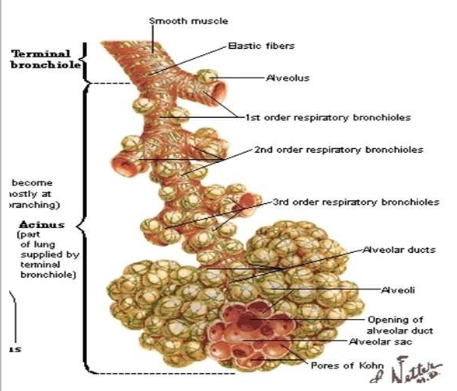

Slide 9
RB-ILD is defined by the presence of changes of RB as the sole pathologic finding in a current or former cigarette smoker with clinical evidence of interstitial lung disease
The degree to which fibrosis extends into the alveolar wall has sometimes been used to distinguish RB from RB-ILD, but most pathologists believe that the two processes cannot be distinguished on pathologic grounds alone.
Thus, RB-ILD probably represents a subset of individuals with a more severe stage in the spectrum of RB and is much less common than RB.

Slide 10
Incidence (RB-ILD)
RB is a common finding among smokers, but RB-ILD is uncommon. As an example, in a series of 79 smokers with spontaneous pneumothorax requiring surgical intervention, RB was found in 89 percent of the lung biopsies
Although the exact incidence of RB-ILD is not known, in a review of 168 lung biopsies performed for suspicion of idiopathic pulmonary fibrosis, 10 were RB-ILD

Slide 11
PATHOGENESIS – smoking, duration, intensity
Not related fibroblastic foci
Related with DIP

Slide 12
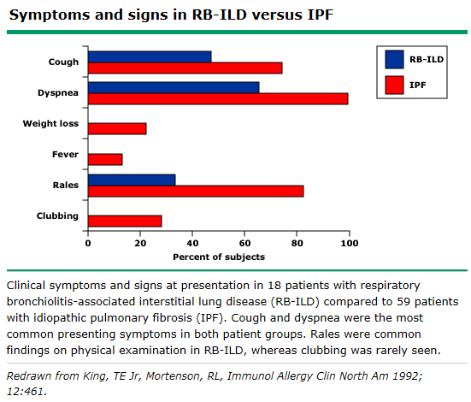
Notes:
30~40대
Pneumothorax, hemoptysis, and acute respiratory failure are less common

Slide 13
Diagnostic criteria (RB-ILD)
A history of current or recent cigarette smoking
cough or dyspnea, ±crackles
PFT of a restrictive or mixed
HRCT- especially diffuse or patchy ground glass opacities in a mosaic pattern or fine nodules and air trapping
Lung bx - changes of respiratory bronchiolitis (RB) without evidence of other causes of diffuse parenchymal lung disease, especially idiopathic pulmonary fibrosis
Notes:
진단이 안되고, 증상이 더 심해지는 경우만 BAL, TBLB, Bx

Slide 14
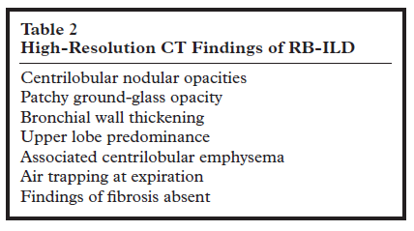

Slide 15
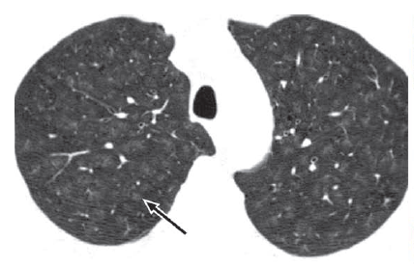
Notes:
RB-ILD in a 32-year-old man with a 17 pack-year history of smoking who presented with a cough,
restrictive PFT results, and reduced diffusion capacity. (a) High-resolution CT image obtained through the upper
lungs shows bilateral centrilobular ground-glass nodules (arrow).

Slide 16
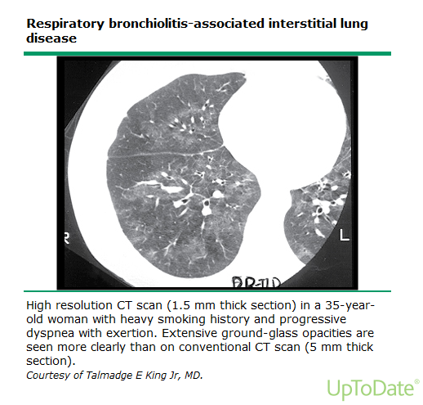
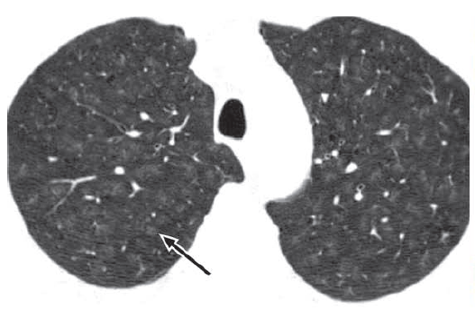

Slide 17
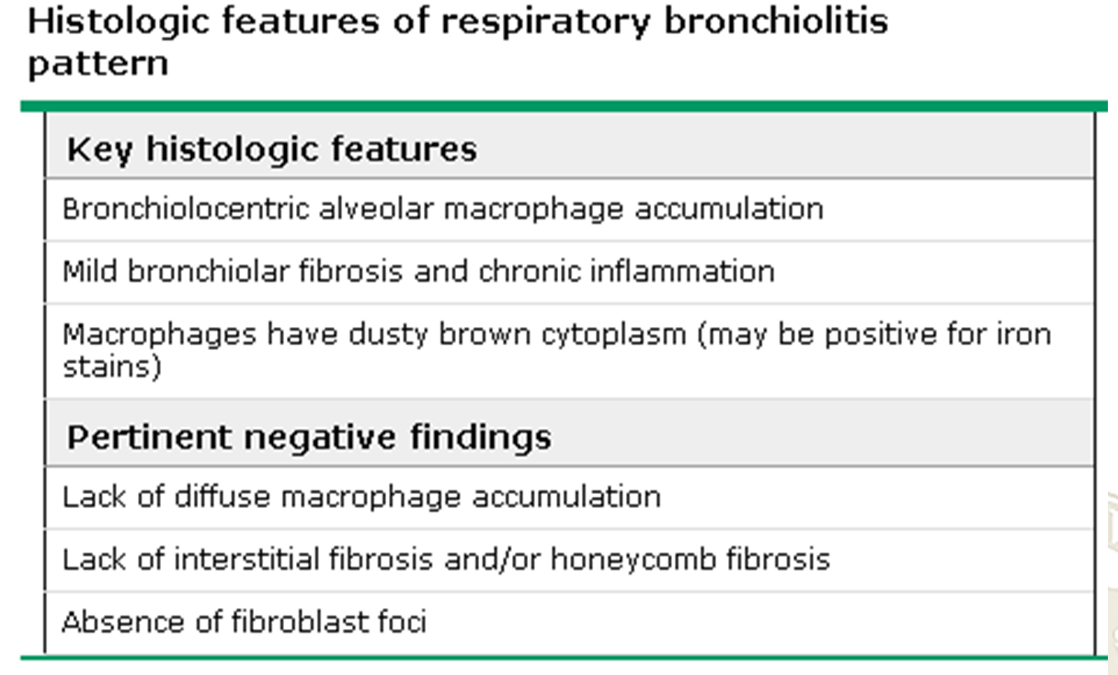
Notes:
DIP is characterized by a prominent and diffuse accumulation of intraalveolar macrophages (that may show fine granular positivity with iron stains), hyperplasia of type II pneumocytes, and mild interstitial chronic inflammation.
The main feature that distinguishes DIP from RB-ILD is that DIP affects the lung in a more uniform and diffuse manner, lacking the bronchiolocentric distribution seen in RB-ILD, but there is considerable clinical, radiologic, and histologic overlap between these entities

Slide 18
Management (RB-ILD)
Smoking cessation
Supportive care
Glucocorticoid and immunosuppressive therapy – 1mg/kg start -> 6~9 month
Lung transplantation

Slide 19
DIP
not desquamation of epithelial cells-> predominant pathologic feature is the intraalveolar accumulation of pigmented macrophages
end spectrum of RB-ILD

Slide 20
DIP
90% of patients with DIP are smokers (systemic disorders, infections, and exposure to occupational or environmental agents or drugs)
Dyspnea, dry cough
Inspiratory crackles are heard in 60%
digital clubbing occurs in nearly one-half

Slide 21
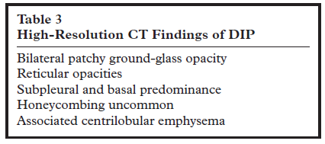
Notes:
X-ray: reported to be normal in 3%–22% of biopsy-proved cases
patchy ground glass opacities with a lower lung and peripheral predominance -> peripheral, patchy, or diffuse in distribution
A peripheral subpleural and basal predominance of ground-glass opacity is most commonly seen
Coexistent emphysema may be present.
Small cystic spaces may develop within the areas of ground-glass opacity

Slide 22
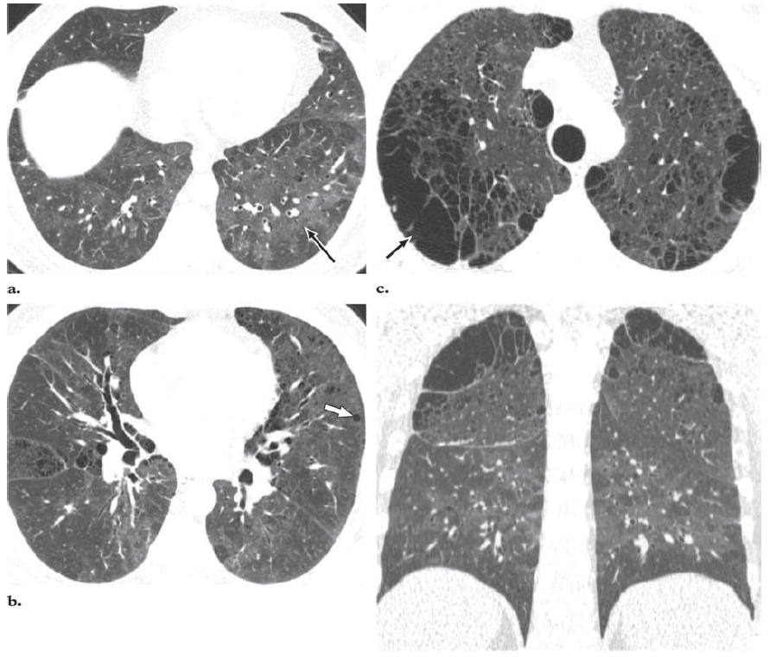
Notes:
DIP and emphysema in a 48-year-old man with a 30 pack-year history of smoking who presented with a
cough, gradually increasing shortness of breath, and mild restriction at pulmonary function testing, with diffusing capacity
of the lung for carbon monoxide (Dlco) 50% of the predicted. (a) High-resolution CT image obtained through the lower
lungs shows bilateral diffuse ground-glass opacity (arrow). (b) High-resolution CT image obtained through the mid lungs
shows diffuse ground-glass opacity, peripheral reticulation, and small cysts (arrow). (c) High-resolution CT image
obtained through the upper lungs shows paraseptal (arrow) and centrilobular emphysema. (d) Coronal reformatted image
shows the basilar predominant distribution of the ground-glass opacity and the apical emphysema.

Slide 23
Treatment & Prognosis
Smoking cessation
Corticosteroid – no RCT
immunosuppressive agents – unclear
The 5- and 10-year survival rates are 95.2% and 69.6%, respectively
Notes:
generally recommended for patients with significant symptoms, PFT abnormalities, and progressive disease
The response to corticosteroids is not uniform, as approximately 25% of patients may continue to progress despite treatment

Slide 24
PLCH
Langerhans cell histiocytosis
Langerhans cell accumulations involve one or more body systems, including bone, lung, pituitary gland, mucous membranes, skin, lymph nodes, and liver

Slide 25
Epidemiologic and clinical feature (PLCH)
Ninety percent to 100% of adults with PLCH are current or former smokers
prevalence of 3.4% in a series of 502 patients undergoing surgical lung biopsy for chronic diffuse infiltrative lung disease
The peak occurrence is at 20–40 years of age
Men and women are equally affected
25% of patients are asymptomatic

Slide 26
cough and dyspnea.
weight loss, fever, night sweats, and anorexia, occur in up to one-third of patients.
In 10% of patients, spontaneous pneumothorax.
Extrapulmonary manifestations may occur in 5%–15% of patients and include bone lesions, diabetes insipidus, and skin lesions
Clubbing is rare
PFTs show normal results or demonstrate mild obstructive, restrictive, or mixed abnormalities; however, the most frequent PFT abnormality is a reduction in diffusion capacity in 60%–90% of patients

Slide 27
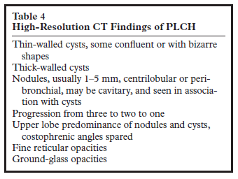

Slide 28
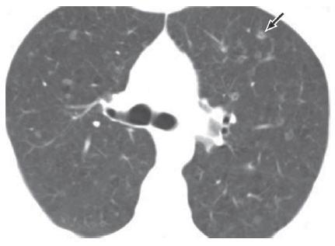

Slide 29
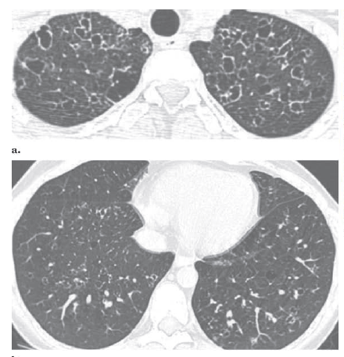

Slide 30
Treatment and Outcome
Smoking cessation
Corticosteroid
vinblastine, methotrexate, cyclophosphamide, etoposide, and cladribine
Lung transplantation
Approximately 50% of patients experience a favorable outcome with partial or complete clearing of radiologic abnormalities and symptom resolution. In 30%–40% of patients, symptoms of variable severity persist; in 10%–20%, recurrent pneumothorax or progressive respiratory failure with cor pulmonale occurs.

Slide 32

Notes:
Itra = sporanox
Posaconazole = noxafil

