Slide 1
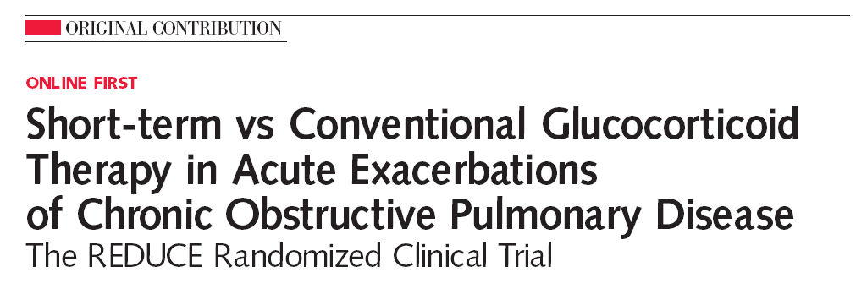
2013.11.7
호흡기내과 R2 이슬아
Notes:
종래의

Slide 2
REDUCE trial
(Reduction in the Use of Corticosteroids in Exacerbated COPD)
Systemic glucocorticoid therapy
in COPD acute exacerbation
Short term (5days) vs. Conventional (14days)
Next exacerbation??
  What percentage of people?
  How soon it comes??
How long does it take until death??
How many people suffer with steroid induced adverse reactions??
Notes:
COPD 급성 악화에 있어 GC 치료가 임상적 유효성(clinical outcome에 benefit을 주고 병원 재원 기간을 줄여준다는 연구 보고)는 많으나 optimal dose, duration에 대해서는 결정된 바가 없음.
GC의 adverse effect 및 potentially large number of exacerbations occurring in patients 고려해 보았을 때 glucocorticoid exposure should be minimized임.

Slide 3
INTRODUCTION
What is the Optimal dose and duration of systemic glucocorticoids ??
+
Large # of exacerbations & Adverse effects of GC use
ll
Glucocorticoid exposure should be minimized!!!
COPD A/E
  Risk factor for disease deterioration
  Mortality ↑
  23~25% of patients with in 1year
Systemic glucocorticoid therapy
    Eg. 30-40 mg of oral prednisolone for 10-14 days
  Clinical outcome ↑
  Length of hospital stay↓
  FEV1 recovery time↑
REDUCE trial
Would a 5-day course of systemic glucocorticoid treatment would not result in an inferior clinical
outcome compared with conventional 14-day treatment??
Notes:
A recent Cochrane6 review of 7 studies 281명에 대해서, short duration (7 days) and longer duration (7 days) of glucocorticoid treatment에 있어 clinical outcome에 차이가 없었다.

Slide 4
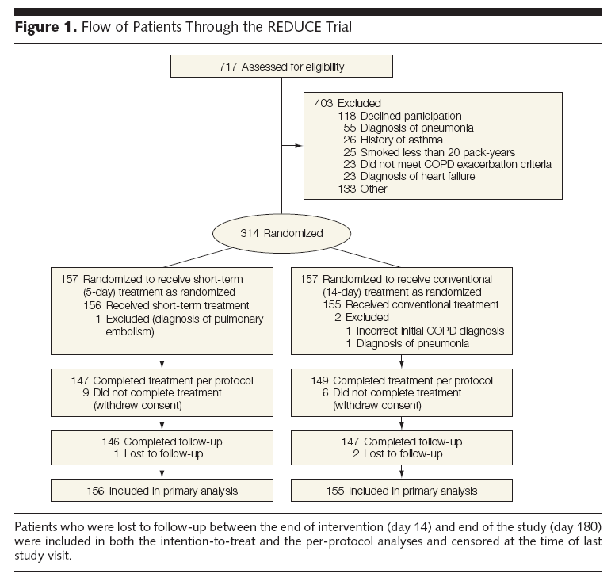
METHODS
Study Design and Patients
From March 2006 through February 2011
At the emergency departments of 5 Swiss teaching hospitals
Inclusion criteria
  ≥ 2 of change in baseline dyspnea, cough, or sputum quantity or purulence
  Age > 40 years
  Smoking history ≥ 20 pack-years
Exclusion criteria
  A history of asthma
  FEV1/FVC ≥ 70% after BD (evaluated by bedside PD spirometry)
  Radiological diagnosis of pneumonia
  Estimated survival of < 6 months due to severe comorbidity
  Pregnancy or lactation
  Inability to give written informed consent.

Slide 5
METHODS
Study Drugs, Procedures, Randomization, and Masking
Study drugs
  Day1
    IV Methylprednisolone 40mg/day
  Day2~5
    Oral prednisone 40mg/day
  Day 6~14
    Oral prednisone 40mg/day(n = 157) or placebo(n = 157)
    + Antibiotics
    + Inhaled glucocorticoids
    + Long-acting β2-agonists and tiotropium
    + Short-acting bronchodilators
End points assessment
  Daily during hospitalization, as well as on days 6, 15, 30, 90 and 180
Allocation : Concealed
Blinding : Blinded (patients, caregivers, investigators, outcome assessors, data collectors, and statistician)

Slide 6
METHODS
End points
Primary end point
  Time to next COPD exacerbation during a f/u of 6 months.
Secondary end points
  Mortality
  FEV1 change
  Clinical performance
  Duration of hospital stay
  Time to open-label glucocorticoid therapy
  Need for mechanical ventilation
  Cumulative glucocorticoid dose
  Glucocorticoid-associated adverse effects (New or worsening hyperglycemia, HTN, infection…)
Notes:
daily as needed while hospitalized. Inhaled glucocorticoids twice daily combined with inhaled 2-agonist twice daily plus tiotropium 18 g once daily were given throughout the study. Physiotherapy, supplemental oxygen, and ventilatory support were administered according to American Thoracic Society/European Respiratory Society guidelines.16 Additional glucocorticoids could be administered at the discretion of the treating physicians.
Next COPD exacerbation의 정의는 an acute clinical deterioration beyond usual day-to-day variation, requiring interaction with a clinician.으로 내렸음.

Slide 7
METHODS
Statistical analysis
Definition of Noninferiority
  Clinically tolerable upper limit
    A 15% absolute difference in the percentage of patients with a re-exacerbation during the 6 months of follow-up (≤ HR 1.515)
  2-sided, 90% CI for the HR b/w 2 group in an intention to-treat and per-protocol analysis ≤ 1.515
Notes:
50% of patients would experience an exacerbation during follow-up라는 가정은 지난 연구들을 참고한 것임.
Exponential proportional hazards survival model에 따르면 HR이 1.515 이하여야 한다.
10. Niewoehner DE, Erbland ML, Deupree RH, et al;Department of Veterans Affairs Cooperative Study Group. Effect of systemic glucocorticoids on exacerbations of chronic obstructive pulmonary disease. N Engl J Med. 1999;340(25):1941-1947.
22. Christ-Crain M, Jaccard-Stolz D, Bingisser R, et al. Effect of procalcitonin-guided treatment on antibiotic
use and outcome in lower respiratory tract infections: cluster-randomised, single-blinded intervention trial. Lancet. 2004;363(9409):600-607.

Slide 8
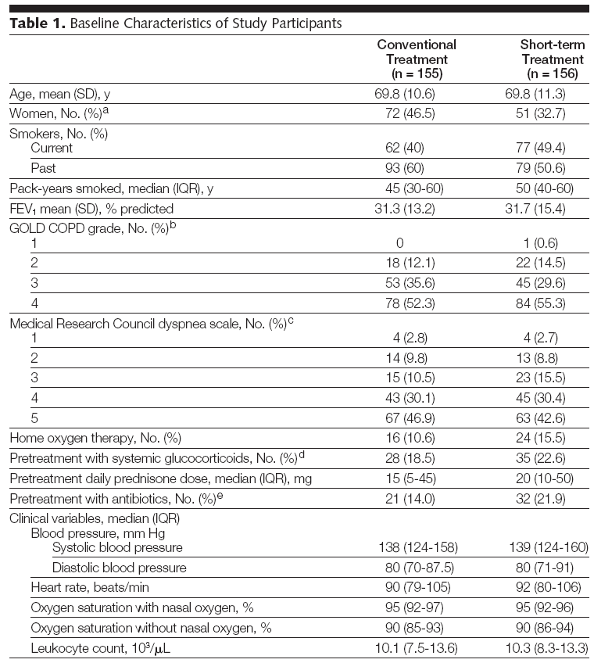
RESULTS
Baseline Characteristics of Study Participants
Notes:
The 2 treatment groups were well balanced in terms of age, severity of airway obstruction, and pretreatment with glucocorticoids (Table 1). There were more women in the conventional group than in the short-term treatment group (46.5% vs 32.7%; P=.02); the other baseline variables did not differ significantly between groups.

Slide 9
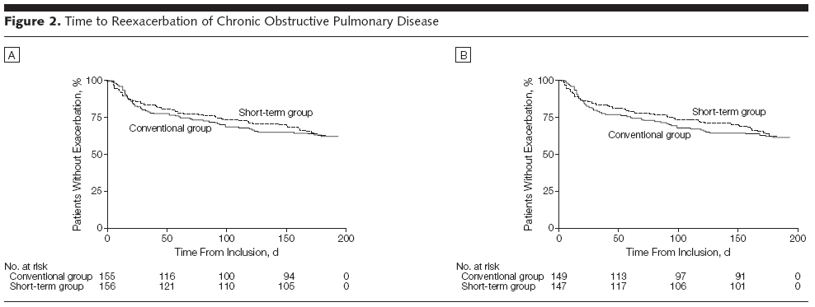
RESULTS
Primary end point
HR 0.95
(p=.006)
HR 0.93
(p=.005)
Notes:
the Kaplan-Meier plots

Slide 10
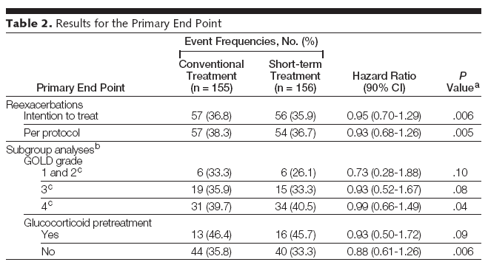
RESULTS
Primary end point
1
Notes:
Cox regression analysis

Slide 11
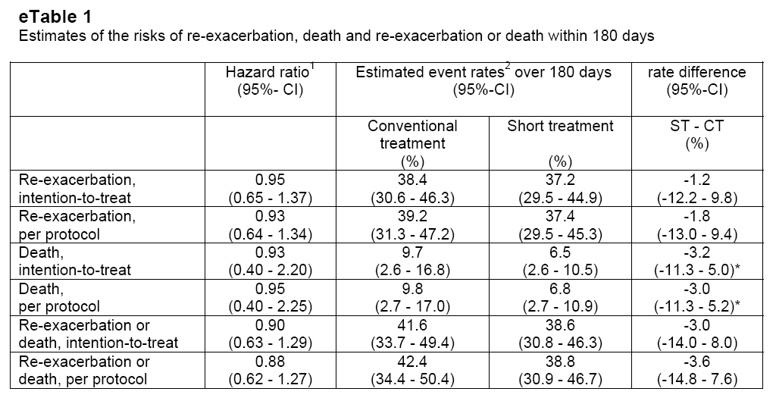
RESULTS
Primary end point
Notes:
In a Cox regression analysis
average event-free survival 도 비슷하였음.

Slide 12
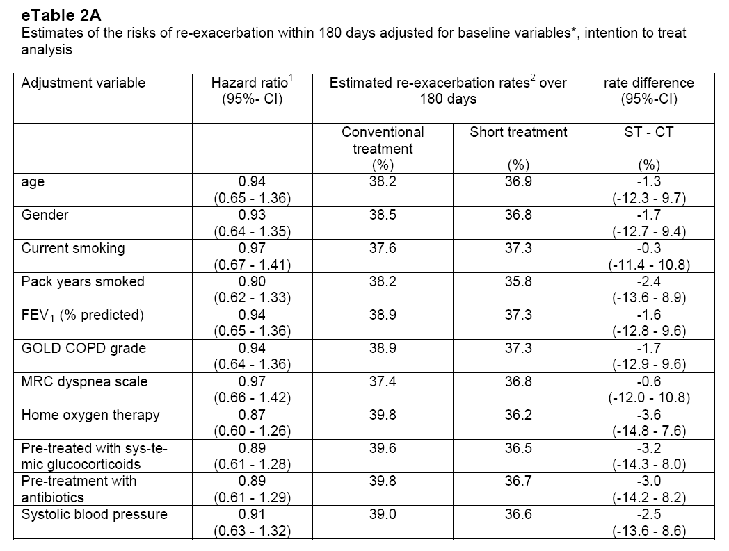
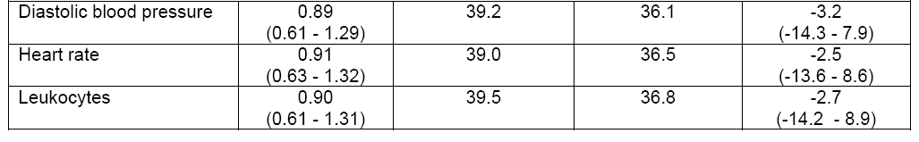
RESULTS
Primary end point
Notes:
results of sensitivity analyses for the primary end point adjusted for baseline variables.

Slide 13
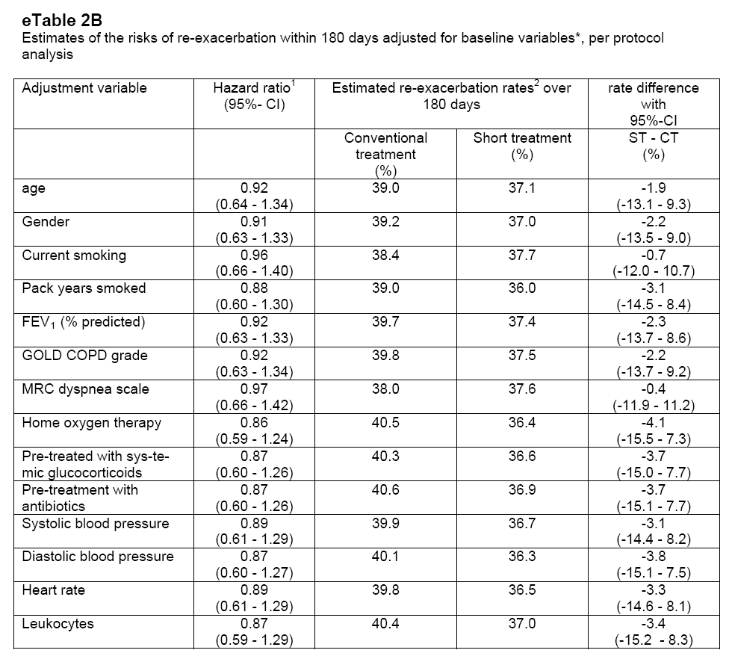
RESULTS
Primary end point
Notes:
results of sensitivity analyses for the primary end point adjusted for baseline variables.

Slide 14
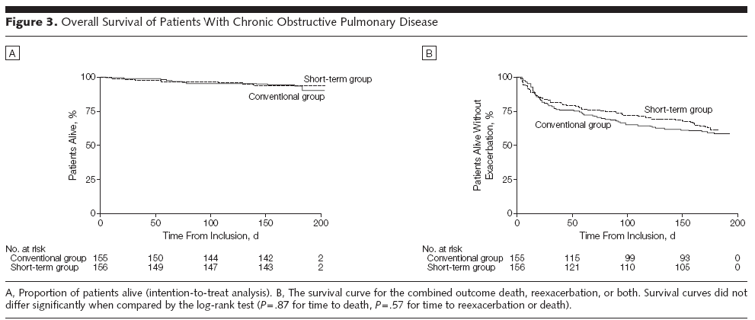
RESULTS
Secondary end points
HR 0.93
(p=.87)
HR 0.95
(p=.91)

Slide 15
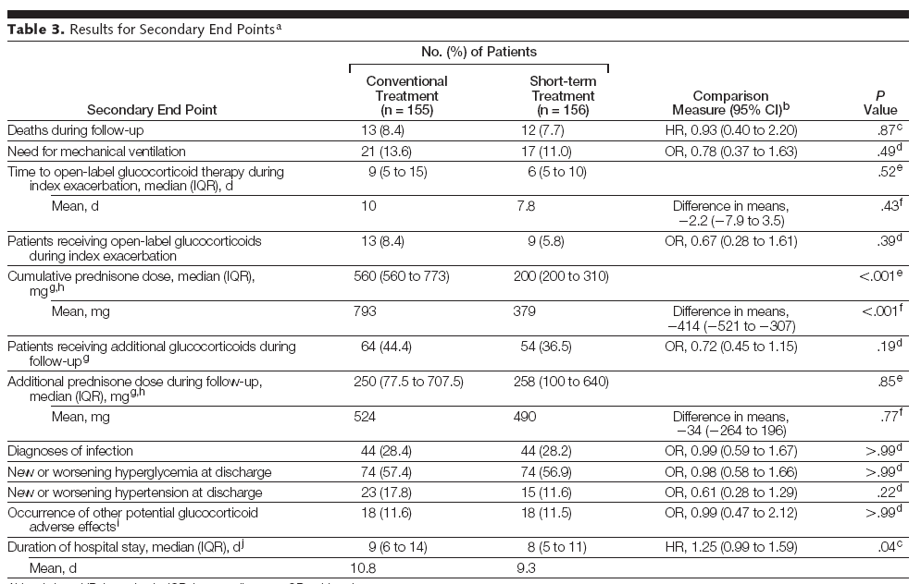
RESULTS
Secondary end points

Slide 16
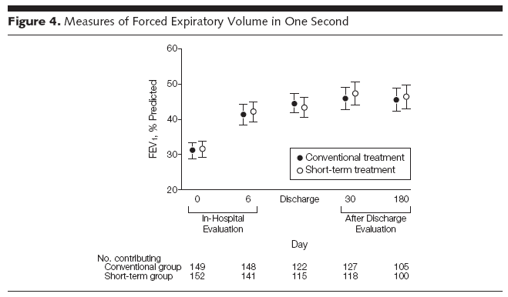
RESULTS
Secondary end points
Notes:
significant amelioration of dyspnea (eFigure 1A), bronchitis associated quality of life (eFigure 1B), and patient-assessed overall performance (eFigure 1C) occurred during the first 5 days of the study; respective scores did not change significantly thereafter

Slide 17
DISCUSSION
A 5-day treatment course of 40mg of prednisone daily is non-inferior to a 14-day treatment course with respect to re-exacerbation
Duration of hospital stay was significantly shorter in the 5-day treatment group
No significant differences in glucocorticoid-related, short term adverse effects
Notes:
Systemic
Corticosteroids in Chronic Obstructive
Pulmonary Disease Exacerbations
(SCCOPE) trial

Slide 18
DISCUSSION
LIMITATIONS
Reexacerbation rate of 1/3 = Sufficient GC dose
  + with Inhaled, long-acting b-agonists, glucocorticoids, and tiotropium)
The Adverse effects of glucocorticoid do not develop immediately after initiation of treatment.
All Pts. with Antibiotics → Not always complying with current guidelines.
Can we expect same result on Pts. with less severe COPD and Non-smokers??
Notes:
이전 SCCOPE trial 등에서 삼았던 regiment보다 훨씬 적은 양의 GC를 사용하려고 했었는데 양군 모두 예상보다 relapse rate 적어 GC 요구량은 충분했다 근데 다른 함께 쓴 약의 종류가 많았기에 overtreated 된 사람들도 많았을 것으로 사료 됨. (SCCOPE : 2.6g/2g = 비슷, 40mg/placebo = less relapse rates.
For the detection of hyperglycemia and hypertension, we focused on the hospitalization period, during which these parameters were assessed daily, excluding reporting bias. We surmise that the length of hospital stay was insufficient to detect significant differences in blood pressure and blood glucose levels between groups, because these glucocorticoid adverse effects do not develop immediately after initiation of treatment.

Slide 19
SUMMARY
Systemic glucocorticoid treatment in a 5-day vs. a 14-day course
  Noninferior with respect to
    Reexacerbation during 6months of follow-up
    Recovery of lung function
    Disease-related symptoms
  Glucocorticoid exposure amount ↓ with 5day course

