Slide 1

Sepsis induced cardiomyopathy
Hong Ji Young
Division of Pulmonology,
Department of Internal Medicine,
Institute of Chest Diseases,
Severance hospital, Yonsei University College of Medicine

Slide 2
Introduction
Cardiovascular involvement associated with sepsis
  Hyperdynamic phase (“warm shock")
    increased cardiac output and decreased systemic vascular resistance
  Hypodynamyc stage ocurred ("cold shock")
    systemic vascular resistance increased to compensate for reduced cardiac output
    Ann Surg 1966; 163: 866-85
Fluid resuscitation

Slide 3
The study of Parker and coworkers at 1984
A cohort of 20 patients with septic shock
Survivors (13 of 20),
  Initial left ventricle ejection fraction (LVEF) less than 40% (p <0.005)
  with mean end-systolic volume and end-diastolic volume increased substantially with a normal stroke volume
  gradually returned to normality by 10 days after the onset of shock
Nonsurvivors
  had normal LVEF and ventricular volumes
Notes:
SIMD 의 개념은 Parker 등의 연구가 시발점이 되었고
Radionucleotide ventriculography thermodilution 에 의해 CO 를 측정하였음.

Slide 4
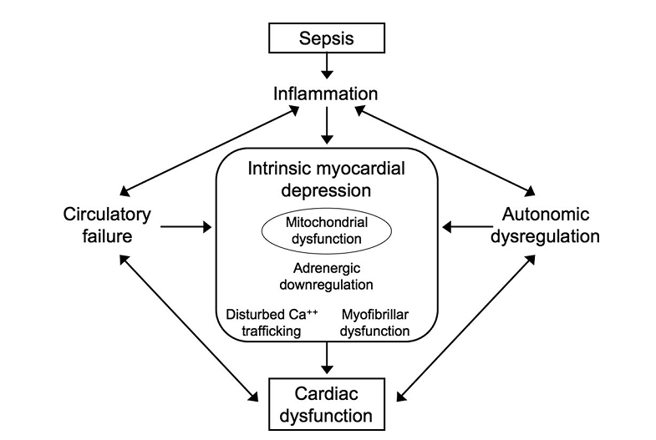
Mechanism
Notes:
Figure 1. Sepsis-induced cardiac dysfunction. Cardiac performance during sepsis is impaired due to
changes in the macro- and microcirculation, autonomic dysfunction, and inﬂammation-induced
intrinsic myocardial depression. The mechanisms of myocardial depression include down-regulation
of adrenergic pathways, disturbed intracellular calcium (Ca2) trafﬁcking, and impaired electrome-
chanical coupling at the myoﬁbrillar level. Mitochondrial dysfunction seems to plays a central role in
this sepsis-induced organ dysfunction.

Slide 5
Circulatory and Microvascular Changes
  Macrocirculatory coronary blood ﬂow ↑
  Alterations in the microcirculation
  Vascular endothelial cells ↔ Cardiac myocytes
    Endothelial cell activation→ NO, endothelin, prostaglandins → Impaired isometric contractions of isolated cardiac trabeculae
Autonomic Dysregulation
  Sepsis-related tachycardia
    Restricted diastolic ventricular ﬁlling
    Increased oxygen requirements
    tachycardia-induced cardiomyopathy

Slide 6
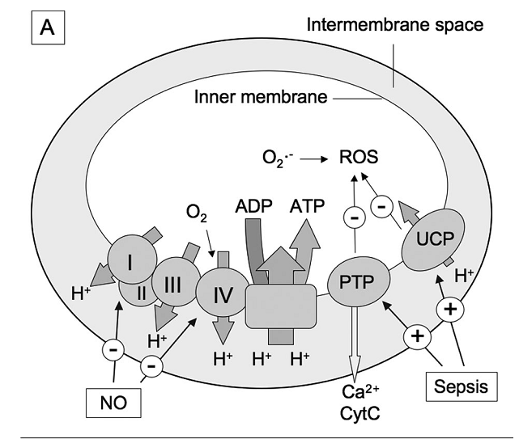
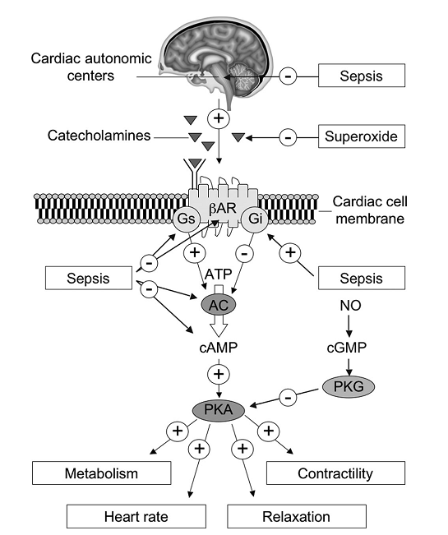
Mitochondrion
Adrenergic signaling.
UCP : PG collpase reducing ATP and ROS production
PTP opening: PG collapse, calcium efflux, CytC release( apoptosis activator)
Notes:
Uncoupling proteins (UCP)
dissipate the proton gradient, thereby potentially reducing ATP and ROS production. Opening of the
permeability transition pore (PTP) results in mitochondrial swelling, proton gradient collapse, calcium
efﬂux, and release of cytochrome c (CytC), an activator of apoptosis.
Beta adrenergic receptor 가 줄어들어 있음

Slide 7
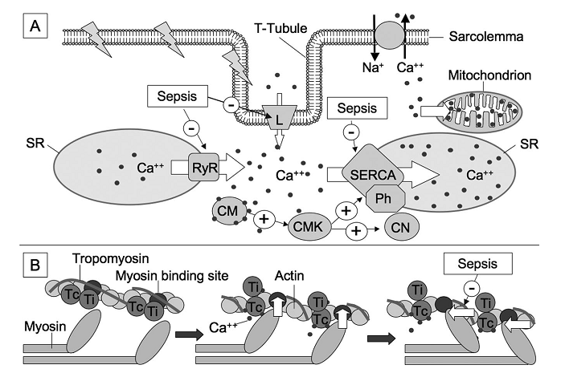
Calcium trafﬁcking
Intracellular Ca ²⁺ →Contraction
Sepsis Calcium sensitivity ↓
Regulated by Cytokines and NO
Crit Care Med 2007 Vol. 35, No. 6

Slide 8
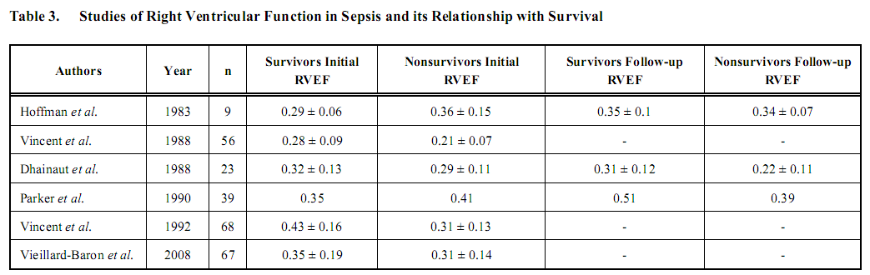
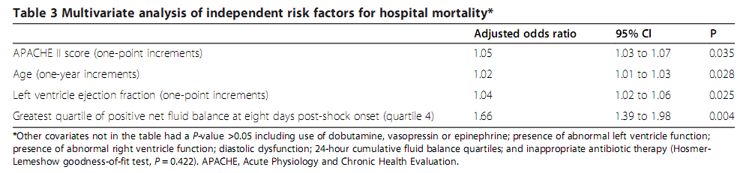
Micek et al. Critical Care 2013, 17:R246

Slide 9
Echocardiography parameter
Early goal-directed optimization of CO by intensive fluid therapy →
morbidity and mortality ↓
can offer parameters such as respiratory
variation of the inferior vena cava diameter and stroke volume

Slide 10
LV systolic function
LVEF
  is clearly influenced not only by LV contractility, but also by the state of preload and afterload.
  LVEF measurement has proved to be very sensitive to changes in contractility when ventricular function is decreased.
E-IVS (Distance between E & IVS) >1cm
MAPSE (Mitral annular plane systolic excursion) <1cm

Slide 11
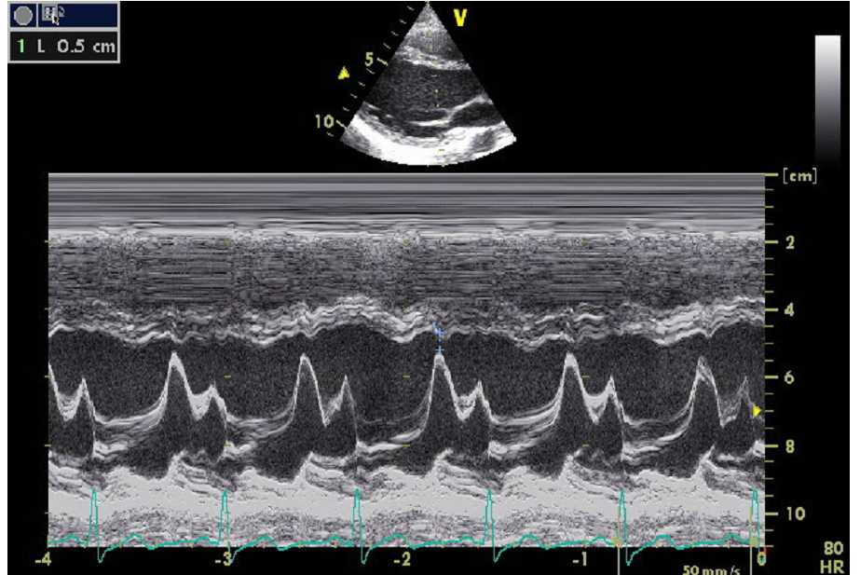
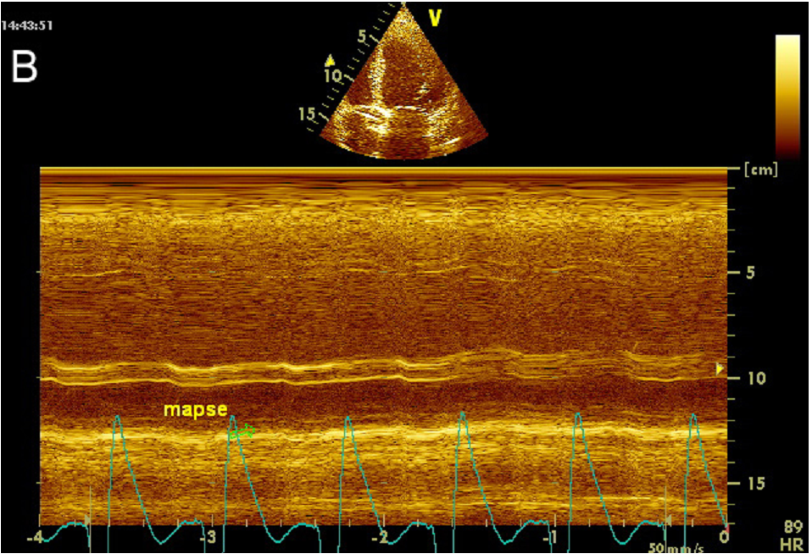
E-IVS
MAPSE

Slide 12
Left Ventricular Diastolic Function (LVDF)
E/E’
  The ratio of mitral velocity to early diastolic velocity of the mitral annulus
  A ratio E/E '<8 :normal M-LVDP
  A ratio E/E'> 15: very high M-LVDP
  failure of weaning from mechanical ventilation
  prognostic value in septic patients
  Better discrimination between hospital survivors and non-survivors than cardiac biomarkers BNP

Slide 13
RV systolic function
Tricuspid Annular Plane Systolic Excursion (TAPSE) < 1.6cm
RV Tei index (IVCT+IVRT/EF)
ALI/ARDS or PTE
  Higher afterload in RV → decrease in right ventricular cardiac output
  RV dilatation → diastolic overload → dyskinesia of the IVS → systolic overload →coronary perfusion pressure↓
  SPAP=MRAP+ (4 x velocity²) >35mmHg

Slide 14
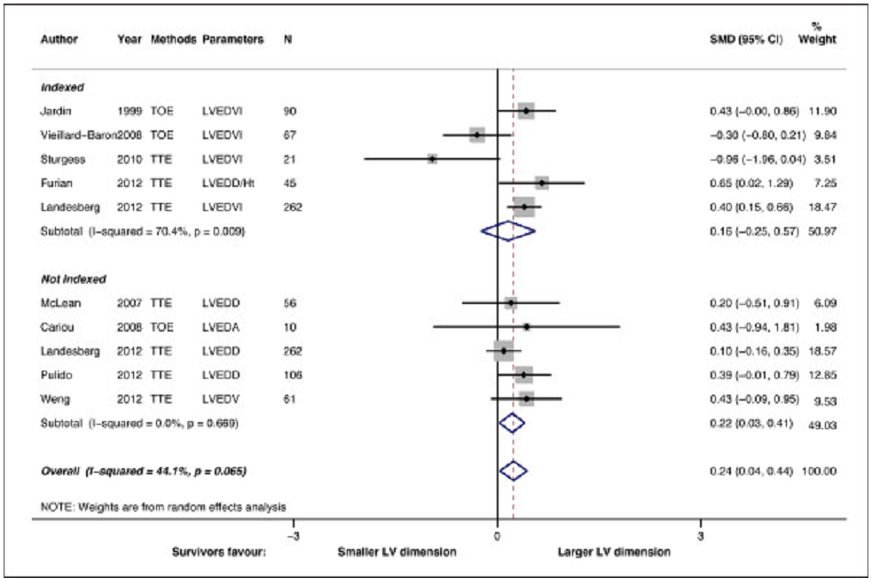
NO evidence that the survivors from severe sepsis or septic shock had lower EF
Huang et al. Critical Care 2013, 17:R96

Slide 15
Laboratory test
B-type natriuretic peptide (BNP)
  produced by ventricular myocytes
  BNP concentration in the log-quartile was associated with higher mortality in septic patients (p <0.001)
  Lower was the LVEF, higher was the plasma concentration of BNP (p <0.05)
  The plasma concentration of BNP had significant predictive value for survival at 30th day
Crit Care Med 2004; 32(8): 1643-7
Crit Care Med 2008; 36: 3030-7.

Slide 16
Filling
Pressure
Cardiac dysfunction
BNP
Fluid
Balance
LPS/
Proinflammatory cytokine
Notes:
치료 후 3-5 일에 EF 감소 BNP 증가
NT pro BNP 의 증가는 fluid responsive 의 감소를 의미한다.crp procalcitonin 과의 관련도

Slide 17
Troponin I
  Sepsis produces coronary hypoperfusion and ischemia
  Sepsis would result in an increased platelet reactivity forming microthrombus
  78% of cTnI+ patients had reduced LVEF compared with 9% of cTnI- individuals.
  Abnormal levels of cTnI were more frequent in nonsurvivors than in survivors (p <0.05).
Clin Chem 2000; 46: 650-7
Intensive Care Med 2001; 27: 965-9.

Slide 18
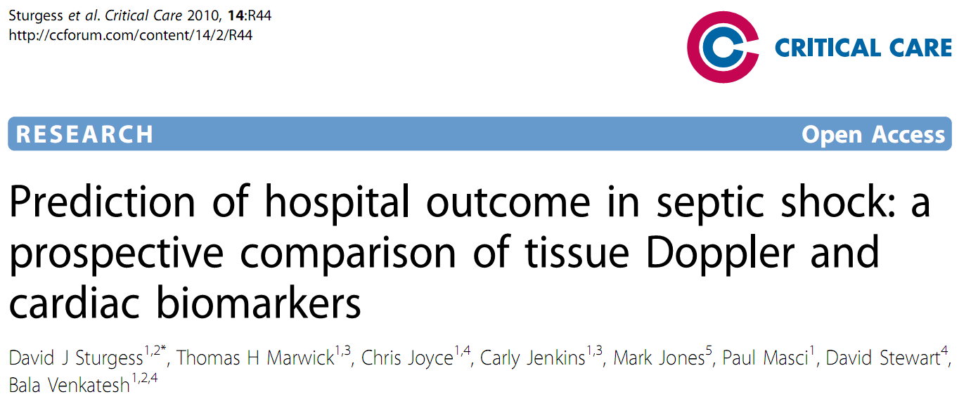

Slide 19
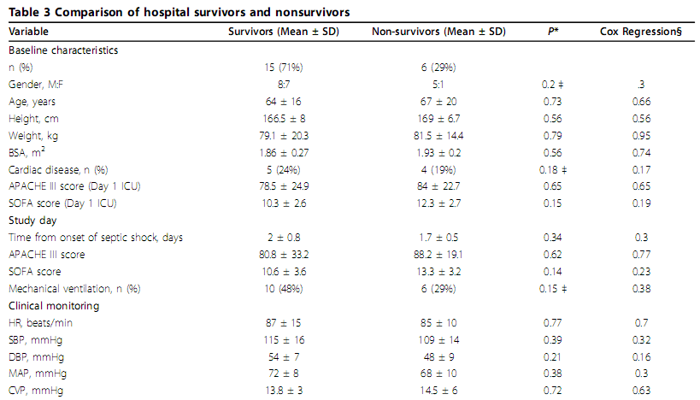
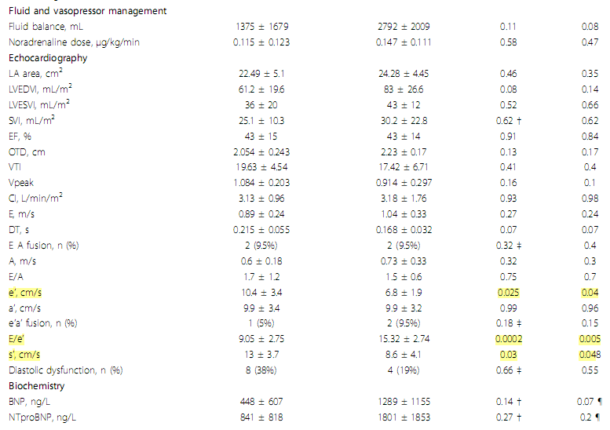

Slide 20
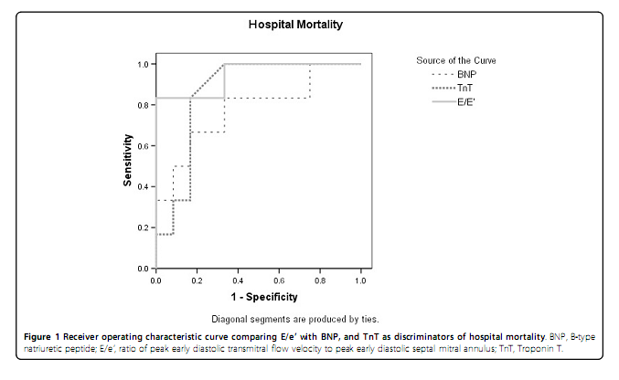
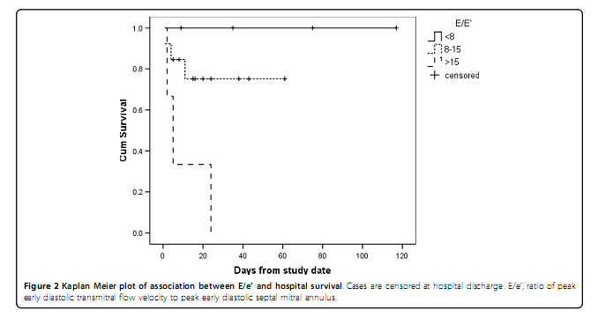

Slide 21
Independent predictors of BNP concentration
  APACHE III (P = 0.033),
  Fluid balance (P = 0.001)
  Diastolic dysfunction (P = 0.009)
  (adjusted R ² 0.713)
Other studies
  Parker et al Ann Intern Med 1984, 100:483-490
    non-survivors did not demonstrate LV dilation (’preload adaptation’)
    unable to maintain stroke volume and CO
  McLean et al Crit Care Med 2007, 35:1019-1026.
    E/e’ to be non-significantly lower in non-survivors (survivors 14.8 ± 7.4, non-survivors 12.1 ± 4.6; P = 0.452

Slide 22
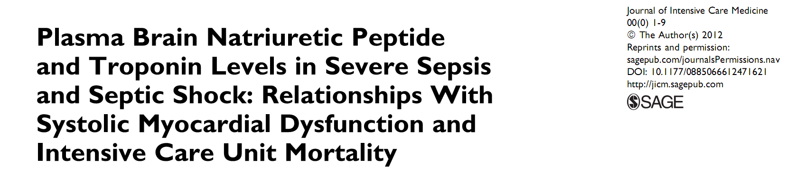
Time course of BNP levels seems helpful to discriminate between surviving and nonsurviving patients with sepsis and to detect myocardial dysfunction, but TnT dosen’t.

Slide 23
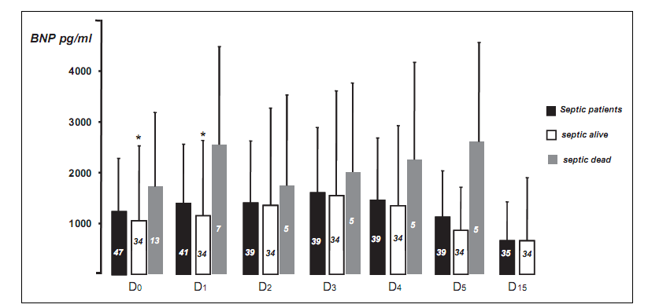
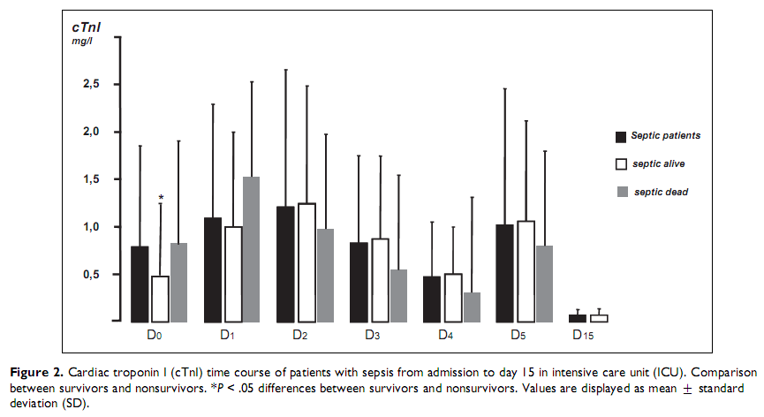

Slide 24
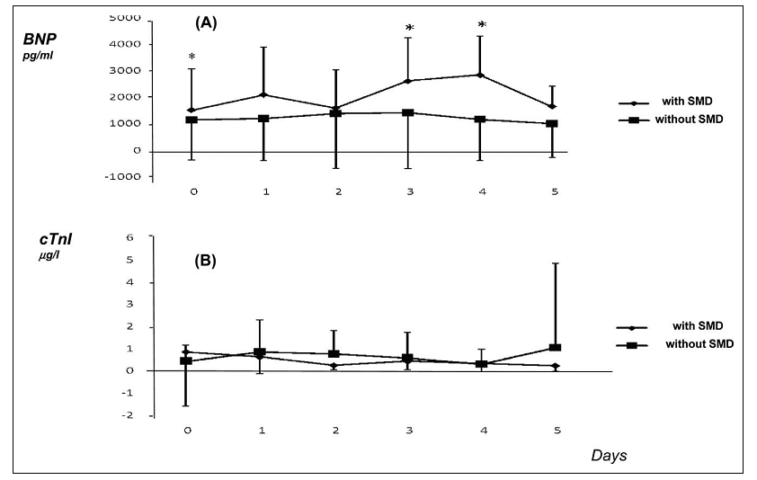

Slide 25
Treatment
There is no adequate treatment, although it seems that might be necessary to seek a cardioprotective therapy and supportive measures
Dobutamine is the preferred treatment
in patients with persistently low cardiac output despite adequate LV filling pressure (or clinical assessment of adequate fluid resuscitation),

Slide 26
Treatment
Levosimendan
  Considering that the SIMD is determined largely by a decrease in myofilament response to calcium, sensitization with levosimendan becomes an attractive therapeutic option.
  Two published clinical trials with levosimendan in sepsis
  An increase in SVI, CI and LVEF compared to baseline was observed.
  Mortality??

Slide 27
Treatment :Beta-blockers
Combined milrinone and enteral metoprolol
  Maintained cardiac index with a lower heart rate and a higher stroke volume index
  → Treatment with beta blockers was a way to “economize” cardiac function
  Crit Care med 2008; 12(4): R99.
Open-label use of esmolol vs standard care
  Associated with reductions in heart rates to achieve target levels, without increased adverse events.
  The observed improvement in mortality and other
  secondary clinical outcomes warrants further investigation.
  JAMA 2013 Oct 23;310(16):1683-91

Slide 28
Treatment
Simvastatin
  a randomized double-blind study
  Due to low recruitment, the study was stopped early
  No differences in the incidence of severe sepsis with administration of simvastatin
  A decrease in the levels of TNFα and IL-6

Slide 29


