Slide 1
EphA2 levels in sepsis patients
Su Hwan Lee
Division of Pulmonology,
Department of Internal Medicine,
Institute of Chest Diseases,
Severance Hospital,
Yonsei University College of Medicine,

Slide 2
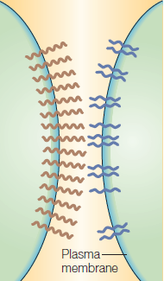
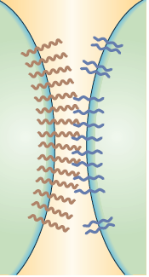
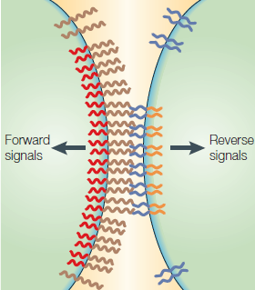
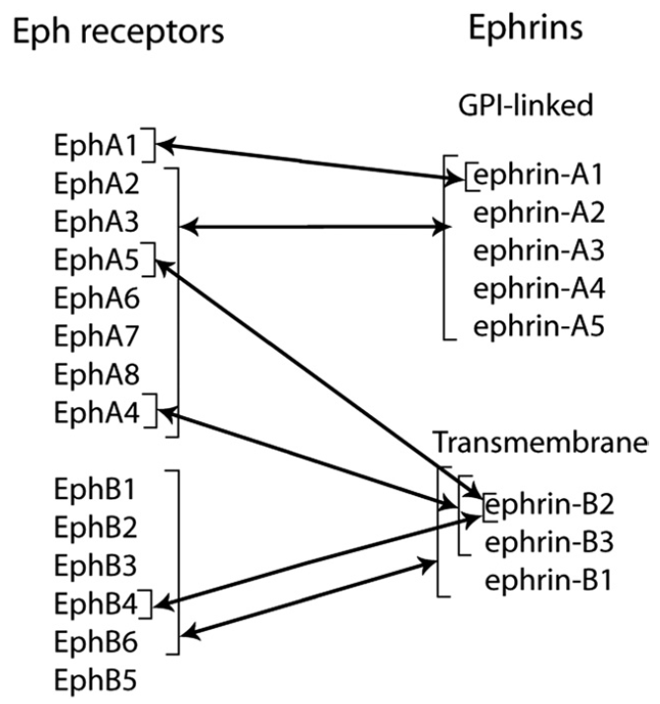
Back ground
The Eph receptor and ephrin families
Pasquale EB et al. Cell 2008; 133: 38-52
The American Journal of Pathology 2012; 181(5)
Nature reviews Molecular cell biology 2005; 6: 462-475
Notes:
Eph receptor 는 thyrosine kinase receptor 들과 ephrin ligand 로 구성되어있고 cell to cell communication에 관여하고 있습니다.
이 Eph/eprhin famuily 는 많은 병의 patholgenesis 에 영향을 주고 있는 것으로 알려져 있습니다.

Slide 3
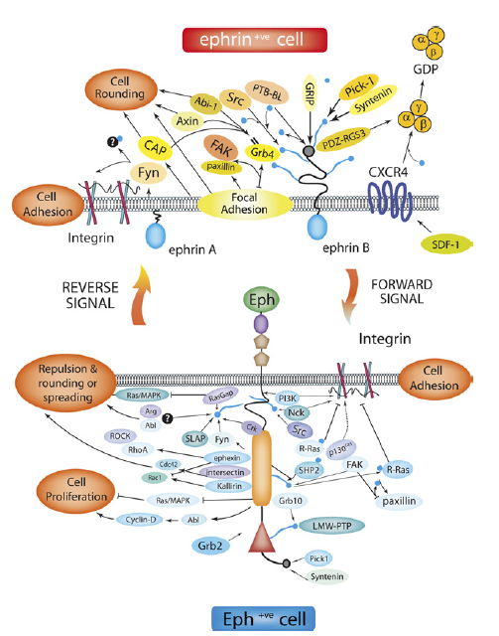
Back ground
Wound healing
Vascular endothelial injury and leak
Chronic inflammation
Ischemia-Reperfusion injury
Tumor
Optic nerve and spinal cord injury
The American Journal of Pathology 2012; 181(5)
Notes:
Figure 3. Eph/ephrin signaling pathways. Structurally and functionally significant
domains within Eph and ephrin proteins and signaling pathways of
activated Eph receptors and ephrins that modulate cell shape and attachment.
Arrows, positive outcome; blue circle, phosphorylation; flat end
lines, inhibition. Adopted and modified from Himanen et al,20 with the
permission of Taylor and Francis Group Ltd (copyright 2010).
→ 설명 추가할 것 : 여러질환에서 기전이 연구되고 있음

Slide 4
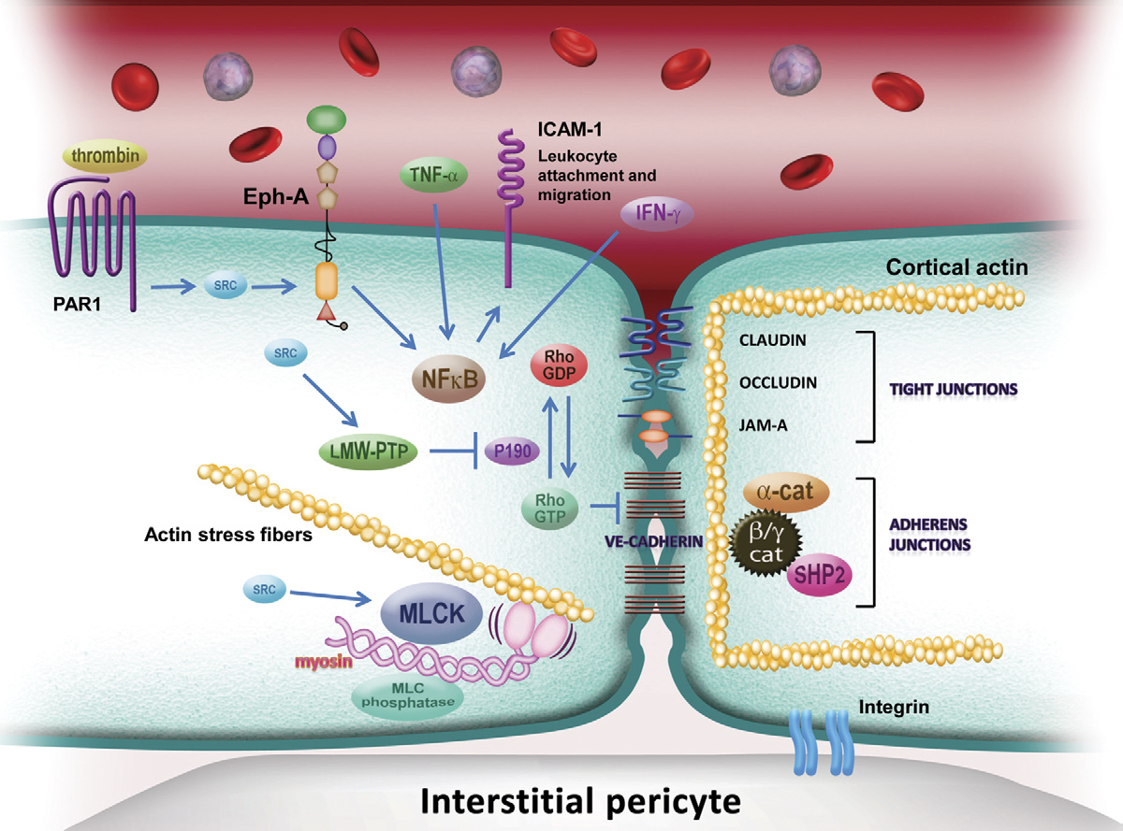
Back ground
The American Journal of Pathology 2012; 181(5)

Slide 5
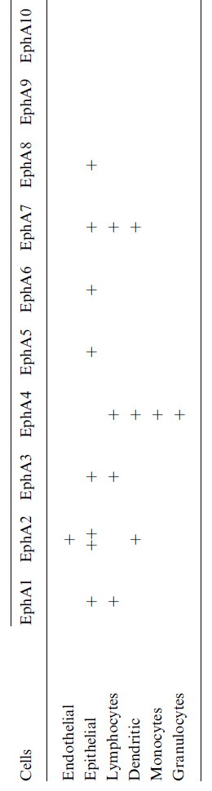
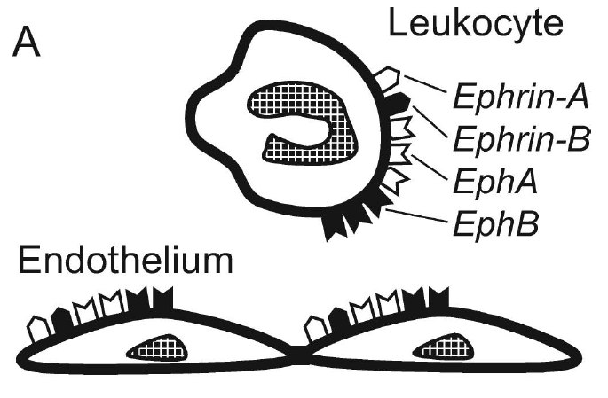
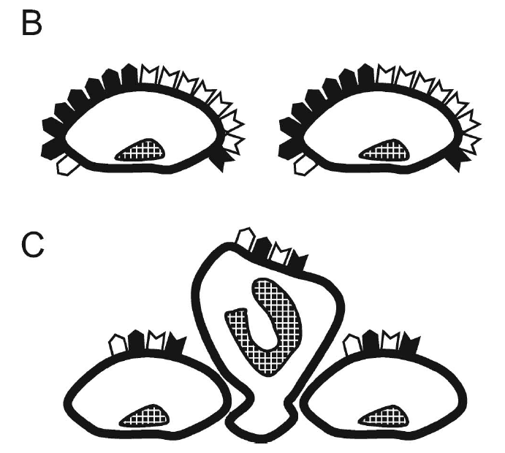
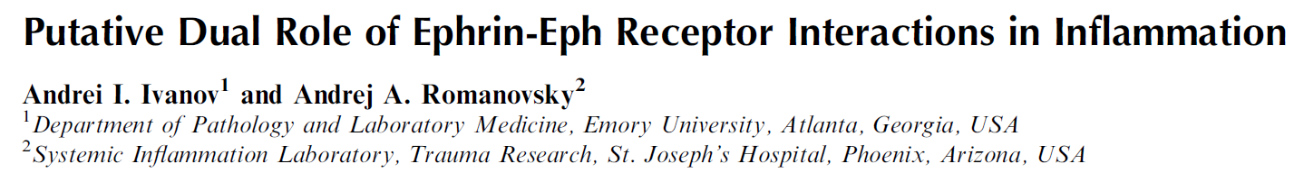
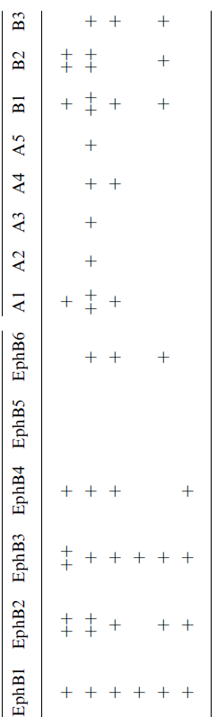
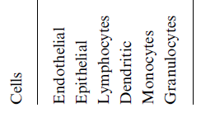
At early stages of inflammation, EphA2 receptor and ephrin-B2 are overexpessed in endothelial and epithelial cells, thus leading to those events (expression of adhesion molecules on the cell surface and reorganization of the intracellular cytoskeleton) that cause cell repulsion and disruption of endothelial and epithelial barriers.
IUBMB Life, 58 (2006), pp. 389–394
Notes:
Expressional changes of ephrins and Eph receptors in inflammation. The early transcriptional upregulation of ephrin-B2 and EphA2 on endothelial and epithelial cells triggers intracellular events that result in cell repulsion and increase barrier permeability (B) compared to normal conditions (A).
The subsequent transcriptional downregulation of several EphA and EphB receptors on leukocytes and endothelial cells signals those events (expression of adhesion molecules on the cell surface and reorganization of the intracellular cytoskeleton) that cause leukocyte-endothelial adhesion (C). The transcriptional changes of signaling molecules shown in both panels B and C promote leukocyte
extravasation and tissue transmigration.

Slide 6
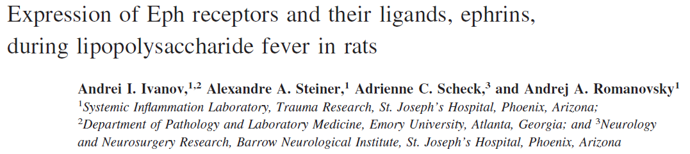
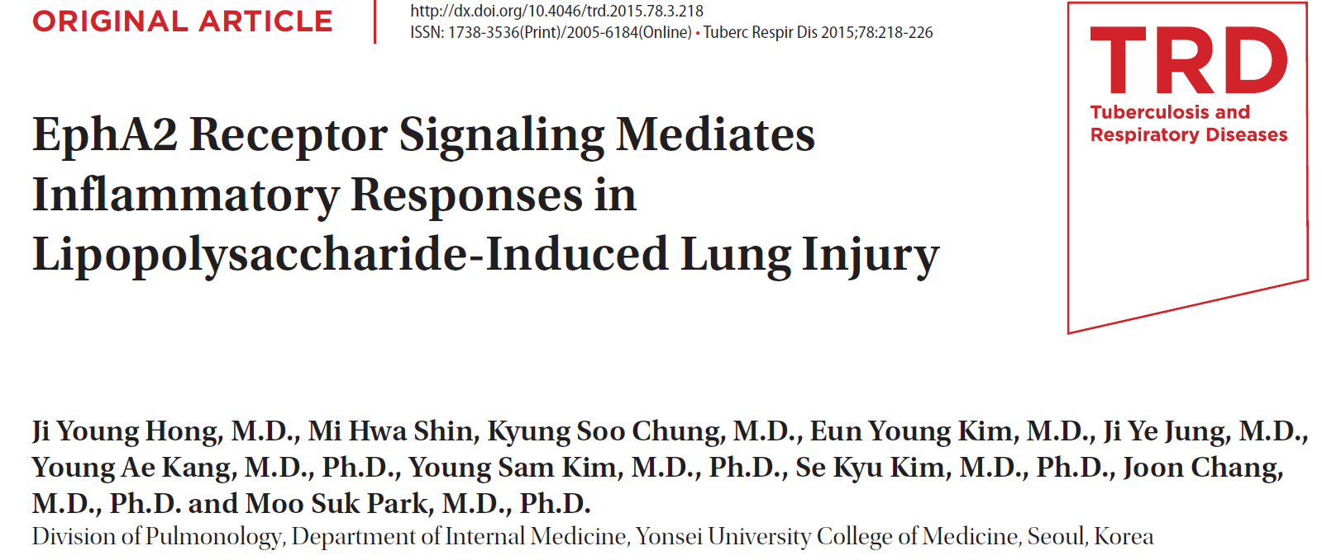
Physiol Genomics 21: 152–160, 2005
Tuberc Respir Dis 2015;78:218-226
Notes:
Liver, lung, hypothalamus

Slide 7
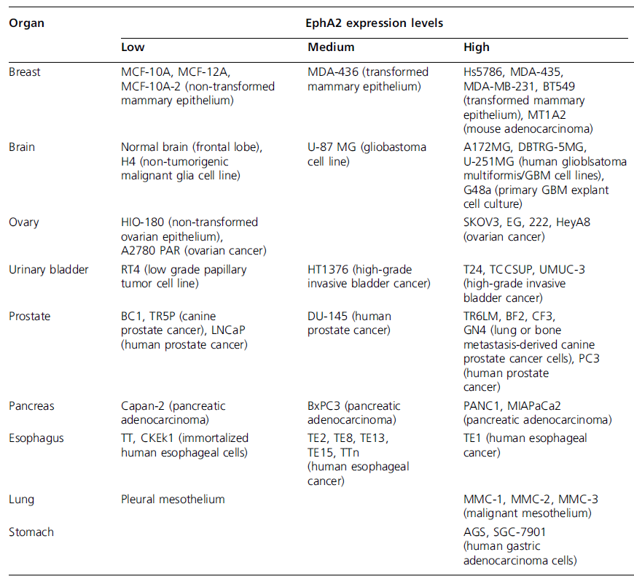
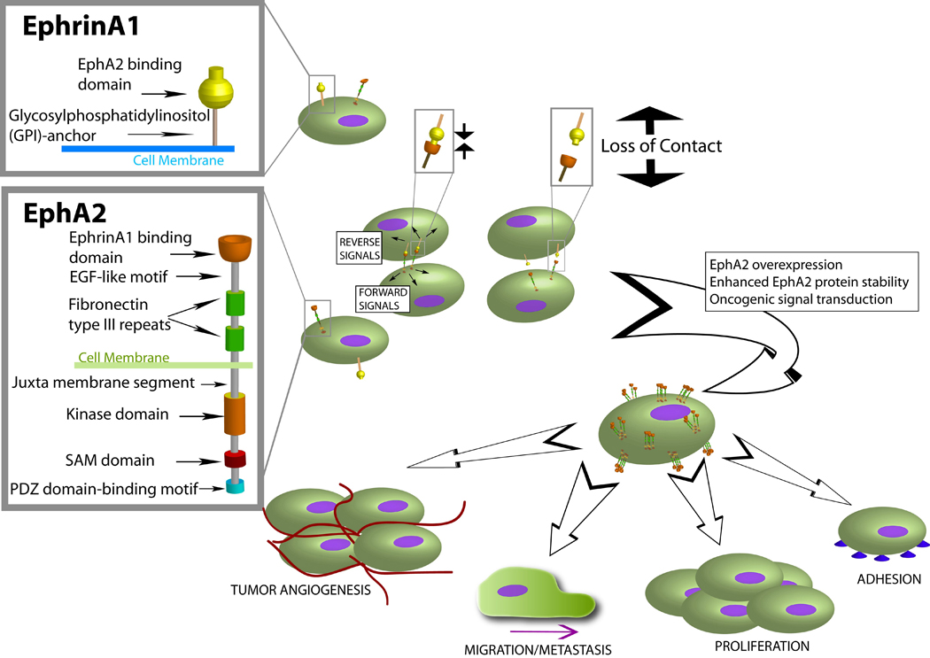
Back ground
Expert opinion on therapeutic targets 2011; 15: 31-51
Notes:
during oncogenesis due to loss of cell contacts, the normal EphA2-EphrinA1 signaling is disrupted leading to the overexpression of EphA2 and oncogenic signal transduction. This deregulated signaling is implicated in several critical aspects of oncogenesis such as cytoskeleton modulation, cell adhesion, migration, metastasis, proliferation and angiogenesis.

Slide 8
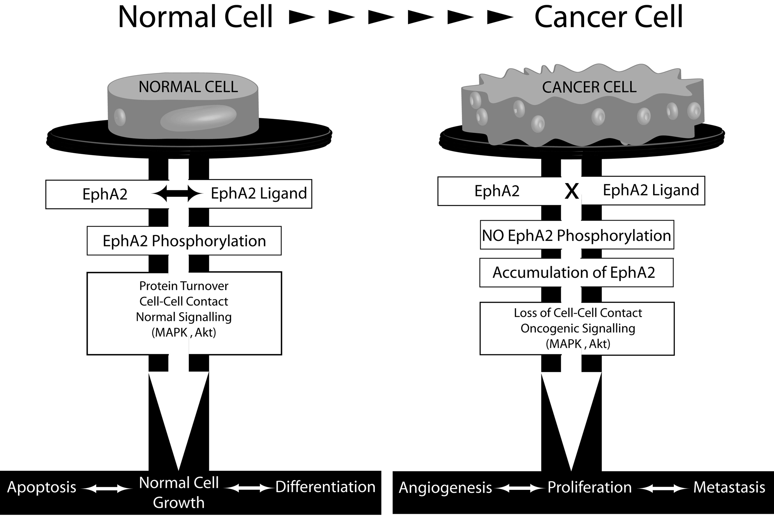
Notes:
중용한 dounstream molecules 은 phosphatidyl inositol 3’kinase (PI3K) , Src family kinase, Rho and Rac 1 GTPases, mitogen activated kinase (MAPK) and integrins along with the cross- talk of other oncogenic receptors.

Slide 9
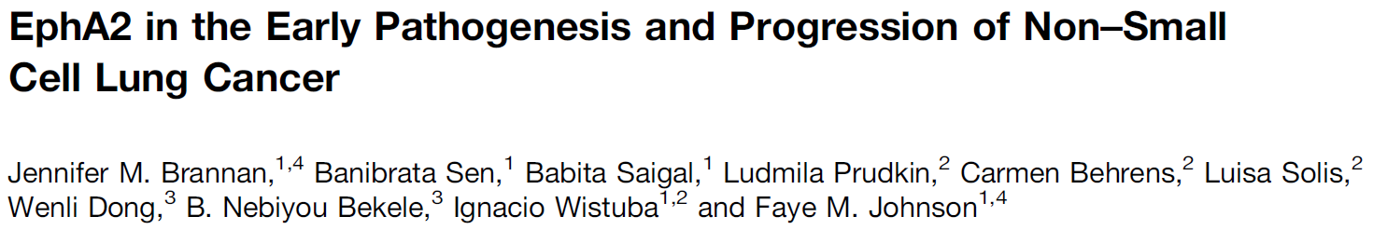
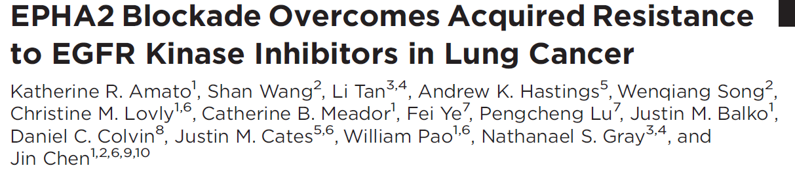
Clin Cancer Res. 2003 Feb;9(2):613-8.
Cancer Prev Res 2009;2(12) December 2009
Cancer Res; 76(2); 305–18. 2016 AACR.

Slide 10
Aim
To evaluate the association between plasma EphA2 receptor level and sepsis

Slide 11
Study design and participants
Retrospective cohort study of prospectively collected samples and clinical data in medical ICU of Severance hospital
Period: Mar 2015 ~ Aug 2015
Inclusion criteria
  Age ≥ 18
  Patients with SIRS, sepsis, severe sepsis or septic shock
  With consent
  Blood sampling
  Within 1 day on ICU admission
  Storage at -80℃ refrigerator = DNA, serum, plasma
  Luminex® (ELISA) analysis
Notes:
Sepsis
??????? (sepsis-2 정의 입니다)
Bacteremia
More than one pathogenic organism was isolated in the blood cultures
Co-morbidity
Charlson’s co-morbidity index
Severity of organ dysfunction measured by
Sequential Organ Failure Assessment (SOFA) score
Acute Physiology and Chronic Health Evaluation (APACHE) II

Slide 12
Study flow
Total ICU admission
( n = 262 )
Exclude 117 subjects who
did not meet inclusion criteria
Enrolled subjects
( n = 145 )

Slide 13
Results
Baseline characteristics of total patients
Variables | Total
 | (n = 145)
Age, years ,median (IQRs) | 70 (61-77)
Male, sex, N(%) | 95 (65.5)
Developed of ARDS, N (%) | 27 (18.6)
≥ Severe sepsis, N (%) | 106 (73.1)
Positive of blood culture, N(%) | 37 (25.5)
Charlson comorbidity index, median (IQRs) | 3 (2-5)
CRP, mg/L, median (IQRs) | 87.3 (22.3-141.2)
Procalcitonin, ng/mL, median (IQRs) | 0.8 (0.2-6.2)
APACHE II, median (IQRs) | 25 (18-31)
SOFA 1 score, median (IQRs) | 10 (7- 13)

Slide 14
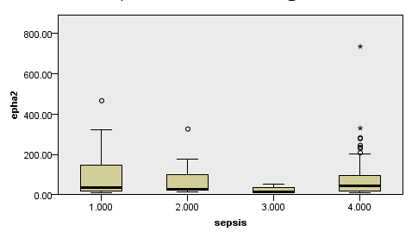
Sepsis and EphA2
P = 0.159

Slide 15
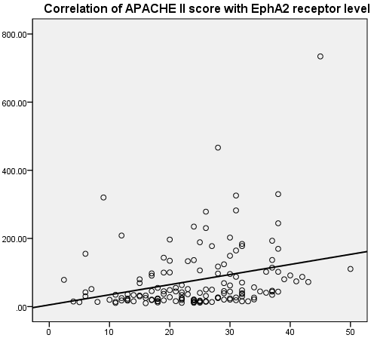
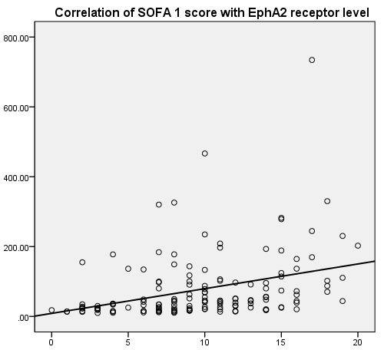
Correlation of APACHE II, SOFA with EphA2 level
Plasma EphA2 receptor level
r = 0.291
P < 0.001
r = 0.341
P < 0.001
APACHE II score
SOFA score

Slide 16
Comparison of characteristics between 28-d survivor and 28-d non-survivor
Variables | Survivor 102 (70.3%) | Non survivor 43 (29.7%) | P-value
Male, sex, N (%) | 67 (65.7) | 28 (65.1) | 0.947
Age, year, median (IQRs) | 69 (57.8-77.0) | 72 (63.1-84.2) | 0.202
BMI, median (IQRs) | 20.6 (18.9-26.6) | 21.7 (19.4-30.0) | 0.081
Clinical parameters
Developed of ARDS, N (%) | 13 (12.7) | 14 (32.6) | 0.005
≥ Severe sepsis, N (%) | 69 (67.6) | 37 (86.0) | 0.022
Positive of blood culture, N(%) | 24 (23.5) | 13 (30.2) | 0.398
Charlson comorbidity index, median (IQRs) | 3 (1.0-4.3) | 3 (2.0-5.0) | 0.080
APACHE II, median (IQRs) | 24.0 (16.8-29.2) | 29.0 (20.0-36.0) | 0.002
SOFA1, median (IQRs) | 8.0 (6.0-11.3) | 13.0 (10.0-16.0) | <0.001

Slide 17
Comparison of characteristics between 28-d survivor and 28-d non-survivor
Variables | Survivor 102 (70.3%) | Non-survivor 43 (29.7%) | P-value
Laboratory parameters
CRP, mg/mL, median (IQRs) | 73.5 (17.5-158.4) | 97.0 ( 47.0-186.0) | 0.347
Procalcitonin, ng/mL, median (IQRs) | 0.5 (0.1-6.3) | 1.8 (0.5-5.7) | 0.181
DNI, %, median (IQRs) | 3.2 ( 1.1-6.9) | 3.8 ( 2.1-13.3) | 0.202
RDW, %, median (IQRs) | 15.0 (14.1-16.5) | 17.1 (15.9-19.6) | <0.001
EphA2, pg/mL, median (IQRs) | 33.3 (18.8-71.0) | 78.5 (36.3-164.5) | <0.001
IL-1beta, pg/mL, median (IQRs) | 14.5 (12-26.8) | 19.0 (12-31.3) | 0.327
IL-10, pg/mL, median (IQRs) | 84.8 (27.5-127.9) | 99.5 (28.5- 465.5) | 0.113
IL-18, pg/mL, median (IQRs) | 408.6 (267.9-751.3) | 835.5 (467.8-1719.0) | <0.001
IL-6, pg/mL, median (IQRs) | 311.6 (109.3-1123.6) | 2329.2(247.5-7570.0) | 0.002
TNF alpha, pg/mL, median (IQRs) | 41.0 (27.7-70.2) | 45.0 (27.3-100.3) | 0.320
IP-10, pg/mL, median (IQRs) | 618.6 (217.2-2205.9) | 1597.0 (499.3-5468.3) | 0.013

Slide 18
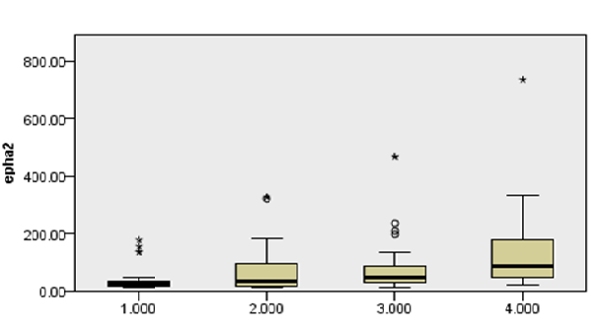
Association of the SOFA group and plasma EphA2 receptor level
Plasma EphA2 receptor level
P < 0.001
Group 1
Group 2
Group 3
Group 4
Group by IQR | SOFA score
1 | ≤ 6
2 | 6 ~ 9
3 | 9 ~ 13
4 | > 13
Notes:
Graph그림에서
1,2,3,4 → SOFA점수 직접 기입하고 밑에 표는 빼주세요

Slide 19
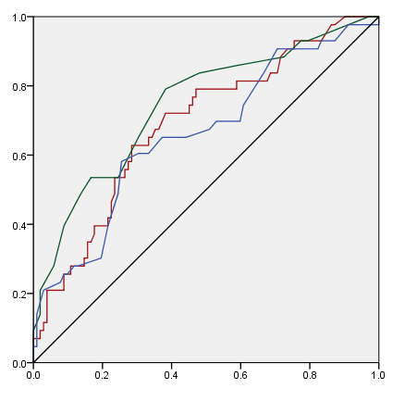
ROC curve of EphA2, SOFA and APACHE II for 28-d mortality prediction
Sensitivity
AUC
EphA2
0.707
P = 0.704
SOFA
0.728
APACHE II
0.668
1- specificity
Notes:
AUC옆에 95% CI 를 넣어주고
써 놓은 P 는

Slide 20
Cox proportional hazard regression analysis
Variable | Univariate analysis |  |  |  | Multivariate analysis
 | HR | 95% CI | P-value |  | HR | 95% CI | P-value
Sex (female) | 1.26 | 0.658-2.402 | 0.488
Age, y | 1.02 | 0.997-1.042 | 0.094 |  | 1.02 | 0.999-1.044 | 0.066
BMI (kg/m²) | 1.04 | 0.957-1.128 | 0.359
ARDS | 1.82 | 0.911-3.617 | 0.090 |  | 1.92 | 0.986-3.755 | 0.055
Blood culture (+) | 0.89 | 0.452-1.750 | 0.734
EphA2 (log) | 3.94 | 1.847-8.382 | <0.001 |  | 4.14 | 1.986-8.628 | <0.001
≥ Severe sepsis | 2.76 | 1.092-6.951 | 0.032 |  | 2.71 | 1.123-6.525 | 0.027

Slide 21
Conclusion
Increased plasma EphA2 receptor level was associated with sepsis severity and 28 days-mortality of sepsis patients.
Plasma EphA2 receptor level can be used for therapeutic target monitoring.

Slide 22
Limitation
This was just a small pilot study for plasma EphA2 receptor level in sepsis in a single center.
Measurement of plasma EphA2 receptor level should be validated.
We need obvious evidence for association between EphA2 signaling and sepsis in vitro and vivo data.

Slide 23
Thank U

Slide 24
Current recruiting clinical trials
EphA2 Gene Targeting Using Neutral Liposomal Small Interfering RNA Delivery :
  The goal of this clinical research study is to learn about the safety of siRNA-EphA2-DOPC when given to patients with advanced, recurrent cancer. Researchers also want to learn the highest tolerable dose of this drug that can be given. (M.D. Anderson Cancer Center)
CAR-T Cell Immunotherapy for EphA2 Positive Malignant Glioma Patients :
  The purpose of this study is to evaluate the safety and effectiveness of CAR-T cell immunotherapy in treating with EphA2 positive malignant glioma patients. (Fuda Cancer Hospital, Guangzhou)
Safety and Bio-Imaging Trial of DS-8895a in Patients With Advanced EphA2 Positive Cancers (LUD2014-002) :
  The purpose of this study is to find a more effective way of treating solid tumors. This study will test the safety, bio-distribution, and tumor uptake of a new treatment for cancer called DS-8895a in patients with advanced solid tumors. (Ludwig Institute for Cancer Research)
https://clinicaltrials.gov/ “EphA2”

