Slide 1




Pulmonary Rehabilitation
Review of the Recent Literature
호흡기내과 R4 황의동
Division of Pulmonology
Department of Internal Medicine
Yonsei University College of Medicine

Slide 2
INTRODUCTION
In 1952, reported on the importance
of exercise for patients with emphysema.
Opinions on its benefits remained equivocal.
In 1991, after high-intensity cycle training in COPD, lactate threshold, oxidative capacity.
subsequent accumulation of high-quality data to support the effectiveness of PR.

Slide 3


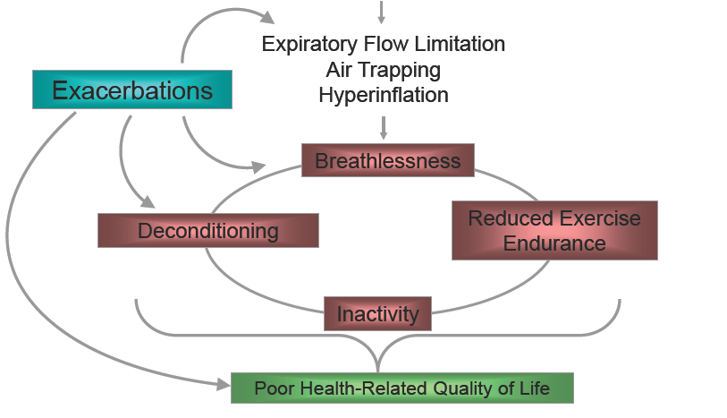
INTRODUCTION

Slide 4
Pulmonary Rehabilitation
Joint ACCP/AACVPR statement 2007
“Pulmonary rehabilitation is a multidimensional continuum of services directed to persons with pulmonary disease and their families, usually by an interdisciplinary team of specialists, with the goal of achieving and maintaining the individual's maximum level of independence and functioning in the community."

Slide 5
Patient Assessment
Multidimensional Indices
BODE index (2004):most well known
:BMI, airflow obstruction, dyspnea, exercise capacity
:predict mortality
N Engl J Med .2004
ADO index
:age, dyspnea, and airflow obstruction
Lancet . 2009
DOSE index
:dyspnea, airflow obstruction, smoking status,exacerbation frequency
:simple, valid tool for assessing the severity of COPD
Am J Respir Crit Care Med . 2009

Slide 6
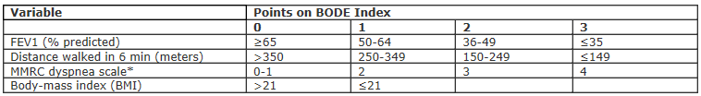
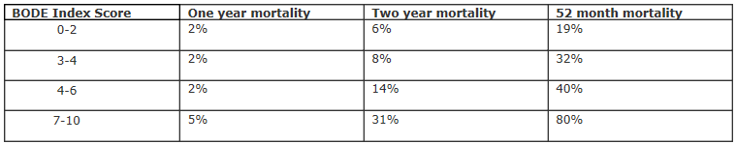
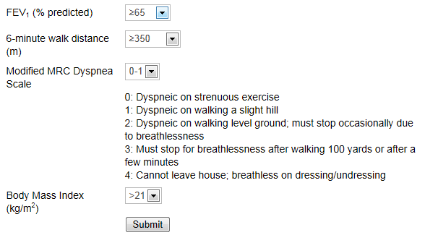
BODE index

Slide 7
Physical Activity
Am J Respir Crit Care Med . 2005
-Sedentary lifestyle is a predictor of clinical outcomes,including hospitalization and mortality.
Thorax . 2006
Notes:
clearly showed that most patients with COPD spend significantly less time walking and standing and more time
sitting and lying in daily life when compared with sedentar healthy elderly subjects. In addition, when patients with COPD
do walk, they walk significantly slower than healthy subjects. Finally, the present study showed that a reduced 6MWD is the
best surrogate marker of inactivity during daily life in patientswith COPD.

Slide 8
Physical Activity
Measure
-Self-report questionnaires
:lack precision (recall bias…)
-Pedometers
:lack sensitivity to detect slow walking speeds
-Accelerometers
:Accurate but expensive

Slide 9
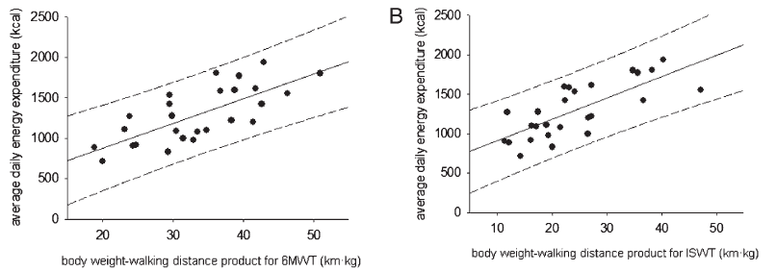
Physical Activity
Measure
- 6-min walk and incremental shuttle walk tests
:strongly associated with average daily energy expenditure.
:field-based walking tests are markers of physical activity.
Chest . 2012 ; 141 ( 2 ): 406 - 412
Notes:
6MWD and ISWD, but not V ˙ o2 peak, were associated with DEE; (2) the strength of the associations between 6MWD and ISWD with DEE increased when the distance achieved was multiplied by body weight; (3) participants who achieve ≥ 450 m on the ISWT were more likely to undertake sufficient physical activity to confer health benefits and may not require specific physical activity programming; and (4) individuals with COPD have little aerobic reserve to increase the intensity of physical activity during daily life.
this finding is that therapies that aim to optimize the habitual DEE of people with COPD may have greater success if they focus on increasing the frequency or duration rather than the intensity of physical activity.

Slide 10
Exercise Training
Aerobic exercise training increases exercise tolerance,reduces dyspnea and fatigue.
But so-called non-responders ventilatory limitation to exercise.
Recent training focused on reducing ventilatory limitation during exercise.

Slide 11
Exercise Training
Interval Training
-High intensity exercise interspersed with low-intensity exercise or rest.
-Compared interval to continuous exercise noted no differences between groups
Thorax . 2010 ; 65 ( 2 ): 157 - 164 .
-in the absence of sophisticated equipment until the patient learns to alternate work. higher staff to-patient ratio than continuous training.

Slide 12
Exercise Training
Manipulating the Inspired Gas
-increasing the Fio2 during exercise.
:reduces ventilation, hyperinflation, dyspnea.
Eur Respir J . 2001 ; 18 ( 1 )
-supplemental oxygen not hypoxemic at rest remains controversial.
-supplemental oxygen or ambient air
:Increase exercise endurance reduced dyspnea
no differences in maximum power, peak rate of oxygen uptake
Cochrane Database Syst Rev . 2007 ;

Slide 13
Exercise Training
Manipulating the Inspired Gas
-Heliox and Helium-Hyperoxia
:Replacing nitrogen with helium decreases airway resistance.
-heliox [HO](79% helium and 21% oxygen)
:increases inspiratory capacity, reduces dynamic hyperinflation, reduces dyspnea.
J Appl Physiol . 2004; 97( 5): 1637- 1642.

Slide 14
Exercise Training
Manipulating the Inspired Gas
-Heliox and Helium-Hyperoxia
-helium-hyperoxia [HH]
:(60% helium and40% oxygen)
:greater gains in cycle exercise endurance in the HH group compared with the ambient air control group.
Chest . 2010 ; 138 ( 5 ): 1133 - 1139
In clinical practice, barriers to the widespread Use cost, administration.

Slide 15
Exercise Training
Ventilatory Strategies
-NIPPV
:reduces the inspiratory work, enhances oxygenation of the quadriceps, increases exercise capacity
Chest . 2010 ; 138 ( 5 ): 1133 - 1139 .
-In clinical practice, the cost and technical support requirements for NIPPV will preclude its use.
Notes:
NIV may allow an increased exercise intensity and duration during pulmonary rehabilitation in patients with moderate to very severe COPD, (according to the American Thoracic Society guidelines), resulting in a greater training effect and a prolonged exercise capacity. Further research

Slide 16
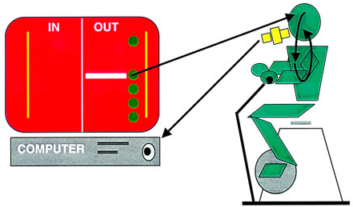
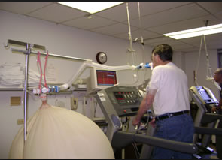
Exercise Training
Ventilatory Strategies
-Ventilation-Feedback
:set a slow respiratory rate and prolong expiratory
time.(reduced hyperinflation)
:VF to exercise training gains in exercise endurance
Am J Respir Crit Care Med . 2008 ; 177 ( 8 ): 844 - 852 .

Slide 17
Exercise Training
Transcutaneous Electrical Muscle Stimulation
-In many studies, gains in muscle function and
exercise capacity.
If expertise in neuromuscular electrical stimulation is available, selected patients (low BMI with evidence of quadriceps weakness) who are unable or unwilling to participaten in pulmonary rehabilitation could be considered for (Grade D)
Thorax 2013;68:ii1–ii30

Slide 18
Exercise Training
Partitioning Exercising Muscle.
-exercising with a smaller muscle mass,
ventilatory -limited patients would perform more high-intensity work.
-one-legged vs two-legged cycling
:same peak rate of oxygen uptake, prolonged endurance time.
Chest . 2006 ; 129 ( 2 ): 325 - 332 .
Notes:
hypothesized that by exercising with a smaller muscle mass, ventilatory-limited patients would perform more high-intensity, muscle-specific work

Slide 19
Increasing Peripheral
Muscle Strength
-Quadriceps cross-sectional area is a predictor of Mortality.
-Resistance training
:combination of progressive muscle resistance and aerobic training should be delivered.
-Nutritional interventions, creatine supplementation, use of testosterone.
:remains inconclusive, not recommended

Slide 20
Self-Management
Teaches disease specific education, action plans, health behavior changes.
self-management revealed reductions in hospitalizations and a small improvement in HRQL.
Arch Intern Med . 2003 ; 163 ( 5 ): 585 - 591

Slide 21
Psychologic Support
Anxiety and depression are common in COPD.
associated with poor exercise capacity, greater dyspnea.
since scientific evidence is lacking, current practice and expert opinion support the inclusion of psychosocial interventions as a component of pulmonary rehabilitation.

Slide 22
Acute Exacerbations
safe and effective during or immediately following an AECOPD
resistance exercise performed during hospitalization for AECOPD optimized muscle force without increasing systemic inflammation.
Strongly recommended wthin 1month (CTS clinical guideline)
:improved dyspna,exercise tolerance than usual care, reduced hospital admission and mortality.

Slide 23

COPD patients with comorbidities
Land-based exercise can be difficult for people with COPD who have coexisting obesity, musculoskeletal or neurological conditions
improved peak and endurance exercise capacity significantly more than an equivalent land-based exercise training program, water-based exercise training may provide an alternative mode of training.
McNamara et al. Eur Respir J 2013

Slide 24
Respiratory Conditions Other than COPD
Interstitial lung disease
-Improvements in functional exercise capacity, dyspnoea and quality of life
-little evidence regarding longer-term effects
Cochrane Database Syst Rev 2008
Life-long asthma
-Supervised exercise training improves symptoms and QOL
Respiration . 2011 ; 81 ( 4 ): 302 - 310 .

Slide 25
Future Directions
Optimizing access to PR.
Translating gains in exercise capacity into increased physical activity.
Strategies to maintain the gains made
during PR.

Slide 26
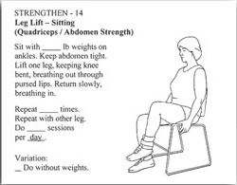
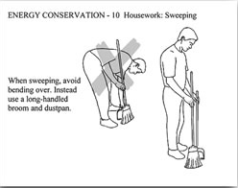
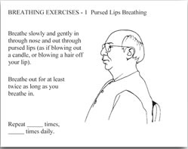
Instructional Handouts

Slide 27
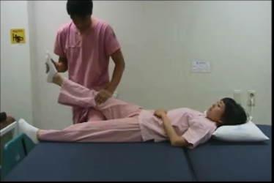
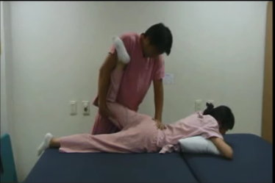
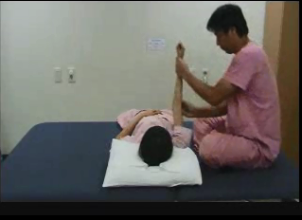
Instructional Handouts

