Slide 1
MUC5B Promoter Polymorphism and Interstitial Lung Abnormalities
N Engl J Med 2013;368:2192-200
Dept. of Internal medicine, R2 Y.J.Lee

Slide 2
Introduction
Interstitial lung abnormality
:Smokers & elderly ↑
Is there a genetic association?!
SNP : rs35705950 -> Mucin 5B (MUC5B)
-> Interstitial lung disease
Age / Smoking

Slide 3
Methods
Framingham Heart Study
2764 adult
Spirometry, DLco, chest CT
Taqman Genotyping Assays
3 readers: 2 Radiologist + 1 Pulmonologist
Interstitial lung abnormality (>5%) / Intermediate / None

Slide 4
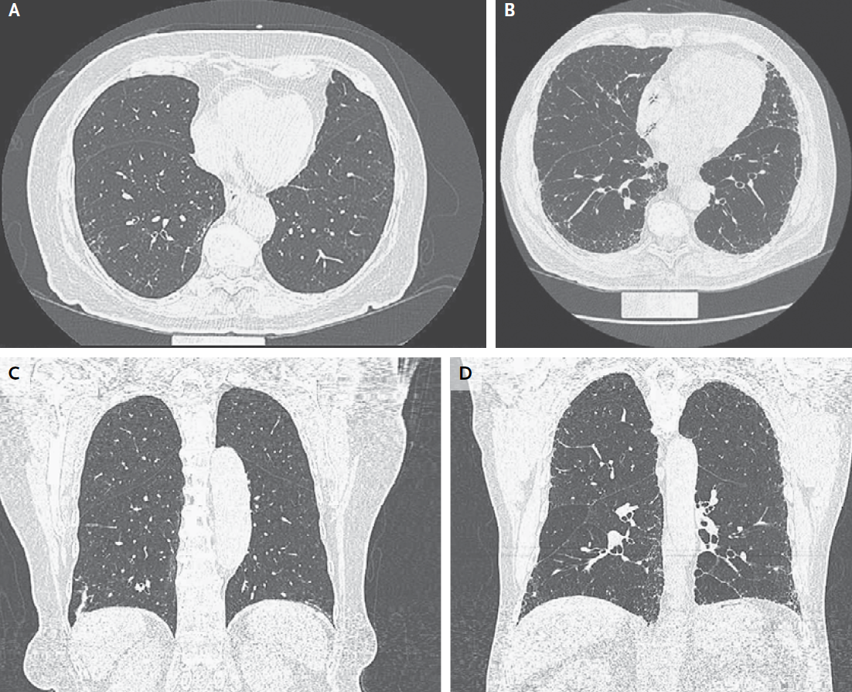
Generalized linear models
Additive genetic model
Interaction test
P < 0.05

Slide 5
Results
1.Thoracic CT scans
Total 2764 patients
2633 (95%) - Genotype data + CT
177 (7%) – Interstitial lung abnormalities
1086 (41%) – Intermediate
1370 (52%) – None

Slide 6
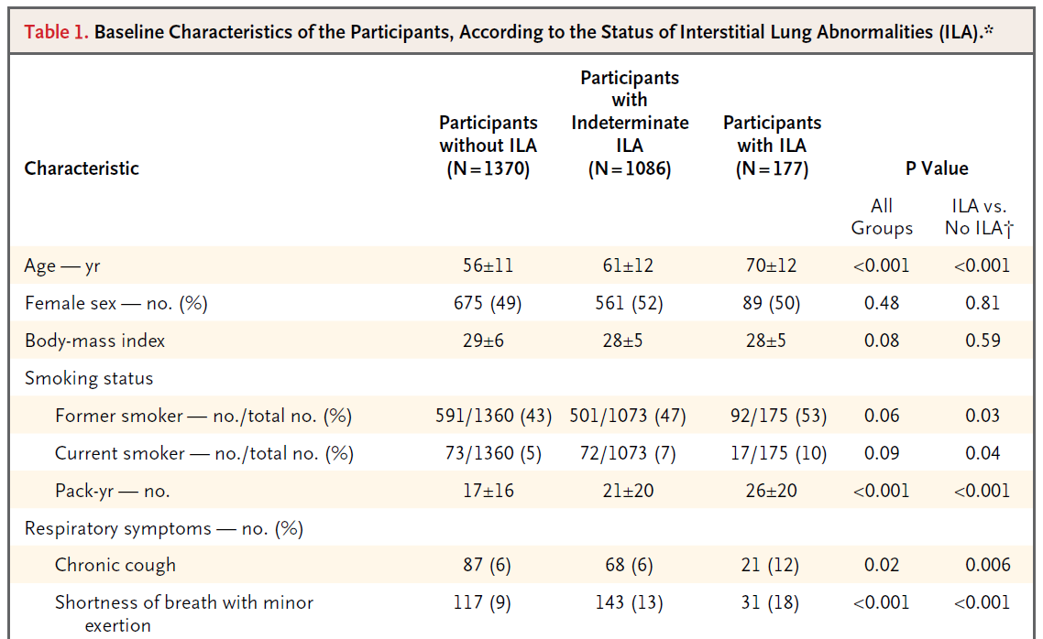

Slide 7
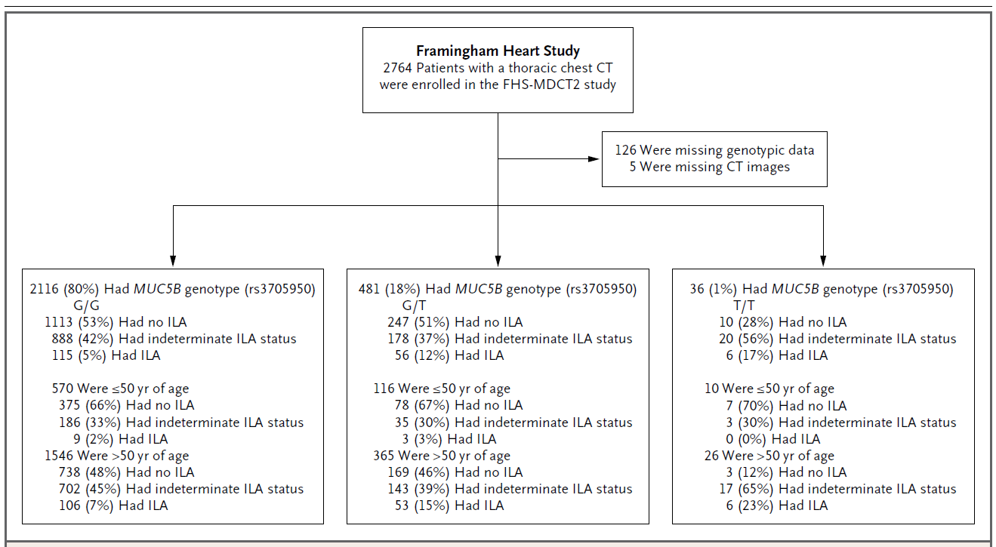

Slide 8
2.Lung abnormalities and characteristics of participants
Pt with abnormalities
Older, smoker
Chronic cough, shortness of breath ↑
3. DLco(12%), TLC(9%)↓

Slide 9
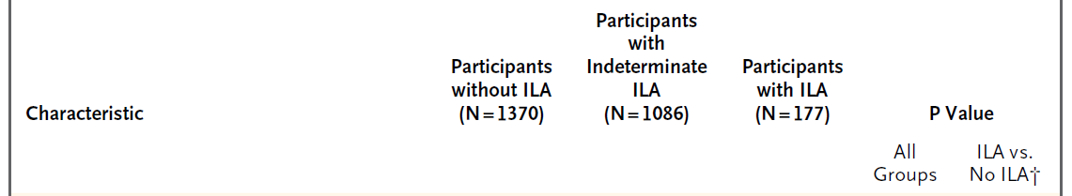
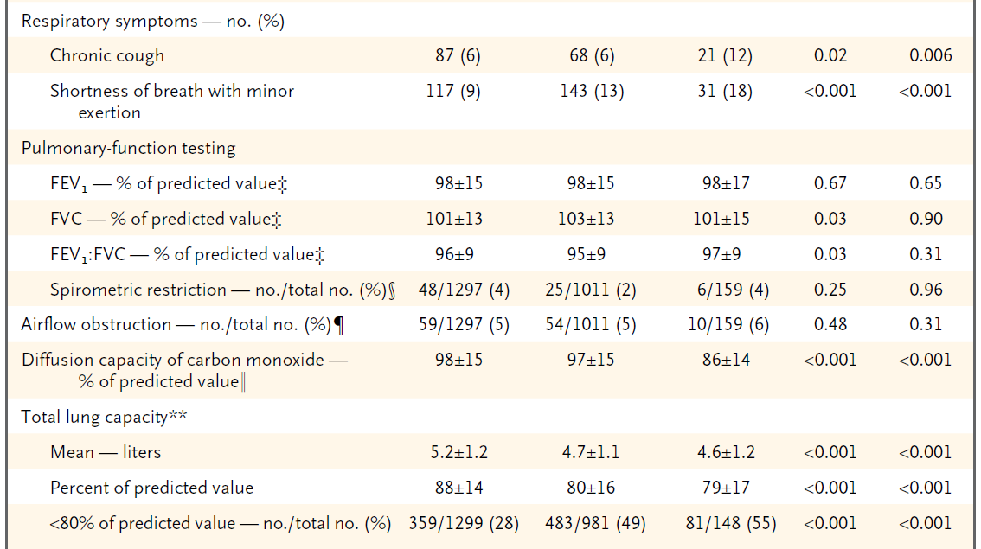

Slide 10
3.MUC5B Genotype and lung abnormalities

Slide 11
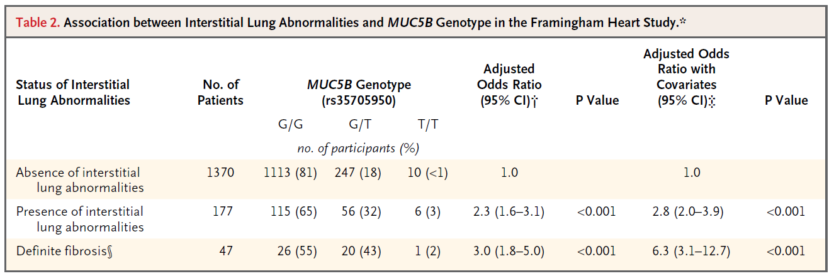

Slide 12
4.MUC5B genotype, lung abnormalities, and age
Age & Interstitial lung disease
<50yrs : 2%
>50yrs : 9%
→ For each copy of MUCB5 variant
: More than double of having ILA

Slide 13
5.MUC5B genotype and interstitial subtype

Slide 14
6.MUC5B genotype, lung abnormalities, and smoking status
Not influenced by smoking
But, for each copy of MUC5B variant
1) Never smoker : > double the odds of having ILA
2) Current / former smoker : > triple the odds of having ILA

Slide 15
Discussion
At least some component of the genetic predisposition for interstitial lung abnormalities and idiopathic pulmonary fibrosis is shared
ILA may represent an early/subclinical stage of pulmonary fibrosis.
+ MUC5B promotor polymorphism could be used to identify person at risk

Slide 16
Difference between ILA and IPF
Framingham study
: ILA 9%, Definite fibrosis 2% (>50yrs)
Possible Explanation ?!
1) Only some of ILA represent an early stage of IPF
2) IPF may be underdiagnosed / underreported

Slide 17
Limitations
1) Misclassification bias
2) Chest CT is unlikely to be useful in genetic studies of ILA in 50yrs or less
3) Adult & mainly European descent
4) Linkage-disequilibrium pattern on chromosome 11p15.5

