Slide 1

VATS conference review
: Primary pulmonary MALT lymphoma
Leem Ah Young
Division of Pulmonology,
Department of Internal Medicine,
Institute of Chest Diseases,
Severance hospital, Yonsei University College of Medicine

Slide 2
Introduction
Mucosa‑associated lymphoid tissue (MALT) lymphoma
  Extranodal marginal zone lymphoma of mucosa-associated lymphoid tissue
  Extranodal lymphoma that arises in a number of epithelial tissues, including the stomach, salivary gland, lung, small bowel, and elsewhere
  8‑10% of all non‑Hodgkin lymphomas
  Separated into those developing in the stomach (gastric MALT) and those developing in non-gastric extranodal locations (non-gastric MALT)

Slide 3
Introduction
Pulmonary MALT lymphoma (pMALToma)
  Bronchial‑associated lymphoid tissue lymphoma
  Rare disease
  Associated with chronic inflammation due to autoimmune or infectious diseases
  Usually has an indolent course
  Majority of patients have a favorable prognosis

Slide 4
Clinical presentation
Most common form of primary pulmonary lymphoma
  But, rare disease
Median age at diagnosis for pMALToma is 50‑60 years
  Only few patients aged <30 years

Slide 5
Clinical presentation
May be comorbid with autoimmune or infectious diseases
  Sjögren's syndrome
  Rheumatoid arthritis
  Dysgammaglobulinemia
  Amyloid deposits
  Collagen vascular diseases
  Helicobacter pylori infection
  Acquired immune deficiency syndrome

Slide 6
Clinical presentation
Symptom
  Cough
  Mild dyspnea
  Chest pain
  Hemoptysis
  -> But, majority of the patients are asymptomatic

Slide 7
Diagnostic evaluation
Symptoms and physical signs contribute little to diagnosis
Image finding
  Manifests diverse lung abnormality patterns on computed tomography (CT) scans
  Present with single or multiple radiologically detected pulmonary nodules or consolidations

Slide 8
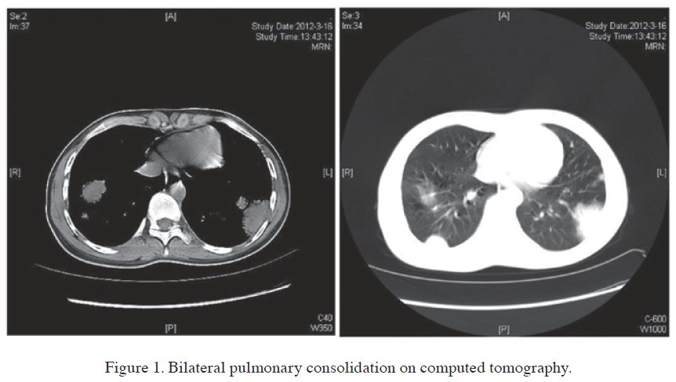
Notes:
하나 혹은 그 이상의, Nodule 혹은 consolidation

Slide 9
Diagnostic evaluation
Histological examination
  Definitive diagnosis may be achieved following
  Biopsy specimens
    Transbronchial biopsy
    Radiologically‑guided transthoracic core‑needle biopsy
  Surgical biopsies
    Tissue sample is occasionally inadequate for diagnosis, particularly In patients with atypical CT findings

Slide 10
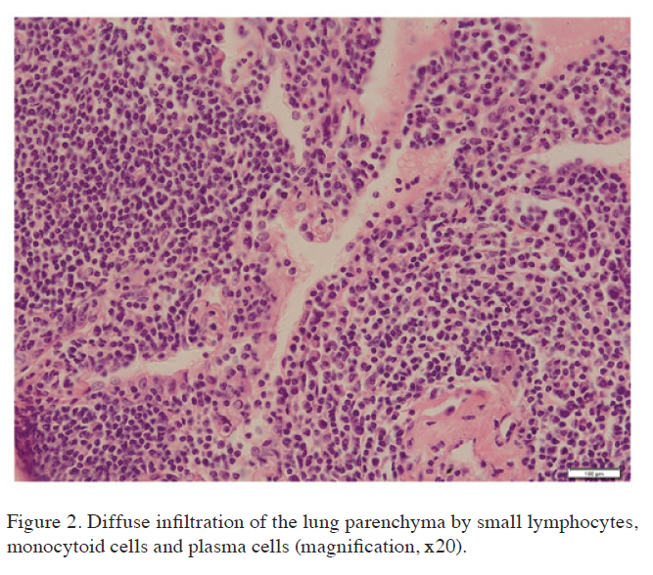
Notes:
Neoplastic small lymphoid cell 의 diffuse infiltration

Slide 11
Prognosis
Typically have an indolent course and a good prognosis
  In the study of Borie et al.
    63 cases with pMALToma
    Estimated 5‑ and 10‑year overall survival rates were 90 and 72%
Borie R, Wislez M, Thabut G, et al. Eur Respir J 34: 1408‑1416, 2009
Systemic dissemination and transformation into high‑grade B‑cell lymphoma may occur

Slide 12
Treatment
Optimal therapy remains under debate
  Chemotherapy
  Surgery, Radiation therapy
    Problems with lung function
    It remains unclear as to whether radiotherapy and surgical removal of localized pMALToma is the optimal treatment
  In the study of Oh et al.
    1991 to 2008, a total of 61 patients with biopsy confirmed were retrospectively analyzed
    No differences between the operation group and chemotherapy group in terms of median time to progression
  Oh SY, Kim WS, Kim JS, et al. Ann Hematol 89: 563‑568, 2010

Slide 13
Treatment
  In the study of Wang et al.
    38 consecutive patients from single center
    -> 25 patients with localized disease
    No significant difference in overall survival (OS) was found between patients who received surgery or not
    Patients treated with chemotherapy had superior progression-free survival (PFS) than surgery
    No significant differences in PFS and OS exist between those who received adjuvant treatment or not
    Wang L, Xia ZJ, Zhang YJ, Huang HQ, Lin TY, Lu Y. Tumour Biol. 2015 Mar 24

Slide 14
Treatment
Chemotherapy
  Fludarabine and mitoxantrone-containing regimens
  chlorambucil currently appears to be the optimal treatment option for cases with disseminated disease
Therapeutic role of rituximab remains unclear
  only a limited number of case reports with conflicting results
  As pMALToma cells express the CD20 antigen, the therapeutic possibility of rituximab appears to be promising

Slide 15
Treatment
In the study of Zinzani et al
  Observational retrospective study of 17 patients with pMALToma
  Treated with fludarabine and mitoxantrone‑
  containing regimens
  82.3% of the patients achieved a complete response and 11.8% a partial response
  Remarkable progression‑free survival (71%) and overall survival (100%) were reported at 14 years
  Zinzani PL, Pellegrini C, Gandolfi L, et al. Hematol Oncol 31: 183‑188, 2013

Slide 16
Summary
Rare disease
Progression is generally indolent
May be accompanied by autoimmune diseases
Diagnosis
  Histological examination - Definitive diagnosis
Treatment
  Surgery, Radiation therapy
  Chemotherapy
    Fludarabine and mitoxantrone-containing regimens
    Chlorambucil‑based regimen

Slide 17
Reference
[1] Borie R, Wislez M, Thabut G, et al: Clinical characteristics and prognostic factors of pulmonary MALT lymphoma. Eur Respir J 34: 1408‑1416, 2009
[2] Marginal zone B‑cell lymphoma of bronchus‑associated lymphoid tissue: imaging findings in 21 patients. Chest 133: 433‑440, 2008.
[3] Zinzani PL, Pellegrini C, Gandolfi L, et al: Extranodal marginal zone B‑cell lymphoma of the lung: experience with fludarabine and mitoxantrone‑containing regimens. Hematol Oncol 31: 183‑188, 2013
[4] Oh SY, Kim WS, Kim JS, et al: Pulmonary marginal zone B‑cell lymphoma of MALT type what is a prognostic factor and which is the optimal treatment, operation, or chemotherapy?: Consortium for Improving Survival of Lymphoma (CISL) study. Ann Hematol 89: 563‑568, 2010

Slide 18


