Slide 1
In depth 2014. 01. 06
The undiagnosed
pleural effusion
Fellow Inseon Lee

Slide 2
Undiagnosed pleural effusion
Transudate vs Exudate
Light’s criteria
    Pleural ﬂuid protein / serum protein >0.5
    Pleural ﬂuid LDH / serum LDH is >0.6
    Pleural ﬂuid LDH > 2/3 the upper limits of laboratory normal value for serum LDH.
  Misclassify as exudates : 15~20% of pts with LC or CHF, particularly if the pts receiving diuretics before thoracentesis.
    Serum protein –pleural fluid protein > 3.1g/dL ➔ transudate
    ( Serum albumin-pleural fluid albumin >1.2 g/dL→ transudate )
    NT-proBNP :
      sensitive marker of both systolic and diastolic heart failure.
      Cut- off value varied widely form 600 to 4000 pg/ml ( m/c used 1500pg/ml)
Notes:
신속한 진단을 통하여 불필요한 invasive investigation 을 줄이고 적절한 치료를 통해
Therapuetic aspiration 을 반복하는 것을 최소화시킬수 있다.
Pleural ﬂuid is an exudate if one or more of the following
Diuretics 사용 하면 fluid의 protein과 L오 가 농축되기 때문에 …
Both BNP and NT-proBNP are secreted almost exclusively from the ventricles in re-
sponse to pressure and volume overload. Patients
with a serum BNP level <100 pg/mL or NT-proBNP
<400 pg/mL are unlikely to have HF, whereas those
with respective concentrations of >400 pg/mL and
>2,000 pg/mL are likely to have HF.
29
Overall, as

Slide 3
Causes of pleural transudates
Very common causes
  Left ventricular failure
  Liver cirrhosis
Less common causes
  Hypoalbuminemia
  Peritoneal dialysis
  Hypothyroidism
  Nephrotic syndrome
  Mitral stenosis
Rare causes
  Constrictive pericarditis
  Urinothorax
  Meigs’ syndrome
  CSF leakage to the pleura

Slide 4
CASE 1.

Slide 5
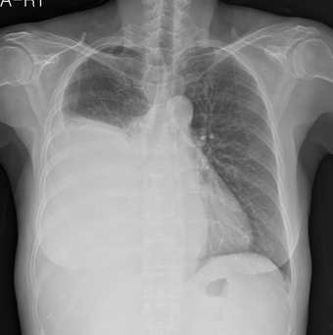
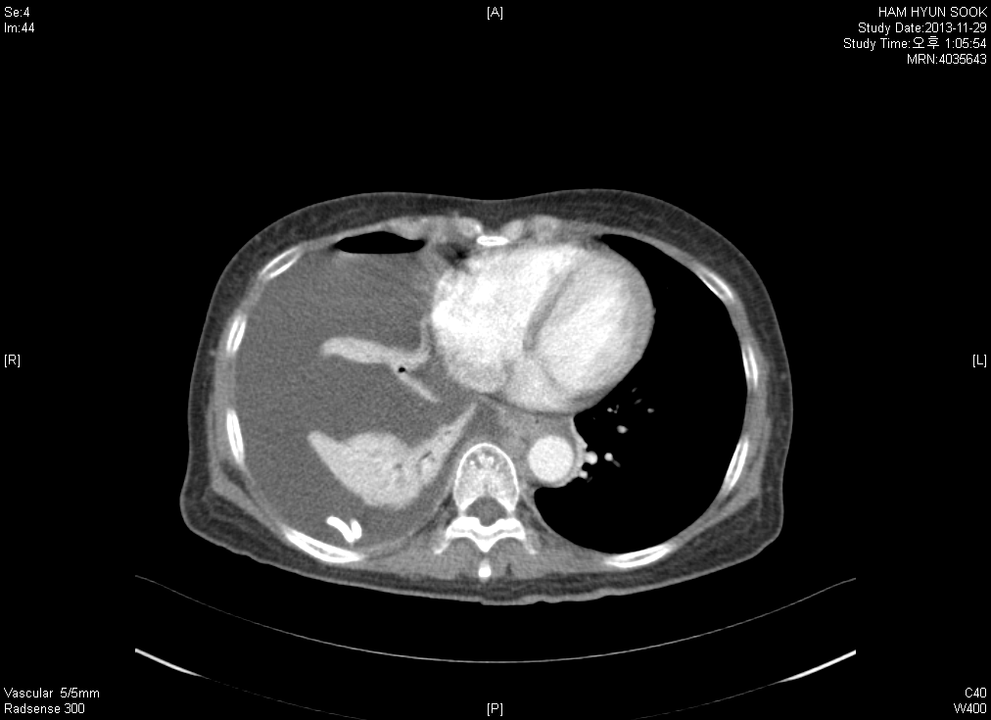
Cirrhosis with hepatic hydrothorax
함O숙, F/63, # 4035643,
Past hx: Liver cirrhosis
Pleural fluid analysis
  Color : Straw, Turbidity: Hazy RBC : 1020
  WBC 300 (Poly 5%, Mono 95%)
  pH 7.4
  Glucose 150 mg/dL
  T. protein 1500mg [Serum 7.1 g/dL ]
  LDH 50 IU/L [Serum LDH 350 IU/L]
  Albumin
P/E : no ascites

Slide 6
Cirrhosis with hepatic hydrothorax
Hepatic hydrothorax should be suspected in all pts with cirrhosis or portal hypertension, regardless of the presence of ascites
Location
  Rt (85%) >Lt (13%)> bilateral(2%)
In uncomplicated hepatic hydrothorax
  Cell count<250 PMN cells mm
  Protein <2.5g/dL
  Pleural fluid/serum total protein ratio<0.5
  Serum to pleural fluid albumin gradient >1.1
  Pleural fluid/serum bilirubin ratio<0.6
  pH>7.4
  Glucose level similar to that of serum
d/t defects in their diaphragm.
Dx: radioactivity in the thorax after the intraperitoneal injection of technetium-99m (99mTc)-sulfur colloid.
Spontaneous bacterial empyema
  Bacterial culture (+) + PMN >250cells/mm
  Or negative culture +PMN >500 cells/mm
Notes:
Pleural fluid proein level 이 보통 serum 보다 높았지만 그래도 <3.0 미만이었다.

Slide 7
Transudate pleural effusions
Nephrotic syndromes
  More than 20% of pts with NS have pleural effusions, which are usually bilateral .
  It should be remembered that the incidence of pulmonary emboli is high with NS
Urinothorax
  retroperitoneal urinary leakage secondary to urinary tract obstruction or trauma with subsequent dissection of the urine into the pleural space
    looks and smells like urine
    pleural fluid Cr > serum Cr
    low glucose level & a low pH level
CSF leakage
  m/c cause Ventriculopleural shunting
  Protein levels are usually very low.
  Presence of β2 transferrin in pleural fluid
Notes:
→ all pts with chronic transudative pleural effusions should be evaluated for proteinuria and hypoproteinemia.

Slide 8
Causes of pleural exudates
Common causes
  Malignancy
  Parapneumonic effusions
  Tuberculosis
Less common causes
  Pulmonary embolism
  Rheumatoid arthritis and other autoimmune pleuritis
  Benign asbestos effusion
  Pancreatitis
  Post-myocardial infarction
  Post-coronary artery bypass graft
Rare causes
  Yellow nail syndrome (and other lymphatic disorders eg, LPM)
  Chylothorax and pseudochylothorax
  Drugs
  Fungal infections
  Ovarian hyperstimulation syndrome

Slide 9
Differential cell counts
Neutrophil dominant
(>50% of cells)
  - acute injury to the pleural surface
  Parapneumonic effusion
  Subphrenic abscess
  Pancreatitis
  Pulmonary embolism
  benign asbestos pleural effusion
  Acute TB (<10%)
  Malignancy ( <20%)
Lymphocyte dominant
  (> 50% of cells )
  Malignancy (metastatic adc& mesothelioma)
  Tuberculosis
  Lymphoma
  Cardiac failure
  Post-CABG
  Rheumatoid effusion
  Chylothorax
  Uraemic pleuritis
  Sarcoidosis
  Yellow nail syndrome
Very high lymphodominant >80%

Slide 10
Differential cell counts
Eosinophilia ( > 10% of cells )
: never diaginostic
  Air or blood in the pleural spaces( m/c)
  Idiopathic (25%)
  parapneumonic effusions (20%)
  Malignancy (20%)
  Drug-induced pleurisy
  Churge-Strauss syndrome
  lymphoma
  pulmonary infarction and parasitic disease.
Myth: repeated thoracentesis is a common cause of eosinophilic effusion?
No
An early study of 130 pts undergoing a single repeated thoracentesis showed that only 3 (2.3%) cases became eosinophilic on the second pleural tap.
Very high eosinophils >40% → lower likelihood of malignancy

Slide 11
Parapneumonic effusion
pH and glucose
  All transudates and all other exudates have pleural fluid glucose concentration similar to that of blood glucose
  A low pleural fluid glucose concentration (less than 60 mg/dL [3.33 mmol/liter], or a pleural fluid/serum glucose ratio less than 0.5) narrows the differential diagnosis of the exudate to the following possibilities
    Rheumatoid pleurisy
    Complicated parapneumonic effusion or empyema
    Malignant effusion
    Tuberculous pleurisy
    Lupus pleuritis
    Esophageal rupture
parapneumonic effusion with a low pleural fluid pH (≤7.15) indicates a high likelihood of necessity for pleural space drainage
If the pts has a chronic illness with predominantly neurtophils in the pl. fluid, it is imperative to obtain anaerobic cultures of the pleural fluid. ( actinomycosis and nocardiosis)

Slide 12
Malignant pleural effusion
Lung cancer (m/c),
Breast cancer(2nd m/c)
  – mean interval between the diagnosis and the apperance of pl.effusion is 2yrs.
Hematologic malignancy (lymphoma and leukemias)
  10% of pts with Hodgkin’s lymphoma, 25% of pts with non-Hodgkin’s lymphoma at presentation, especially if mediastinal involvement is present.
  10~30% of pts receiving BMT develop pleural effusions.
  Acute and chronic leukemias, MDS, are rarely accompanied by pleural involvement.
  Usually extudates -serous or serosanguineous.
  12 % of the cases of pleural effusions in NHL, the fluid may be chylous.
Primary effusion lymphoma( PEL):
  rare , initially observed in HIV-positive pts, and characterized by lymphomatous effusions of the pleural, pericardial, or peritoneal cavity in the absence of clinically identifiable tumor masses.
  associated with HHV-8, and EBV infection.
  pt has AIDS and a lymphocytic pl.effusion with high LDH
Mesothelioma
  history of asbestos exposure
  Should be considered whenever a pt’pleural fluid cytology or pleural biopsy suggests metastatic adenocarcinoma.
  IHC : calretinin 5/6 and cytokeratin → mesothelioma vs CEA, MOC-3,1,B72.3 → metastatic adc
  mesothothelin

Slide 13
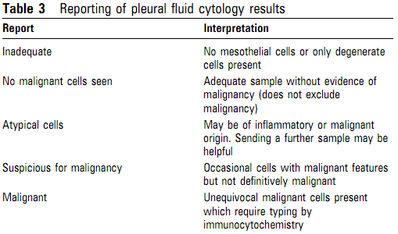
Malignant pleural effusion
Cytology
  Malignant effusions can be diagnosed by pleural ﬂuid cytology in about 60% of cases.
  A negative pleural ﬂuid cytological examination does not rule out malignancy
  The yield from sending more than two specimens (taken on different occasions) is very low and should be avoided.
  As much ﬂuid as possible should be sent for cytology from the available diagnostic sample (likely to be 20~40 ml) and, when the initial result is negative but malignancy is suspected, the sending of a higher volume sample following a second aspiration should be considered.
  Immunocytochemistry should be used to differentiate between malignant cell types and can be very important in guiding oncological therapy.

Slide 14
Malignant pleural effusion
Tumor marker
  Pleural ﬂuid and serum tumur markers do not currently have a role in the routine investigation of pleural effusions.
  Mesothelin : more promising diagnostic characteristics.
    glycoprotein tumour marker that is present at higher mean concentrations in the blood and pleural ﬂuid of patients with malignant mesothelioma
    sensitivity of 48~84% , speciﬁcity of 70~ 100% for the dx of mesothelioma.
    False positive : bronchogenic adenocarcinoma, metastatic pancreatic carcinoma, lymphoma and ovarian carcinoma
    A positive serum or pleural ﬂuid mesothelin level is highly suggestive of pleural malignancy and might be used to expedite a tissue diagnosis, but a negative result cannot be considered reassuring.
Notes:
In patients with stage I or II disease, the sensitivity was only 32 percent when a specificity criterion of 95 percent was used. Furthermore, the potential utility of serum SMRPs is limited to patients with epithelioid or mixed mesotheliomas and not those with sarcomatoid lesions

Slide 15
TB pleurisy
Unilateral in almost all cases : right side > left (55% vs 45%)
  Typically small to moderate in size <1/3 of hemithorax in 82% of pt.
  Parenchymal disease on CXR in upto 50% of pts.
  Always occurs on the same side as the parenchymal infiltrate.
Neurtophils predominate in the first few days of a tuberculous pleural effusion and lymphocytes predominate thereafter.
Eosinophil infiltration is uncommon.→ >10% eosinophils usually excludes the diagnosis of tuberculous pleuritis.
Pleural fluid cultures are positive in less than 30%.
Pleural biopsy culture may increase the yield to >90%.
  Most sensitive evaluation for pleural tB ( Granuloma in 50~97%, culture (+) in 40~80% )
  Sensitivity generally increased with th number of biopsies taken.
The sensitivity and specificity of Xpert MTB/RIF assay were 25 and 100 %, respectively.
Notes:
When pleural biopsies are taken, they should be sent for both histological examination and culture to improve the diagnostic sensitivity for TB.

Slide 16
TB pleurisy
ADA in pleural fluid :
  easy and inexpensive method for diagnosing tuberculosis pleurisy, regardless of the patient’s immune status (cut off value >45 to 60U/L, sensitivity 100%, specificity 96% )
  Extremely high ADA in pleural ﬂuid should raise suspicion of a non-tuberculous effusion → rheumatoid effusion, empyema, mesothelioma, lung cancer, parapneumonic effusion. Hematologic malignancy, fungal diseases.
  ADA-1 is increased in empyemas. ADA-2 is increased in tyberculous effusions.
IFN-r levels in pleural fluid
  very efficient at differentiating tuberculous from non-tuberculous pleural effusion. ( using cut off level 140 pg/mL → sensitivity 95%, specificity 96%).
Useful ‘rule out’ tests in low incidence countries.
  If the level of ADA is less than 40 IU/L or the level of g-interferon is less than 140 pg/mL, the diagnosis can be virtually excluded.
Presumptive therapy is warranted for patients with lymphocytic exudate and a positive tuberculin skin test or serum IFN-G release assay, even in the absence of difinitive diagnosis.
With appropriate therapy most pts defervesce within two weeks, in most cases, pleural fluid is resorbed within six weeks.
Residual pleural thickening can occur in 50% of pts.
Notes:
특히 lympho dominant , very high ADA 를 보이는 pe 에서는 fungal culture 를 나가야 한다.

Slide 17
CASE 2.

Slide 18
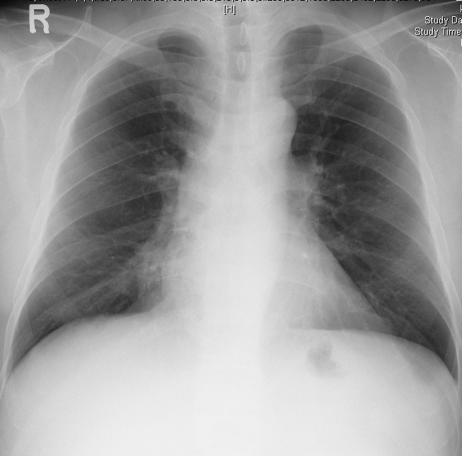
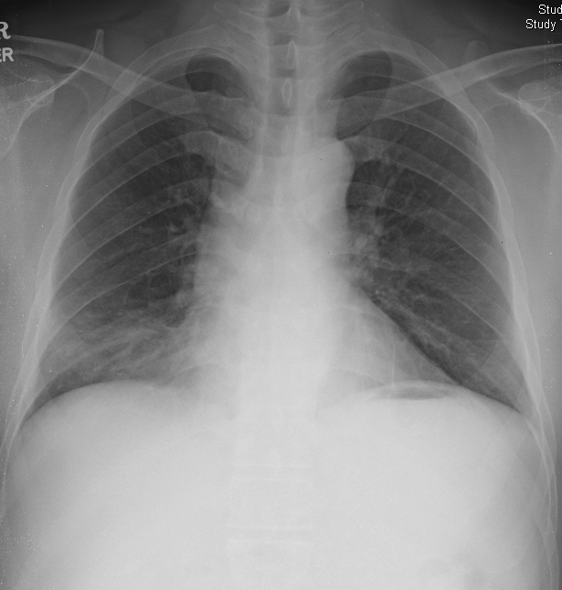
김 O 환 M/54 # 5149331
C.C: Hemoptysis
간디스토마 history
2006-10-15 경구 항생제 복용
2006-12-28

Slide 19
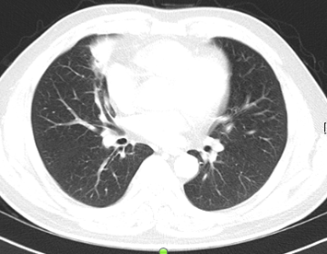
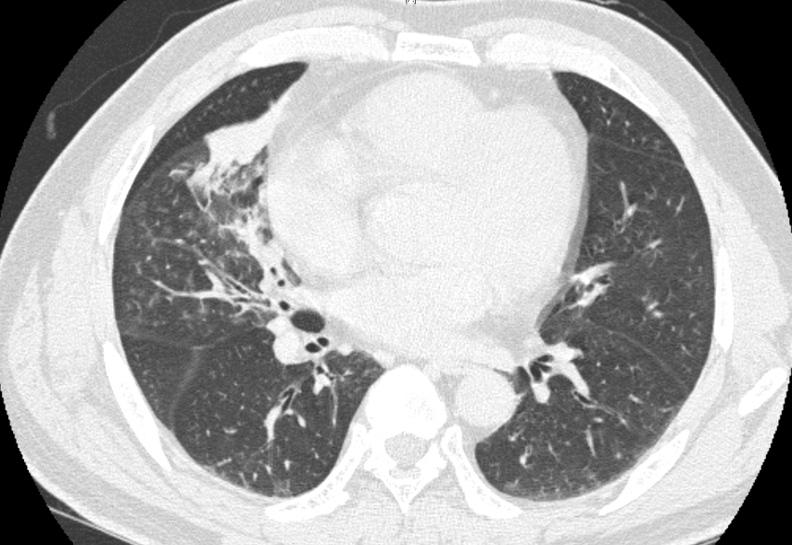
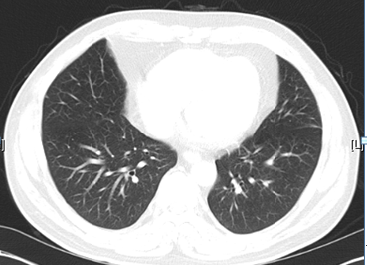
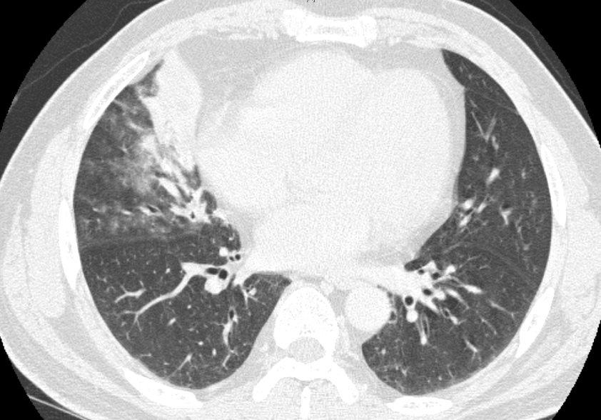
김 O 환 M/54 # 5149331
2006-10-12
2006-12-27
Notes:
Rt and Lt: no endobronchial lesion
RML medial segment 의 subsegments 는 3 개였으며 각각에서
forcep insertion 하여 TBLB 2/2/3 pieces 시행함.

Slide 20
김 O 환 M/54 # 5149331
* TBLB 2007-01-02
  Rt and Lt: no endobronchial lesion
  RML medial segment 의 subsegments 는 3 개였으며 각각에서
  forcep insertion 하여 TBLB 2/2/3 pieces 시행함.
Pathology 2007-01-02
  Lung, right middle lobe, TBLB
  Chronic nonspecific inflammation in the bronchial wall
Bronchial washing cytology: NOM
* RML lobectomy under VATS 2007-01-05
  frozen result : pneumonia and bronchiectasis
Pathology 2007-01-05
  Lung, right middle lobe, lobectomy
  1. Actinomycosis
  2. Chronic bronchitis with focal necrosis, lymphoid hyperplasia, hemorrhage and fibrosis
  Lymph node, interlobar: Reactive hyperplasia
  Note: Brown-Brenn stain reveals gram-positive bacilli in the sulfur granule. Ziehl-Neelsen stain reveals no acid-fast bacilli and PAS stain reveals no fungal hyphae.

Slide 21
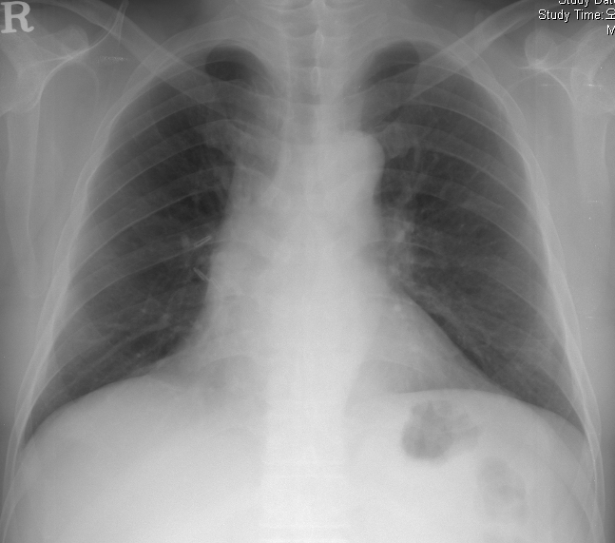
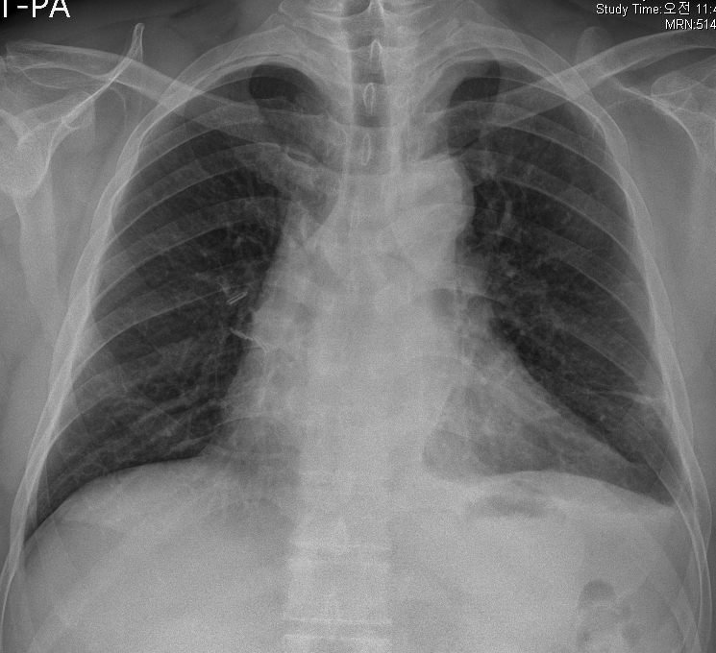
김 O 환 M/54 # 5149331
2007-12-7
moxicle 6개월 종결
2013-10-19
Pleuritic chest pain 으로 내원.

Slide 22
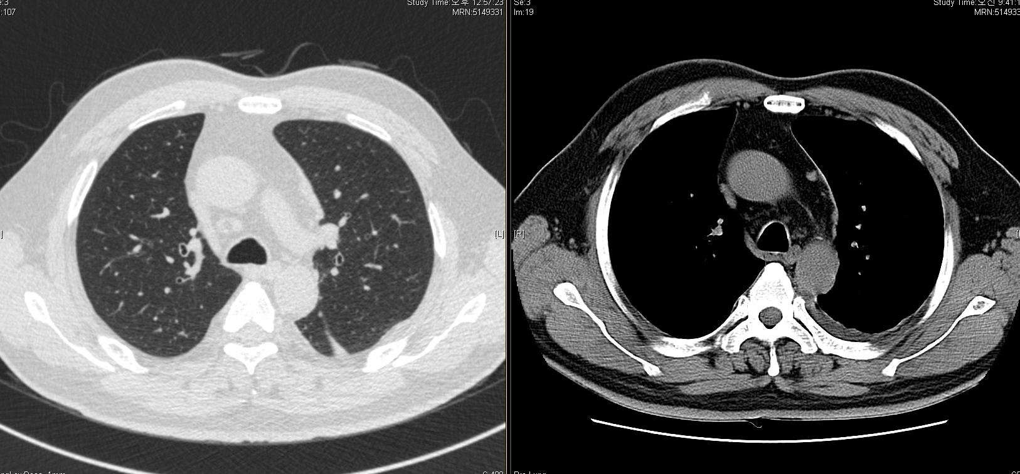
김 O 환 M/54 # 5149331
2013-10-23 low dose chest CT
Notes:
s/p RML lobectomy.
Pleural thickening at Lt. mediastinal pleura, Lt. apical pleura, and costal pleura with small amount of Lt. pleural effusion.
Suspected progression of pleural thickening at mediastinal pleura.
Several fissural nodules at Lt., major and accessory fisssures.
Diaphragmatic pleural nodules are also visible, Lt.
Tiny non-calcified nodules at LUL.
No LNE at hila and mediastinum.
IMP: r/o pleural metastasis or pleural malignancy at the Lt.
(이전에 보였던 lung nodules은 거의 대부분 thin section image에서 pleural nodules로 보입니다.)
rec) PET correlation and pleural Bx.

Slide 23
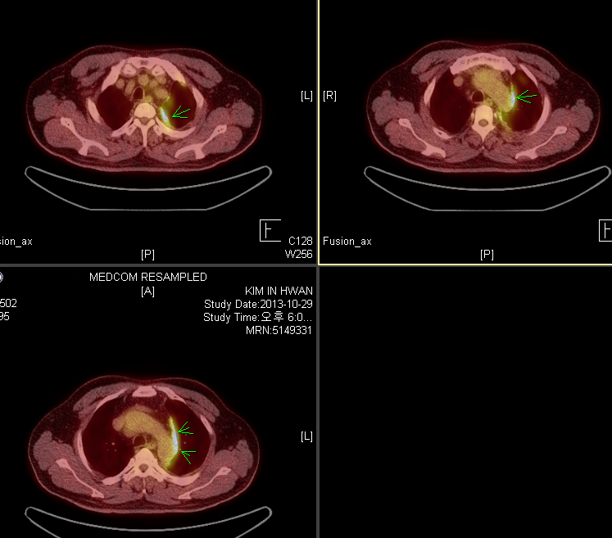
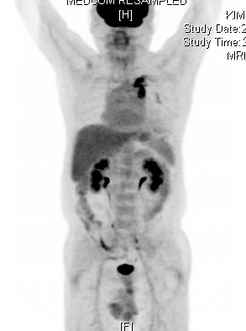
2013-10-29 PET- CT
Notes:
1. Increased FDG uptake is seen in pleural thickening at apical pleura, mediastinal pleural, costal pleura, and diaphragmatic pleura with pleural effusion in left hemithorax
- Intense FDG uptake is noted especially in apical and mediastinal pleura
- Pleural malignancy or plerual metastases should be considered, rec> tissue confirm
2. No definite abnormal FDG uptake to suggest primary cancer lesion which could be the origin of pleural lesions
3. No other abnormal FDG uptake to suggest malignant process
4. GB stones

Slide 24
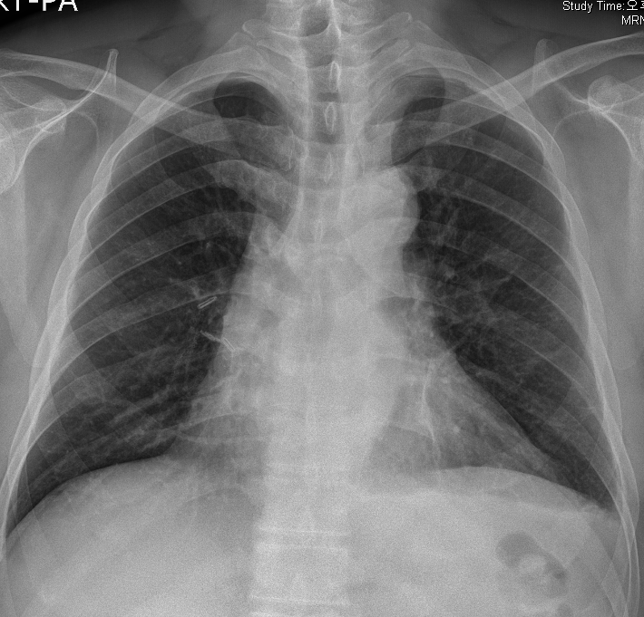
김 O 환 M/54 # 5149331
*pleural biopsy under VATS
  Lt. approach
  no pleural adhesion
  pleural seeding
  전반에 걸쳐 pleural mass 존재하여 Bx
Pathology 2013-11-6
  Pleura, left, biopsy VATS under
  Malignant mesothelioma, epithelioid type
    Note) The immunohistochemical stain results:
    D2-40 and Calretinin: Positive in tumor cells
    WT1: Focal positive in tumor cells
    TTF-1, napsin A, CEA and CD15: Negative in tumor cells
  → 종양내과 f/u 중
2013-11-14 f/u CXR
Notes:
2006년 CEA, CYFRA 21-1 , SCC Ag , CYFRA 21-1 모두 negative
Pleural effusion analysis 는 하지 않음.

Slide 25
CASE 3.

Slide 26
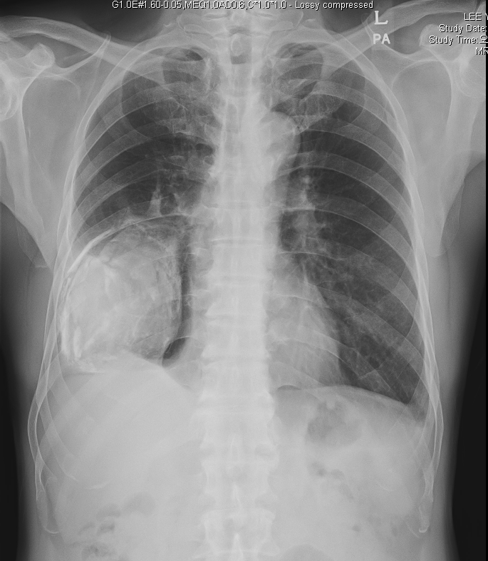
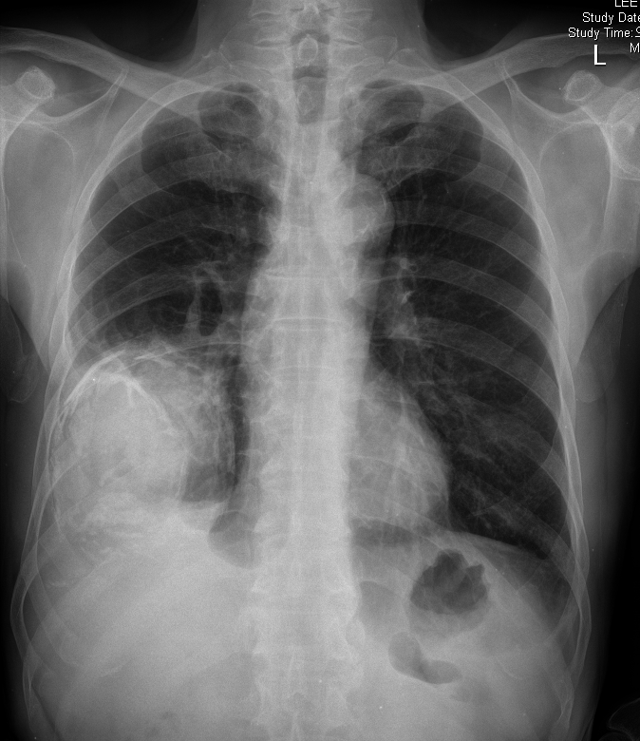
이 O 학 M/71 #5054174
2012-5-18
2013-11-20
Notes:
Chronic empyema 로 f/u 해오던 중 DOE 악화를 주소로 내원.

Slide 27
이 O 학 M/71 #5054174
C.C: Dyspnea on exertion ( 10 days)
ROS
  C/S/R(-/-/-)
  Dyspnea/ DOE(-/+)
  Chest pain/ discomfort(-/+)
  Fever/ chilling(-/-)
P/E
  N/C
Past History
  HTN/DM/Hepatitis (-/-/-)
  Pulmonary Tuberculosis – 50년전 신체검진에서 늑막염 진단받은적 있으나 치료 잘 받지 못함.
  Smoking Hx- exsmoker 15년전 금연, 0.5*30 -> 15pyr
Laboratory finding (2013-12-23)
  CBC 14250(780.0%)/ 12.4/213K
  BUN/Cr 14.3/0.86
  T.p/alb 4.7/2.9
  OT/PT 22/14/
  E 139/4.1/106
  aPTT/PT 32.0sec/0.90 INR
  CRP 0.9 mg/L
Sputum AFB smear/ culture (-/-)
PFT
  FEV1/FVC 50%
  FEV1 1.27L(51%) FVC 2.53L(69%)
  DLCO/VA 4.11 113%
Notes:
원래 DOE (+) 있었는데 최근 날씨 추워지면서 10일전부터 증세 악화

Slide 28
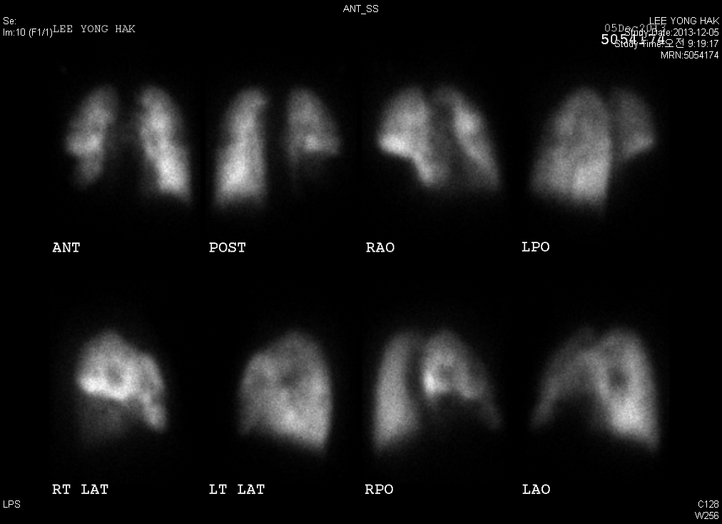
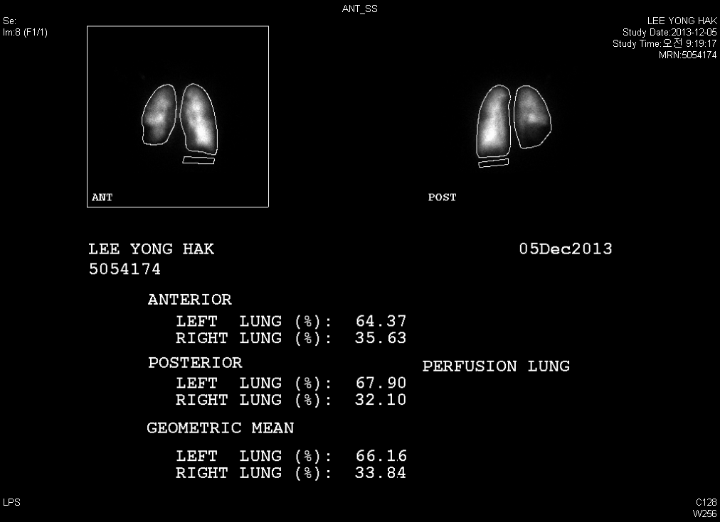
이 O 학 M/71 #5054174
2013-12-5 Lung perfusion scan

Slide 29
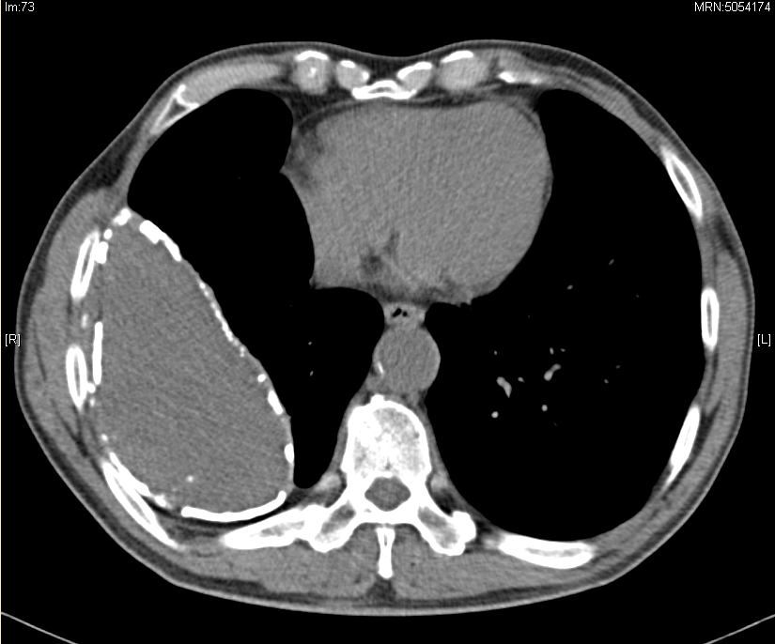
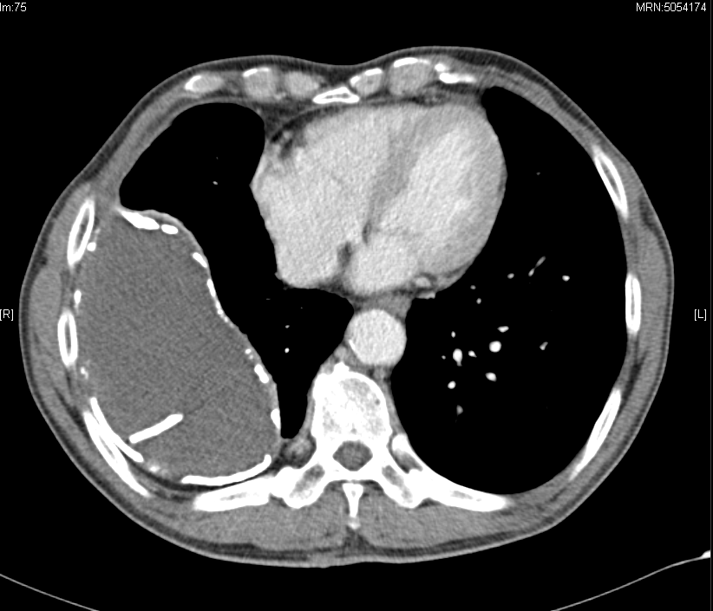
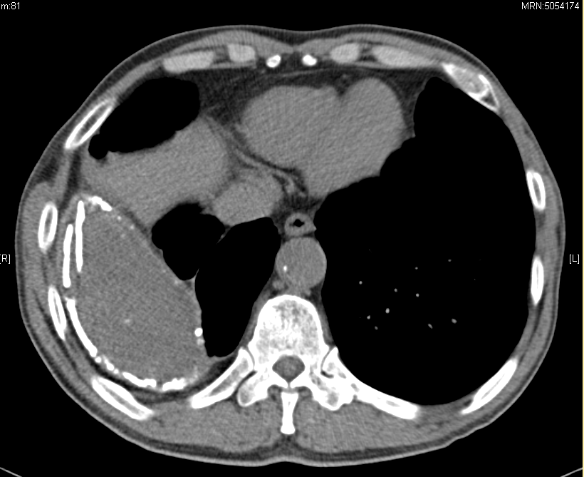
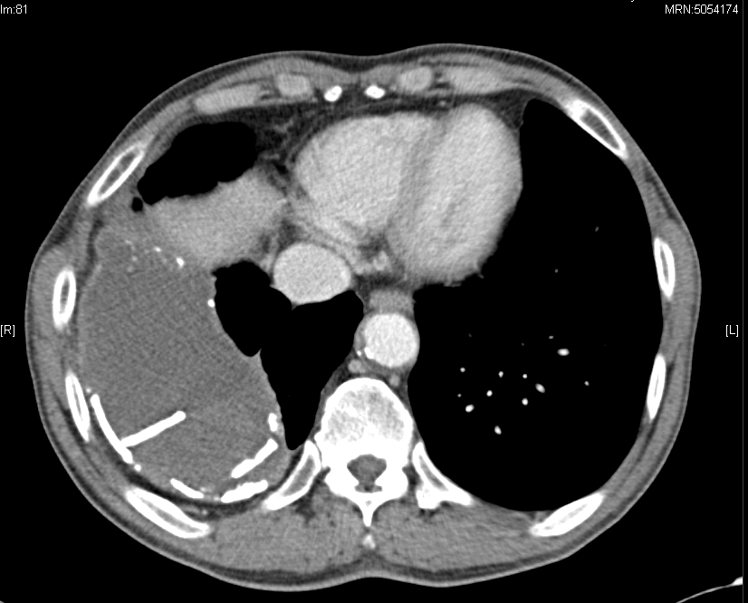
2012-5-19 외부 chest CT
2013-11-20
Notes:
Chest CT외부 (2013-11-22)
2013 Nov-20 outside chest CT;
Compared to outside chest CT of 2012 May-18,
Increased amount of loculated pleural effusion and dense calcification in Rt lower thorax with aggravated extension through the parietal pleura(into extrapleural fat layer), probably empyema necessitatis
-DDx. malignancy associated with chronic empyema

Slide 30
이 O 학 M/71 #5054174
2013-12-23 Lung, empyema sac, right, decortication and empyemectomy
  Severe calcification empyema sac.
  adhesion between the sac and the lung was severe and during dissection, minimal lung injury was caused.
[Pathology]
Lung, empyema sac, right, decortication and empyemectomy
  1. Chronic granulomatous inflammation with necrosis and multinucleated giant cells, see note.
  2. Dense fibrosis with calcification
    Note)
      1. Ziehl-Neelsen stain reveals no acid-fast bacilli.
      2. D-PAS stain reveals no fungal hyphae.
      3. Tb-PCR; negative

Slide 31
CASE 4.

Slide 32
김 O 혁 M/72 #5955952
C.C: Rt pleuritic pain
  신촌 연세 병원 2013.10.4~11 입원 TB pleurisy 진단하에 HERZ 2013.10.4~ medication 중
ROS
  C/S/R(-/-/-)
  Dyspnea/ DOE(-/+)
  Chest pain/ discomfort(+/+)
  Fever/ chilling(-/-)
P/E
  N/C
Past History
  HTN/DM/Hepatitis (-/-/-)
  Pulmonary Tuberculosis (-)
  Smoking Hx- exsmoker 5년전 금연, 1*40 -> 40pyr
  직업력: 인테리어
Laboratory finding (2013-12-23)
  CBC 14250(780.0%)/ 12.4/213K
  BUN/Cr 14.3/0.86
  T.p/alb 4.7/2.9
  OT/PT 22/14/
  E 139/4.1/106
  aPTT/PT 32.0sec/0.90 INR
  CRP 0.9 mg/L
외부병원thoracentesis Lt (2013-10-4)
  WBC 12340( lympho 79%)
  Total protein 3.89
  LDH 1343
  ADA 90.2
  CEA 0.98
Sputum AFB smear/ culture (-/-)

Slide 33
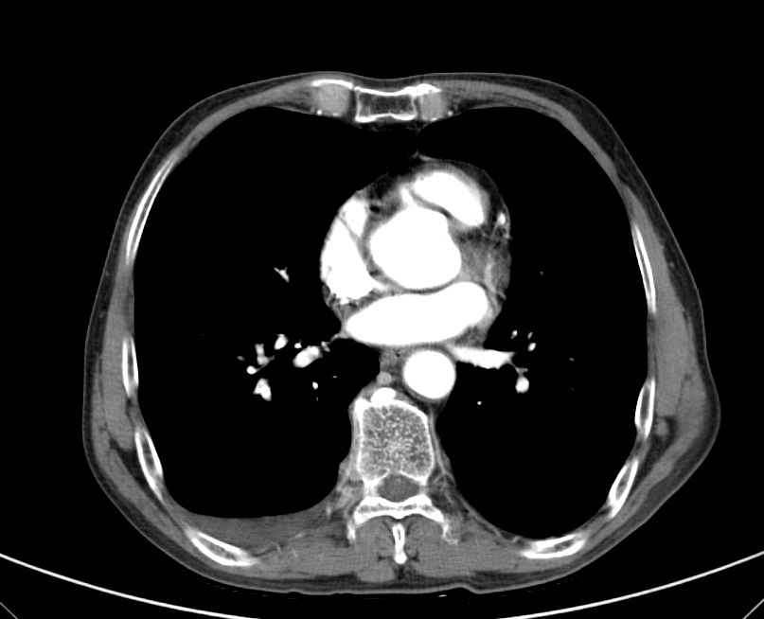
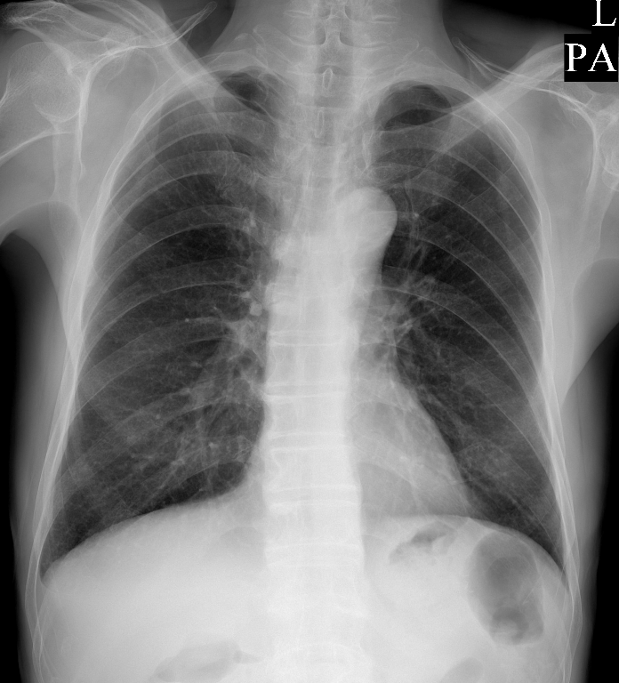
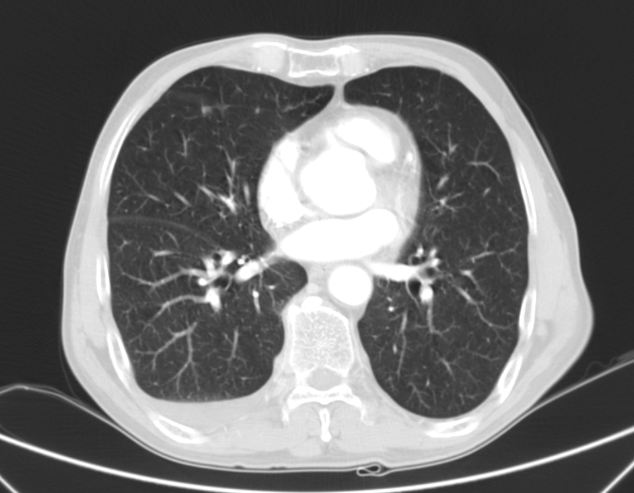
2013-10-04 외부
Notes:
외부 CT reading :
Subpleural nodular lesions in RML.
A small amount of right pleural effusion.
No LN enlargement in the thorax.

Slide 34
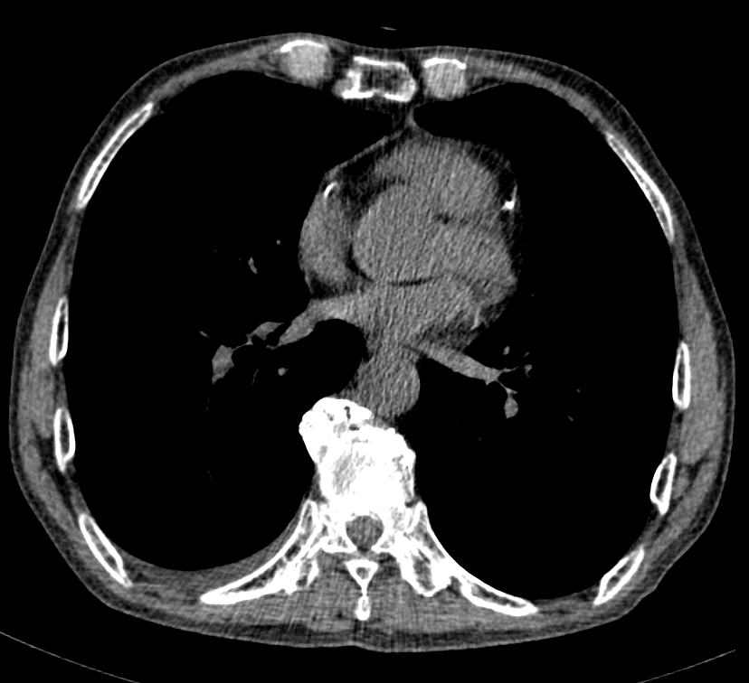
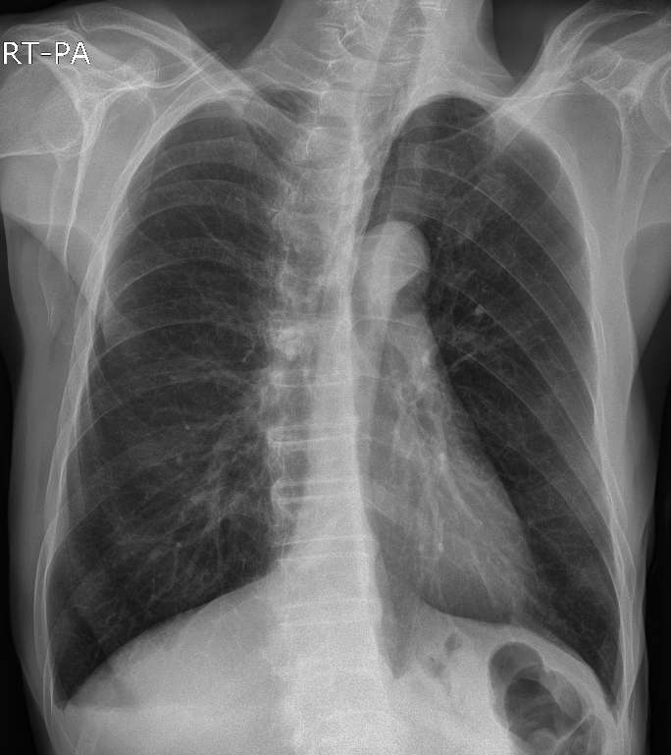
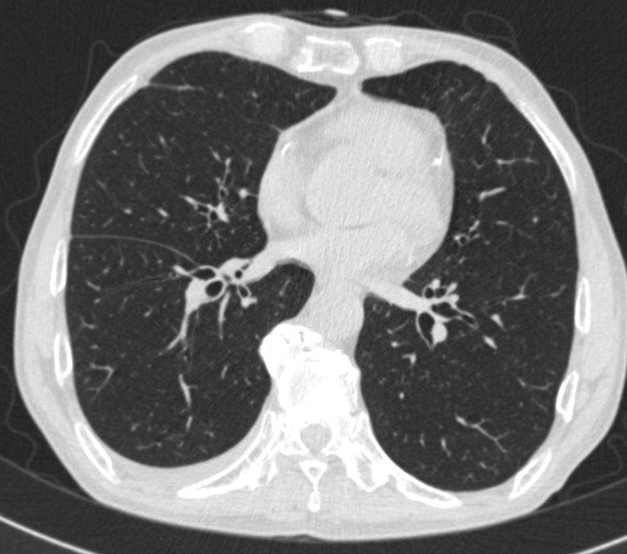
2013-11-04 본원
Notes:
외부 chest CT 10-4와 비교했을때,
Rt pl. effusion 은 줄었지만 아직 남아있고, subpleural nodular lesion RML 변화없다.

Slide 35
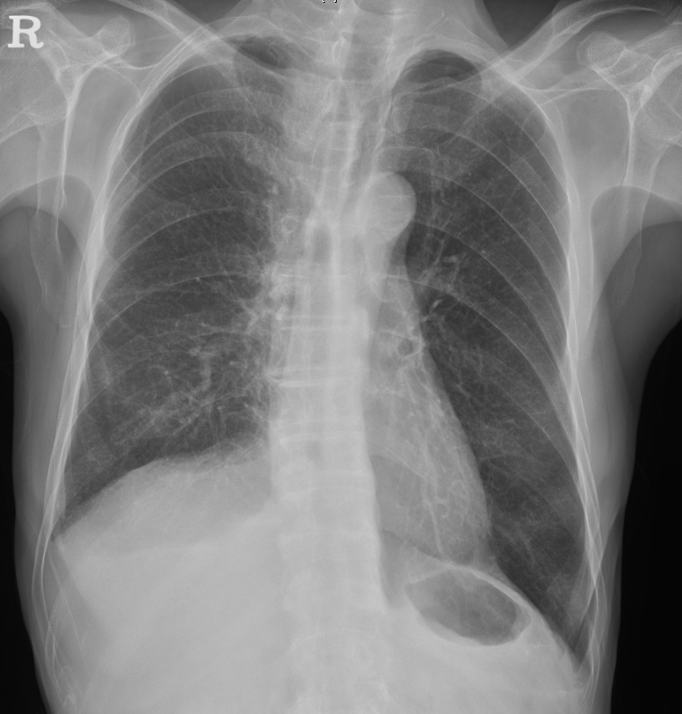
김 O 혁 M/72 #5955952
지속되는 통증 호소
본원 thoracentesis f/u [2013-11-29]
  WBC 1390 ( mono 100% )
  pH 7.6
  Total protein 5300
  LDH 1473
  Glucose 86
  ADA 148.5
  CEA 0.98
  cytology :Negative for malignancy
결핵균 특이항원 자극 IFN-r (IGRA) Negative
Pleural fluid AFB smear/ culture : -/ impending
→ Tb medication hold(12/3~)하고 pleural biopsy under VATS 계획으로 입원.
2013-11-29

Slide 36
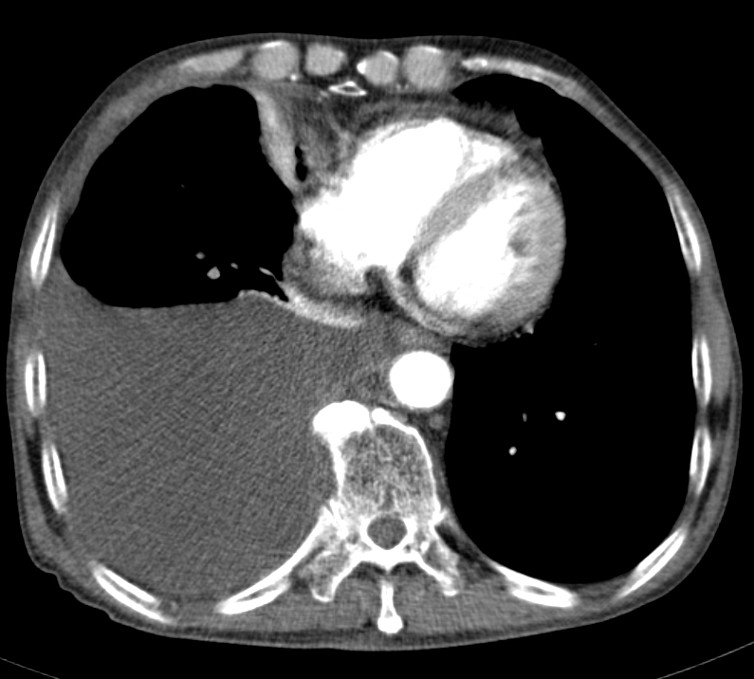
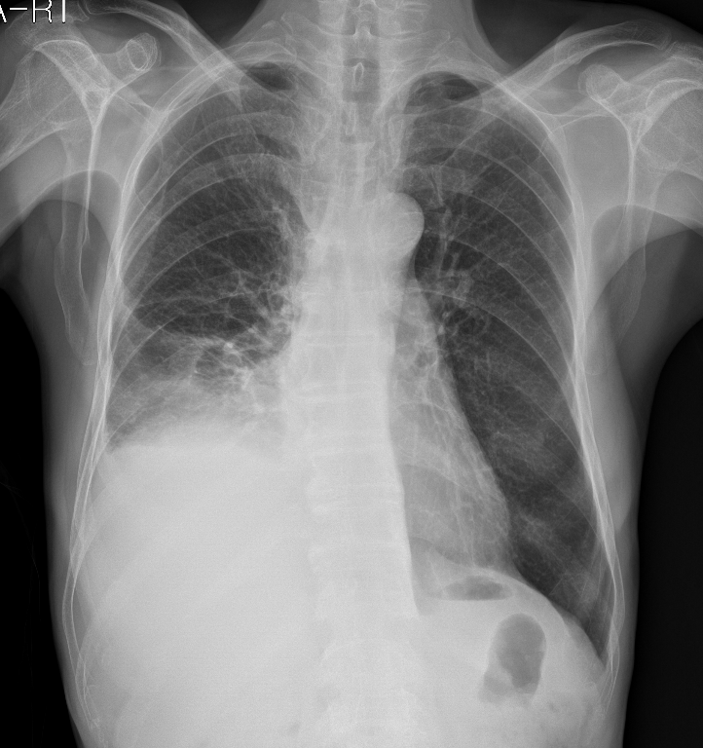
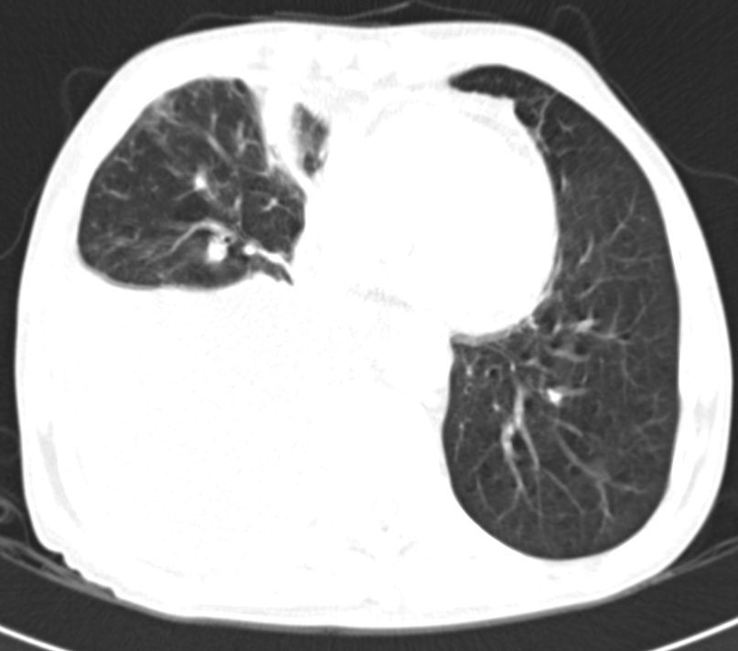
2013-12-05 입원
Notes:
Compared to the CT taken on 2013-11-04,
Markedly increased Rt. pleural effusion. rec) pleural fluid cytology.
Intraluminal filling defects at the RLL basal segmental PAs, LUL lobar with anterior segmental, lingular segmental, LLL lobar with superior and basal segmental PAs, suggesting acute PTE.
Subsegmental collapses at RML and RLL.
Suspected RVE, rec) echo corelation.
Minimal pericardial effusion.
Previously noted subpleural nodule at RML was obscured by subsegmental collapse.

Slide 37
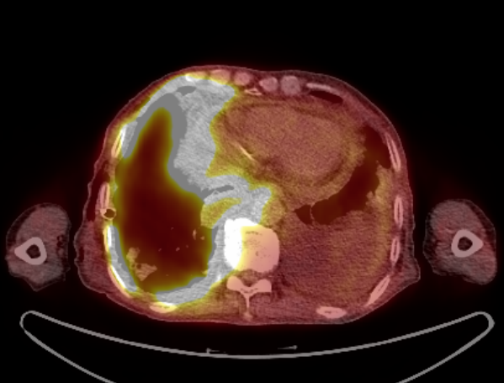
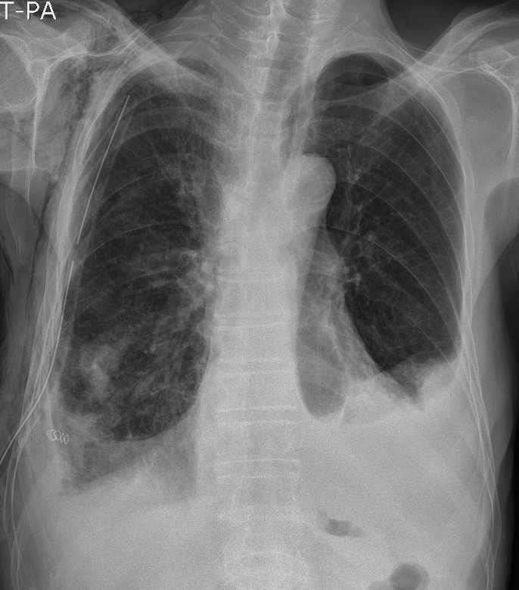
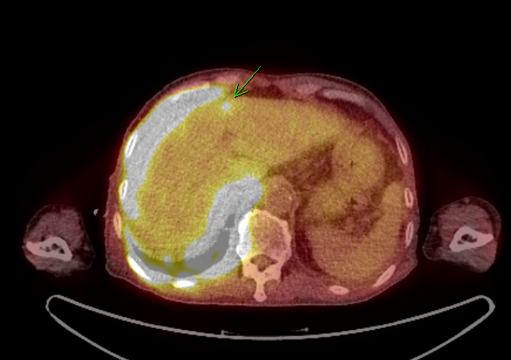
2013-12-19
2013-12-19 PET-CT
Notes:
PET-CT
1. Diffuse intensely increased FDG uptake is seen along the right pleura with loculated pleural effusion; clinically informed malignant lymphoma uptake - Moderate amount of pleural effusion in left hemithorax with mild FDG uptake in collapsed lung; rec> clinical correlation for rule out malignant pleural effusion
3. Multifocal increased FDG uptake in skull base, left humerus, left scapula, left 3rd rib, L-spines, sacrum, both pelvic bones and right femur; suggestive of malignant lymphoma involvement
4. Suspicious of focal increased FDG uptake in the liver, left lobe; malignant lymphoma involvement should be considered, rec> contrast-enhanced liver CT
5. Diffusely increased FDG uptake in bilateral adrenal glands without nodular lesion; r/o benign adrenal hyperplasia, rec> follow-up
6. No other definite abnormal FDG uptake to suggest malignant lymphoma involvement

Slide 38
김 O 혁 M/72 #5955952
[Pathology]
Pleura, right, biopsy under VATS [2013-12-19]
  CD3+ and CD56+ medium to large sized atypical lymphocyte infiltration, consistent with extranodal NK/T-cell lymphoma, see note.
  Note) The immunohistochemical stain results:
    CD30, CD20 (L26), Herpes virus 8 (HHV-8) and bcl-2: not expressed in tumor cells

Slide 39
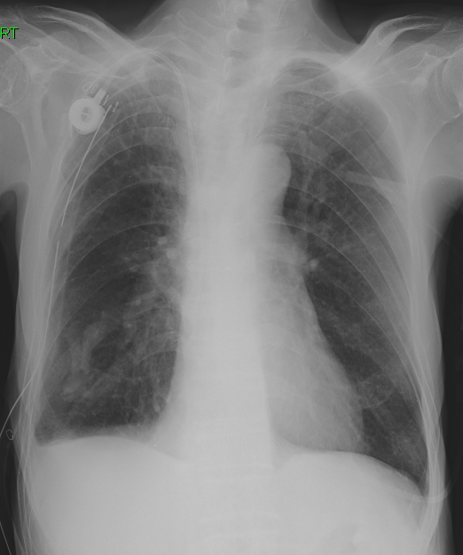
김 O 혁 M/72 #5955952
1st IMVP-16PL (2013-12/24-12/28)
  IFOS 1000mg/m2 -> 800; 1272mg IVF 1hrs, D1~5, 20% DR
  MTX 30mg/m2 -> 47.7 mg IV D3, D10"
  "VP-16 100mg/m2 ->80; 127.2 mg IVF 2hrs,D1~3 ; 20% DR
  Mesna 255 mg *3 IV D1~D5
  Dexa 20mg #2 D1~D5
Fragmin 10000U SC daily.
Chest tube Rt daily 600~1000ml 나오던중 12/26일부터 <100ml 감소.
2014-01-06
Notes:
recommend 했으나 현재 nadir 진입상태로 추후 회복되면 시행후 tube remove 하기로 함.

Slide 40
Connective tissue diseases
Rheumatoid arthritis-associated pleural effusions
  Exudate with low glucose, low pH,and high LDHlevels.
  → very low glucose level of <1.6 mmol/l (29 mg/dl).
  The first manifestation of RA is virtually never a pleural effusion →old age men who have subcutaneous nodules
Systemic lupus erythematosus (SLE)
  SLE may present with a pleural effusion.
  The drug –induced lupus should always be considered.
  (Hydralazine, procainamide, isoniazid, phenytoin, and chlorpromaxine)
  Pleural ﬂuid ANA should not be measured routinely as it reﬂects the serum level and is therefore usually unhelpful.

Slide 41
Drug related pleural effusion
Commonly prescribed drugs known to cause pleural effusions (over 100 cases reported globally)
  Methotrexate
  Amiodarone
  Phenytoin
  Nitrofurantoin
  β-blockers
  dantrolene(a muscle relaxant), ergot alkaloids (bromocriptine or pergolide) → Parkinson’s disease , methysergide, procarbazine, clozapine, dapsone, metronidazole, mitomycin, isotretinoin, propylthiouracil, simvastatin,warfarin.
Most patients who have drug-induced pleural effusions have peripheral eosinophilia.
When the drug is discontinued, the effusion usually resolves rapidly

Slide 42
Chylothorax vs pseudochylothorax
Centrifuge-> supernatant “cloudy”
Chylothorax
  Trauma: thoracic surgery (especially if involving posterior mediastinum, eg esophagectomy), thoracic injuries
  Neoplasm: lymphoma or metastatic carcinoma
  Miscellaneous: disorders of lymphatics (including lymphan-gioleiomyomatosis), tuberculosis, cirrhosis, obstruction of central veins, chyloascites
  Idiopathic (about 10%)
Pseudochylothorax
  Tuberculosis
  Rheumatoid arthritis

Slide 43
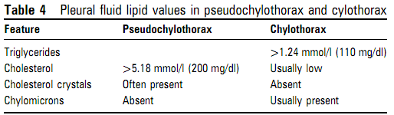
Chylothorax vs pseudochylothorax
Chylothorax
  Acute illness, pleural surfaces are normal on chest CT
Pseudochylothorax
  More than 5 yrs, markedly pleural thickened on CT
Examine sediment :
2
< 50 mg/dl
TG 50~110mg/dl
1
3. Lipoprotein analysis

Slide 44
Pleural effusion d/t pulmonary embolism
Pleural effusions occur in at least 30% of pts with pulmonary emboli , and they are almost always exudative.
Usually small amount < 1/3 of the hemithorax .
→ spiral CT

Slide 45
Pleural effusion after CABG
Approximately 10% of pts who undergo CABG surgery have a pleural effusion that occupies more than 25% of their hemithorax 28 days after surgery .
  Lymphocyte dominant exudate
  LDH level approximately equal to the upper limit of normal for serum.
  → ddx. Tb) ADA level < 40 U/L
  Can persist for years on rare occasion.
Postcardiac injury syndrome (PCIS) =Dressler’s syndrome
  characterized by the development for fever, pleuropericarditis, and parenchymal pulmonary infiltrates in the weeks after trauma to the pericarium or myocardium.
  symptoms usually develop between the first and third weeks but can develop any time between 3 days and 1 year.
  frankly bloody in approximately 30% of pts
  predominantly neutrophils or mononuclear cells, depending on the acuteness of the pro
  cess

Slide 46
Management of persistent undiagnosed effusions
Even after a complete investigation including thoracoscopic biopsies, a signiﬁcant number of patients with pleural exudates are diagnosed with ‘non-speciﬁc pleuritis’ and no speciﬁc diagnosis can be made.
One study monitored 143 patients who had a non-diagnostic pleural fluid analysis and pleural biopsy. Follow-up ranging from one to six years revealed that 29 (20 percent) had malignancy, and one had tuberculosis.
A retrospective study of 75 such pts found that only 8.3% of these turned out to be malignant over a 2-year follow-up period.
Another study found neither malignancy nor tuberculosis during a mean follow-up of 33 months in 53 patients with nonspecific pleuritis

Slide 47
Management of persistent undiagnosed effusions
Biochemical pleural fluid analysis did not predict these outcomes.
If this LDH level tends to decrease with time, the pleural process is resolving and one can be conservative in the approach to the patient. Alternatively, if the LDH level is increasing with time, the process is getting worse and one should be aggressive in pursuing a diagnosis
Of the 93 pts with massive pleural effusion, 55(59%) had malignancy, 21(23%)had parapneumonic effusion,9(10%) had tuberculous effusions,4 had other exudates and 4 had transudative effusions.
In pts not ﬁt enough for thoracoscopy, it is sensible to reconsider diagnoses with a speciﬁc treatment (eg, TB, pulmonary embolism, lymphoma and chronic heart failure).

Slide 48
References
The Undiagnosed Pleural Effusion
  Clin Chest Med 27 (2006) 309 – 319
  Richard W. Light, MD
Investigation of a unilateral pleural effusion in adults: British Thoracic Society pleural disease guideline 2010
  Thorax 2010;65
  Clare Hooper, Y C Gary Lee and Nick Maskell
Pearls and myths in pleural ﬂuid analysis
  Respirology (2011) 16, 44–52
  JOSÉ M. PORCEL
Pleural diseases fifth edition
  Richard W. Light, MD

