Slide 1




Pirfenidone in patients with idiopathic pulmonary fibrosis (CAPACITY)
: two randomised trials
Paul W Noble, Carlo Albera, Williamson Z Bradford, Ulrich Costabel, Marilyn K Glassberg, David Kardatzke, Talmadge E King Jr, Lisa Lancaster, Steven A Sahn, Javier Szwarcberg, Dominique Valeyre, Roland M du Bois, for the CAPACITY Study Group
Lancet 2011; 377: 1760–69
R3 임아영

Slide 2
Introduction (1)
Idiopathic pulmonary fibrosis
  Chronic, progressive, and fatal lung disease with no known cause or cure
  Characterised by progressive dyspnea and irreversible loss of lung function
  Estimated median survival of 2–5 years
Pirfenidone (5-methyl-1-phenyl-2-[1H]-pyridone)
  Regulate the activity of TGF-β and TNF-α in vitro
  Inhibit fibroblast proliferation and collagen synthesis and reduce cellular and histological markers of fibrosis in animal models of lung fibrosis

Slide 3
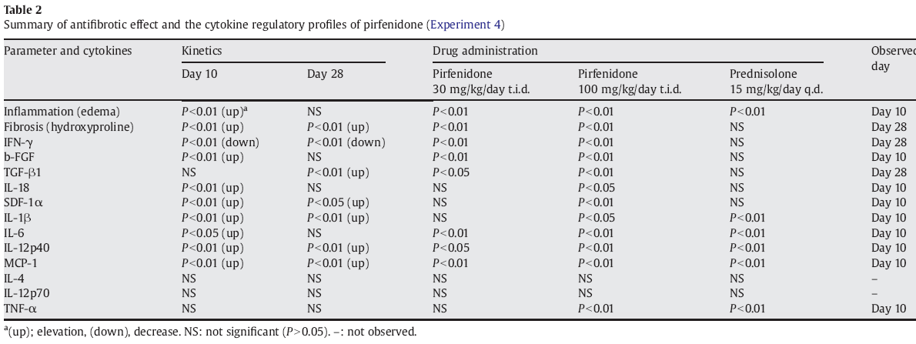
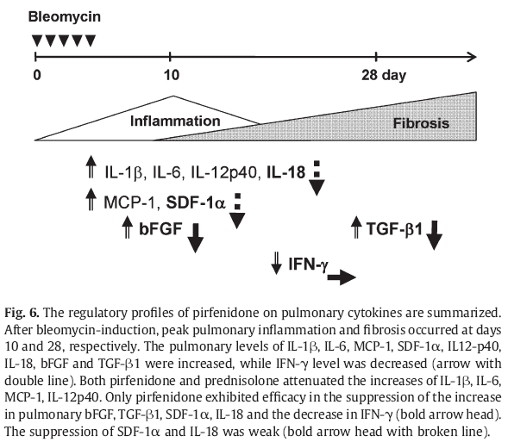
(Antifibrotic action of pirfenidone and prednisolone: Different effects on pulmonary cytokines and growth factors in bleomycin-induced murine pulmonary fibrosis,
Hisashi Oku et al., European Journal of Pharmacology, 2008)
Notes:
본 표의 내용은 Hisashi 등이 European journal of pharmacology 에 2008년 발표했던 내용에서 따온 것으로 pirfenidone 이 다음과 같은 cytokine 에 영상을 미쳐, fibrosis 를 감소시키는 것을

Slide 4
Introduction (3)
Phase 2 study of 107 Japanese patients
  Randomised, double-blind, placebo-controlled
  Reduced decline in the mean change in vital capacity in pirfenidone-treated patients (p=0.037)
  Led to three phase 3 studies
Japanese phase 3 study of 275 patients
  Pirfenidone reduced mean change in vital capacity at week 52 (p=0.042)
  Improved progression-free survival time (p=0.028)
  => approval of pirfenidone in Japan for the treatment of idiopathic pulmonary fibrosis
Notes:
Vital capacity 의 저하를 감소

Slide 5
Introduction (4)
The CAPACITY (Clinical Studies Assessing Pirfenidone in idiopathic pulmonary fi brosis: Research of Efficacy and Safety Outcomes) programme
  Included two similar multinational trials (studies 004 and 006)
  Designed to confirm the effect of pirfenidone on reduction of decline in lung function
Notes:
Pirfenidone 의 폐기능 저하 경감 효과

Slide 6
Methods (1)
Patients
  110 centres in 13 countries, studies 004 and 006
  Eligible patients
    Aged 40–80 years
    Diagnosis of IPF in the previous 48 months
    No evidence of improvement in measures of disease severity over the preceding year
  Inclusion criteria
    Predicted FVC of at least 50%
    Predicted DLco of at least 35%,
    Either predicted FVC or predicted DLco of 90% or less
    6-min walk test (6MWT) distance of at least 150 m

Slide 7
Methods (2)
    Younger than 50 years and those not meeting protocol criteria for definite IPF
    => Have a lung biopsy sample showing usual interstitial pneumonia
  Exclusion criteria
    Obstructive airway disease, connective tissue disease, alternative explanation for ILD, and being on a waiting list for a lung transplant
Randomisation and masking
  In study 004 - 2:1:2 ratio to pirfenidone 2403 mg/day, pirfenidone 1197 mg/day, or placebo
  In study 006 - 1:1 ratio to pirfenidone 2403 mg/day or placebo

Slide 8
Methods (3)
  Three daily doses (pirfenidone 801 mg or 399 mg) and increased to full dose over 2 weeks
  Physical examination and clinical laboratory assessments were done at weeks 2, 4, 6, and 12, and every 12 weeks thereafter
  Pulmonary function, exercise tolerance, and dysnea
Statistical analysis
  Primary endpoint
    Change in percentage of predicted FVC from baseline to week 72

Slide 9
Methods (4)
  Secondary efficacy endpoints
    Categorical FVC (5-level scale)
    Progression-free survival (time to confirmed ≥10% decline in percentage predicted FVC, ≥15% decline in percentage predicted DLco or death),
    Worsening IPF (time to acute exacerbation, death, lung transplantation, or admission to hospital for respiratory problems)
    Dyspnea
    6MWT distance
    Worst peripheral oxygen saturation (SpO2) during the 6MWT
    Percentage predicted DLco
    Fibrosis by use of HRCT (study 006 only)

Slide 10
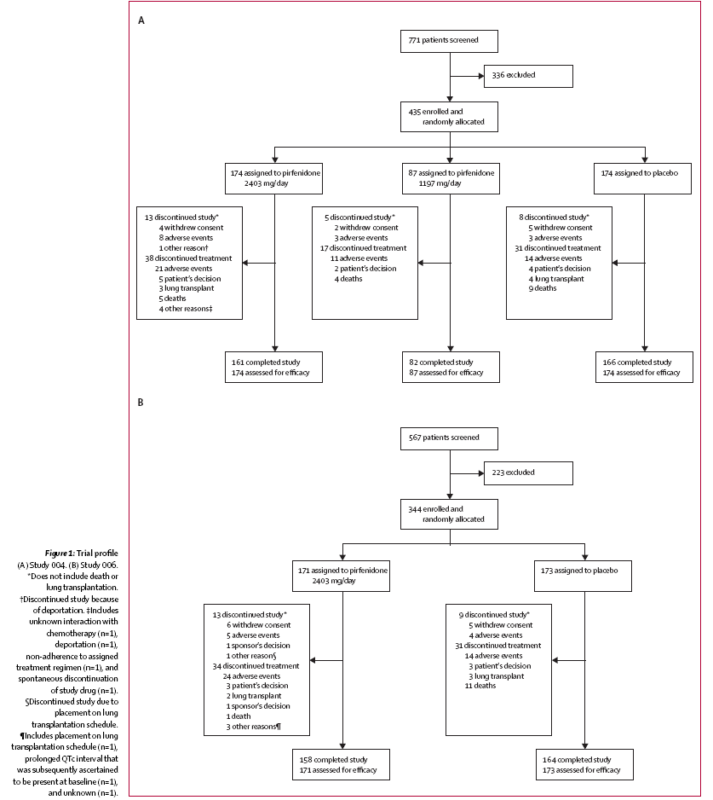

Slide 11
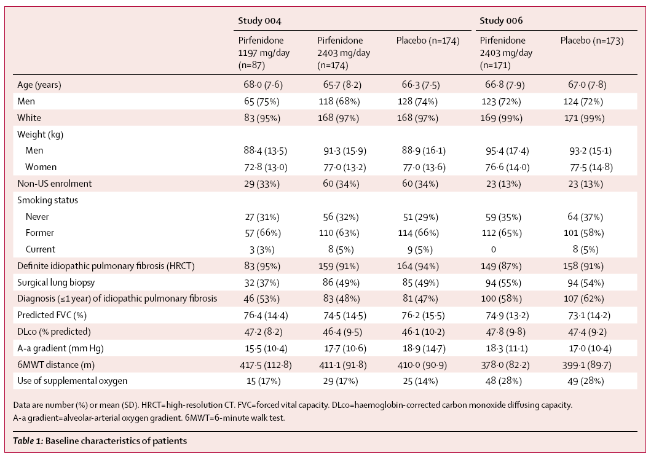
Results (1)
Notes:
본 표는 baseline characteristics 를 나타낸 것-> 두 그룹간 확연한 imbalance 는 없었음.
다만, 1년 이내 진단, O2 supplement 는 006에서 높음

Slide 12
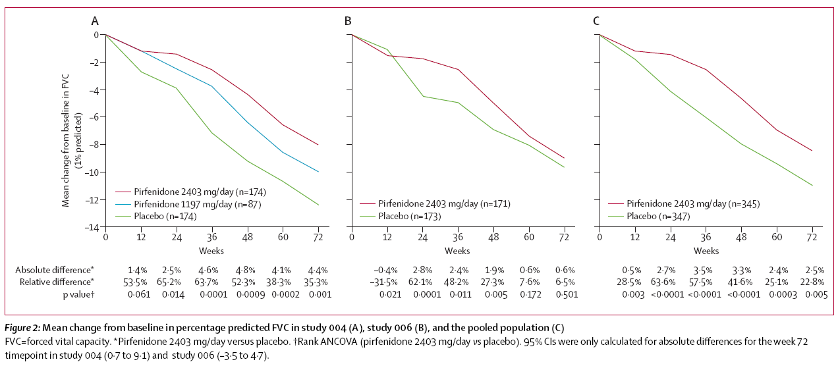
Results (2)
Notes:
본 그래프는 study 004, study 006, 그리고 pooled population 에서의 basline 에서의 FVC의 변화를 나타낸 것
Study 004 에서, 72주의 2403mg 투여 group 에서 placebo group 과 비교하였을 때 FVC % 의 감소율이 확연하게 적었음을 볼 수 있었음. 이러한 treatment effect 는 24주부터 명확하게 나타나기 시작함. 1197mg group 의 outcome 결과는 두 그룹의 중간으로 나타남.
Study 006 에서는 72주에서의 pirfenidone group 과, placebo group 간의 차이가 명확하게 나타나지 않았음. 그러나 12주에서, 48주까지는 유의한 차이 보임.
Pooled population 에서는, pirfenodone group 과 placebo group 간 treatment point 의 차이

Slide 13
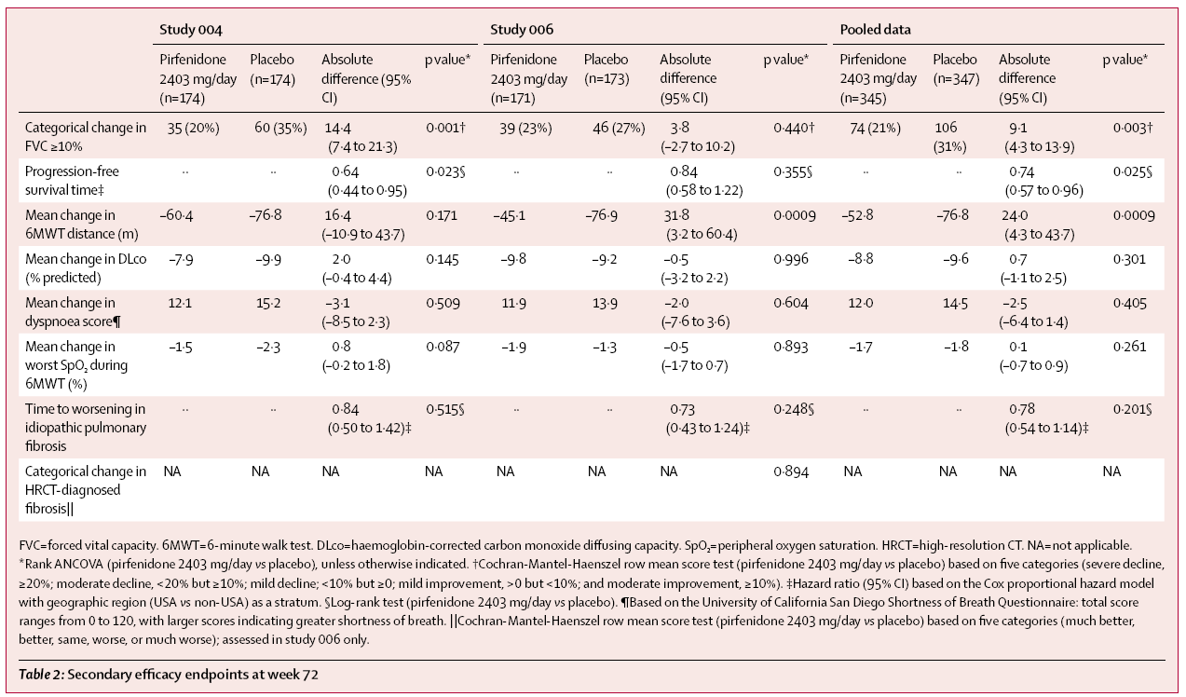
Results (3)
Notes:
본 표는 72주의 secondary efficacy endpoint 를 나타낸 것
FVC 가 10% 이상의 categorical change 를 보인 비율은 pirfenidone 과 placebo 간에서 study 004 에서는 유의한 차이, 006 에서는 유의한 차이를 보이지 않았음.
PFS 의 경우 study 004 에서는 pirfenidone 2403mg group 에서 placebo 에 비하여 36% 의 risk 감소, study 006에서는 유의하지 않음, pooled data 에서는 26% 의 risk 감소
6MWT distance 는 study 004 에서는 차이 없음. Study 006 에서는 유의한 차이
나머지는 유의한 차이 없음.

Slide 14
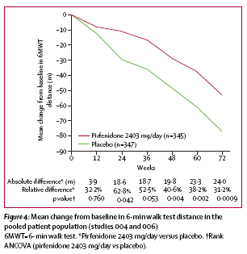
Results (4)
Notes:
본 그래프는 pooled population 에서의 6분 보행 검사 거리의 baseline 에서의 mean change ,72주에서 31.2%의 relative difference
통계적으로 유의하게 6분 보행검사 거리 감소를 낮춤

Slide 15
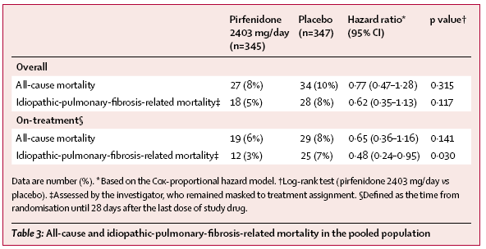
Results (5)
Notes:
본 표는 pooled population 에서의 all-cause , IPF –related mortality 를 나타낸 것.
Overall all-cause mortality, IPF related mortality 그리고 on-treatment all-cause mortality, IPF-related mortality 에 있어 모두 pirfenidone group 의 mortality 낮음.

Slide 16
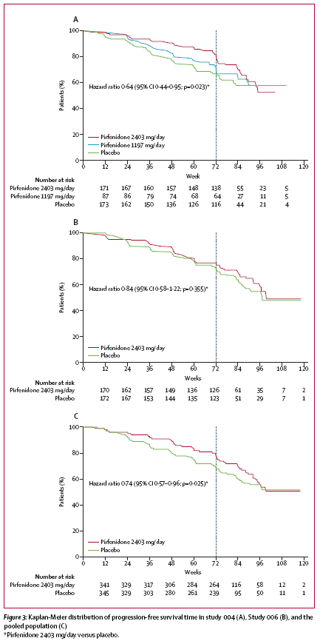
Notes:
본 그래프는 study 004, 006, pooled analysis 에서의 PFS time에 대한 K-M curve
Pooled population 의 analyses 에서

Slide 17
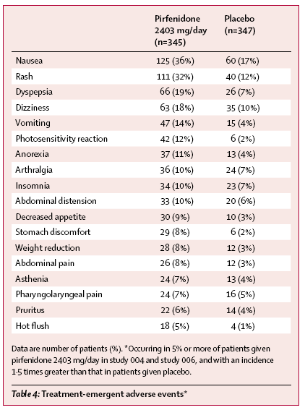
Results (7)
Notes:
본 표는 adverse event 에 관한 것
GI event, sking disorder, 주로 mild to moderate grade

Slide 18
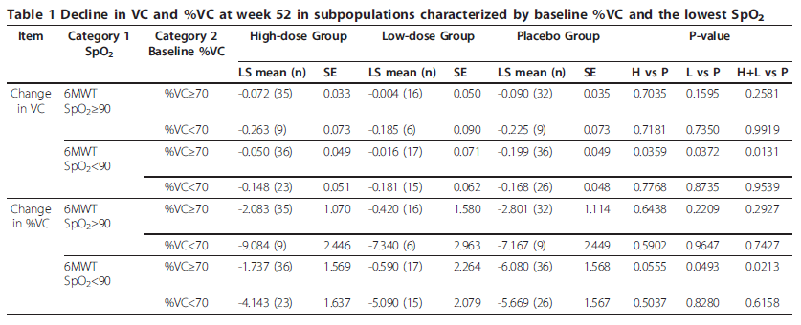
Results (8)
Subgroup analysis
(Exploratory analysis of a phase III trial of pirfenidone identifies a subpopulation of patients with idiopathic pulmonary fibrosis as benefiting from treatment
Azuma et al. Respiratory Research 2011, 12:143)
Notes:
본 표는 2011. Respiratory research 에 실린 subgroup analysis
표1, 6분 보행 검사 후 가장 낮은 saturation 90% 미만이면서 baseline 의 %VC>70인 경우 pirferidone이 더 effective

Slide 19
Discussion (1)
In study 004
  Pirfenidone treatment effect on the change in percentage predicted FVC at week 72, also noted at earlier timepoints
  Progression-free survival and categorical FVC change
  Efficacy dose response relation
In study 006
  No significant difference percentage predicted FVC change at week 72, treatment effect was noted on all timepoints during the first year

Slide 20
Discussion (2)
Pooled data
  Pirfenidone treatment effect on percentage predicted FVC, progression-free survival, and 6MWT distance
Pirfenidone was safe and well tolerated
The difference in FVC outcomes in the two studies
  Partly attributable to a lower than expected rate of FVC decline in study 006 after 1 year
  Magnitude of decline over time was similar in the two pirfenidone groups, those in the two placebo groups differed
Notes:
1년 이후 study 006 에서의 PFV 감소가, 기대하였던 것보다 작게

Slide 21
Discussion (3)
    Study 006 had a greater proportion of patients with a recent diagnosis of IPF
    The placebo group in study 006 had a greater proportion of patients with obstructive airway disease
  -> associated with reduced FVC decline
The collective data provide evidence that pirfenidone reduces decline in lung function in patients with IPF
  Pooled FVC data provide evidence for a pirfenidone treatment effect
  Efficacy dose response relation was noted in study 004

Slide 22
Discussion (4)
In the pooled analysis of categorical FVC change
  Pirfenidone reduced the proportion of patients with a 10% or more decrement by 30% compared with placebo
Pirfenidone was associated with
  26% reduction in the risk of death or disease progression in analyses of progression-free survival
  31% reduced mean decline in 6MWT at week 72
  Favorable direction of effect on mortality
  => Consistency with other phase 3 studies

Slide 23
Discussion (5)
Phase III clinical trial in Japan
  Decline in VC was significantly reduced at week 52 with a similar magnitude of effect to that at week 48
Independent Cochrane meta-analysis of all three phase 3 trials
  Significant improvement in progression-free survival , reductions in lung function
Limitations
  Enrolled patients with mild to moderate IPF and few comorbidities

Slide 24
Discussion (6)
  Concomitant administration of other treatments for idiopathic pulmonary fibrosis was prohibited
  : Effect of these therapies in patients given pirfenidone is not known
  Effect of treatment for longer than 72 weeks on pulmonary function and disease status is not known

Slide 25
Conclusion
IPF remains a progressive and fatal disorder
No treatment so far has been shown to be efficacious
The data from these two phase 3 studies
  Show benefit and favorable safety profile of pirfenidone in patients with idiopathic pulmonary fibrosis
Pirfenidone has a favorable benefit-risk profile and represents a suitable treatment option for patients with IPF

