Slide 1
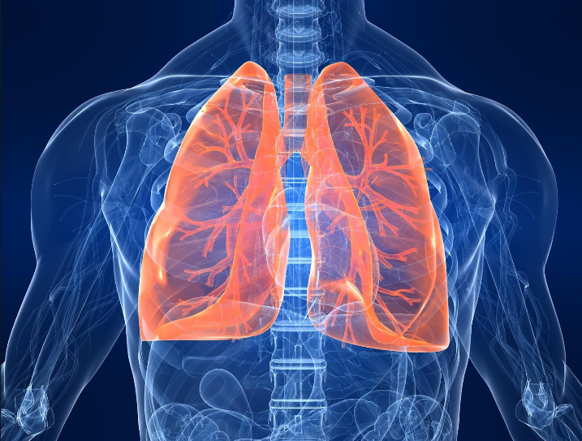
Significance of PRA & DSA in outcomes of Lung Transplantation
< In depth review >
2015.03.31
R4 박지은
Supervisor Pf. 김송이

Slide 2

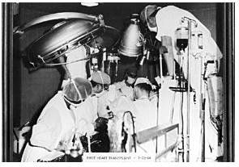
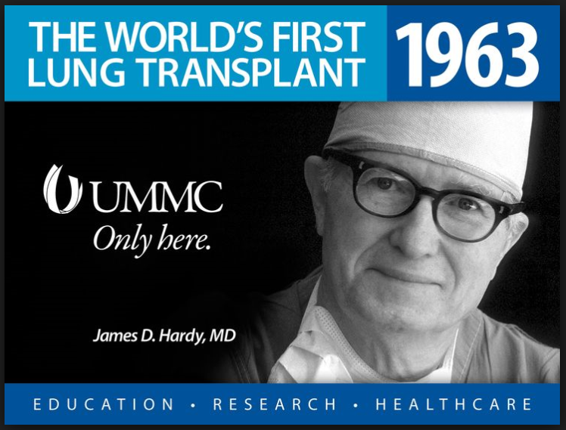
The History of Lung Transplantation (1)
The first human lung transplant was performed in 1962 by Hardy.
Immunosuppressive regimen
: azathioprine, prednisone, and cobalt radiation (mediastinum, thymus)
He died 18 days after the transplant.

Slide 3
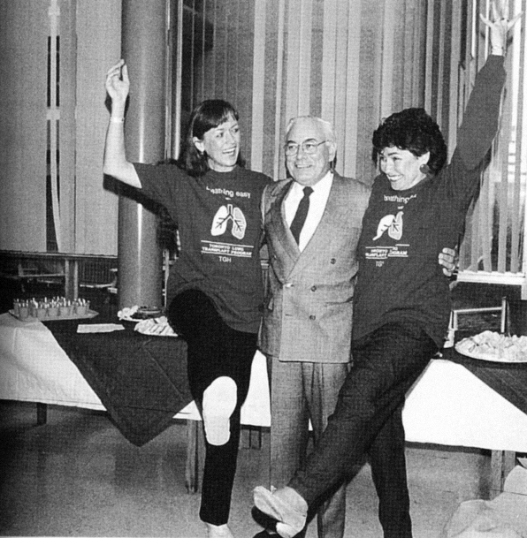
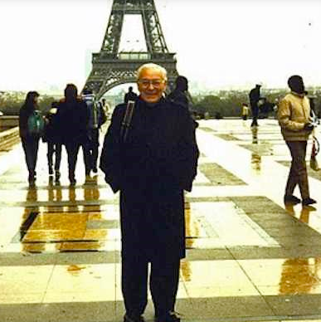
The History of Lung Transplantation (2)
In 1983, the Toronto Lung Transplant Group performed the first successful lung transplant.
Immunosuppression
: cyclosporine, azathioprine
: initially did not receive steroids to minimize the risk of airway anastomotic dehiscence.

Slide 4
The History of Lung Transplantation (3)
In 1987, approximately 45 transplants were performed.
By 1990, over 400 were performed worldwide.
Until the mid 1990’s, at approximately 1400.
In recent years, the number of transplants has increased to approximately 2200 per year.
The United Network for Organ Sharing Registry,
the 20,135 patients transplanted, between 1987 ~ 2011.
[ DePasquale EC et al. Lung transplantation in scleroderma. J Heart Lung Transplant 2014 ]

Slide 5
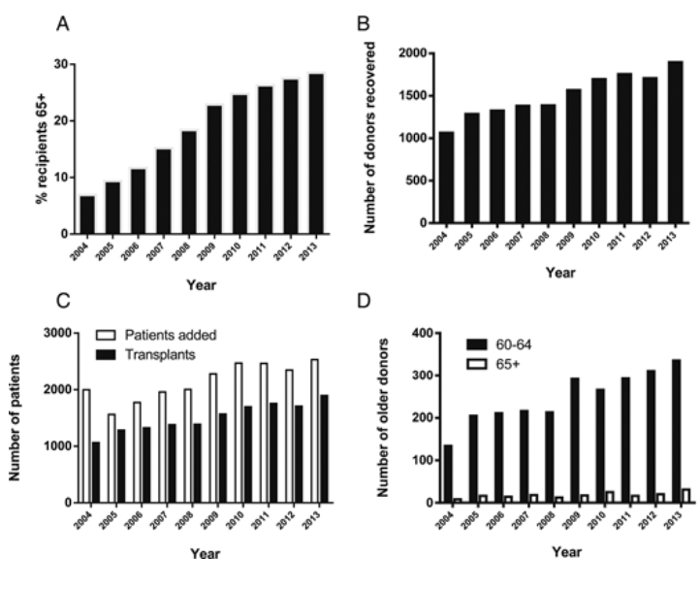
Growing trends in lung transplantation
[ Steven D et al. The Future of Lung Transplantation. Chest 2015 ]

Slide 6
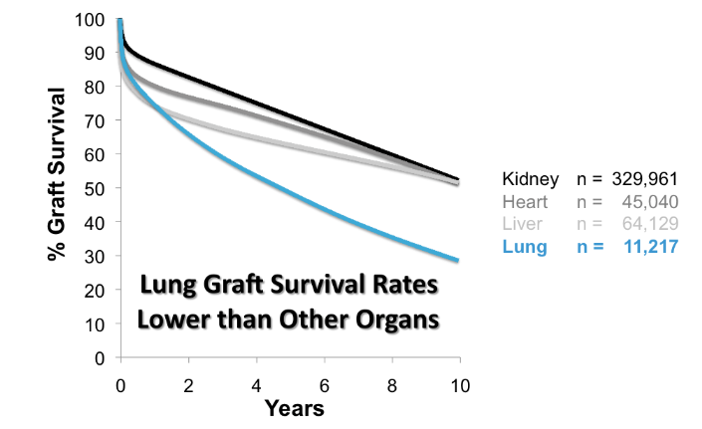
Lung Transplant: Graft Survival
Transplants 1985-2009 at 400+ centers worldwide.
[ www.ctstransplant.org. Accessed Sep-2011 ]

Slide 7
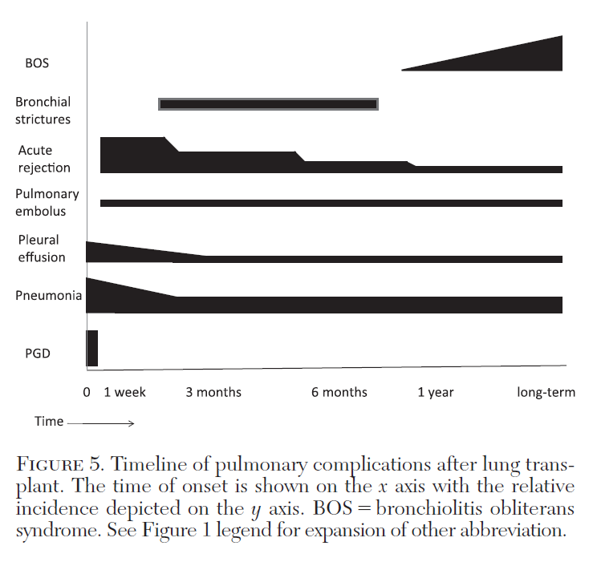
Timeline of pulmonary complications after lung transplant
[Shahzad Ahmad et al. Pulmonary Complications of Lung Transplantation. Chest 2011 ]

Slide 8
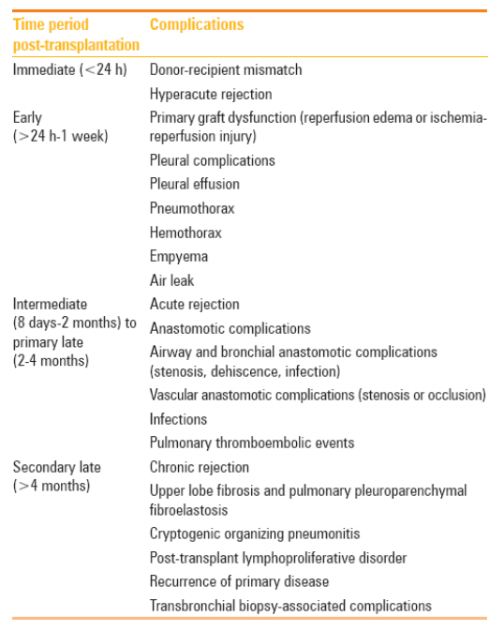
Complications following lung transplantation based on time of occurrence.
[Rachna Madan et al. Imaging in lung transplants: Checklist for the radiologist. Indian J Radiol Imaging 2014 ]

Slide 9
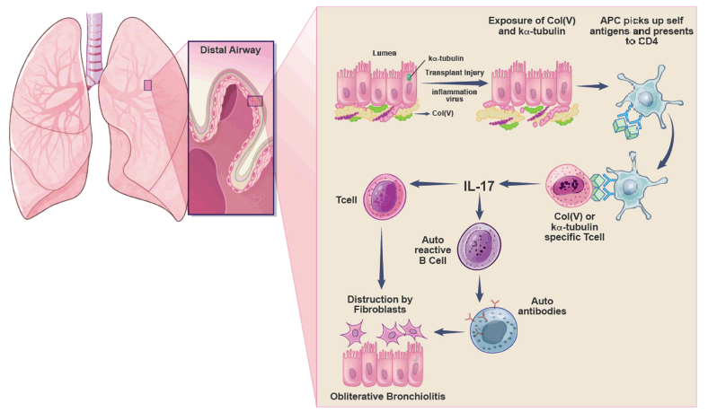
Autoimmunity in lung transplantation.
[Daniel J et al. The role of autoimmunity in obliterative bronchiolitis after lung transplantation. Am J Physiol 2012 ]

Slide 10
In Severance..
1996.07.07 ~ 2015.03.15
총 119명 (강남 64명 + 신촌 55명)
강남 64명 중 16명 생존 (25%)
신촌 55명 중 38명 생존 (69%)

Slide 11
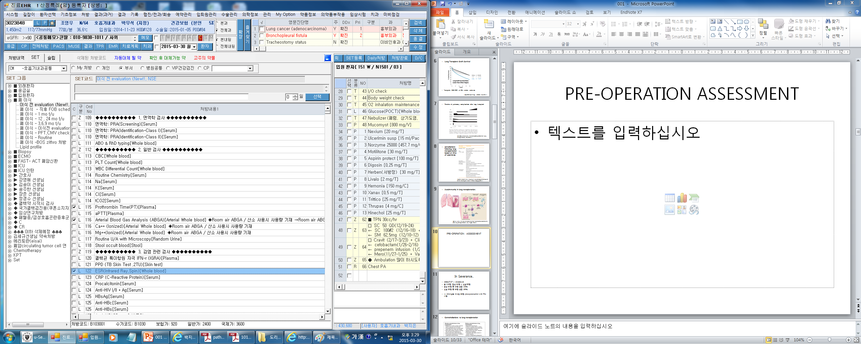
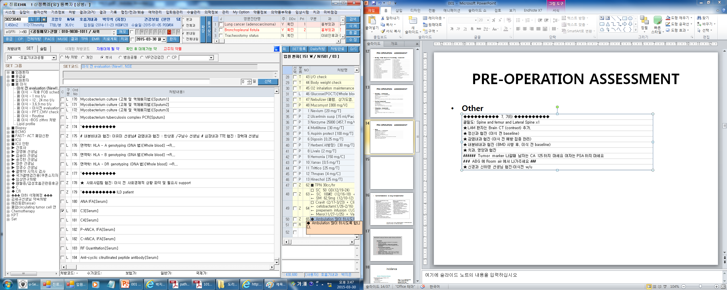
PRE-OPERATION ASSESSMENT
Immunology Blood Tests
Hematology Blood & Biochemistry Tests

Slide 12
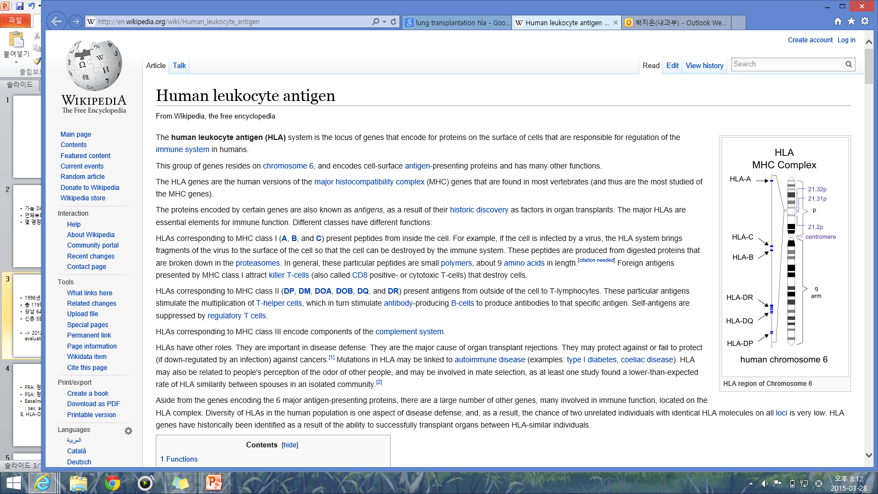
Immunology Blood Tests
PRA(panel-reactive antibody)
anti-HLA class l : Negative / Positive
anti-HLA class ll : Negative / Positive
-> PRA 검사는 bead-based immunoassay 법으로 혈청내 HLA Class I 또는 Class II 항원에 대한 IgG 항체를 검출
An elevated panel-reactive antibody (PRA) before transplant has been associated with more days on the ventilator after surgery, an increased risk of bronchiolitis obliterans syndrome, and poor post-transplant survival in lung transplant recipients.

Slide 13
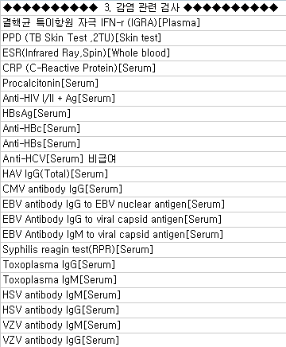
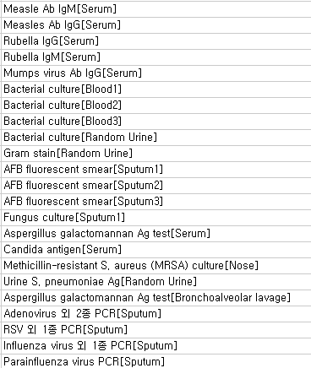
PRE-OPERATION ASSESSMENT
Serology Blood Sample & Microbiology Assessment

Slide 14
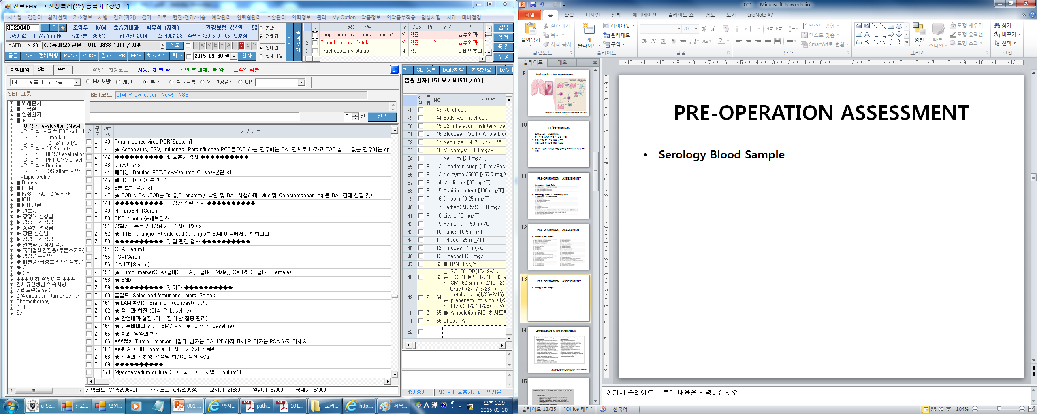
PRE-OPERATION ASSESSMENT
Pulmonary Assessment
Cardiac Assessment
Malignancy Assessment

Slide 15
PRE-OPERATION ASSESSMENT
Other

Slide 16
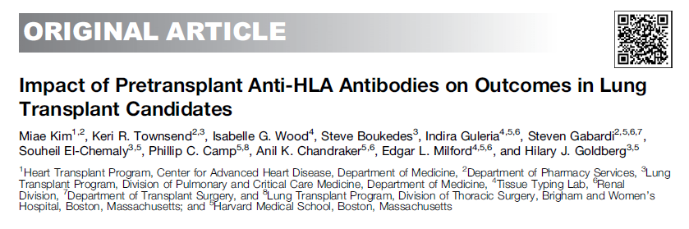
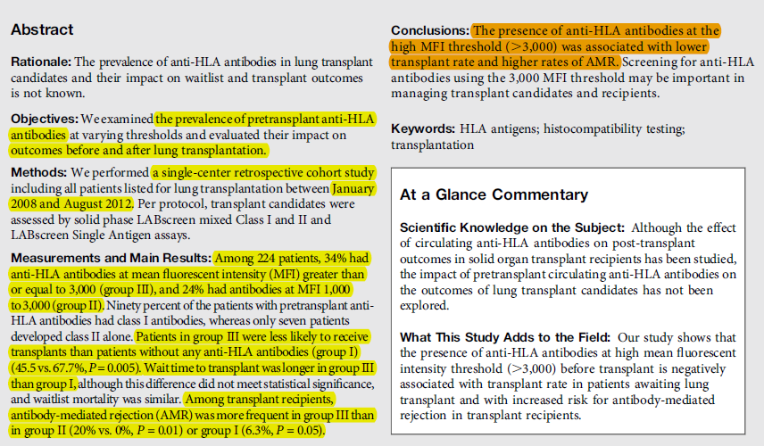
[ Miae Kim et al. Impact of Pretransplant Anti-HLA Antibodies on Outcomes in Lung Transplant Candidates. Am J Respir Crit Care Med 2014 ]

Slide 17
Method
A retrospective cohort study
Between January 2008 - August 2012.
All patients listed for lung transplantation at institution

Slide 18
Method
Assessment of Anti-HLA Antibodies
candidates were assessed for the presence of class I and class II anti-HLA antibodies using the One Lambda, Inc. Single Antigen/LABScreen assay
For subjects in whom testing was performed more than once, all anti-HLA antibodies measured at mean fluorescent intensity (MFI)
Calculated PRA (cPRA) was measured using the OPTN website Cpra calculator

Slide 19
Method
Organ Offer Assessment Algorithm (1)
Candidates listed for lung transplantation were assessed for the presence of donor specific antibodies (DSA) with each donor offer, using an MFI threshold of 1,000.
  DSAs were defined as recipient anti-HLA antibodies directed at the antigens of the potential donor.
The presence of DSA did not preclude transplantation.
Rather, in the presence of DSA, a prospective complement-dependent cytotoxic (CDC) crossmatch against the potential donor was performed before transplant.

Slide 20
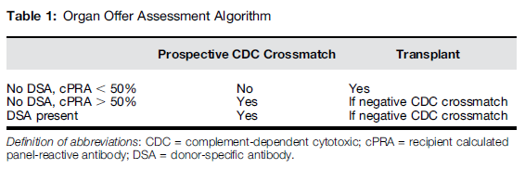
Method
Organ Offer Assessment Algorithm (2)
A prospective CDC crossmatch was also obtained if the candidate’s cPRA was greater than or equal to 50%, regardless of whether DSA was present.
CDC T-cell crossmatches were performed with anti-human globulin.
Any positive prospective CDC crossmatch excluded transplantation.

Slide 21
Method
Immune Suppression and Prophylaxis
All patients received a standardized immunosuppressant regimen in accordance with our institutional protocols.
Rabbit antithymocyte globulin (1.5 mg/kg in the operating room, then 1 mg/kg daily for four doses) and high-dose methylprednisolone were used for induction therapy.
Triple agent maintenance immunosuppression (prednisone, mycophenolate mofetil, and tacrolimus) was initiated.
All patients received empiric broad-spectrum peritransplant antimicrobial agents tailored to respiratory tract cultures obtained in donors and recipients.
A majority of patients received Pneumocystis jiroveci prophylaxis with trimethoprim-sulfamethoxazole.

Slide 22
Method
Assessment of antibody-mediated rejection (AMR)
AMR was defined as the development of allograft dysfunction in the presence of circulating DSA, pathologic changes consistent with a complement-mediated injury or capillaritis, or both, that led to initiation of treatment targeting an antibody-mediated inflammatory response.
Treatment of AMR included plasmapheresis (PP), intravenous immune globulin (IVIG 100 mg/kg after each run of PP or 2 g/kg once at the conclusion of PP), and rituximab (375 mg/m2)

Slide 23
Method
Analysis of Outcomes
The results of
  CDC crossmatches performed against all potential donors,
  Proportion of patients who underwent transplantation,
  Wait time to transplant,
  Waitlist mortality,
  Incidence of treatment for AMR,
  12-month post-transplant mortality

Slide 24
Results
Among 224 patients,
group I
  93 patients (41.5%), no anti-HLA antibodies at MFI greater than or equal to 1,000 pre-transplant
group II
  Fifty-four (24.1%), anti-HLA antibodies at MFI between 1,000 and 3,000
group III
  77 patients (34.4%), anti-HLA antibodies at MFI greater than or equal to 3,000

Slide 25
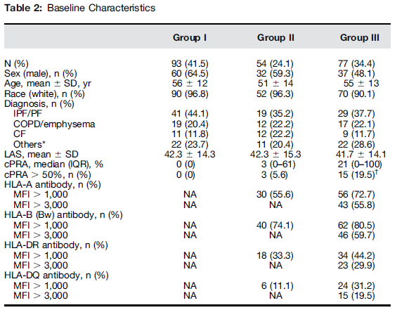
Results

Slide 26
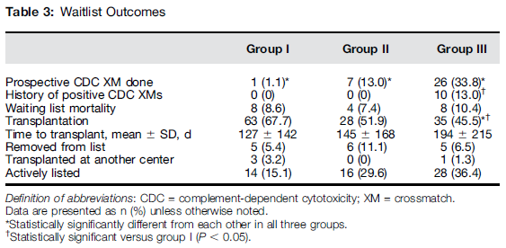
Results

Slide 27
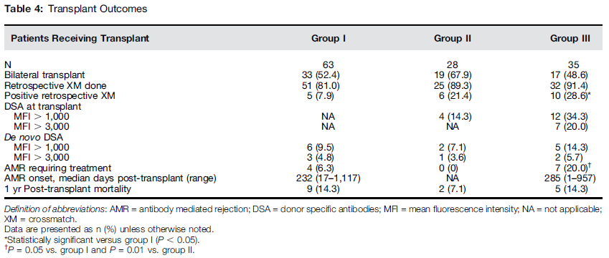
Results

Slide 28
Conclusions
Screening for anti-HLA antibodies and DSA using a high threshold (MFI > 3,000) may be appropriate in identifying lung transplant candidates at risk for prolonged wait times and post-transplant AMR and may help to guide management before transplant, at the time of the organ offer, and in transplant recipients.

Slide 29
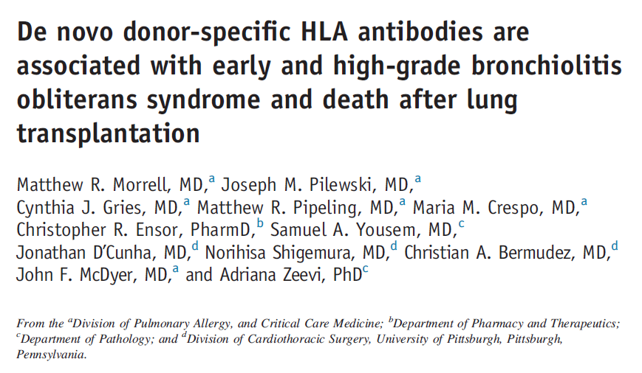
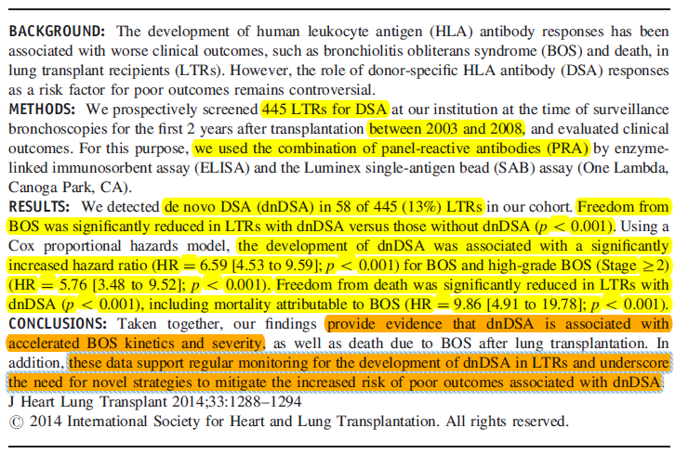
[ Morrell et al. dnDSA and BOS/Death After Transplant. J Heart Lung Transplant 2014 ]

Slide 30
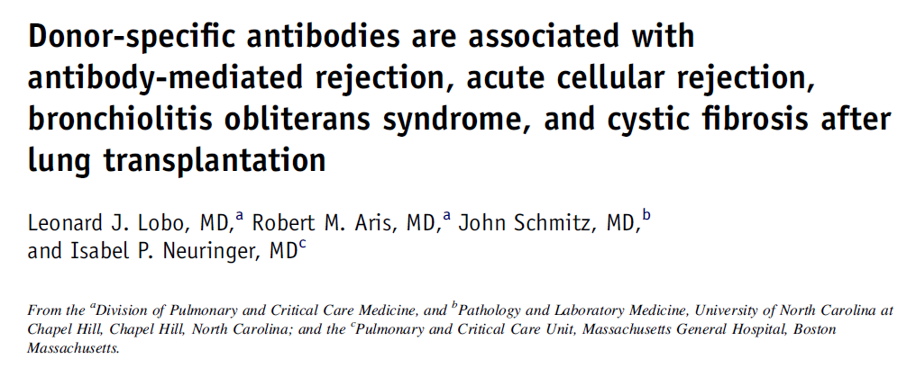
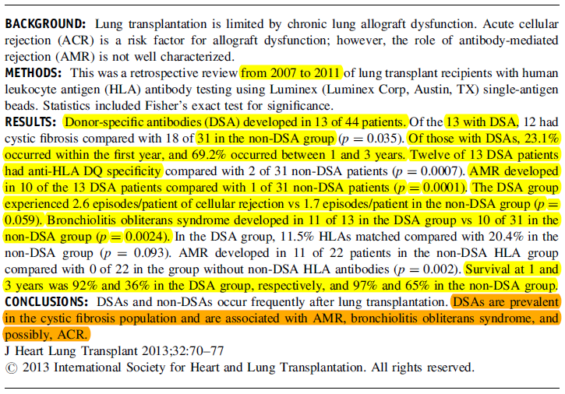
[Lobo et al. Significance Of DSAs After Lung Transplantation. J Heart Lung Transplant 2013 ]

Slide 31
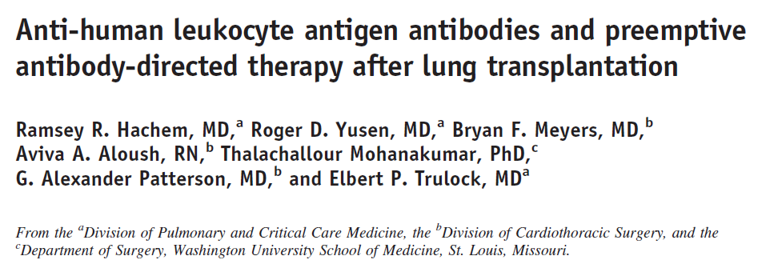
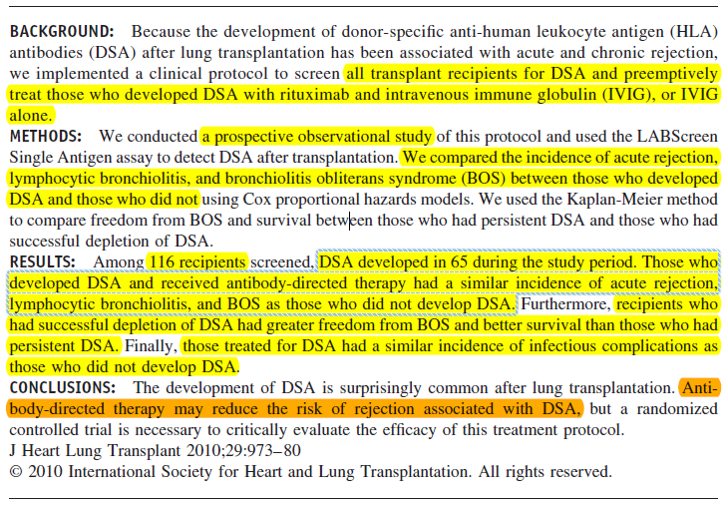
[Hachem et al. DSA After Lung Transplantation. J Heart Lung Transplant 2010 ]

Slide 32
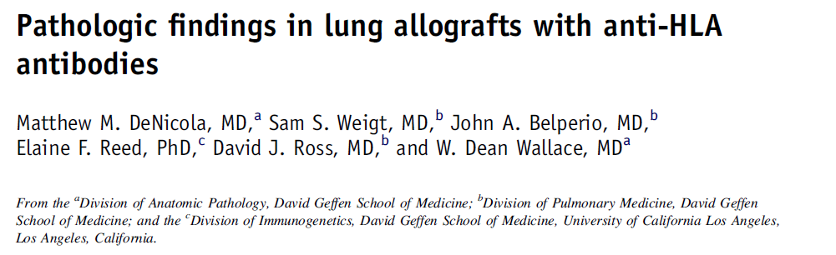
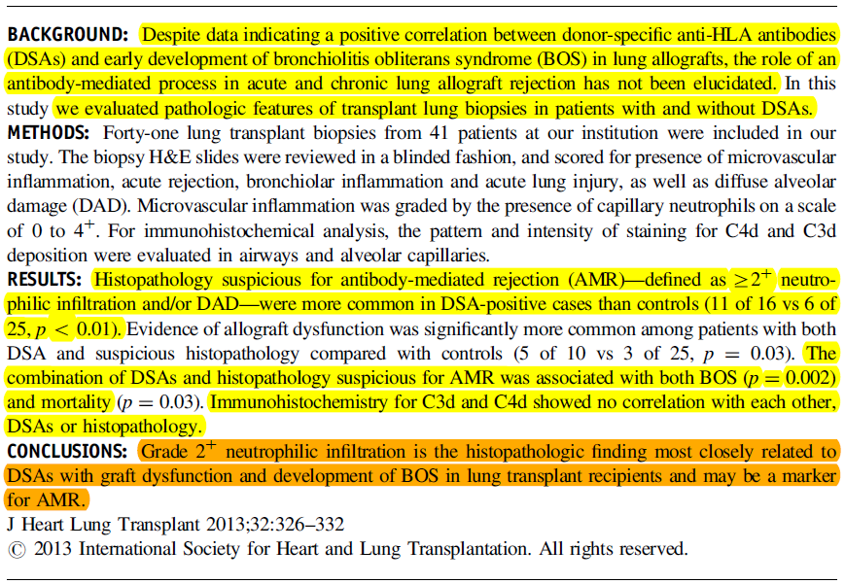
[DeNicola et al. Histopathology of DSA-positive Lung Allografts. J Heart Lung Transplant 2013 ]

Slide 33
In Severance..
1996.07.07 ~ 2015.03.15
총 119명 (강남 64명 + 신촌 55명)
강남 64명 중 16명 생존 (25%)
신촌 55명 중 38명 생존 (69%)
-> 2012년도 이후 이식한 65명,
pre-op evaluation 시에 PRA 시행.

Slide 34
Immunology Blood Tests
PRA(panel-reactive antibody)
anti-HLA class l : Negative / Positive
anti-HLA class ll : Negative / Positive
-> PRA 검사는 bead-based immunoassay 법으로 혈청내 HLA Class I 또는 Class II 항원에 대한 IgG 항체를 검출
An elevated panel-reactive antibody (PRA) before transplant has been associated with more days on the ventilator after surgery, an increased risk of bronchiolitis obliterans syndrome, and poor post-transplant survival in lung transplant recipients.

Slide 35
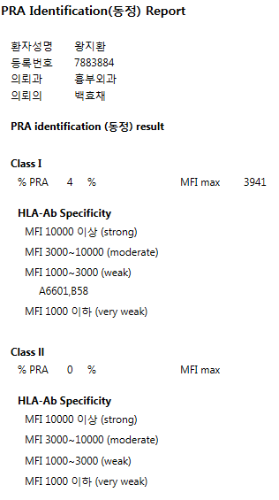
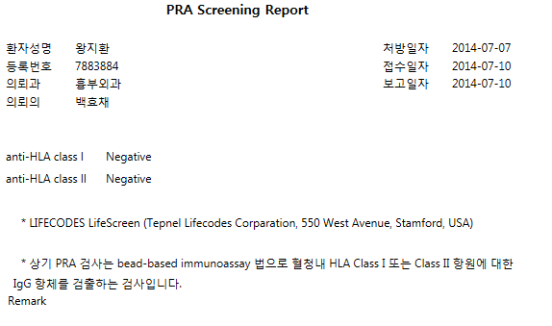
본원 Report

Slide 36
STUDY DESIGN
PURPOSE
: the prevalence of anti-HLA antibodies in lung transplantation candidates and their impact on transplant outcomes.
Outcomes
  - The mean waiting time for lung transplantation
  AMR
  Lung rejection (ISHLT)
  BOS (0-3)
  Mortality
  etc..

Slide 37
STUDY DESIGN
Baseline characteristics
: sex, age, diagnosis, PRA, HLA-A, HLA-B, HLA-DR
  PRA Cut off level?
  : depending on the difference in the MFI cut-offs and the length of follow-up in each study.
  -> MFI 3000이하 / 3000이상
  -> MFI 1000이하 / 1000~3000 / 3000이상 구분

Slide 38
OUTCOME
AMR (antibody-mediated rejection)
A diagnosis of AMR requires some of the following criteria
  (1) histologic evidence of capillary injury
  (2) circulating DSAs in serum
  (3) C4d staining of the sub-endothelium
  (4) clinical evidence of allograft dysfunction
Graft dysfunction
  > 4 liters of supplemental oxygen above baseline
  radiographic change
  a precipitous decline in PFT

Slide 39
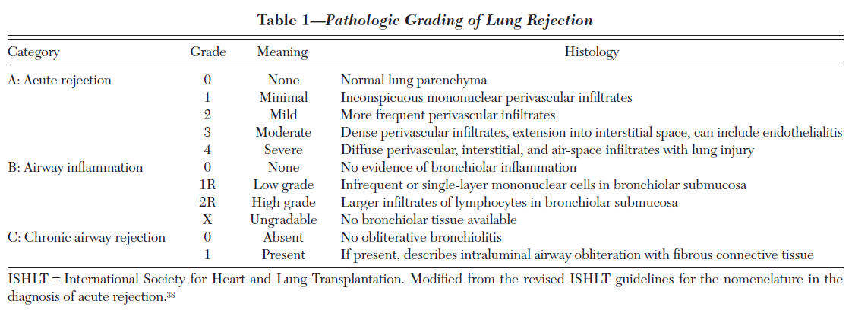
OUTCOME
Lung Bx : rejection

Slide 40
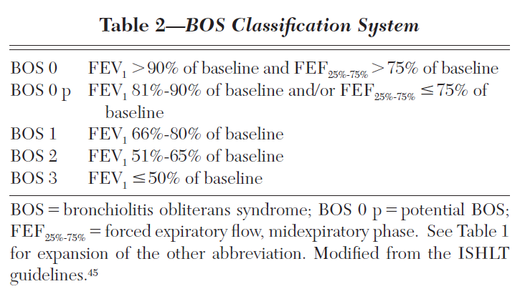
OUTCOME
BOS

Slide 41
OUTCOME
The mean waiting time for lung transplantation
Median time to develop de novo DSA
-> 본원에서 op 후 f/u 검사는 시행하지 않아 확인 어려움
  AMR requiring treatment
Lung rejection (ISHLT)
BOS (0-3, classification system)
Post-transplant mortality
- 90 days / 120 days / 1 yr / 2 yrs post-transplant mortality

