Slide 1
Fungal pneumonia after Lung Transplantation
S. H. Lee,
Division of Pulmonology
Department Of internal medicine
Yonsei University College of Medicine

Slide 2

NOTE: This figure includes only the lung transplants that are reported to the ISHLT Transplant Registry. As such, this should not be construed as representing changes in the number of lung transplants performed worldwide.
ISHLT
J Heart Lung Transplant. 2012 Oct; 31(10): 1045-1095
Notes:
전세계적으로 폐이식은 전체적으로 증가추세이며, double lung 이 증가추세이다.

Slide 3
ADULT LUNG TRANSPLANTS -Kaplan-Meier Survival-
(Transplants: January 1994 - June 2010)

Slide 4
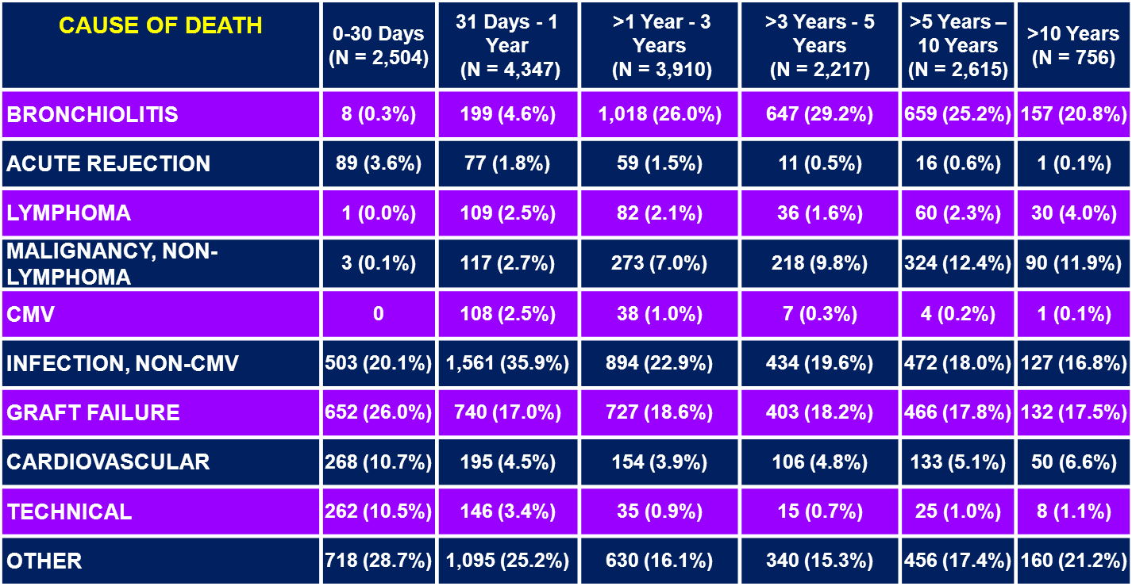
ADULT LUNG TRANSPLANT RECIPIENTS
Cause of Death (Deaths: January 1992 – June 2011)
Notes:
전체적으로 mortality 의 25%가 infection 에 의함

Slide 5
Bronchiolitis obliterans and lung transplantation: evidence for an infectious etiology, Semin Respir Infect. 2002;17(4):310
CMV infection was noted to have a hazard ratio of 1.62
Aspergillus colonization of the lung allograft is a risk factor for bronchiolitis obliterans syndrome, Am J Transplant. 2009;9(8):1903
201 lung transplant recipients in which 54 (27 percent) were colonized with Aspergillus spp, such colonization was found to be an independent risk factor for BOS on multivariate analysis (hazard ratio 1.81, 95% CI 1.03-3.19)
A higher (47%) incidence of BOS has been noted during the respiratory virus season
CMV pneumonitis was associated with relative risk of 2.3.
Notes:
BOS는 lung transplant 의 long term survival을 늘리기 위해 중요하다.

Slide 6
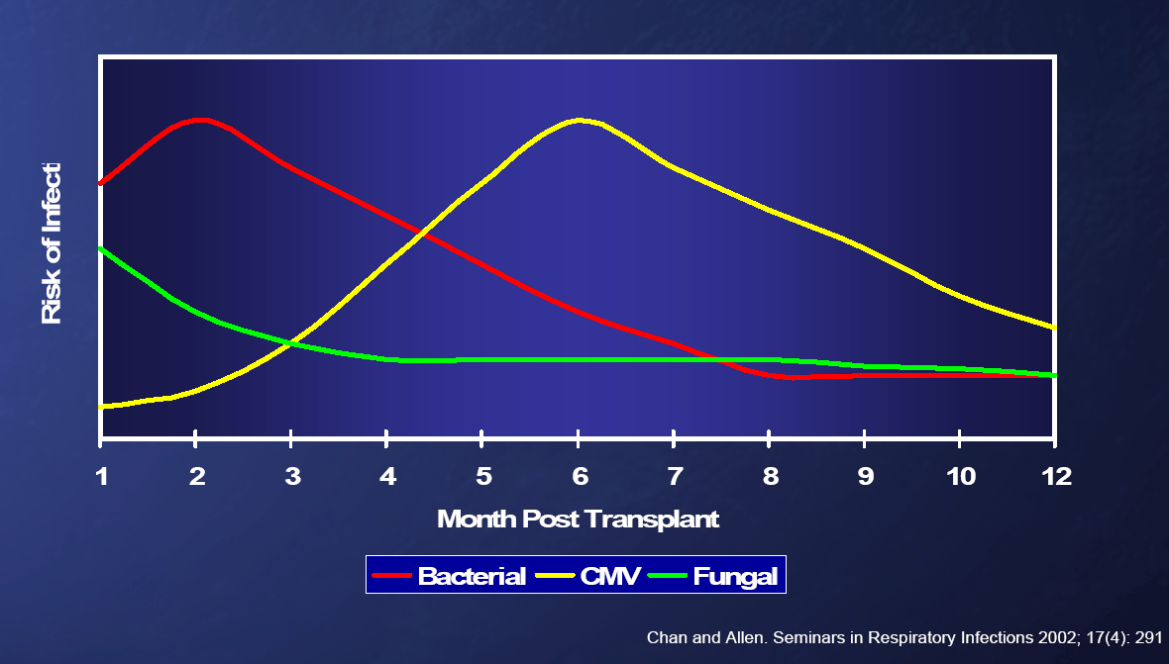
TIMELINE OF INFECTION
Candidemia
Aspergilosis
Notes:
Candidemia usually occurs during the first month following lung transplantation as a result of intensive care unit exposure and recent surgery.
Aspergillosis occurs a median of 3.2 months following lung transplantation, with 72 percent of cases occurring within the first six months
1개월 내 aspergilosis 26%

Slide 7
Introduction
Fungal infections : 11.6 per 1000 patient-years
RISK OF INFECTION
  The high level of immunosuppression
  Adverse effects of transplantation on local pulmonary host defenses (loss of lymphatics, reduced mucociliary clearance, decreased cough).
  Constant environmental contact allowing pathogens direct access into the allograft
Notes:
Aspergillus and candida species(m/c), 그 외 cryptococcus, mucormycosis, endemic fungi(histoplasma, coccidioides) 등
Pneumonia - the most common type (inhalation)
Pretransplant colonization (eg, Aspergillus spp)
그외 환자의 상태(ECMO, infection, steroid, inotropics, cardio problem으로 heparin 이나 plavix)

Slide 8
Pneumonia is the most common type of infection in lung transplant recipients.
The majority of non-Candida fungal infections are acquired through inhalation. Pretransplant colonization, particularly with filamentous molds (eg, Aspergillus spp), also increases the risk of posttransplant pulmonary fungal infection.
Notes:
The likelihood and type of infection varies with the degree of host immunosuppression, timing since transplantation, nature and duration of antimicrobial prophylaxis, and local hospital and regional microbiology.

Slide 9
Lung transplantation
Mortality, morbidity: high
  Infection, bronchiolitis obliterans syndrome
  changes to the host defenses of the respiratory tract (airway architecture, disruption of lymphatic channels)
23 LT pt. vs 6 control, BAL fluid
Decreased microbial diversity
P.aeruginosa and S.aureus – overwhelming presence in several cases
Dominant microbe was also cultured in routine culture
Fungal (candida, aspergillus) – also dominant
The association between microbiome and rejection: not reported
- Lung-enriched organisms and aberrant bacterial and fungal respiratory microbiota after lung transplant, AJRCCM, 2012
4 LT pt. vs 2 control, BAL fluid, pyrosequencing the 16S rRNA gene
Burkholderiaceae (Proteobacteria phylum) in transplant samples
Longitudinal analysis of the lung microbiome in lung transplantation,
FEMS Microbiol Lett 2013

Slide 10
ASPERGILLOSIS
most common cause: invasive fungal infection
  40.5 in LT VS. 1.2 in KT, 4.8 in all SOT (per 1000 pts-yrs)
Approximately 6 percent (range 3 to 15 percent) of lung transplant recipients develop aspergillosis
A. fumigatus is the most common species
A. terreus : resistant to amphotericin B in vitro

Slide 11
Risk Factor [ASPERGILLOSIS]
Airway colonization with Aspergillus spp
  Airway colonization occurs in 25 to 30 percent of lung transplant recipients but in approximately 50 percent among those with cystic fibrosis
  Recipients of single lung transplants are at risk for aspergillosis
Airway ischemia
Bronchiolitis obliterans (rejection)
Notes:
Specific risk factors for invasive aspergillosis
Those who developed invasive aspergillosis were more likely to have chronic obstructive pulmonary disease, which predisposes to colonization with Aspergillus spp.
Risk factors for invasive aspergillosis that are common to all solid organ transplant recipients include rejection, cytomegalovirus (CMV) disease, high doses of glucocorticoids, and the use of anti-T cell agents

Slide 12
Clinical manifestations [ASPERGILLOSIS]
Aspergillus infections after LT: clinical differences in type of transplant and implications for management:
40 report, ~2000.12’
Total 78 cases, The median incidence: 6.2%
37% - tracheobronchitis (29)
32% - invasive pulmonary aspergillosis (25)
20% - anastomotic infections (16)
10% - disseminated infections (8)
Single lung transplant with Aspergillus infections :
older (p = 0.006), COPD as an underlying illness (p = 0.05] invasive aspergillosis (p = 0.11)
J Heart Lung Transplant. 2003;22(3):258-
Notes:
Overall mortality in lung transplant recipients with Aspergillus infections was 52%
TBA can be asymptomatic and detected only by surveillance bronchoscopy. Reported clinical findings have included fever, cough, wheezing, and/or hemoptysis.

Slide 13
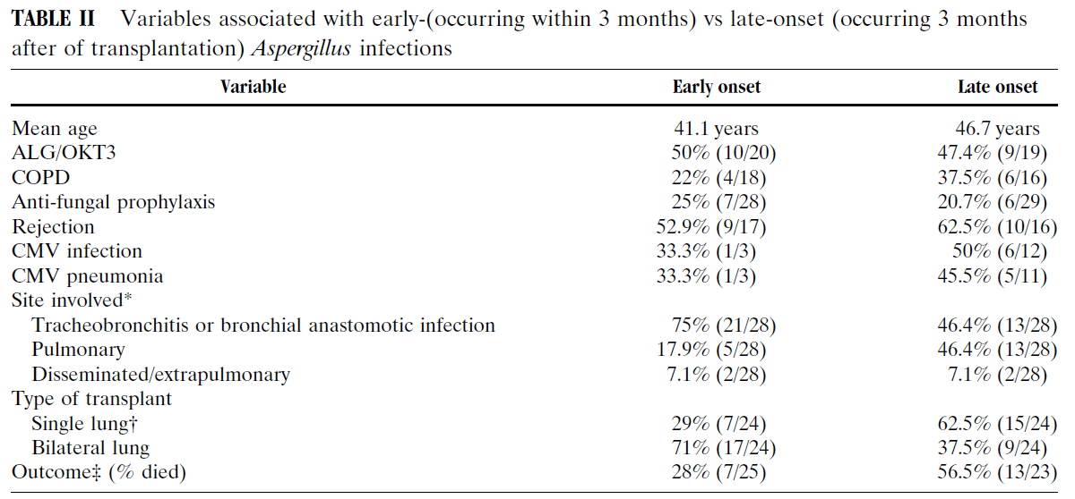

Slide 14
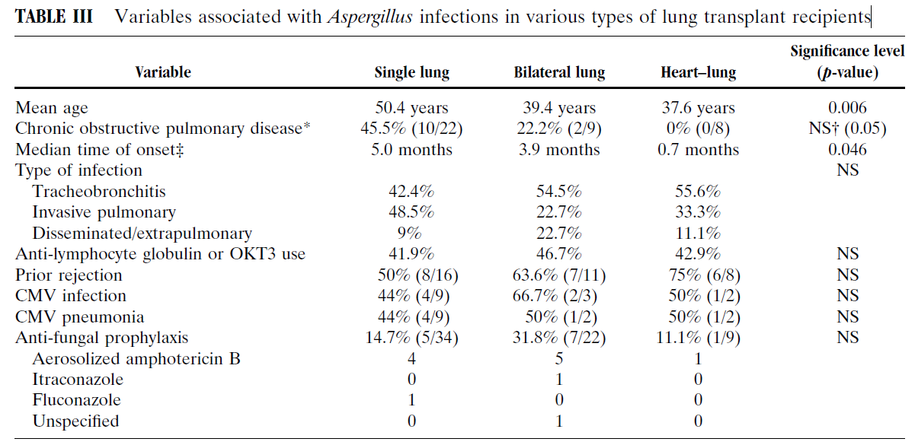
Notes:
34명 single, 23 double, 9 HL
COPD의 전체 유병율은 30.8% 였음.
전체 평균 나이는 45.9yr

Slide 15
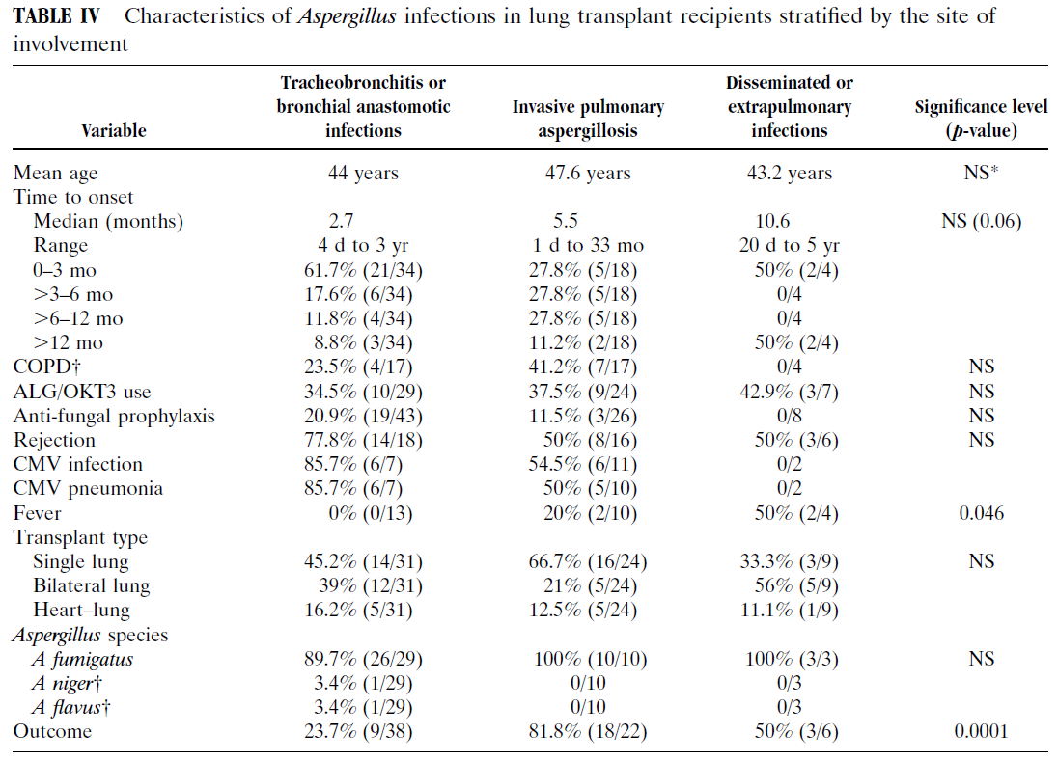

Slide 16
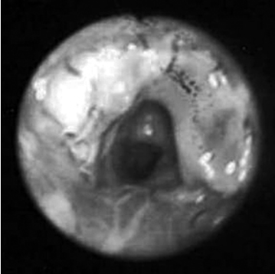
Diagnosis [ASPERGILLOSIS]
Bronchoscopy + CT+ Lab + Pathology
Early surveillance bronchoscopies to examine the anastomosis as well as fungal staining and culture of (BAL) fluid
Notes:
erythema, pseudomembranes, or ulcerations

Slide 17
Diagnosis [ASPERGILLOSIS]
CT findings
  consolidation (40 percent)
  cavitary lesions (30 percent)
  nodular or mass-like lesions (30 percent)
CT or (MRI) of the CNS is advised in lung transplant recipients with invasive pulmonary aspergillosis to evaluate for dissemination.

Slide 18
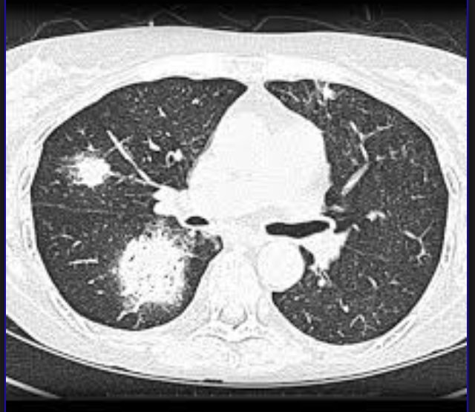
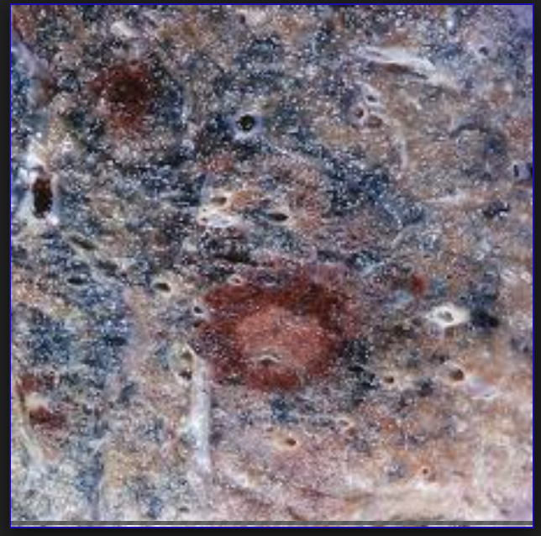
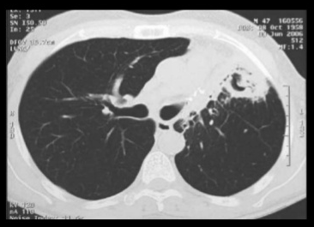

Slide 19
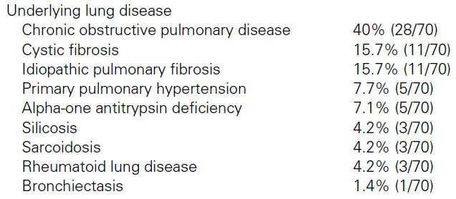
Method:
70 pt, twice weekly for galactomannan
IA: 17.1%(12/70)
cut-off value ≥0.5 sensitivity 30%, specificity 93%
cut-off value ≥0.66 sensitivity 30%, specificity 95%
Total 14: false(+)- cystic fibrosis or COPD (9), 6/14 within 3 days, 9/14 within 7 days
Prospective assessment of Platelia Aspergillus galactomannan antigen for the diagnosis of invasive aspergillosis in LT
-Am J Transplant. 2004;4(5):796-
Notes:
IA가 많은 이유: single lung 이 52.9%

Slide 20
A total of 333 BAL samples from 116 patients
IA: 5.2% (6/116)
Cut-off value ≥0.5, sensitivity 60%, specificity 95%
Cut-off value ≥1.0, sensitivity 60%, specificity of 98%
Platelia EIA index cut-off > or =1.0 in the BAL fluid in a lung transplant recipient with a compatible clinical illness may be considered as suggestive of IA
Aspergillus galactomannan antigen in the bronchoalveolar lavage fluid for the diagnosis of invasive aspergillosis in lung transplant recipients -Transplantation. 2007;83(10):1330-

Slide 21
AG false (+) in Tazocin
Galactomannan in Piperacillin-Tazobactam: How Much and to What Extent? -Antimicrob Agents Chemother. 2005-
90 piperacillin-tazobactam vials VS NS control group
Drug–laboratory interaction between beta-lactam antibiotics and the galactomannan antigen test used to detect mould infections
no drug–laboratory interaction with piperacillin/tazobactam and a possible drug–laboratory interaction with imipenem/cilastatin
79 vial (76%) – false (+), agreement with previous reports
due to the presence of GM in TZP VS a cross-reaction with the antibiotic

Slide 22
AG false (+) vs Tazocin
Method: Serum samples 09.10’~ 10.10’
76 HSCT recipients for GM testing: 2/wk (defined as GM ≥ 0.5)
Without tazo group: 25/1606 (1.6%)
With tazo group: 10/394 (2.5%) (P = 0.18)
Median GM: 0.122 versus 0.141 (P < 0.001)
Although some residual GM might still be present
no longer responsible for false-positive GM results
Piperacillin/tazobactam (Tazocin™) seems to be no longer responsible for false-positive results of the galactomannan assay
-J Antimicrob Chemother 2012 Jul;67(7):1746-8-
Notes:
본래 81명 환자 -> 76명만 data available, 8명이 probable IA, 9명은 false (+)

Slide 23
Treatment [ASPERGILLOSIS]
Tracheobronchial aspergillosis
Pulmonary and disseminated aspergillosis
283pt
15 (5.3%): anastomotic infections
Aspergillus: 6 pt
voriconazole + nebulized amphotericin B
144: voriconazole group
133: amphotericin B group
CR/PR (53% vs 32%)
mortality rate (29% vs 42%]
Changing anti [36% vs 80%]
Severe AD
Significant interactions with immunosuppressants!!
Anastomotic infections in lung transplant recipients
- Ann Transplant. 2000;5(3):13-
Voriconazole vs. ampho B for primary Tx of invasive aspergillosis
- N Engl J Med. 2002;347(6):408-
Notes:
NEJM: 12주의 결과

Slide 24
Treatment [ASPERGILLOSIS]
Alternatives to voriconazole
  amphotericin B deoxycholate
  lipid formulations of amphotericin B.
  Posaconazole
  Echinocandins (caspofungin, micafungin, and anidulafungin)
Notes:
Echinocandins (caspofungin, micafungin, and anidulafungin) have some in vitro activity against Aspergillus but have not been studied as first-line therapy
Combination systemic therapy with voriconazol -> not well studied

Slide 25
Combination of voriconazole and caspofungin as primary therapy for invasive aspergillosis in solid organ transplant recipients
Prospective, multicenter, observational study
voriconazole and caspofungin (n=40) VS lipid formulation of AmB (n=47), Survival at 90 days
Sur: 67.5% (27/40) VS 51% (24/47), P=0.117
recipients with renal failure (HR 0.32, P=0.022)
A. fumigatus infection (HR 0.37, P=0.019)
Conclusion: Combination of voriconazole and caspofungin might be considered preferable therapy
Transplantation. 2006;81(3):320
Notes:
2003 and 2005 VS 1999 and 2002

Slide 26
Liposomal amphotericin B in combination with caspofungin for invasive aspergillosis in patients with hematologic malignancies: a randomized pilot study (Combistrat trial)
- Combination of liposomal (AmB) (3 mg/kg daily) + caspofungin VS high-dose AmB regimen (10 mg/kg daily)
- 21 men and 9 women) with hematologic malignancies
PR or CR: 67% VS 27%
Survival rates at 12 weeks: 100% VS. 80%
A 2-fold increase in serum creatinine : 7% VS 23%
combination of liposomal AmB and caspofungin was promising as therapy for IA compared with monoThx
Cancer. 2007 Dec 15;110(12):2740-6

Slide 27
Outcome
Invasive aspergillosis - 52 to 55%
Tracheobronchitis - approximately 25%
Invasive pulmonary infections - 67 to 82%

Slide 28
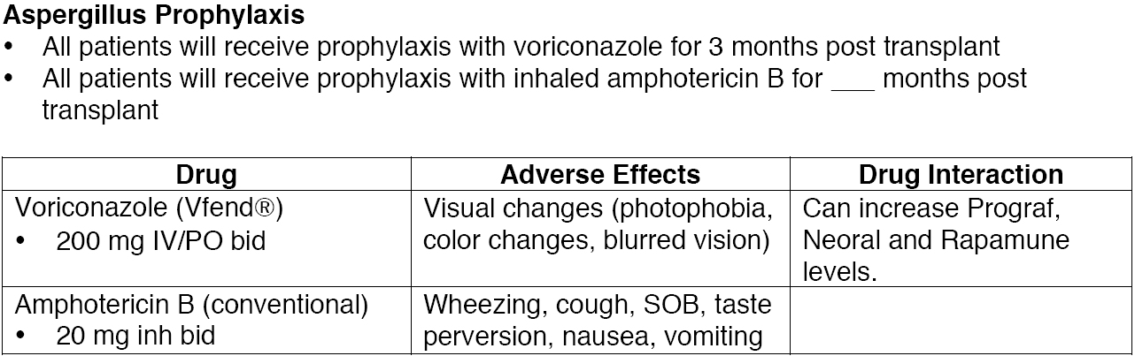
PROPHYLAXIS
68% monotherapy – voriconazole or itraconazole
Optimal prophylazix and duration or therapy : remain unclear
Notes:
25% infection으로 사망하고, aspergillosis에 의한 사망률 또한 52%로 높기 때문에 면역억제제를 많이 쓰는 폐이식 환자에 있어서 prophylactic 한 antifungal agent 사용은 합리적이라고 판단됩니다.
68%의 기관들이 monotherapy를 하고 보통 voriconazole 이나 itraconalzoles사용하며
경우에 따라 GI candida colonization을 예방하기 위해 nystatin을 사용한다.

Slide 29
PROPHYLAXIS [Efficacy]
Nebulized amphotericin B
Azoles
55pts -> 80%(44) nAB
18pt -> aspergillus
nAB group: OR 0.13
Prospective, 100 pts
AmBd VS ABLC
Intolerance 12.2% vs 5.9%
nonrandomized, retrospective
voriconazole (n = 65) itraconazole (n = 30)
Invasive aspergillosis 1.5% vs. 23%; p = 0.001
J Heart Lung Transplant. 2001;20(12):1274
Transplantation. 2004;77(2):232
Am J Transplant. 2006;6(12):3008

Slide 30

Notes:
Itra = sporanox
Posaconazole = noxafil

