Slide 1
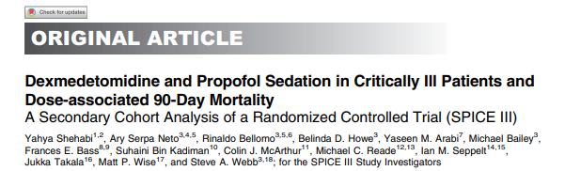
2023.09.05
내과 R2 최경은

Slide 2
Abstract
The SPICE III (Sedation Practice in Intensive Care Evaluation) trial
report significant heterogeneity in mortality with dexmedetomidine treatment
Supplemental propofol was commonly used to achieve desirable sedation
Objectives
To quantify the association of different infusion rates of dexmedetomidine and propofol with mortality
modified by age ??

Slide 3
Introduction
Sedatives ↑ for mechanically ventilated critically ill patients
Clinical practice guidelines
Recommend light sedation
avoidance of benzodiazepines
propofol or dexmedetomidine as the preferred sedatives
targeting adequate and safe sedation with monotherapy is difficult

Slide 4
Their use in combination
↓ the need for dose escalation of a single agent
↓ the risk of dose-related adverse events
( such as propofol infusion syndrome , severe bradycardia, hypotension with dexmedetomidine )
However, the impact of sedative combinations, dose on mortality, their pharmaco-dynamic interaction, and the influence of age remain unknown

Slide 5
The SPICE III
randomize patients to early sedation with dexmedetomidine
Patients < 65 years of age (dexmedetomidine as the primary sedative) were more likely to die
→ ↑ dose of dexmedetomidine or propofol to achieve target sedation would be associated with mortality differently in younger vs older patients
possible explanation for the observed HTE (heterogeneity of treatment effect) in SPICE III

Slide 6
Methods
- Study design and population
secondary cohort analysis of the SPICE III trial
a multinational, randomized controlled trial
(between November 2013 and February 2018 )
The protocol, statistical analysis plan, and study results have been previously published

Slide 7
Methods
- Study interventions and Trematment
patients randomized to the dexmedetomidine arm
→ received supplemental propofol
divided according to age ( 65 years )
Exclusion : patients who also received midazolam
( because of its major confounding effect )
Dexmedetomidine infusion was started at 1 μg/kg/h , titrated, ranging from 0 to a maximum of 1.4 μg/kg/h, to desired clinical effect
Protocolized supplemental propofol at the lowest possible dose (range, 10–70 mg/h) when maximal-does dexmedetomidine was insufficient or unsafe

Slide 8
Methods
- Outcomes and study Measurements
The main outcome : time to death
The Sedation Index : the sum of negative Richmond Agitation Sedation Scale (RASS) scores divided by the number of RASS measurements during study treatment
Deep sedation = RASS score of -3 to -5
corresponding Sedation Index >3

Slide 9
Methods
- Statistical Analysis
categorical variables as numbers and percentages
compared using x2 tests
Double stratification resampling analysis
assess the impact of different propofol and dexmedetomidine dose combinations
Multivariable Cox proportional hazard regression
confirm the robustness of our findings
mean hourly infusion rates of dexmedetomidine and propofol were assessed in their continuous form
including an interaction between their mean hourly rate

Slide 10
Methods
- Sensitivity Analysis
Using the double stratification model
in patients who were alive and in the ICU at 48 hours after randomization
uniform exposure unaffected by informative censoring
remove the confounding effects of early death, extubation, ICU discharge
Quantify the relative risk an unmeasured confounder

Slide 11
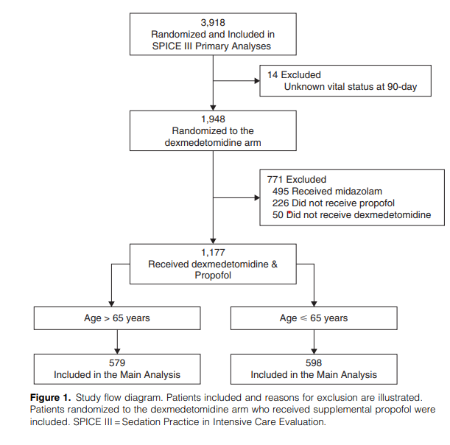
Results
- patients
Of the 3,918 patients
→ 1,948 patients randomized to the dexmedetomidine arm

Slide 12
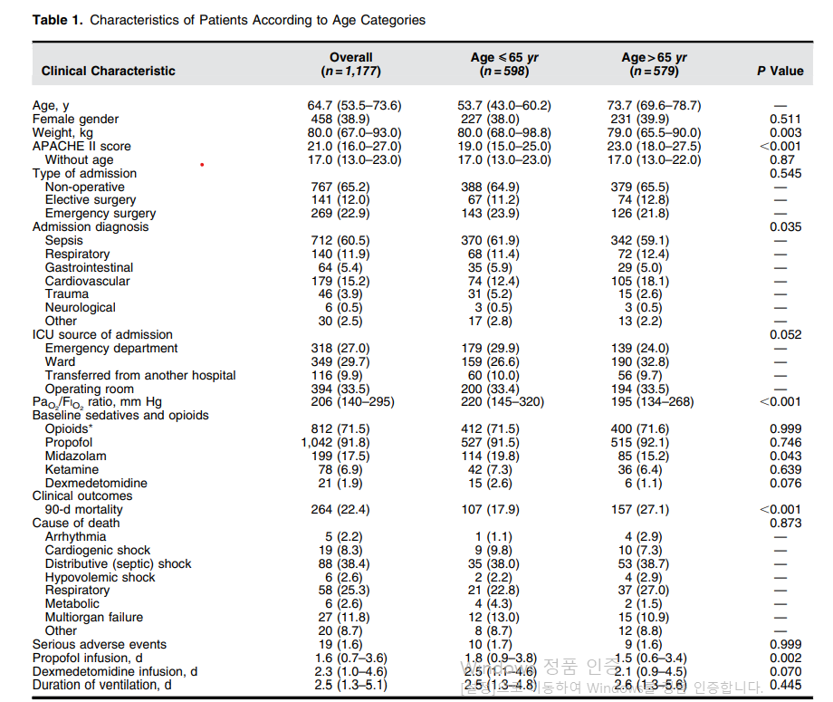

Slide 13
Results
- Dexmedetomidien and propofol doses
1) younger patients
receive significantly ↑ hourly infusion rates of dexmedetomidine
higher hourly infusion rates of propofol
( Sedation Index was comparable in both age groups)

Slide 14
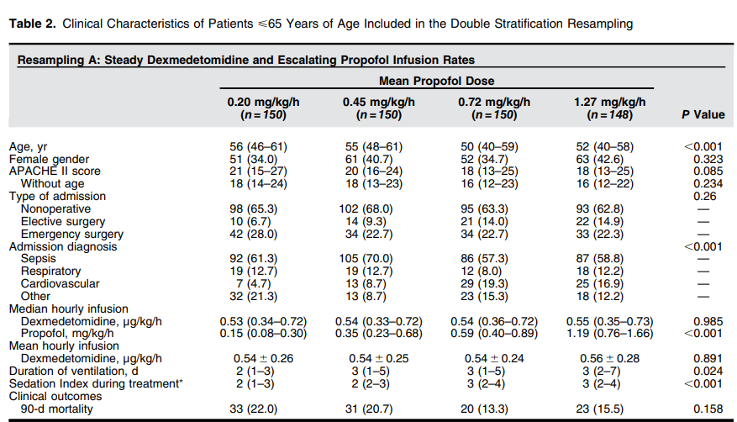
Results
-Association of Dexmedetomidine or Propofol Dose with Mortality
Double stratification resampling in younger vs older patients
Notes:
escalating propofol dose was associated with an incrementally higher median Sedation Index. After adjustment for confounders, including the Sedation Index, such increased dose of propofol was associated with reduced 90-day mortality (Figure 2A, under “Resampling A” for age

Slide 15
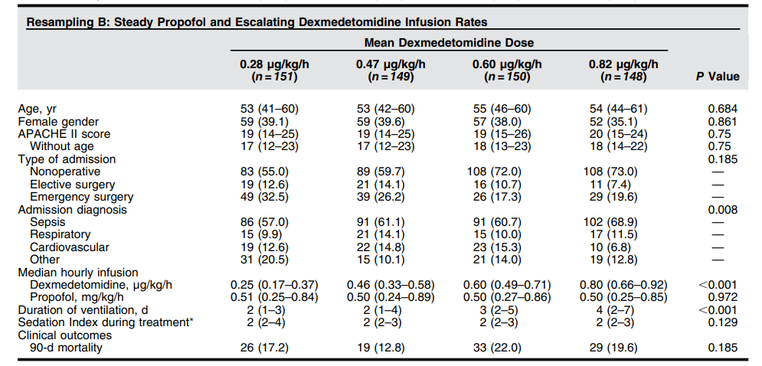
Notes:
. In such younger patients, escalating dexmedetomidine dose did not result in an incrementally higher Sedation Index and was not associated with a significantly increased adjusted risk of death (Figure 2A, under“Resampling B” for age

Slide 16
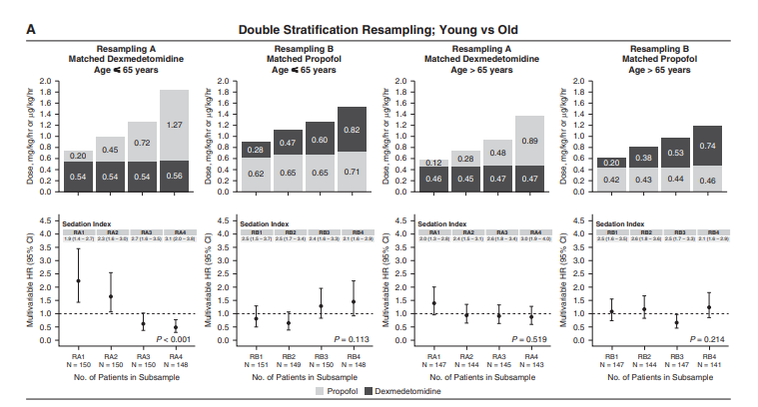
→ significant reduction in adjusted risk of death at 90 days.
Notes:
The clinical characteristics of older patients (.65 years) are presented in Table E4 (under“Resampling A” and “Resampling B”). In these patients, there was no association with mortality with escalating dexmedetomidine infusions combined with steady infusions of propofol or vice versa (Figure 2A, under“Resampling A” for age . 65 years and “Resampling B” for age . 65 years). However, th

Slide 17
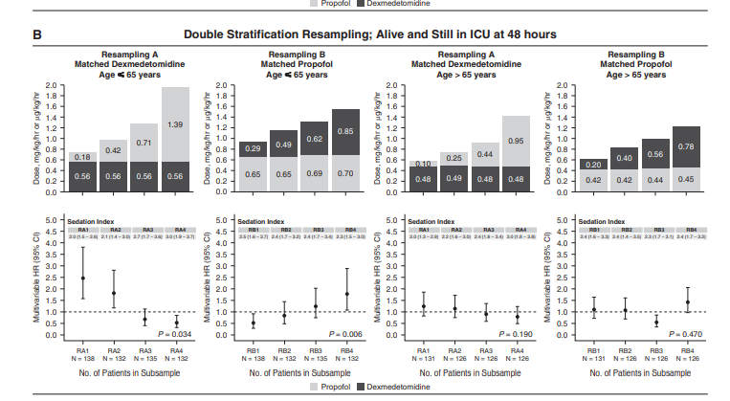
significant increased risk of death with
escalating dexmedetomidine
Notes:
) Resampling of patients who were alive and still in the ICU at 48 hours. A significant association with increased risk of death with escalating dexmedetomidine is observed in younger patients. No association with risk of death was seen in older patients. The numbers inside the bars are the mean doses per kilogram per hour of dexmedetomidine and propofol. The Sedation Index, while ventilated, is shown for respective quartiles. Circles and error bars are HRs and 95% CIs for risk of death at 90 days, calculated for each quartile in comparison with the mean risk in the

Slide 18
younger patients
→ ↑ Propofol dose
↑higher median Sedation Index
associated with reduced 90-day mortality
escalating dexmedetomidine dose did not result in an incrementally higher Sedation Index

Slide 19
older patients (>65 years)
no association with mortality
with escalating dexmedetomidine infusions combined with steady infusions of propofol

Slide 20
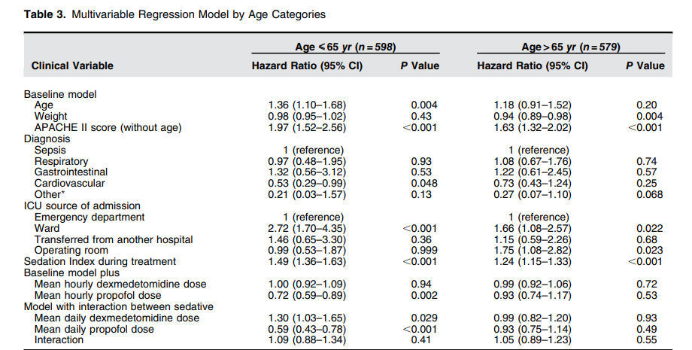
Results
- Multivariable Regression Analysis
association with ↑mortality with escalating dexmedetomidine dose (HR, 1.30; 95% CI, 1.03–1.65; P = 0.029)
No associations with mortality were seen in older
Notes:
Conversely, there was an association with increased mortality with escalating dexmedetomidine dose (HR, 1.30; 95% CI, 1.03–1.65; P = 0.029). In contrast, no associations with mortality were seen in older patients (Table 3).
In addition, a higher Sedation Index was independently associated with increased risk of death in both younger and older deeply sedated patients (Table 3).

Slide 21
Results
- Sensitivity Analysis
A sensitivity analysis among patients alive and still in the ICU at 48 hours
This cohort excluded 96 of 1,177 (8.1%) patients
53 of 96 (55.2%) were discharged alive
43 of 96 (44.8%) died within the first 48 hours
Multivariable regression modeling applied to the 48-hour cohort was also consistent with the above findings

Slide 22
Discussion
Dexmedetomidine
; does-dependent bradycardia, bimodal blood pressure effect , pharmacokinetic modified by age
Propofol
; dose-dependent hypotension, respiratory depression, and loss of consciousness
concomitant use of dexmedetomidine and propofol is widespread
little is known about the possible impact on mortality of dose changes of sedatives

Slide 23
Discussion
- Relationship with Previous Studies
The DESIRE (Dexmedetomidine for Sepsis in Intensive Care Unit Randomized Evaluation) ; compare dexmedetomidine with usual care in patients with sepsis
2) MENDS2 (Maximizing the Efficacy of Sedation and Reducing Neurological Dysfunction and Mortality in Septic Patients with Acute Respiratory Failure)
; compare dexmedetomidine with propofol in ventilated patients with sepsis
daily average doses of 0.15 and 0.25 μg/kg/h of dexmedetomidine
/ median 0.42 mg/kg/h propofol
3) SPICE III trial
dexmedetomidine within hours of starting mechanical ventilation
with a higher dexmedetomidine does ( constant)

Slide 24
Discussion
- Implications of Study findings
further insight into the age-related HTE found in the SPICE III trial
high-dose dexmedetomidine when combined with propofol
negative direct cardiac effects ↑
↓plasma concentrations of epinephrine and norepinephrine
↓ other hormonal effects
future research should also evaluate important cardiovascular, hormonal, and other end-organ effects of possible interaction with sedative combinations !!

Slide 25
Discussion
- Strengths and limitation
the largest sedation trial to date
The large number of patients
The international multicentric nature of the study
complete follow-up allowed robust statistical analysis
↑external validity, ↓ ascertainment bias
→ our analysis replicated real clinical practice
inevitable limitations→ post hoc analysis

Slide 26
Conclusions
In ventilated critically ill younger adults
the preferential use of incremental doses of propofol or dexmedetomidine
associated with divergent 90-day mortality
pharmacodynamically plausible explanation of the age-related HTE observed in the SPICE III trial

Slide 27
References
1. Devlin JW, Skrobik Y, Gelinas C, Needham DM, Slooter AJC, Pandharipande PP, et al. Clinical practice guidelines for the prevention and management of pain, agitation/sedation, delirium, immobility, and sleep disruption in adult patients in the ICU. Crit Care Med 2018;46: e825–e873.
2. Martin J, Heymann A, Basell K, Baron R, Biniek R, B € urkle H, € et al. Evidence and consensus-based German guidelines for the management of analgesia, sedation and delirium in intensive care—short version. Ger Med Sci 2010;8:Doc02.
3. Nasraway SA Jr, Jacobi J, Murray MJ, Lumb PD; Task Force of the American College of Critical Care Medicine of the Society of Critical Care Medicine and the American Society of Health-System Pharmacists, American College of Chest Physicians. Sedation, analgesia, and neuromuscular blockade of the critically ill adult: revised clinical practice guidelines for 2002. Crit Care Med 2002;30: 117–118.
4. Grounds M, Snelson C, Whitehouse T, Willson J, Tulloch L, Linhartova L, et al. Intensive Care Society review of best practice for analgesia and sedation in critical care. London: The Intensive Care Society of the UK; 2014.
5. Vincent J-L, Shehabi Y, Walsh TS, Pandharipande PP, Ball JA, Spronk P, et al. Comfort and patient-centred care without excessive sedation: the eCASH concept. Intensive Care Med 2016;42:962–971

Slide 28
감사합니다

