Slide 1
Delta Neutrophil Index
2015.1.13
R3 곽은경

Slide 2
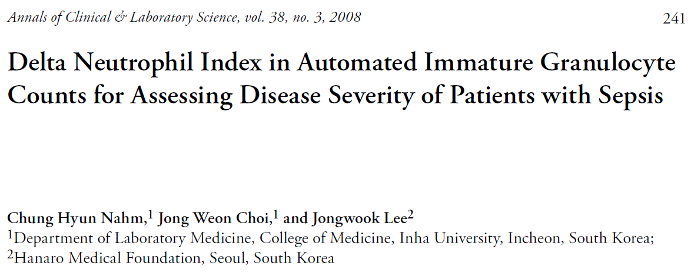

Slide 3
Introduction
Sepsis
  the presence of bacteria or their toxic products in the blood and the appearance of resultant clinical manifestations.
Blood culture is essential for the diagnosis of sepsis, but additional tests are needed for a rapid presumptive diagnosis until the culture results are Verified.
Coagulation parameters
  important in the diagnosis of sepsis
  hypercoagulable state is often present before the onset of clinical signs.
  severe cases of sepsis are associated with disseminated intravascular coagulation (DIC)
Delta neutrophil index (DN)
  corresponds to the fraction of immature granulocytes(IG) in circulating blood
  the difference between the leukocyte differentials assayed in the MPO channel and those measured in the nuclear lobularity channel (ADVIA 120, Siemens, Inc.)
We investigated the relationship between DN and the disease severity of sepsis, especially on the basis of the DIC score, positive blood culture rate, and mortality in patients with suspected sepsis.

Slide 4
Materials and Methods
Total 237 patients under clinical investigation of sepsis
  125 males, 112 females
  mean age : 59 years
Control group
  age matched healthy individuals, n=28
  no recent infection or disease
Exclusions
  Hematologic malignancy (n=3)
  Pregnant women (n=1)
  Missing values, fibrinolytic therapy, unknown survival status (n=4)
Assays
  Coagulation indices (PT, aPTT)
  Fibrinolytic activity (fibrinogen, AT III, D-dimer)
  Inflammation parameters (ESR, CRP)

Slide 5
DN in leukocyte differentials was calculated using the following formula.
  DN
= (the leukocyte subfraction assayed in the MPO channel by cytochemical reaction)
– (the leukocyte subfraction counted in the nuclear lobularity channel by the reflected
light beam)
A 200-cell manual differential count was done on blood smears
  123 patients by a hematologist
  IG : promyelocytes, myelocytes, and metamyelocytes, but not blasts.
Subjects were categorized into 3 groups based on DN.
  low DN group (5-20%, n = 147)
  intermediate DN group (21-40%, n = 52)
  high DN group (>40%, n = 38)
Further stratified into 5 subgroups
  group I (DN; 5-10%, n = 61)
  group II (DN; 11-20%, n = 86)
  group III (DN; 21-30%, n = 34)
  group IV (DN; 31-40%, n = 18)
  group V (DN >40%, n = 38)

Slide 6
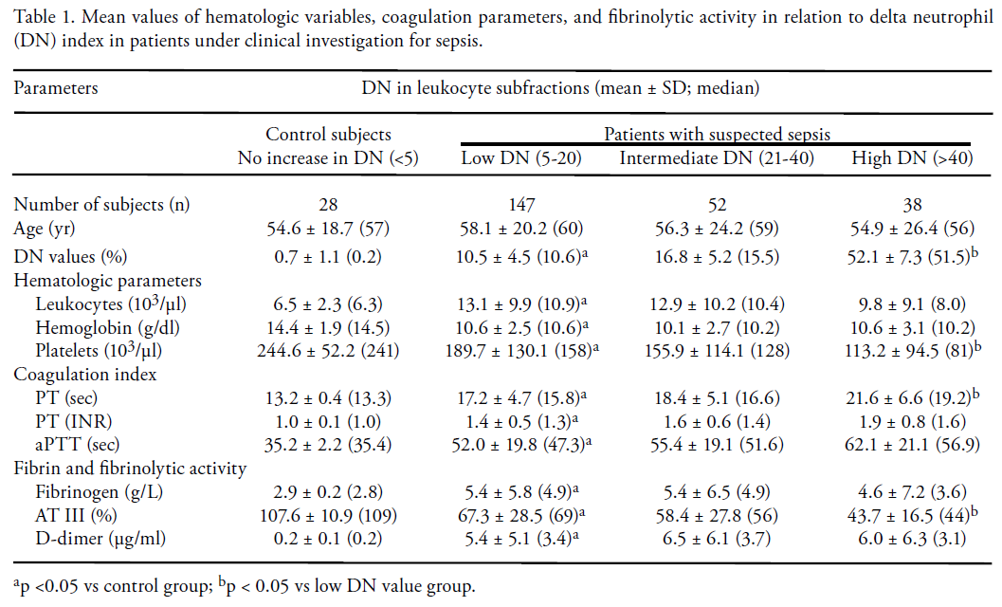
Results

Slide 7
Results

Slide 8
Results

Slide 9
Results

Slide 10
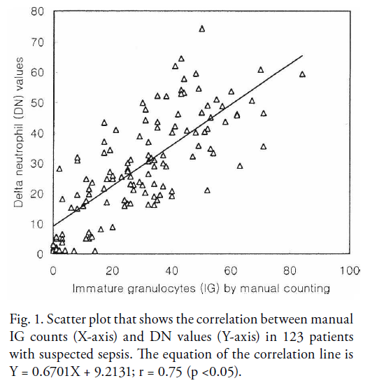

Slide 11
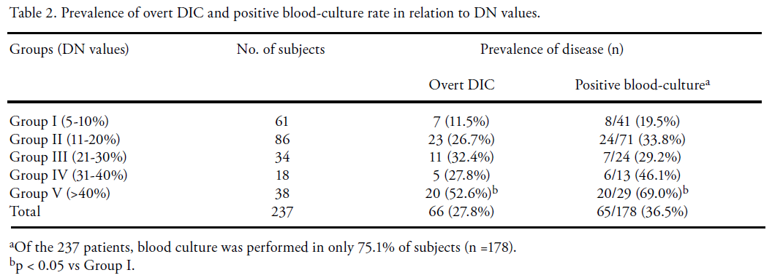

Slide 15
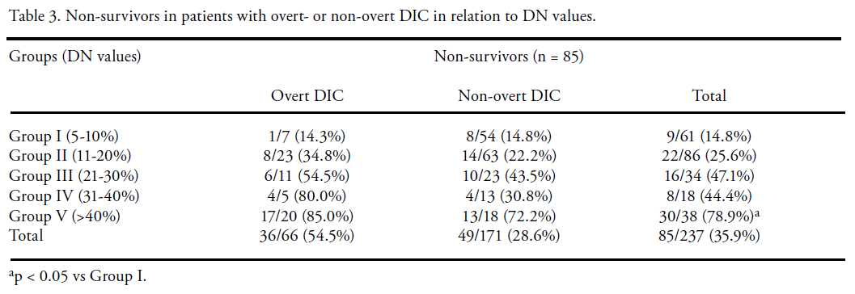
v
Mortality associated with disease
  Assessed 28 days after the enrollment

Slide 16
Mortality associated with disease
  Assessed 28 days after the enrollment

Slide 17
Mortality associated with disease
  Assessed 28 days after the enrollment

Slide 18
Mortality associated with disease
  Assessed 28 days after the enrollment

Slide 19
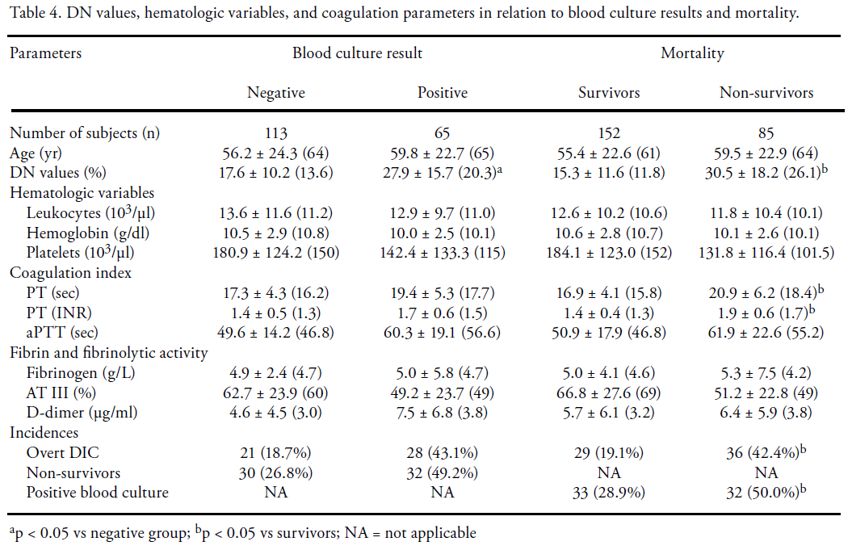

Slide 22
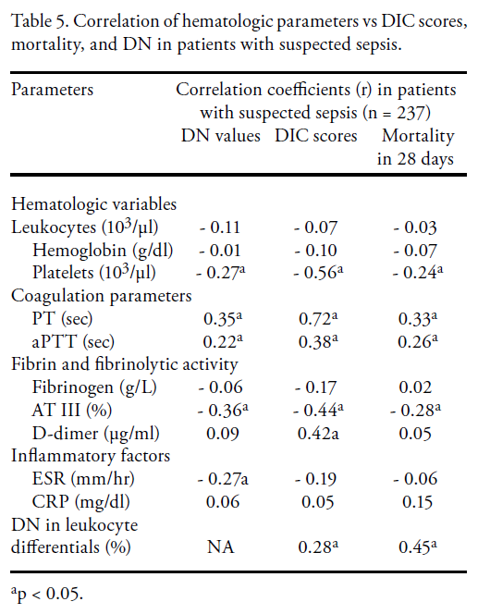

Slide 27
Discussion
The DN can be substituted for the manual procedure, especially for assays of granulocyte precursors in peripheral blood.
The DN correlated significantly with PT, AT III, and platelets.
The positive blood culture rate was several-fold higher in patients with high DN than those with low DN.

Slide 28
The DIC scores
  correlated strongly with PT and platelet counts, but not with fibrinogen and CRP
  more closely associated with AT III activity than D-dimer and aPTT levels
  Plasma fibrinogen level is still used in the DIC scoring system, but it has poor discriminative power.
  AT III and DN, can be considered as alternative constituents of the DIC score, rather than plasma fibrinogen level.

Slide 29
PT and DN values
  in non-survivors were significantly higher than those in survivors.
  the mortality rate of patients was more closely associated with PT and DN than aPTT, platelet count, AT III, and D-dimer
  DN in conjunction with PT may be helpful for assessing the clinical severity of patients with suspected sepsis
Limitation for the use of DN
  this index is only obtained with the ADVIA-series cell analyzer

Slide 30
In conclusion,
The DN is significantly associated with DIC scores, positive blood culture rate, and mortality in patients with suspected sepsis.
Measurement of DN may offer valuable information for assessing the progression of disease in patients with sepsis,
although the estimation of DN is limited to the users of one type of cell analyzer.

Slide 31
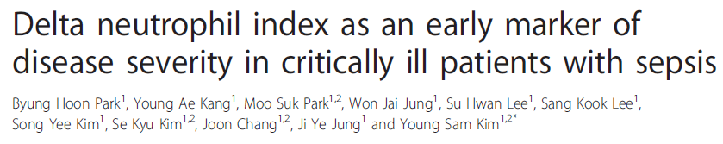
BioMedCentral Infectious Diseases
2011, 11:299

Slide 32
July 2010 ~ December 2010
All consecutive patients with clinically diagnosed sepsis at the time of ICU admission.
Exclusion criteria
  Age < 18 years
  Pregnancy
  Hematologic malignancy
  Received granulocyte colony stimulating factors
  Glucocorticoid
  Other immunosuppressants before study enrollment
Total 103 patients are enrolled

Slide 33
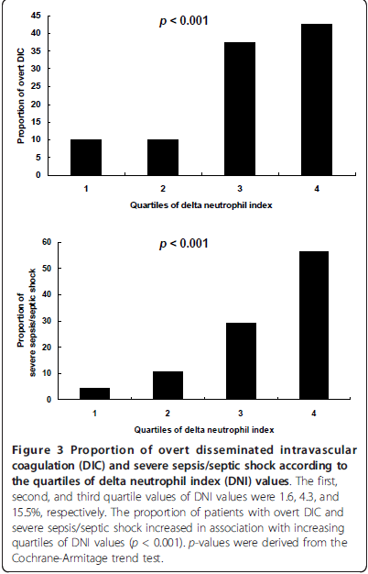
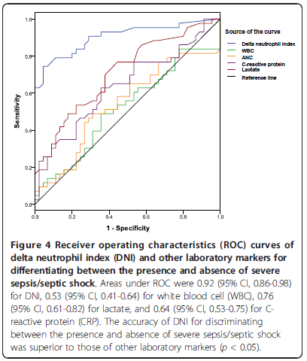

Slide 34
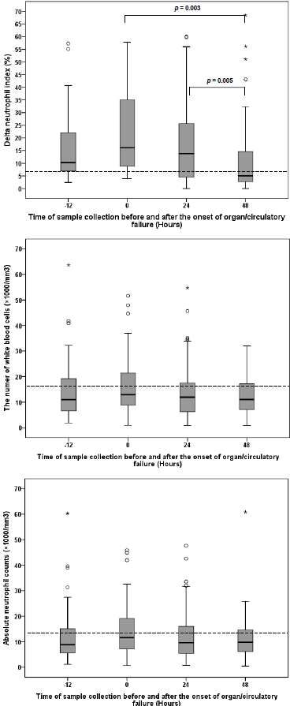
DNI values had already increased before
the onset of organ/circulatory failure in 82% of the patients with severe sepsis/septic shock.
DNI may help to identify patients with an imminent risk of developing severe sepsis/septic shock.
Cut-off value of DNI : 6.5%

Slide 35
DNI values had already increased before
the onset of organ/circulatory failure in 82% of the patients with severe sepsis/septic shock.
DNI may help to identify patients with an imminent risk of developing severe sepsis/septic shock.
Cut-off value of DNI : 6.5%

Slide 36
In conclusion,
DNI correlates with disease severity of sepsis in critically ill patients admitted to the medical ICU.
For assessing the risk of severe sepsis/septic shock, DNI may be a better predictive marker than other leukocytederived parameters.

Slide 37
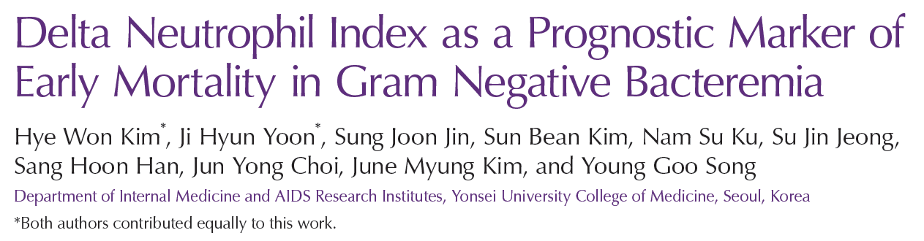
Infection and Chemotherapy
2014;46(2):94-102

Slide 38
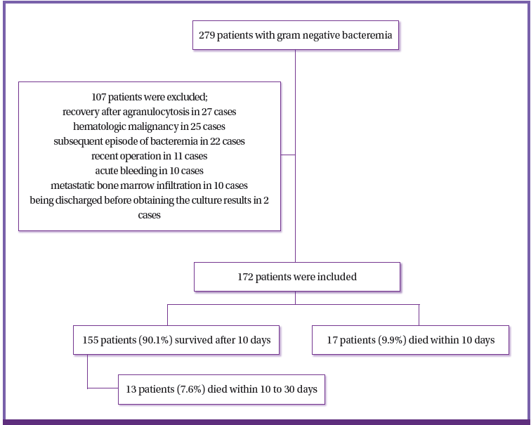
November 2010~March 2011
Adult patients(≥18 years of age)

Slide 39
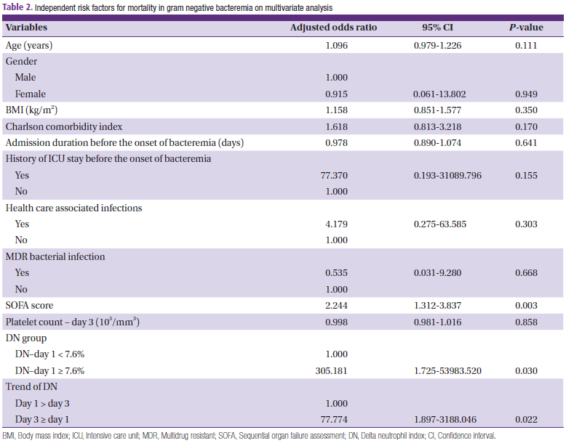

Slide 41
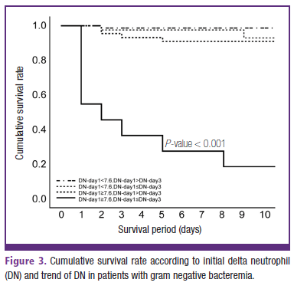
Divided all patient into 4 groups according to initial DN and DN trend.
The best cut-off value of initial DN for predicting early mortality in GNB was 7.6%, which corresponded to a sensitivity and specificity of 76.5% and 74.2%, respectively.

Slide 42
In conclusion,
DN to be a potentially useful marker of early mortality in patients with GNB. Mortality rates were significantly higher when initial DN was greater than 7.6% and did not decreased until the third day after onset of bacteremia.

Slide 43
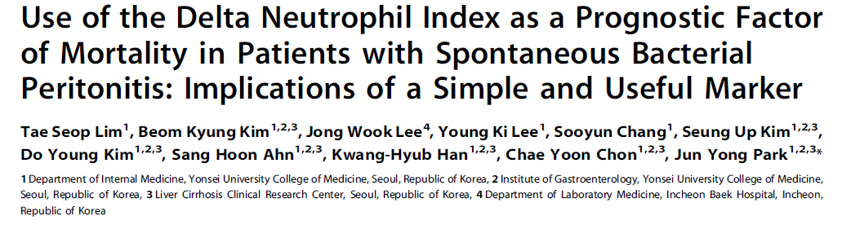
PLOS ONE
January 2014;9(1)

Slide 44
The major goal of this study was to predict 30-day mortality rates based on DNI.
April 2010 ~ May 2012
143 consecutive patients diagnosed with SBP and admitted to Severance Hospital
Exclusions
  HCC (n=40)
  With other cancers (n=6)
  Ascites caused by either pancreatitis or tuberculosis,
  Culture results were suggestive of polymicrobial secondary bacterial
  peritonitis (n=22)
  → After these exclusions, 75 cirrhotic patients with SBP were enrolled in the study.
Median age : 59.0 yrs
87.7% were male
m/c etiology of cirrhosis : chronic hepatitis B viral infection (n=43, 57.3%)
Thirty-day mortality : 25.3% (n=19)

Slide 45
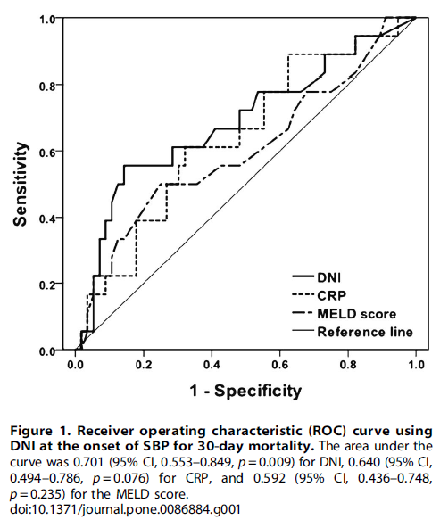
Usefulness and Accuracy of DNI
The optimal cutoff value of DNI, obtained from the Youden index, was 5.7%.

Slide 46
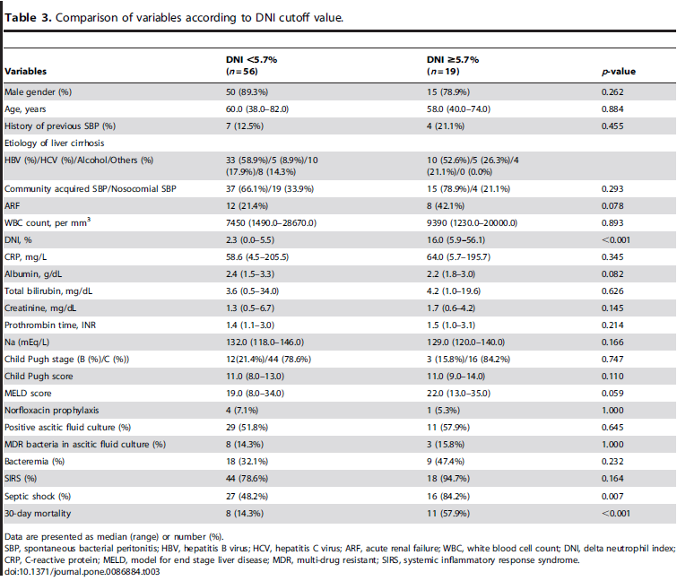

Slide 48
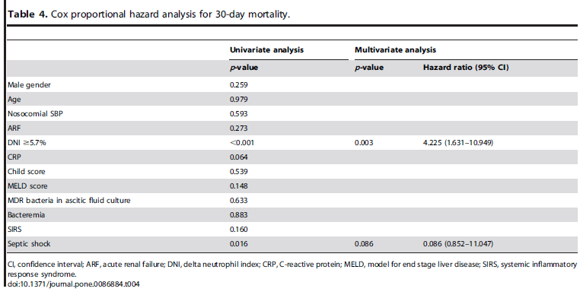

Slide 51
In conclusion,
In conclusion, DNI at diagnosis of SBP is a useful prognostic factor for the determination of 30-day mortality. Patients with high DNI level should be cautiously monitored, and treatment strategies should be appropriately adapted for their future needs.

Slide 52
Thank you for your attention !

