Slide 1


Broncholithiasis
Chest Conference 2019.07.04
F. 송명진

Slide 2
Definition and Symptoms
Definition
  presence of calcified or ossified material within the lumen of the bronchus
Symptoms
  nonproductive cough
  hemoptysis
  secondary infection after obstruction of the distal portion of the lung that causes pain, chills, and fever
  expectoration of calcified material (lithoptysis)

Slide 3
Radiologic Findings
Calcified nodule in endobronchus or peribronchus
Bronchial obstruction, atelectasis, mucoid impaction, obstructive pneumonitis, bronchiectasis, expiratory air trapping
RadioGraphics 2002; 22:S199–S213

Slide 4
Etiology
1) Erosion of a calcified adjacent lymph node (m.c)
2) Aspirated foreign material
3) Erosion by and extrusion of calcified or ossified bronchial cartilage plates
4) Migration to a bronchus of calcified material from a distant site
(such as a pleural plaque or the kidney, via a nephrobronchial fistula)
5) Primary endobronchial infection (ex. calcified fungal ball)
6) Calcified endobronchial tumor
J Thorac Dis 2018;10(Suppl 28):S3419-S3427
RadioGraphics 2002; 22:S199–S213

Slide 5
Erosion of a calcified adjacent LN (m.c)
Necrotizing granulomatous lymphadenitis - Mycobacterium tuberculosis, Histoplasma capsulatum, actinomycosis, coccidioidomycosis, and cryptococcosis
Repeated physical impingement of calcified peribronchial LN on the bronchial wall during respiratory motion
Commonly affected bronchi : proximal RMLB, RBI, origin of the anterior segment RULB
Notes:
Nodal calcification in the thorax most often occurs from long-standing lymphadenitis related to fungal or mycobacterial infections, with Histoplasma capsulatum representing the most common causative organism in the United States. Less common infectious etiologies include tuberculosis, actinomycosis, coccidioidomycosis, and cryptococcosis

Slide 6
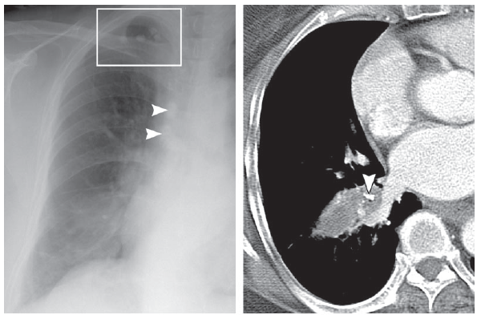
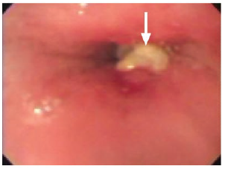
Case : Broncholithiasis due to extrusion of a calcified LN in a 61 year-old woman who presented with hemoptysis
Notes:
Broncholithiasis due to extrusion
of a calcified lymph node in a 61-year-old
woman who presented with hemoptysis.
(a) Posteroanterior radiograph shows consolidation
in the right lower lobe. Calcified
granulomas in the right apex (boxed area) and
calcified right paratracheal lymph nodes due
to previous tuberculosis (arrowheads) are also
shown. (b) CT scan shows a calcified nodule
(arrowhead) in the anterior basal segmental
bronchus of the right lower lobe with atelectasis.
(c) Bronchoscopic image shows a yellowish
hard material with surrounding granulation
tissue (arrow), which was removed.

Slide 7
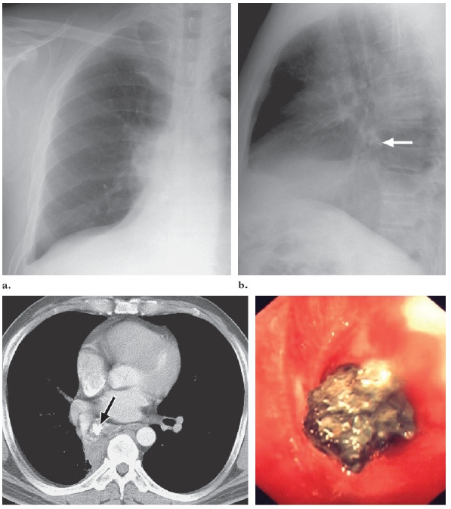
Foreign body aspiration
Aspiration of radiopaque fragments or in situ calcification of foreign Material
Case : Broncholithiasis due to calcification of an aspirated foreign body
53-year-old man
who presented with cough
Notes:
Broncholithiasis due to calcification of an aspirated foreign body in a 53-year-old man
who presented with cough. (a, b) Posteroanterior (a) and lateral (b) radiographs show combined
atelectasis of the right middle and lower lobes. A calcified irregular nodule is in the infrahilar area
on the lateral chest radiograph (arrow, b). (c) CT scan shows a calcified nodule in the bronchus
intermedius with atelectasis of the right lower lobe (arrow). (d) Bronchoscopic image shows a
brownish, hard material in the bronchus intermedius. When removed bronchoscopically, it was
found to be vegetable fiber with dystrophic calcification.

Slide 8
Primary endobronchial Infection
Calcified fungal ball
  Fungus ball : a conglomeration of intervened fungal hyphae admixed with mucus and cellular debris within the pulmonary cavity or ectatic bronchus
Actinomycosis

Slide 9
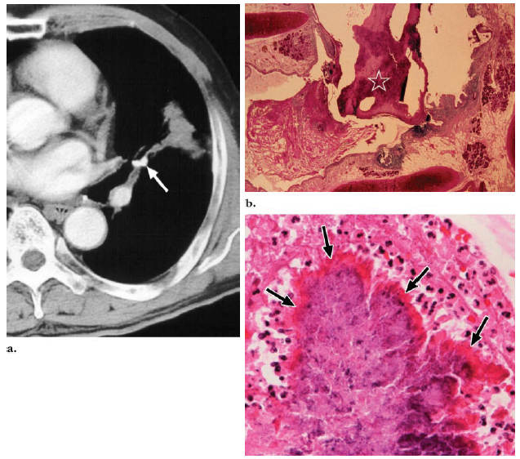
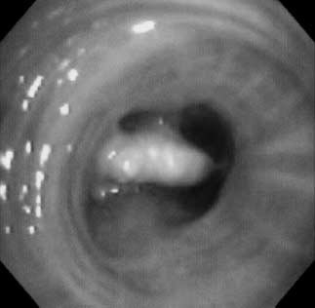
Case : Primary endobronchial actinomycosis with dystrophic calcification in a 61-year-old man who presented with left-sided chest pain
Respiration 2003;70:110–113
Notes:
(a) CT scan shows a calcified nodule
within the bronchus of the lingular division of the left upper lobe (arrow) with peripheral atelectasis.
At bronchoscopy, a yellowish, hard material was seen to obstruct the bronchial lumen. Because the lesion
was firmly attached to the bronchial wall, removal of it with a bronchoscopic forceps was impossible.
(b) Photomicrograph (original magnification, 10; H-E stain) of a section obtained along the axis of the
bronchus shows that the mass was partly calcified () and within the bronchus but did not infiltrate into
the pulmonary parenchyma. There was no evidence of a coexisting foreign material or a calcified lymph
node. (c) Photomicrograph (original magnification, 400; H-E stain) shows sulfur granules surrounded
by eosinophilic “clubbing” materials (arrows); this finding is typical for actinomycosis. (Reprinted, with
permission, from reference 21.)

Slide 10
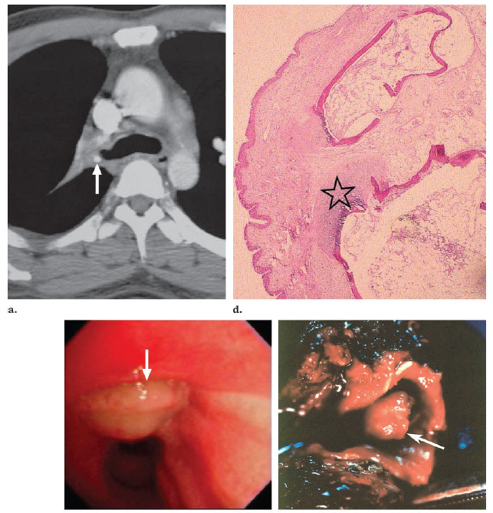
Calcified endobronchial tumor
Carcinoid tumors, Hamartoma, amyloidomas, osteomas, osteosarcomas, chondromas, and chondrosarcomas
Case : Calcified endobronchial hamartoma mimicking broncholithiasis in a 48-year-old man who
presented with cough
Notes:
radiography (not shown) revealed atelectasis of the right upper lobe. (a) CT
scan shows a small, calcified nodule obstructing the right upper lobar bronchus (arrow). (b) Bronchoscopic
image shows a yellowish movable mass at the orifice of the right upper lobar bronchus (arrow). Bronchoscopic
biopsy revealed chronic inflammation. (c) Photograph of the resected specimen shows a round,
reddish endobronchial mass (arrow). The cut surface of the mass was white and firm (not shown).
(d) Photomicrograph (original magnification, 100; H-E stain) shows the mass is covered with normal
respiratory epithelium. Areas of bone and cartilage tissue () and mature fat tissue are mixed.

Slide 11
Management
Patient symptoms, the size of the broncholith, its relationship with the airway wall, and its proximity to or involvement of adjacent thoracic structures
Conservative management :
  asymptomatic patients and those with minimal or non-recurring, non-life-threatening symptoms.
  cough suppression, bronchodilators, and empiric antimicrobial therapy
Indications for bronchoscopic or surgical intervention :
  intractable cough, recurrent pulmonary infections, symptomatic bronchiectasis, hemoptysis, fistula formation

Slide 12
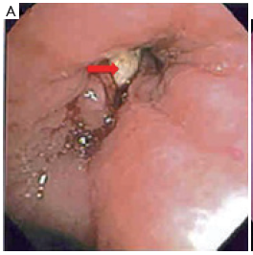
Bronchoscopy or surgery
Differ from traditional forms of foreign body removal!
  Adjacent airway mucosa is often inflamed and friable with blood oozing when touched. Granulation tissue may also be present.
Degree of broncholith mobility
Involvement of important structures beyond the bronchial wall, such as pulmonary vasculature
Contrast CT imaging prior to bronchoscopic removal attempt
J Thorac Cardiovasc Surg 2008;136:186-90.
Am J Respir Crit Care Med 1999;160:766-70.

Slide 13
Indications for bronchoscopic intervention
Loose and mobile broncholiths
  reported success rates approach 100%
Partly embedded broncholithiasis without complications
  reported success rates ranges from 0–48%
  hemorrhage, broncholith dislodgement, fistula formation
Patients with poor medical conditions
J Thorac Cardiovasc Surg 2008;136:186-90.
Am J Respir Crit Care Med 1999;160:766-70.

Slide 14
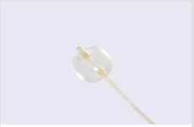
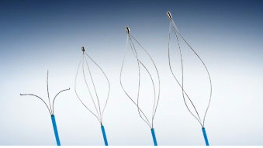
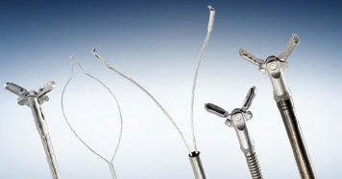
Bronchoscopic intervention
Flexible bronchoscopy
Rigid bronchoscopy
Cryotherpy probe

Slide 15
Indications for surgical intervention
Broncholithiasis with Complications
Chronic pulmonary suppurative disease
(bronchiectasis, bronchocele, lung abscess)
Massive hemoptysis
Bronchoesophageal fistulas
Broncholithiasis too firmly embedded
Massive bleeding during bronchoscopic removal
Failure of bronchoscopic removal
No surgical contraindications
Ann Thorac Surg 2005;79:1774–6

Slide 16
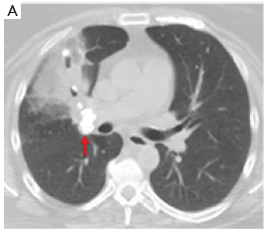
Surgical intervention
Bronchotomy
Anatomic pulmonary resection
  hemoptysis or chronic obstruction with resultant end stage parenchymal damage
Notes:
Advanced complications of broncholithiasis that required surgery. (A) Axial CT image of an otherwise healthy patient with several calcified lymph nodes surrounding the distal bronchus intermedius (arrow) with complete obstruction of the right middle lobe airway and secondary bronchiectasis and pneumonitis that was treated with thoracotomy and bilobectomy;

