Slide 1

Changes in NSCLC practice guideline from NCCN
Eun Young Kim
Divison of Pulmonology
Department of Internal Medicine
Yonsei University College of Medicine

Slide 2
NSCLC Practice guidelines
NCCN guideline – www.nccn.org
  Easy to read (Flow chart)
  Frequent update
ASCO guideline – www.jco.org
ACCP guideline – www.chestjournal.org

Slide 3
What`s new in NCCN 2010
Staging system (AJCC 7th)
Adjuvant/Neoadjuvant therapy option
First-line systemic therapy option in advanced NSCLC patients
Maintenance therapy
  Continuation / Switch maintenance

Slide 4
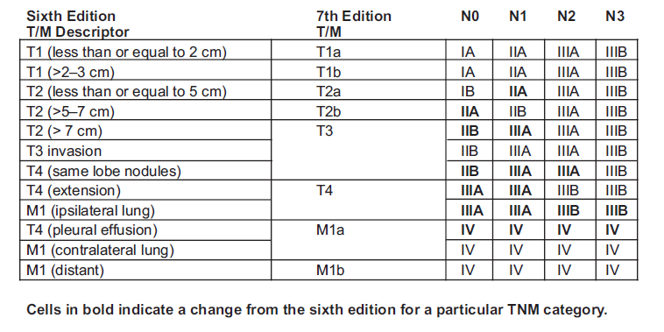
Staging system (AJCC 7th)
Size > 7cm : T2 → T3
Same lobe nodule : T4 → T3
Ipsilateral lung nodule : M1 → T4
Pleural effusion : T4 → M1a
T4N0-1 : stage IIIB → IIIA
J Thorac Oncol 2007;2:706-714
Notes:
2010년 1월 1일부터 모든 기관에서 적용 하기로 하였음.

Slide 5
Staging system (AJCC 7th)
Case 1
T: 4cm, N: hilar LN+, M: ipsilateral nodule+
  AJCC 6 : T2N1M1, Stage IV
  AJCC 7 : T4N1M0, Stage IIIA
Case 2
T: 4cm, Pleural effusion, N: mediastinal LN+, M: no mets
  AJCC 6 : T4N2M0, Stage IIIB
  AJCC 7 : T2aN2M1a, Stage IV

Slide 6
Adjuvant/Neoadjuvant therapy option
Stage IB - adjuvant chemotherapy는 high-risk인 경우만 시행한다. (Butts et al. Updated Survival analysis of JBR-10. J Clin Oncol. 2009;JCO.2009.2024.0333.)
  IB-high risk:
    poorly differentiated
    vascular invasion
    wedge resection
    minimal margin
    > 4cm
    visceral pleural involvement

Slide 7
Adjuvant/Neoadjuvant therapy option
Stage II, resection margin (-) - adjuvant CCRT changed Category 2B to Category 3
T3N2, no metastasis - “surgical resection for excellent response” after definitive CCRT removed as a treatment option
(목적이 induction therapy라면 수술고려)
T4N0-1, unresectable - Consolidation chemotherapy after CCRT changed Category 2B to Category 3
Notes:
T3N2 환자 initial therapy로 Definitive CCRT 를 시행한 경우 “surgical resection for excellent response” 항목을 삭제 (목적이 induction therapy라면 수술고려)

Slide 8
First-line systemic therapy
Erlotinib(Gefitinib) has been added, but only for patients who test positive for an epidermal growth-factor receptor (EGFR) mutation.
Bevacizumab, used in combination with chemotherapy, should be given until progression. The restriction modified (“untreated CNS metastasis” deleted)
Notes:
* 미국에서는 Gefitinib이 허가가 취소되어 가이드라인에 Erlotinib만 나와있다.

Slide 9
First-line systemic therapy
Pemetrexed should not be given to patients with squamous histology. Pemetrexed should also be used in combination with chemotherapy, not as a single therapy, unless it is a maintenance therapy.
Cetuximab plus vinorelbine and cisplatin is a treatment option for patients with a PS of 0 or 1 and those with a PS of 2. However, cetuximab is not approved for this use by the US FDA

Slide 10
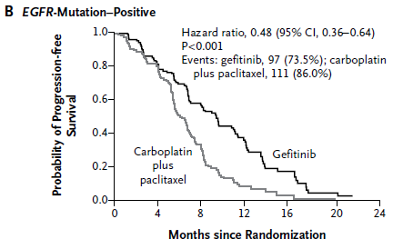
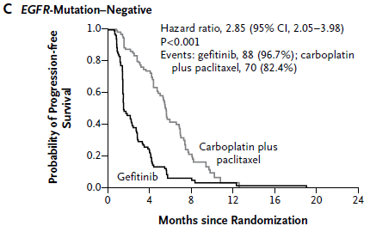
IPASS (Iressa vs PC)
NEJM 2009;361:947-57
Primary end point : Progression free survival (PFS)
EGFR (+) : HR 0.48 (Gefitinib ORR: 71.2%)
EGFR (-) : HR 2.85 (Gefitinib ORR: 1.1%)
Gefitinib is superior to carboplatin–paclitaxel as an initial treatment for pulmonary adenocarcinoma among nonsmokers or former light smokers in East Asia.
Notes:
PC : Paclitaxel carboplatin

Slide 11
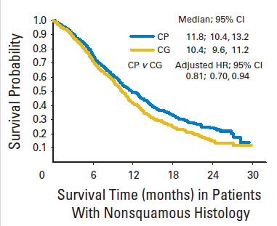
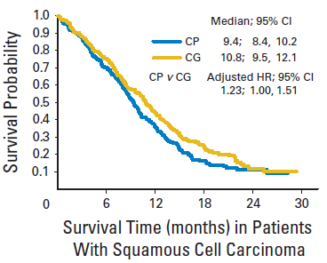
Pemetrexed/Cis vs Gemcitabine/Cis
Advanced (Stage IIIB or IV) NSCLC, First-line
1725 patients enrolled
Primary endpoint: OS
OS of PC vs GC : 10.3 m vs 10.3 m
PC provides similar efficacy to GC, with better tolerability
PC superior in patients with non-squamous histology
JCO 2008;26:543-3551

Slide 12
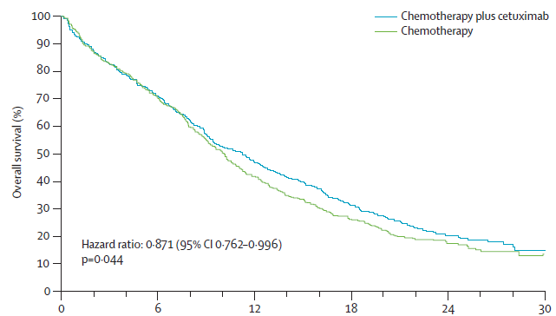
FLEX study
Median OS : 11.3 vs 10.1
(P=0.044)
Lancet 2009;373:1525-1531
1125 advanced NSCLC patients
Cetuximab/Vinorelbine/Cisplatin vs Vinorelbine/Cisplatin
Primary endpoint : OS

Slide 13
Maintenance therapy
Continuation therapy can be carried out with bevacizumab, cetuximab, or pemetrexed, according to the guideline.
Switch maintenance therapy is what it sounds like: after first-line chemotherapy, nonprogressing patients are switched to either pemetrexed or erlotinib.

Slide 14
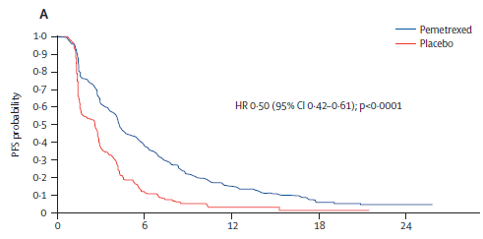
Switch to Pemetrexed maintenance
PFS : 4.3 m vs 2.6 m (HR: 0.50)
Lancet 2009;374:1432-1440
663 NSCLC patients
2:1 randomization after 4 cycles of Platinum-doublet
Primary endpoint : PFS
Pemetrexed improved PFS and OS

Slide 15
Switch to Erlotinib maintenance (SATURN)
889 NSCLC Patients enrolled
non-PD after 4 cycle chemotherapy
Erlotinib (n=438) or Placebo (n=451)
Primary endpoint : PFS
PFS was significantly prolonged with E versus P in all patients (HR 0.71 [95% CI 0.62-0.82]; p<.0001)
JCO (meeting abstracts) 2009;27:8001 (SATURN study)

Slide 16
Changes in Flow chart

Slide 17
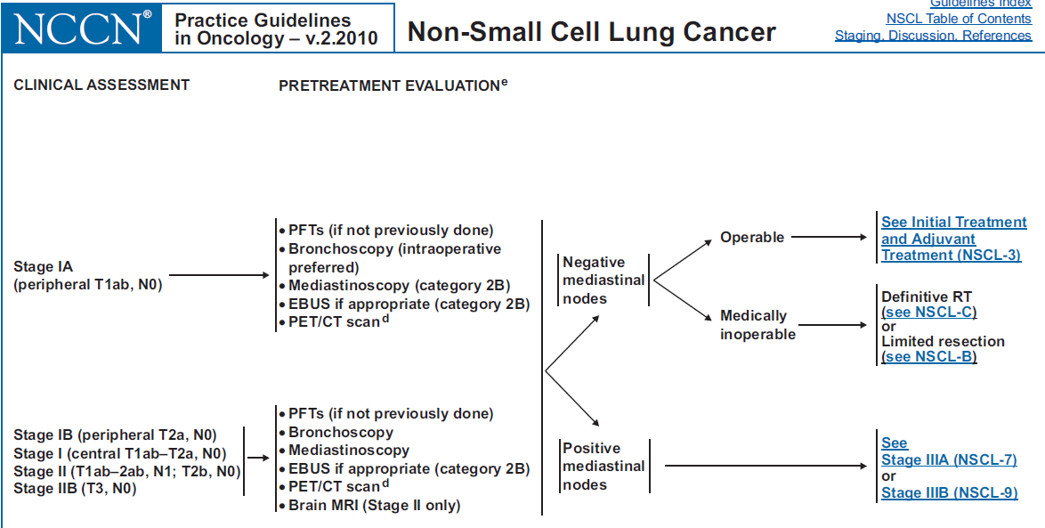
Evaluation에 필요한 경우 EBUS 추가 (Category 2B)
Inoperable 할 경우 limited resection이 추가

Slide 18
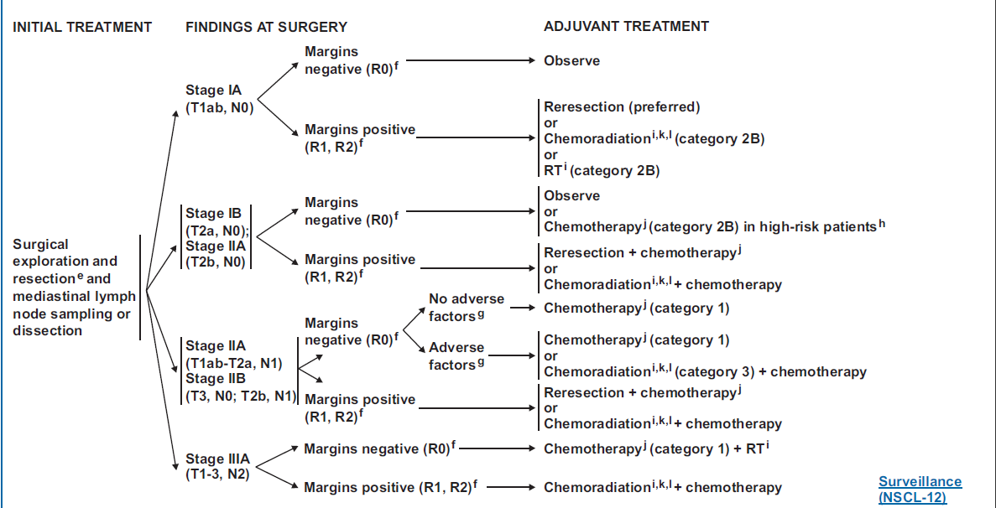
inadequate mediastinal LN dissection, extracapsular spread, multiple positive hilar nodes, close margins
IA, margin- : chemo option 삭제
IA, margin+: resection `preferred`, chemoradiation 후 chemo 삭제
IB, margin-: 선택적 chemo
Stage II, margin-: adverse factor를 갖는 환자에서 CCRT가 category 2B에서 3로 변경됨
(CCRT 시행 반대 의견 있음)
Notes:
Adverse factor : inadequate mediastinal LN dissection, extracapsular spread, multiple positive hilar nodes, close margins

Slide 19
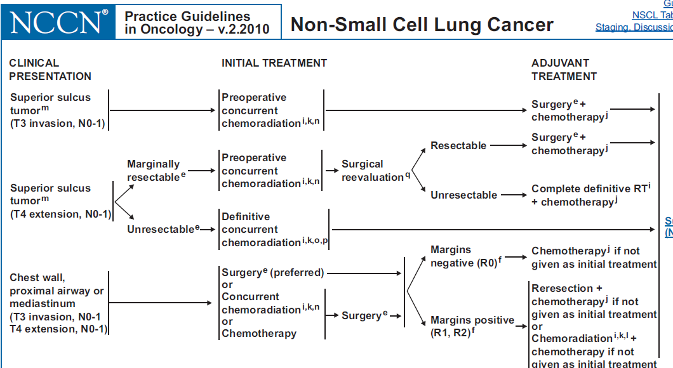
Initial Tx로 RTx (category 3)가
삭제되었음

Slide 20
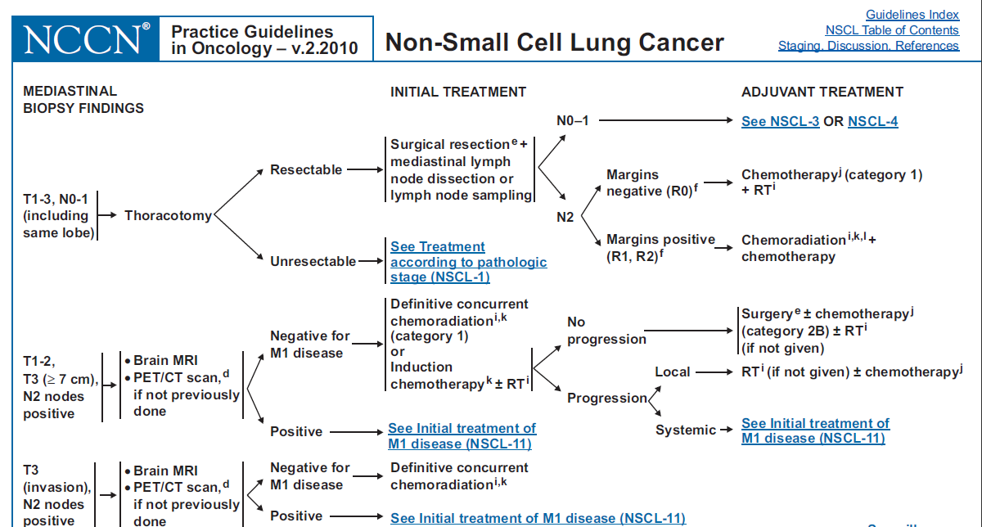
T1-3, N0-1에서 “or lymph node sampling” 추가
Margin-인 pN2인 경우 adjuvant CCRT option 이 삭제됨
T3N2에서 Definitive CCRT 시행한경우 resection option이 삭제됨. Induction therapy이후 surgery는 option으로 남아 있음.

Slide 21
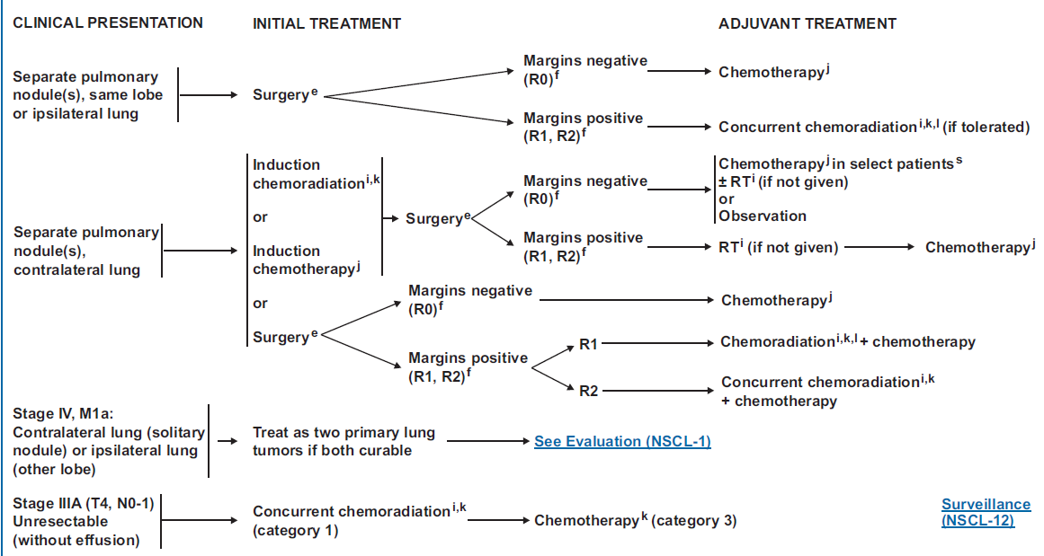
Contralateral lung nodule인 경우 M1a로 새로 분류
Unresectable IIIA인경우 CCRT 이후 consolidation chemo가 Category 2B에서 3로 변경됨
Notes:
Ipsilateral or contralateral lung nodule인 경우 operable 하다면 surgery 시행 (이전과 치료는 차이 없으나 stage만 down grade됨)
Reference가 본원 CS article!!
Lee JG, Lee CY, Kim DJ, Chung KY, Park IK. Non-small cell lung cancer with ipsilateral pulmonary metastases: prognosis analysis and staging assessment. Eur J Cardiothorac Surg. 2008;33:480-484

Slide 22
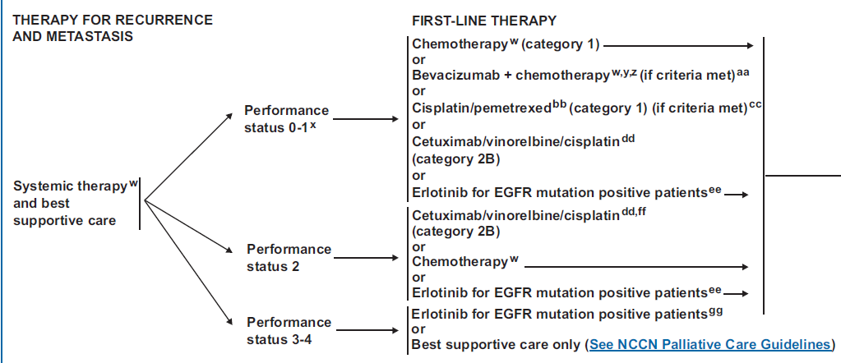
Stage IV first-line Pemetrexed/Cisplatin(Category 1), Erlotinib 추가
Cetuximab/Vinorelbine/cisplatin (Category 2B)
Bevacizumab criteria 바뀜
Criteria for adding Bevacizumab: non-squamous NSCLC, and no history of hemoptysis (치료안한 CNS lesion 항목은 삭제됨)
Pemetrexed is not recommended for squamous histology

Slide 23
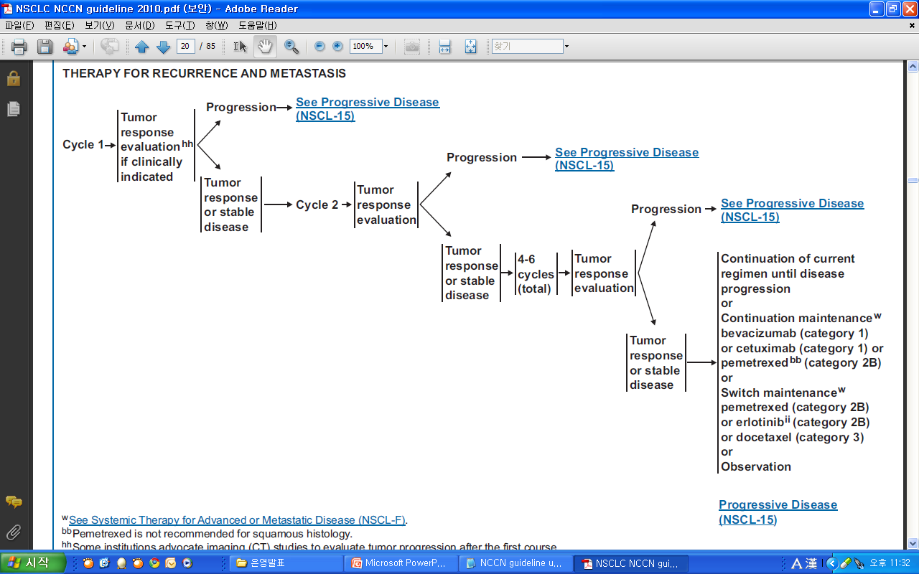
1차 chemo 후에 non-PD라면 Continuation maintenance therapy를 고려

Slide 24
Take Home Message
Staging system changed – AJCC 7th
Stage IB with high risk – adjuvant CTx
First-line – Erlotinib(Gefitinib), Bevacizumab, Cetuximab, Pemetrexed/Cisplatin
Maintenance therapy – Continuation or Switch (Erlotinib, Pemetrexed)

