Slide 1
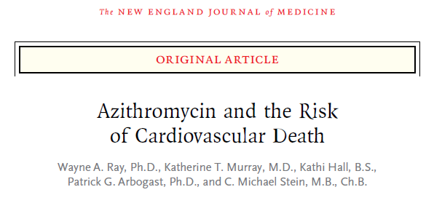
내과 R2 문도창

Slide 2
BACKGROUND
Erythromycin, clarithromycin
  Can increase the risk of serious ventricular arrhythmias
  Associated with an increased risk of sudden cardiac death

Slide 3
BACKGROUND
  Azithromycin also may have proarrhythmic effects
  (7 published reports)
  pronounced Qt interval prolongation
QT prolongation associated with azithromycin/amiodarone combination. Pacing Clin Electrophysiol 2001;24:1572-4. Samarendra P
A case of QT-interval prolongation precipitated by azithromycin. N Z Med J 2003; 116:U666. Matsunaga N
Azithromycin-induced QT prolongation in elderly patient. Acta Biomed 2006;77:30-2. Russo V
  torsades de pointes
  M. Torsade de pointes and cardiorespiratory arrest induced by azithromycin in a patient with congenital long QT syndrome. Med Clin (Barc) 2001;117:118-9. (In Spanish.) Arellano-Rodrigo E
  Azithromycin as a cause of QT-interval prolongation and torsade de pointes in the absence of other known precipitating factors. J Interv Card Electrophysiol 2007;18:243-6. Kezerashvili A,
  Azithromycin-induced torsade de pointes. Pacing Clin Electrophysiol 2007;30:1579-82. Huang BH,
  polymorphic ventricular tachycardia
  Polymorphic ventricular tachycardia with a normal QT interval following azithromycin. Pacing Clin Electrophysiol 2005; 28:1221-2. Kim MH,

Slide 4
BACKGROUND
A retrospective cohort study
Hypothesis
patients who took azithromycin would have an increased risk of cardiovascular death, particularly sudden cardiac death
compared with persons who did not take antibiotics and with patients who took other selected antibiotics

Slide 5
METHODS
Study oversight
  designed by the authors and approved by the local IRB and the Tennessee Bureau of TennCare and Department of Health
Notes:
테네시 주의 보건국, local IRB 승인으로 진행하였다.
Tenncare is the us state of tennessee;s health care insurance program

Slide 6
METHODS
Study Cohort
Computerized Medicaid data, pharmacy file
death certificates, hospital-discharge database….
Antibiotics, other medication
Patients
Prescribed azithromycin between 1992 and 2006
Excluded at high risk for death from causes unrelated to a short term effect of proarrhythmic medication
30 to 74 years of age
No life-threatening noncardiovascular illness,
Not received a diagnosis of drug abuse
Not been hospitalized in the prior 30 days.
Required at least 365 days of Medicaid enrollment and regular use of medical care
Notes:
컴퓨터 데이터와 pharmary file 이용
Excluded 와 그 외 필요 요건

Slide 7
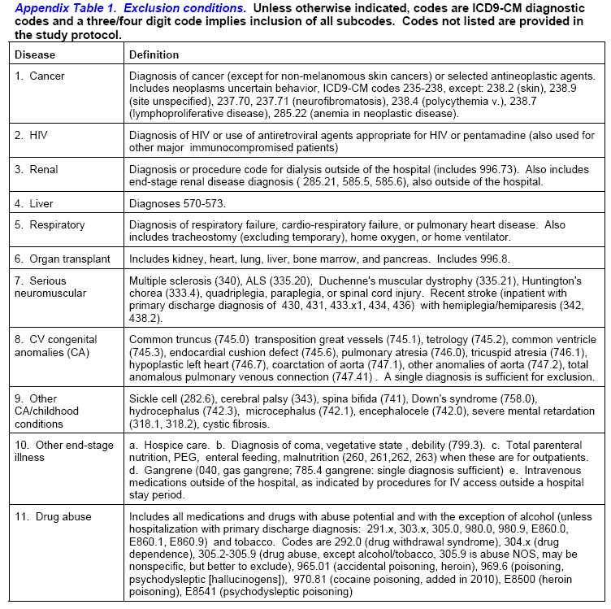

Slide 8
METHODS
Additional control groups
To attempt to control for confounding by indication
Amoxicillin
  Primary control antibiotics
  indications that are similar to those of azithromycin
  has not been shown to have adverse cardiac effects
Ciprofloxacin, Levofloxacin
  overlapping indecation of azithromycin
  CF : minimal adverse cardiac effect
  LF
greater proarrhythmic potential
numerous case reports of torsades de pointes
Notes:
Non anti user 뿐만 아니라 confouning factor를 줄이기 위해 추가적 control goups 을 두었다.
Amoxicillin 이 primay control

Slide 9
METHODS
Study End point
Cardiovascular death
  incidence of cardiovascular death should be increased if azithromycin is proarrhythmic,
Death of any cause
Notes:
Sudden cardiac death4-6 was defined as a sudden pulseless condition that was fatal, consistent with a
ventricular tachyarrhythmia, and occurred in the absence of a known noncardiac condition as the proximate
cause of the death.5 This excluded deaths of patients admitted to the hospital, that were not sudden, or with
evidence for an extrinsic (e.g., cocaine) or noncardiac (e.g., pneumonia) etiology or a different cardiac etiology
(e.g., heart failure).
multiple sources of data, including computerized death certificates, hospital discharge
files, and Medicaid files with terminal outpatient medical care encounters.
with an estimated sensitivity of 75%.

Slide 10
METHODS
Statistical analysis
A fixed period
correspond to the period of greatest risk of adverse cardiac effects, given that the case reports for azithromycin suggest an acute mechanism
-5day period
(recommended for azithromycin)
-10day period
(for other study antibiotics)
D6-10: azithromycin interval→ separately analyzed
-
Notes:
분석에 쓰인 study unit은 azithromycin 5일, 다른 anti 10일 fixed period로 이에 대하여 분석하였다
Azithromycin 투여 환자에서 D6-10은 대게 약을 복용하지 않는 기간이므로 이 구간은 따로 분석함
이 항생제 투여 기간에 대하여 분석한 것은 그간의 case reports등에서 azithromycin으로 인한 acute mechanism으로 cardiac A/E risk가 greater 되는 기간에 상응하는 시점을 택한 것이다

Slide 11
METHODS
Point estimates
Death during a course of antibiotic therapy
Cumulative incidence
(unadjusted, by mean of the product-limit method)
Relative risk
(adjusted for subjects characteristics, hazard ratio from Cox regression models*)
Notes:
논문은 anti Tx 동안 발생하는 death의 incidence와 RR 을 보고자 하였다
cumulative incidence(P-L method mean값으로 계산, adjusted 하지 않은 incidence), RR(subject characteristics에 대해 adjusted 하였고 cox regression model을 통해 hazard ratio 계산함)
*Cox regression model(=cox proportional hazards regression): survival analysis에서 multivariate(다변량) 분석 할 때 쓰는 젤 common 한 test(confouding factor를 통계 프로그램에 다 넣고 돌리면 factor들이 survival에 미치는 영향을 알아서 adjust 해줌)
*Supplementary appendix – Cox regression model 부분 발췌
The regression model coefficients for the study covariates must be interpreted cautiously. Because
controlling for confounding relies upon the propensity score, these coefficients are not completely adjusted for
other factors. For example, male sex is associated with increased risk. However, the corresponding HRs for
these covariates are not well adjusted for other cardiovascular risk factors, as the propensity score can only be
demonstrated to perform this adjustment for azithromycin.

Slide 12
METHODS
Adjustment
Each study comparison was adjusted for an extensive set of covariates that were possibly associated with both the use of the study antibiotic and the risk of death
-Propensity score (153 covaiates)
Indications for propensity scores and review of their use in pharmacoepidemiology. Basic Clin Pharmacol Toxicol 2006; 98:253-9. Glynn RJ
-Pairwise comparison
(propensity score percentiles, comparability)
Notes:
각 group 간 비교시 anti 사용과 death risk에 영향을 줄 수 있는 가능한 모든 covariates 들을 adjust 하였다
153개의 covaiates
이 adjustment에는 Glynn RJ 등이 indications for propensity scores and review of their use in pharmacoepidemiology 에서 고안한 propensity score을 사용하였다
Azithro group과 other anti 또는 non-user group 비교 시 pairwise comparison을 통해 각 군의 propensity score 수준과 분포를 추산하여 comparability를 확인하였다(는 다음 슬라이드에 자세히)

Slide 13
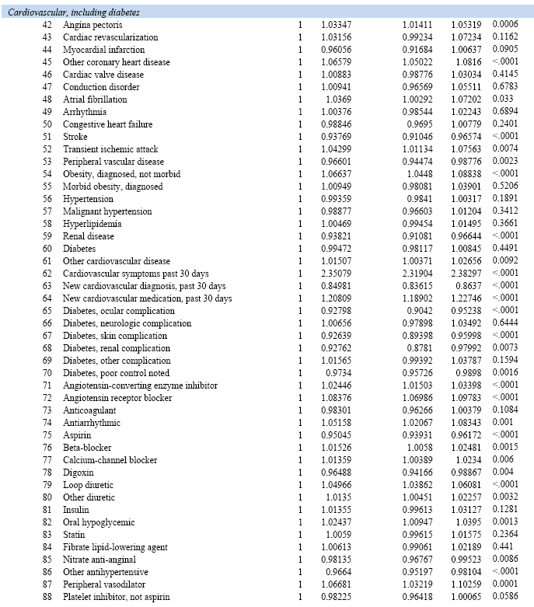
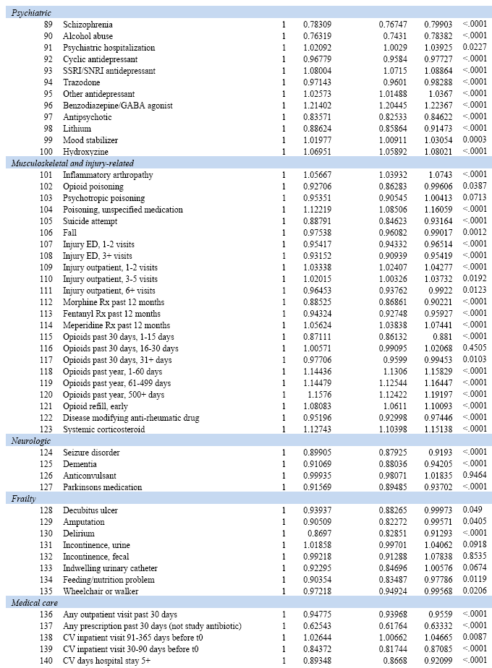
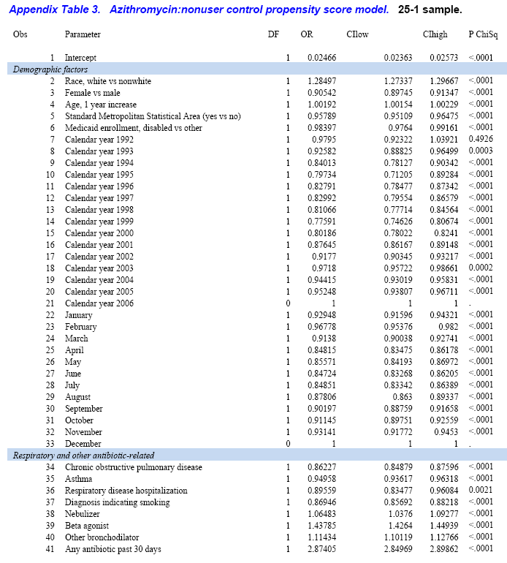

Slide 14
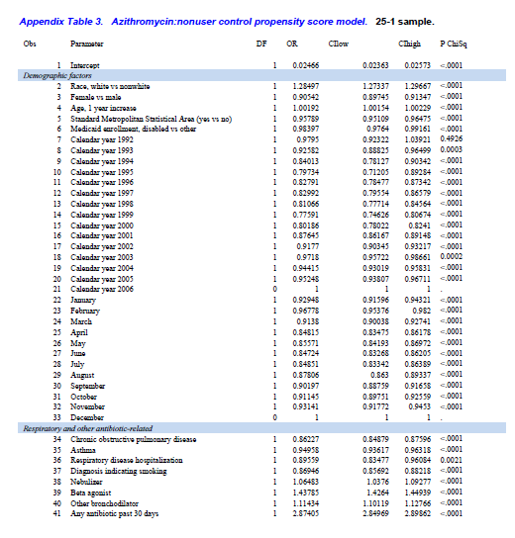
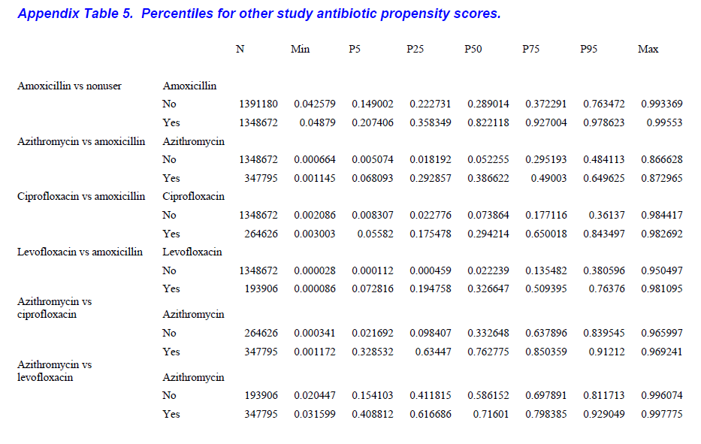
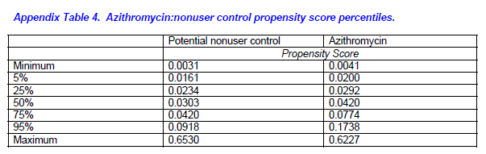
- Analytic strategies to adjust confounding using exposure propensity scores and disease risk scores: Nonsteroidal antiinflammatory drugs and short-term mortality in the elderly. Am J Epi 2005;161:891-898. Sturmer T,
- An alternative approach to age adjustment of cancer survival rates. Eur J Cancer 2004;40:2317-2322. Brenner H
Notes:
1. Propensity score에 사용된 기준표
2. Score pairwise를 통해 non-user gr. 과 azithromycin gr. 의 comparability 확인→ 이 두 gr. 간 비교는 score distribution이 balance 있게 matching하고 있어 adjust 하지 않은 상태로 analyze 하였다
3. amoxicillin gr.과 azithromycin gr. 비교 시 양 군의 distribution이 다르게 나타나 다음표 에서 처럼 각 comparison 마다 balance를 확인하였고 이를 azithromycin gr. 의 distribution에 기준하여 standarization하여 adjustment 하였다
*이 방법은 Analytic strategies to adjust confounding using exposure propensity scores and disease risk scores: Nonsteroidal antiinflammatory drugs and short-term mortality in the elderly. Am J Epi 2005;161:891-898.등에서 사용된 Brenner et al 등이 고안한 standarization 방법을 따랐다

Slide 15
METHODS
Cardiovascular death risk calculation
cardiovascular death without antibiotic
This score estimated the probability of cardiovascular death (in the absence of use of a study antibiotic) as a function of the indicators of coexisting conditions
- Adjustment of multiple cardiovascular risk factors with a summary risk score. Epidemiology 2008;19:30-7. Arbogast PG
Notes:
Cardiovascular death risk 를 측정하기 위해 anti 사용 없이 발생하는 cardiovascular death와 연관된 CVD risk score을 다음 문헌에서 인용하여 계산하였다
Azithromycin course 별로 additional risk는 요렇게 계산했다
이 risk 차이 계산은 CVD risk score을 통해 추산한 cardiovascular risk 십분위수에 따라 분류하여 계산하였다

Slide 16
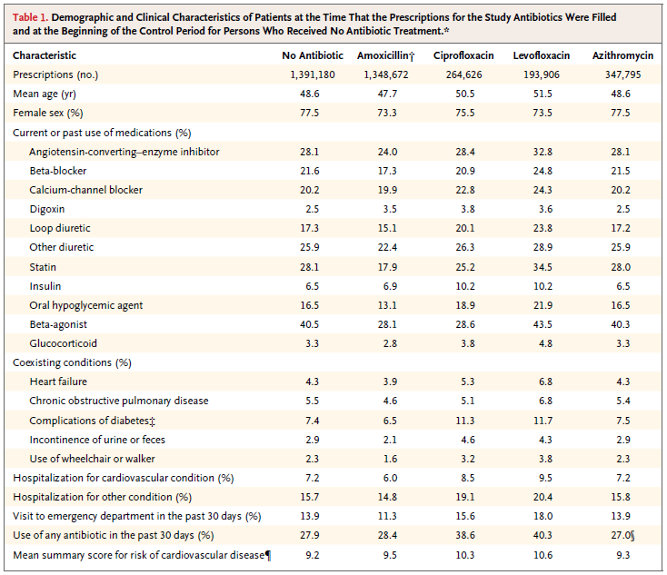
Results
Characteristics of the study cohort
Notes:
azithromycin subjects characteristics 특징은 77.5%가 여자, mean age가 49세, cardiovascular medi 나 respiratory medi 사용이 많았고 ER 내원, 이전 anti 사용했던 비율이 높았다
Cardiovascular risk score은 표 젤 아랫줄, 그래서 azithro보다 control에서 대체로 score가 높았다

Slide 17
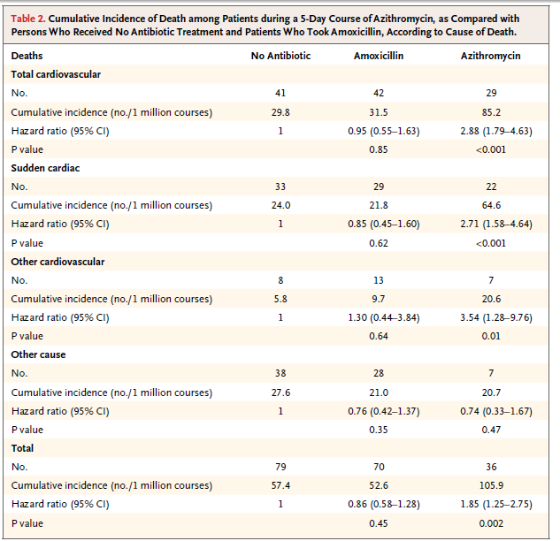
Cardiovascular death and total deaths
1. cumulative incidence
2. product-limit method, during a 10-day period
Notes:
이 risk 는 sudden cardiac death 와 other cardiovascular death에서 모두 증가하는 것으로 나타났으며, non-cardiac death risk는 증가하지 않음에도 all cause death risk 가 증가하였다

Slide 18
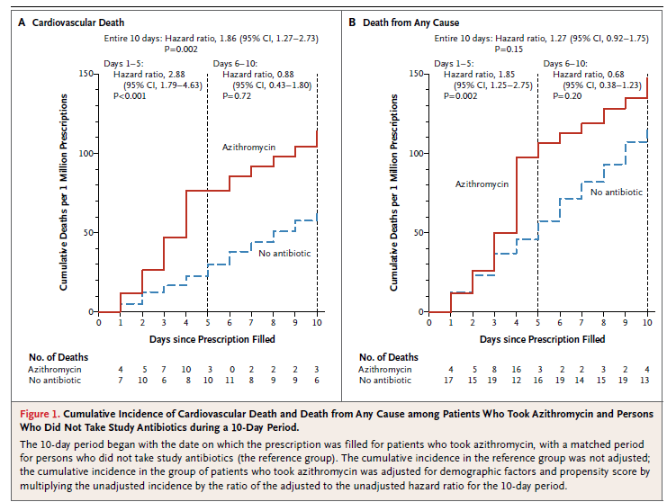
Cardiovascular death and total deaths
1. cumulative incidence
2. product-limit method, during a 10-day period
Notes:
Cumulative incidence를 product limit method를 통해 그래프로 나타내었다
non user 과의 비교 그래프
:5day course에서 cv- death, all cause death 모두 증가한 risk를 보인다
10day period에서 cv-death는 azithro에서 유의하게 증가한 결과를 보였으나 all cause death는 HR도 크지 않고 CI 가 1을 포함하여 유의하지 않은 결과를 보인다

Slide 19
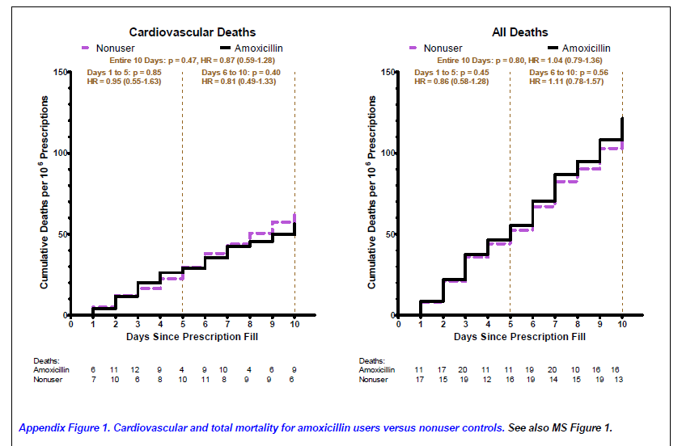
Notes:
Azithromycin과 다르게 amoxicillin gr.은 non-user gr.과 비교시 cv-death 와 non-cv death, any cause death, 5day model 과 10day model 모두에서 유의한 risk 증가를 보이지 않았다

Slide 20
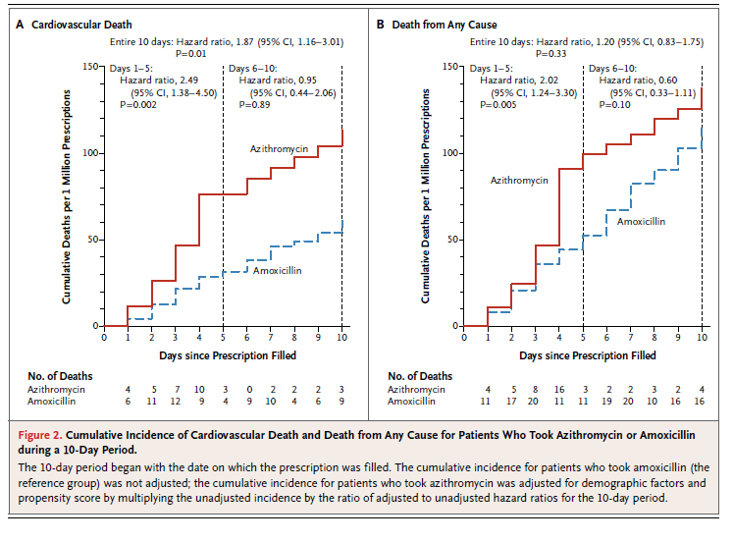
Thus, patients who took azithromycin had an estimated 47 additional cardiovascular deaths per 1 million 5-day courses of therapy

Slide 21
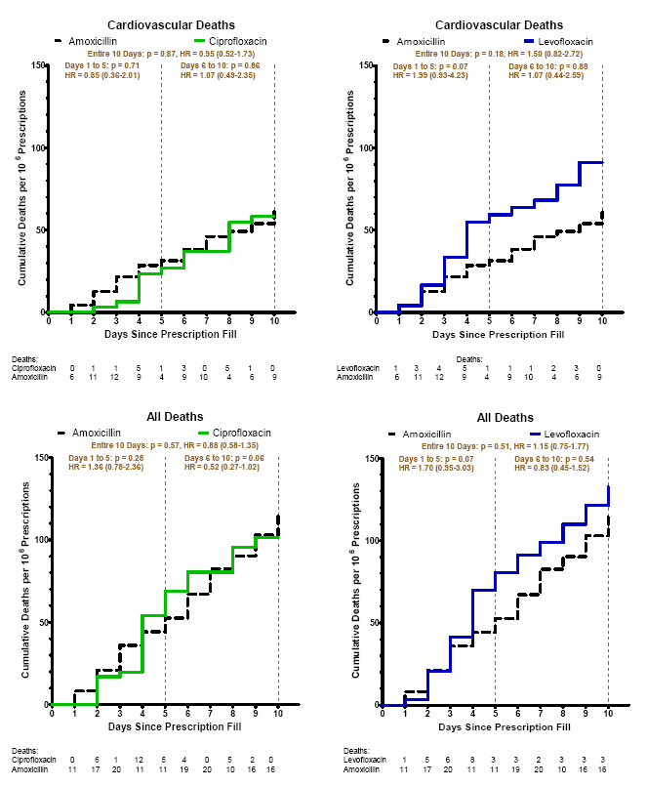

Slide 22
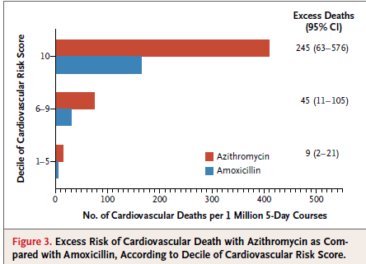
in the highest risk scores, 245 additional cardiovascular deaths per 1 million 5-day courses of azithromycin therapy

Slide 23
Discussion
Summary
  5-day course of azithromycin was associated with a small absolute increase in the risk of cardiovascular death
    most pronounced for patients in the highest decile of the baseline risk of cardiovascular disease
  increase in the risk of death from any cause
    no increased risk of death from noncardiovascular causes among patients who took azithromycin
  Risk was significantly greater with azithromycin than with either amoxicillin or ciprofloxacin but did not differ significantly from the risk with levofloxacin

Slide 24
Discussion
Confounding factor
Cardiovascular disease, coexisting conditions
behavioral risk factors associated with cardiovascular disease
(e.g., smoking, high bodymass index, poor diet, and low physical activity), indication for antibiotic therapy
Propensity score matching
2. Courses of amoxicillin therapy
To minimize confounding by the short-term effects of infections
Indications similar to those for azithromycin
Amoxicillin had no increase in the risk of either cardiovascular death or death from any cause during the study period
Notes:
Obserbatic study 이므로 confounding factor 조정이 필요
hyperlipidemia, hypertension, diabetes, heart failure, angina, or myocardial infarction.등의 factor를 조정 했으므로 behavior risk 도 조정

Slide 25
Discussion
Serum concentration
  The increased risk of cardiovascular death during the usual 5-day course of azithromycin therapy
  did not persist after the course of therapy ended
  Falling to trough levels within 24 hours after cessation of oral therapy
  For many other drugs with proarrhythmic effects,
  an elevated serum concentration is a key determinant of increased risk(erythromycin)

Slide 26
Discussion
Conclusion
during 5 days of azithromycin therapy, there was a small absolute increase in cardiovascular deaths
As compared with amoxicillin,
There were 47 additional cardiovascular deaths per 1 million courses of azithromycin therapy
For patients in the highest decile of baseline risk of cardiovascular disease, there were 245 additional cardiovascular deaths per 1 million courses

