Slide 1
Weaning Patients from the Ventilator
John F. McConville, M.D., and John P. Kress, M.D.
N Engl J Med 2012;367:2233-9.
2013.02.21
Hee-Seung Lee
Notes:
Astrid van tubergen등이 2012년 발표한 AS 환자에서 새롭게 발생하는 syndesmophytes와 그것을 예측하는 predictor 에 관한 study입니다.
내과 2년차 이희승입니다.

Slide 2
Introduction
Almost 800,000 patients who are hospitalized each year require mechanical ventilation.
Majority of patients who receive mechanical ventilation have acute respiratory failure in the postoperative period, pneumonia, congestive heart failure, sepsis, trauma, or the acute respiratory distress syndrome (ARDS).

Slide 3
Introduction
As soon as the condition that caused respiratory failure has started to improve, the transition from full ventilatory support to spontaneous breathing may be initiated. This transition requires sufficient respiratory-muscle strength to sustain breathing and maintain acceptable gas exchange.
Typical algorithm used by clinicians to discontinue mechanical ventilation. (Figure 1)
Patients are assessed daily for their readiness to undergo a trial of spontaneous breathing

Slide 4
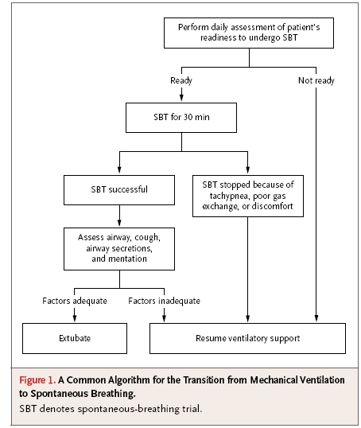
Introduction

Slide 5
Introduction
Typical readiness criteria include hemodynamic stability, a ratio of the partial pressure of arterial oxygen (measured in millimeters of mercury) to the fraction of inspired oxygen (which is unitless) of more than 200 with the ventilator set to deliver a positive end-expiratory pressure of 5 cm of water or less, and some improvement in the underlying condition that caused the respiratory failure.

Slide 6
Introduction
For a spontaneous-breathing trial to be successful, a patient must breathe spontaneously with little or no ventilator support for at least 30 minutes without any of the following:
  Respiratory rate of more than 35 breaths per minute for more than 5 minutes
  Oxygen saturation of less than 90%
  Heart rate of more than 140 beats per minute
  Sustained change in the heart rate of 20%
  Systolic blood pressure of more than 180 mm Hg or less than 90 mm Hg, increased anxiety, or diaphoresis.

Slide 7
Introduction
If a trial of spontaneous breathing is successful, several additional factors need to be assessed before removal of the endotracheal tube
  Ability to protect the airway once the tube is removed.
  Quantity of airway secretions.
  Strength of cough.
  Mentation.

Slide 8
Strategies to Reduce the Duration of Mechanical Ventilation
Several studies suggest that the process of discontinuing ventilation after the underlying cause of respiratory failure has been addressed accounts for more than half the total duration of mechanical ventilation
Minimizing the duration of mechanical ventilation is an important consideration for all clinicians who care for critically ill patients

Slide 9
Strategies to Reduce the Duration of Mechanical Ventilation
In a prospective observational study involving patients with brain injuries, Coplin et al. compared discontinuation of mechanical ventilation within 48 hours after readiness criteria had been met with more than a 48-hour delay in discontinuation.
Higher mortality, an increased risk of pneumonia, and a longer hospital stay in the group with delayed discontinuation

Slide 10
Strategies to Reduce the Duration of Mechanical Ventilation
Efforts to decrease the duration of mechanical ventilation can be divided into two categories
  Earlier appreciation of readiness for spontaneous breathing trials
  Shorter process of discontinuing mechanical ventilation

Slide 11
Strategies to Reduce the Duration of Mechanical Ventilation
Yang and Tobin found that a ratio of the respiratory rate (expressed in breaths per minute) to tidal volume (expressed in liters) (f:Vt) of 105 breaths per minute per liter or less during a 1-minute trial with the use of a T-piece
accurate in identifying patients in whom a subsequent spontaneous-breathing trial would be successful (positive predictive value, 78%; negative predictive value, 95%).

Slide 12
Approaches to Spontaneous Breathing Trials
Respiratory mechanics worsen during a spontaneous-breathing trial, causing increased work in breathing that cannot be maintained in critically ill patients.
Deterioration of respiratory mechanics can result from the following:
  Increased respiratory resistance such as that which occurs in status asthmaticus and other obstructive pulmonary conditions.
  Decreased lung compliance in diseases such as pulmonary fibrosis, pulmonary edema, acute lung injury, or ARDS.
  Air trapping that can occur in chronic obstructive pulmonary disease.
Notes:
다양한 이유로 SBT는 실패한다.

Slide 13
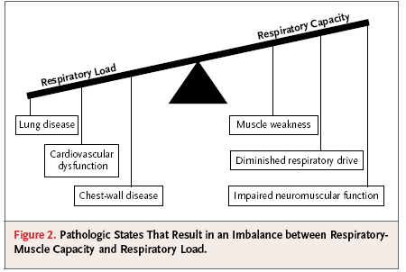
Approaches to Spontaneous Breathing Trials
Notes:
many of the pathologic states that result in an imbalance
between respiratory-muscle strength and respiratory load.

Slide 14
Approaches to Spontaneous Breathing Trials
To better describe the transition from mechanical ventilation to spontaneous breathing, a classification scheme based on the results of spontaneous-breathing trials.
  Simple transition to spontaneous breathing - successful first trial followed by discontinuation of mechanical ventilation.
  Difficult transition - three spontaneous-breathing trials but fewer than 7 days between the first unsuccessful trial and successful discontinuation of mechanical ventilation.
  Prolonged transition - at least three unsuccessful spontaneous-breathing trials or 7 days or more of mechanical ventilation after the initial unsuccessful trial. In-hospital mortality and possibly overall mortality are increased.

Slide 15
Unsuccessful weaning from the ventilator
Approximately 15% of patients in whom mechanical ventilation is discontinued require reintubation within 48 hours.
Patients who require reintubation have an increased risk of death, a prolonged hospital stay, and a decreased likelihood of returning home.

Slide 16
Unsuccessful weaning from the ventilator
Several studies have started to elucidate the difference between readiness for discontinuation of ventilation and successful spontaneous breathing trials.
Inadequate cough, excessive secretions, and poor mental status required reintubation after discontinuation of mechanical ventilation.
It may be wise to delay extubation in patients who have had a successful trial of spontaneous breathing but do not meet these three criteria.
Additional risk factors - increased f:Vt ratio at the end of a spontaneous-breathing trial, a positive fluid balance, diagnosis of pneumonia

Slide 17
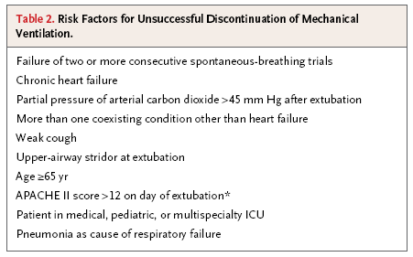
Unsuccessful weaning from the ventilator

Slide 18
Treatment of Respiratory Distress after Extubation
Noninvasive positive pressure entilation in patients in whom respiratory distress develops within 48 hours after extubation
Standard care (primarily oxygen and bronchodilators) or noninvasive positive-pressure ventilation.
Neither study showed a significant between-group difference in the number of patients who required reintubation

Slide 19
Treatment of Respiratory Distress after Extubation
Both studies showed that the groups receiving noninvasive positive pressure ventilation had a reduced need for reintubation
Preemptive use of noninvasive positive-pressure ventilation in the early period after discontinuation of mechanical ventilation in patients deemed to be at increased risk for extubation failure appears to be effective in reducing the need for reintubation.

Slide 20
Treatment of Respiratory Distress after Extubation
This aggressive approach includes assessing all patients in hemodynamically stable condition to determine their readiness for extubation and then performing a 30-minute spontaneous-breathing trial with the use of CPAP of 5 cm of water or less in eligible patients while they are awake and not receiving continuous sedation

Slide 21
Treatment of Respiratory Distress after Extubation
Aggressive approach to discontinuation of mechanical ventilation that emphasizes early spontaneous breathing and seeks to minimize the duration of mechanical ventilation results in fewer ICU-related complications.
We recommend extubation and the use of preemptive noninvasive positive-pressure ventilation in patients who have had a successful spontaneousbreathing trial but are at risk for unsuccessful discontinuation of mechanical ventilation

Slide 22
Thanks for your attention

