Slide 1




Viral pneumonia
강 사 이 인 선

Slide 2
Introduction
Community acquired pneumonia by WHO report
  Incidence : 450 million cases / year;
  Mortality : 7% of 57 million people ( < 5yr , > 75yr )
  In adults, viral etiology in 1%–23% of cases
  inﬂuenza virus being the most common virus
Issue on viral pneumonia
  The emergence of severe acute respiratory syndrome (SARS), avian influenza A (H5N1) virus, and the 2009 pandemic influenza A (H1N1) virus.
  New respiratory viruses—such as human metapneumovirus, coronaviruses NL63 and HKU1, and human bocavirus.
Notes:
-viral pneumonia 로 인한 사망은 주로 5세 미만 소아, 75세 이상 고령에 집중되어있음. 개도국은 선진국의 5배.
-의 등장으로 respiratory virus 로 인한 severe pneumonia 에 대한 관심이 높아졌습니다.
지난 십년간 새로운 respiratory virus 등장했습니다.
In 2005, pneumonia and influenza combined was the eighth most common cause of death in the United States and the seventh most common cause of death in Canada [3,4]. There were over 60,000 deaths due to pneumonia in the United States. Mortality is highest for CAP patients who require hospitalization, with a 30-day mortality rate of up to 23 percent in such patients

Slide 3
Epidemiology of pneumonia
Viruses linked to CAP in children and adults
• Respiratory syncytial virus
• Rhinovirus
• Influenza A, B, and C viruses
• Human metapneumovirus
• Parainfluenza v. types 1, 2, 3, and 4
• Human bocavirus*
• Coronavirus types 229E, OC43, NL63, HKU1, SARS
• Adenovirus
• Enteroviruses
• Parechoviruses
• Epstein-Barr virus
• Human herpesvirus 6 and 7
• Varicella-zoster virus
• Hantavirus
• Herpes simplex virus
• Mimivirus
• Cytomegalovirus†
• Measles†
*Mostly in children. †Mostly in developing countries.

Slide 4
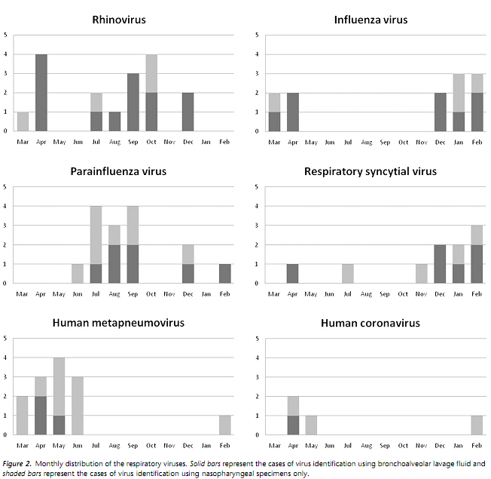
Clinical diagnosis
Seasonal patterns of activity
  RSV- typically every or every other year in late autuumn,
  Rhinovirus in autumn and spring
  Influenza peak in late autumn, early winter

Slide 5
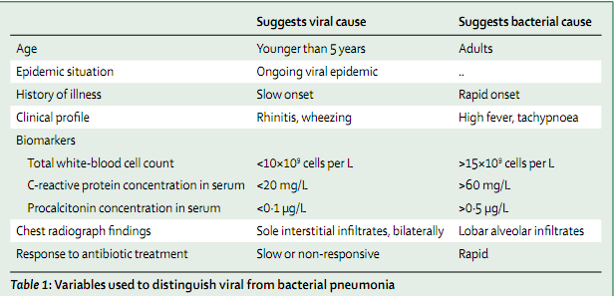
Clinical diagnosis
Notes:
Viral pneumonia 에서는 CRP,procalcitonin 상대적으로 덜 상승, bacterial 에서는 6~12이내에 상승했다가 pneumonia 호전되면 바로 떨어짐.

Slide 6
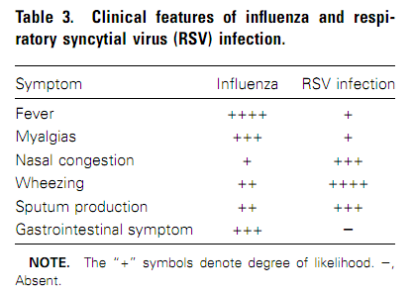
Clinical diagnosis

Slide 7
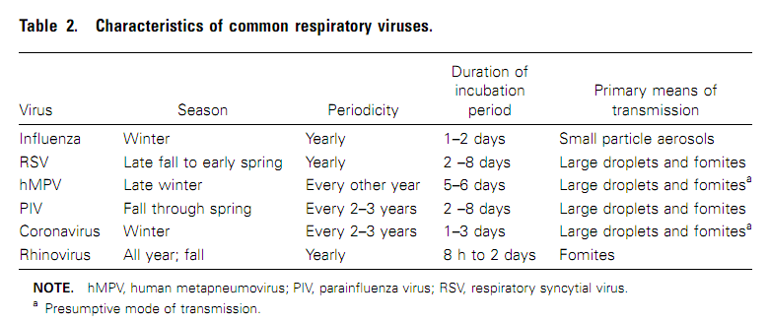
Clinical diagnosis

Slide 8
Diagnosis
Respiratory secretion
  nasal swab or wash specimen( in children), transnasal nasopharyngeal flocked swab( in adults) throat swab, sputum specimens, BAL fluid
Culture
  Gold standard
  Prompt transportation of specimen on ice for immediate inoculation
  Influenza- hardly grow / RSV -insensitive
  PIV, rhinoviruses can be detected

Slide 9
Diagnosis
Rapid antigen detection
  Influenza A,B(sensitivity 50~60%. Specificity >90%), RSV( in children) –immediate results, screening
RT-PCR
  Very sensitive (2~5 times more ) and specific for all common viruses.
Serologic testing
  Retrospective diagnosis when a > 4fold increase in a specific Ab by EIA
  hMPV, coronavirus – only research setting

Slide 10
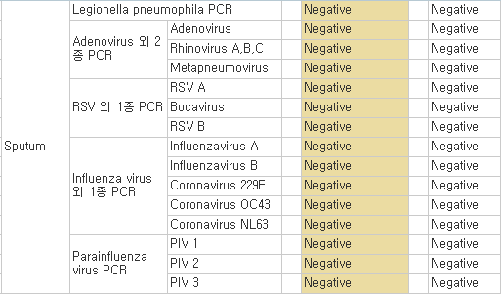
Respiratory virus PCR

Slide 11
Co-infection
Viral-viral co-infection
  In children, human bocavirus and other V
  → more wheezing, more severe pneumonia
Viral-bacterial co-infection
  Influenza pandemic of 1918,1957,1968
  → most death s/t secondary bacterial pneumonia
  Avian H5N1-pneumonia, primarily viral infection
  2009 H1N1 infection, secondary bacterial pneumonia in 4~24% of cases
  In adults, (m/c)strep. pneumoniae with other viruses.
  It remains unclear whether a bacterial coinfection is associated with more severe disease.
Notes:
Poorly studied

Slide 12
Pathology
  Inﬂuenza A : DAD with DAH
  Rhinovirus: thickening of the alveolar septum and hyperplasia , desquamation of the alveolar lining cells and IHC localization of rhinoviral Ag in alveolar epithelial cells and macrophages
  Parainﬂuenza virus : interstitial pneumonitis c cytoplasmic inclusions
  RSV : inﬂammation of the bronchial and alveolar epithelium with resultant airway obstruction
  Metapneumovirus : congestion of the alveolar septum and hemorrhage in the alveoli in human-> bilateral haemorrhagic bronchopneumonia
Notes:
possibly an indication of differences in viral infections and comorbidity.
Generally, interstitial pneumonitis with lymphocytic inﬁ ltrations is seen in viral pneumonitis

Slide 13
Viruses
Influenza virus
Parainfluenza viruses
Respiratory syncytial virus
Adenovirus
Human metapneumovirus
Severe acute respiratory syndrome (SARS)
Other coronaviruses
Hantavirus
Avian influenza
Varicella

Slide 14
Influenza virus
Virology
  segmented RNA genomes and are classiﬁed as type A, B, or C.
  2 envelope glycoproteins
  Hemagglutinin (H), neuraminidase (N)
Transmission
  transmitted via small particle aerosols
  2–3day incubation period,
  epidemics of H3N2 infection
Clinical manifestation
  in elderly persons may differ from those of “classic” inﬂuenza (i.e., abrupt fever, myalgias, and headache) seen in younger adults, with older persons having a lower frequency of upper respiratory tract symptoms.
Notes:
Among elderly outpatients, cough, fever, and acute
onset of illness had only a 30% positive predictive value, in
contrast to a positive predictive value of 78% for young adults
[7]. In a study of older adults hospitalized with documented
inﬂuenza, cough was nearly universal, and fever (temperature,
138C) was seen in 70% [8]. Fever and altered mental status
may be the only signs of inﬂuenza pneumonia in older persons
with cognitive impairment. Gastrointestinal complaints,

Slide 15
Parainﬂuenza viruses (PIVs)
Paramyxoviruses
cause croup, bronchitis, and pneumonia in young children
PIV type 3 infection is endemic year round
PIV types 1 and 2 tend to peak during the fall months
11% of CAP and 7% of those with acute respiratory tract illness in elderly(PIV1 or 3)
precursor to an outbreak of invasive pneumococcal disease in a long-term care facility

Slide 16
RSV
second–m/c identiﬁed cause of viral pneumonia in older persons.
Virology
  RNA virus , Paramyxoviridae family
  Two major antigenic groups of RSV (A and B) → does not undergo major periodic antigenic changes
Rates of pneumonia and death ranged from 5% to 55% and 0% to 53%, respectively.
  The typical RSV illness begins with nasal congestion, which gradually progresses to wheezing and difﬁculty breathing.
CXR : typically show patchy bilateral alveolar inﬁltrates and interstitial changes.
Notes:
Compared with inﬂuenza, RSV infec-
tion is more often associated with rhinorrhea, sputum pro-
duction, and wheezing, whereas fever and gastrointestinal com-
plaints are more common with inﬂuenza

Slide 17
Adenovirus
double-stranded DNA genome
Subgroup B types 3, 7, 14, and 21 have been associated with severe and complicated pneumonia
more severe in infants than older children
CXR- diffuse bilateral pulmonary infiltrates similar to those of other viral pneumonias
Pathologic changes include necrotizing bronchitis, bronchiolitis, and pneumonia with mononuclear cell infiltration, hyaline membranes, and necrosis
→ high incidence of pulmonary sequelae in children, especially bronchiectasis

Slide 18
Human metapneumovirus (hMPV)
newly identiﬁed by Dutch researchers in 2001 in young children with resembling RSV bronchiolitis
Virology
  RNA virus, Paramyxoviridae family and metapneumovirus genus
less severe than RSV infection and inﬂuenza, with lower rates of mechanical ventilation and death noted in one study

Slide 19
Coronaviruses.
Virology
  RNA viruses that derive their name from the crown-like appearance of club-shaped surface proteins.
  OC43 and 229E most often occur in late winter and early spring, demonstrating 2–3-year periodicity
In healthy adults, low-grade fever, malaise, and nasal symptoms.
Pneumonia has been reported in young children, immuno compromised patients, and elderly

Slide 20
Rhinoviruses.
the most frequent cause of the common cold, circulate throughout the year, but activity peaks in the fall and spring.
The role of rhinoviruses in pneumonia remains somewhat controversial.
pneumonia have been described in very young children and severely immuno compromised patients
Notes:
Because replication is restricted at core
body temperature, rhinoviruses were once dismissed as a cause
of pneumonia.

Slide 21
Treatment
 | Treatment | Prevention
Influenza A and B | Oseltamivir(po); zanamivir(inhalation,IV); peramivir(IV) | Vaccines(inactivated, live) Oseltamivir, zanamivir
Influenza A | Amantadine(po); rimantadine (po)
RSV | Ribavirin(inhalation,IV) | Palvizumab(IM)
Adenovirus | Cidofovir(IV) | Vaccine for types 4 & 7
Rhinovirus | Pleconaril
hMPV | Ribavirin(IV)
VZV | Aciclovir(IV) | Vaccine

Slide 22
Treatment
Do all pts with CAP, including those with evidence of viral infection, need to be treated with antibiotics?
→ no clear consensus
  Recommendations of the BTS are that antibiotic treatment can be withheld in young children with mild illness in whom viral infection is likely.
  Only one RCT, in children CAP
  → no clinically signiﬁcant eﬃcacy of antibiotics was recorded.
Experience with antivirals for CAP caused by viruses other than inﬂuenza is scarce.
  ribavirin aerosol- bronchiolitis and pneumonia by RSV
  IV ribavirin - severe pneumonia by RSV, hMPV, parainﬂ uenza virus, on the basis of experience in immunosuppressed patients

Slide 23
Cidofovir - should be considered for treatment of new adenovirus subtype 14 pneumonia.
combination of IV ribavirin & immuno globulin –hMPV
Varicella pneumonia should be treated with aciclovir.
Use of corticosteroids for treatment of viral community-acquired pneumonia is controversial.
  For management of SARS, inconclusive results were reported in 26 treatment studies, and possible harm was indicated in four trials

Slide 24
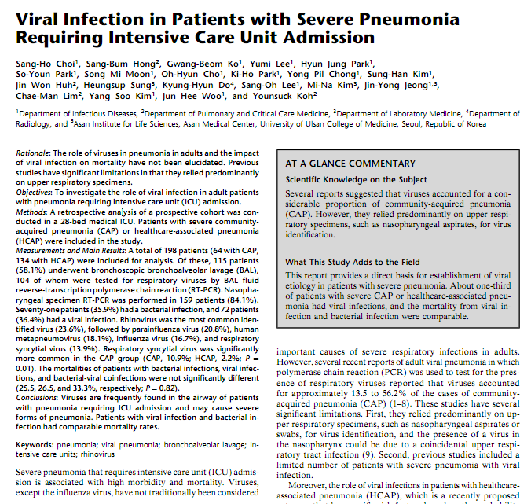
Notes:
AJRCCM 2012.Aug 15
Asan hospital

Slide 25
Study design and patients
FOB&BAL
  bilateral interstitial-pattern pneumonia or pneumonia not responding to empirical antimicrobial therapy for more than 48 to 72 hours.
prospective cohort study conducted
from March 1, 2010 to February 28, 2011.
> 18 years with “severe” CAP and “severe” HCAP
a total of 198 pts (64 pts with CAP, 134 pts with HCAP)
Notes:
Severe pneumonia was diagnosed if there was a require-
ment for invasive mechanical ventilation or septic shock with the need
for a vasopressor

Slide 26
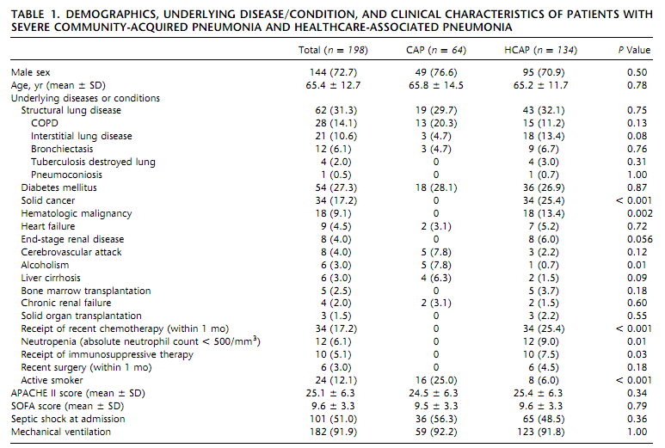

Slide 27
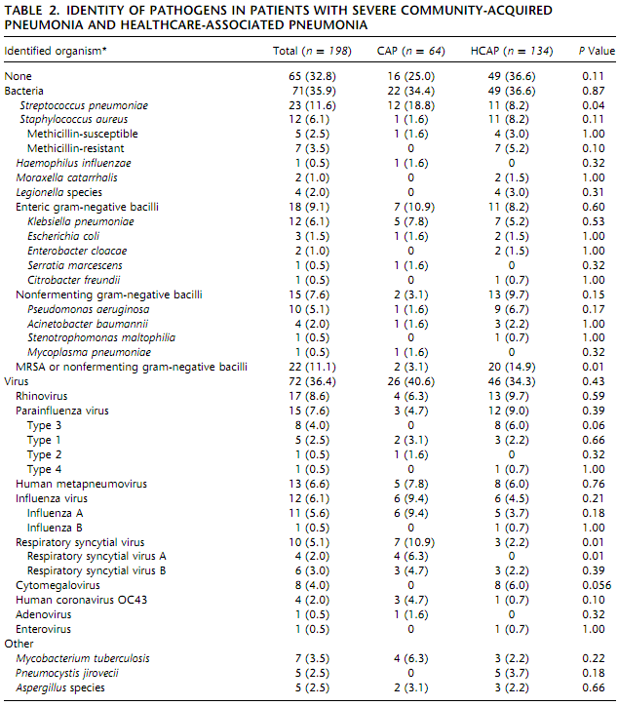

Slide 28
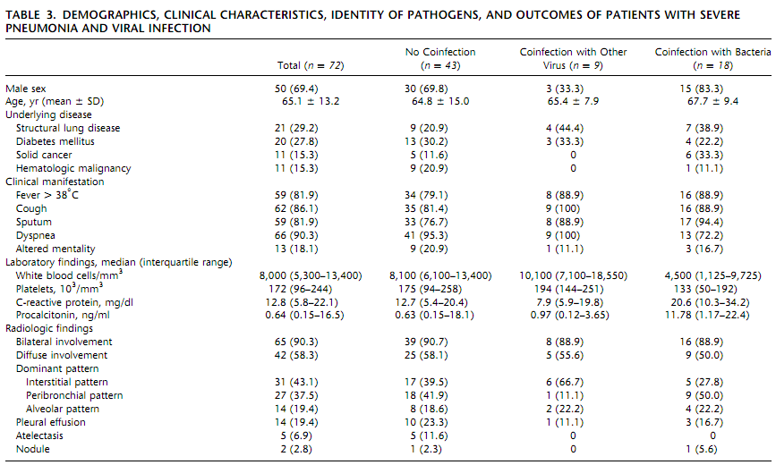

Slide 29
References
1. Ruuskanen O, Lahti E, Jennings LC, Murdoch DR. Viral pneumonia. Lancet 2011;377:1264-1275.
2. Falsey AR, Walsh EE. Viral pneumonia in older adults. Clinical infectious diseases : an official publication of the Infectious Diseases Society of America 2006;42:518-524.
3. Choi SH, Hong SB, Ko GB, Lee Y, Park HJ, Park SY, Moon SM, Cho OH, Park KH, Chong YP, Kim SH, Huh JW, Sung H, Do KH, Lee SO, Kim MN, Jeong JY, Lim CM, Kim YS, Woo JH, Koh Y. Viral infection in patients with severe pneumonia requiring intensive care unit admission. Am J Respir Crit Care Med 2012;186:325-332.

