Slide 1
Castleman's disease,
Pleural effusion in SLE
Ji-Eun Park
Division of Pulmonology
Department of Internal Medicine
Yonsei University College of Medicine

Slide 2
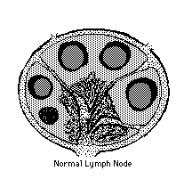
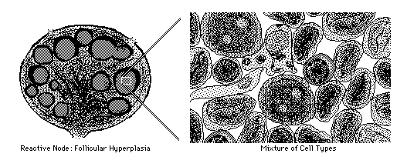
Background (1)
heterogenous group of lymphoproliferative disorders
Follicular hyperplasia of lymph nodes with abnormally increased interfollicular vascularity
Angiofollicular lymph node hyperplasia

Slide 3
Background (2)
Castleman disease is a rare disease in which
the body’s disease-fighting network (lymphatic system)
contains more than required cells (overgrowth of cells).
→ It is also known as giant lymph node hyperplasia
and angiofollicular lymph node hyperplasia.

Slide 4
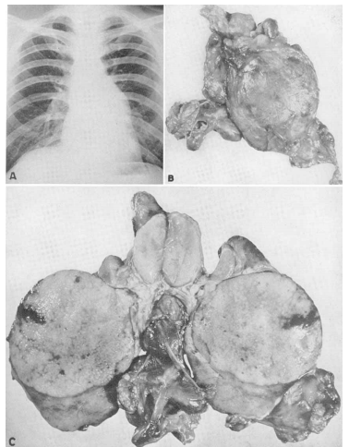
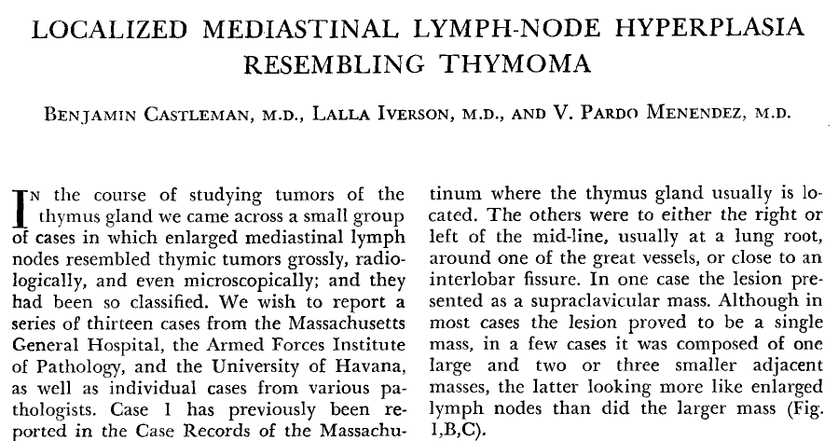
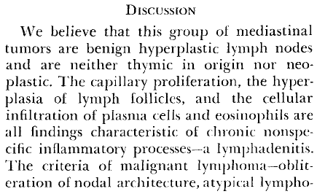
Background (3)
First described by Benjamin Castleman in 1956

Slide 5
Background (4)
All of the patients described in these early papers had localized disease
→ Unicentric Castleman's disease (UCD)
Generalized peripheral lymphadenopathy, hepatosplenomegaly, frequent fevers, night sweats
→ Multicentric Castleman's disease (MCD)
Viral infection: human herpesvirus 8 (HHV-8),
human immunodeficiency virus (HIV)
Malignancies: Kaposi sarcoma, non-Hodgkin lymphoma,
Hodgkin lymphoma, and POEMS syndrome.

Slide 6
Types of Castleman’s disease
Clinically,
Unicentric (localized) vs. Multicentric (widespread)
histopathologically,
Hyaline vascular vs. Plasmacytic vs. Mixed cellularity
HIV + vs. HIV -

Slide 7
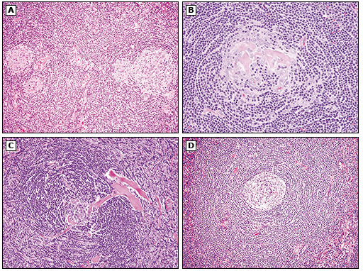
Pathologic features of CD (1)
Hyaline-vascular variant
Hyaline deposits are present within the germinal center
Hyaline vascular ("lollipop") lesion, a follicle is radially penetrated by a sclerotic blood vessel
The follicle is surrounded by a broad mantle zone composed of concentric rings of small lymphocytes (so-called "onion skin")

Slide 8
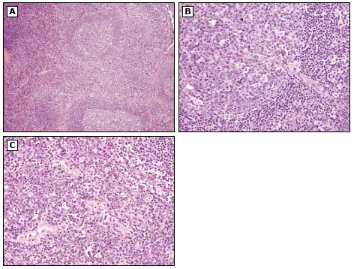
Pathologic features of CD (2)
Plasma cell variant
Reactive lymphoid follicles and interfollicular plasmacytosis are present
the reactive germinal center is radially penetrated by a prominent blood vessel.
Sheets of cytologically mature plasma cells are present within the interfollicular region.

Slide 9
Unicentric Castleman’s disease
Rare, no reliable estimates of its incidence
At any age, generally younger adults (median 35 years)
Male = Female
Hyaline vascular variety: common, asymptomatic
: presents as slow growing solitary mass typically
located in the mediastinum or mesenteries
Plasma cell variety: less common,
: systemic Sx - fever, night sweats, Wt loss

Slide 10
Unicentric Castleman’s disease
Median size: 5.5cm
Sites:
- chest (24~70%)
- abdomen, retroperitoneum and pelvis (10~20%)
- neck (10~20%)
- axilla, groin..
Not associated with progression to malignancy
Treated by surgical resection with excellent results

Slide 11
Multicentric Castleman’s disease(1)
Median age 50-65, younger if HIV+
HIV associated MCD: 8.3 cases/10,000 patient-yrs
Male > Female
Plasmacytic type or mixed cellularity variety
Widespread lymphadenopathy, Hepatosplenomegaly
systemic symptoms
: fatigue, fever, Wt loss, night sweats, severe peripheral
edema, anemia, hypoalbuminemia, peripheral neuropathy
HHV-8 infection, overproduction of IL-6

Slide 12
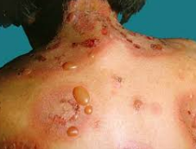
Multicentric Castleman’s disease(2)
Anemia, thrombocytosis, hypoalbuminemia, polyclonal hypergammaglobulinemia
ESR, IL-6, VEGF, LDH, and CRP ↑
Can be associated with
  Autoimmune hemolytic anemia
  Multiple myeloma
  Amyloidosis
  Pemphigus
  POEMS (polyneuropathy, organomegaly, endocrinopathy, monoclonal gammopathy, skin changes)
Rapidly progressive form can lead to death within weeks
Chronic persistent form with relapses is more common

Slide 13
HIV association
More likely to be associated with MCD
More likely to be caused by HHV-8
Tend to pursue an acute course
Poor prognosis and progression to malignancy
Initiation of HAART may lead to fulminant MCD

Slide 14
Role of HHV-8
HHV-8 + in significant number of MCD
HHV-8 is universally found in HIV+ MCD, but only in 40-50% of HIV- MCD
HHV-8 infected immunoblasts are highly proliferative and may coalesce to form so-called “microlymphomas”, or develop into frank lymphoma
It is hypothesized that the hyperproliferative state induced by HHV-8 permits the accumulation of new mutations in the genomes of the infected B immunoblasts.

Slide 15
Role of IL-6
Possible link between overexpression of IL-6 to the systemic manifestations of both UCD and MCD
HHV-8 expresses a viral IL-6 gene that activates the human IL-6 receptor
This can induce proliferation of human myeloma cell lines
→ Treatment with antibodies that specifically inhibit
human IL-6 can result in the resolution of the
systemic symptoms and hypergammaglobulinemia
of MCD

Slide 16
Malignancy
Kaposi’s sarcoma: up to 70% in HIV+/HHV+
Non-Hodgkin’s lymphoma: 15-20% of patients
Hodgkin’s lymphoma: both MCD & UCD
POEMS syndrome
: polyneuropathy, organomegaly, endocrinopathy,
monoclonal gammopathy, and skin changes

Slide 17
Treatment
No standard therapy and clinical practice varies
Depends upon whether HIV/HHV-8 positive?
  Steroids: 15-20%, not in HIV+
  Antiviral agent: acyclovir, ganciclovir, foscarnet
  – in HIV+ and HHV-8+
  Rituximab: anti-CD20 monoclonal Ab
  → complete remission in few cases
  CHOP or CVAD: 90%
  * cyclophosphamide, doxorubicin, vincristine, prednisone
  ** cyclophosphamide, vincristine, doxorubicin, dexamethasone
  Anti-IL 6 or Anti-IL6 receptor antibody

Slide 18
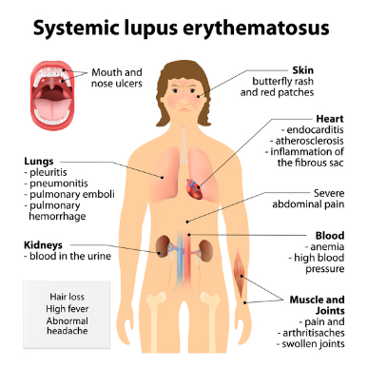
Pulmonary manifestations of SLE
Pleural disease
: pleural effusion, pneumothorax, fibrothorax
Acute pneumonitis
Pulmonary hemorrhage
Interstitial lung disease
Thromboembolic disease
Pulmonary hypertension
Shrinking lung syndrome

Slide 19
Pleural effusion in SLE
Pleural involvement is common, 93% (autopsy)
Bilateral (50%) / Exudative / LDH↑
Clear, serous, sero-sanguineous, bloody
Exclusion of other causes
: drug induced pleuritis, infection, heart failure, nephrotic
syndrome, uremia or malignancy
→ Hx taking, P/E: flare of SLE vs. other causes
ANA+ in pleural fluid
→ no additional diagnostic information
* if sufficient pleural fluid is present,
→ exudative? Microbiologic and Cytologic analysis

Slide 20
Pleural effusion in SLE
Treatment
  NSAIDs
  : contraindicated by GI trouble, renal disease,
  heart failure
  → if no response within 1-2 weeks,
  Systemic glucocorticoids
  (eg. Prednisone 20mg/d, by a taper over 2-3 weeks)
  Immunosuppressive agents: rarely indicated

Slide 21
Review
Antinuclear antibody testing in pleural fluid for the diagnosis of lupus pleuritis. - Porcel JM et al, Lupus, 2007
  266 patients with effusions
  ANA, dsDNA, extractable nuclear antigens(ENA) on pleural fluid
  ANA staining patterns in pleural fluid did not help to discriminate lupus pleuritis from non-lupus etiologies.
Usefulness of pleural effusion antinuclear antibodies in the diagnosis of lupus pleuritic
- C Toworakul et al, Lupus, 2011
  A prospective study of 54 patients with pleural effusion (12 lupus pleuritis, seven parapneumonic effusion, 26 malignancy-associated pleural effusions, nine transudative effusions) was performed.
  the pleural effusion ANA at a titer of ≥1 : 160 is a sensitive and specific diagnostic biomarker for lupus pleuritis in patients with lupus. However, pleural effusion ANA can occasionally be found in other conditions.

Slide 22
Review
Characteristics of pleural effusions in systemic lupus erythematosus: differential diagnosis of lupus pleuritic - BY Choi et al, Lupus, 2014
  A prospective analysis of 17 SLE patients with pleural effusion. 30 non-SLE patients with pleural effusion (control)
  pleural fluid ANA titer and serum CRP levels are significantly increased in lupus pleuritis.

Slide 23
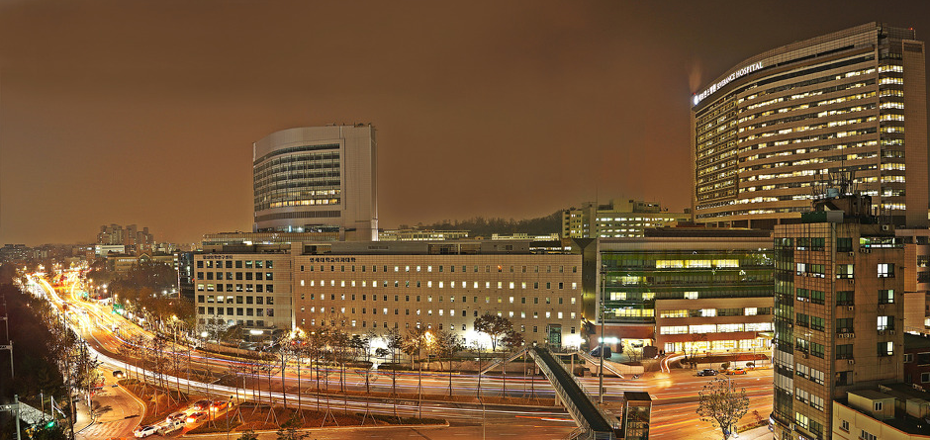
Thank you for your attention

