Slide 1
Cystic lung disease
Eun Hye Lee
Division of Pulmonology
Department Of internal medicine
Yonsei University College of Medicine

Slide 2
Cystic lung diseases
23
Cystic Lung Diseases: Algorithmic Approach
  Raoof S¹, Bondalapati P², Vydyula R³, Ryu JH⁴, Gupta N⁵, Raoof S⁶, Galvin J⁷, Rosen MJ⁸, Lynch D⁹, Travis W¹⁰, Mehta S¹¹, Lazzaro R¹², Naidich D¹³. Chest. 2016 Oct;150(4):945-965
Multiple cystic lung disease
  Ferreira Francisco FA¹, Soares Souza A Jr², Zanetti G¹, Marchiori E³. Eur Respir Rev. 2015 Dec;24(138):552-64

Slide 3
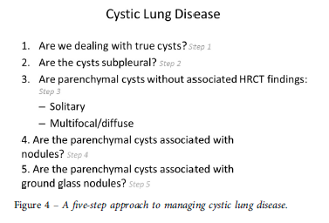
22
Cystic Lung Diseases: Algorithmic Approach Chest, Volume 150, Issue 4, 2016, 945–965
Notes:
Suhail Raoof, Praveen Bondalapati, Ravikanth Vydyula, Jay H. Ryu, Nishant Gupta, Sabiha Raoof, Jeff Galvin, Mark J. Rosen, David Lynch, William Travis, Sanjeev Mehta, Richard Lazzaro, David Naidich

Slide 4
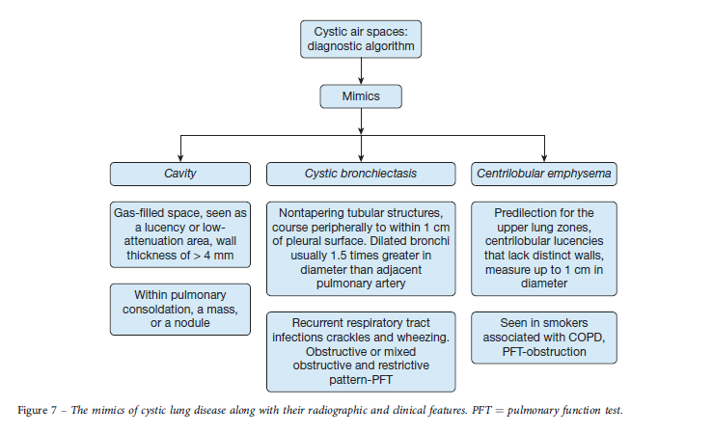
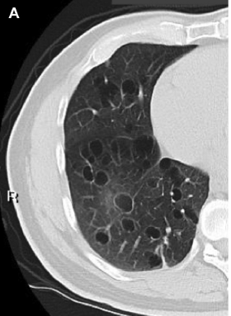
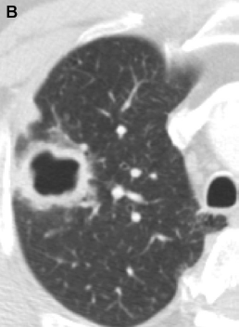
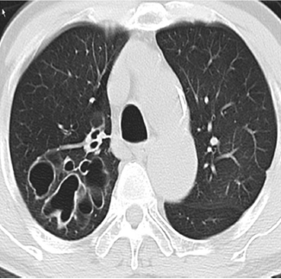
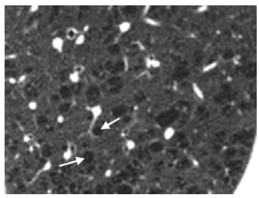
Step 1: Are There True Cystic Lesion(s)?
21
Cystic Lung Diseases: Algorithmic Approach Chest, Volume 150, Issue 4, 2016, 945–965
Notes:
Figure 1 – A, True cysts: Round parenchymal lucencies surrounded by distinct wall < 2 mm in thickness, exhibiting a well-defined interface with
normal lung tissue. Cysts may be seen in otherwise normal individuals but may occur in association with other lung diseases.
B, Cavity. This is a gas-filled space, seen as a lucency or low-attenuation area, with a wall thickness > 4 mm. It is seen within pulmonary consolidation, a mass, or nodule.
Figure 8 – Centrilobular emphysema. These lucencies demonstrate a predilection for the upper lung zones. Centrilobular lucencies are seen that lack distinct walls and measure up to 1 cm in diameter. The lucencies may have a dot in the center, representing a branch of pulmonary artery.
Cavity : Gas-filled space, seen as a lucency or lowattenuation area, wall thickness of > 4 mm , Within pulmonary consoldation, a mass, or a nodule
Cystic bronchiectasis : typically associated with bronchial dilation adjacent to the accompanying pulmonary artery (“signet-ring sign”), absence of
tapering of bronchi, and identification of bronchi within 1 cm of the pleural surfaces. There may be accompanying bronchial wall thickening,tree-in-bud opacities, and a mosaic pattern
opacities, and a mosaic pattern
Bronchiectatic cysts display the signet ring or Cabochon ring sign due to an accompanying artery in their wall
Centrilobular emphysema : centrilobular lucencies that lack distinct walls, measure up to 1 cm in diameter, and have a predilection for the upper lung zones (Fig 8). Many of these luciencies exhibit a central dot that is a branch of the pulmonary artery within the secondary lobule
Honeycombing results from advanced and irreversible fibrotic lung disease that may lead to cysts that are typically 3 to 10 mm in diameter, clustered (the walls of the cyst abut each other), with thick walls
(1-3 mm or larger), and with architectural distortion and reticulation of intervening lung

Slide 5
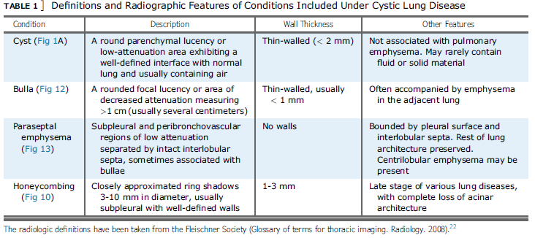
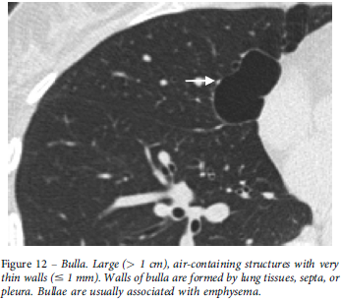
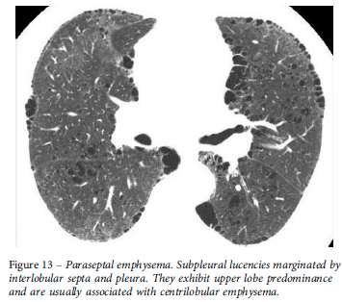
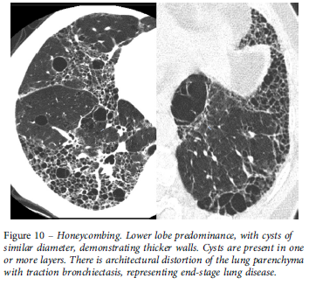
Step 2: Are the Cysts Located in the Subpleural Areas?
20
Cystic Lung Diseases: Algorithmic Approach Chest, Volume 150, Issue 4, 2016, 945–965
Notes:
Cavity : Gas-filled space, seen as a lucency or lowattenuation area, wall thickness of > 4 mm , Within pulmonary consoldation, a mass, or a nodule
Cystic bronchiectasis : Nontapering tubular structures, course peripherally to within 1 cmof pleural surface. Dilated bronchi usually 1.5 times greater in diameter than adjacent pulmonary artery
subpleural areas (Fig 11). If so, the differential diagnosis includes bullae (mostly > 1 cm in diameter or paraseptal emphysema and honeycombing (usually < 1 cm diameter).
Bullae: A bulla is a rounded focal lucency or area of decreased attenuation > 1 cm in diameter, bounded by a
thin, almost imperceptible wall. Emphysematous spaces and bullae usually have an imperceptible wall and occasionally central vessels.
Paraseptal Emphysema: This subtype of emphysema involves distal alveoli, including alveolar ducts and sacs (Fig 13).
Honeycombing: This results from advanced fibrotic lung disease and may lead to cysts that are typically uniform in size (3-10 mm diameter), clustered (the walls of the cysts abut each other) with thick walls (1-3 mm or larger). multilayered or multi-tiered.

Slide 6
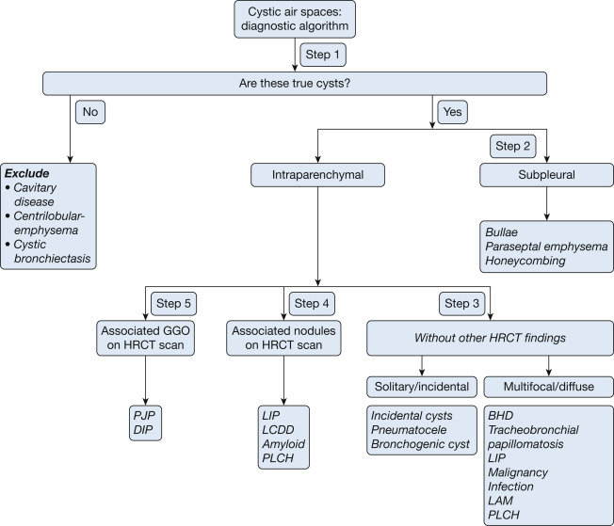
Step 3: Are Cysts Detected in Lung Parenchyma Without Other Radiographic Abnormalities?
19
Cystic Lung Diseases: Algorithmic Approach Chest, Volume 150, Issue 4, 2016, 945–965
Notes:
Figure 6 – Detailed algorithmic approach to cystic lung disease. It is important to exclude mimics of cystic lung disease before proceeding with the actual
algorithm. BHD ¼ Birt Hogg Dube syndrome; DIP ¼ desquamative interstitial pneumonia; HRCT ¼ high-resolution CT scan; LAM ¼ lymphangioleiomyomatosis;
LCDD ¼ light-chain deposition disease; LIP ¼ lymphoid interstitial pneumonia; PJP ¼ pneumocystis jirovecii pneumonia;
PLCH ¼ pulmonary Langerhans cell histiocytosis.

Slide 7
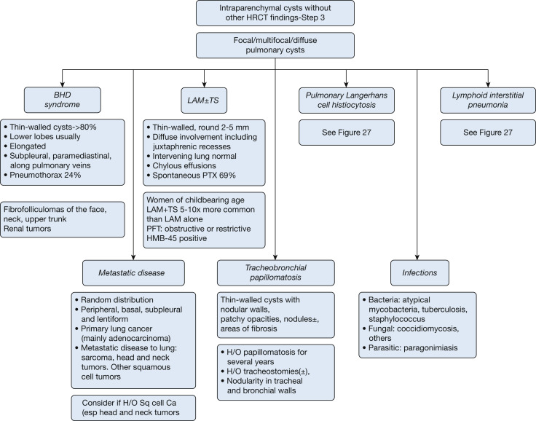
Step 3: Are Cysts Detected in Lung Parenchyma Without Other Radiographic Abnormalities?
18
Cystic Lung Diseases: Algorithmic Approach Chest, Volume 150, Issue 4, 2016, 945–965
Notes:
Figure 18 – Algorithmic approach to intraparenchymal cysts–multiple. See Figure 6 and 7 legends for expansion of abbreviations.

Slide 8
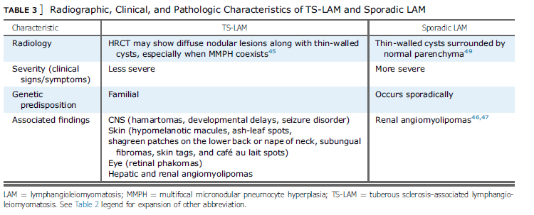
Lymphangioleiomyomatosis
17
slowly progressive lung disease
primarily affects women of reproductive age
sporadically (S-LAM) or with tuberous sclerosis complex (TSC).
TSC : autosomal-dominant neurocutaneous syndrome characterised by hamartoma formation in multiple organ systems, cerebral calcification, seizures, and cognitive defects
TSC-LAM : 5–10 times more common than S-LAM
Cystic Lung Diseases: Algorithmic Approach Chest, Volume 150, Issue 4, 2016, 945–965

Slide 9
Lymphangioleiomyomatosis
16
Clinical symptoms
  Most patients, pulmonary manifestations : progressive dyspnea, chest pain, cough, wheezing, and recurrent pneumothorax, which occurs in up to 40–50%
  Lymphatic abnormality is common in S-LAM due to lymphatic obstruction
  can lead to interstitial septal thickening, chylous pericardial or pleural effusion, thoracic and abdominal lymphadenopathy, thoracic duct enlargement
  Non-lymphatic extrathoracic features : hepatic and renal angiomyolipoma, as well as meningioma. Renal angiomyolipoma is the most common
Dignosis :
  Biopsy is the gold standard
  Histopathology : characterised by nodules or small clusters of smooth muscle cells (LAM cells) near cystic lesions and around terminal bronchioles, alveolar walls, pulmonary vessels, and lymphatics
  eosinophilic cytoplasm, appear spindle-shaped, stain with HMB-45
  terminal bronchiole obstruction by LAM cells with associated air trapping : cause progressive dilatation of the distal airspaces leading to cyst formation

Slide 10
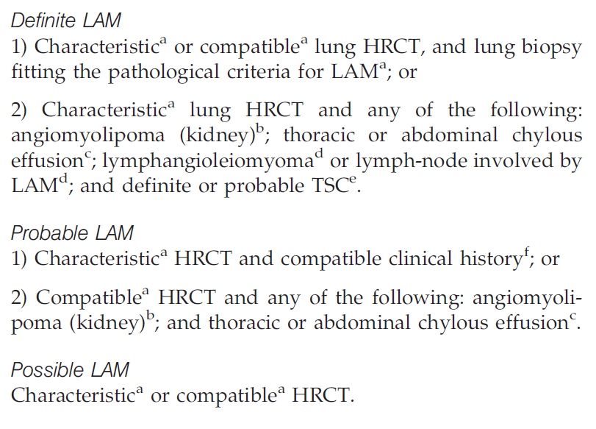
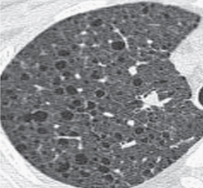
Lymphangioleiomyomatosis
15
Dignosis :
  ERS dignostic guidelines : classified as definite, probable or possible
  Cysts in LAM : typically thin walled, multiple, well circumscribed, diffusely throughout the lungs with normal intervening lung, without lobar predominance
  Characteristic HRCT appearance requires multiple (>10) thin-walled cysts with normal or increased lung volumes, with no other significant interstitial abnormality
  Compatible HRCT findings are defined by the appearance of fewer (>2 but <10) typical cysts
  VEGF-D levels >800 pg·mL⁻¹ and the presence of pulmonary cysts on imaging : specific for S-LAM and identify LAM in females with TSC
Eur Respir J. 2010 Jan;35(1):14-26.
European Respiratory Society guidelines for the diagnosis and management of lymphangioleiomyomatosis
Notes:
a) As defined below.
b) Diagnosed by characteristic CT features and/or on pathological examination.
c) Based on visual and/or biochemical characteristics of the effusion.
d) Based on pathological examination.
e) See appendix 2 (available in the online supplementary material; www.erj.ersjournals.com)
f) Compatible clinical features include pneumothorax (especially multiple and/or bilateral) and/or altered lung function
tests as in LAM.

Slide 11
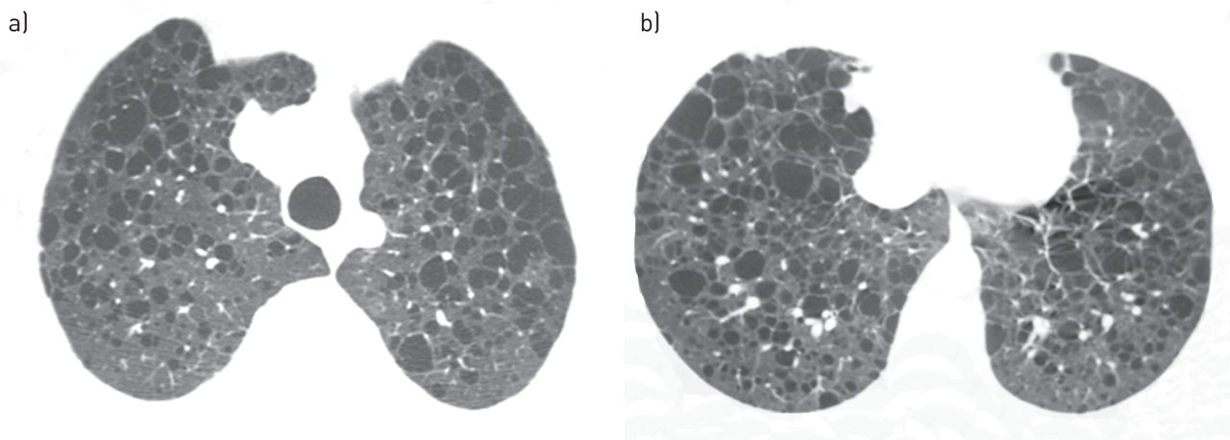
14
A 38-year-old woman with lymphangioleiomyomatosis
Flavia Angélica Ferreira Francisco et al. Eur Respir Rev 2015;24:552-564
Notes:
FIGURE 1 A 38-year-old woman with lymphangioleiomyomatosis. High-resolution computed tomography
scans of a) upper and b) lower lobes show multiple thin-walled cysts distributed symmetrically throughout
both lungs, with normal intervening lung parenchyma.

Slide 12
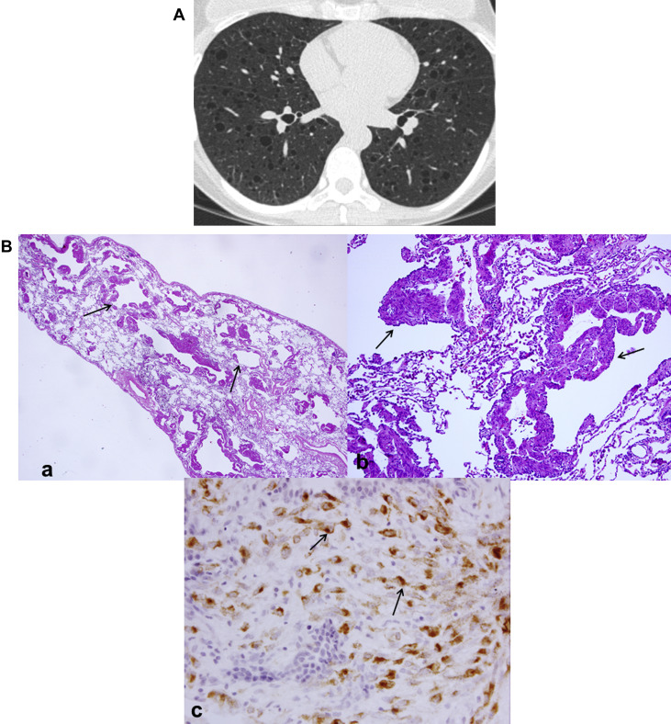
13
Lymphangioleiomyomatosis
Cystic Lung Diseases: Algorithmic Approach Chest, Volume 150, Issue 4, 2016, 945–965
Notes:
Figure 24 – A, Lymphangioleiomyomatosis (LAM). Thin-walled round (2-5 mm) cysts usually involve juxtaphrenic recesses and spare the extreme
apices. The intervening lung between cysts is normal. B, LAM pathologic findings. (a) Low power histology shows multiple cysts surrounded by bundles
of smooth muscle. (b) Surrounding cystic spaces are nodules of haphazardly arranged smooth muscle bundles. (c) HMB-45 immunohistochemistry
shows positive cytoplasmic staining of the LAM cells.

Slide 13
Lymphangioleiomyomatosis
12
Prognosis
  Progressive lung disease with a poor long-term prognosis
  Patients diagnosed at younger ages tend to have more aggressive courses
Treatment
  Mutations in the TSC genes lead to the activation of mammalian target of rapamycin kinase (mTOR), resulting in proliferation of LAM cells.
  mTOR inhibitor sirolimus (rapamycin) appears to be the most effective drug
  Lung transplantation is an option for patients with severe impairment
Notes:
a) As defined below.
b) Diagnosed by characteristic CT features and/or on pathological examination.
c) Based on visual and/or biochemical characteristics of the effusion.
d) Based on pathological examination.
e) See appendix 2 (available in the online supplementary material; www.erj.ersjournals.com)
f) Compatible clinical features include pneumothorax (especially multiple and/or bilateral) and/or altered lung function
tests as in LAM.

Slide 14
Folliculin gene-associated syndrome (FLCN-S)
(Birt–Hogg–Dubé syndrome)
11
Autosomal dominant, multi systemic disorder
Typically third or fourth decade of life, reported 20-85 years
No gender predominance
Characterized by cutaneous fibrofolliculomas, multiple lung cysts, spontaneous pneumothorax, and renal cancer
Common presentation : skin lesions and a history of recurrent and familial pneumothorax (occur in ∼35% of patients)
renal findings : tend to be bilateral and multifocal; range from benign oncocytomas to malignant renal carcinomas

Slide 15
Folliculin gene-associated syndrome (FLCN-S)
(Birt–Hogg–Dubé syndrome)
10
Cyst : thin-walled cysts in > 80% patients, predominantly seen in peripheral lung zones at lung bases and along the mediastinum, less in number compared with LAM
Folliculin : tumor-suppressor protein, highly expressed in the stromal cells and type I pneumocytes of the lungs, skin and kidneys
  mutations in the gene leading to abnormal mesodermal development.
Diagnosis : mutation in the FLCN gene and the presence of multiple lung cysts and/or characteristic skin lesions and/or malignant kidney tumor
Treatment : No specific therapy for this cystic lung disease is currently available.
Prognosis : based on comorbidities, such as renal cell carcinoma or pneumothorax, rather than on the lung cysts.

Slide 16
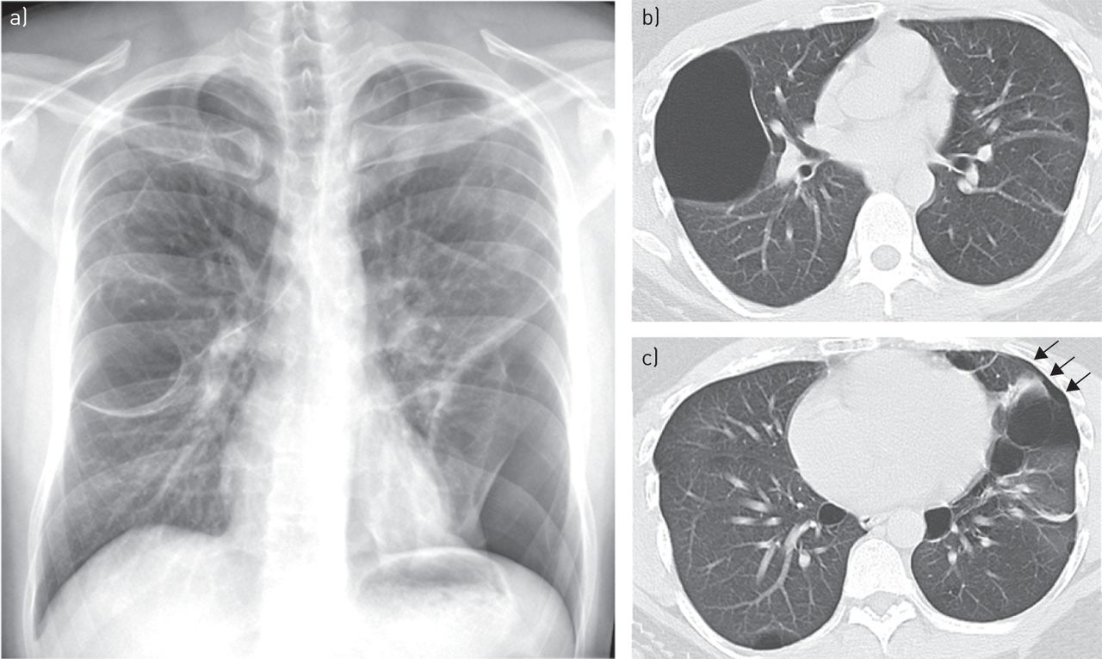
A 33-year-old man with Folliculin gene-associated syndrome (FLCN-S)
(Birt–Hogg–Dubé syndrome)
9
Flavia Angélica Ferreira Francisco et al. Eur Respir Rev 2015;24:552-564
Notes:
FIGURE 3 A 33-year-old man with folliculin gene-associated syndrome (Birt–Hogg–Dubé syndrome). a) A
chest radiograph shows bilateral bullous formation with left basal pneumothorax.
b, c) High-resolution computed tomography performed 1 week later demonstrates thin-walled cysts of varying sizes in both lungs,
some with a lentiform shape, with characteristic lower lung zone distribution. A small residual left pneumothorax (arrows) is also present.

Slide 17
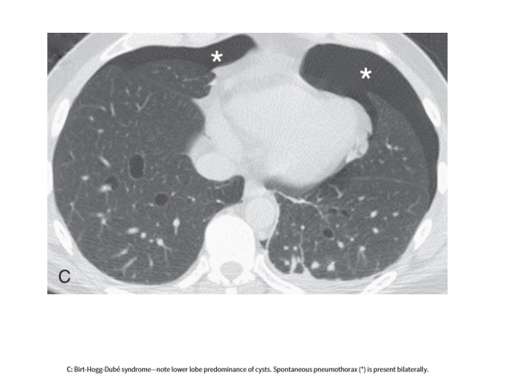
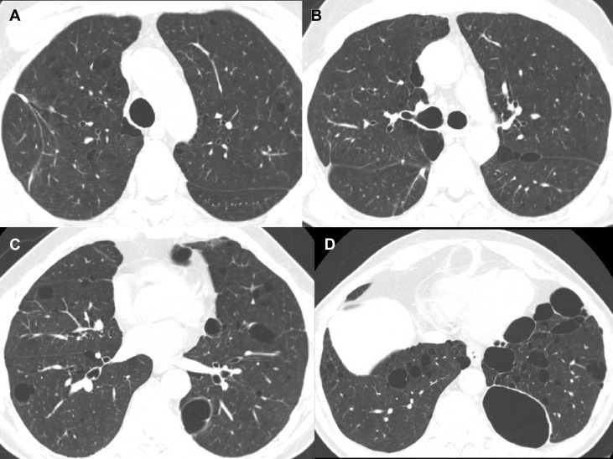
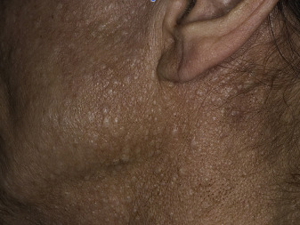
Folliculin gene-associated syndrome (FLCN-S)
(Birt–Hogg–Dubé syndrome)
8
Cystic Lung Diseases: Algorithmic Approach Chest, Volume 150, Issue 4, 2016, 945–965
Notes:
Figure 20 – A-D, Axial CT chest images of a patient with Birt-Hogg-Dubé (BHD) syndrome. Multiple, thin-walled cysts are seen in approximately
80% of patients. These cysts are distributed predominantly in the peripheral lung zones, at lung bases, and along the mediastinum. These are less in
number generally, compared with those seen in lymphangioleiomyomatosis (LAM).
Figure 19 – Fibrofolliculomas (dome shaped, whitish papules) of the
face, neck and upper trunk are seen in Birt-Hogg-Dubé (BHD)
syndrome.

Slide 18
Pulmonary Langerhans Cell Histiocytosis
7
Young adults, between the ages of 20 and 40 years , reported range of 1–69 years
No gender predominance
90–100% of patients are smokers, often smoking >20 cigarettes per day
Histologically, peribronchiolar infiltration by Langerhans cells and formation of granulomas, leading to stellate nodule formation. These stellate nodules can later cavitate, resulting in bronchial dilatation and formation of thin- and then thick-walled cysts and cavities.
Most are asymptomatic, cough and dyspnea, pneumothorax (occur in about 15% of patients)
PLCH in adults is usually a single-system disease
Extra pulmonary manifestations : Bone lesions (<20% of patients) diabetes insipidus resulting from infiltration of the posterior pituitary (5% of patients), pain due to skeletal involvement and skin rashes

Slide 19
Pulmonary Langerhans Cell Histiocytosis
6
CT findings reflect the temporal heterogeneity of the disease
Early phases : a predominantly nodular pattern
Later phases : thin-walled cysts
main imaging feature is a combination of nodular and cystic lesions
Nodules and cysts :
  Cyst : thick, irregular walled, bizzare-shaped
  more numerous in the upper lobes than in the lower lung zones
  costophrenic angles, lung bases, and anterior tips of the right middle lobe and lingular are typically spared
Highly likely PLCH : young smoker with pulmonary nodules and cysts showing an upper lobe distribution

Slide 20
Pulmonary Langerhans Cell Histiocytosis
5
Definitive diagnosis of PLCH requires identification of Langerhans cell granulomas, which is usually achieved by surgical lung biopsy
Pathology : destruction of the distal bronchioles with poorly formed granulomas comprised of predominantly Langerhans cells. Langerhans cells stain positive with S-100, although this stain is not specific to them
Complete remission of PLCH may occur on smoking cessation
Smoking cessation is the only therapeutic intervention. otherwise, no effective treatment is available
Cladribine (2-chlorodeoxyadenosine), a synthetic purine analogue chemotherapeutic agent, reported to be effective in several cases of progressive PLCH
A number of patients with very severe respiratory failure or major pulmonary hypertension have been treated with lung transplantation

Slide 21
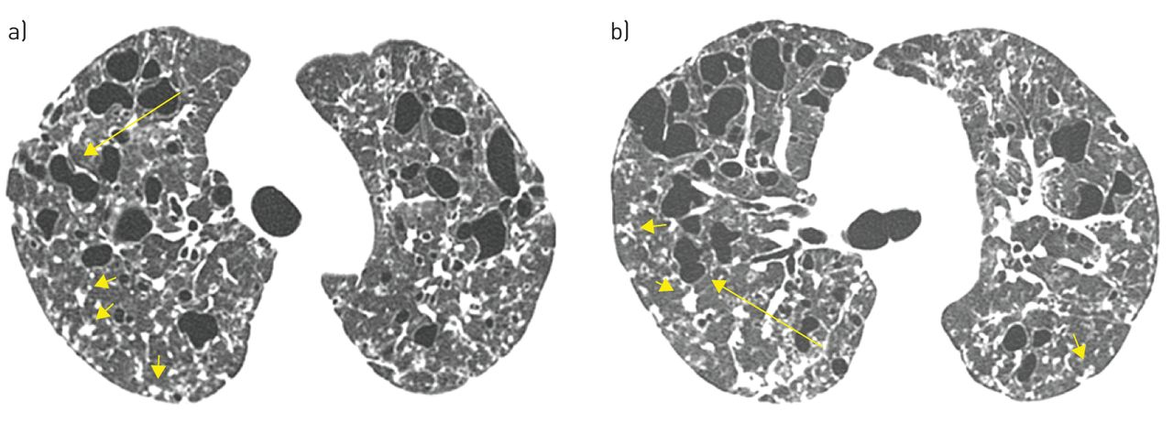
4
A 27-year-old man with pulmonary Langerhans cell histiocytosis
Flavia Angélica Ferreira Francisco et al. Eur Respir Rev 2015;24:552-564
Notes:
FIGURE 2 A 27-year-old man with pulmonary Langerhans cell histiocytosis. High-resolution computed
tomography scans of a) upper and b) middle lung regions show multiple thin-walled cysts, some with
irregular shapes (arrows), in both lungs. Multiple small nodules (short arrows) are also present.

Slide 22
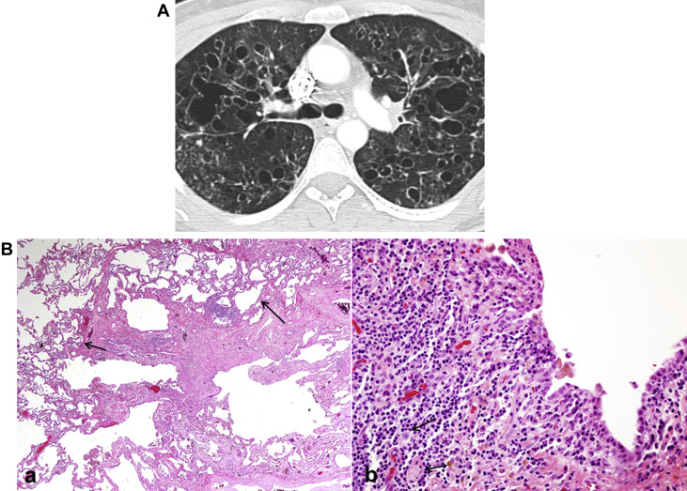
3
pulmonary Langerhans cell histiocytosis
Cystic Lung Diseases: Algorithmic Approach Chest, Volume 150, Issue 4, 2016, 945–965
Notes:
Figure 25 – A, Pulmonary Langerhans cell histiocytosis. Generally seen in young smokers (most commonly between 20 and 40 years of age). Cysts are
seen predominantly in upper and middle lobes, are variable in size, are thick- or thin-walled, and have bizarre shapes. The costophrenic angles are
spared. The intervening lung parenchyma exhibits architectural distortion. B, Langerhans cell histiocytosis pathologic findings. (a) Low-power histology
shows a stellate nodule composed of fibrosis with some cellular infiltrates. At the edges of the fibrotic scar is paracicatricial emphysema, giving some
cystic appearance. (b) High-power shows a cellular proliferation of Langerhans cells.

Slide 23
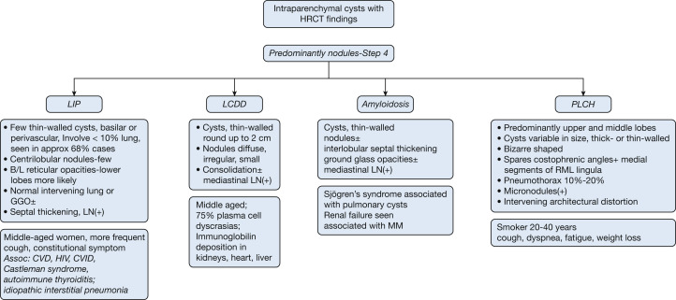
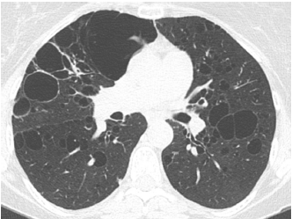
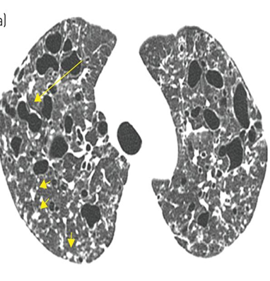
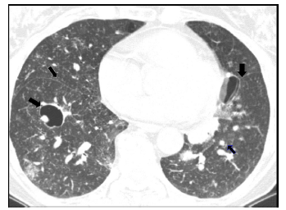
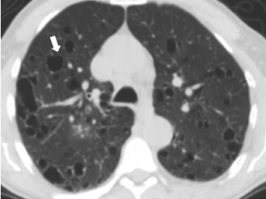
Step 4: Are the Lung Parenchymal Cysts Associated With Nodules?
2
Cystic Lung Diseases: Algorithmic Approach Chest, Volume 150, Issue 4, 2016, 945–965
Notes:
Figure 21 – Lymphoid interstitial pneumonia. Cysts are thin-walled, random in distribution, and typically involve < 10% of lung parenchyma.
Note the scattered foci of increased lung density in close proximity to the medial aspect of a cyst in the right lower lobe (solid black arrow).
There are multiple small nodules. The thin black arrow on the right side shows these nodules in the fissure.
Figure 28 – A, Light-chain deposition disease (LCDD). Cysts are thin-walled, round, and may reach up to 2 cm in diameter (white arrow). Associated
nodules are diffuse, irregular, and small. Consolidation of lung parenchyma may be present, as well as associated mediastinal lymphadenopathy. B,
LCDD pathologic findings. (a) Low power shows a subpleural cystic area. (b) Focally in the wall of one of the cysts is a nodular focus of amorphous
eosinophilic material characteristic of LCDD (black arrow).
Figure 29 – Amyloidosis. Cysts are thin-walled with or without nodules.
Interlobular septal thickening may be prominent. Ground-glass opacities
can be seen, along with associated mediastinal lymphadenopathy.

Slide 24
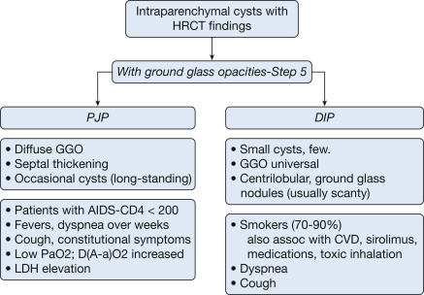
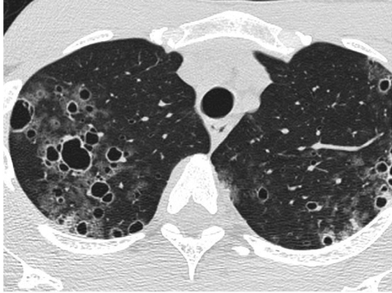
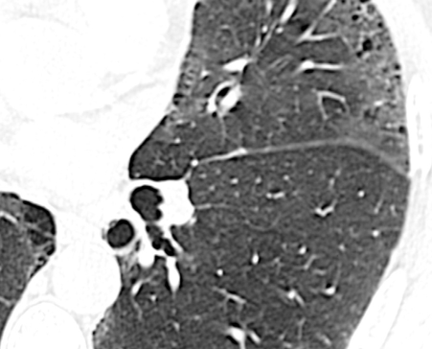
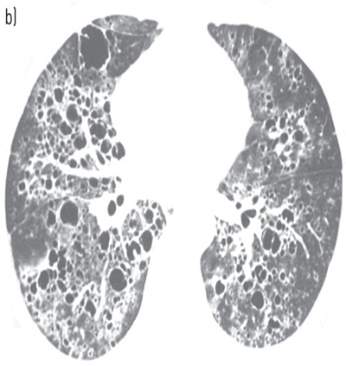

Step 5: Are Cysts Associated With Ground-Glass Opacities?
1
Cystic Lung Diseases: Algorithmic Approach Chest, Volume 150, Issue 4, 2016, 945–965
Notes:
Figure 32 – A, Pneumocystis jirovecii: Diffuse ground glass opacities with septal thickening and occasional cysts (long-standing). B, P jirovecii pathologic
findings. (a) Low- power histology from a case of long-standing P jirovecii pneumonia shows cystic spaces surrounded by thickened fibrotic walls containing
some calcification. (b) High power of GMS (Gomori methenamine silver) stain shows characteristic cysts of P jirovecii with darkly stained foci.
FIGURE 5 A 37-year-old man with Pneumocystis jiroveci pneumonia. High-resolution computed tomography
scans of a) upper and b) lower lobes demonstrate thin-walled cysts associated with ground-glass opacities
distributed throughout both lungs.
Figure 31 – Desquamative interstitial pneumonia (DIP). Ninety percent
of cases of DIP are seen in smokers. Small cysts are seen in the milieu of
universal ground-glass opacities and scanty ground-glass nodules.

Slide 25
Reference
Chest. 2016 Oct;150(4):945-965. doi: 10.1016/j.chest.2016.04.026. Epub 2016 May 13. Cystic Lung Diseases: Algorithmic Approach. Raoof S¹, Bondalapati P², Vydyula R³, Ryu JH⁴, Gupta N⁵, Raoof S⁶, Galvin J⁷, Rosen MJ⁸, Lynch D⁹, Travis W¹⁰, Mehta S¹¹, Lazzaro R¹², Naidich D¹³.
Eur Respir Rev. 2015 Dec;24(138):552-64. doi: 10.1183/16000617.0046-2015. Multiple cystic lung disease. Ferreira Francisco FA1, Soares Souza A Jr2, Zanetti G1, Marchiori E3.
Eur Respir J. 2010 Jan;35(1):14-26. doi: 10.1183/09031936.00076209. European Respiratory Society guidelines for the diagnosis and management of lymphangioleiomyomatosis. Johnson SR1, Cordier JF, Lazor R, Cottin V, Costabel U, Harari S, Reynaud-Gaubert M, Boehler A, Brauner M, Popper H, Bonetti F, Kingswood C; Review Panel of the ERS LAM Task Force.

Slide 26


