Slide 1
Solitary Fibrous Tumor
Eun Hye Lee
Division of Pulmonology
Department Of internal medicine
Yonsei University College of Medicine

Slide 2
Solitary Fibrous Tumor (SFT)
DEFINITION
CLINICAL PRESENTATION
DIAGNOSIS
TREATMENT & PROGNOSIS

Slide 3
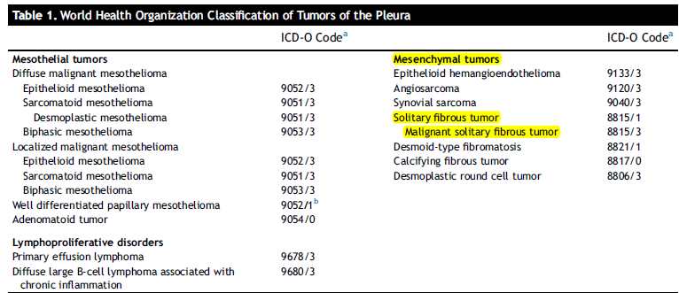
Solitary Fibrous Tumors of the pleura (SFTP)
Fibroblastic mesenchymal tumor , first described in the pleura
Primary tumors of the pleura : diffuse (Mesothelioma) and localized tumors
localized tumors : lack expression of cytoplasmic keratins (epithelial marker)
Express vimentin, a marker of mesenchymal cells
Express CD34 observed in interstitial spindle cells involved in antigen presentation
Solitary (localized) fibrous tumors of the pleura (SFTP)
Rare, slow-growing neoplasms less than 5% of all pleural neoplasm
Notes:
membrane composed of simple squamous cells that forms the lining of several body cavities: the pleura, peritoneum, mediastinum and pericardium.
Mesothelium is the epithelial component of serosa, it is form of simple squamous epithelium!! -> cytokeratin +

Slide 4
Solitary Fibrous Tumor (SFT)
Rarely metastasizing, commonly intrathoracic tumors
Recently been reported in extrathoracic sites
30 % : in the thoracic cavity (including pleura, lungs, and mediastinum)
30 % : peritoneal cavity, retroperitoneal soft tissue, or pelvis (including visceral sites)
20 % : head and neck (including the meninges)
Notes:
2015 WHO classification : tumor of the pleura

Slide 5
Solitary Fibrous Tumor (SFT)
EPIDEMIOLOGY AND RISK FACTORS
True incidence is difficult to ascertain
Rare, less than 2 percent of all soft tissue tumors
only 900 cases were reported in the literature up to 2005
Pleural SFTs (solitary fibrous tumors of the pleura (SFTP) → less than 5 percent of all tumors arising from the pleura
Most common in the fifth to seventh decades
Men and women are affected with equal frequency.
No known association with environmental exposure to radiation, tobacco, asbestos, or other toxicants, and no known inherited, predisposing risk factors.

Slide 6
Solitary Fibrous Tumors of the pleura (SFTP)
CLINICAL PRESENTATION
50% of the patients with SFTP are asymptomatic
50 %, nonspecific pulmonary symptoms, cough, shortness of breath, or chest pain, hemoptysis and obstructive pneumonitis
Digital clubbing and hypertrophic pulmonary osteoarthropathy (Pierre-Marie-Bamberg syndrome) : 10% ~ 20% of patients with either benign or malignant SFTP, an abnormal production of hepatocyte growth factor or an excessive release of hyaluronic acid by the tumor
Less than 5% : secrete insulin-like growth factor II, causes refractory hypoglycemia (Doege-Potter syndrome)

Slide 7
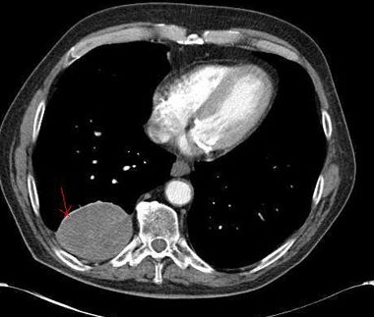
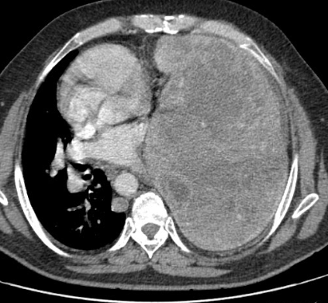
Solitary Fibrous Tumors of the pleura (SFTP)
DIAGNOSIS
Imaging findings
  well-defined, rounded, homogeneous mass , occasionally lobulated mass
  typically appear in contact with the pleural surface
  tend to displace rather than invade surrounding tissues
  pedicle is present in 40 percent of cases resulting in change in shape or location
  enhance after contrast administration

Slide 8
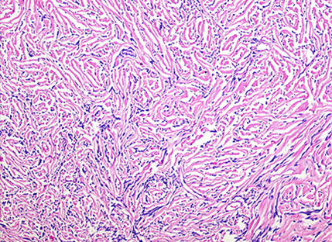
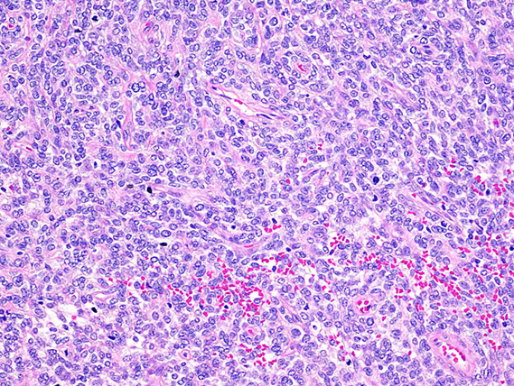
Solitary Fibrous Tumors of the pleura (SFTP)
DIAGNOSIS
Histopathology
  Complete resection is required for full histopathologic evaluation
  Fine needle aspiration biopsies (FNAB) : little diagnostic value
  range from <1 cm to over 40 cm in diameter
  hypocellular - dense collagenous background, atypical spindled cells are arrayed haphazardly within this stroma, in a storiform configuration or in randomly oriented fascicles, characteristically referred to as the so-called "patternless pattern.“
  hypercellular - composed of solid nests of neoplastic cells branching and anastomosing "staghorn" capillaries

Slide 9
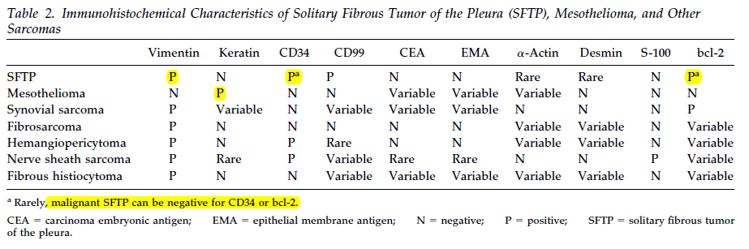
Solitary Fibrous Tumor (SFT)
DIAGNOSIS
Immunohistochemistry
  Conventional IHC markers of SFT : CD34, Bcl2, CD99, and vimentin
  Absence of actin, desmin, S100 protein, or epithelial markers (epithelial membrane antigen [EMA], low molecular weight cytokeratins).
  Nuclear expression of the C-terminal of STAT6
de Perrot, M., et al. Solitary fibrous tumors of the pleura.
Ann Thorac Surg 2002;74:285–93
Notes:
no strict dichotomy between benign and malignant SFT, and all tumors likely have some degree of metastatic potential, albeit quite low in the majority of cases. Therefore, the behavior of SFT is difficult to predict based upon histologic features alone. This has led to attempts to combine histologic and clinical features into scoring systems to estimate the risk of malignant behavior
presence of the NAB2–STAT6 fusion protein).

Slide 10
Solitary Fibrous Tumor (SFT)
DIAGNOSIS
Malignant SFT include one of more of the following:
  Mitotic activity >4 mitotic figures per 10 high-powered fields (HPF)
  Presence of necrosis (or hemorrhage in some series)
  Tumor size
  Increased cellularity (defined as lack of intervening collagenous stroma, nuclear overlap, and crowding)
  Nuclear pleomorphism
  Stromal infiltration beyond pseudocapsule or vascular invasion (reported in some series)
Notes:
no strict dichotomy between benign and malignant SFT, and all tumors likely have some degree of metastatic potential, albeit quite low in the majority of cases. Therefore, the behavior of SFT is difficult to predict based upon histologic features alone. This has led to attempts to combine histologic and clinical features into scoring systems to estimate the risk of malignant behavior

Slide 11
Solitary Fibrous Tumor (SFT)
PROGNOSIS
In general, solitary fibrous tumors (SFTs) are indolent tumors.
Reported 10-year disease-specific survival rates for both pleural and extrapleural SFTs are between 73 and 100 percent
Majority of SFTs behave in a benign fashion after complete resection and do not recur either locally or with distant metastases
The behavior of SFT is difficult to predict based upon histologic features alone
Risk criteria for recurrence/metastasis in SFT : incomplete surgical resection, metastatic disease at presentation, tumor size >10 cm , high mitotic rate, and the presence of tumor necrosis.
Notes:
England et al. reported 233 cases from the AFIP, of which 82 were described as histologically malignant. Their histologic criteria for malignancy are outlined in the table (table 2) [45]. Whereas none of the patients with histologically benign disease died, 55 percent of those with malignant SFT died because of recurrence or metastases. Among the malignant variants, complete resectability was the single most important predictor of outcome.
●De Perrot reviewed a total of 185 reported cases of pleural SFT in the literature that had adequate follow-up; 19 (10 percent) had at least one recurrence, and 16 (9 percent) died of their disease [59]. Histologically benign pedunculated tumors comprised 35 percent of the total and only recurred 2 percent of the time, while sessile, histologically malignant pleural SFT, accounting for 23 percent of the total, recurred in up to 63 percent of cases. The authors used the absence/presence of pleural pedunculation with histologic features of malignancy and the presence of metastasis to create a five-tiered staging system, which correlated with risk of local recurrence (table 3).
The de Perrot classification was validated in a another series of 88 SFTs, in which de Perrot stage 0 to I tumors accounted for 67 percent, stage II for 18 percent, and stage III to IV for 15 percent of cases. Stage significantly correlated with disease-specific survival and overall survival [70]. Local recurrence was documented in 16 cases (18 percent of the total), but the authors did not provide a stratification of recurrence rate according to de Perrot stage.

Slide 12
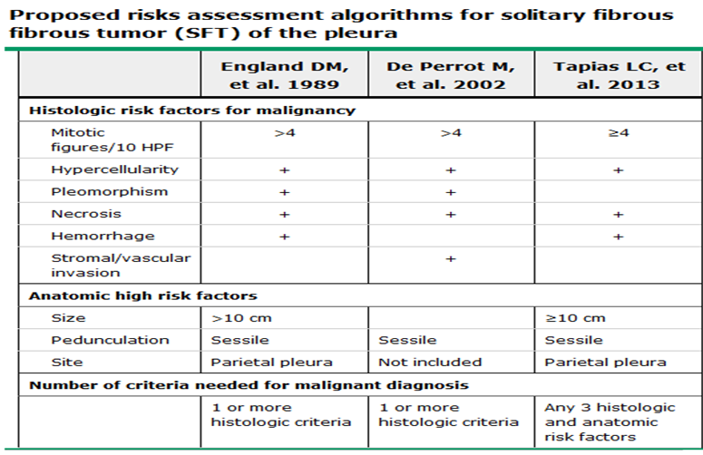
Solitary Fibrous Tumor (SFT)
PROGNOSIS
Notes:
England et al. reported 233 cases from the AFIP, of which 82 were described as histologically malignant. Their histologic criteria for malignancy are outlined in the table (table 2) [45]. Whereas none of the patients with histologically benign disease died, 55 percent of those with malignant SFT died because of recurrence or metastases. Among the malignant variants, complete resectability was the single most important predictor of outcome.
●De Perrot reviewed a total of 185 reported cases of pleural SFT in the literature that had adequate follow-up; 19 (10 percent) had at least one recurrence, and 16 (9 percent) died of their disease [59]. Histologically benign pedunculated tumors comprised 35 percent of the total and only recurred 2 percent of the time, while sessile, histologically malignant pleural SFT, accounting for 23 percent of the total, recurred in up to 63 percent of cases. The authors used the absence/presence of pleural pedunculation with histologic features of malignancy and the presence of metastasis to create a five-tiered staging system, which correlated with risk of local recurrence (table 3).
The de Perrot classification was validated in a another series of 88 SFTs, in which de Perrot stage 0 to I tumors accounted for 67 percent, stage II for 18 percent, and stage III to IV for 15 percent of cases. Stage significantly correlated with disease-specific survival and overall survival [70]. Local recurrence was documented in 16 cases (18 percent of the total), but the authors did not provide a stratification of recurrence rate according to de Perrot stage.

Slide 13
Solitary Fibrous Tumor (SFT)
TREATMENT
Localized disease — Complete en bloc surgical resection is the mainstay of therapy for all localized SFTs
Complete surgical resection to negative margins (R0 resection) even for tumors classified as high-risk, given the low overall metastatic potential and the lack of effective adjuvant therapy.
Pleural tumors
  Pedunculated tumors : wedge resection
  large sessile tumors : occasionally require a lobectomy, pneumonectomy, or a chest wall or diaphragm resection to achieve a complete (R0) resection
Extrapleural tumors
  complete surgical resection is the primary approach
Notes:
In a retrospective series, 157 patients with a pleural SFT underwent complete en bloc resection, which required wedge resection in 122, lobectomy of one or more lobes in 19, pneumonectomy in four, chest wall resection in 8, diaphragm resection in 3, and multilevel hemivertebrectomy in 1 [25]. Despite R0 resection, 15 (10 percent) recurred at a median of 29 months. Ten recurred locally, while five recurred at distant sites. In 9 of the 10 cases with a local recurrence, disease control was achieved with re-resection. Recurrences were more common in patients with malignant histology (19 versus 1.3 percent). At a median follow-up of 14 years, the overall 5- and 10-year survival rates for the entire cohort were 86 and 77 percent; long-term survival was significantly better in those with a histologically benign SFT as compared with those with malignant features (at five years, 96 versus 68 percent, respectively).
Lahon B, Mercier O, Fadel E, et al. Solitary fibrous tumor of the pleura: outcomes of 157 complete resections in a single center. Ann Thorac Surg 2012; 94:394.
Another multi-institutional study focused on 50 malignant pleural SFTs treated over a 10-year period at one of four institutions [24]. Complete resection was achieved in 46 cases (92 percent), and required extended resection in 15. At a median follow-up of 52 months, the overall survival rates at 5 and 10 years were 81 and 67 percent, and the disease-free survival rates at 5 and 10 years were 72 and 61 percent. Even patients with an England score of 4 had an 80 percent long-term survival rate
Lococo F, Cesario A, Cardillo G, et al. Malignant solitary fibrous tumors of the pleura: retrospective review of a multicenter series. J Thorac Oncol 2012; 7:1698.

Slide 14
Solitary Fibrous Tumor (SFTs)
TREATMENT
Radiation therapy , Adjuvant chemotherapy
  No adjuvant RT or CTx for histologically malignant, completely resected tumors
  use of adjuvant RT for incompletely resected or recurrent SFTs
Advanced disease
  Optimal management for locally advanced unresectable or metastatic SFT is not established
  Cytotoxic chemotherapy : Traditional sarcoma CTx agents (ie, anthracycline, ifosfamide)
  Molecularly targeted agents
    targeting the vascular endothelial growth factor (VEGF) : bevacizumab
    other tyrosine kinase signaling pathways : Sunitinib, Pazopanib, Sorafenib, Axitinib
    insulin-like growth factor 1 receptor inhibitor : phase I trial
Notes:
small case series and retrospective reviews; there are no prospective trials:
A retrospective review included 30 patients with advanced SFT derived from the European rare cancer database who were treated with traditional sarcoma chemotherapy [94]. At three months, among those treated with an anthracycline-based regimen (single-agent anthracyclines [n = 7] or a combination of anthracyclines plus ifosfamide [n = 23]), there were six (20 percent) partial responses, and eight (27 percent) had stable disease. However, the median progression-free survival (PFS) was only four months, and only six (20 percent) remained progression-free at six months. Analysis of 19 patients in the group who received single-agent high-dose ifosfamide revealed that 10 percent had a partial response, 26 percent had stable disease; the median PFS was only four months.
Stacchiotti S, Libertini M, Negri T, et al. Response to chemotherapy of solitary fibrous tumour: a retrospective study. Eur J Cancer 2013; 49:2376.
One report included 24 patients with locally advanced unresectable or metastatic SFT, 17 of whom received systemic cytotoxic chemotherapy (17 anthracycline-based, 2 temozolomide plus bevacizumab, and 1 trabectedin, an experimental drug) [79]. Three others received axitinib. There was one objective partial response, and 20 patients with stable disease. Median PFS in the entire cohort was 4.2 months. Constantinidou A, Jones RL, Olmos D, et al. Conventional anthracycline-based chemotherapy has limited efficacy in solitary fibrous tumour. Acta Oncol 2012; 51:550.
●By virtue of their use in gliomas, the combination of bevacizumab (VEGFa inhibitor) and temozolomide was tested in 14 patients with SFT and shown to have evidence of activity [98]. Median PFS in this group of locally advanced, unresectable, or metastatic patients was 9.7 months. The partial response (PR) rate was 14 percent with 76 percent stable disease. Interestingly, when non-dimensional Choi criteria (which invoke change in density and tumor size in a response criterion [99]) were used instead of RECIST, 79 percent of the patients exhibited a PR. Some of the patients involved in this single-institution study were converted to resectable disease.
Park MS, Patel SR, Ludwig JA, et al. Activity of temozolomide and bevacizumab in the treatment of locally advanced, recurrent, and metastatic hemangiopericytoma and malignant solitary fibrous tumor. Cancer 2011; 117:4939.

Slide 15
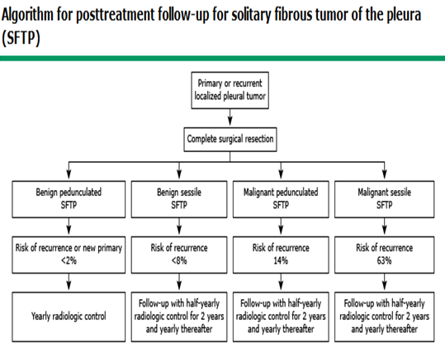
Solitary Fibrous Tumor (SFTs)
POSTTREATMENT SURVEILLANCE
No widely accepted guidelines
Continued long-term follow-up is needed for high-risk individuals
Late recurrence up to 20 years after initial treatment
de Perrot, M., et al. Solitary fibrous tumors of the pleura.
Ann Thorac Surg 2002;74:285–93

Slide 16
Reference
England DM, Hochholzer L, McCarthy MJ. Localized benign and malignant fibrous tumors of the pleura. A clinicopathologic review of 223 cases. Am J Surg Pathol 1989; 13:640.
de Perrot M, Fischer S, Bründler MA, et al. Solitary fibrous tumors of the pleura. Ann Thorac Surg 2002; 74:285.
Tapias LF, Mercier O, Ghigna MR, et al. Validation of a scoring system to predict recurrence of resected solitary fibrous tumors of the pleura. Chest 2015; 147:216.
Tapias LF, Mino-Kenudson M, Lee H, et al. Risk factor analysis for the recurrence of resected solitary fibrous tumours of the pleura: a 33-year experience and proposal for a scoring system. Eur J Cardiothorac Surg 2013; 44:111.
Thway, K., et al. (2016). "The Current Status of Solitary Fibrous Tumor: Diagnostic Features, Variants, and Genetics." Int J Surg Pathol 24(4): 281-292.
Demicco EG, Park MS, Araujo DM, et al. Solitary fibrous tumor: a clinicopathological study of 110 cases and proposed risk assessment model. Mod Pathol. 2012;25:1298-1306.
Cardillo G, Carbone L, Carleo F, et al. Solitary fibrous tumors of the pleura: an analysis of 110 patients treated in a single institution. Ann Thorac Surg. 2009;88:1632-1637.
de Perrot, M., et al. (2002). "Solitary fibrous tumors of the pleura." Ann Thorac Surg 74(1): 285-293.

Slide 17


