Slide 1
VATS conference review
: metastatic pulmonary calcification
Lee Jung Mo
Division of Pulmonology,
Department of Internal Medicine,
Institute of Chest Diseases,
Severance hospital, Yonsei University College of Medicine

Slide 2
Contents
Introduction
Epidemiology
Clinical menifestation and course
Pathogenesis
Diagnosis
  Images and pathology
Treatment

Slide 3
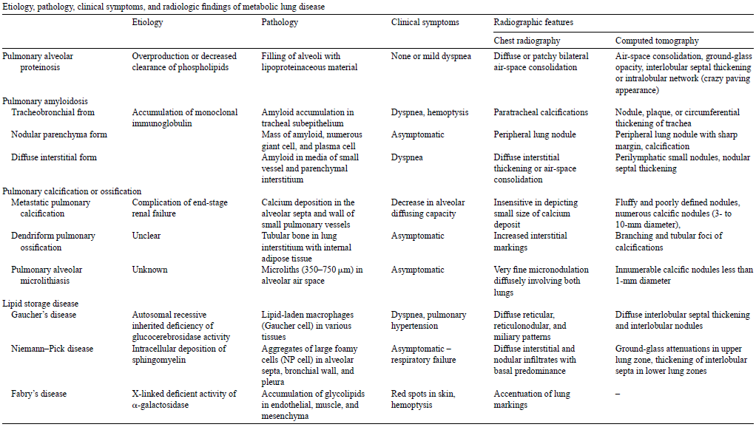
Metabolic lung disease

Slide 4
Metastatic pulmonary calcification
One of metabolic lung disease
Deposition of Ca in lung parenchyme
Commonly associated with ESRD
Frequently asymptomatic & benign course
Fulminant respiratory failure in some cases

Slide 5
Classification
Pulmonary calcification
  Metastatic pulmonary calcification
  Dystrophic pulmonary calcification
  Idiopathic pulmonary calcification
Notes:
각각 설명 필요
Injured tissue

Slide 6
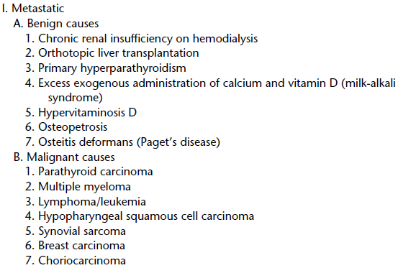
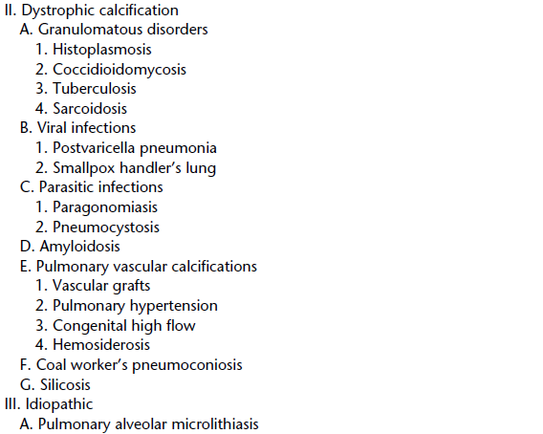
Causes of pulmonary calcification

Slide 7
Epidemiology
Only 14 cases in 7000 autopsies
but, 60-75% of autopsy in HD pts
CKD with 2ndary hyperparathyroidism
Multiple myeloma : m/c cause of cancer-associated hypercalcemia
Fewer cases of MPC have been reported recently.
  Imporved dialysis techniques
  Phosphate binding agents and Vit D analogues

Slide 8
Clinical menifestations
Usually minimal symptom
Dyspnea & chronic, non-productive cough occasionally
Can mimic pneumonia, pulmonary edema → ARDS
Degree of macroscopic calcification is not correlated with degree of respiratory distress

Slide 9
Clinical course
Factors associated aggressive form of MPC : not fully understood
Acceleration of MPC
  Failed renal transplantation
  HyperCa
Resolution of MPC in CKD pts
  Parathyroidectomy
  Renal transplantation
  Dialysis
  Spontaneous resolution

Slide 10
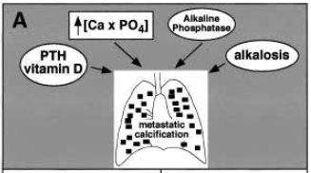
Pathogenesis
Role of calcuim excess
Role of alkaline environment
Role of lung injury or fibrosis

Slide 11
Role of calcuim excess
↑calcium-phosphate product
Azotemia, elevated PTH hormone, exogenous Vit D in normal Ca-P
Pulmonary parenchymal granuloma, mediastinal lymphadenopathy can cause dystrophic calcification.
  Injured tissue
  MQ produce 1,25 vit D
Notes:
MQ in granuloma 가 1.25 VitD

Slide 12
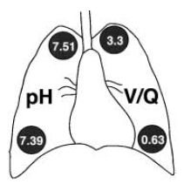
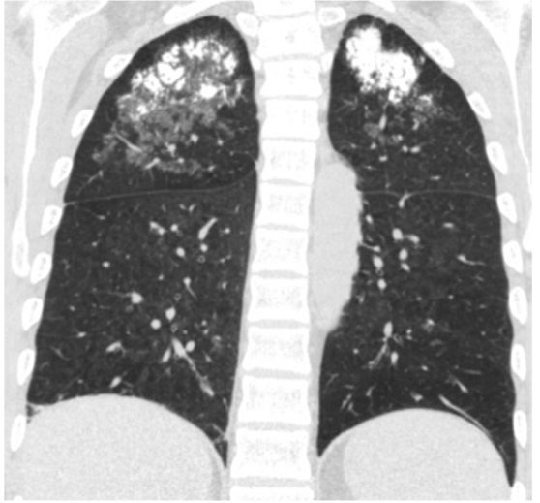
Role of alkaline environment
Alkaline environment fosters Ca precipitation.
Upper lobe predominance and V/Q ratio
CKD with HD & relative alkalosis
Pul a. obstruction
  ↓CO2 delivery
  hyperventilation

Slide 13
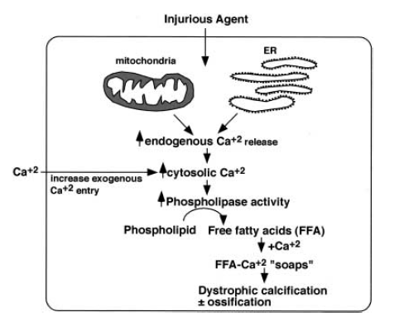
Role of lung injury or fibrosis
Dystrophic pulmonary calcification
  Site of previous cellular or tissue injury
  ↑cytosolic Ca
  Enzyme activity & necrotic cell death

Slide 14
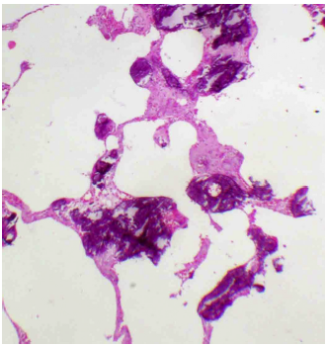
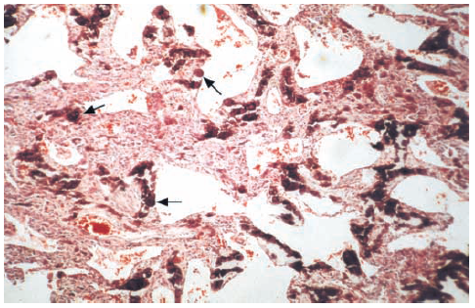
Pathology
Deposition of Ca salts in the alveolar epithelial basement membrane, alveolar capillary walls, bronchial walls, bronchioles, media of pulmonary arterioles
Fibrous widening of the alveolar septa

Slide 15
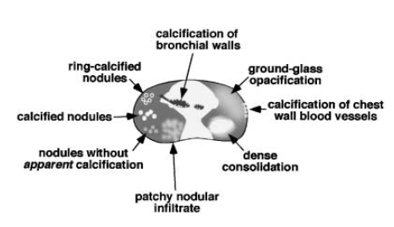
Images
Chest CT
  Multiple calcified and/or noncalcified nodules
  Diffuse or patch areas of GGO or ill-defined patchy infiltrate
  Relatively dense area of consolidation
  Calcification of tracheobronchial walls and in chest wall blood vessels

Slide 16
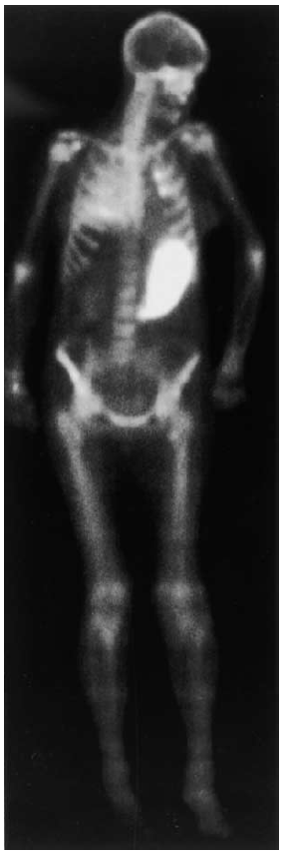
Nuclear medicine
Tc99m-MDP
(Technetium-99-m-methylenediphosphonate)
Detection of extraosseous calcification

Slide 17
Pulmonary function test
Usually normal
Diffuse involvement of alveolar septa
☞ Diffusing capacity ↓
Anatomical changes d/t Ca deposit
☞ Restrictive pattern

Slide 18
Treatment of MPC
Majority of pts do not require intervention
Main stay of tx : normalize Ca and phosphate biochemistry
Successful renal transplantation
Parathyroidectomy in severe cases with primary or tertiary hyperparathyroidism

Slide 19
Summary
Commonly associated with ESRD
Often asymptomatic
Potential risk to respiratory failure
HRCT or Tc99m-MDP scan can be helpful.

Slide 20
References
Chan ED, Morales DV, Welsh CH, McDermott MT, Schwarz MI. Calcium deposition with or without bone formation in the lung. Am J Respir Crit Care Med 2002;165:1654e69.
Belém LC, Zanetti G, Souza AS Jr, Hochhegger B, Guimarães MD, Nobre LF, Rodrigues RS, Marchiori E. Metastatic pulmonary calcification: State-of-the-art review focused on imaging findings. Respiratory Medicine 108:5, 668-676
Hartman TE, M¨uller NL, Primack SL, et al. Metastatic pulmonary calcification in patients with hypercalcemia: findings on chest radiographs and CT scans. Am J Roentgenol 1994;162:799–802.

Slide 21


Slide 22
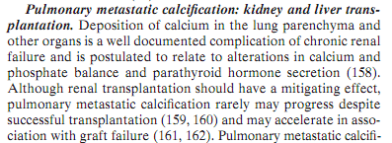

Slide 23
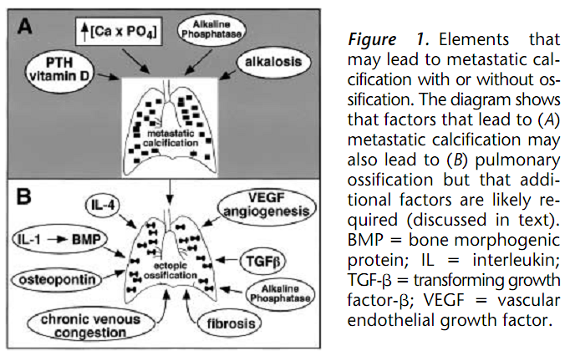

Slide 24
