Slide 1
Bronchiolitis obliterans organizing
pneumonia(BOOP)
Chi Young Kim
Division of Pulmonology
Department Of internal medicine
Yonsei University College of Medicine
Notes:
발표를 맡게된 강사 김치영 입니다. BOOP에 대해 간단히 topic review를 하도록 하겠습니다.

Slide 2
Bronchiolitis obliterans organizing pneumonia
Type of diffuse interstitial lung disease
- distal bronchioles, respiratory bronchioles, alveolar ducts,
and alveolar walls
Cryptogenic organizing pneumonia (COP)
- the idiopathic form of organizing pneumonia (formerly
called bronchiolitis obliterans organizing pneumonia or BOOP)
Secondary organizing pneumonia - connective tissue diseases, a variety of drugs, malignancy, and other interstitial pneumonias
Notes:
BOOP은 diffuse ILD로서 distal bronchioles, respiratory bronchioles, alveolar ducts, and alveolar walls 을 침범하는 질환이며 primary 침범하는 site는 alveolar wall입니다.
COP는 BOOP의 idiopathic form이며 , 2ndary organizing pneumonia의 원인으로는 여러가지 원인들이 관련되어 있습니다.
최근에는 BOOP이라는 말대신 COP라는 단어를 많이 사용한다.

Slide 3
Epidemiology
unknown
6~7 per 100,000 in Canada
1.1 per 100,000 in Iceland
56 to 68 % of organizin pneumonia cases have been deemed cryptogenic rather than secondary
Notes:
역학을 보시게 되면 정확히 알려져 있지는 않습니다. 논문에서는 canada 만명중의 6명, 아이슬랜드의 십만명중 1명 꼴로 확인된다고 하며
이들의 원인으로는 secondary cause 보다는 cryptogenic 한 것이 더 많은 것으로 되어 있습니다.

Slide 4
Pathology
Excessive proliferation of granulation tissue(loose collagen-embedded fibroblasts) & myofibroblasts involving alveolar ducts and alveoli
Intraluminal plugs of granulation tissue extend from one alveolus to the adjacent one through -> characteristic "butterfly" pattern
Uniform appearance within involved areas and a patchy distribution without severe disruption of the lung architecture.
Notes:
Pathology를 보시면 COP는 excessive granulation tissue proliferation과 myofibroblsts의 alveolar ducts and alveoli 침범을 특징으로 하며,
이들 granulation tissue 는 pores of Kohn을 통해 다른 alveolus로 이동하게되며 , 이들이 모여서 characteristic butterfly pattern을 나타내게 됩니다.
또한 이는 Lung의 심한 구조적 파괴가 없는 동일한 form의 pachy distribution을 나타내게 됩니다.
Pathologic lesion is predominantly within the airspace

Slide 5
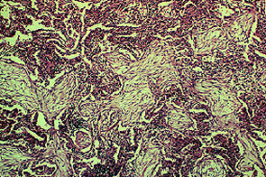
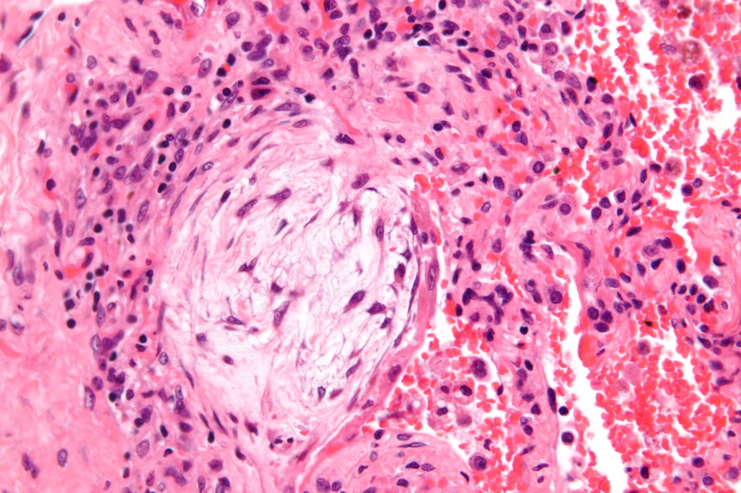
Pathology
Sara et all. Ann Thorac Med. 2008 Apr-Jun; 3(2): 67–75
Notes:
병리 사진상에서 pale staining fibroblastic tissue로 이루어진 intramural plug를 확인할수 있으며
Respiratory bronchiole and alveolar ducts의 lumen을 granulation tissue 로 채우는 fibroblast로 이루어진 Polypoid masses 확인할수 있는데 이를 masson body라고 부릅니다.
(macrophages and fibrin found in pulmonary alveoli in organizing pneumonia.)

Slide 6
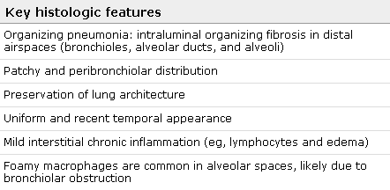
Histologic features of organizing pneumonia
J-F. Cordier et all. Eur Respir J 2006; 28: 422–446
Notes:
BOOP의 key histologic finding 으로는 다음과 같은 소견들이 있습니다.
첫째로 intramuralorganizing fibrosis와 pathy peribronchiolar distribution, lung의 architecture 보존 , mild interstitial edema, foamy macropha를 특징으로 한다고 합니다.

Slide 7
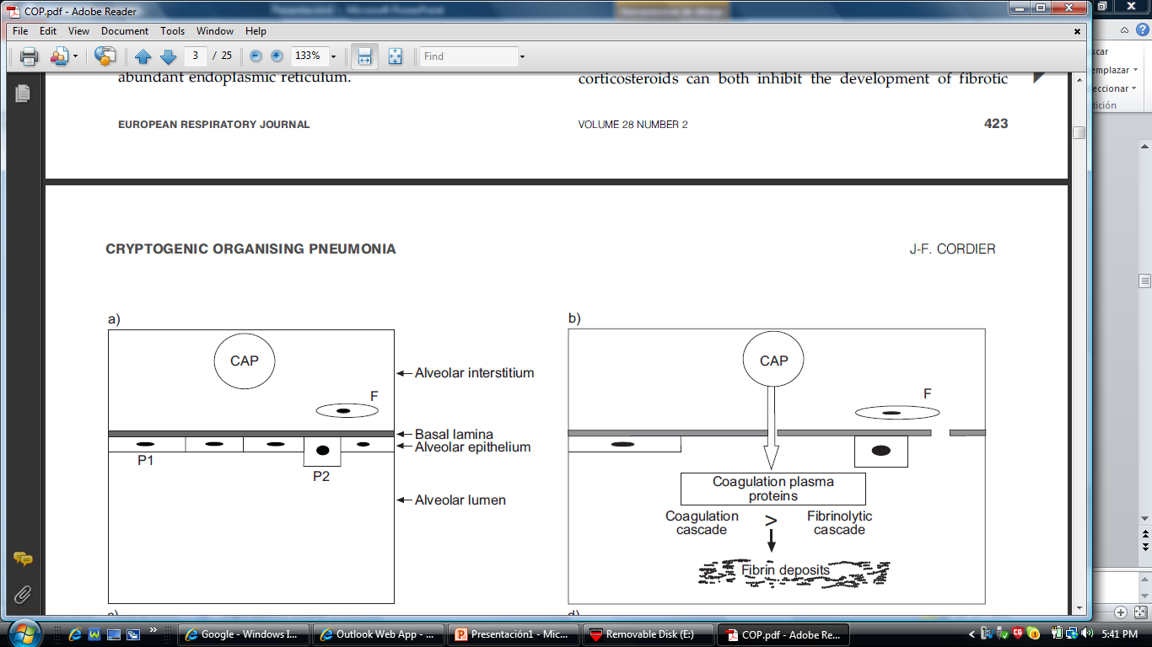
Pathogenesis/ First stage
J-F. Cordier et all. Eur Respir J 2006; 28: 422–446
Notes:
대부분의 COP에서 발생하는 intraalveolar fibrosis는 대부분 steroid에 반응이 좋으며, dramatic 하게 좋아지는 경우가 많은 것으로 알려져 있습니다.
왼쪽그림은 Normal alveolus로 normal alveolus에 첫번째 순서로 alveolar epithelial injury가 발생하게 되며, Pneumocytes(esp type 1)의 손상 및 epithelial alveolar injury 는 basal lamina에 gap을 만들게 됩니다
이는 coagulation plasma protein의 intraalveolar leakage를 가져오게 되며, 이는 coagulation and fibrinolytic cascades 중에 coagulation cascade의 우세를 가져오게 되어, fibrin의 intra-alveolar deposits 을 가져오게 되고

Slide 8
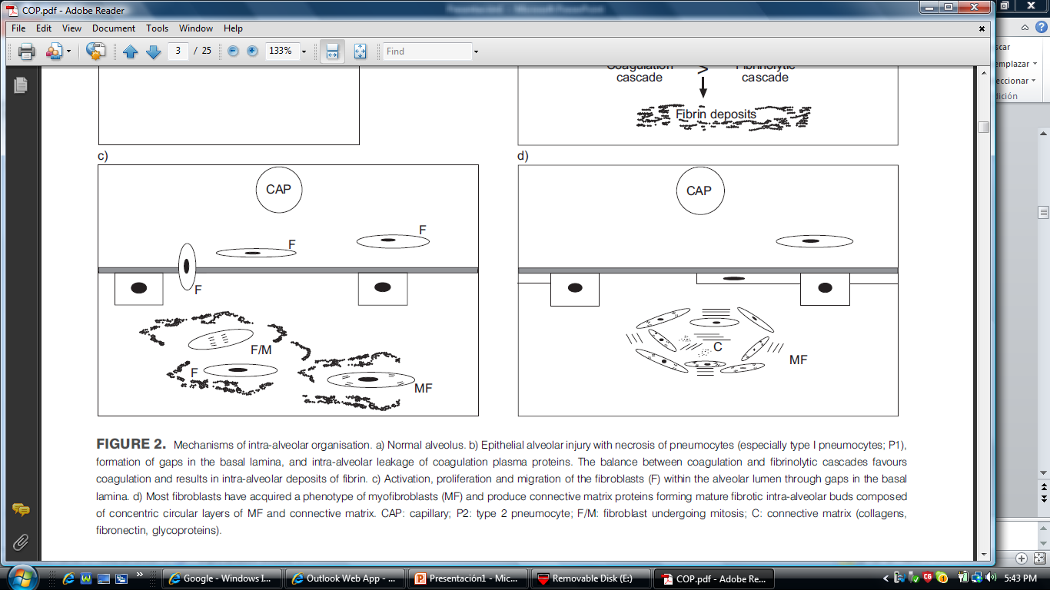
Pathogenesis/ Second stage
J-F. Cordier et all. Eur Respir J 2006; 28: 422–446
Notes:
Basal lamina의 gap을 통해서 fibroblasts의 proliferation과 activation 이 활성화 되게 되고, 이때 prominent bands of fibrin and inflammatory cells 를 가진 fibrinoid inflammatory cell clusters를 형성하게 됩니다.
, fibrin은 분해되고 inflammatory cell이 감소하게 되어 fibroinflammatory buds를 형성하고 interstitium으로부터 fibroblast가 이동하여 증식을 하게 됩니다.
Alveolar cell에서의 Myofibroblast의 이동은 basal lamina의 reepithelization 을 시키게되며 , …………….

Slide 9

Pathogenesis/Third stage
J-F. Cordier et all. Eur Respir J 2006; 28: 422–446
Notes:
대부분의 fibroblasts들이 myofibroblasts (MF)의 phemotype을 갖게 되어, connective matrix proteins들을 만들게 되고, fibroblasts 의 concentric ring 을 만들게 되며
염증세포들은 사라지게 되고, Concentric rings of fibroblasts의 concentric ring이 결합 조직의 층으로 대체 되게 된다.

Slide 10
Pathogenesis
Connective Matrix
-Loose connective matrix with high type III collagen content
which is more susceptible to degradation and reversal of
fibrosis
Angiogenesis
-Prominent capillarization of the intraalveolar buds.
-Vascular endothelial growth factor and basic fibroblast
growth factor
-Angiogenesis could contribute to the reversal of buds in OP
Notes:
Type 3 collagen으로 이루어진 matrix는 더 쉽게 분해되며 더 쉽게 fibrosis가 분해되게 되며,
Angiogenesis로 인한 capillarization 및 VEGF 등도 역시 OP의 buds reversal에 영향을 끼치게 됩니다.
많은 설이 제시되고 있지만 왜 UIP는 ongoing fibrosis를 일으키고 COP는 reveribility를 갖게 되는지는 아직 밝혀지지 않았습니다.

Slide 11
Clinical features
Disease onset : fifth or sixth decades
Men ≒ women
Rarely reported in children
Smoking 25 to 50 percent
Notes:
질병은 대새 50~60대에 특징적으로 많으며

Slide 12
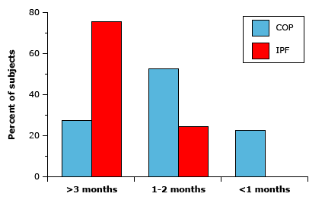
Clinical features
Typically presents with cough, dyspnea, fever, and malaise - short duration (less than two months)
acute onset of a flu-like illness with fever, malaise, fatigue, and cough(50%)
Other patients the onset of symptoms is less acute.
A lack of response to empiric antibiotics for CAP
-initial clue to the presence of a noninfectious,
inflammatory pneumonia

Slide 13
Evaluation
P/E : inspiratory crackles (74%)
normal (25%)
Wheezing(rare)
clubbing<5%
Lab : No specific studies
- Leukocytosis(50%), ESR &CRP↑(70~80%)

Slide 14
Radiology-CXR
Distinctive with bilateral, patchy or diffuse, consolidative
or ground glass opacities in the presence of normal lung
volumes
peripheral distribution of the opacities, similar to
chronic eosinophilic pneumonia
Recurrent or migratory pulmonary opacities are
common(up to 50 percent of subjects in some series)
Rare : unilateral consolidative and GGO
irregular linear or nodular opacities
pleural effusion, pleural thickening
hyperinflation, cavities
Notes:
표로 대체할까 ???????

Slide 15
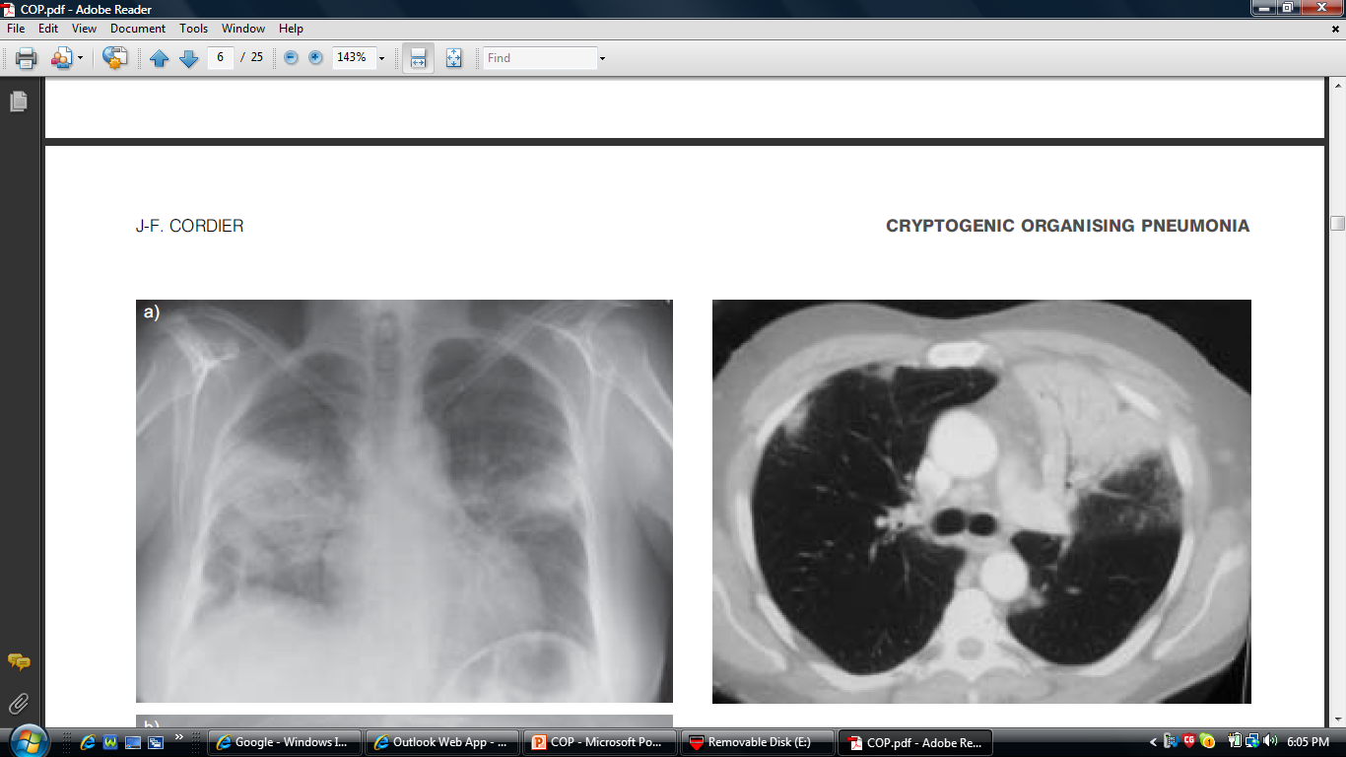
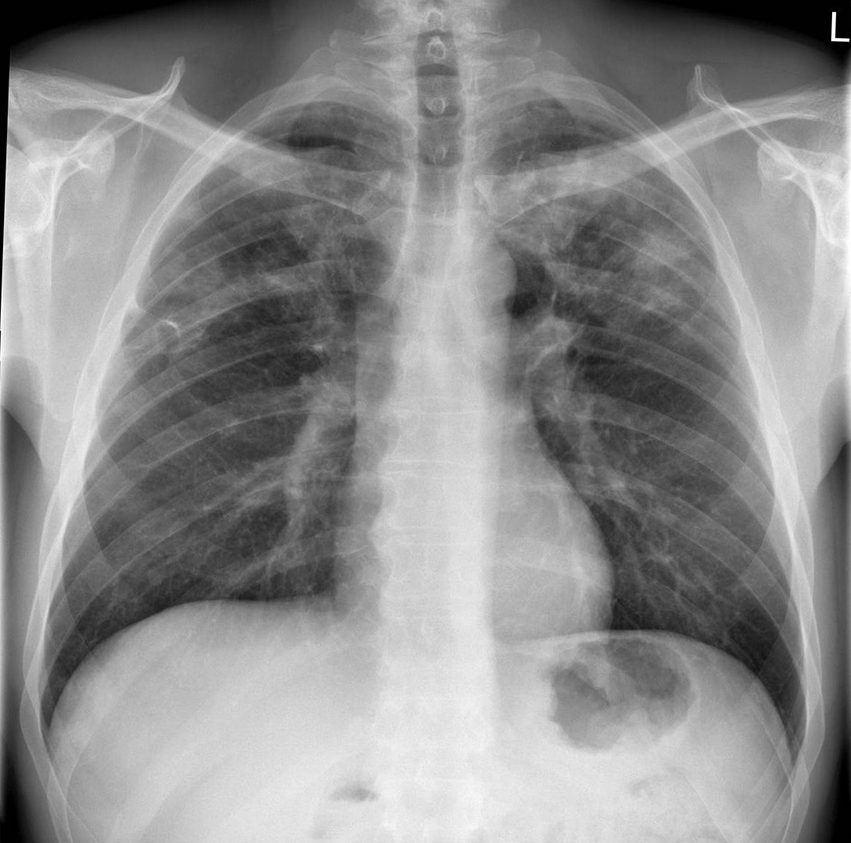
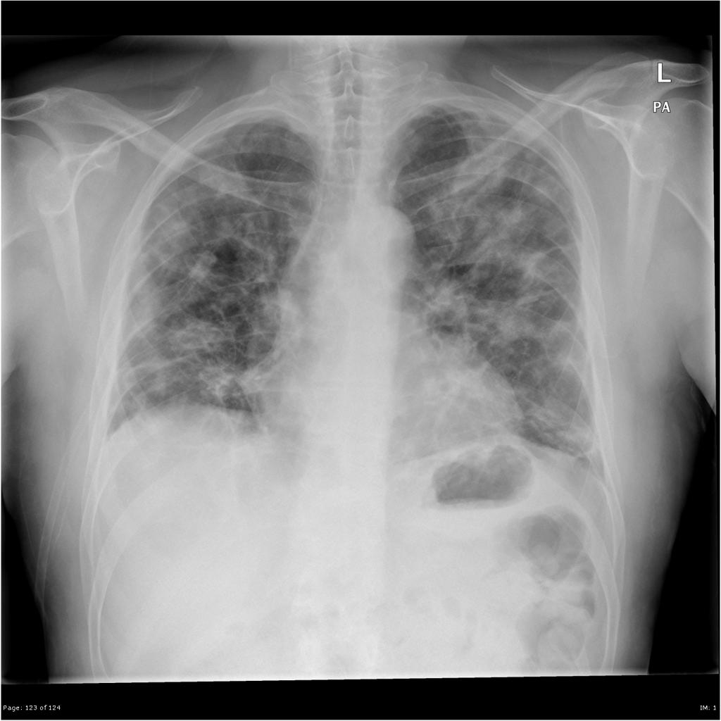

Slide 16
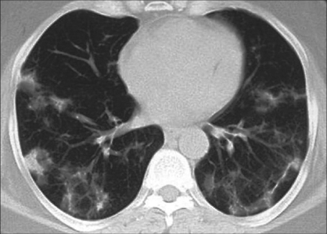
Radiology- Chest CT
Chest CT : patchy air-space consolidation, ground-glass opacities, small nodular opacities, and bronchial wall thickening with dilation
Patchy opacities occur more frequently in the periphery of the lung and are often in the lower lung zone
Notes:
x-ray 보다 심하다.
Radiography 만으로는 chronic eosinophilic pneumonia와 구별이 불가능하다.

Slide 17
PFT : mild to moderate restrictive defect & DLCO↓
BAL : In radiographic evidence of involvement area
or RML, Lt.lingula
-Typical finding : lymphocytes (20 to 40 %)↑
eosinophils (5 to 25 %) ↑
neutrophils (5 to 10 %)
foamy macrophages, mast cells, plasma cells
CD4/CD8 T cell ratio↓, an increase in
activated T lymphocytes↑
(HLA-DR or interleukin-2 receptor expression)
Notes:
similar in proportion to hypersensitivity pneumonitis

Slide 18
TBLB : to identify other disease processes in the differential diagnosis. on the other hand, some guidelines suggest that a diagnosis can be made on the basis of a transbronchial biopsy in a patient with typical clinical and radiologic features.
Surgical Bx. : obtain an adequate sample of lung tissue (eg, >4 cm diameter in the greatest dimension when inflated) for definitive diagnosis
Notes:
The histologic features of organizing pneumonia can be seen as a minor finding in other interstitial lung diseases, so reliance on small transbronchial biopsies increases the likelihood of missing the central diagnosis.

Slide 19
Diagnosis
Clinical, radiological and pathological diagnosis.
Exclusion of any possible cause.
Histopathology: Buds of granulation tissue consisting of fibroblasts, myofibroblasts embedded in connective tissue.

Slide 20
Differential diagnosis
Community acquired pneumonia
Idiopathic interstitial pneumonias
Hypersensitivity pneumonitis
Granulomatous organizing pneumonia
Chronic eosinophilic pneumonia
Pulmonary lymphoma
Pulmonary lymphomatoid granulomatosis
Diffuse alveolar damage
Acute fibrinous and organizing pneumonia

Slide 21
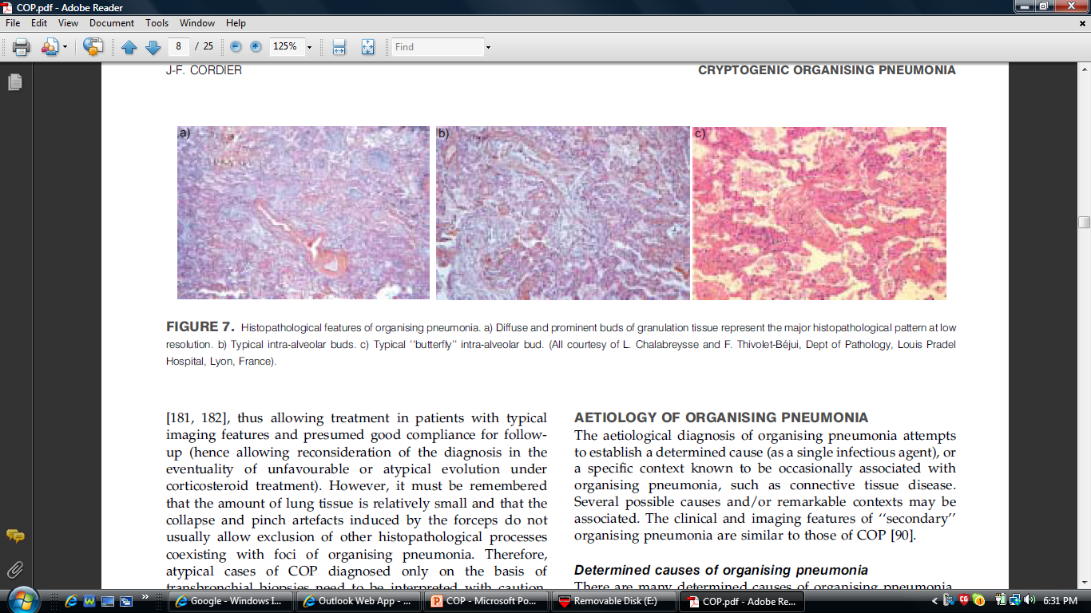
J-F. Cordier et all. Eur Respir J 2006; 28: 422–446
Notes:
저배율에서 특징적인 granulation tissue의 diffuse 하고 prominent한 buds.
Typical albeolar buds
Typical butterfly intraalveolar bud

Slide 22
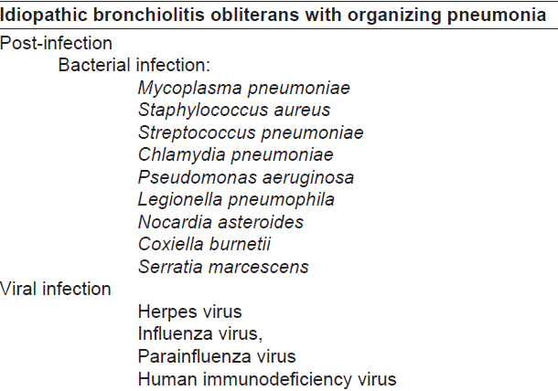
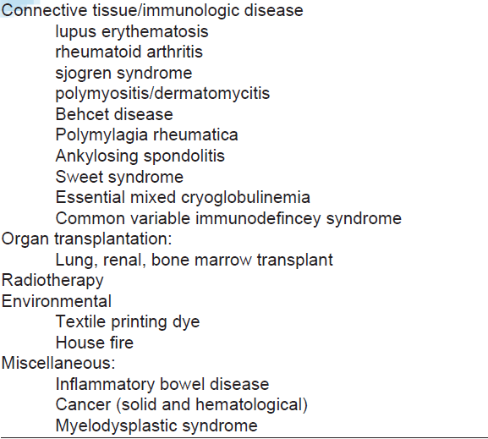
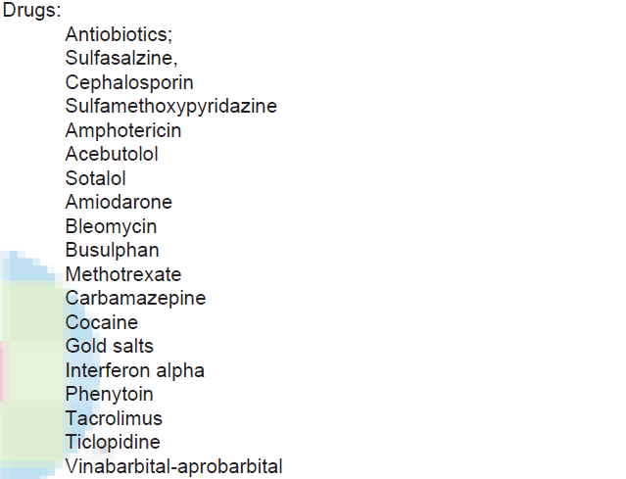
Conditions associated with organizing pneumonia
Sara et al…, Annals of Thoracic Medicine - Vol 3, Issue 2, April-June 2008

Slide 23
Treatment
The precise dose and duration of treatment have not been established
Prednisone 0.75–1.5 mg/kg/day
0.75 mg/kg/day during 4 weeks, followed by 0.5 mg/kg for 4 weeks, then 20 mg for 4 weeks, 10 mg for 6 weeks, and then 5mg for 6 weeks
Complete clinical and physiologic recovery in 65 % of patients
Predictors of relapse: delayed treatment and mildly increased gammaglutamyltransferase and alkaline phosphatase levels
Notes:
Gary Epler. Bronchiolitis Obliterans Organizing Pneumonia. NEJM; 1985:152-8

Slide 24
Treatment
Severe cases: prednisolone 2mg/kg/day for the first 3-5 days

Slide 25
Treatment
Spontaneous improvement
Macrolides:
-Patients with minimal symptoms and/or
minimal physiologic impairment
-Adjuvant therapy in patients receiving st
eroids
-Patients who cannot tolerate steroids.
-3 to 6 months or longer
Stover at el… Chest 2005 Nov;128(5):3611-7.

Slide 26
Reference
American Thoracic Society/European Respiratory Society. Classification of the idiopathic interstitial pneumonias: international multidisciplinary consensus. American Thoracic Society/European Respiratory Society. Am J Respir Crit Care Med 2002;165: 277–304.
J.-F. Cordier. Cryptogenic organizing pneumonia. Clinics in Chest Medicine 2004;25 : 727– 738
J.-F. Cordier. Organising pneumonia. Thorax 2000;55:318–328.
J.-F. Cordier. Cryptogenic organizing pneumonia. Eur Respir J 2006; 28: 422–446
Al-Ghanem Sara. Bronchiolitis obliterans organizing
pneumonia: Pathogenesis, clinical features, imaging and
therapy review. Annals of Thoracic Medicine Vol 3, Issue 2,
April-June 2008

Slide 27


