Slide 1
Thrombotic thrombocytopenic purpura after Lung transplantation
Ji-Eun Park
Division of Pulmonology
Department of Internal Medicine
Yonsei University College of Medicine

Slide 2
Thrombotic thrombocytopenic purpura (TTP)
Hemolytic uremic syndrome (HUS)?
Microangiopathic hemolytic anemia (MAHA)?
Thrombotic microangiopathy (TMA)?

Slide 3
Definitions
Microangiopathic hemolytic anemia (MAHA)
  non-immune hemolysis resulting from intravascular red blood cell fragmentation that produces schistocytes on the peripheral blood smear. Abnormalities in the microvasculature, including small arterioles and capillaries, are frequently involved.
  direct antiglobulin (Coombs) test: negative / LDH ↑/ indirect bilirubin ↑/ haptoglobin ↓
Thrombotic microangiopathy (TMA)
  a specific pathologic lesion in which abnormalities in the vessel wall of arterioles and capillaries lead to microvascular thrombosis.
Not all MAHA is caused by a TMA, but nearly all TMAs cause MAHA and thrombocytopenia.
  primary TMA syndromes
  Systemic disorders c MAHA + Thrombocytopenia

Slide 4
Overview (1)
Primary TMA syndromes
  1. TTP (hereditary or acquired)
  : ADAMTS13 deficiency–mediated TMA
  2. Shiga toxin-mediated HUS
  3. Drug-induced TMA syndromes
    immune mediated
    dose-dependent, toxicity-mediated
  4. Complement-mediated TMA (hereditary or acquired)
  5. Metabolism-mediated TMA
  6. Coagulation-mediated TMA

Slide 5
Overview (2)
Systemic disorders
associated with MAHA+Thrombocytopenia
  1. Pregnancy complications
  : preeclampsia, HELLP syndrome
  2. Severe hypertension
  3. Systemic infections
  4. Systemic malignancies
  5. Systemic rheumatic disorders
  : SLE, SSc or scleroderma, antiphospholipid syndrome (APS)
  6. Hematopoietic stem cell transplant or organ transplantation
  7. Disseminated intravascular coagulation (DIC)
  8. Severe vitamin B12 deficiency

Slide 6
Overview (1)
Primary TMA syndromes
  TTP (hereditary or acquired)
  : ADAMTS13 deficiency–mediated TMA
  2. shiga toxin-mediated HUS
  3. Drug-induced TMA syndromes
    immune mediated
    dose-dependent, toxicity-mediated
  4. Complement-mediated TMA (hereditary or acquired)
  5. Metabolism-mediated TMA
  6. Coagulation-mediated TMA

Slide 7
TTP (1)
History
  In 1924, Moschcowitz described a 16-year-old girl with weakness, pallor, purpura, and hemiparesis who died after 14 days with cardiac failure.
  Autopsy: hyaline thrombi in terminal arterioles and capillaries throughout most organs.
  the first description of TMA, presumably TTP.

Slide 8
TTP (2)
Cause
  In 1982, unusually large multimers of von Willebrand factor were observed in patients with chronic, relapsing (hereditary) TTP. This finding led to the discovery of a von Willebrand factor–cleaving protease that was subsequently characterized as ADAMTS13.
  ADAMTS13 cleaves von Willebrand factor multimers that are secreted from vascular endothelial cells. ADAMTS13 deficiency results in unusually large von Willebrand factor multimers and the risk of platelet thrombi in small vessels with high shear rates.
  Hereditary: ADAMTS13 mutations / Acquired: autoantibody inhibition

Slide 9
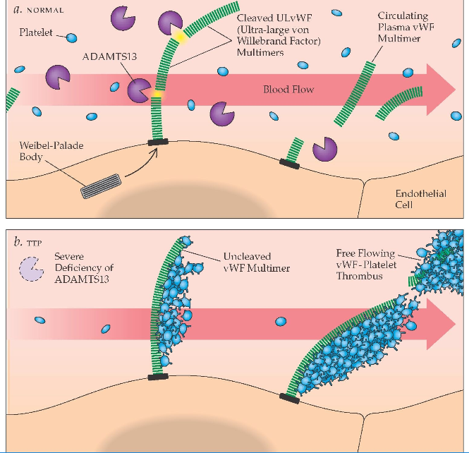

Slide 10
TTP (3)
Presentation and diagnosis
  rarely causing severe acute kidney injury
  Hereditary TTP
    Recurrent, MAHA+Thrombocytopenia, often with neurologic abnormalities or other signs of organ injury.
    documentation of ADAMTS13 deficiency, an absence of ADAMTS13 autoantibody inhibitor, documentation of ADAMTS13 mutations.
  Acquired TTP
    minimal~critically ill.
    MAHA+thrombocytopenia, weakness, gastrointestinal symptoms, purpura, and transient focal neurologic abnormalities without another apparent cause.
    An ADAMTS13 level ≤10% of normal activity

Slide 11
TTP (4)
Treatment
  hereditary TTP: plasma infusion (ADAMTS13 replacement)
  acquired TTP: Plasma exchange, immune suppression
    Before the use of plasma exchange, survival from acquired TTP was 10%.
    In 1991, a randomized, controlled trial documented a survival rate of 78% with plasma exchange. The high mortality without treatment creates urgency to begin plasma exchange, which often results in treatment of patients who do not have TTP.
    Glucocorticoids are standard Tx.
    Rituximab and other immunosuppressive agents are appropriate when the clinical course is complicated.
    Dialysis is rarely required.
Long-term outcomes
  hereditary TTP: Unknown
  acquired TTP: a risk of relapse17 and cognitive impairment↑,24 major depression, SLE, hypertension, and death.

Slide 12
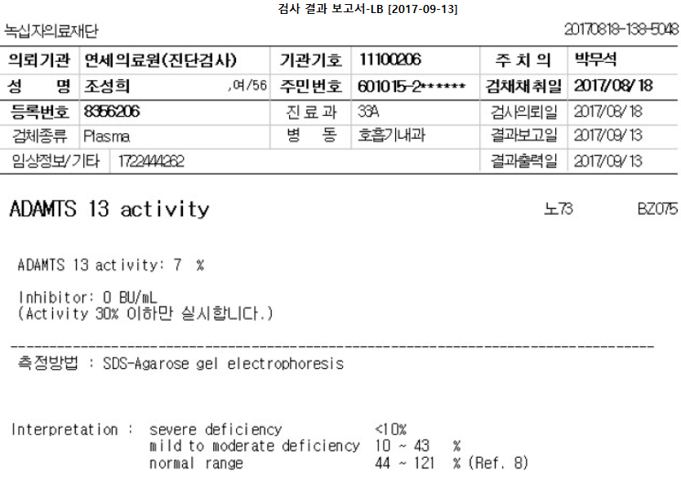
Case: 조 O 희

Slide 13
Overview (1)
Primary TMA syndromes
  TTP (hereditary or acquired)
  : ADAMTS13 deficiency–mediated TMA
  2. shiga toxin-mediated HUS
  3. Drug-induced TMA syndromes
    immune mediated
    dose-dependent, toxicity-mediated
  4. Complement-mediated TMA (hereditary or acquired)
  5. Metabolism-mediated TMA
  6. Coagulation-mediated TMA

Slide 14
Drug-mediated TMA
Immune mediated
  Adverse drug reactions can be caused by non–dose-related idiosyncratic, immunologic reactions
  sudden onset of severe systemic symptoms, often with anuric acute kidney injury, within hours after drug exposure.
Toxic dose-related
  immunosuppressive and chemotherapeutic agents and vascular endothelial growth factor (VEGF) inhibitors
  calcineurin inhibitors (cyclosporine, tacrolimus): endothelial dysfunction, platelet aggregation↑, possibly through the inhibition of prostacyclin.

Slide 15
Overview (2)
Systemic disorders
associated with MAHA+Thrombocytopenia
  1. Pregnancy complications
  : preeclampsia, HELLP syndrome
  2. Severe hypertension
  3. Systemic infections
  4. Systemic malignancies
  5. Systemic rheumatic disorders
  : SLE, SSc or scleroderma, antiphospholipid syndrome (APS)
  6. Hematopoietic stem cell transplant or organ transplantation
  7. Disseminated intravascular coagulation (DIC)
  8. Severe vitamin B12 deficiency

Slide 16
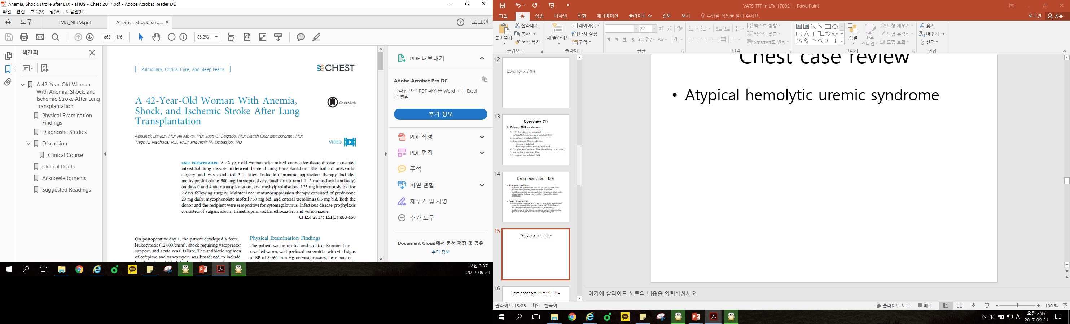

Slide 17
POD1
  Fever, leukocytosis (12,600/cmm), shock (vasopressor), acute renal failure.
  TTE: distributive shock, RWMA(-), valve: nl
POD2
  anemia and thrombocytopenia, requiring frequent transfusions
  bleeding(-) on CT
  Chest tube: not sanguineous
POD3
  Rt. Side hemiparesis

Slide 18
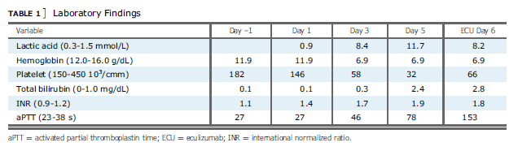
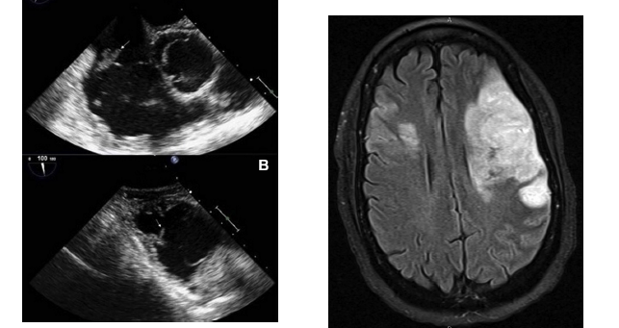

Slide 19
Atypical hemolytic uremic syndrome
-> Complement-mediated TMA
  DDx: HIT, TTP, HUS, DIC, and aHUS.
  the result of uncontrolled activation of a complement cascade. It can present as systemic inflammatory syndrome and TMA after stressful conditions such as SOT in patients with redisposed genetic susceptibility.
  Early identification and effective treatment are necessary to prevent morbidity and mortality associated with aHUS. Checking complement levels when suspicious can help in the early diagnosis of this condition.

Slide 20
Overview (1)
Primary TMA syndromes
  1. TTP (hereditary or acquired)
  : ADAMTS13 deficiency–mediated TMA
  2. Shiga toxin-mediated HUS
  3. Drug-induced TMA syndromes
    immune mediated
    dose-dependent, toxicity-mediated
  4. Complement-mediated TMA (hereditary or acquired)
  5. Metabolism-mediated TMA
  6. Coagulation-mediated TMA

Slide 21
Complement-mediated TMA
Cause
  Complement-mediated TMA results from uncontrolled activation of the alternative pathway of complement.
  The precise role of complement dysregulation in TMA has not been fully defined. Endothelial injury as well as complement dysregulation on the platelet surface causing activation may be involved.
Treatment
  Eculizumab (anti-C5 monoclonal antibody) is currently the only available anticomplement agent.

Slide 22
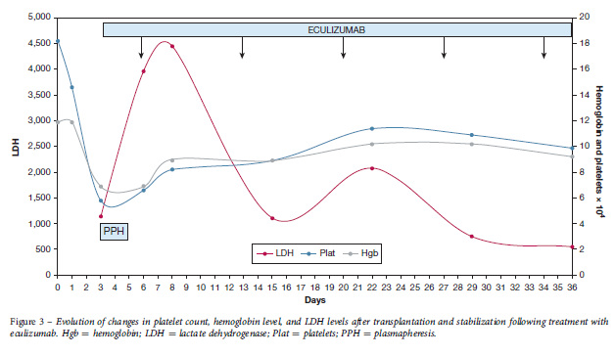
Current recommendations suggest that empiric PPH be started as early as possible, preferably within 24 h of diagnosis. However, if there is a persistence of hemolysis or lack of improvement in renal function after an appropriate trial of PPH, switching to eculizumab is then required.

Slide 23

Case: 이 O 자
PPH
LTx
총 22회

Slide 24
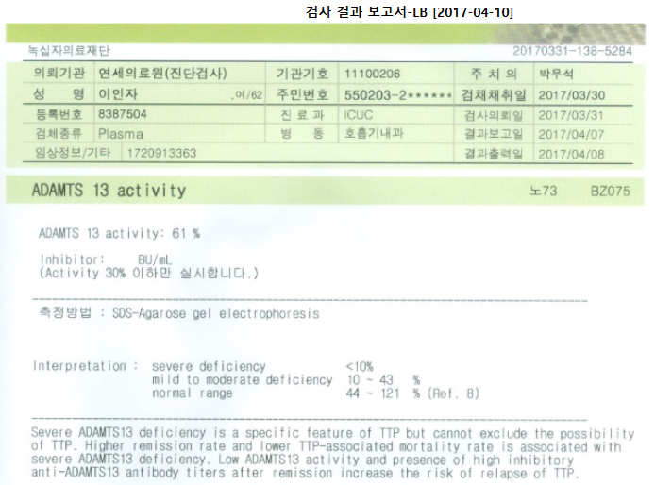
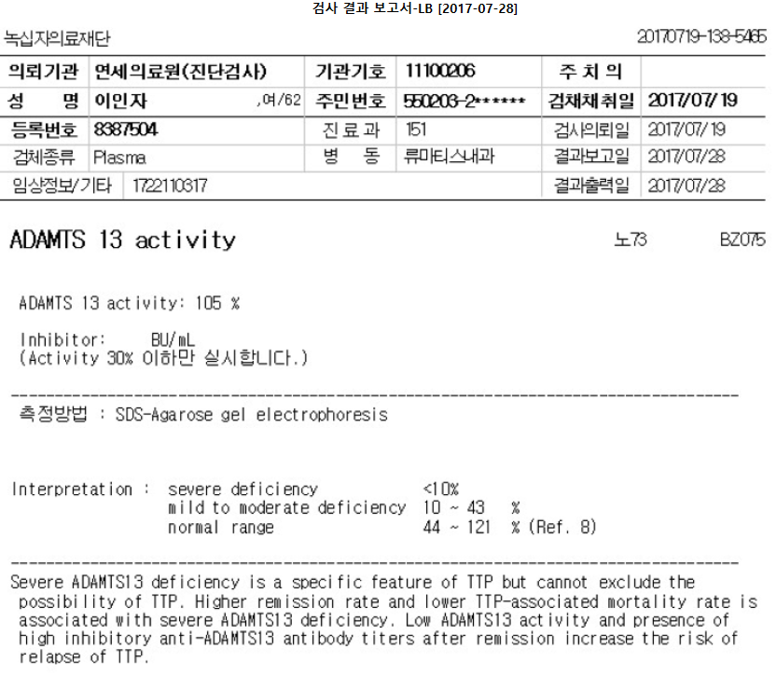
Case: 이 O 자

Slide 25
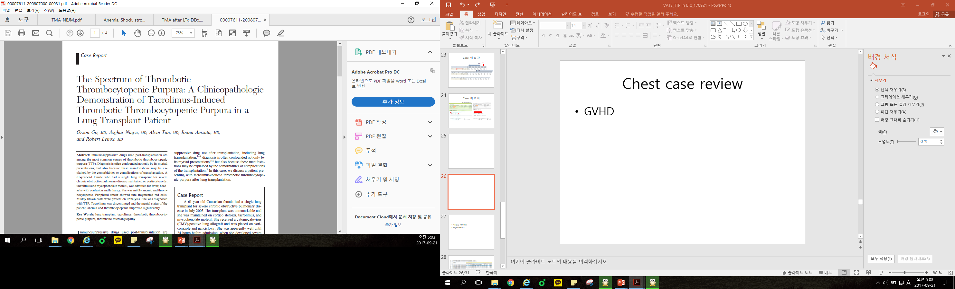
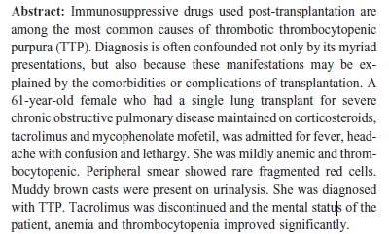
2008, Southern Medical Association

Slide 26
DDx: CVA, infections (CMV enchphalitis), neurologic adverse effects of immunosuppressive agent(leukoencephalopathy, seizure)
confirmed with a kidney Bx.
The diagnosis of TMA is difficult.
  The signs and symptoms are often nonspecific.
  the classic pentad of TTP, including hemolytic anemia, thrombocytopenia, renal insufficiency, neurologic abnormalities, and fever, is often incomplete, especially in drug-induced cases.
  the diagnosis is often obscured by other more common potential complications.

Slide 27
Intravascular platelet thrombi and endothelial cell injury are the histologic hallmarks of thrombotic microangiopathy.
However, kidney biopsy in the setting of thrombocytopenia and potentially “uremic platelets” carries an increased risk of bleeding and may be relatively contraindicated.
An undetectable or abnormally low serum haptoglobin can be highly suggestive of the diagnosis.
TTP is a serious complication after organ transplantation; it requires a high index of suspicion because the presenting signs and symptoms are often nonspecific.

Slide 28
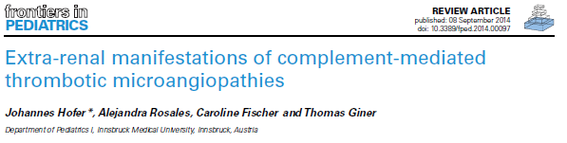
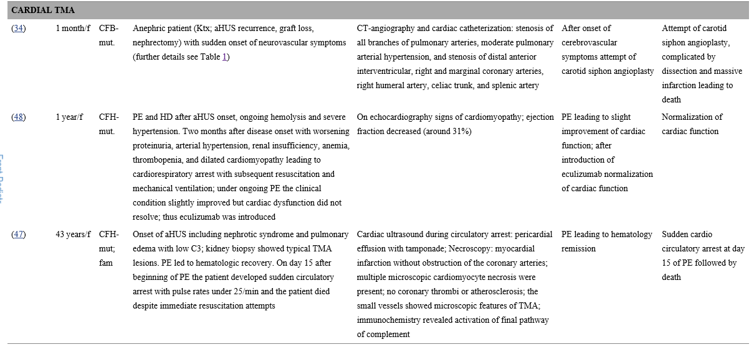

Slide 29
Summary
TMA: the pathological features are vascular damage that is manifested by arteriolar and capillary thrombosis with characteristic abnormalities in the endothelium and vessel wall.
An activation of a complement cascade can present as systemic inflammatory syndrome and TMA after stressful conditions such as SOT in patients.
A combination of microangiopathic hemolytic anemia, thrombocytopenia, and intravascular thrombosis is a rare condition encountered after SOT.
A systematic approach is necessary to identify the cause and to institute appropriate treatment in a timely.
The diagnosis of TMA requires a high index of suspicion.

Slide 30

Thank you for your attention

Slide 31
