Slide 1
VATS Conference
2017.07.20.
Department of pathology

Slide 2
8447012 김O이
SS17-30682
SF17-02821
SF17-02821

Slide 3
SS17-30682
Lung, LUL, bx

Slide 4
SS17-30682
Lung, LUL, bx

Slide 5
SF17-02821
Lung, RUL, wedge resection
ADC, PA, 1.6cm, pT1aN0
EGFR e19del

Slide 6
TTF-1

Slide 7
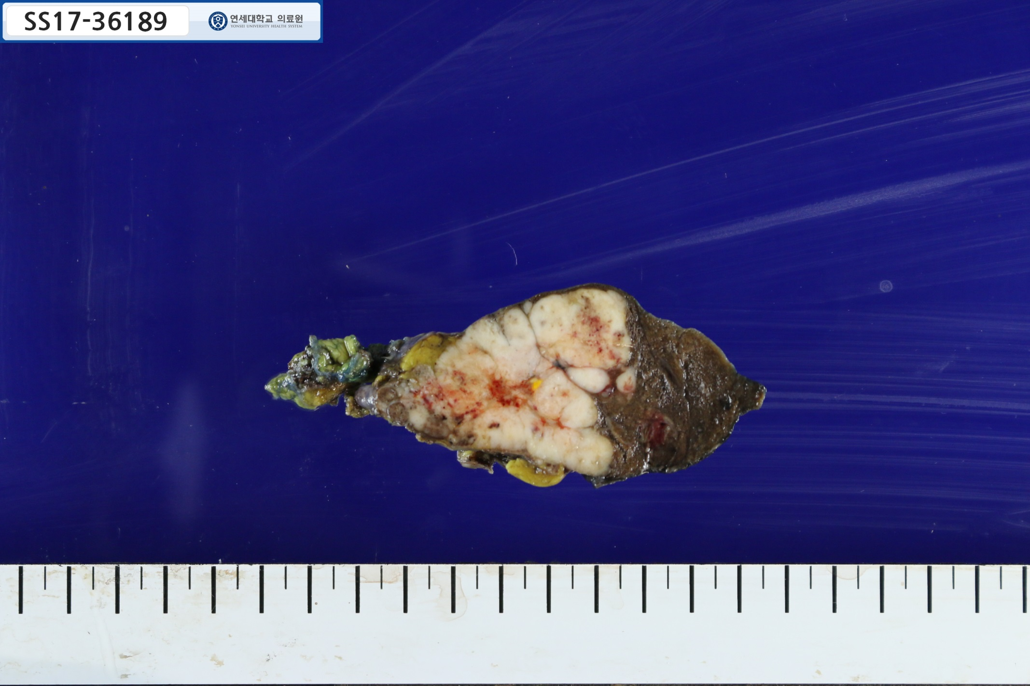
5.5cm

Slide 8
SS17-36189
Thymus and lung (LUL)

Slide 9
8465123 김O지
SS17-35395

Slide 10
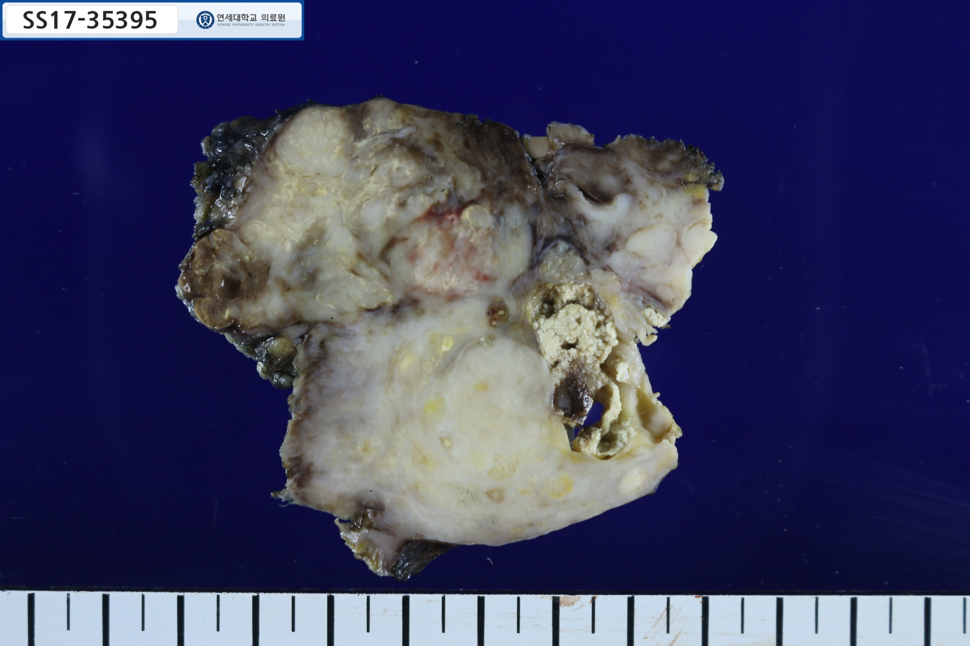
7cm

Slide 15
CK20
CDX2
p40
CD5

Slide 16
8468193 이O진
SS17-36854

