Slide 1
VATS conference
2017. 04. 20.
Department of pathology

Slide 2
8406324 OO HASAN F/40
SS17-15521

Slide 3
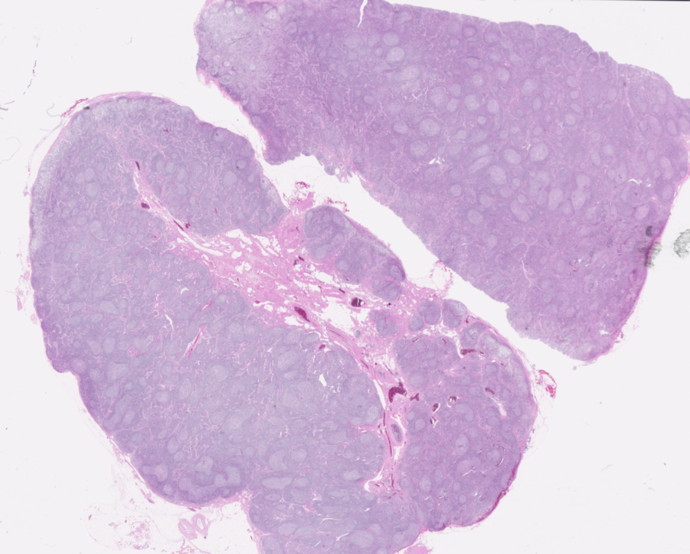
Lymph node, right common iliac

Slide 4
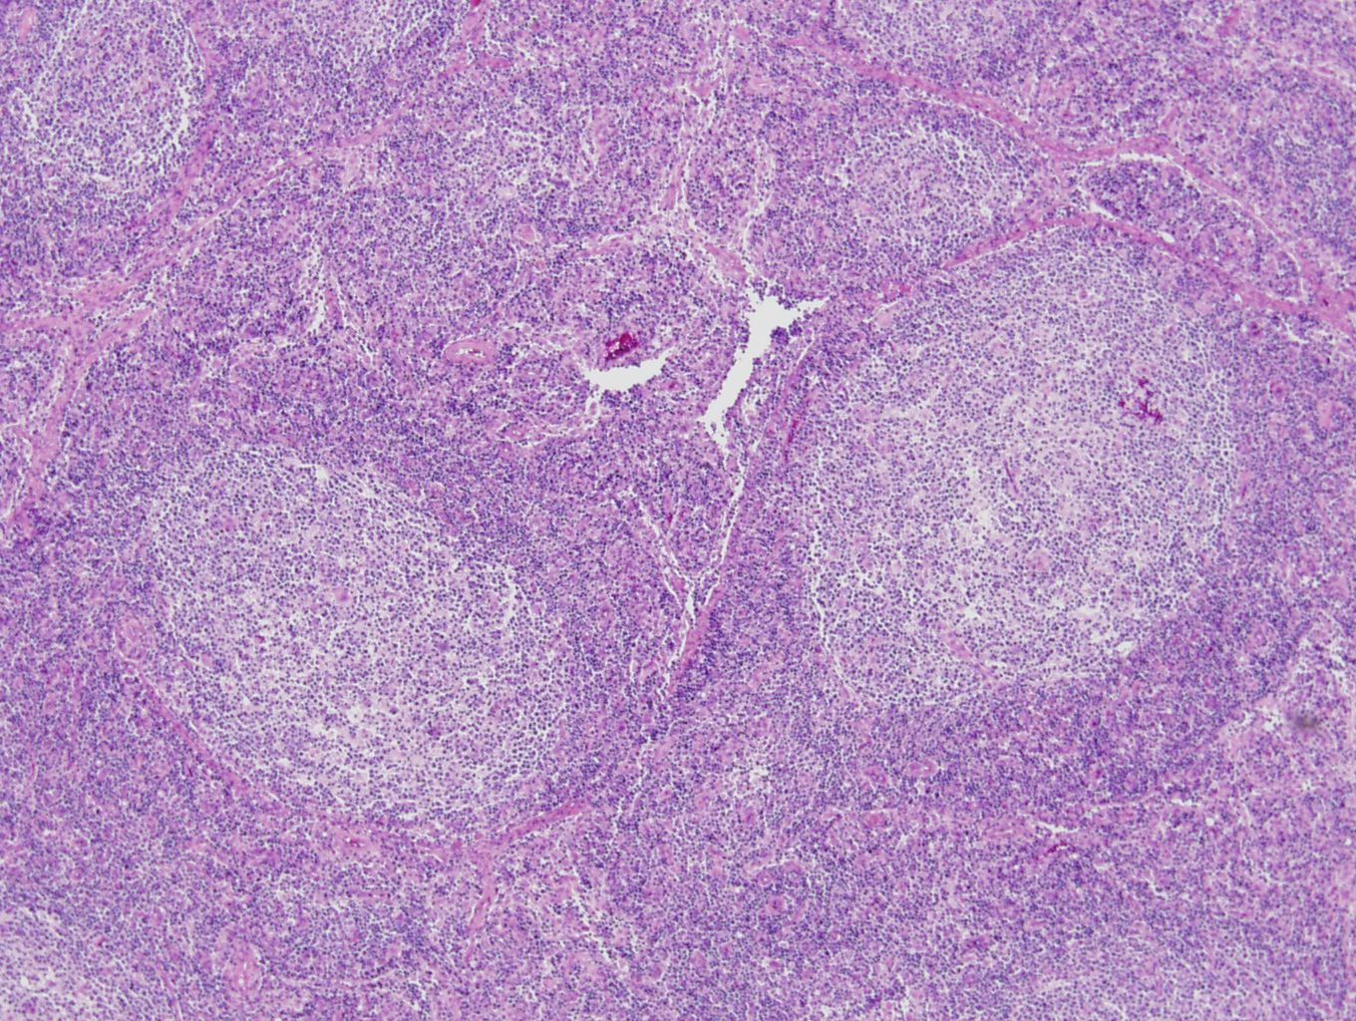

Slide 5
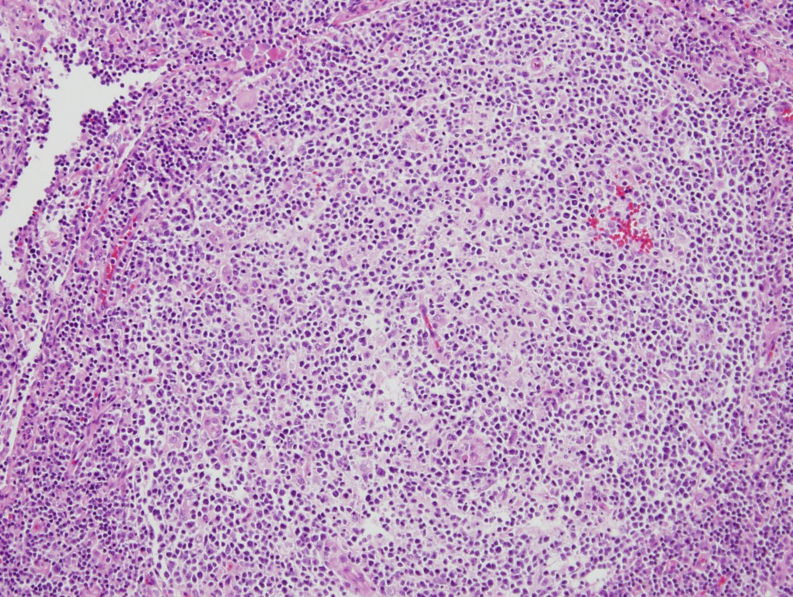

Slide 6
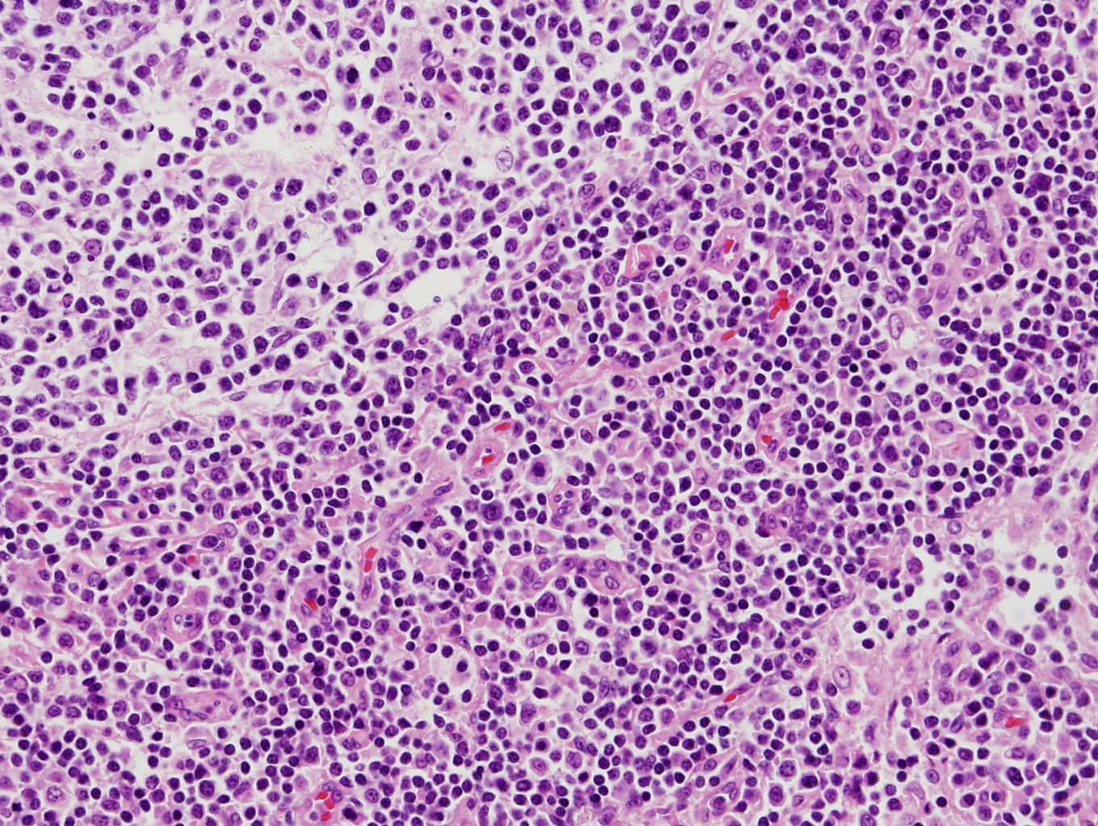
Notes:
In the plasma cell type, an extensive infiltrate by plasma cells is seen in the interfollicular areas. Some patients may be infected by human herpervirus-8 (HHV-8) which may induce interleuchin-6 (IL-6 or IL6) overproduction. IL-6 is believed to play an essential role in the pathogenesis of the disease.

Slide 7
N. Right common iliac: Lymphoid follicular proliferation with increased interfollicular plasma cells, most likely Castleman disease, plasma cell variant, see note.
A. Right ovarian cyst: Consistent with endometriotic cyst
B. Left ovarian cyst: Organizing thrombus
Note)
1. The immunohistochemical stain results:
CD20 (L26): Diffusely expressed in germinal center B cells
CD3 (T-cell): Expressed in reactive T cells
Bcl-2: Not expressed in germinal center
Bcl-6: Expressed in germinal center
CD30: Negative
Herpes virus 8 (HHV-8): Negative
IgG4 positive plasma cells: 85/HPF
IgG4+/IgG+ ratio: 85/243 = 35%

Slide 8
8367561 김O희 F/30
SF17-01373

Slide 9
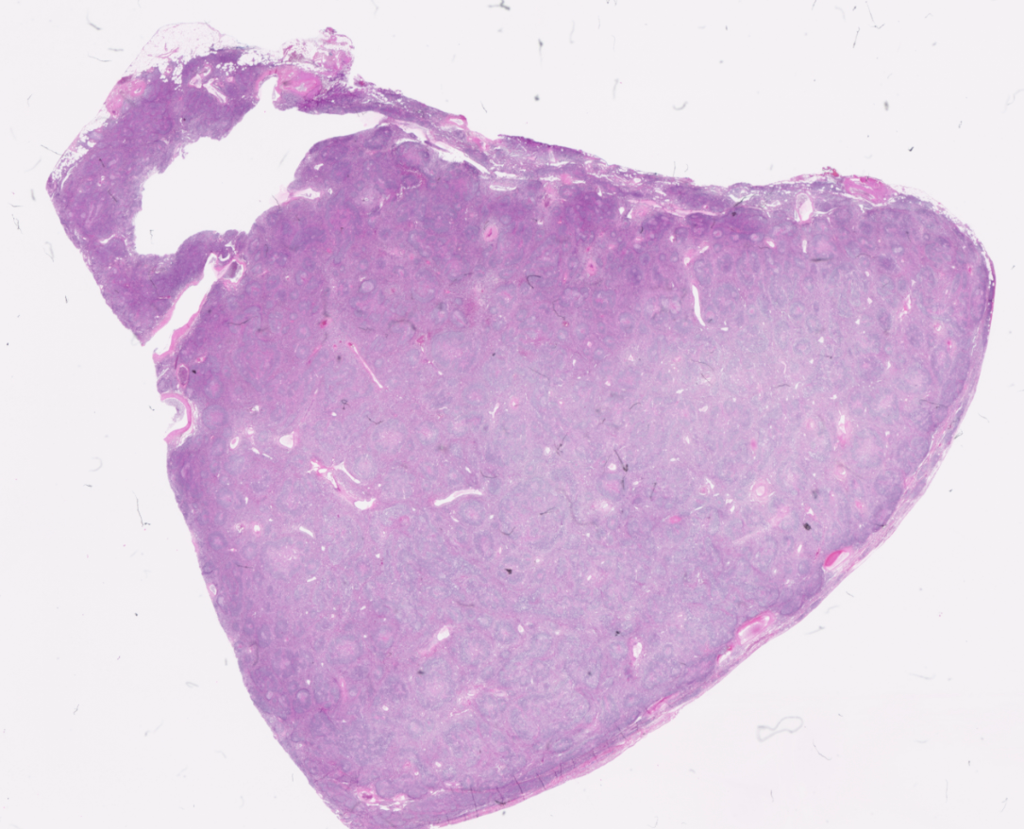
Mediastinum, left, mass excision

Slide 10
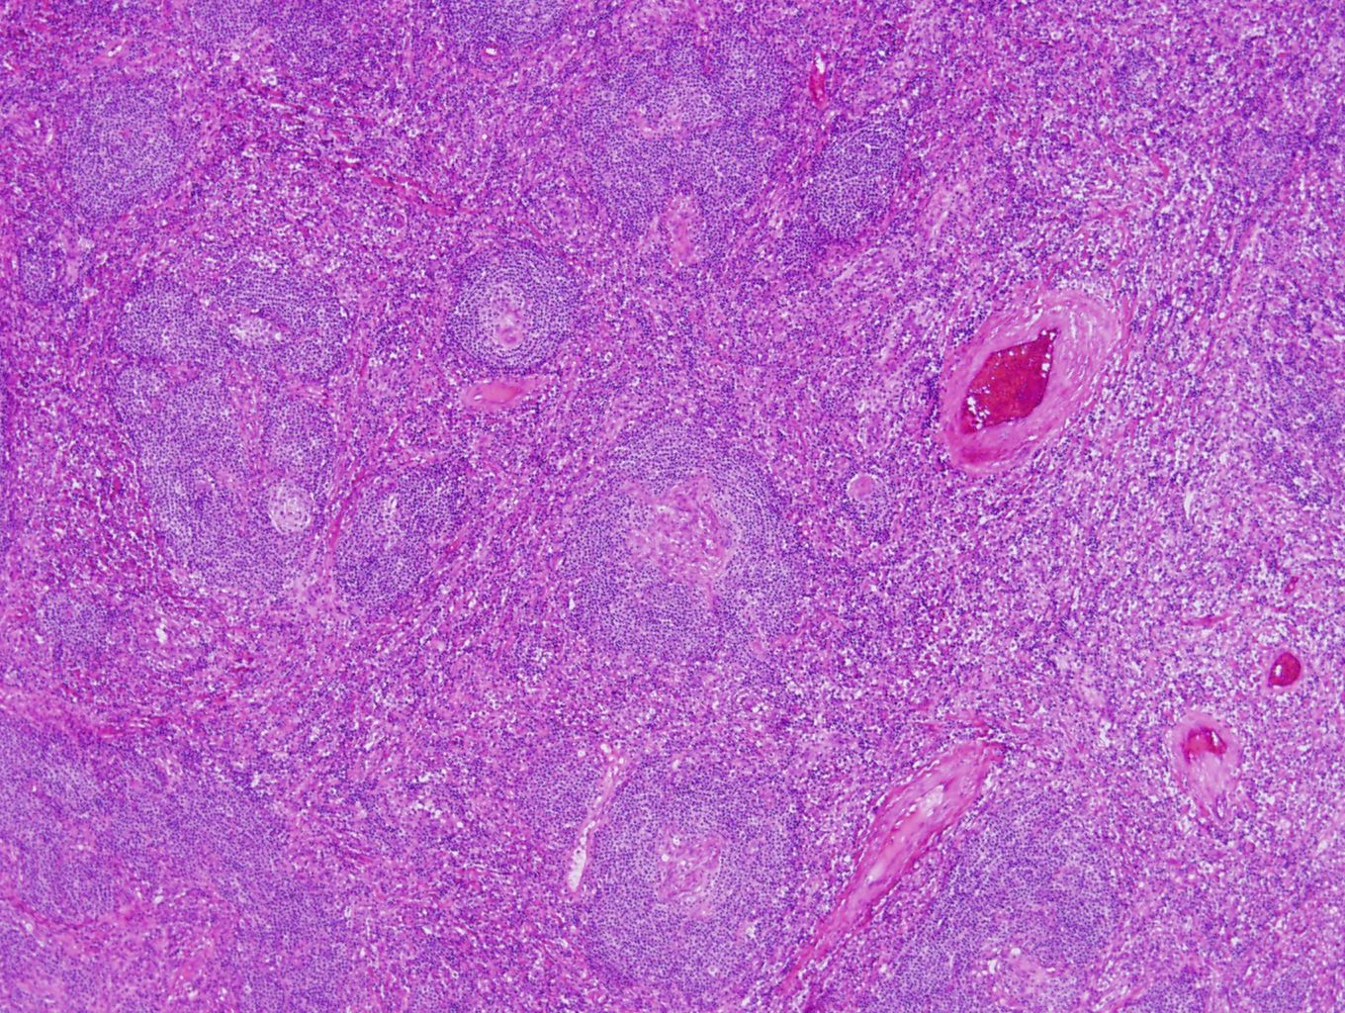
Notes:
In the hyaline-vascular type, numerous lymphoid follicles contain small germinal centers, some of which are depleted lymphocytes and composed of concentrically arranged eosinophilic cells penetrated by small capillaries, so-called hyaline-vascular lesions. Vascular proliferation in the interfollicular area is also present.

Slide 11
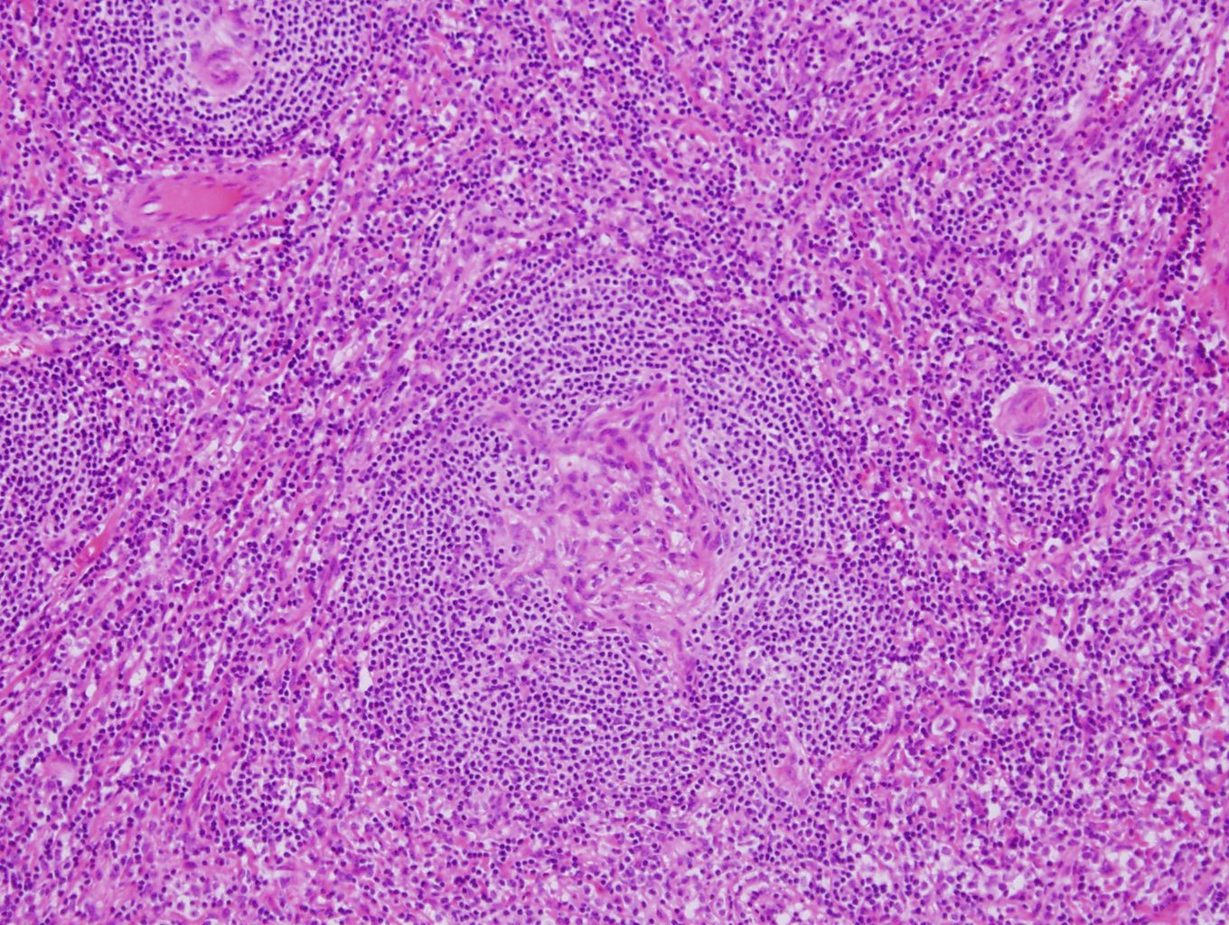
Notes:
In the hyaline-vascular type, there are shrunken germinal centres with concentric expansion of the mantle zones with eosinophils and hyalinization around the vessels.

Slide 12
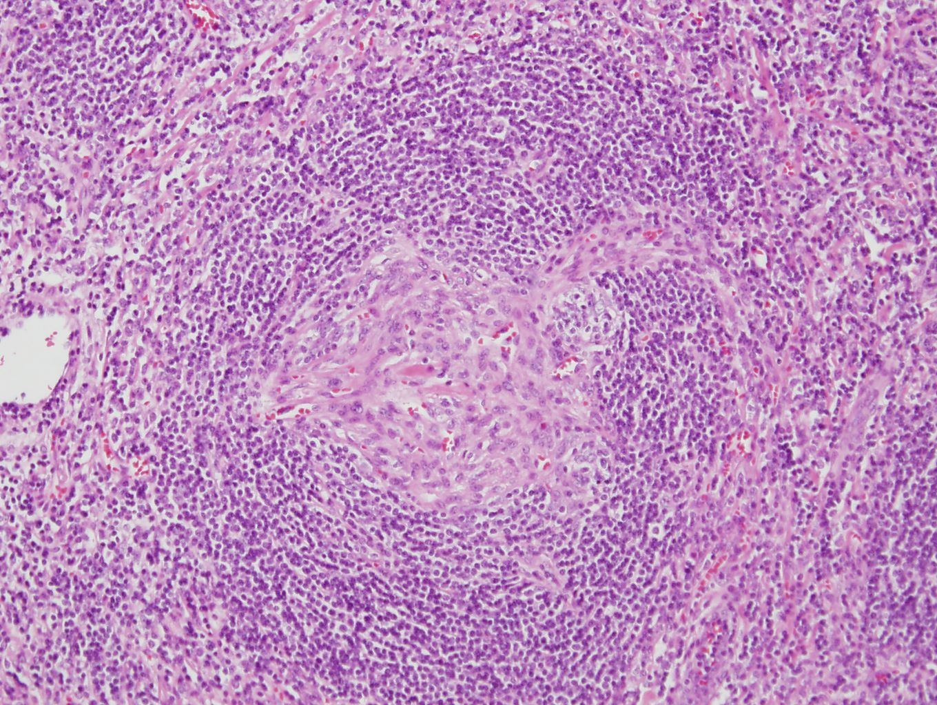

Notes:
In the hyaline-vascular type, there are shrunken germinal centres with concentric expansion of the mantle zones with eosinophils and hyalinization around the vessels.

