Slide 1
VATS conference
2016-07-21
Department of Pathology

Slide 2
3587499 박O규 M/61
SS16-20481, Bx
SS16-32322, Op

Slide 3
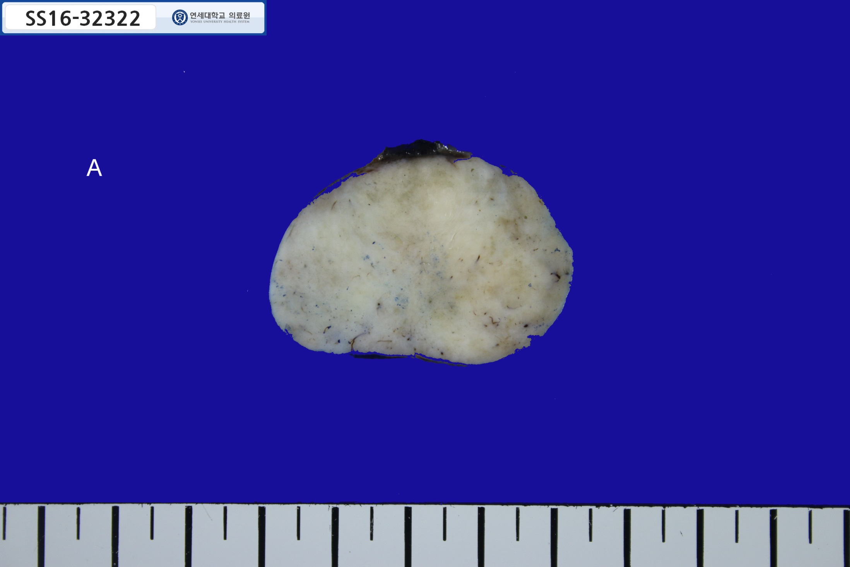
4.2cm

Slide 4
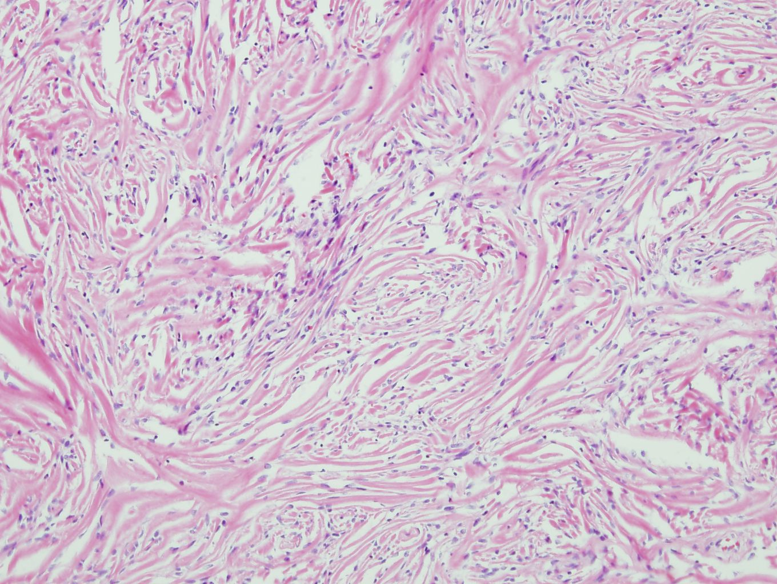

Slide 5
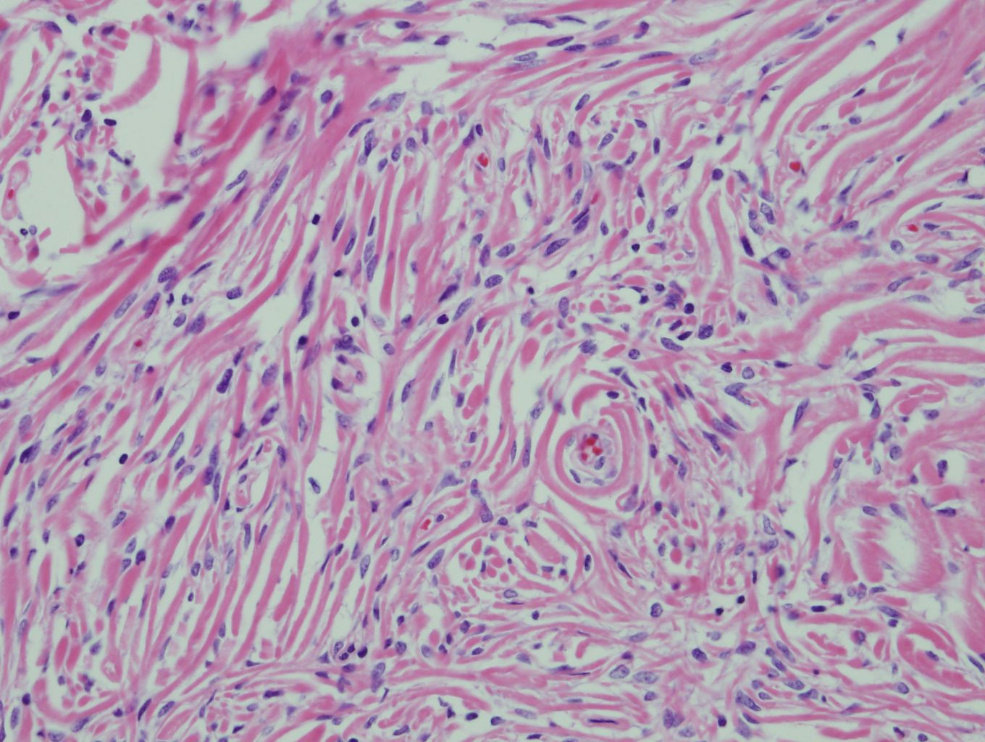

Slide 6
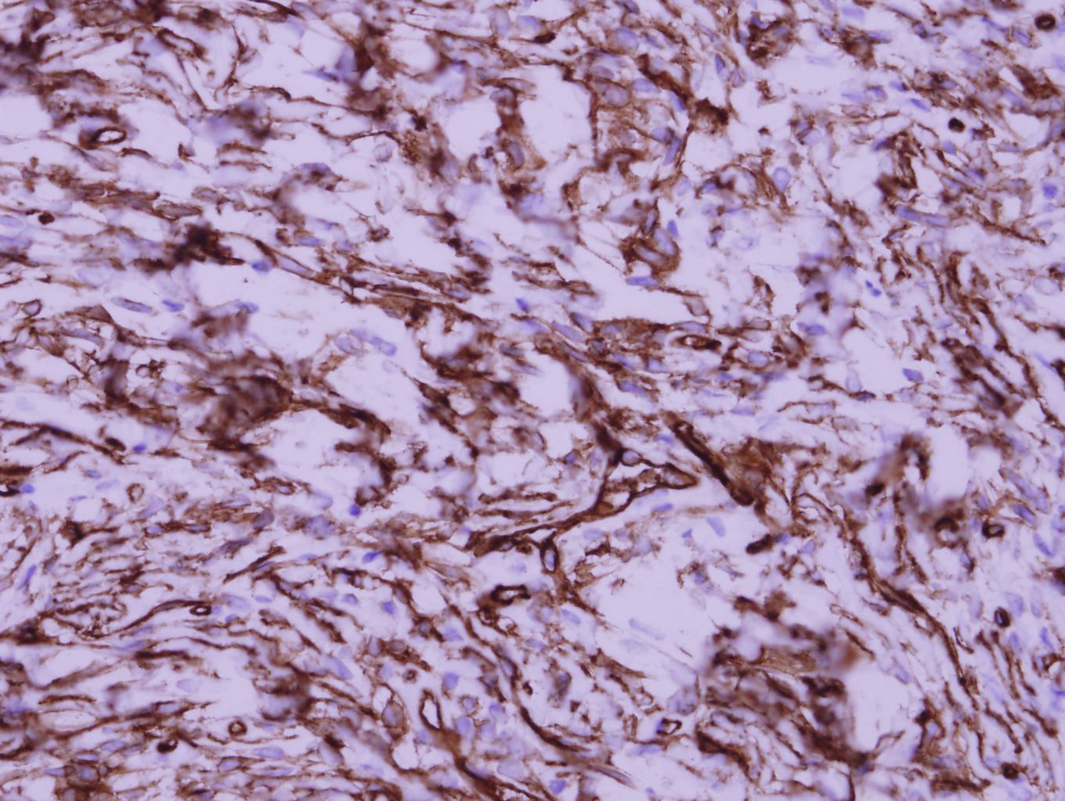
CD34

Slide 7
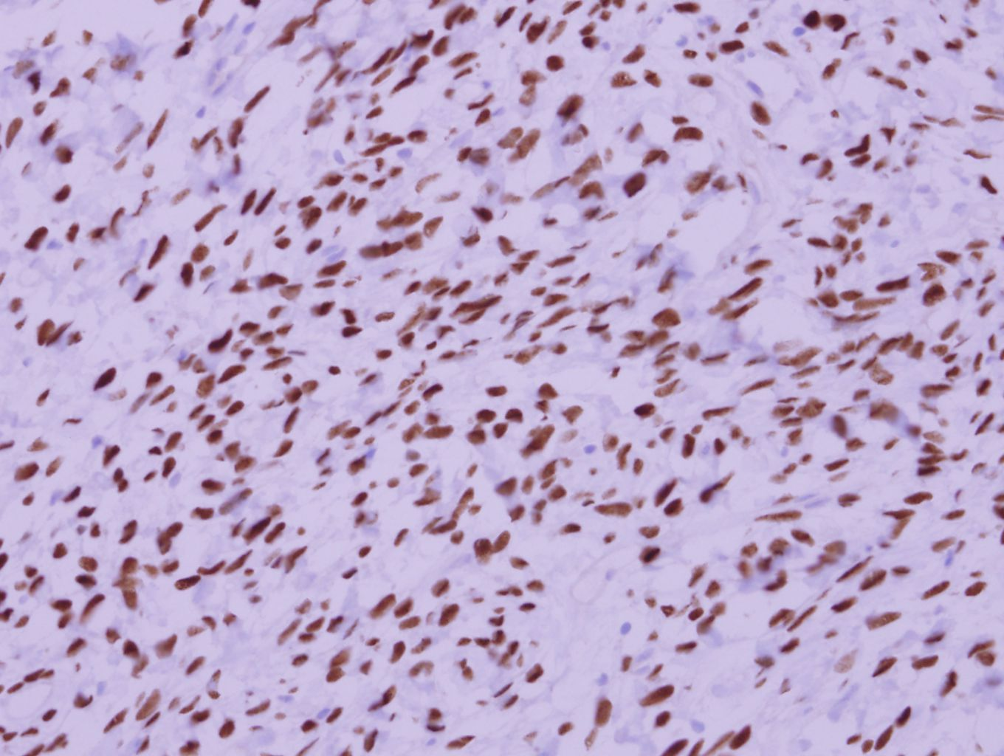
STAT6

Slide 8
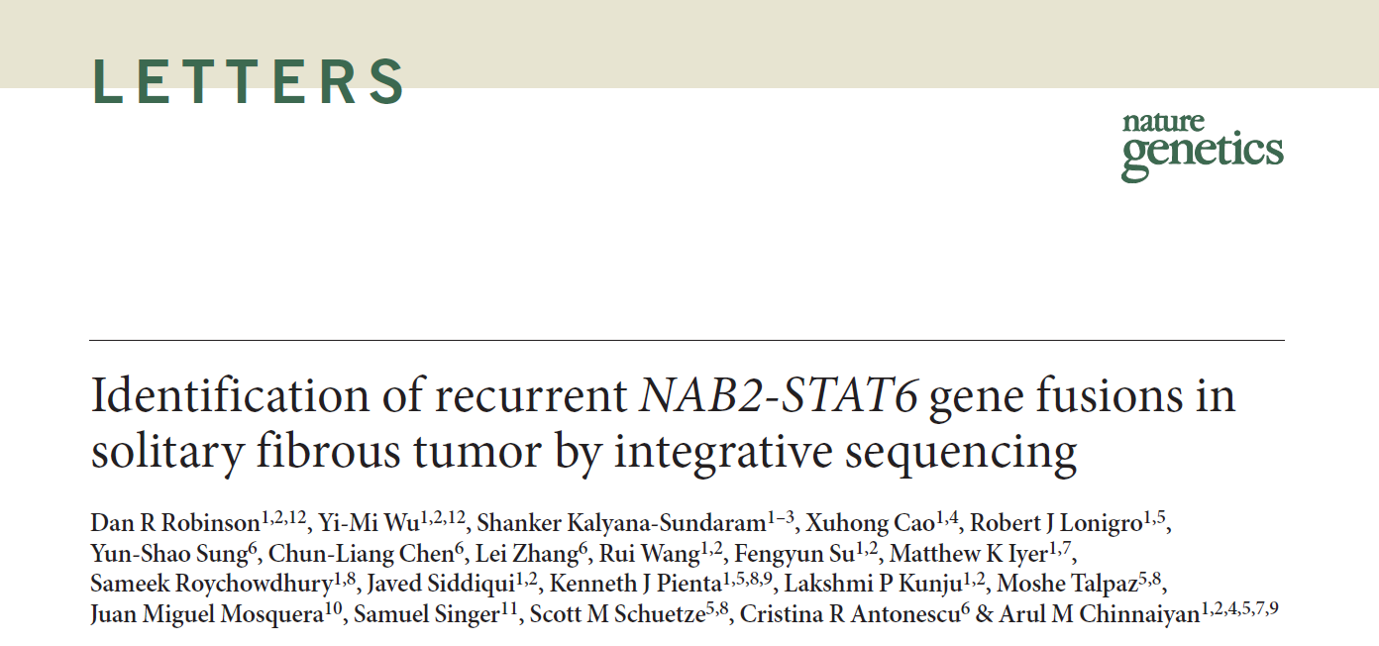
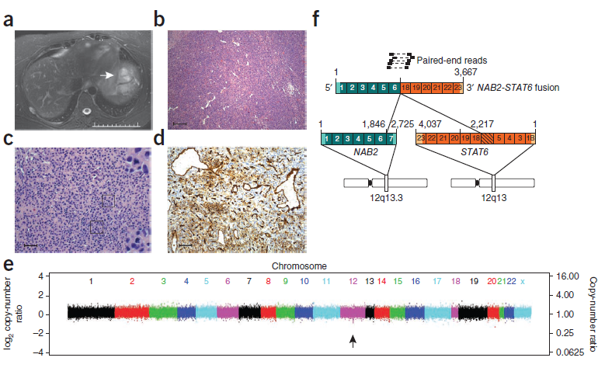
Nat Genet 2013; 45: 180-185.

Slide 9
5828316 김O수 M/67
SS15-66201

Slide 10
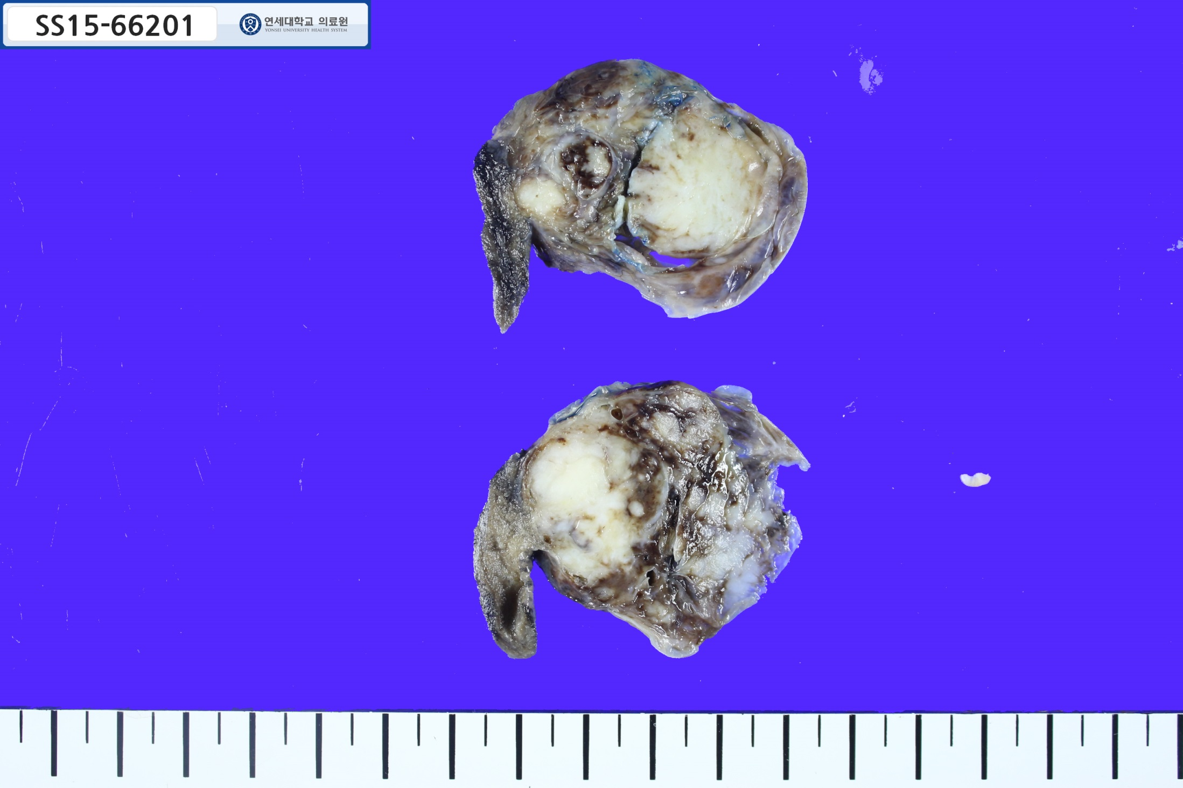
3.5cm

Slide 11
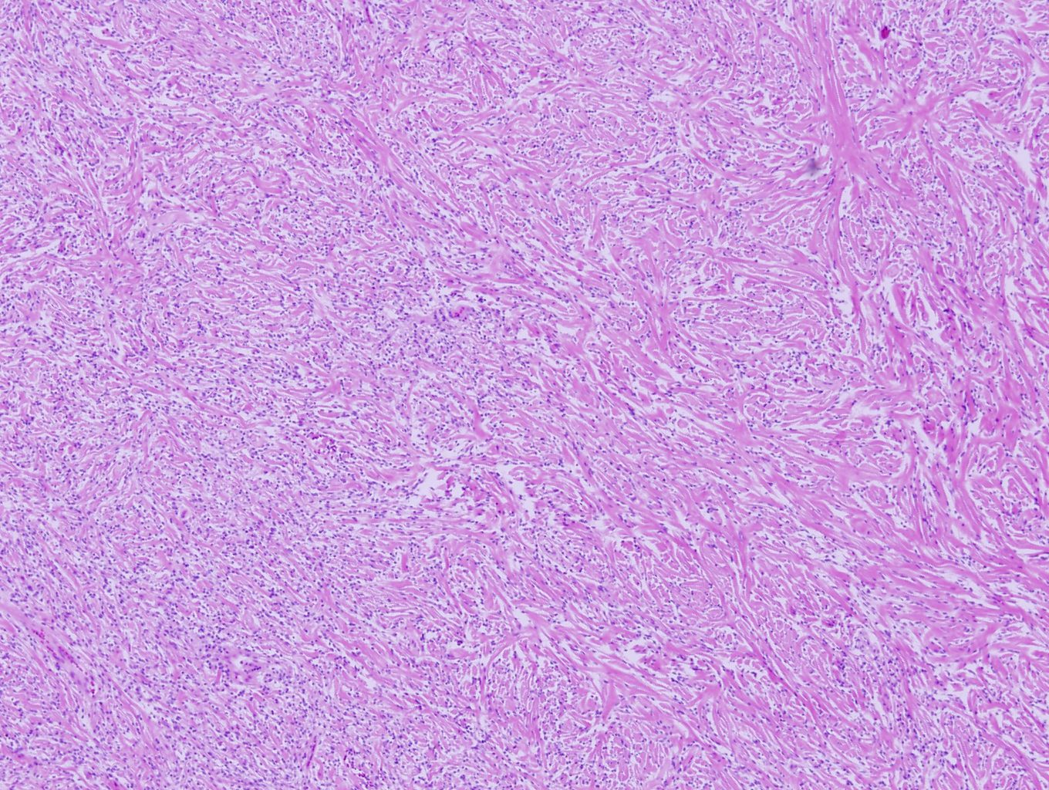

Slide 12
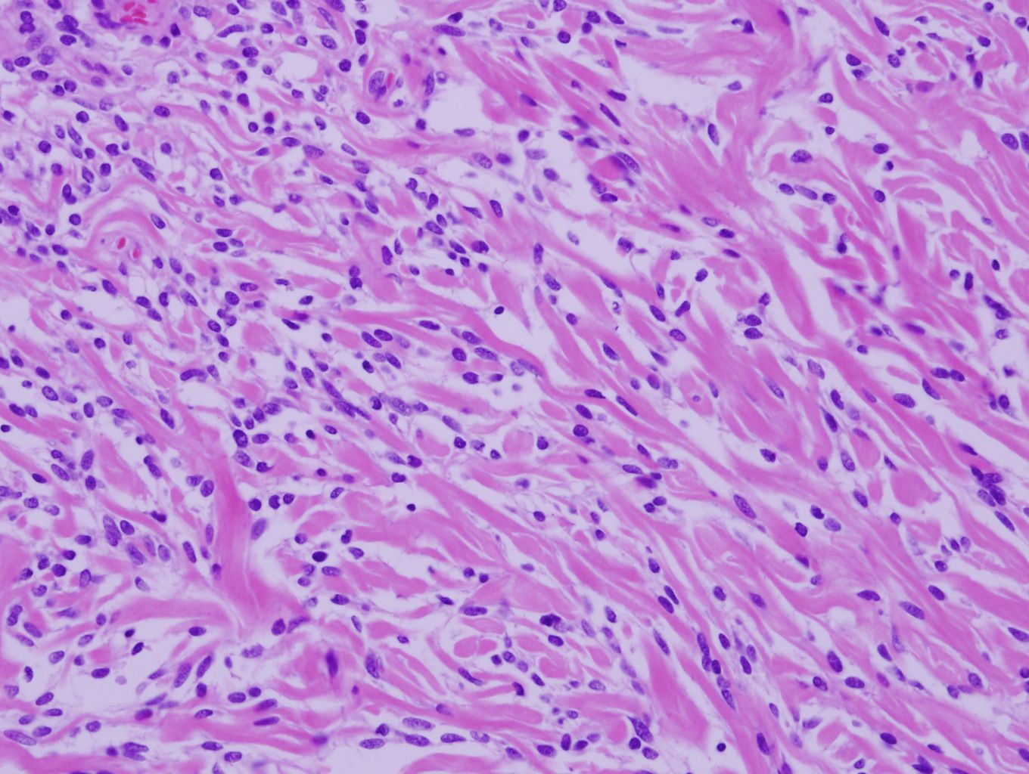

Slide 13
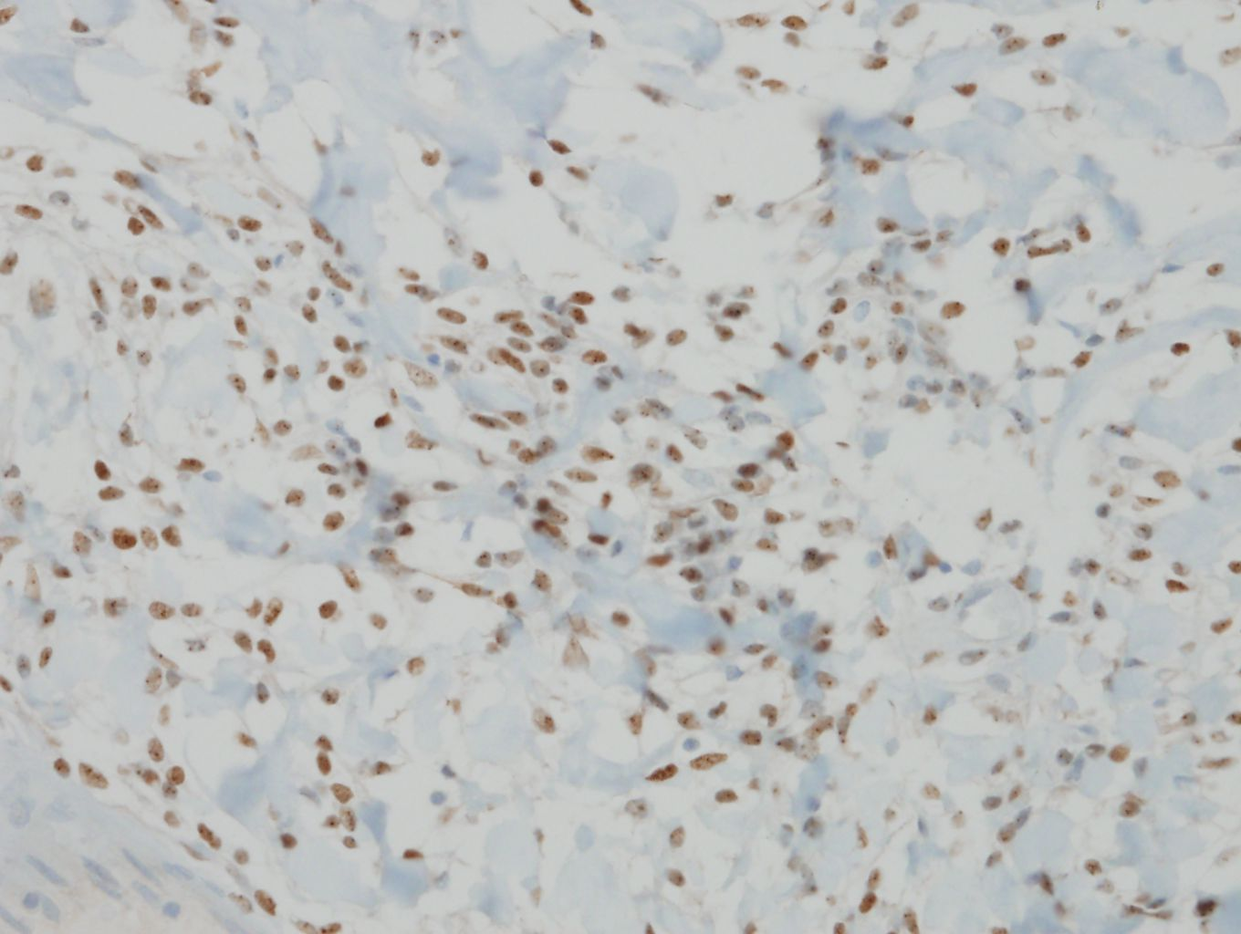
STAT6

Slide 14
5171289 이O섭 F/77
SS06-45613

Slide 15
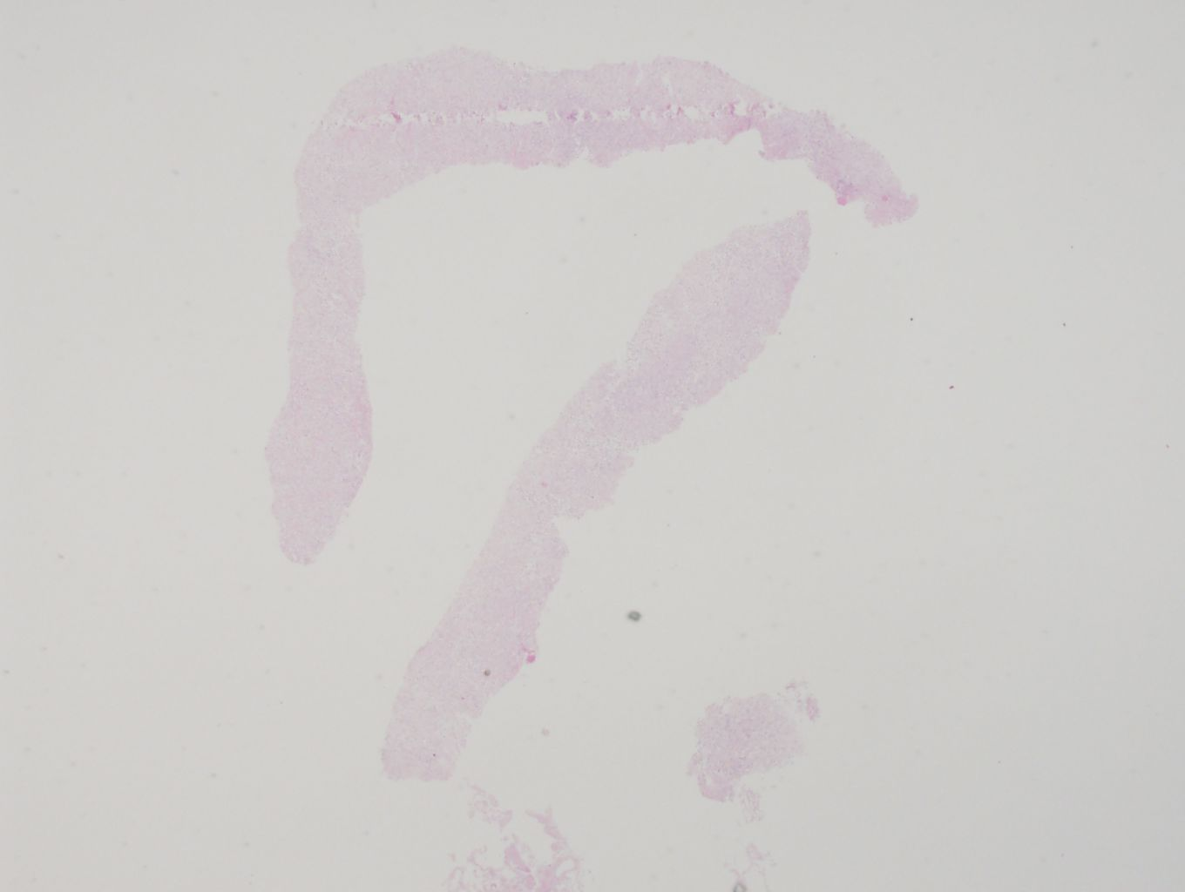

Slide 16
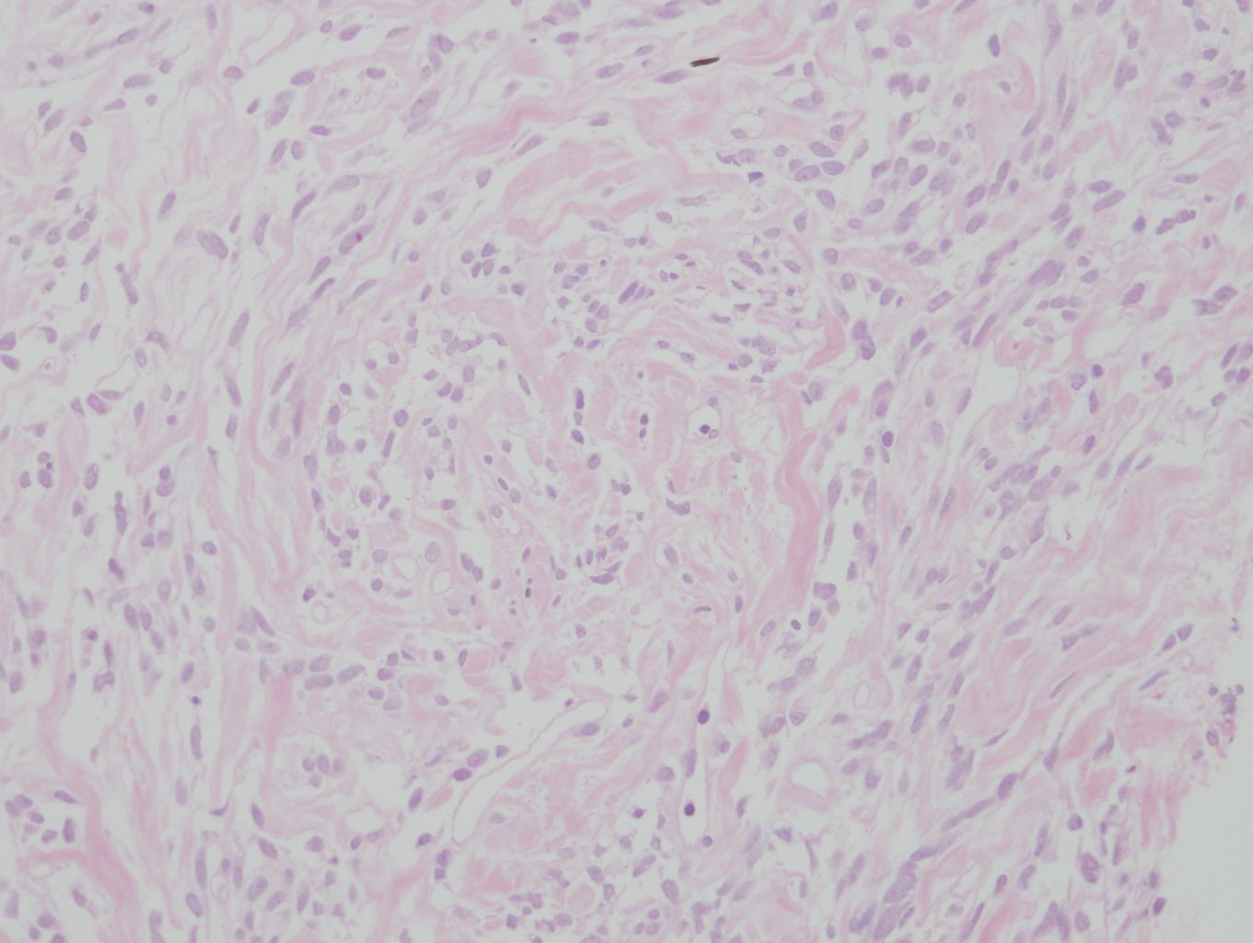

Slide 17
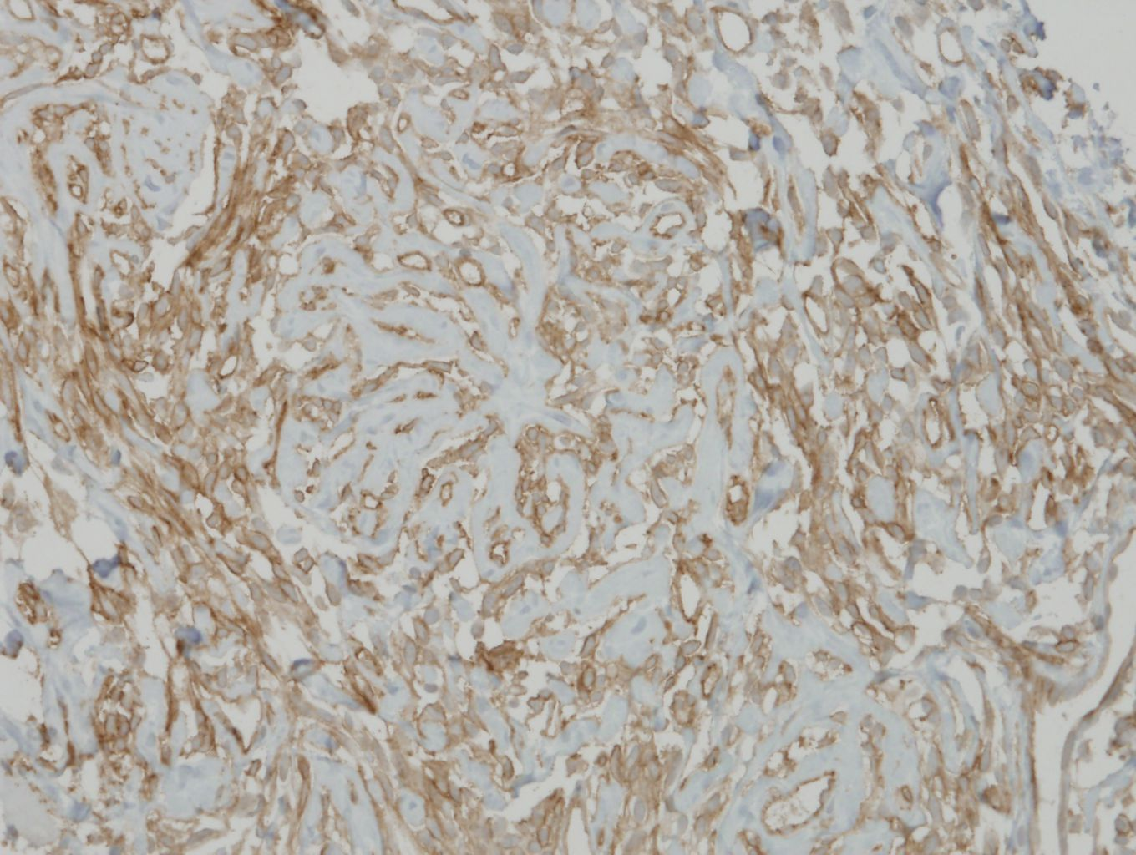
CD34

