Slide 1
VATS conference
2016-06-23
Department of Pathology

Slide 2
3036682 김O환
SS05-21778

Slide 3
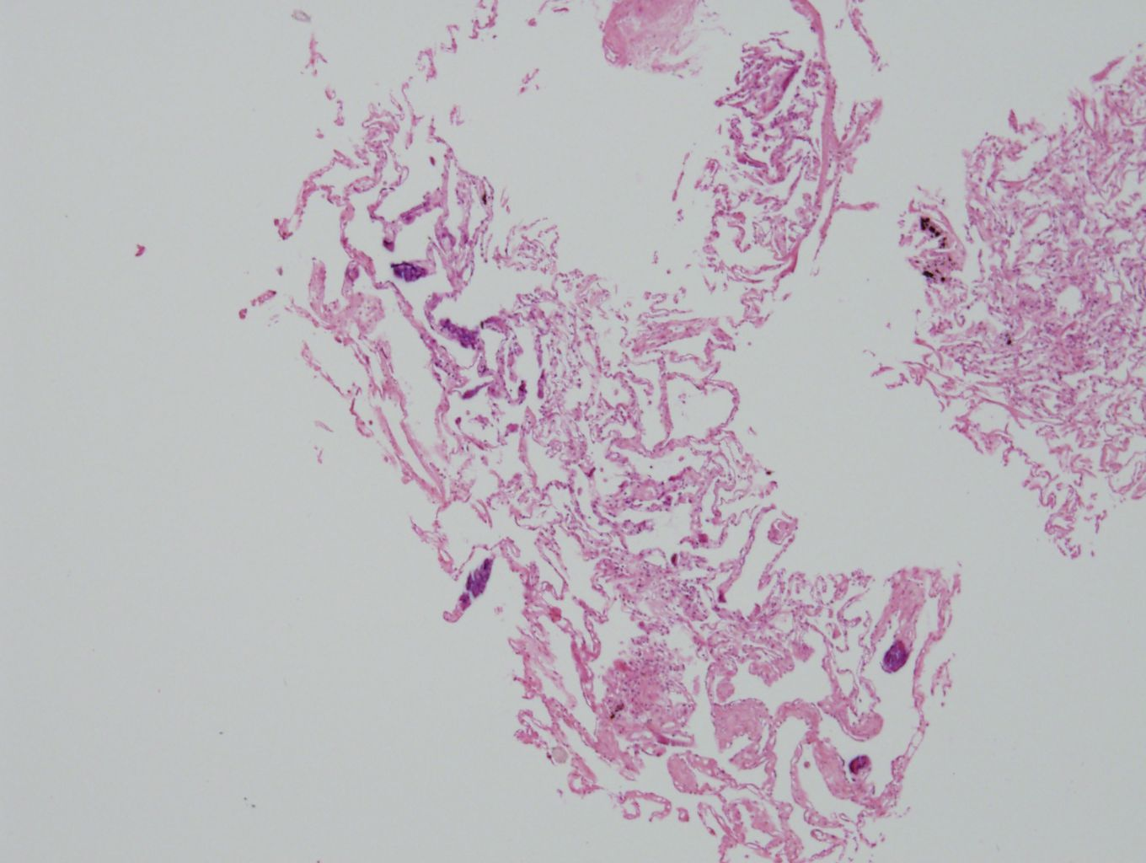

Slide 4
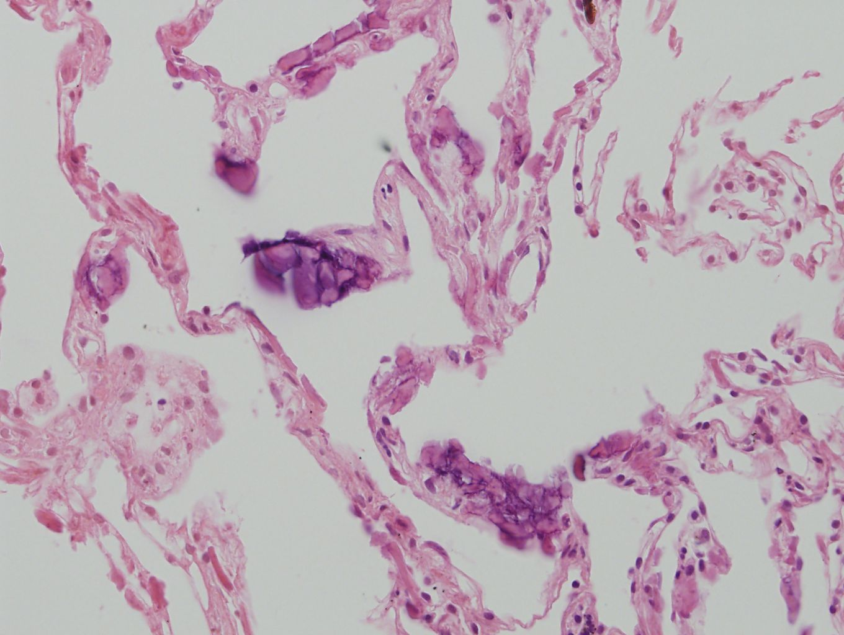

Slide 5
7738981 정O자
SS15-32959

Slide 6
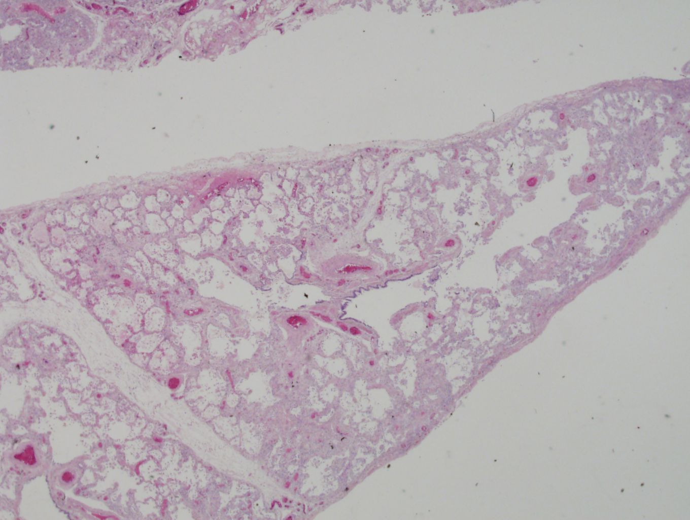
LLL

Slide 7
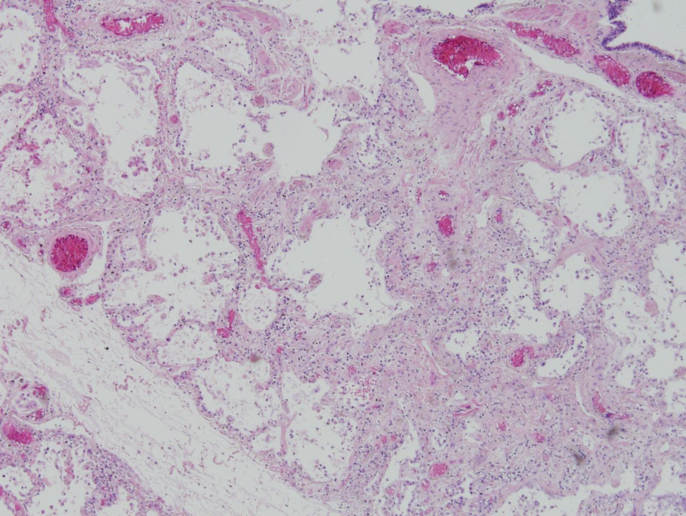
LLL

Slide 8
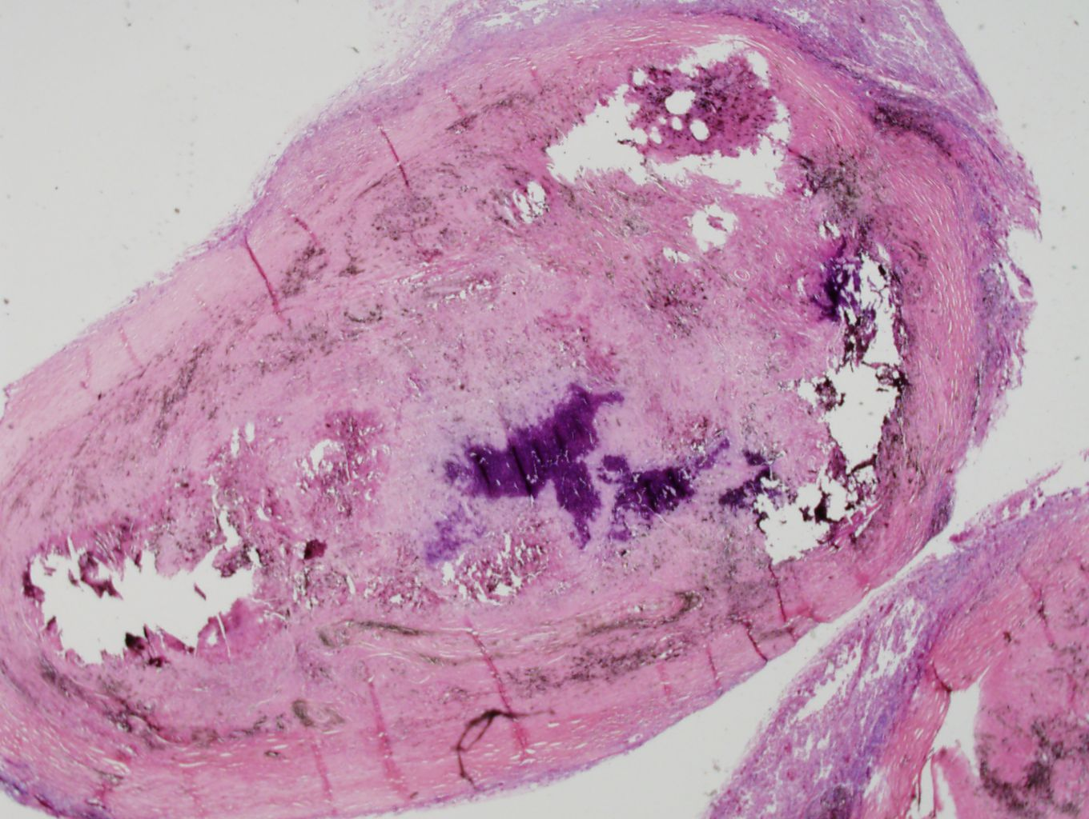
LLL

Slide 9
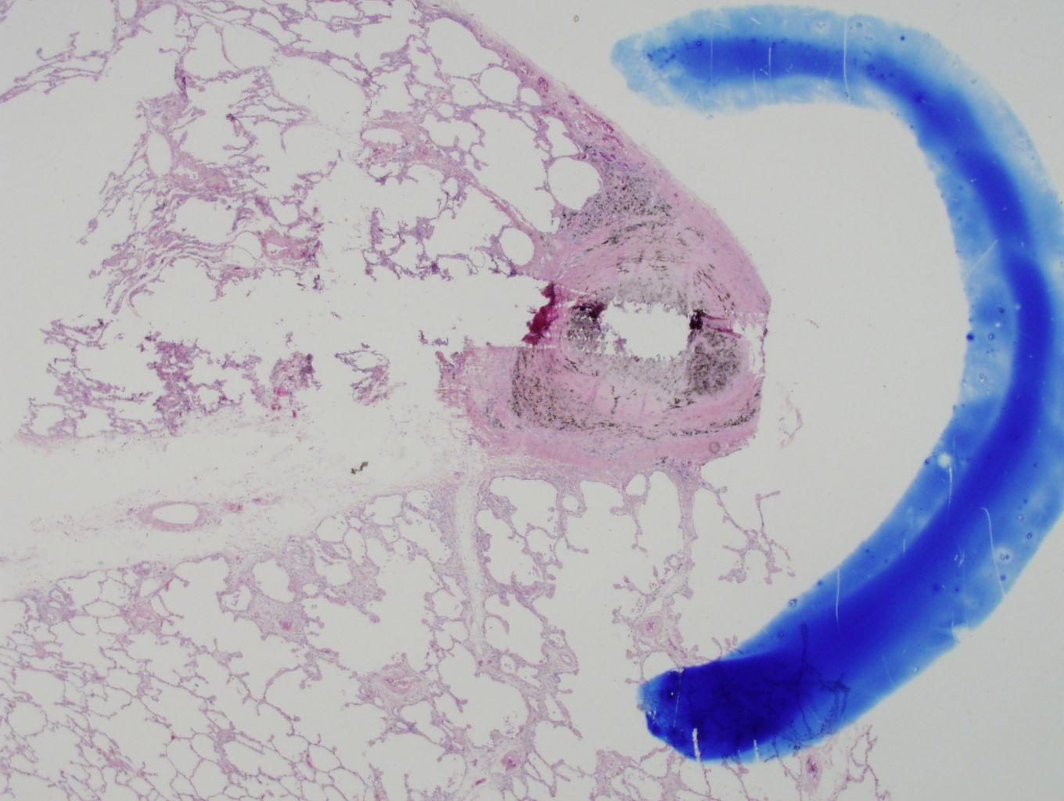
LUL

Slide 10
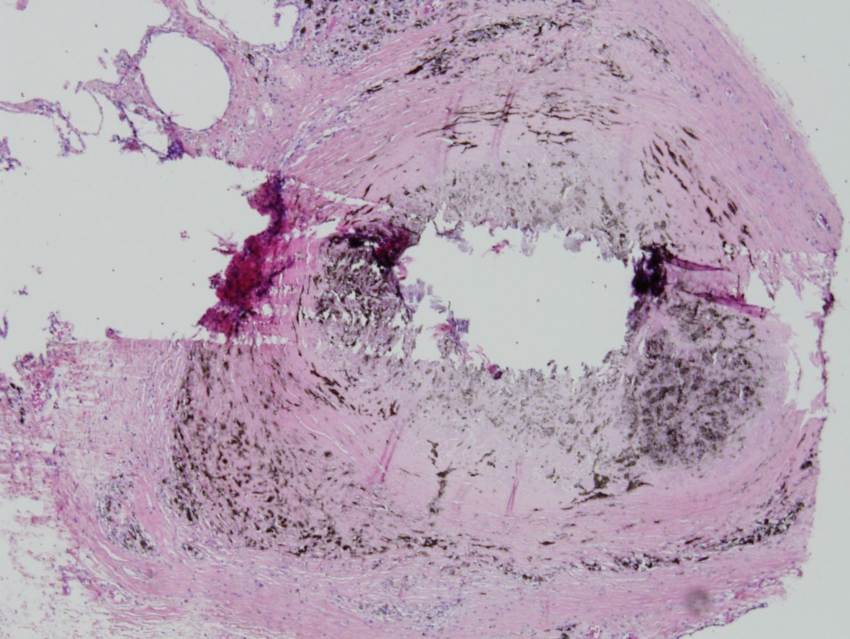
LUL

Slide 11
1608759 이O훈
SS16-26044

Slide 12
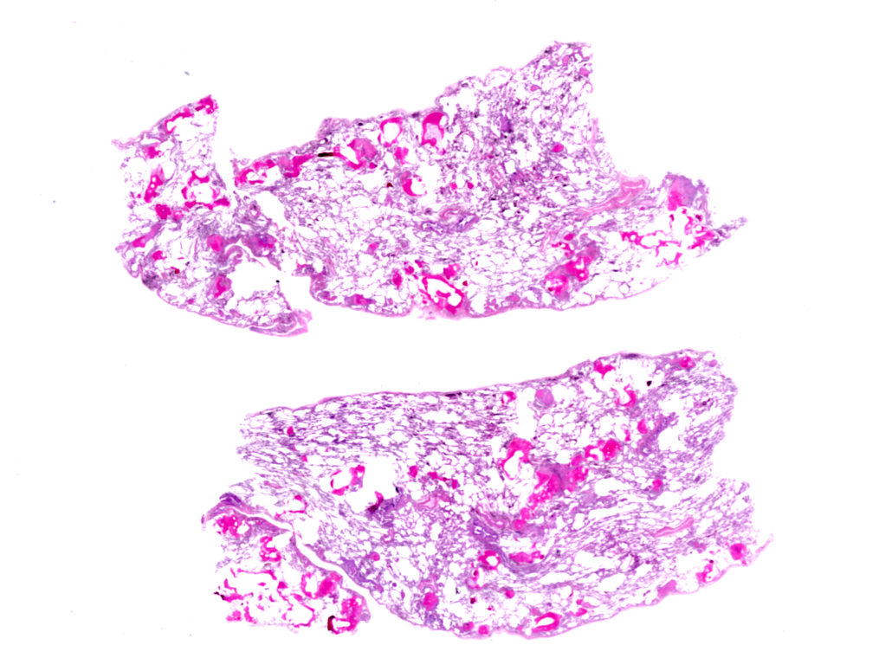

Slide 13
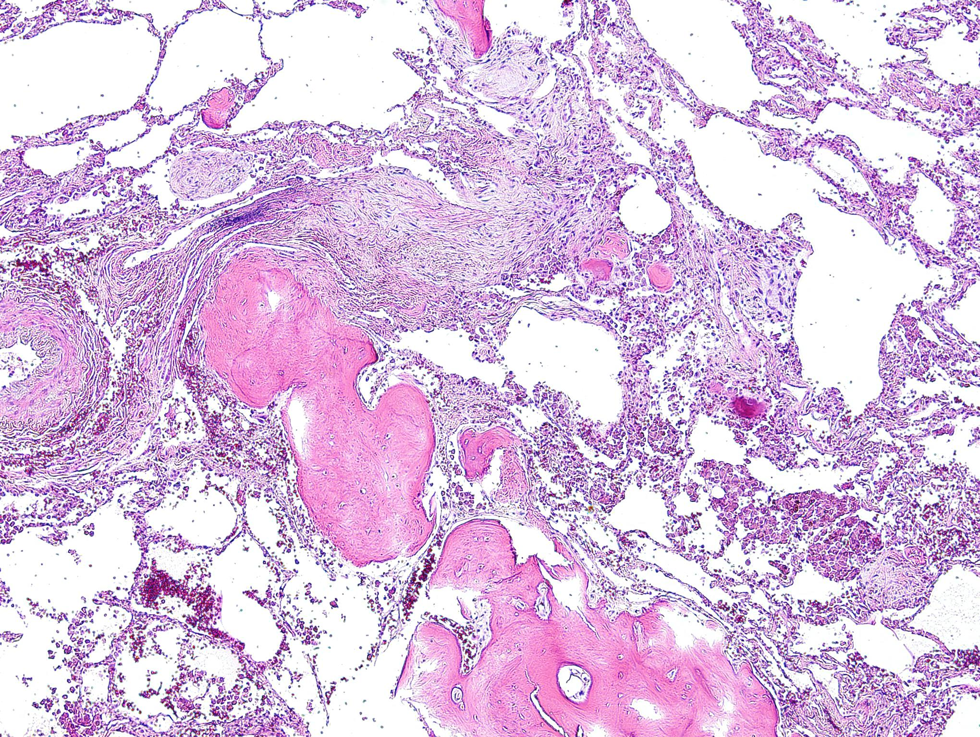

Slide 14
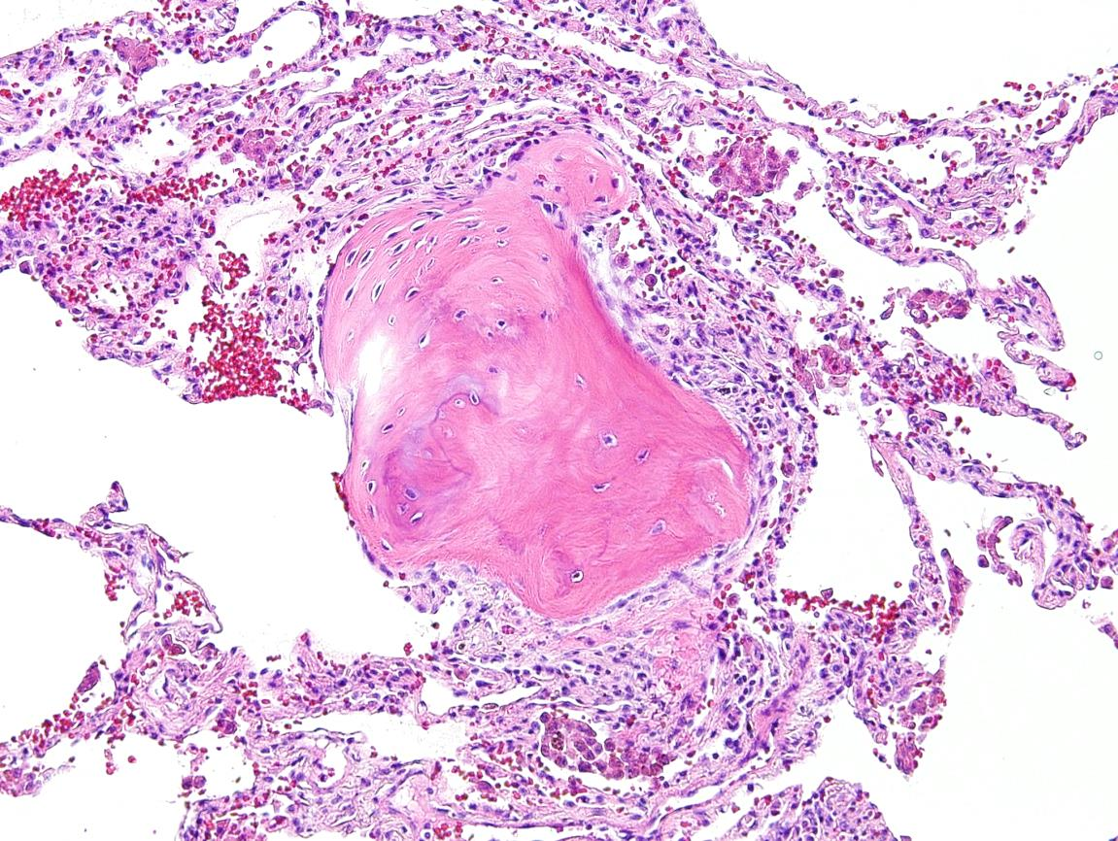
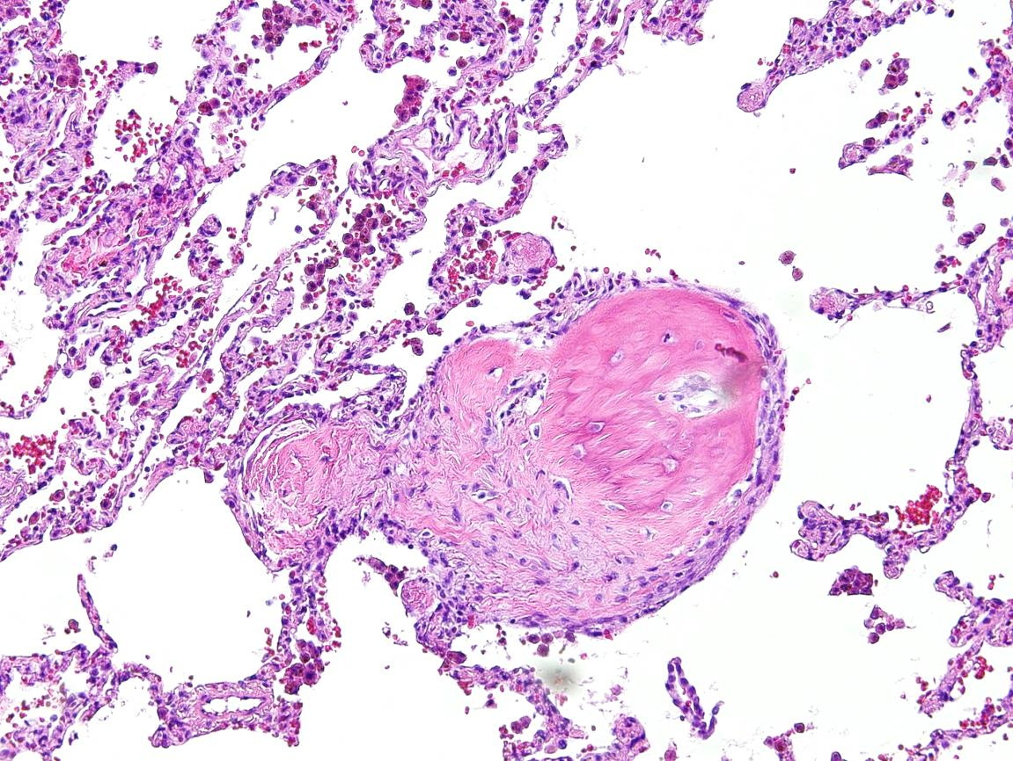
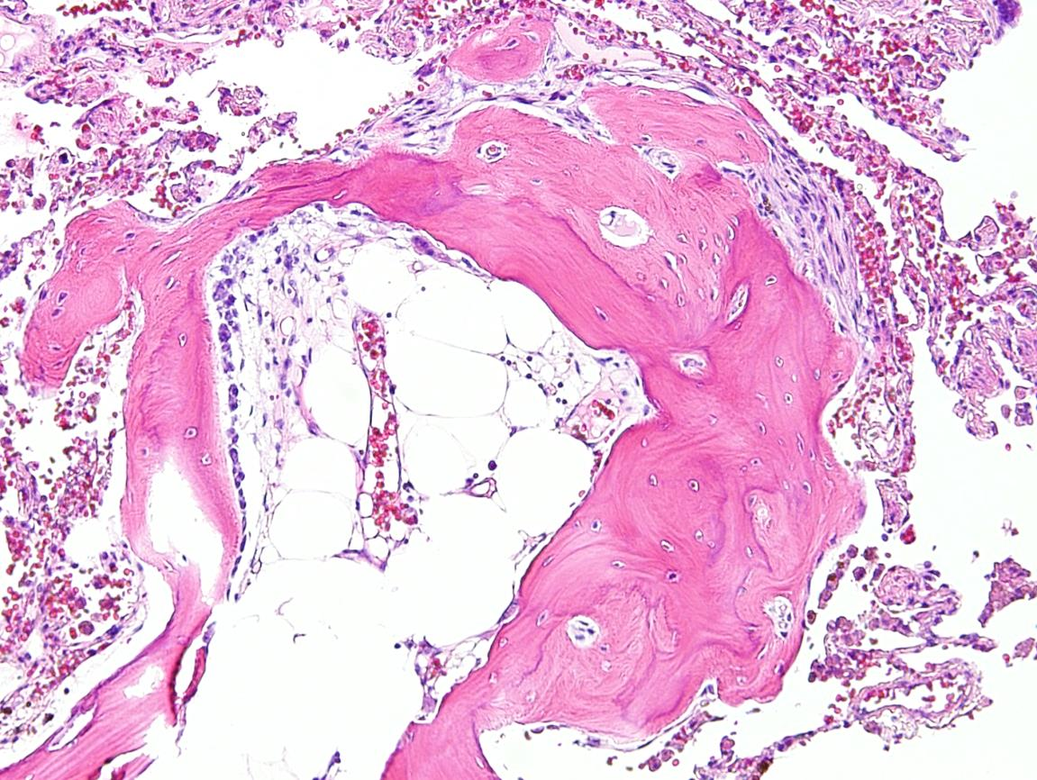
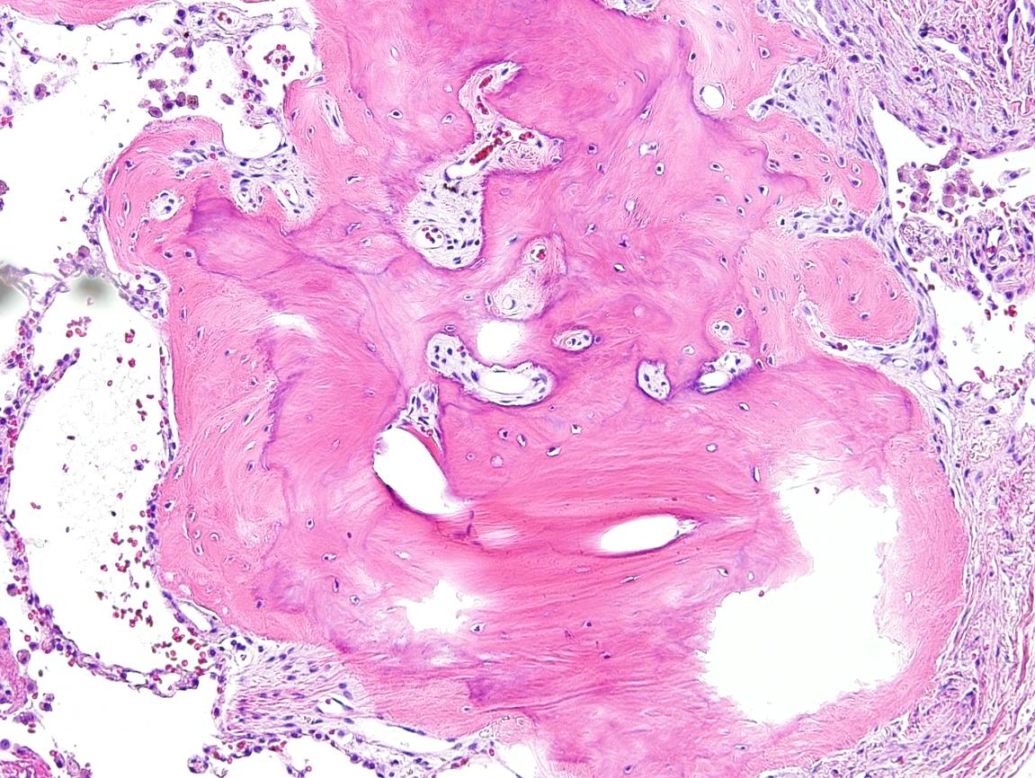

Slide 15
pulmonary ossifications
Nodular pulmonary ossification
- patients with chronic venous congestion (long standing MS)
affects alveolar spaces, preferentially lower lobes
Dendriform pulmonary ossification
‑ patients with interstitial fibrosis
preferentially affects the alveolar interstitium, expanding the alveolar septa rather than the alveolar spaces.
May contain either marrow elements or fat

