Slide 1
VATS conference
Pathology

Slide 2
8070249 홍O수 75/M
SS15-31404

Slide 3
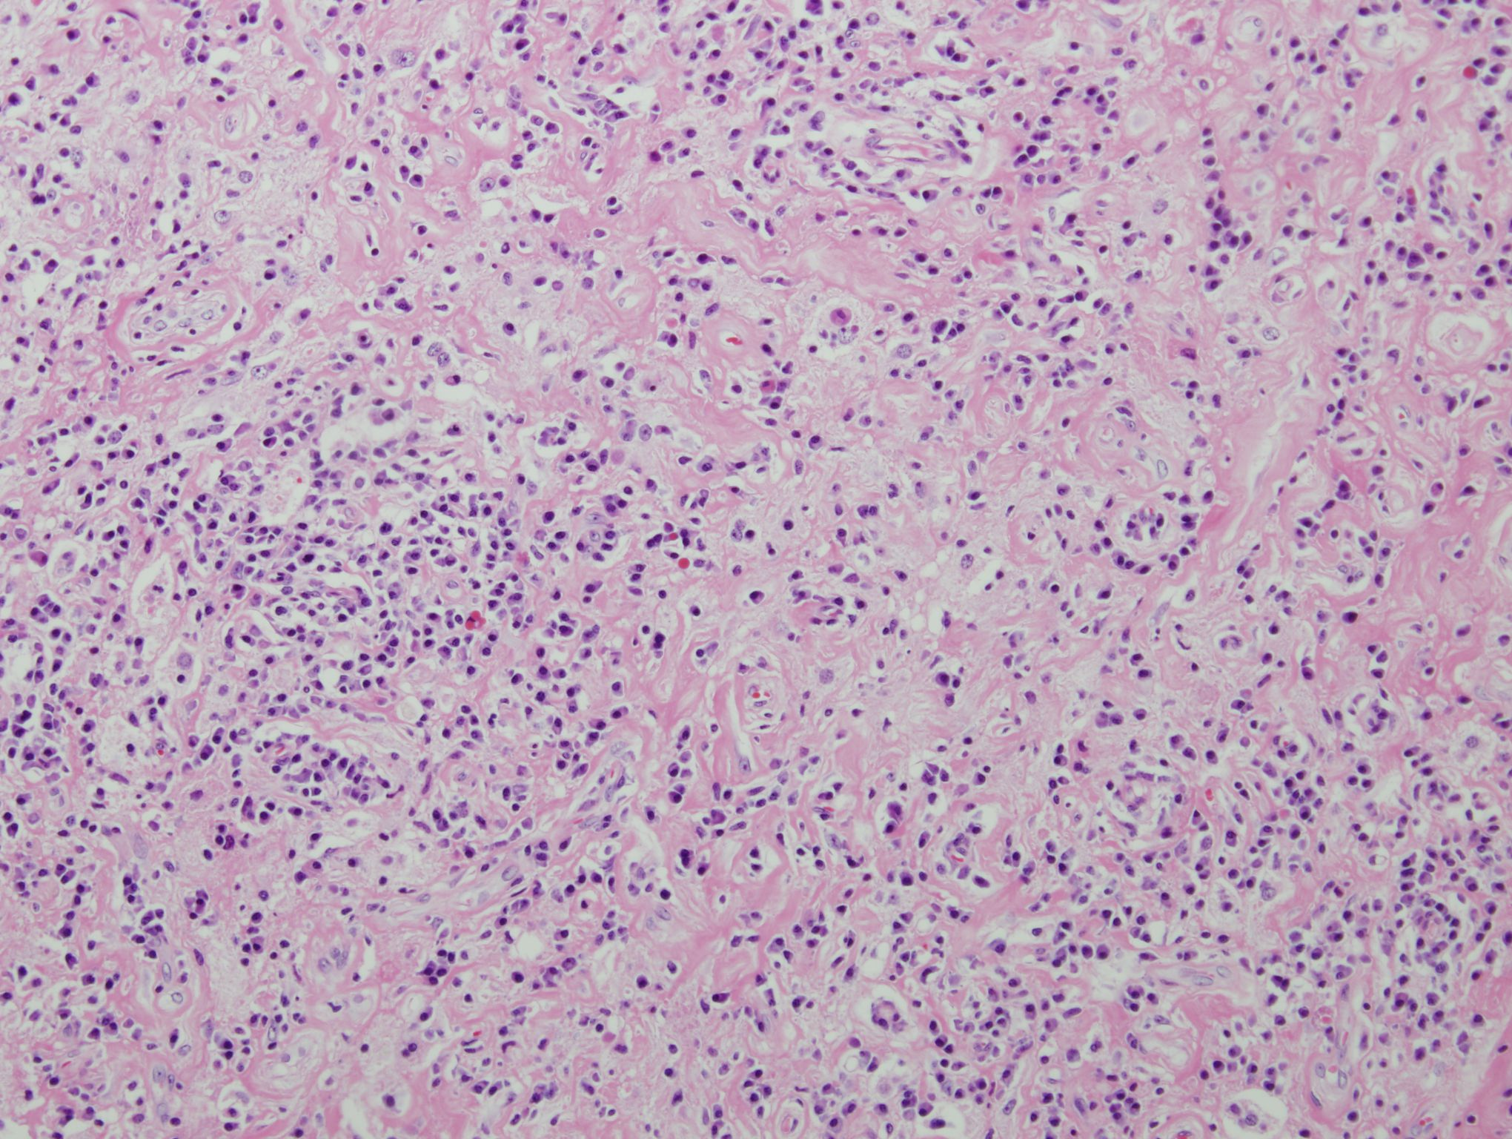

Slide 4
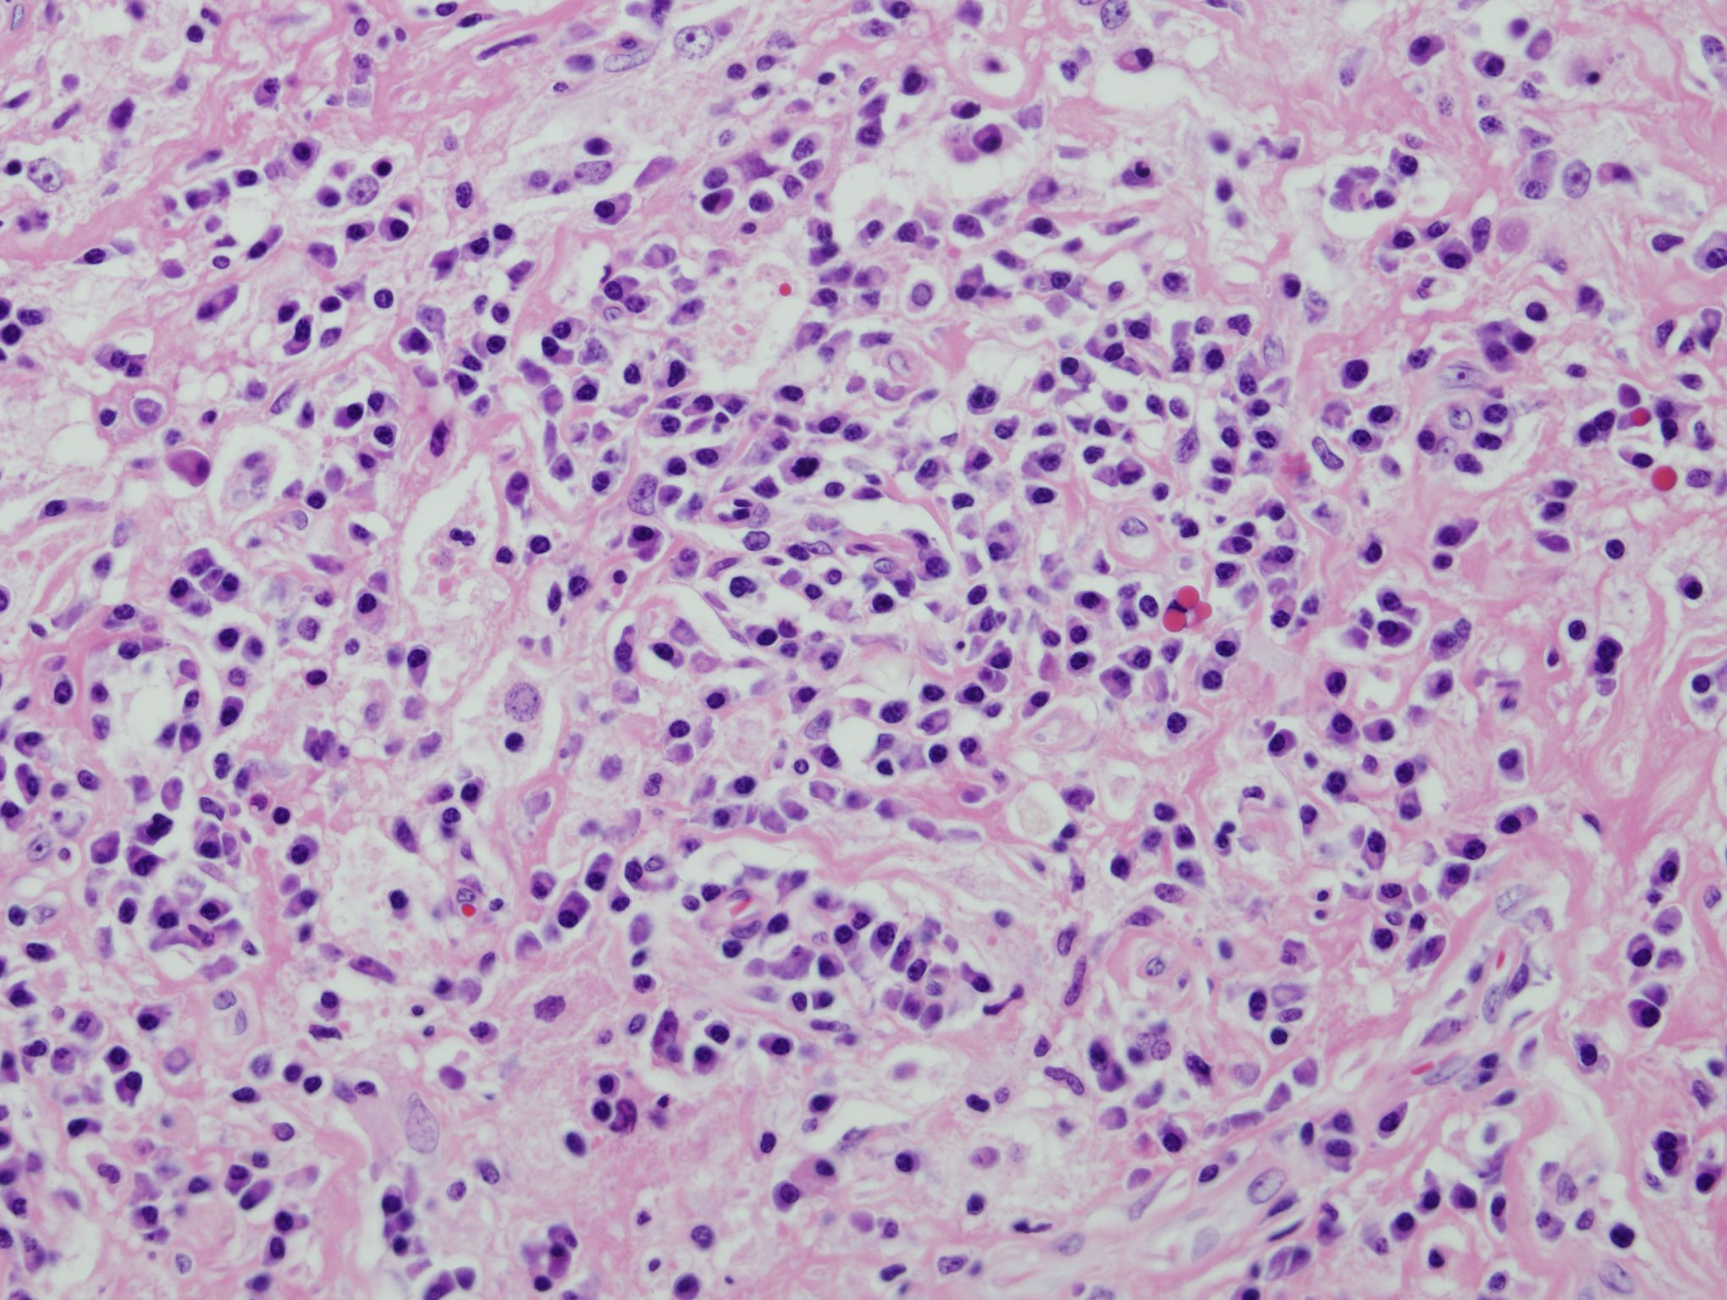

Slide 5
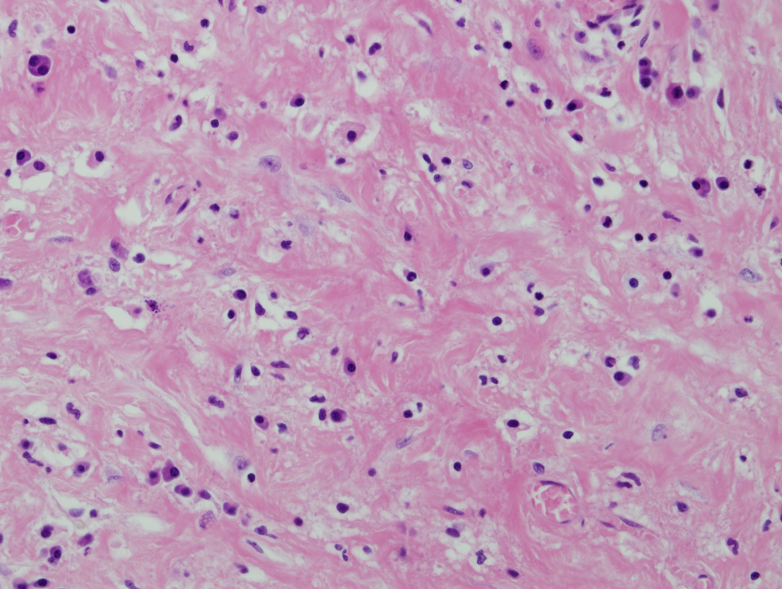

Slide 6
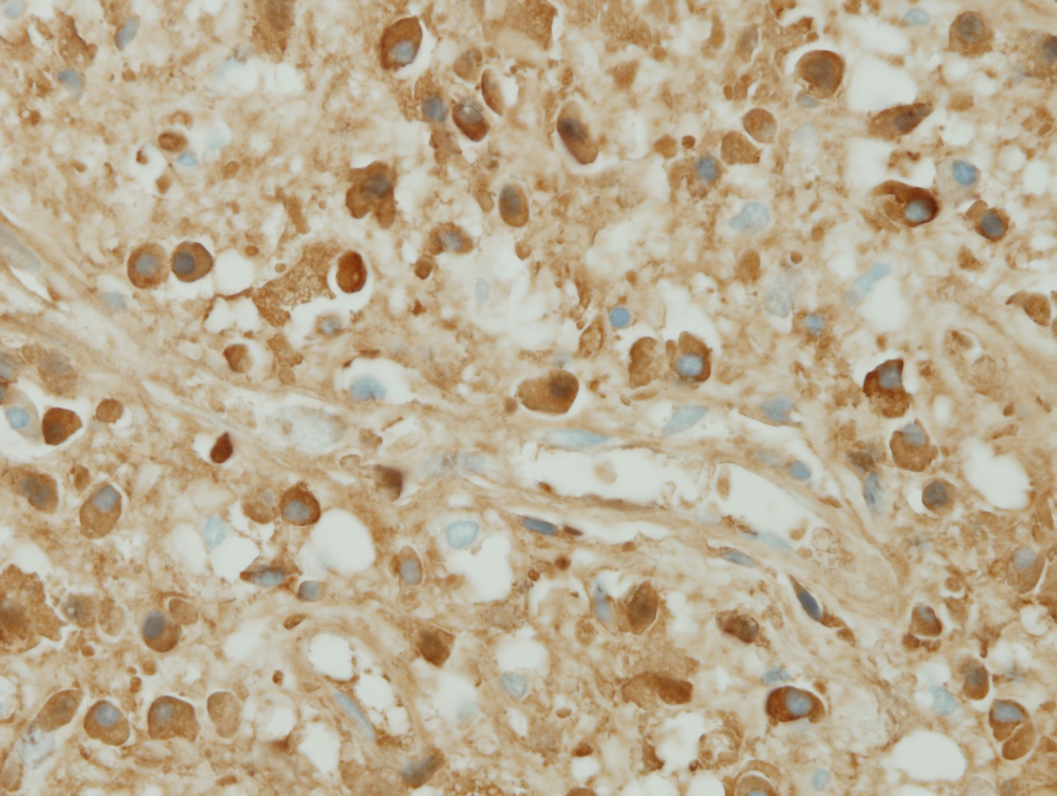

Slide 7
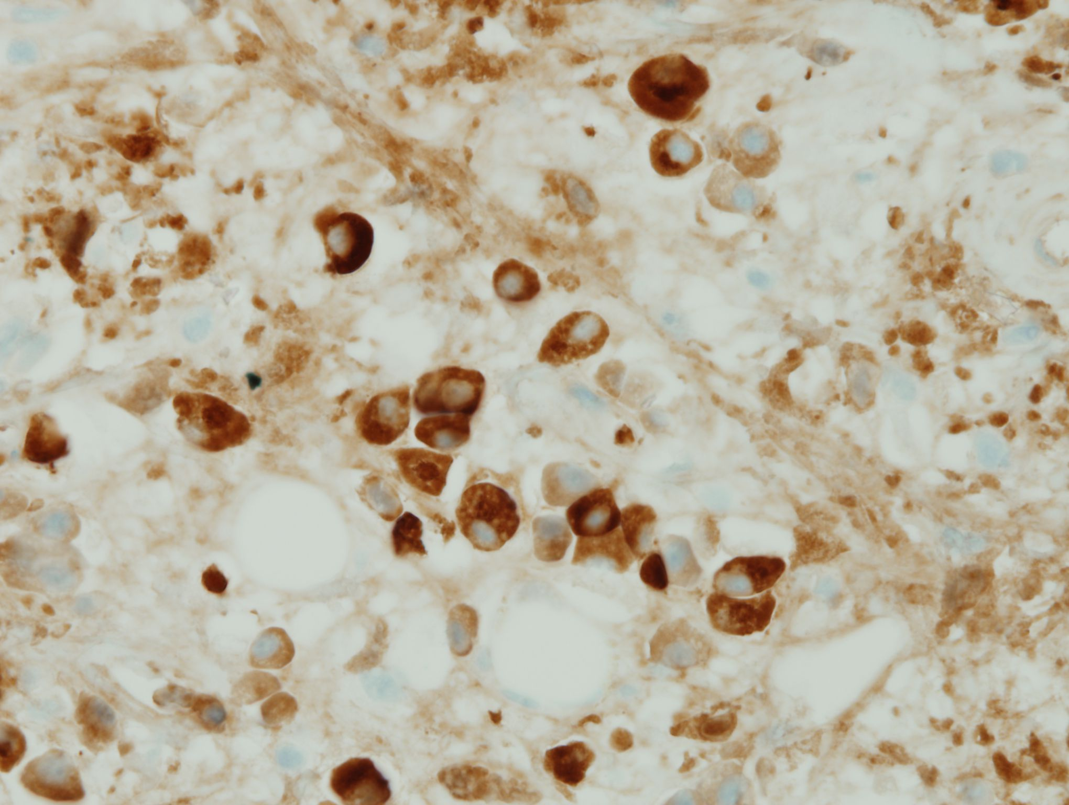
-IgG4 count: 32/HPF
-IgG count: 76/HPF
-IgG4/IgG ratio > 40%

Slide 8
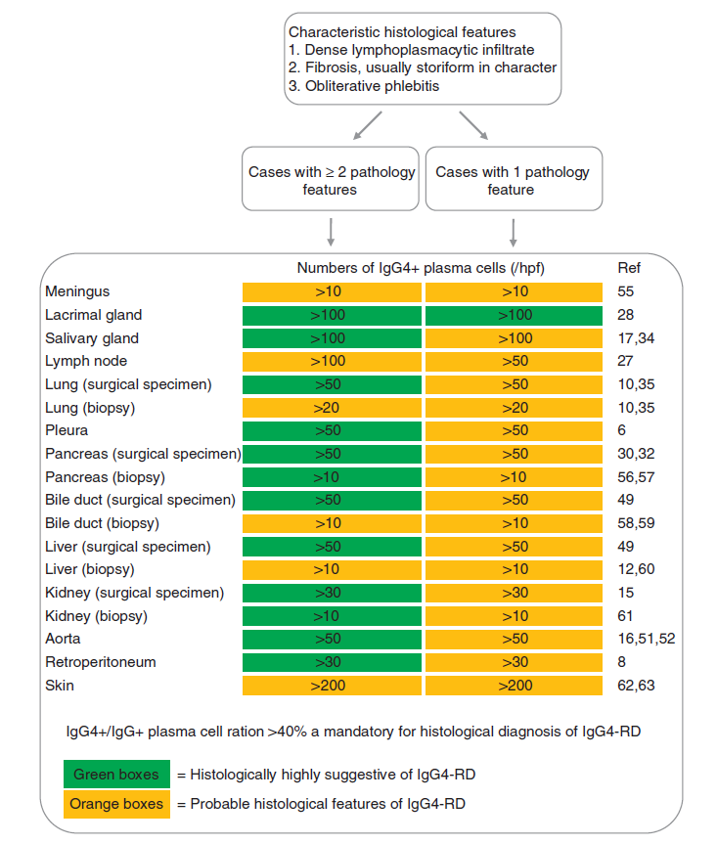
Mod Pathol. 2012;25:1181-92

Slide 9
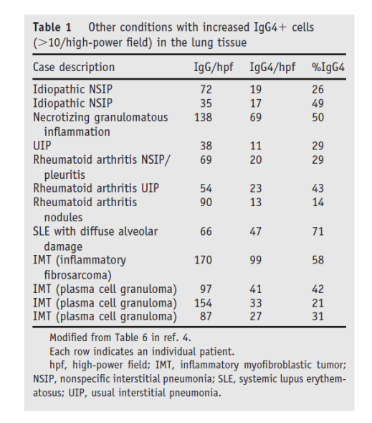
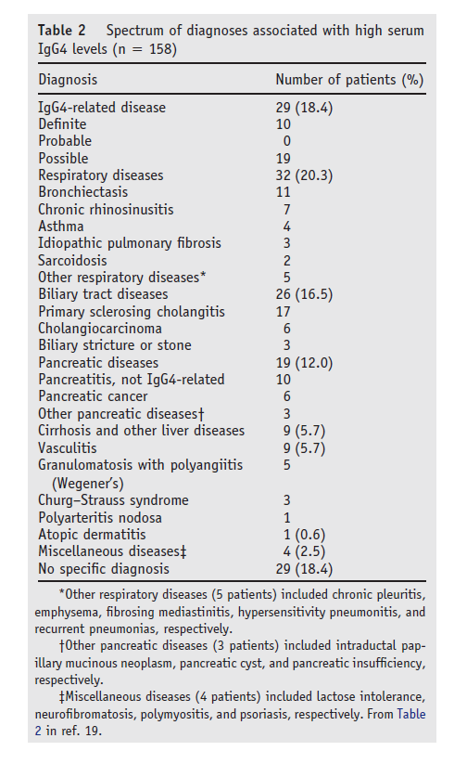
Other diseases associated with infiltrating
IgG4-positive cells in the lung or elevated serum IgG4
Yi et al, Seminars in Diagnostic Pathology (2012) 29, 219-225
Notes:
increased serum IgG4
levels and IgG4+ plasma cells have been revealed to be
common to a variety of localized and non-specific chronic
inflammatory conditions, including malignancies, infections,
chronic skin lesions and rheumatic diseases. Care
must therefore be taken to correctly interpret the plasma cell
counts associated with these typical histopathology features.

Slide 10
4096442 이O희 29/F
SS13-03916

Slide 11
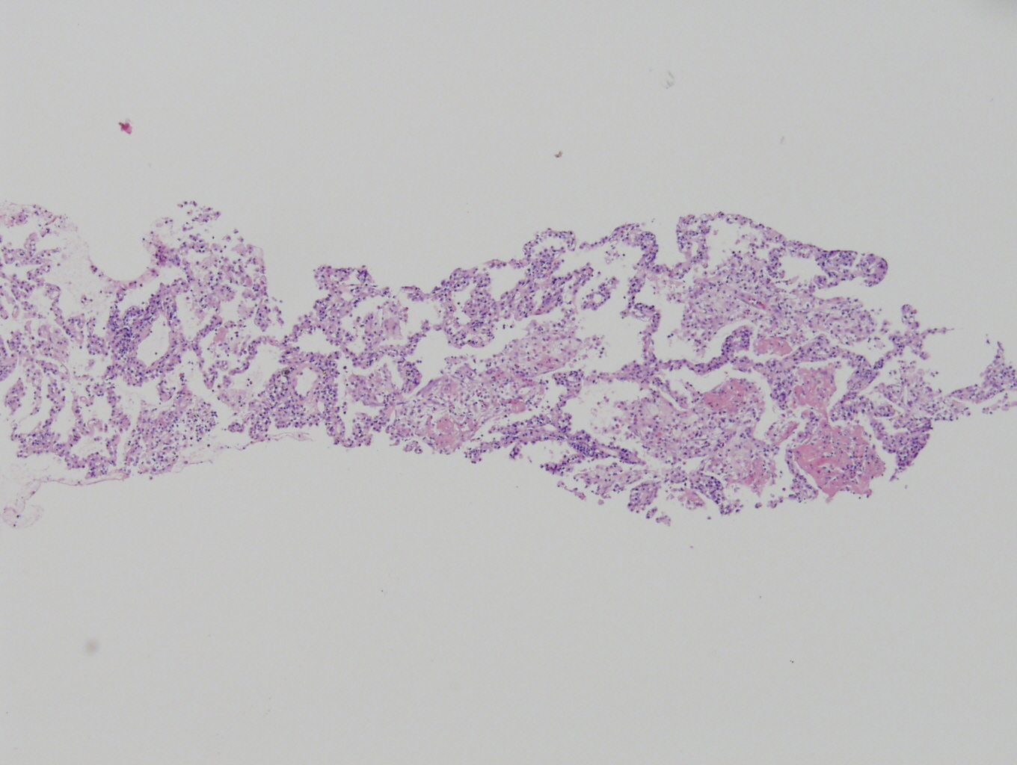

Slide 12
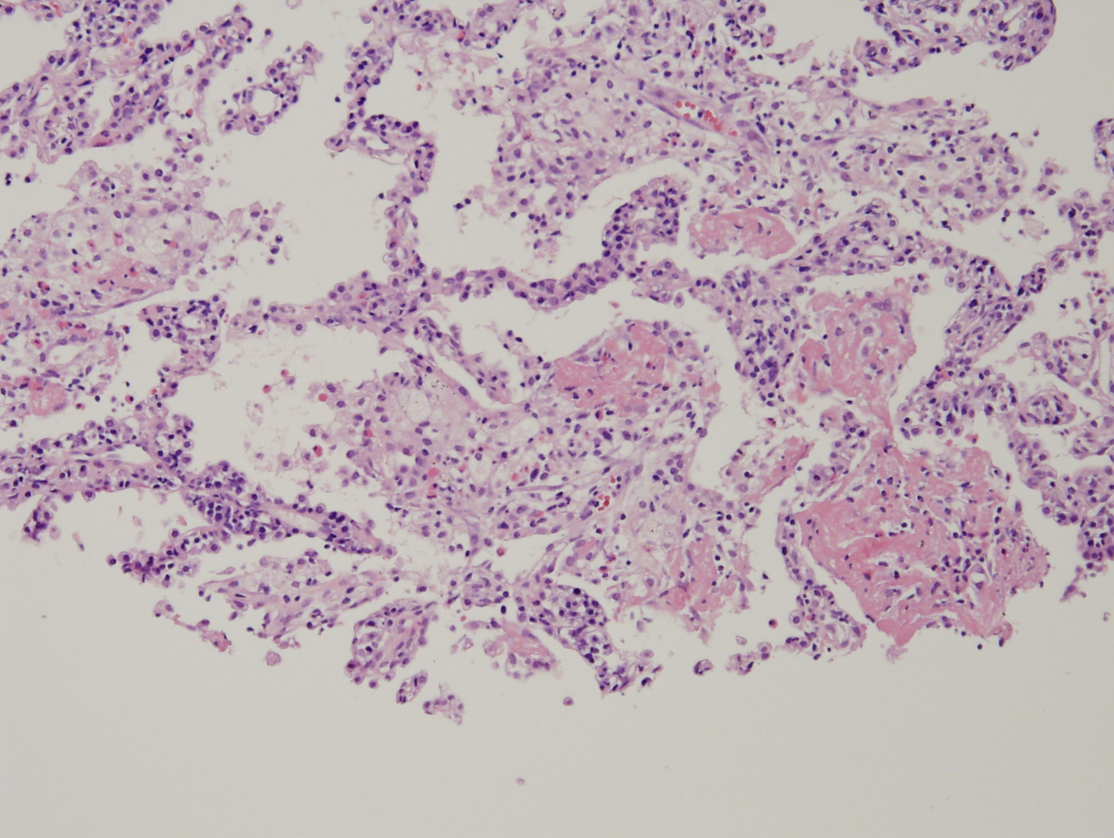

Slide 13
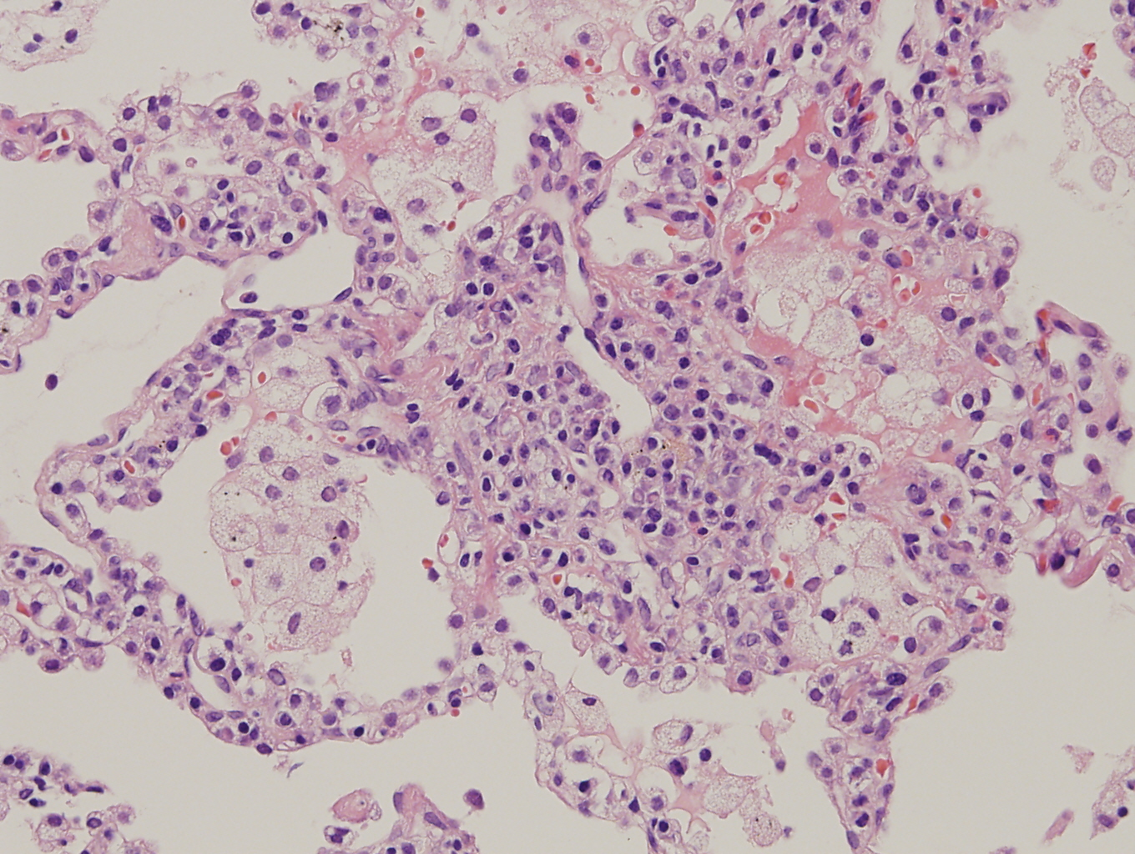

Slide 14
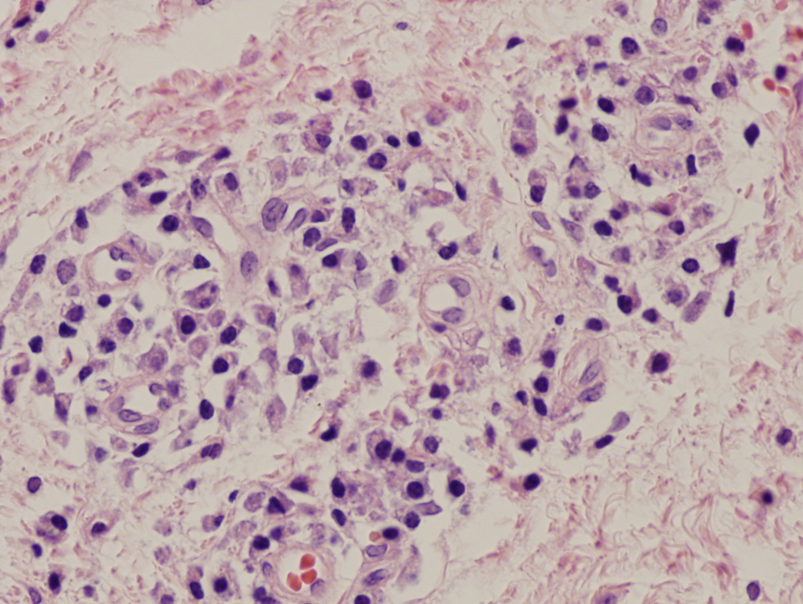

Slide 15
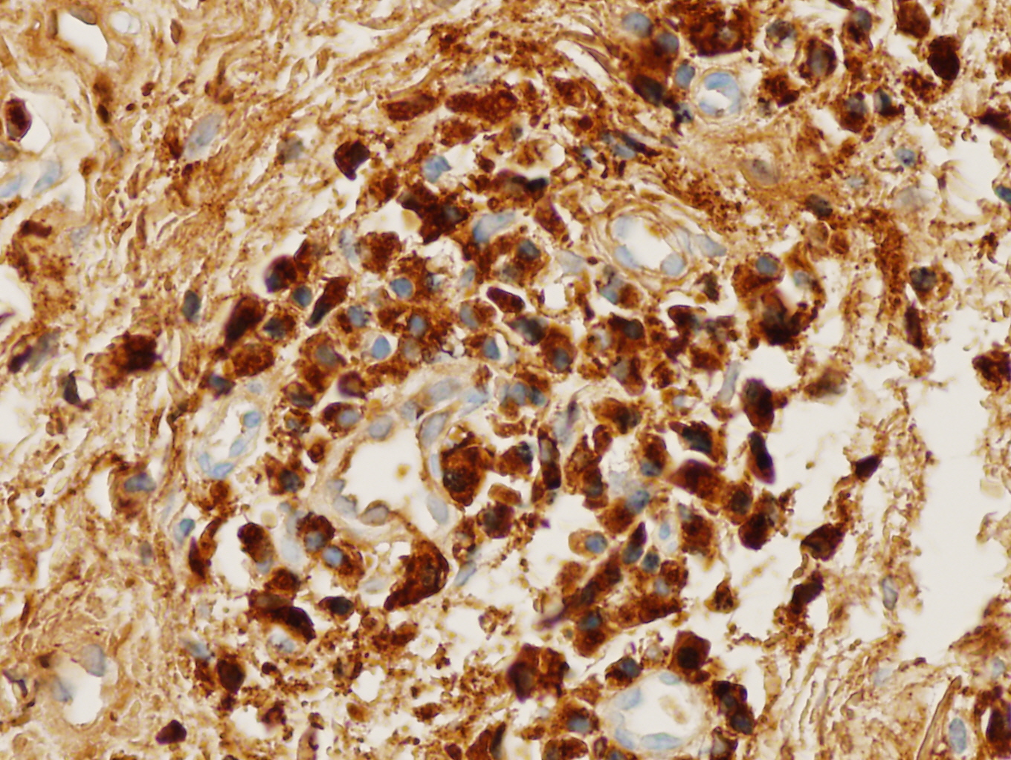

Slide 16
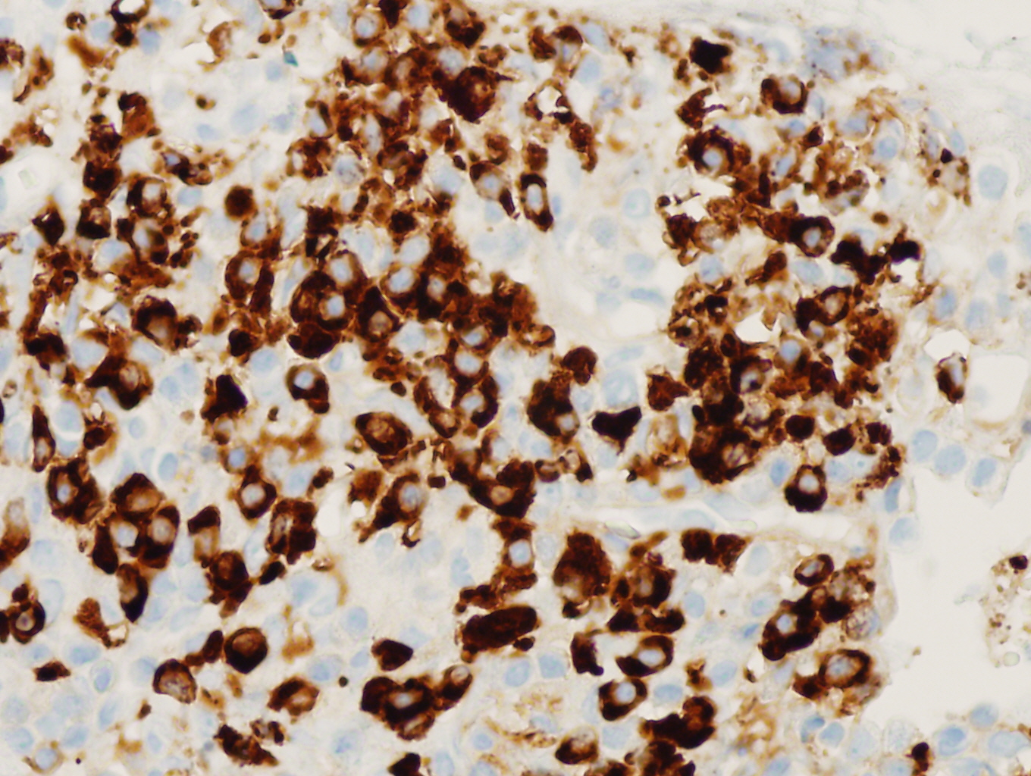
1. The immunohistochemical stains for IgG and IgG4
1) Number of IgG4 positive plasma cells: 224/HPF (hot spot)
2) IgG4:IgG ratio: 60.4%
2. These findings suggest the probable histologic features of IgG4-related disease (Reference: Modern pathology (2012) 25, 1181-1192). Clinical correlation is required.

