Slide 1
VATS conference
2015-09-24
Pathology
병리학교실 심효섭

Slide 2
오O주
7958676

Slide 3
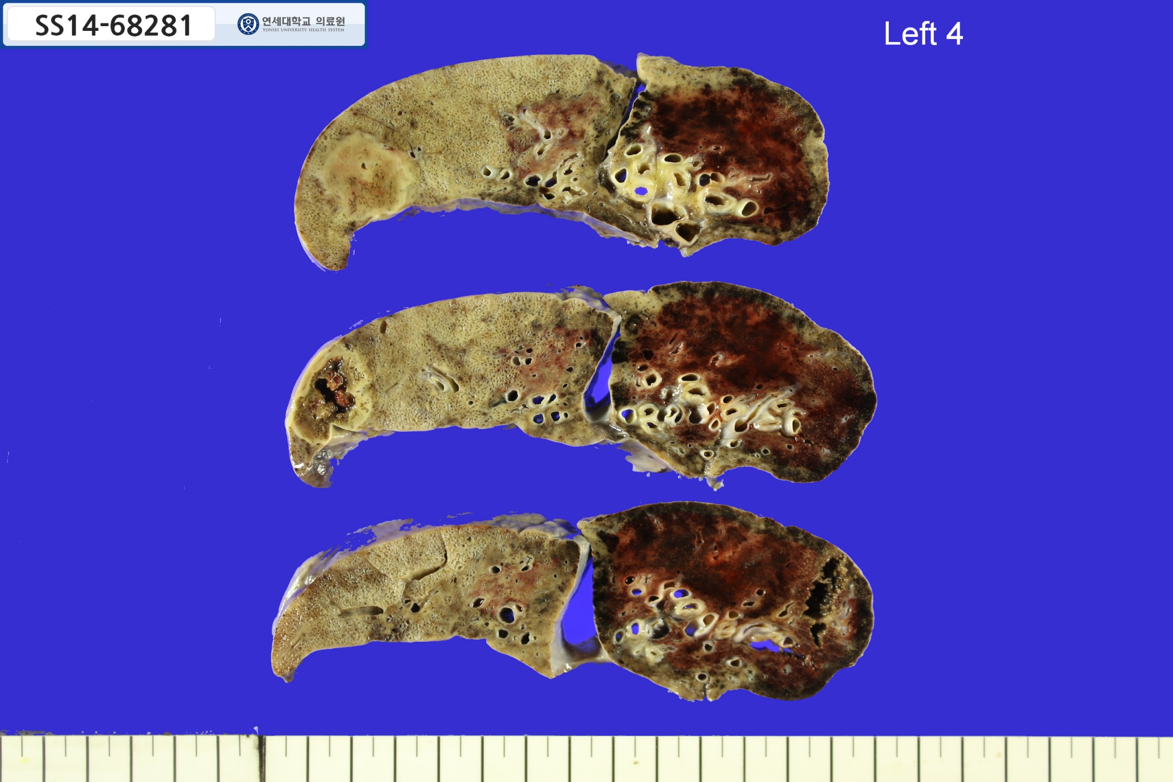

Slide 4
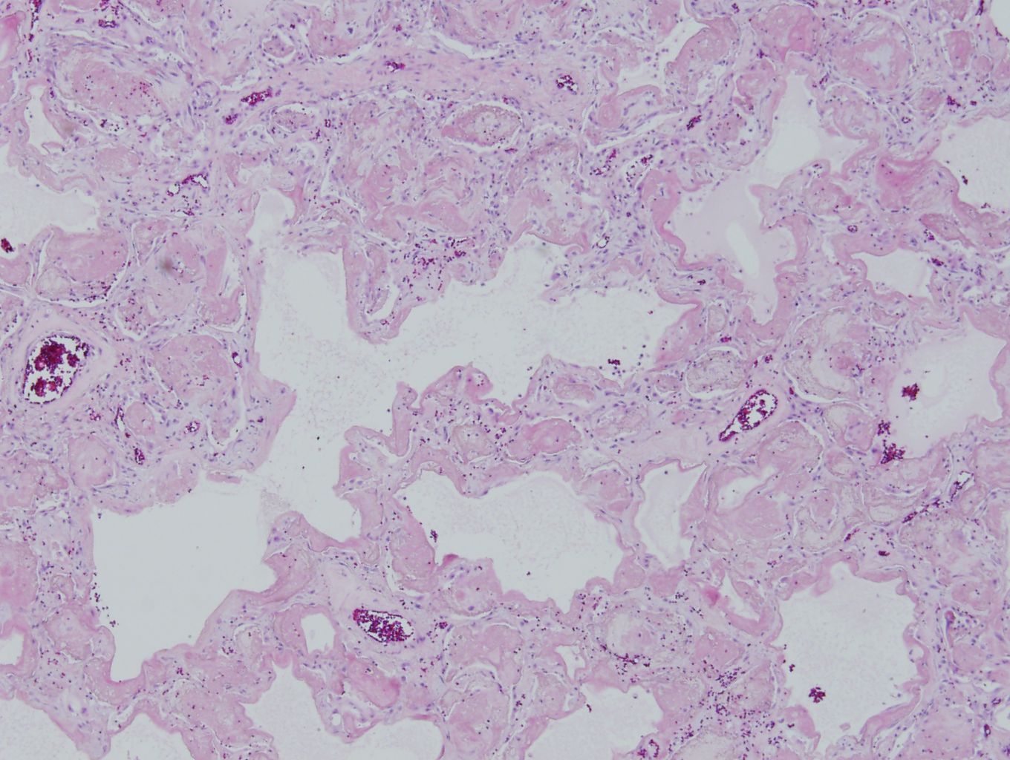

Slide 5
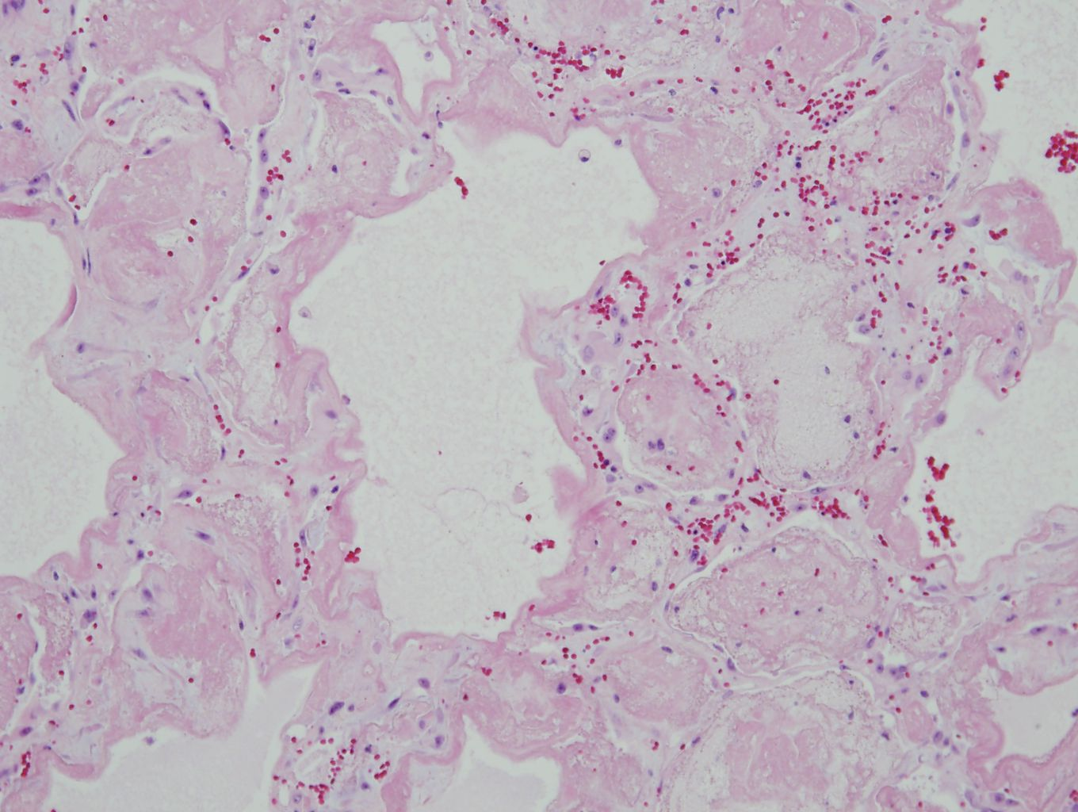

Slide 6
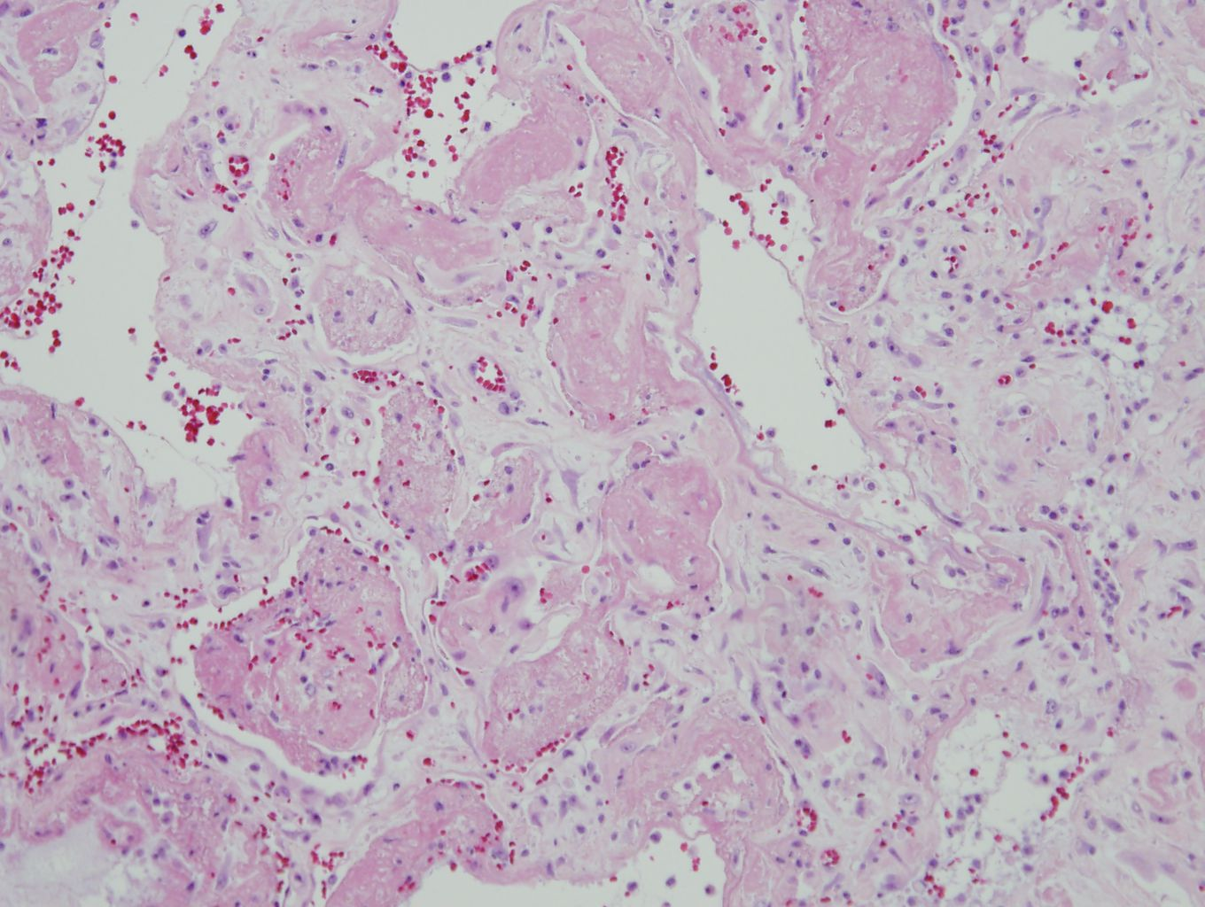

Slide 7
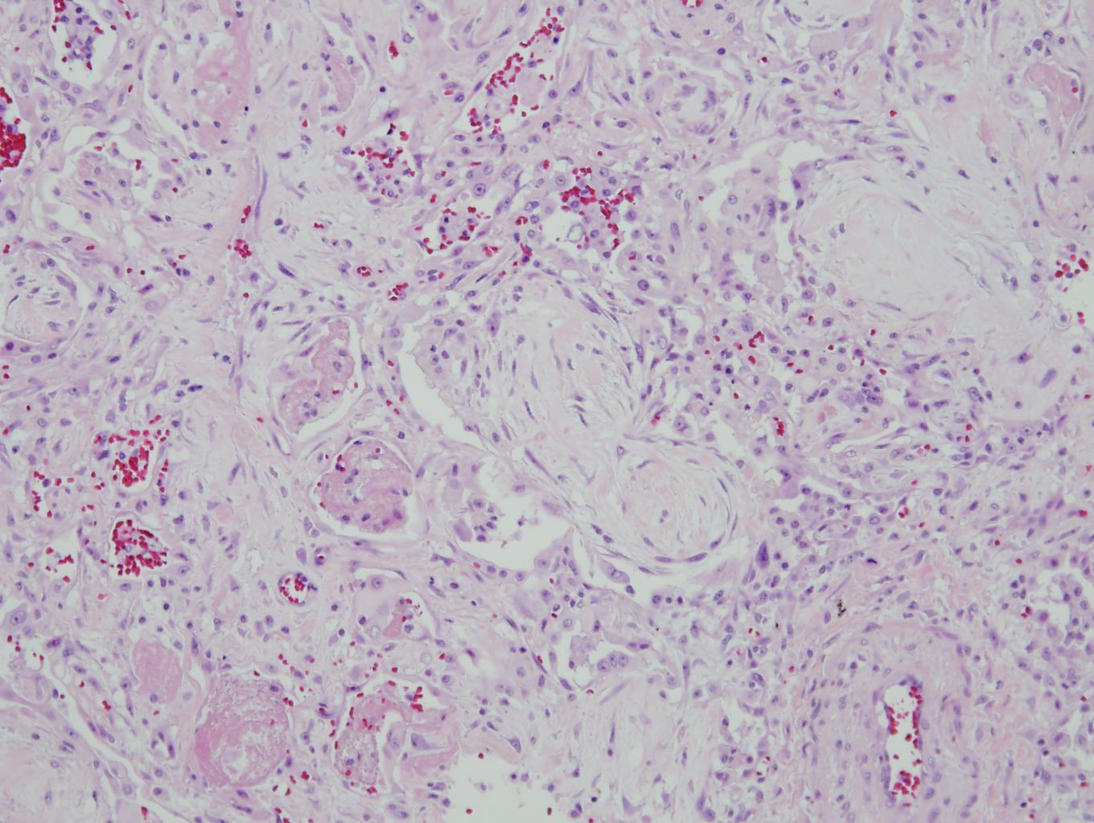

Slide 8
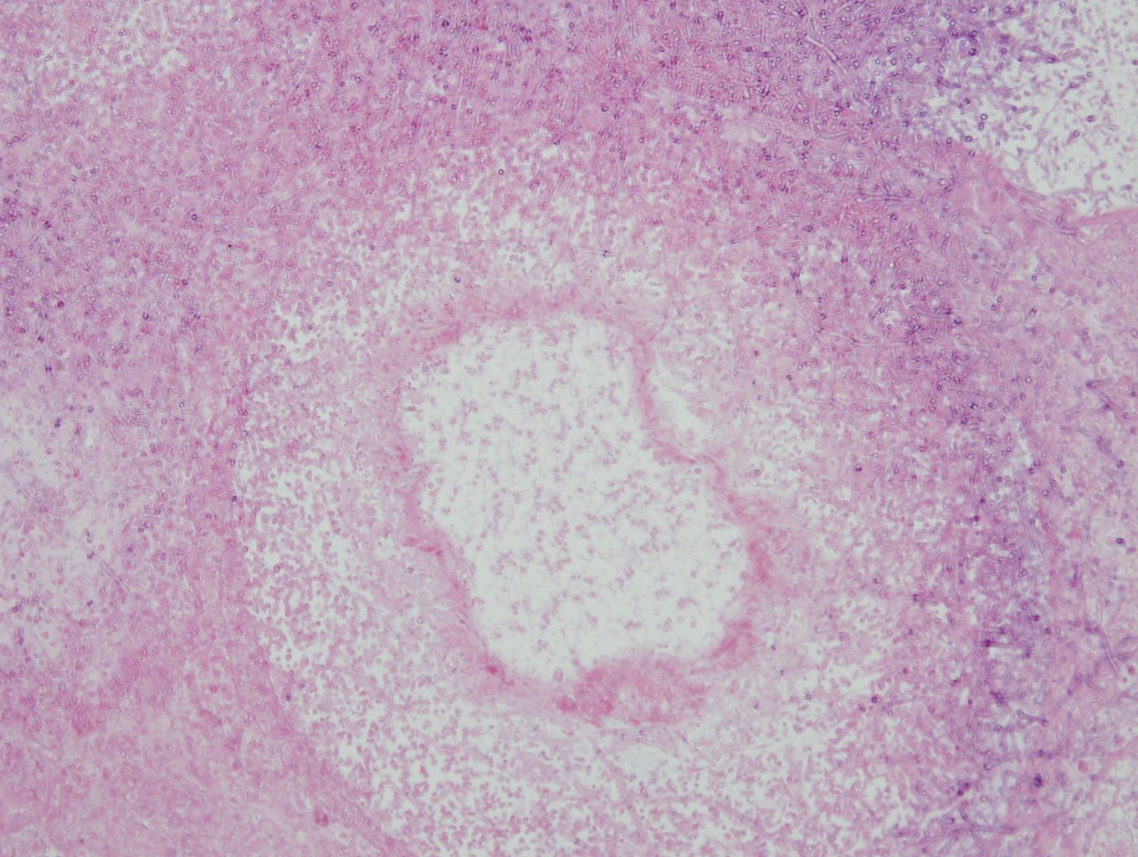

Slide 9
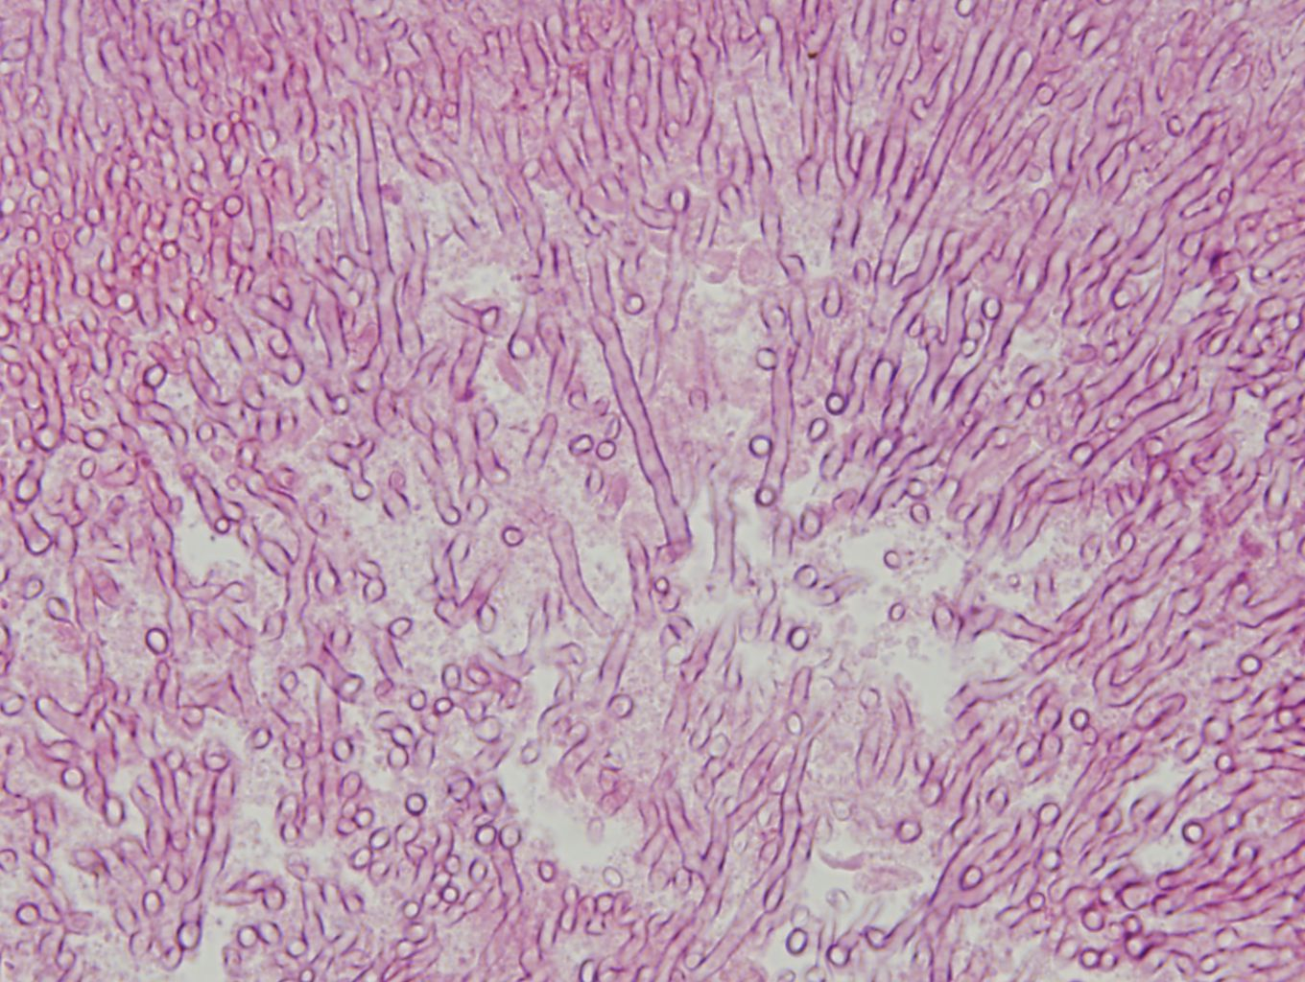

Slide 10
Acute/Subacute Lung Injury pattern
DAD | widespread injury to distal alveoli | AIP
(BO)OP | more localized injury to peribronchiolar parenchyma | COP
DAD
OP
Acute Fibrinous and Organizing Pneumonia

Slide 11
최0성
8069816

Slide 12
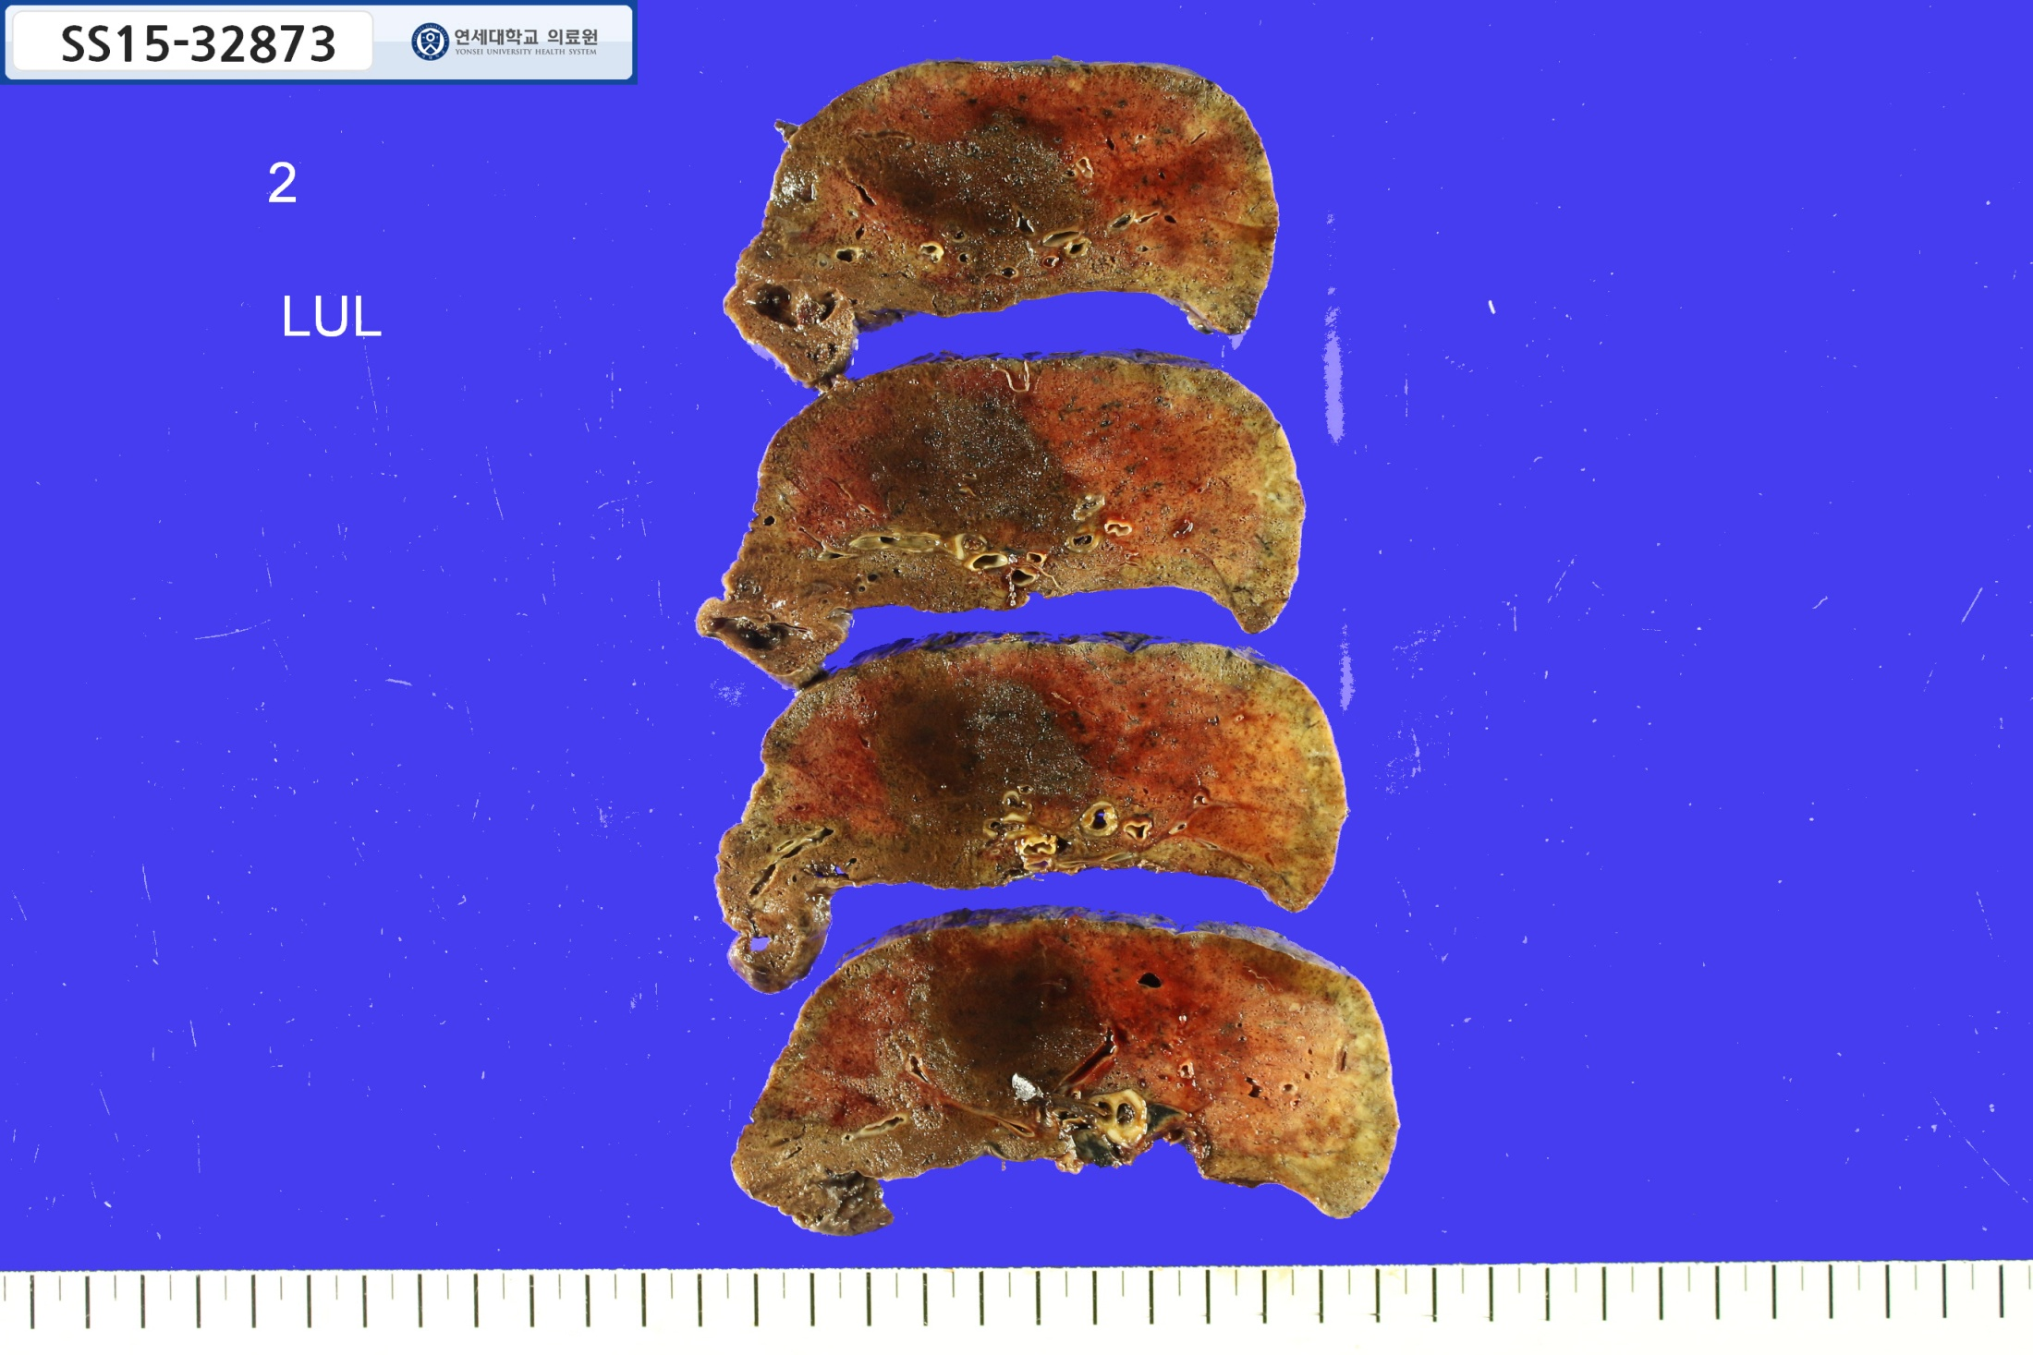

Slide 13
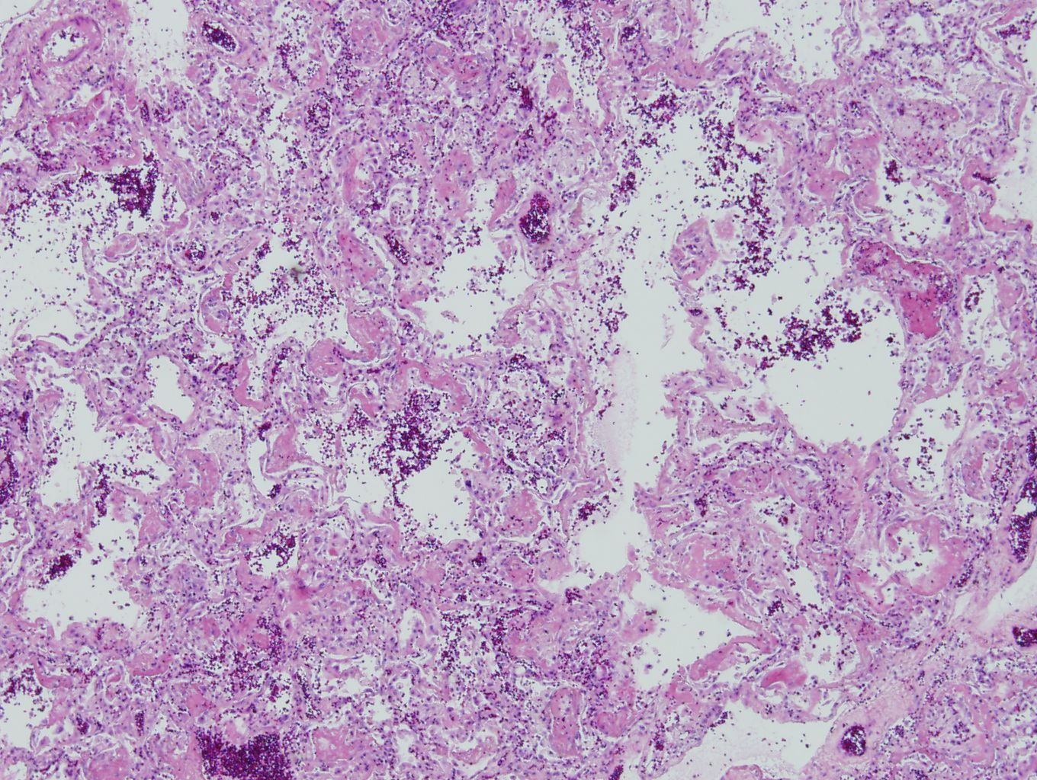

Slide 14
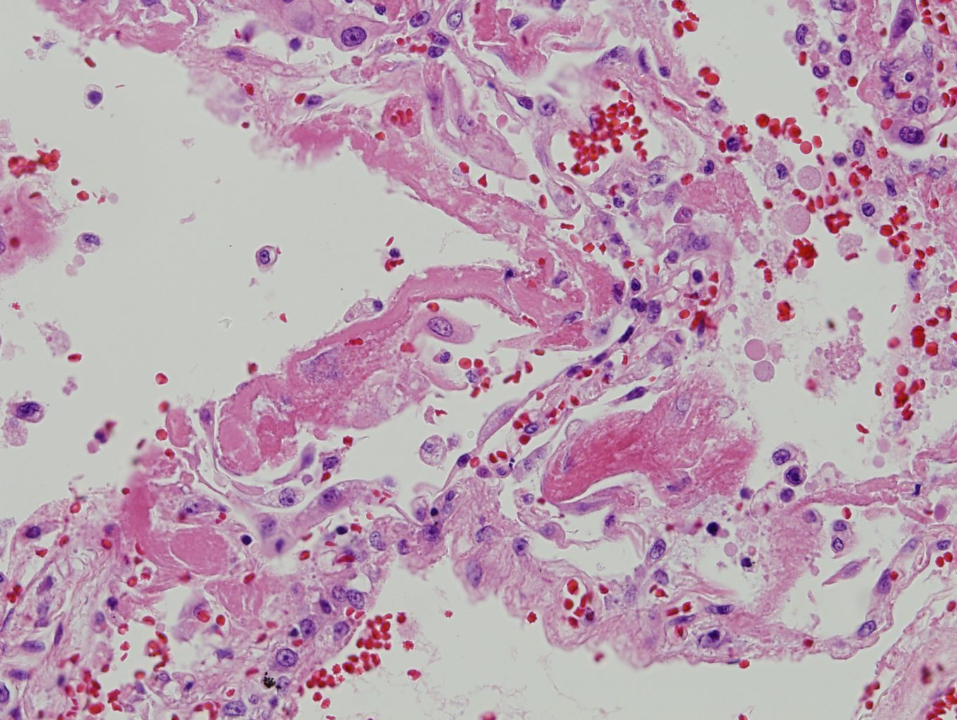

Slide 15
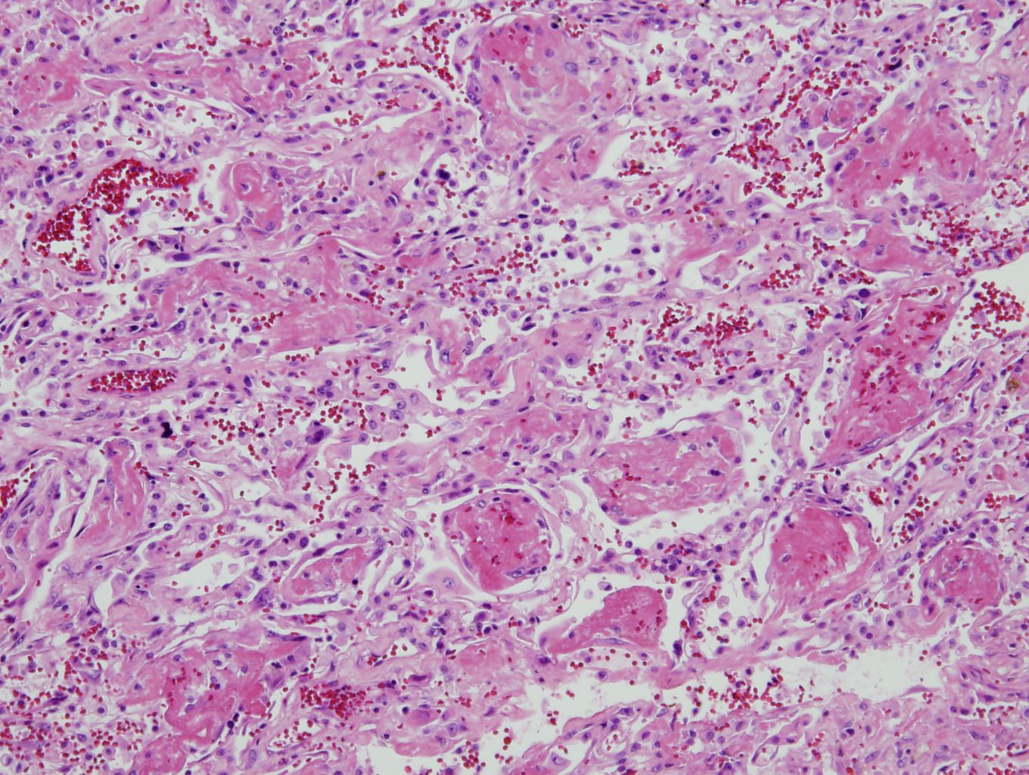

Slide 16
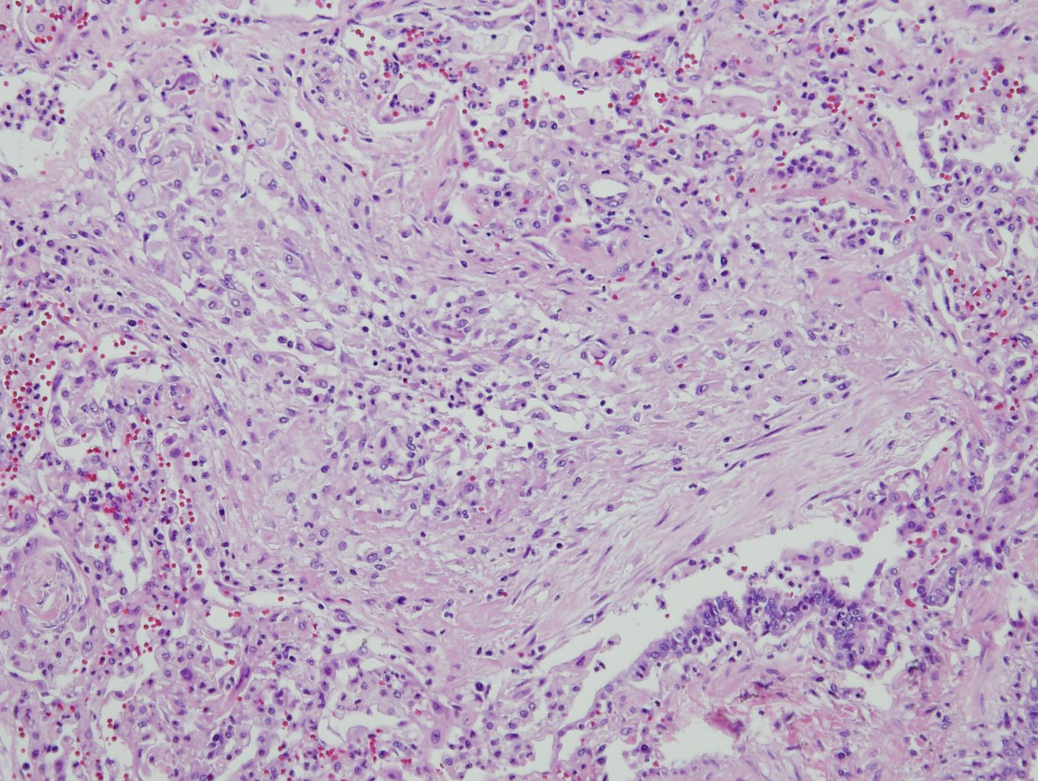

Slide 17
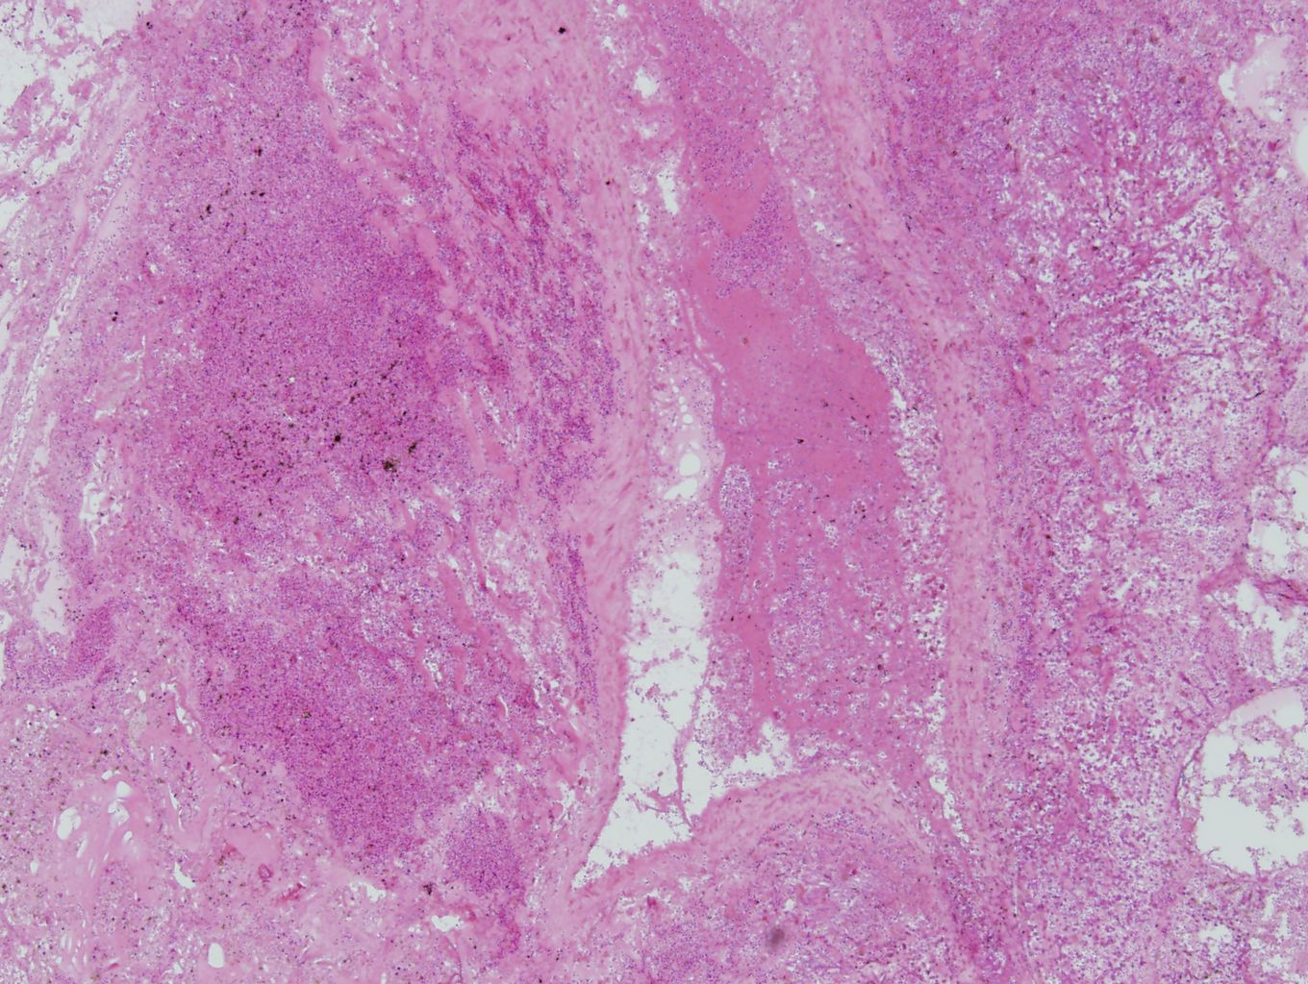

Slide 18
