Slide 1
Diagnosis and Surgical treatment of Mediastinal Tumor
Seong Yong Park, M.D., Ph.D.
Assistant Professor
Department of Thoracic and Cardiovascular Surgery
Ajou University School of Medicine, Suwon, Korea

Slide 2
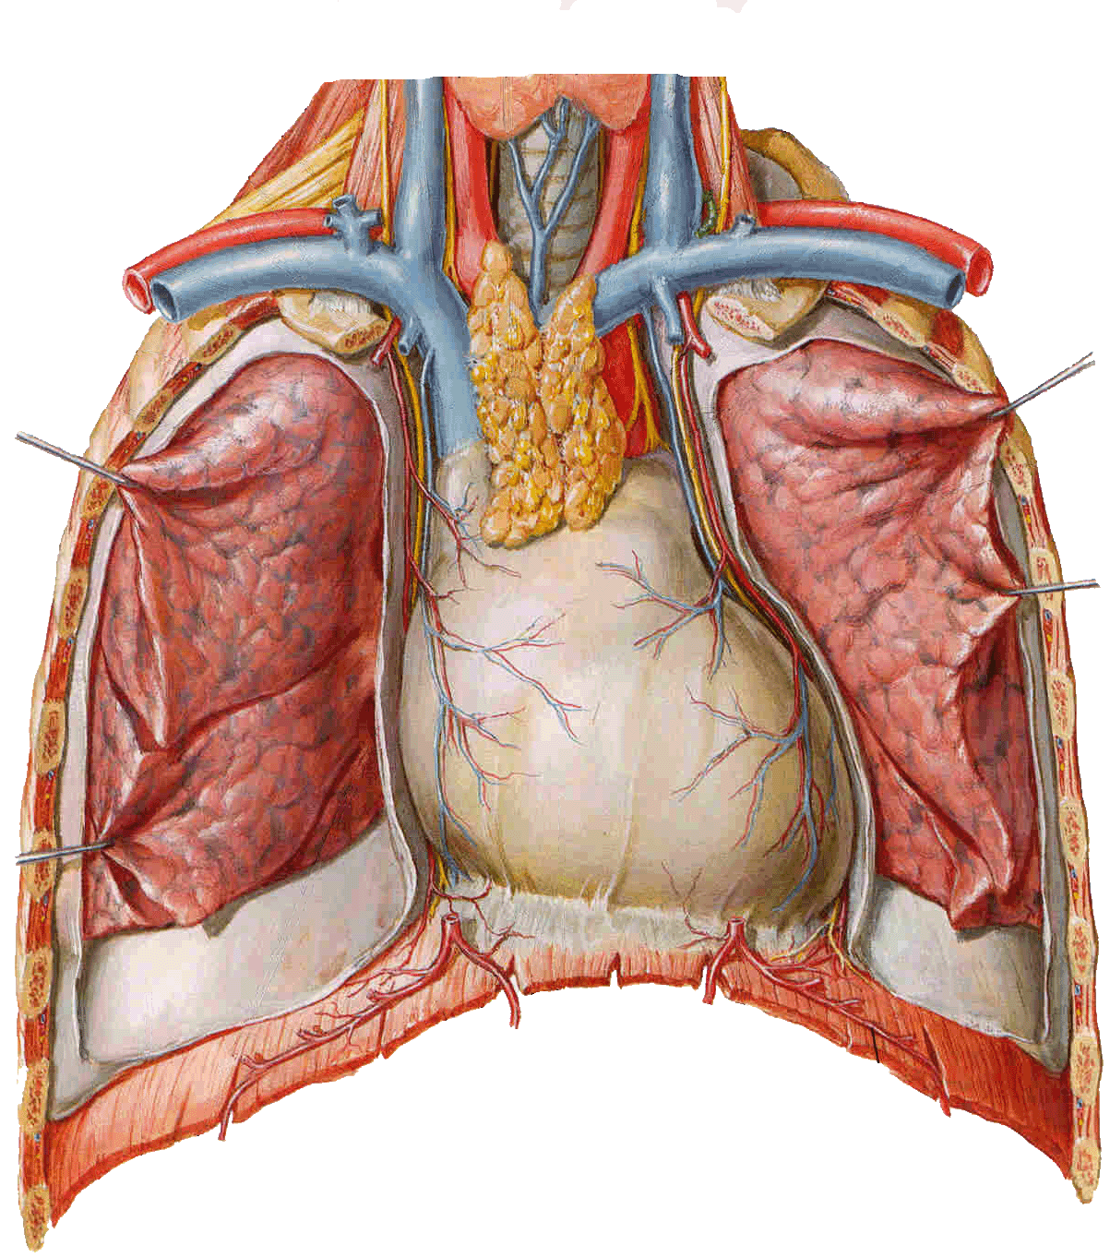
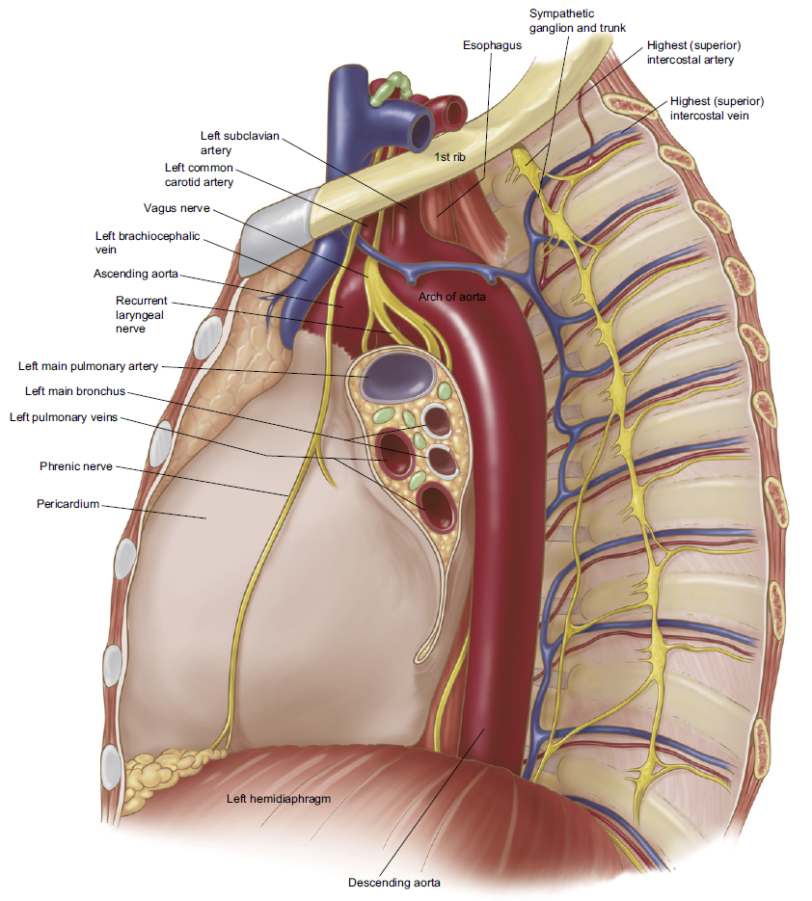
Mediastinum

Slide 3
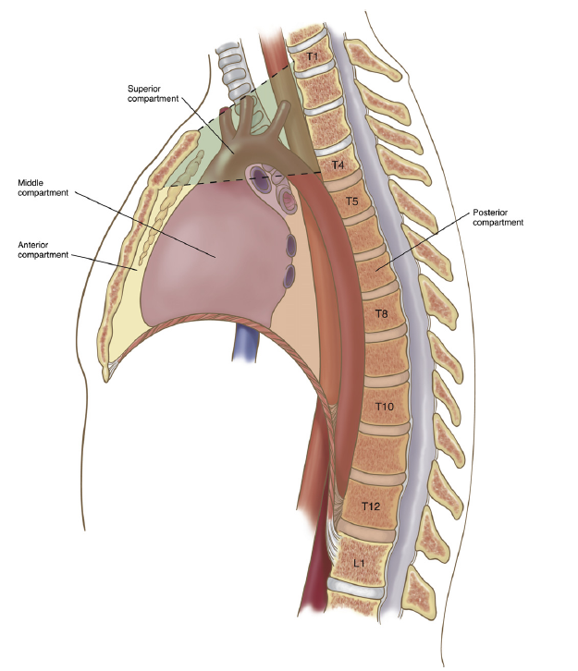
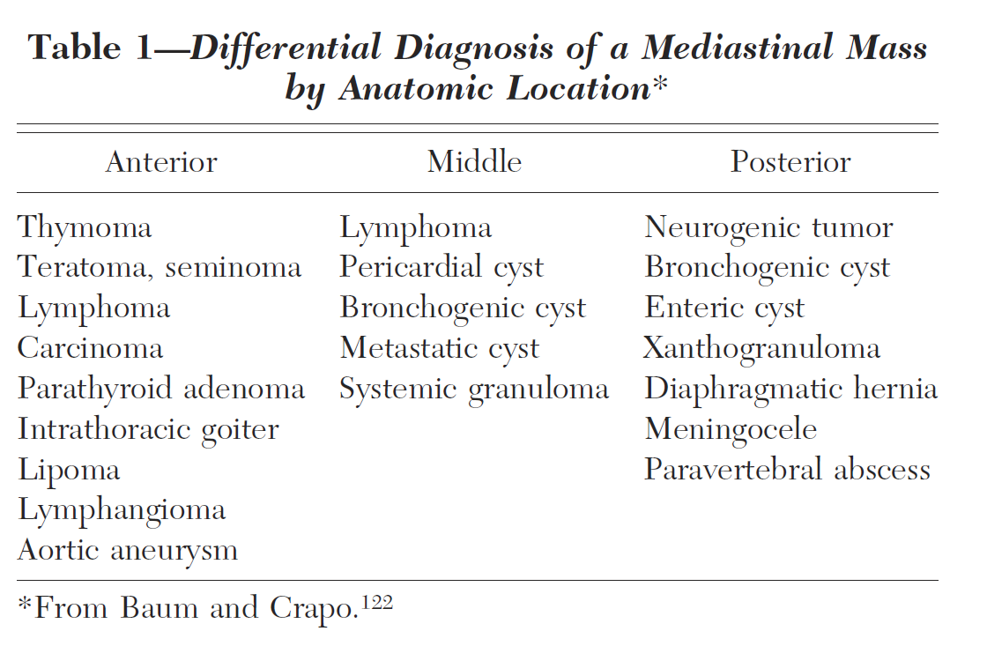
Location and Frequent Disease

Slide 4
Diagnosis
Location
Age
  Lymphomas and germ cell tumor; frequent in 20~40s
  Metastatic tumor; old age
  Posterior mediastinal tumor in young age; high risk of malignancy
Symptoms
  Systemic symptoms
  Local symptoms

Slide 5
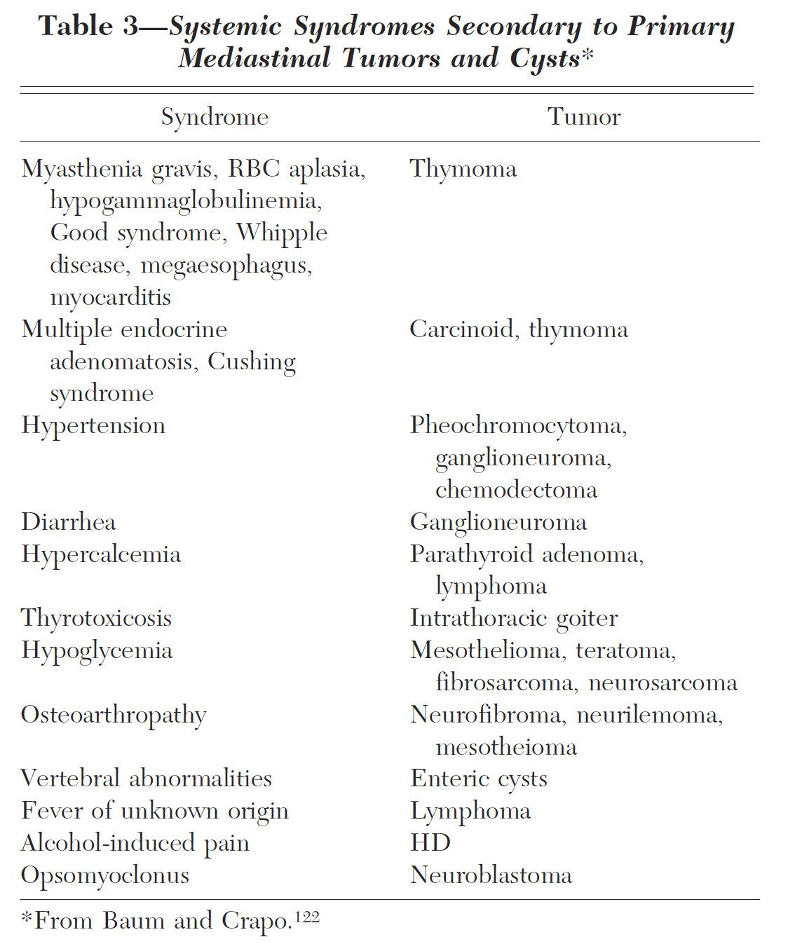
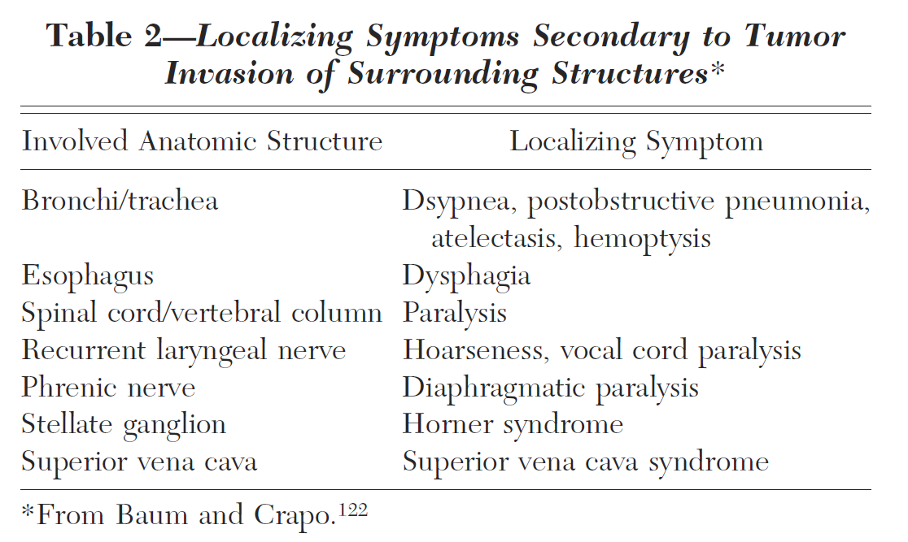
Symptoms

Slide 6
Diagnosis
Imaging
  Chest CT contrast
  MRI
    For evaluation of vascular and cardiac invasion
    Evaluation of neurogenic tumor

Slide 7
Diagnosis - Serum markers
Serum marker
  LDH, alpha-fetoprotein, beta-hCG
Location | Tumor | Serum marker
Anterior | York sac tumor | AFP, LDH
 | Embryonal carcinoma | LDH, TRA-1–60, CD30, β-HCG
 | Choriocarcinoma | β-HCG, LDH
 | Seminoma | PLAP, LDH, NSE, β-HCG
 | Thymic carcinoid | ACTH, chromogranin, NSE
 | Thymic small cell carcinoma | Bombesin, NCAM, NSE
 | Parathyroid adenoma | PTH, chromogranin
Visceral and posterior | Pheochromocytoma Neuroblastoma Ganglioneuroblasoma | Urinec and plasmad catecholamines, and chromogranin, NSE

Slide 8
Diagnosis - Tissue confirmation
Is it needed in all cases?
NAB, Gun-biopsy
Cervical mediastinoscopy
Diagnostic thoracoscopy (VATS)
Parasternal incision (mediastinostomy)

Slide 9
Role of Surgical Treatment
Indication?
Purpose of surgical treatment
  Diagnosis
  Complete resection
Methods of resection
  Mass excision
  Complete Thymectomy vs. Thymomectomy
  Midsternotomy
  VATS (Thoracoscopy)
  Clamshell incision

Slide 10
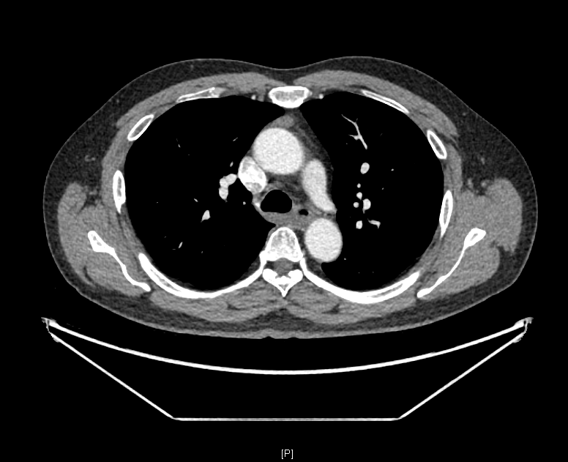
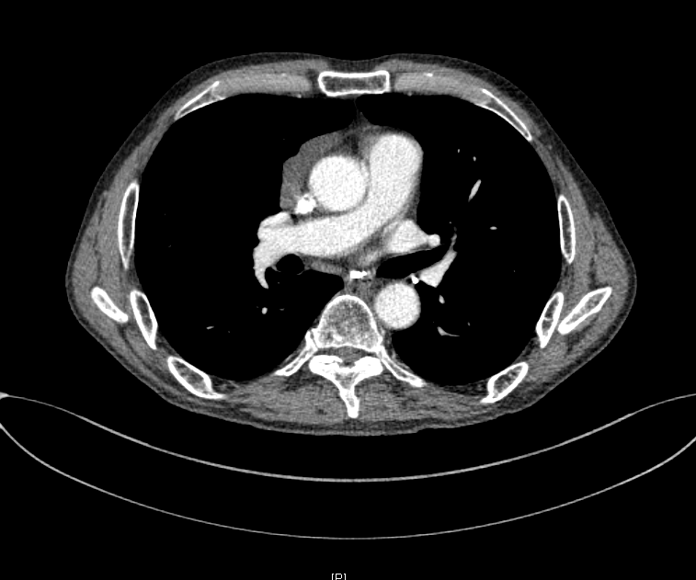
Indication?

Slide 11
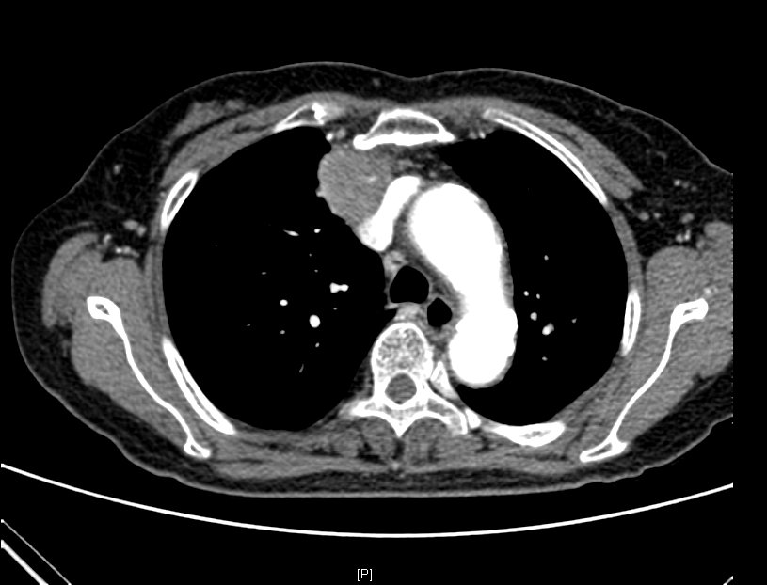
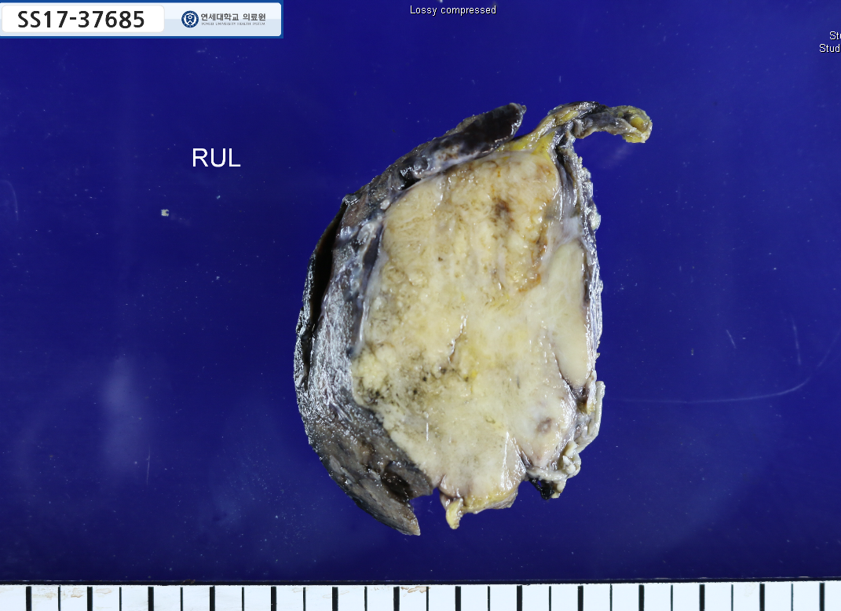
Case / 김 O 자 2453227 F/75
Thymic squamous cell carcinoma, see note
  Size: 5.5x4.5cm
  Transcapsular extension: Present / Perithymic fat tissue invasion: Present
  Lymphovascular invasion: Not identified / Perineural invasion: Not identified
  Lung, right upper lobe: Invasion of carcinoma
  Resection margins,
    Circumferential: Free of carcinoma (safety margin: 250um)
    Lung, parenchyma: Free of carcinoma (safety margin: 0.9cm)

Slide 12
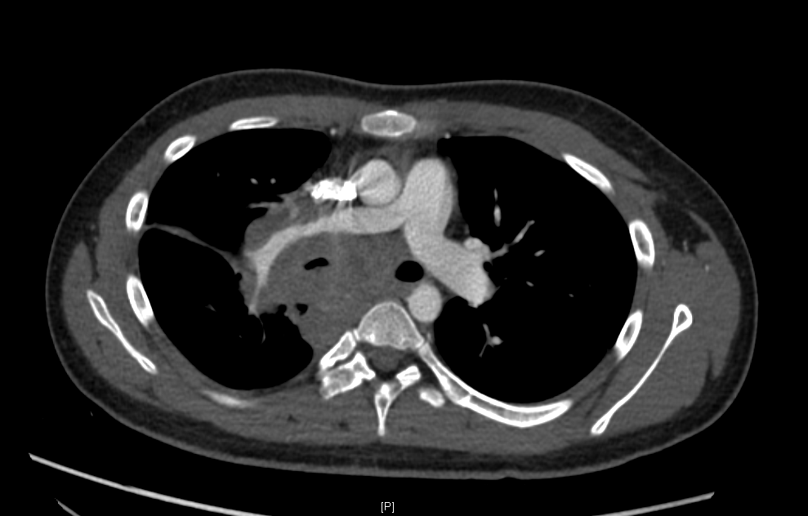
Case / 전 O 학 3557621 M/17
Malignant germ cell tumor, consistent with seminoma
The immunohistochemical stain results:
SALL-4: Positive in tumor cells
OCT 3/4: Positve in tumor cells
CD45: Negative in tumor cells
CD30: Negative in tumor cells
Alpha-fetoprotein: Negative in tumor cells
CK(AE1/AE3): Negative in tumor cells

Slide 13
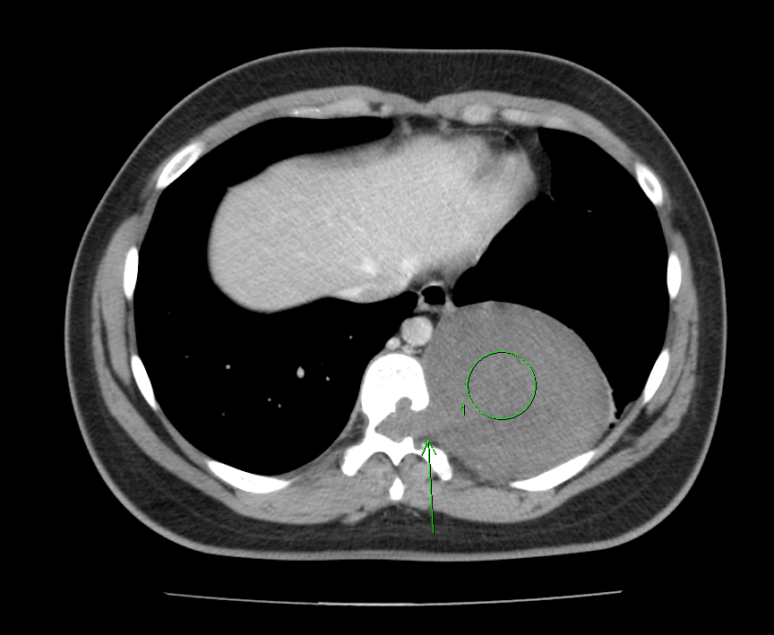
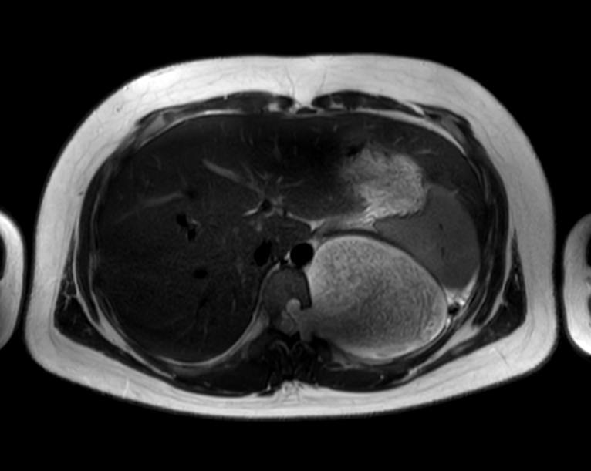
Case / 이 훈 8464819 M/15
Schwannoma
Size: 11.5x10.5x7.3cm
The immunohistochemical stain result: Ki67 L.I.: 1%

Slide 14
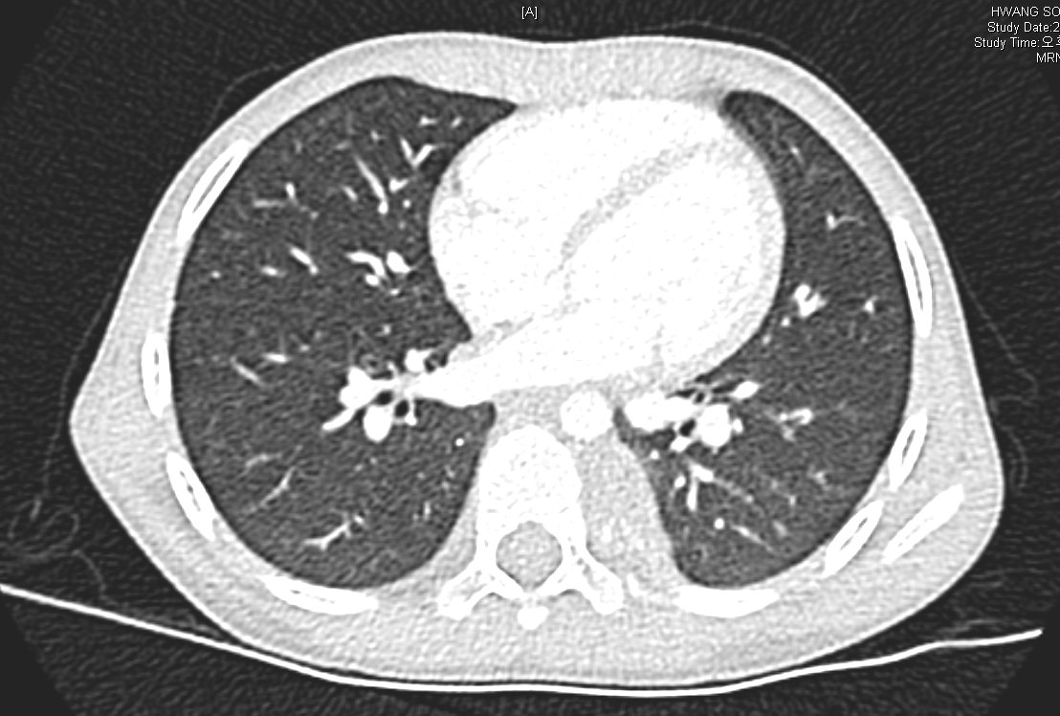
Case / 황 O 택 8441572 M/4
Ganglioneuroblastoma, intermixed, see note.
Size: 3.5x2.5cm / Resection margins, circumferential: abutting of tumor
Note) 본 종양은 storoma rich tumor 에 해당하는 것으로 INP classification 에 따라 favorable histology 로 구분됩니다. stroma poor tumor 일 경우 differentiation grade 및 MKI index 를 구하여 favorable subtype 을 구분하나, 본 종양과 같이 stroma rich tumor 중 intermixed type 의 histology 를 보이는 경우 favorable subgroup 으로 분류됩니다.

Slide 15
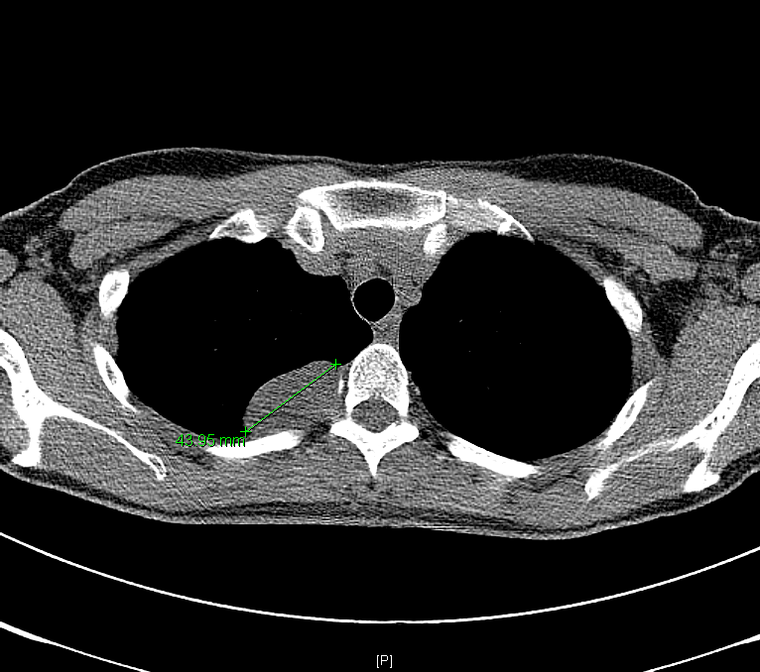
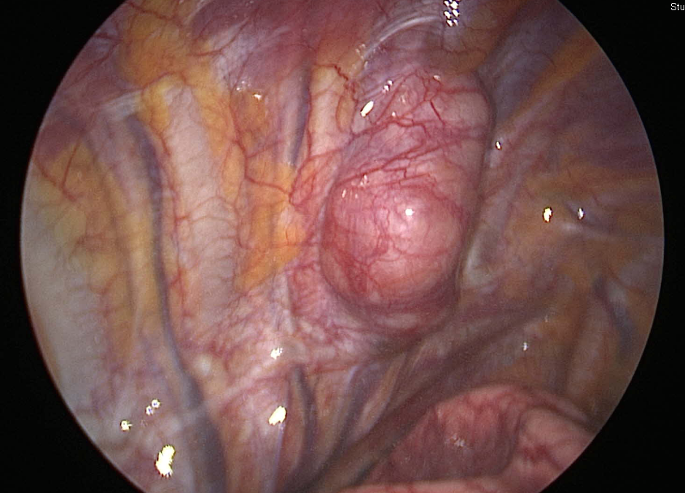
Case / 홍 O 희 8454600 F/30
Schwannoma

Slide 16
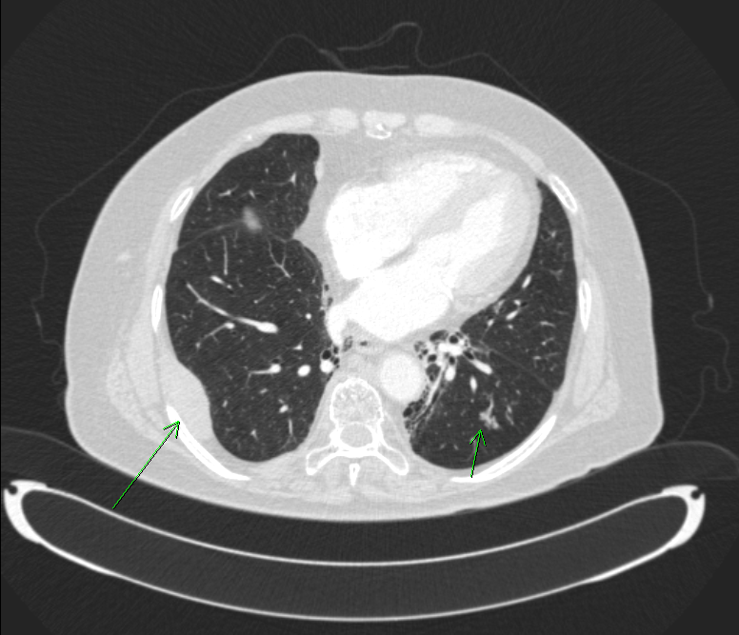
Case / 유 O 자 1591817 F/76
Nodal marginal zone B cell lymphoma

Slide 17
Case review
김O이 8447012 F/70
김O지 8465123 F/17
이O진 8468193 F/31

Slide 18
Take-home message
Diagnosis can be done mainly based on location, age and imaging findings
Serum marker can give the additional information
Resection can be considered in symptomatic benign cases and highly suspected malignant cases

