Slide 1

VATS conference review
: IgG4-related disease
Leem Ah Young
Division of Pulmonology,
Department of Internal Medicine,
Institute of Chest Diseases,
Severance hospital, Yonsei University College of Medicine

Slide 2
Introduction
Immunoglobulin G4-related disease (IgG4-RD)
  Recently described systemic fibroinflammatory disease
  Commonly shared features
    Tumor-like swelling of involved organs
    Lymphoplasmacytic infiltrate enriched in IgG4-positive plasma cells
    Variable degree of fibrosis that has a characteristic “storiform” pattern
  Elevated serum IgG4 concentrations (60-70%)
  Majority of patients respond to glucocorticoids

Slide 3
Pathogenesis
IgG4
  Have a role in tolerance to allergens and in responses to certain infectious agents
  Physiologic role is poorly understood
Suggested that the disorder has an allergic background and is immune-mediated
  Responsiveness to immunosuppressive therapy
  30–50% of patients have a history of allergies, eosinophilia and/or elevated serum IgE levels
Mainly upregulated responses of Th2 (cytokines IL-4, IL-5, IL-13, and IL-21) and regulatory T (Treg) cells (IL-10 and TGF-β1)

Slide 4
Clinical manifestations
Can involve one or multiple organs(60-90%)
Subacute development of a mass in the affected organ
  An orbital pseudotumor, a renal mass, nodular lesions in the lung
Diffuse enlargement of an organ
  Pancreas

Slide 5
Clinical manifestations
IgG4-RD associated disorders
  Type 1 (IgG4-related) autoimmune pancreatitis
  IgG4-related sclerosing cholangitis
  Salivary and lacrimal gland involvement
  Retroperitoneal fibrosis and related disorders
  Aortitis and periaortitis
  Thyroid disease
  Lung and pleural disease
  Renal disease

Slide 6
Diagnosis
Tissue biopsy
  Lymphoplasmacytic tissue infiltration of mainly IgG4-positive plasma cells and lymphocytes
  Fibrosis that has storiform features
  Often by obliterative phlebitis
Modest tissue eosinophilia is often present
Elevated levels of serum IgG4 levels
=> significant aid in diagnosis, although they are not diagnostic
Notes:
Lacrimal gland biopsy showing a lymphoplasmacytic infiltrate enmeshed within a stream of storiform fibrosis.

Slide 7
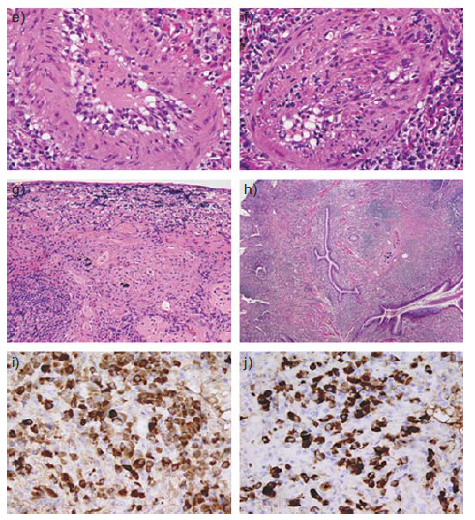
Notes:
e) Endothelialitis characterised by subendothelial mixed inflammatory
infiltrates with reactive endothelial cell changes (HE, 4006). f) Intimal and mural
inflammatory infiltrates accompanied by luminal occlusion owing to cellular
myointimal proliferation (HE, 4006). g) Fibroblastic proliferation in the centre
surrounded by mononuclear infiltrates at the periphery of field (HE, 1006).
h) Peribronchial inflammation without structural alteration of the involved airways
(HE, 406). i) and j) A marked increase in IgG and IgG4-positive plasma cells among
the inflammatory infiltrates showing a high IgG4/IgG ratio (IgG and IgG4, 4006).
Reproduced from [16] with permission from the publisher.

Slide 8
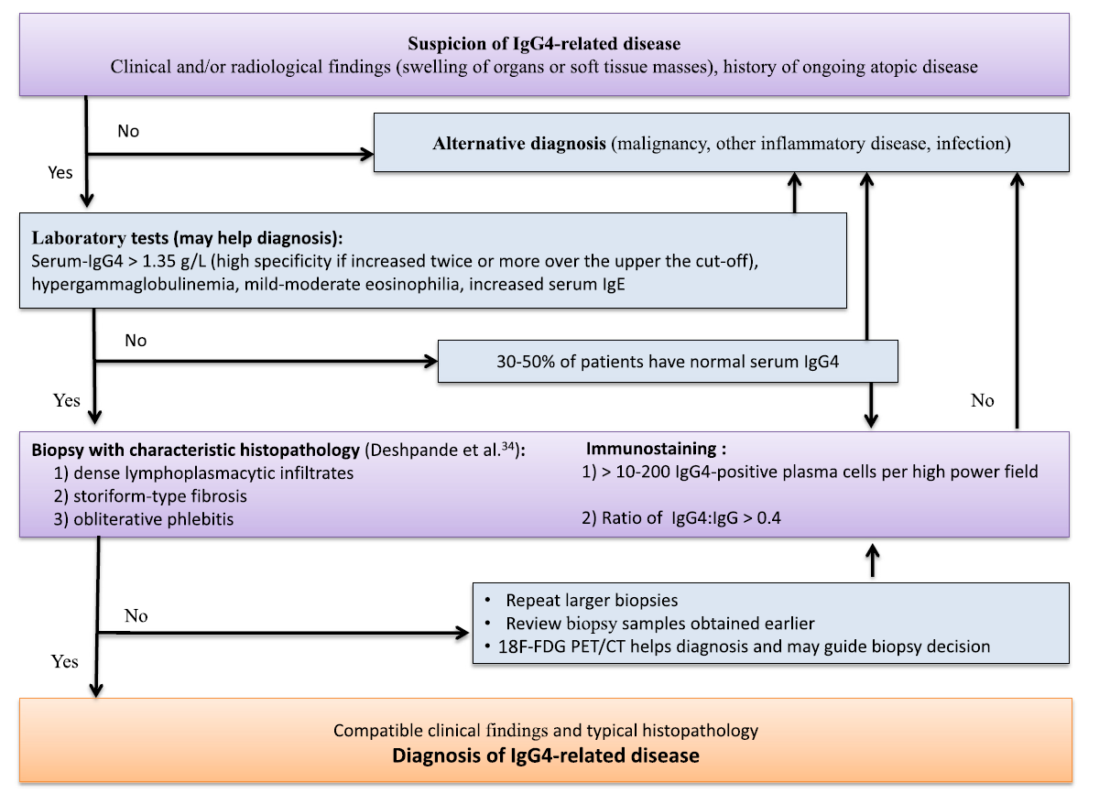

Slide 9
Treatment
No definitive treatment strategy for IgG4-RD has yet been established
Approach to treatment of IgG4-RD is based upon observational data
  Focused on patients with autoimmune pancreatitis (AIP)
  Growing number of reports support the efficacy of B cell depletion with rituximab
“Watch-and-wait” strategy
  In asymptomatic patients or those with limited disease
  Only involvement of lymph nodes or salivary glands

Slide 10
Treatment
Glucocorticoids
  First-line approach for the most patients with symptomatic IgG4-RD
  Most patients (86–99%) respond well to glucocorticoids within 2–4 weeks
  Japanese approach
    Prednisone 0.5–0.6 mg/kg/day or 30–40 mg/day for 2-4 weeks -> tapering by 5–10 mg every 1–2 weeks to 2.5–5 mg/day (6m ~ 3yrs)
  Mayo clinic
    Prednisone 40 mg/day for 4 weeks -> tapering by 5 mg/week during a 7-week taper period
  25–50% of patients relapse on low maintenance dose or after discontinuation of glucocorticoids

Slide 11
Treatment
Rituximab
  Alternative in glucocorticoid resistant, generalized or relapsing disease
Bortezomib, Antihistamines, Tamoxifen, …
Responses are characterized by
  Symptomatic improvement
  Reductions in the size of masses or organ enlargement
  Improvement in organ function
  Often a decrease in serum levels of IgG4

Slide 12
Prognosis
Not well-defined
Minority of patients improve at least temporarily without treatment
Majority of patients have chronic disease that progresses at variable rates
Risk of malignancy
  Non-Hodgkin lymphoma, pancreatic cancer, salivary duct carcinoma, pulmonary adenocarcinoma, small cell carcinoma of the lung, ….

Slide 13
IgG4-related lung disease
In 2004, two separate case reports were published
Broader spectrum of intrathoracic findings
In a cross-sectional study of 114 patients with IgG4-RD 16 (14%) were found to have lung or pleural lesions
In a separate retrospective study that reviewed 90 patients with autoimmune pancreatitis, 54% of patients were noted to have lung lesions

Slide 14
Characteristic lymphoplasmacytic infiltrates enriched in IgG4-positive plasma cells, interspersed with abundant storiform fibrosis
Obliterative arteritis is more common in the lung than in other organs affected by IgG4-RD
May mimic sarcoidosis

Slide 15
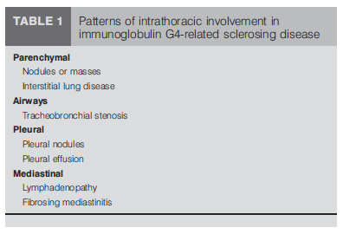
IgG4-related lung disease
Clinical features : Nonspecific
  Respiratory symptoms including cough, exertional dyspnea and chest pain (one-half of patients)
  Fever and weight loss (uncommon)
Patterns of lung involvement

Slide 16
IgG4-related lung disease
Parenchymal disease
  Mainly of rounded opacities (nodules (<3cm) or masses (>3cm) and ILD
  GGO or consolidation, reticular opacities

Slide 17
IgG4-related lung disease
Airway disease
  Rare reports of airway disease
  Tracheobronchial stenosis, extrinsic compression of the central airways due to fibrosing mediastinitis and bronchiectasis
Pleural disease
  Nodular lesions in the visceral or parietal pleura
  Pleural effusion (uncommon)

Slide 18
IgG4-related lung disease
Mediastinal disease
  Mediastinal and/or hilar lymphadenopathy (40-90%, most frequent extrapancreatic lesion)
  Fibrosing mediastinitis (unusual)

Slide 19
IgG4-related lung disease
Diagnosis
  Histopathological examination of tissue biopsy will be useful
  Serum IgG4 level can be elevated in the majority of patients
  BAL fluid analysis has been reported to show elevated IgG4 levels
Treatment
  Corticosteroid
  Rituximab, cyclosporine, cyclophosphamide….

Slide 20
Reference
[1] Stone JH, Zen Y, Deshpande V. IgG4-related disease. N Engl J Med 2012; 366:539
[2] Kamisawa T, Zen Y, Pillai S, Stone JH. IgG4-related disease. Lancet 2015; 385:1460
[3] Kamisawa T, Funata N, Hayashi Y, et al. A new clinicopathological entity of IgG4-related autoimmune disease. J Gastroenterol 2003; 38:982
[4] Cheuk W, Chan JK. IgG4-related sclerosing disease: a critical appraisal of an evolving clinicopathologic entity. Adv Anat Pathol 2010; 17:303
[5] Bateman AC, Deheragoda MG. IgG4-related systemic sclerosing disease - an emerging and under-diagnosed condition. Histopathology 2009; 55:373

Slide 21
Summary
Commonly shared features of IgG4-RD
  Tumor-like swelling of involved organs
  Lymphoplasmacytic infiltrate enriched in IgG4-positive plasma cells
  Variable degree of fibrosis that has a characteristic “storiform” pattern
Patterns of lung involvement
  Parenchymal, Airways, Pleural, Mediastinal disease
Diagnosis
  Based upon biopsy
  Eosinophilia, Elevated serum IgG4 levels
Treatment
  Glucocorticoids
  Rituximab

Slide 22


