Slide 1


Lung malignancy in explanted lungs
after lung transplantation
Bo Ra Yoon, MD.
Division of Pulmonology,
Department of Internal Medicine,
Yonsei University College of Medicine

Slide 2
[Transplantation Proceedings, 50, 234e240 (2018)]
Unexpected Neoplasms in Lungs Explanted From Lung Transplant
Recipients: A Single-Center Experience and Review of Literature
Lung transplantation is an established treatment for end-stage lung disease.
Because the risk factors for end-stage lung disease and lung cancer are often similar, neoplasms are sometimes found in explanted lungs.
Since the 2005 implementation of the new Lung Allocation Score (LAS) system, the number and the mean age of lung transplant recipients have increased, average waiting list time has decreased, and more patients are undergo in transplantation for IPF and other ILDs

Slide 3
These neoplasms may not be discovered pre-transplantation for
The radiographic picture in patients with end-stage lung disease, especially ILD makes it difficult to differentiate.
The ability to perform a biopsy is difficult and complications, such as pneumothorax and respiratory failure, can occur as result of the procedure and carry substantial morbidity and mortality.
An increasing number of patients present with a disease flare-up with ground-glass opacities and consolidation that may obscure the detection of potential neoplasms and also make a biopsy impossible.

Slide 4
Cleveland Clinic, 1990.01.01 ~ 2014.06.30
1303 patients underwent lung transplantation
25 undetected neoplasms were found in 24 patients (1.8%)
Smoking : 21 pts, mean duration (35PYR)
pre-LAS group (before 2005) : 4 pts (0.81%)
post-LAS group (after 2005) : 20 pts (2.5%)
17 ILDs : 15 UIPs, 1 NSIP, 1 Sarcoidosis
8 Emphysemas

Slide 5
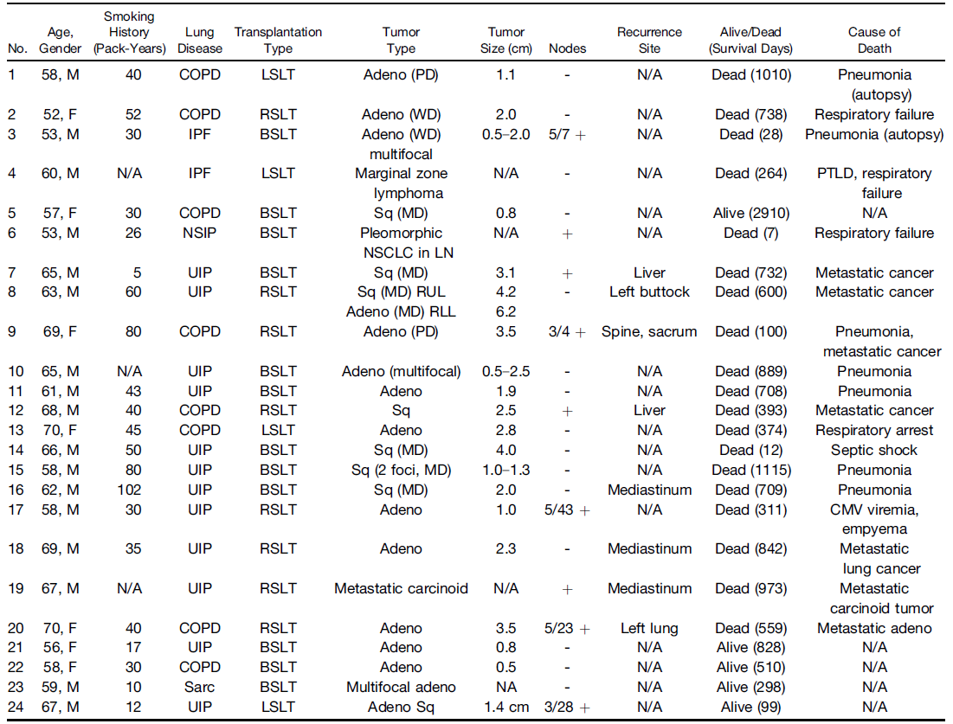

Slide 6
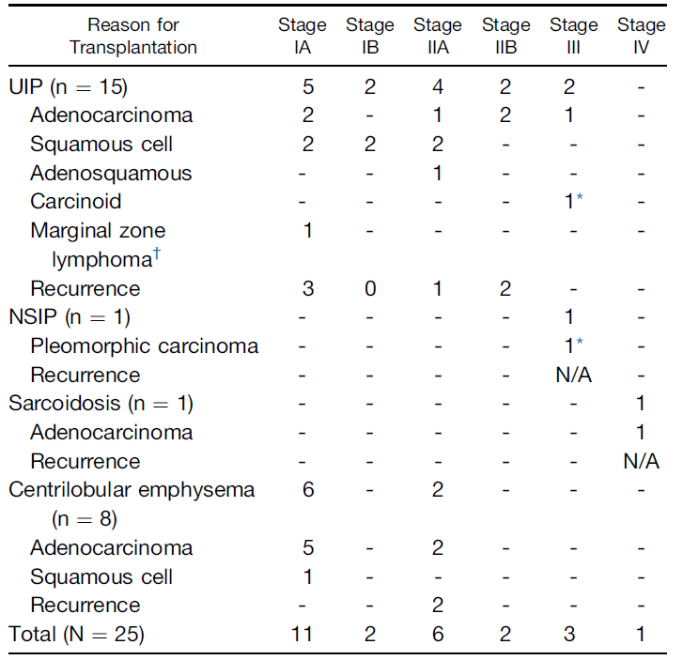
17 ILDs
7 adenocarcinomas
6 squamous cell carcinomas
1 carcinoid tumor
1 B cell lymphoma, marginal zone type
1 adeosquamous carcinoma
1 pleomorphic carcinoma
8 Emphysemas
7 adenocarcinomas
1 squamous cell carcinomas

Slide 7
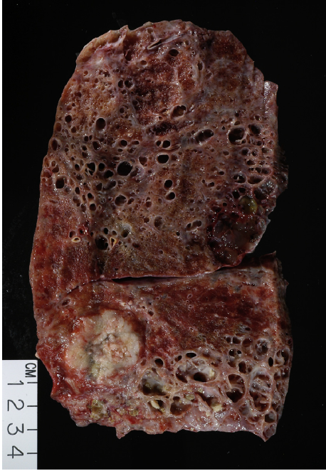
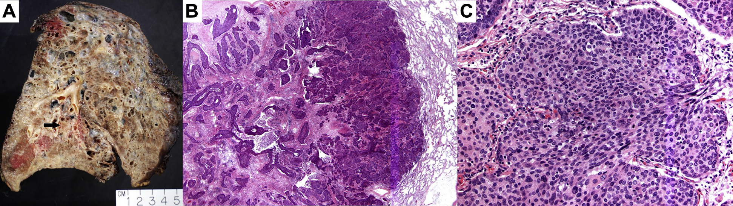
Explanted left lung shows UIP
Lung nodule, LLL
Representing invasive squamous cell carcinoma
Explanted left lung with UIP
Invasive adenocarcinoma, LLL

Slide 8
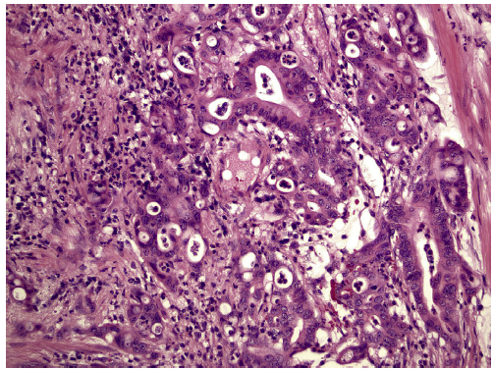
Explanted lung with emphysema
Invasive adenocarcinoma, acinar predominant, detected

Slide 9
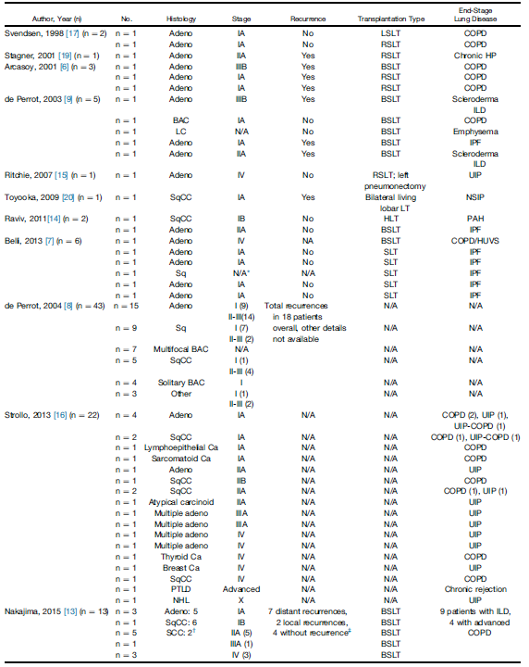
Reviewed 13 articles
105 neoplasms
15 adenocarcinomas (48.6%)
24 squamous cell carcinomas (22.9%)
30 miscellaneous cancer
small cell carcinoma
BAC
metastasis from extrapulmonary cancer
carcinoid tumor
Lymphoproliferative disorder
PTLD (post-transplantation lymphoproliferative disorder

Slide 10
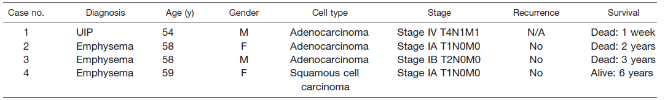
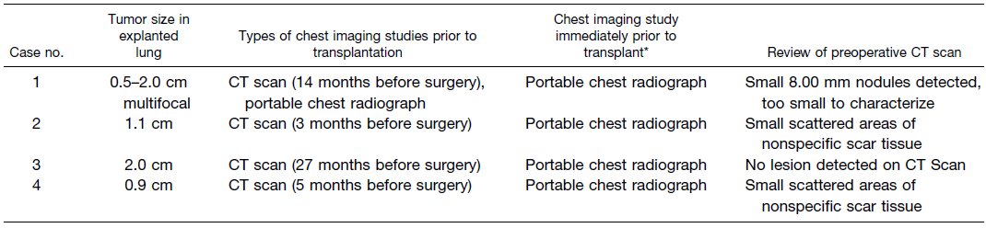
[Transplantation Proceedings, 36, 2808–2811 (2004)]
Incidence of Primary Neoplasms in Explanted Lungs: Long-Term
Follow-Up From 214 Lung Transplant Patients
Cleveland Clinic, 1991.01 ~ 2000.12
214 pts underwent lung transplantation → 4 neoplasms
Notes:
4 Case에 대해 영상, 병리사진 및 clinical outcome을 기술 (이전에는 이런 case 보고가 없었다. ??)
유일하게 CT상 확인된 Case는 14개월 전에 찍고 8mm size 였던 case, 그러나 perioperative에 사망
이 case 역시 UIP
3개월 f/u도 믿을 수 없다.
24시간 내에 f/u

Slide 11
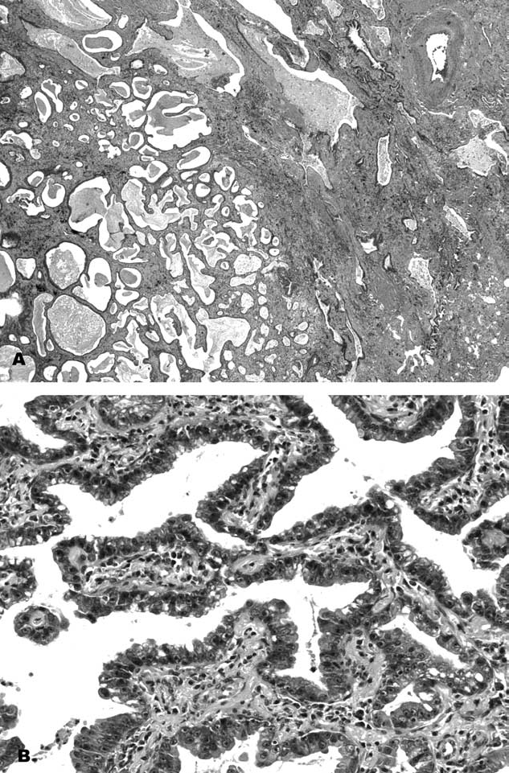
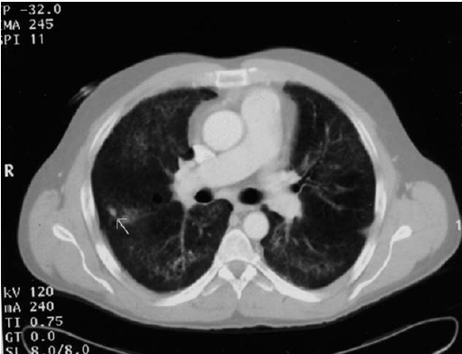
A small (8-mm) nodule, too small to characterize.
Chest CT, because of the cross-sectional capability, is the most sensitive method to detect neoplasms.
HRCT scan immediately (less than 24 hours) prior to transplant may also help to decrease the incidence of undetected primary malignancies in explanted lungs.

Slide 12
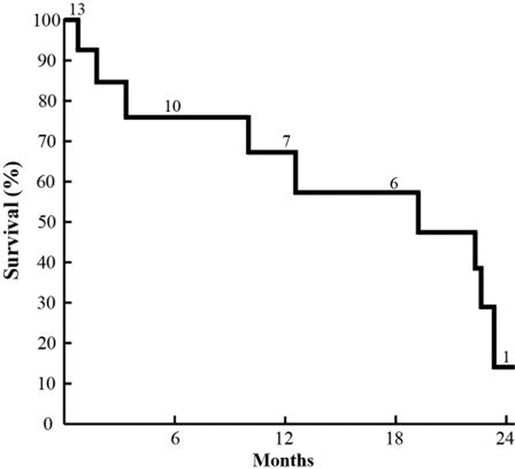
[The Journal of Heart and Lung Transplantation, Vol32, No4S, April 2013]
Losing the War before the First Battle: Explant Malignancy in
Lung Transplantation
Cleveland Clinic, 2007.04 ~ 2012.04
522 pts underwent lung transplantation → 13 neoplasms (2.5%)
Overall survival 14% at 2 years
Notes:
2005 LAS score로 더 많은 lung T가 시행되면서 lung cancer가 늘었다 ??

Slide 13
[European Respiratory Journal 2016 48]
Incidence, outcomes and risk factors for neoplasms in explanted lungs
Bordeaux University, 2008 ~ 2015
132 pts underwent lung transplantation → 5 neoplasms (3.8%)
3 ILDs : 2 at early stage (1A), 1 at advanced stage (IV)
2 Emphysemas : early stage (1A)
Higher (p<0.05) in IPF group (33.3%) compared with others (2.38%)
Others potential risk factors were not associated with significantly higher
rates of cancer in explants.
(tabacco, long period between CT scan and transplantation, etc.)
Notes:
Clevland 외 다른 병원은?
영국 case도 3.8% 비슷 비슷

Slide 14
[Respiratory Medicine Case Reports 25 (2018) 45–48]
Incidental extensive adenocarcinoma in lungs explanted from a transplant recipient with an idiopathic pulmonary fibrosis flare-up: A clinical dilemma
IPF itself increases the risk of lung cancer development
by 6.8% to 20%.
A clinical dilemma in a patient who presented with an IPF flare-up
and underwent urgent evaluation for lung transplantation.
Clinical diagnostic dilemmas such as this emphasize the need for
new noninvasive testing that would facilitate malignancy diagnosis
in patients too sick to undergo invasive tissue biopsy for diagnosis.
Notes:
IPF flare up으로 lung cancer DDX 어려운 case

Slide 15
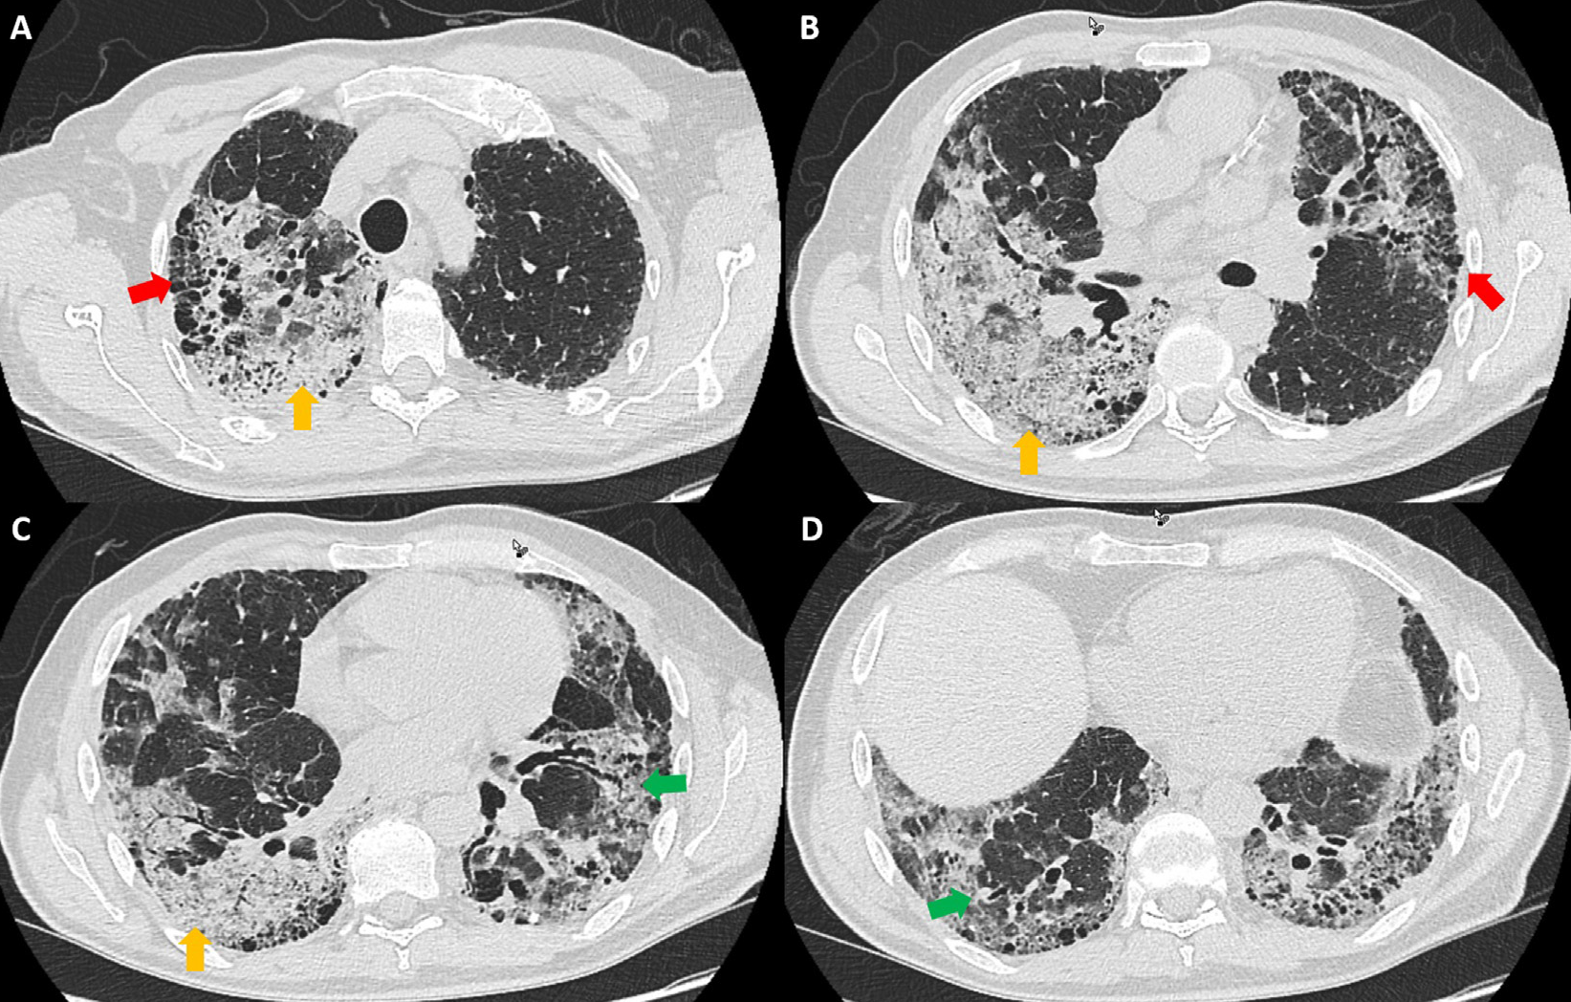
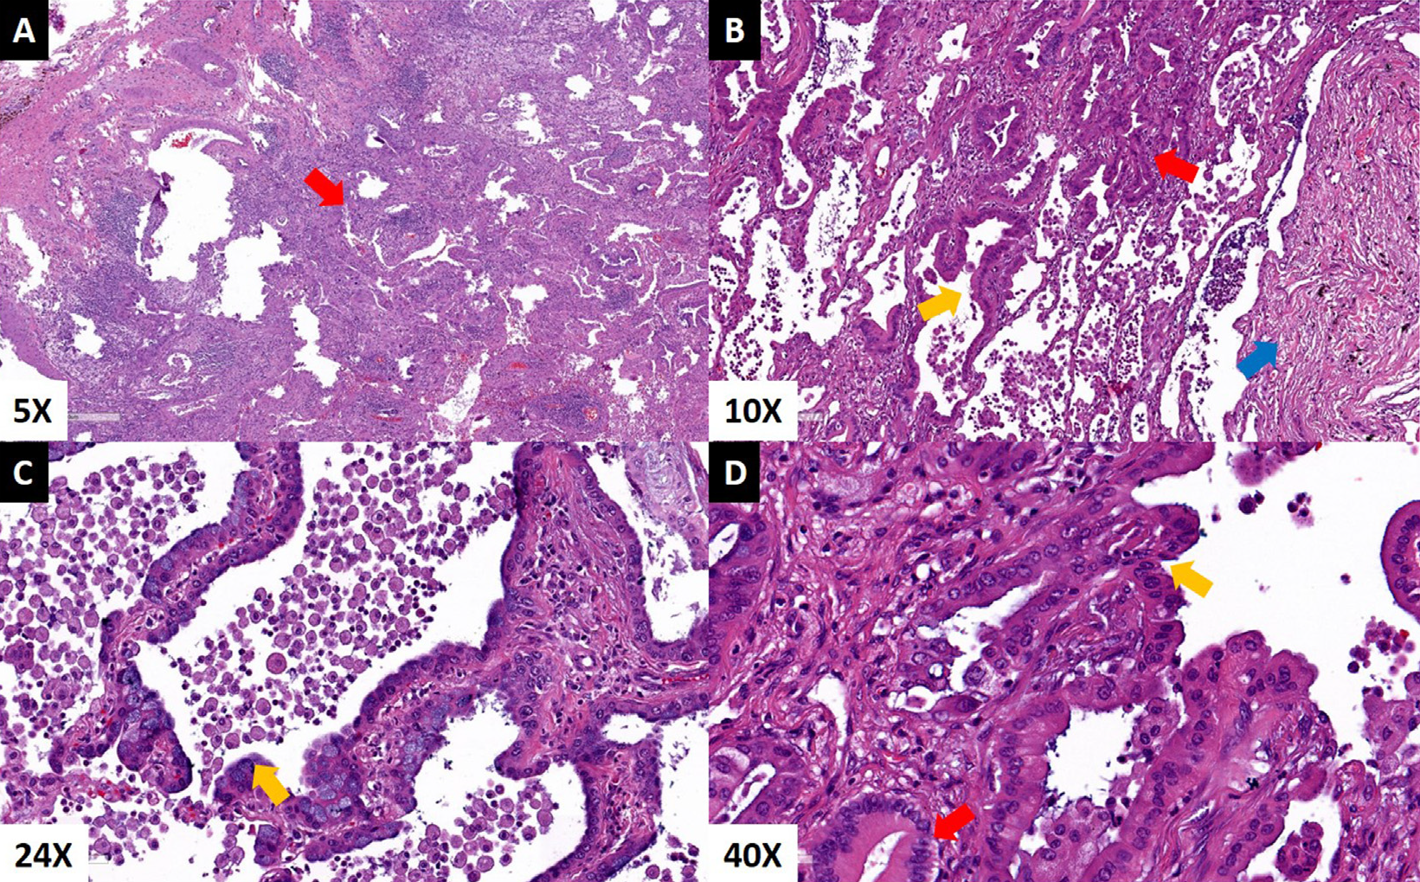
Case (69/M)
PFT : FVC 39%, DLCO 25%
CT : superimposed pneumonia on the UIP or a UIP flare-up
smoking : ex-smoker, quit 20yrs ago, 12PYR
Extensive consolidation
Adenocarcinoma, AIS
Notes:
Lung T 시행받고 5개월 후 back pain으로 ER 내원
PET-CT, spine MRI상 spine, liver metz 진단
Pall. RTx 시행하였으나 pain 심하여 hospice 전원되 7일 후 사망

Slide 16
[Lung Cancer 81 (2013) 451– 454]
Lung cancer following lung transplant: Single institution 10 year experience
Lung cancer following lung transplantation are classified based on donor
or recipient origin.
Recipient tumors can be diagnosed in explanted specimens or found in
contralateral native lungs which remain in place during single lung
transplant (SLTx).
Mayo Clinic, 2001.01 ~ 2011.10
335 lung transplantation recipients
Notes:
Mayo case, donor origin이 특이함.

Slide 17
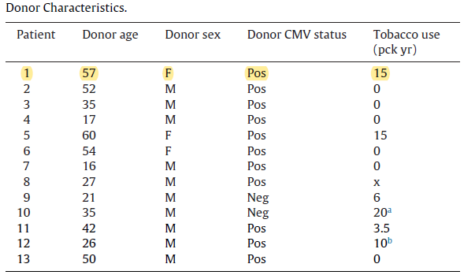
15 Patients were identified with a post-transplant diagnosis of lung neoplasia.
6 pts in explanted lungs
6 pts subsequently developed in native lungs
1 pts donor origin
2 pts exclued : present as a metastasis
Donor screening protocols may be
adequate in excluding those with
primary malignancies.
The donors tend to be low risk for lung cancer as most are
young and have suffered traumatic injuries resulting in brain death.
Notes:
Explanted lung은 1-5 days 후 Bx 결과 확인.
Rt. SLTx 받고 Lt. native lung에 생긴 경우 meal time은 241 days (바로 확인된 것은 아님.)
Donor screening 강조

Slide 18
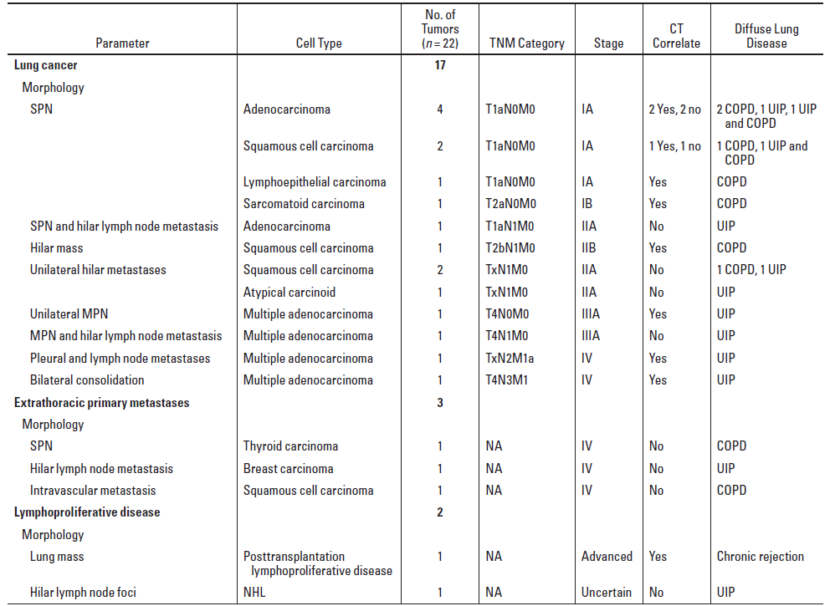
[AJR:201, July 2013]
Malignancies Incidentally Detected at Lung Transplantation: Radiologic and Pathologic Features
CT-pathologic features of cancer incidentally detected at lung T.
University of Pittsburgh Medical Center, 2004.01 ~ 2011.01
759 pts underwent lung transplantation → 22 neoplasms (2.9%)
Miss rate for CT positive findings was 20%
Notes:
영상의학과 저널

Slide 19
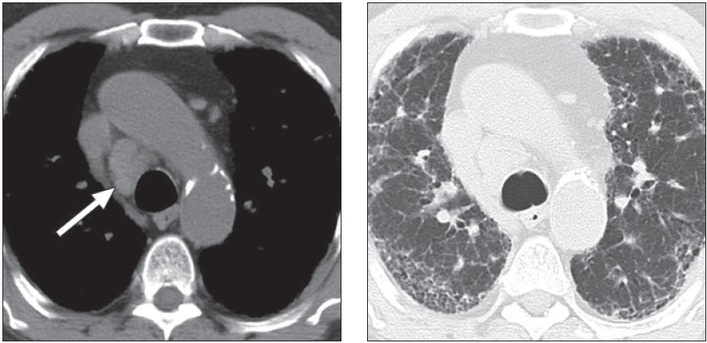
Case 1 (M/59)
UIP, adenocarcinoma (TxN2M1a)
During attempted SLT
→ surgery was aborted
→ died of metastatic lung cancer 8 months later
CT to surgery interval was 2 months
Notes:
14

Slide 20
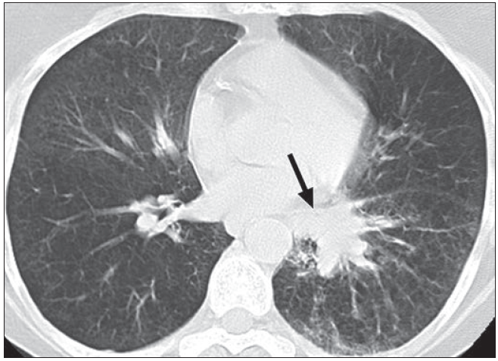
Case 2 (F/59)
Emphysema, Squamous cell carcinoma (T2bN1M0)
Underwent DLT
→ additional hilar resection was performed
→ survived 52 months w/o tumor recurrence
died of graft failure and chronic rejection
CT to surgery interval was 7 days
→ misinterpreted as pneumonia
Notes:
14

Slide 21
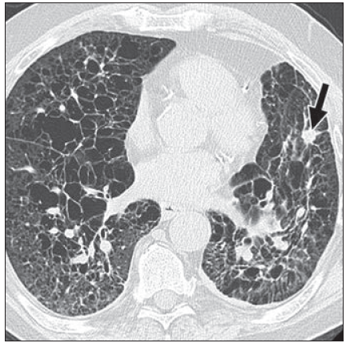
Case 3 (M/65)
Langerhans cell histiocytosis, Squqmous cell carcinoma (T1aN0M0)
Underwent DLT
→ mediastinal LNE developed 10 months after
→ died of HF 1year after DLT
CT to surgery interval was 10 months
→ indeterminate irregular pulmonary nodule was overlooked
Notes:
14

Slide 22
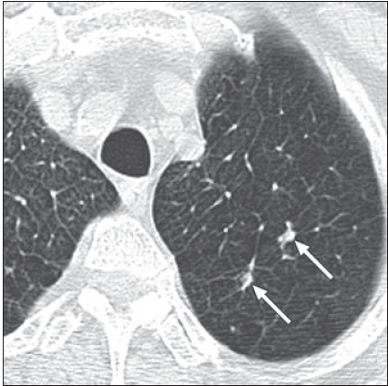
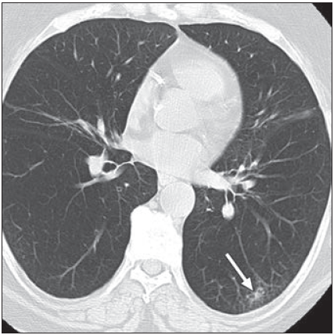
Case 4 (F/54)
Emphysema, lymphoepithelial-like lung carcinoma (T1aN0M0)
Underwent DLT
→ died of metastasis 10 months after transplantation
CT to surgery interval was 1 month
→ interpreted as probably of inflammatory cause
Several nodules (1cm and smaller), LUL
Unchanged for 2 years
Pathology : necrotizing granulomas
Newly developed semisolid nodule, LLL
From 9 months earlier
Pathology : malignancy
Notes:
14

Slide 23
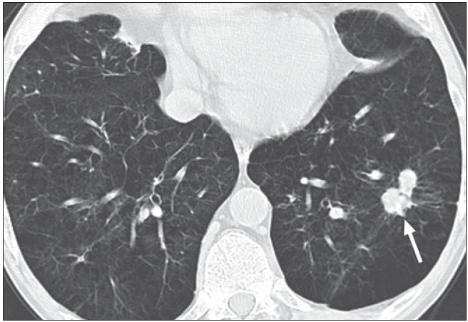
Case 5 (M/65)
Emphysema, Sarcomatoid lung cancer (T2aN0M0)
Underwent DLT
→ survived 5years w/o tumor recurrence
CT to surgery interval was 2 months
→ FNA and repeatd bronchoscopic biopies were negative
Unchanged for 11 months
PET-CT shows lobular LLL nodule was markedly FDG uptake
Notes:
14

Slide 24
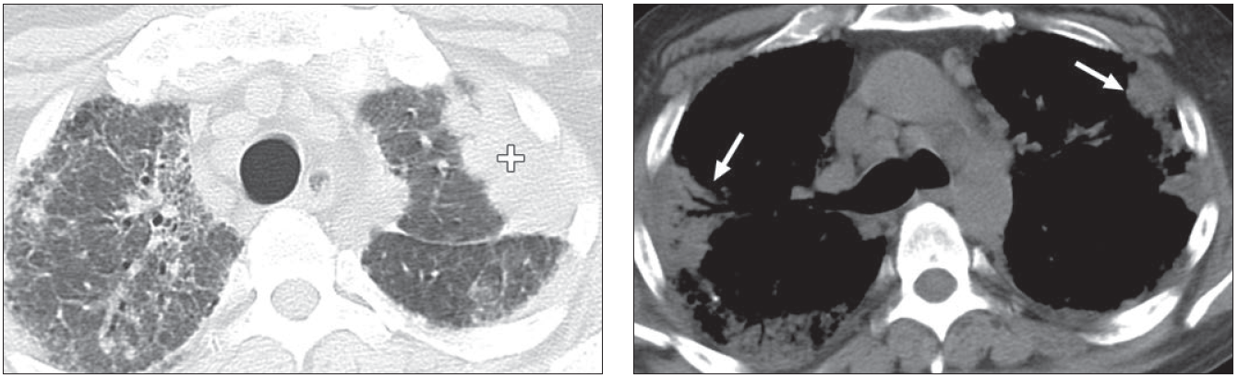
Case 6 (M/43)
UIP from hypersensitivity pneumonitis and fulminant pneumonia
Adenocarcionoma (T4N3M1)
Underwent DLT
→ died 10 days after transplantation owing to cardiac arrest and
extensive matastasis
CT to surgery interval was 1 week
→ Because of patient’s young age and known pneumonia,
CT interpretation suggested multifocal pneumonia superimposed on UIP

Slide 25

With the Love of God, Free Humankind from Disease and Suffering
Notes:
야간 전경 2-B

Slide 26

Notes:
의과대학 1-B

