Slide 1
VATS conference review
: Pulmonary alveolar proteinosis
Lee Jung Mo
Division of Pulmonology,
Department of Internal Medicine,
Institute of Chest Diseases,
Severance hospital, Yonsei University College of Medicine

Slide 2
Contents
Introduction
Pathogenesis
Clinical presentation
Diagnosis
  Images and pathology
Treatment

Slide 3
Pulmonary Alveolar Proteinosis Syndrome
first reported by Rosen and colleagues in 1958
syndrome characterized by disorders of surfactant
  the accumulation of surfactant in alveoli and terminal airways
  resulting in hypoxemic respiratory failure

Slide 4
Pathogenesis
Surfactant
  synthesized and secreted by alveolar type II epithelial cells
  removed by uptake, recycling, and catabolism in these epithelial cells and alveolar macrophages
  GM-CSF(granulocyte-macrophage colony stimulating factor) is essential in catabolism of surfactant in alveolar macrophage

Slide 6
Classification
Primary PAP : caused by disruption of GM-CSF signaling
Secondary PAP : underlying disease that impairs alveolar macrophage functions and/or numbers

Slide 7
Autoimmune PAP
Most common clinical form (90%)
High level of anti-GM-CSF autoAb in lung
→ Disruption of GM-CSF signaling
→ alveolar macrophage dysfunction
→ autoimmune PAP

Slide 8
The incidence and prevalence of autoimmune PAP is 0.49 and 6.2 per million.
Common in males (2:1)
typically presenting in the third through sixth decades
rare in children younger than 10 years of age

Slide 9
Hereditary PAP
accounts for less than 1% of cases
recessive mutations in CSF2RA or CSF2RB → disruption of GM-CSF singaling
clinically, physiologically, and histologically indistinguishable from autoimmune PAP

Slide 10
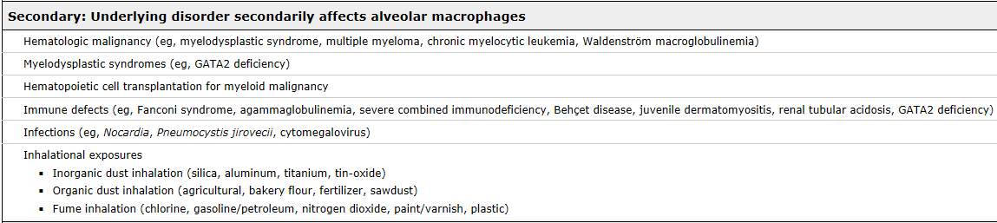
Secondary PAP
Secondary PAP accounts for 8% to 9% of all PAP cases
Various underlying conditions
→ impairing alveolar macrophage number or functions
Surfactant production disorders are less common
Hematologic disorders (especially MDS) are the major underlying disease
  greater than 75% of cases with adult-onset secondary PAP

Slide 11
Clinical presentation
Symptoms in autoimmune PAP
  dyspnea, cough, fatigue, and weight loss are common symptoms
  Fever (1% in Japanese cohort, 11% in Italian cohort, and 15% in Chinese cohort)
  sputum production (4% in Japanese cohort and 1% in Italian cohort)
Secondary PAP with MDS
  fever (45%), dyspnea on exertion (42%), and cough (42%)

Slide 12
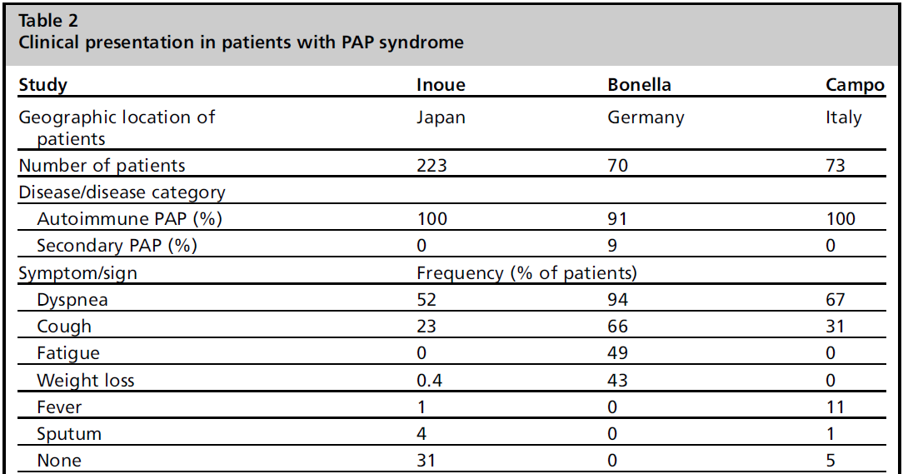

Slide 13
Clinical presentation
smoking history is common
  57% in Japanese cohort, 79% in German cohort, and 64% in Italian cohort
dust or fume exposure
  26% in Japanese cohort, 54% in German cohort, and 32% in Italian cohort
P/Ex is generally unremarkable
  crackles, clubbing, and cyanosis in some patients

Slide 14
Diagnosis
compatible history
typical radiologic findings
BAL cytology and/or lung biopsy findings
biomarkers

Slide 15
Radiologic findings
diffuse, bilateral infiltrates suggestive of pulmonary edema but without findings suggestive of cardiovascular disease
HRCT
  GGO
    patchy geographic pattern distributed in the lower lung fields in autoimmune PAP
    diffuse pattern in secondary PAP
  A “crazy paving” appearance (ground-glass opacities superimposed on septal thickening) and subpleural sparing are frequently seen in autoimmune PAP

Slide 16
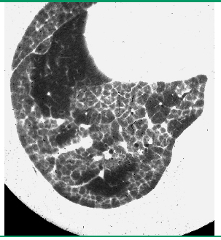
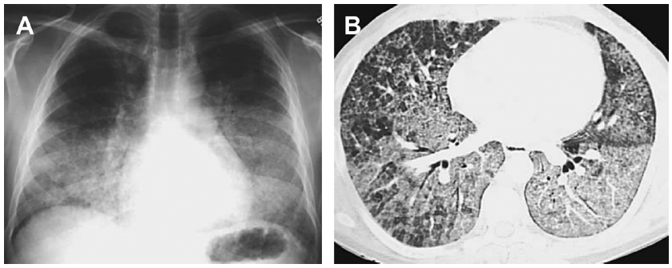

Slide 17
Lab and PFT findings
lactate dehydrogenase (LDH)
  typically elevated, but nonspecific
LDH and PaO_{2,} LDH and alveolar-arterial oxygen gradient (A-aDO ₂ )
  moderately correlated
PFT
  limited usefulness in diagnosing the severity of PAP
  FVC, FEV1 are generally within normal limits.
  DLCO is frequently reduced and correlates with disease severity
  Increased A-aDO ₂ correlates better with disease severity

Slide 18
Bronchoscopic findings
airways is unremarkable
BAL is emerging as a useful diagnostic tool for PAP
  BAL fluid shows a milky, turbid appearance and thick sediment
  diagnosis of PAP in Japanese cohort
    58.7% of patients : HRCT and BAL analysis
    34.1% : HRCT, BAL fluid, and TBLB
    7.2% : HRCT, BAL analysis or TBLB, and VATS
  Cytology of PAP BAL fluid
    PAS stain and oil red O stain positive large foamy macrophages and dirty-appearing sediment

Slide 19
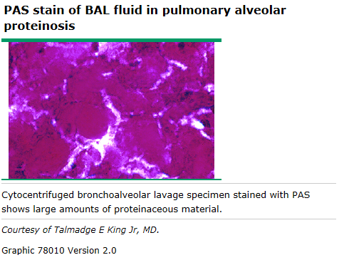

Slide 20
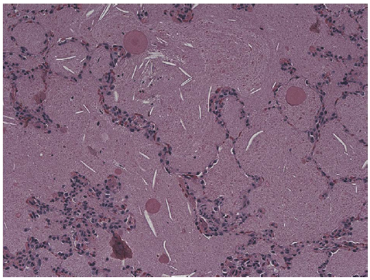
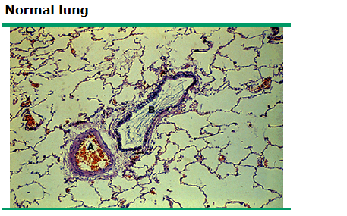
Histopathology
well-preserved alveoli
filled with eosinophilic, granular, and PAS-positive material and foamy alveolar macrophages
minimal interstitial inflammation or fibrosis
Periodic acid-Schiff (PAS) stain,
original magnification ×20

Slide 21
Biomarkers
GM-CSF autoantibody
  only disease-specific biomarker
  reported sensitivity and specificity for autoimmune PAP approaches 100%
  do not correlate with duration of disease, disease severity, PFT findings or other serum biomarkers
  weak correlation with age and the duration of disease

Slide 22
Biomarkers
most of biomarkers are not helpful in establishing a diagnosis
Serum GM-CSF
Whole-blood GM-CSF signaling tests
LDH, SP-A, SP-B, SP-D, KL-6, CEA, M-CSF, and MCP-1 are elevated in PAP
  LDH, KL-6, and CEA are reported to be correlated with some markers of lung function (Pa o ₂ , A-aDO ₂ , or % DLCO)
  NSE and Cyfra 21-1 : elevated in PAP

Slide 23
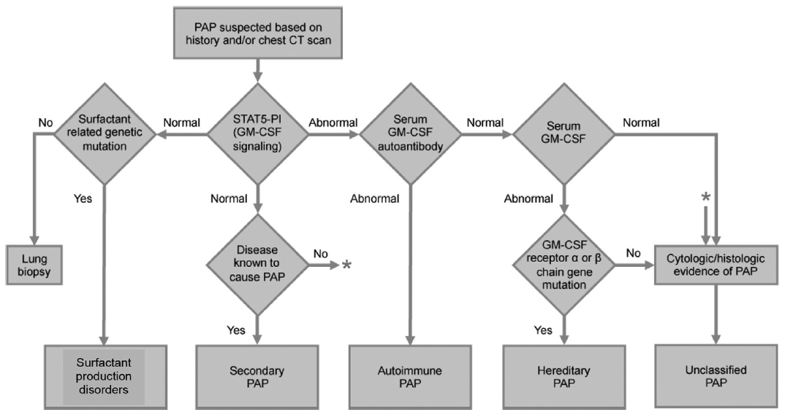
Diagnostic algorithm

Slide 24
Natural history
5%~33% of patients with autoimmune PAP were asymptomatic
Natural history in autoimmune PAP
  spontaneous improvement (ranging from 5% to 7%)
  persistent, unremitting symptoms
  progressive deterioration with respiratory failure
The 5-year survival rate
  85% without therapy
  94% with whole-lung lavage (WLL) therapy
  72% of deaths were caused by respiratory failure and 18% were caused by uncontrolled infections
Natural history in secondary PAP
  strongly influenced by that of the underlying disease
  prognosis is poorer than that of autoimmune PAP

Slide 25
Treatment
Whole Lung Lavage (WLL)
  standard first-line therapy since the 1960s
  many patients with PAP treated with WLL
    28% in the Chinese cohort, 90% in the German cohort, and 54% in the Italian cohort
  procedures are still not standardized and are highly operator-dependent
Lobar and segmental lavage using FOB
  less effective compared with WLL d/t small lavage volume
Corticosteroids : not effective
secondary PAP
  Depends on underlying disease
  improvement after hematopoietic stem cell transplantation in patients with hematologic diseases

Slide 26
Experimental approches
Exogenous GM-CSF
  Subcutaneous GM-CSF
  Aerosolized GM-CSF inhalation
anti-B-cell therapy with Rituximab
  for autoimmune PAP
  reduce the level of GM-CSF autoantibodies
Plasmapheresis
  can remove GM-CSF autoantibodies in autoimmune PAP
These experimental approaches are promising, but further efficacy and safety studies are necessary.

Slide 27
Whole lung lavage
Double-lumen endotracheal tube
General anesthesia
Total intravenous anesthesia (TIVA) usually used.
Complete muscle relaxation
  Facilitate single lung ventilation
  Avoid coughing
10 to 15 L/ lung (up to 50L/lung) with warm saline
Fliud replacement
  Minimal, use of colloids
  Absorption of lavage fluid into the circulation
  Consider IV furosemide, if needed.
Start with the most affected lung.
Positioning : supine or full lateral

Slide 28
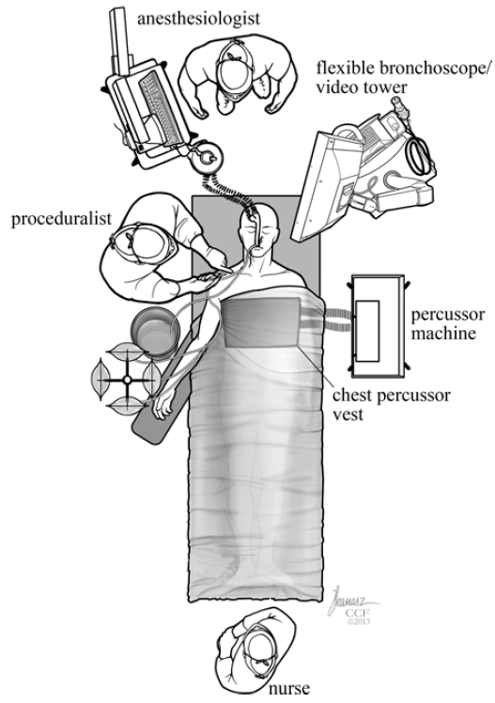
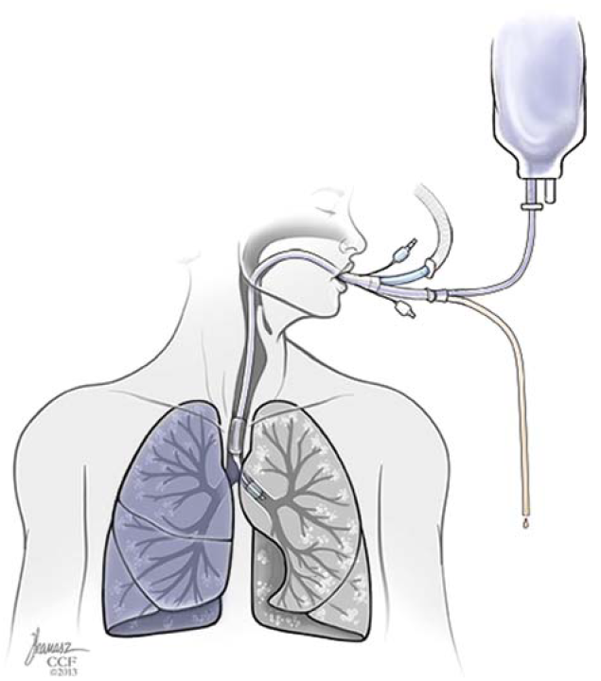
Whole lung lavage
Cleveland Clinic Center for Medical Art & Photography

Slide 29
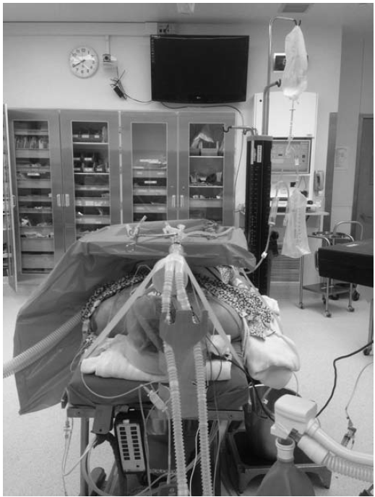
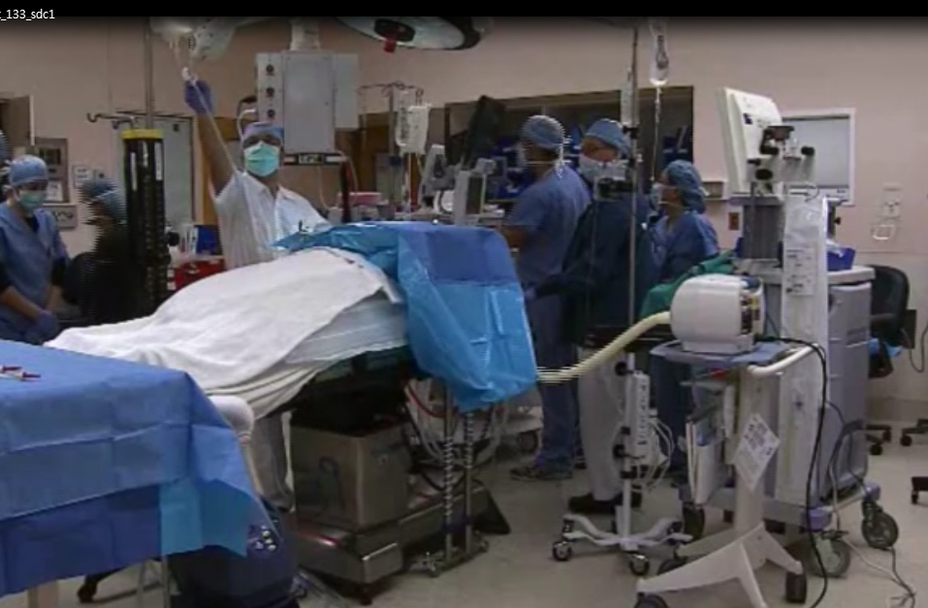
Cleveland Clinic Center for Medical Art & Photography

Slide 30
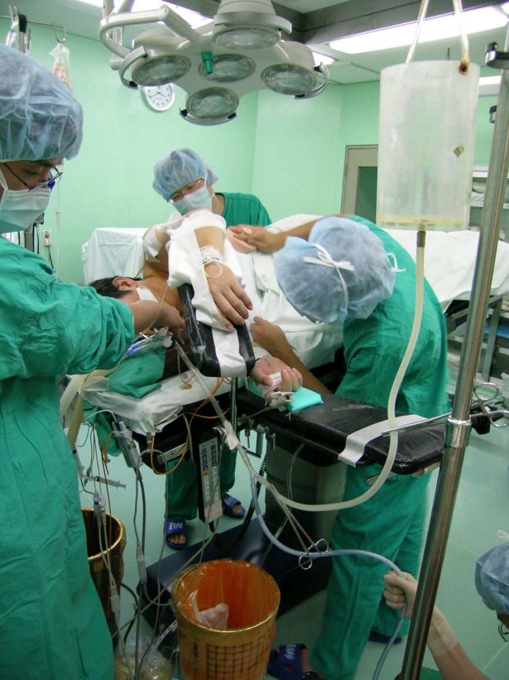
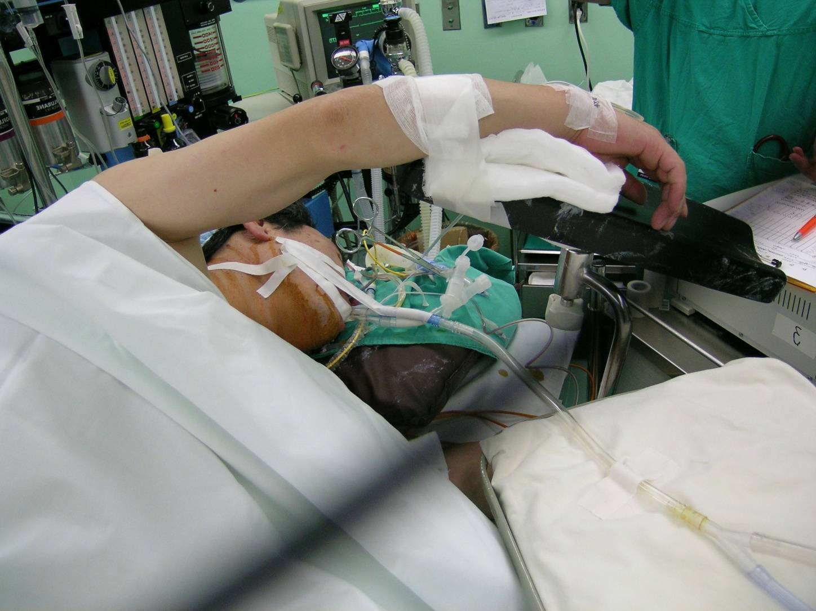

Slide 31
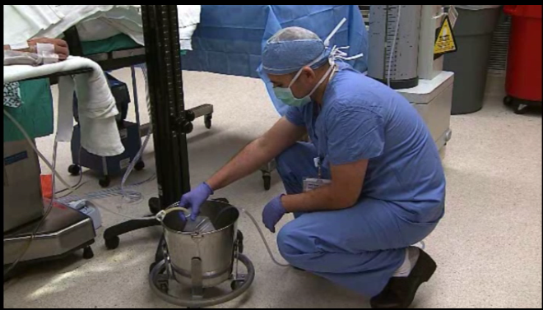
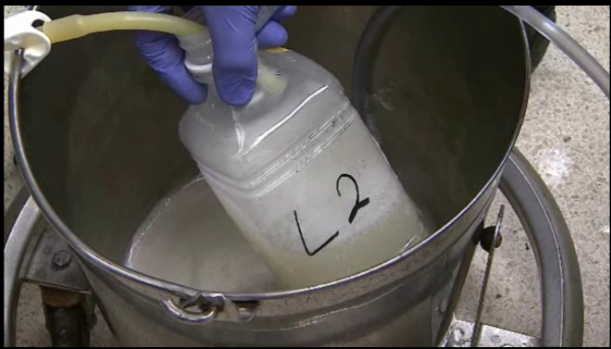

Slide 32
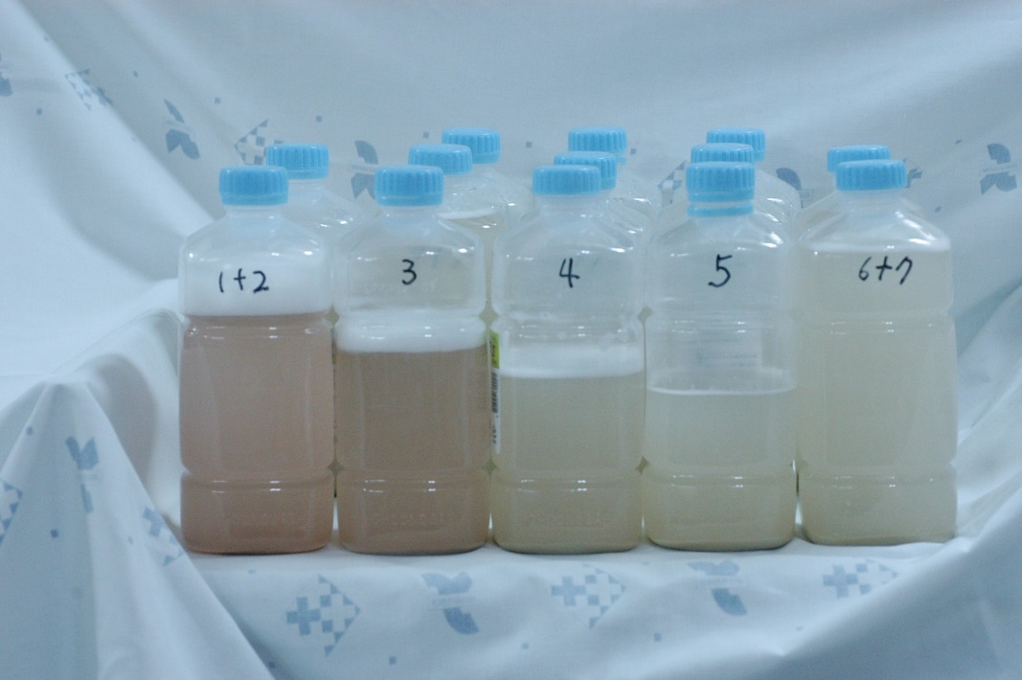
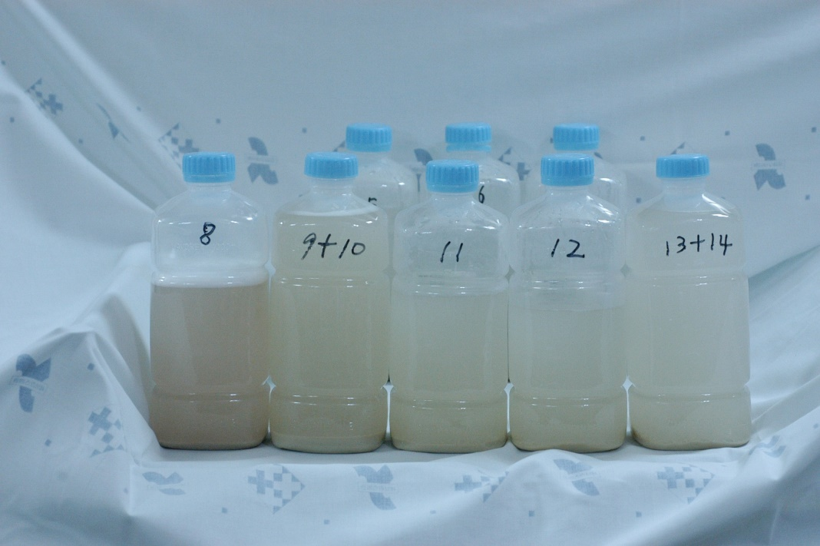
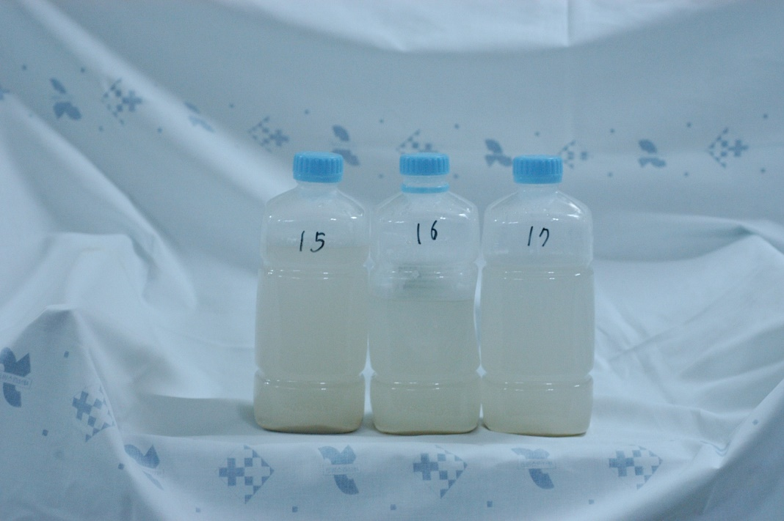

Slide 33
Whole Lung Lavage
1. 환자를 전신 마취를 한 후 supine position에서 double lumen endotracheal intubation을 시행함. 이 때 양측 폐 중 더 심한 부위의 세척을 먼저 시행해야 하므로 만약에 좌측 폐를 먼저 시행한다고 하면, left-sided double-lumen endotracheal tube를 넣은 후에 자세는 right lateral decubitus로 환기를 하는 우측 폐를 아래로 가게하고 세척을 하는 좌측 폐는 위로 가게 한다.
2. 시술 전 양측 폐의 탄성을 각각 측정한 후 기록한다. ( 근육이완제를 투여한 후 Tidal volume breathing을 시행하면서 압력을 측정한 후 이를 기록한다. 총폐탄성의 측정이 가능한 경우에는 이 역시 측정함 )
3. 100%의 산소와 low PEEP으로 20분 동안 한쪽 폐로 기계 환기를 시행하여 세척을 하는 폐를 deflation시키고, 가능한 모든 가스를 제거하여 세척을 해도 안전한 지를 확인한다.
4. 세척을 하지 않는 폐에 100% 산소를 투여하면서 기계 환기를 시작한다. 세척을 하는 폐에 large-bore tubing system을 이용하여 중력을 이용하여 Tidal volume의 37℃ 생리식염수를 유입 및 배출시킨다. 이 때 주입하는 용기는 관의 30 cm 상방에 위치하게 하고, - carina에서 50cm 상방이라는 보고도 있으므로 상황을 보고 30 - 50cm 정도의 위치를 유지하면 될 것으로 생각됨. - 배액관은 관의 20cm 하방에 위치하게 한다. ( 세척을 하는 양은 800 - 1,200 cc정도로 조절하며, - Functional residual capacity의 50%정도까지 할 수 있다 - 한 cycle의 시간은 15분 정도로 한다. 보통 10 - 15 cycle을 시행하게 되므로 한쪽 폐를 시행하는데 3시간 정도 소요된다고 보면 됨). 10 - 20 Liter 정도가 필요하다.

Slide 34
Whole Lung Lavage
5. 배출액이 부유물이 없으면서 맑아질 때까지 세척을 시행한다. 각 cycle 마다 세척부위의 흉부를 진동기와 손바닥을 이용하여 타진하여 폐포 내의 물질과 생리식염수가 잘 섞이게 한다. 주입을 할 때와 배액을 할 때 모두 타진을 하게 되나, 배액 시에 더 열심히 해야 한다. 각 cycle마다 주입되는 양과 배출되는 양을 기록한다. 마지막 cycle이후 기관지내시경을 시행하여 다 배출이 되었는지를 확인하고 남아 있는 세척액을 모두 suction한다.
6. 세척이 끝난 직후 양측 폐의 탄성을 각각 측정한 후 기록한다.
7. 세척을 마친 폐의 탄성도가 세척 전의 수준으로 돌아올 때까지 환기를 시행한다. 처음에는 decubitus position에서 시행을 하다가 나중에는 supine position에서 환기를 시행하게 된다.
8. 1시간 정도 기계 호흡을 한 후 양측 폐의 탄성도가 정상으로 돌아오게 되면, 반대쪽 폐의 세척을 시행한다.

Slide 35


Slide 36
