Slide 1
VATS Conference
2017.06.22.
Department of pathology

Slide 2
4190791 김O숙 F/46
SS17-28989

Slide 3
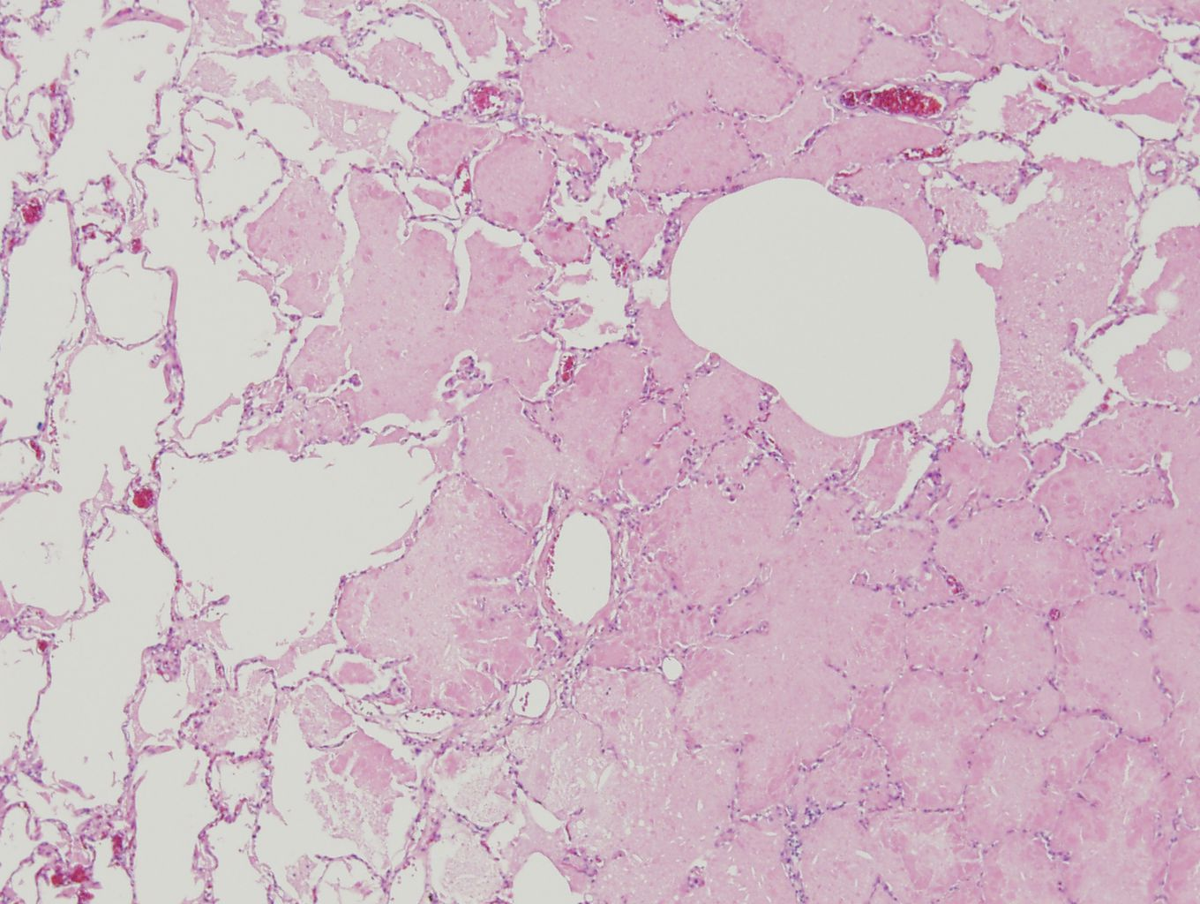

Slide 4
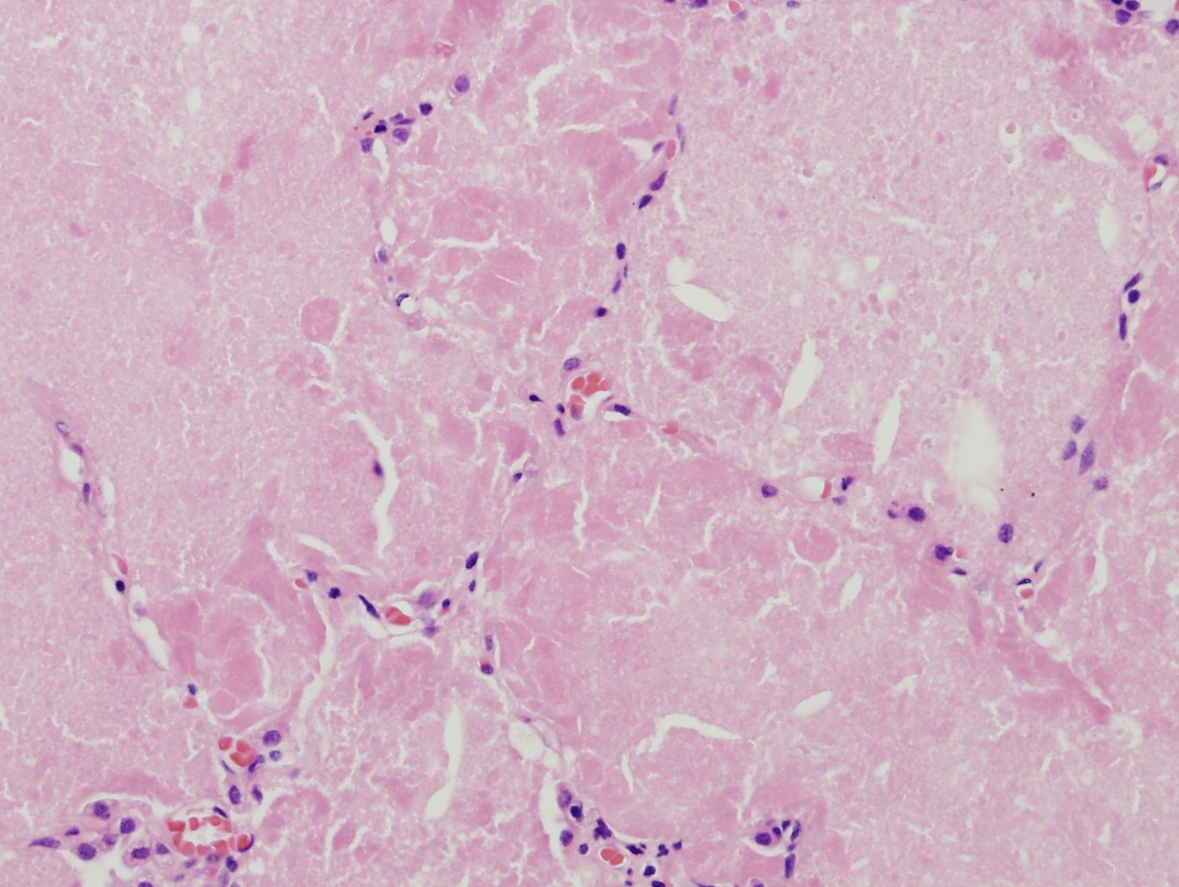

Slide 5
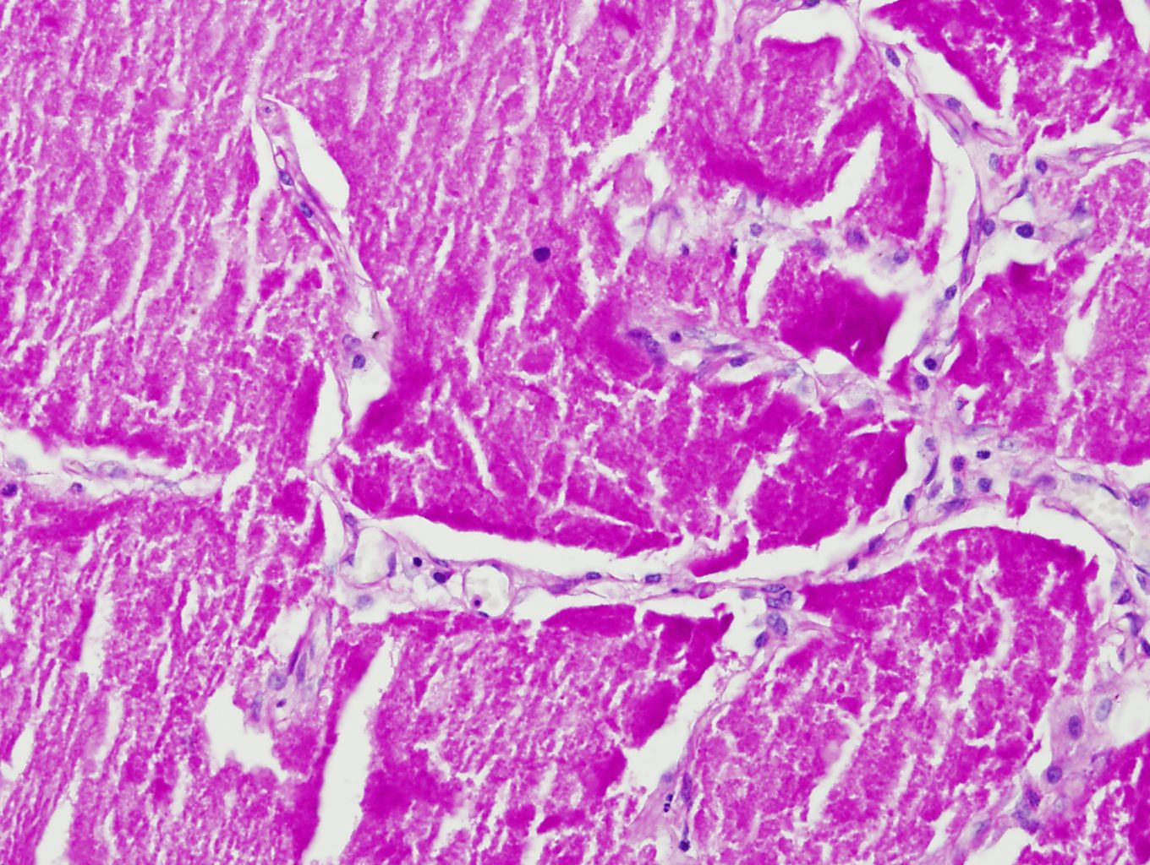

Slide 6
8436082 김O권 M/46
SR17-03683

Slide 7
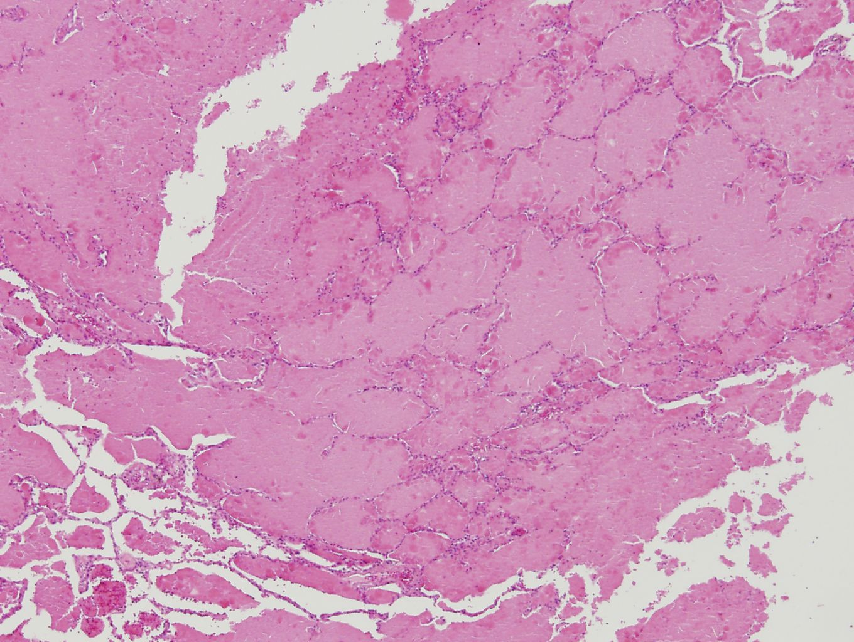

Slide 8
