Slide 1
VATS conference
2015. 10. 22

Slide 2
CASE1
M/49 8036713 채 O 순

Slide 3
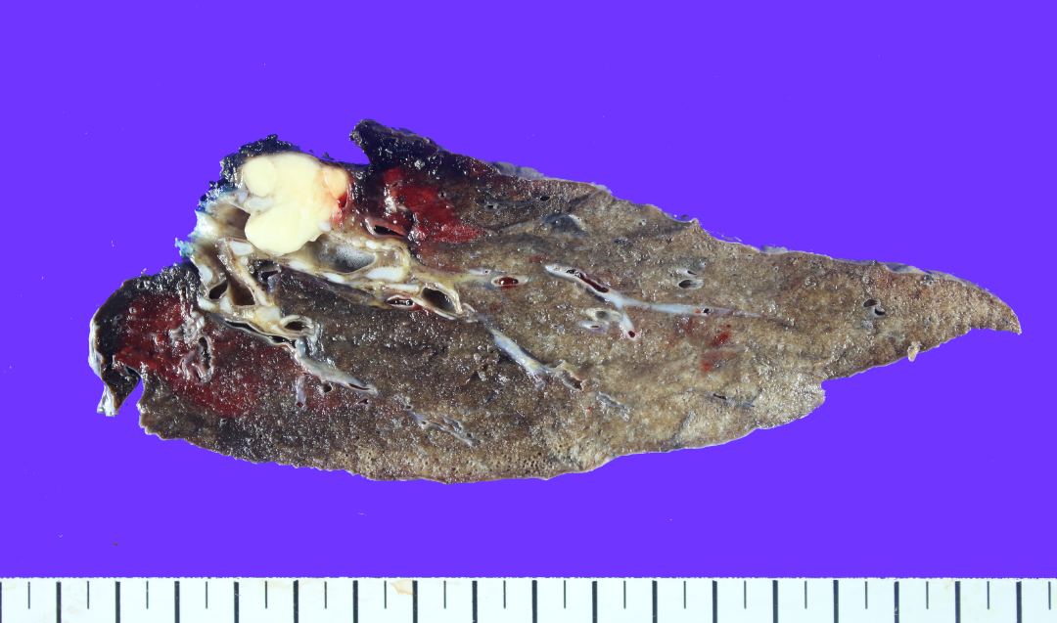
RLL, lobectomy
SS15-24563
anterior basal segmental bronchus 2.5x1.9cm

Slide 4
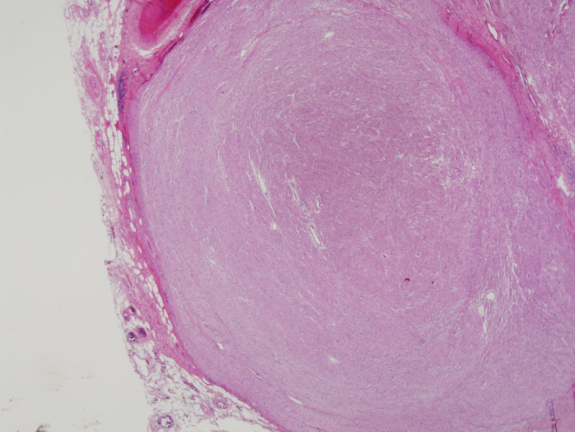

Slide 5
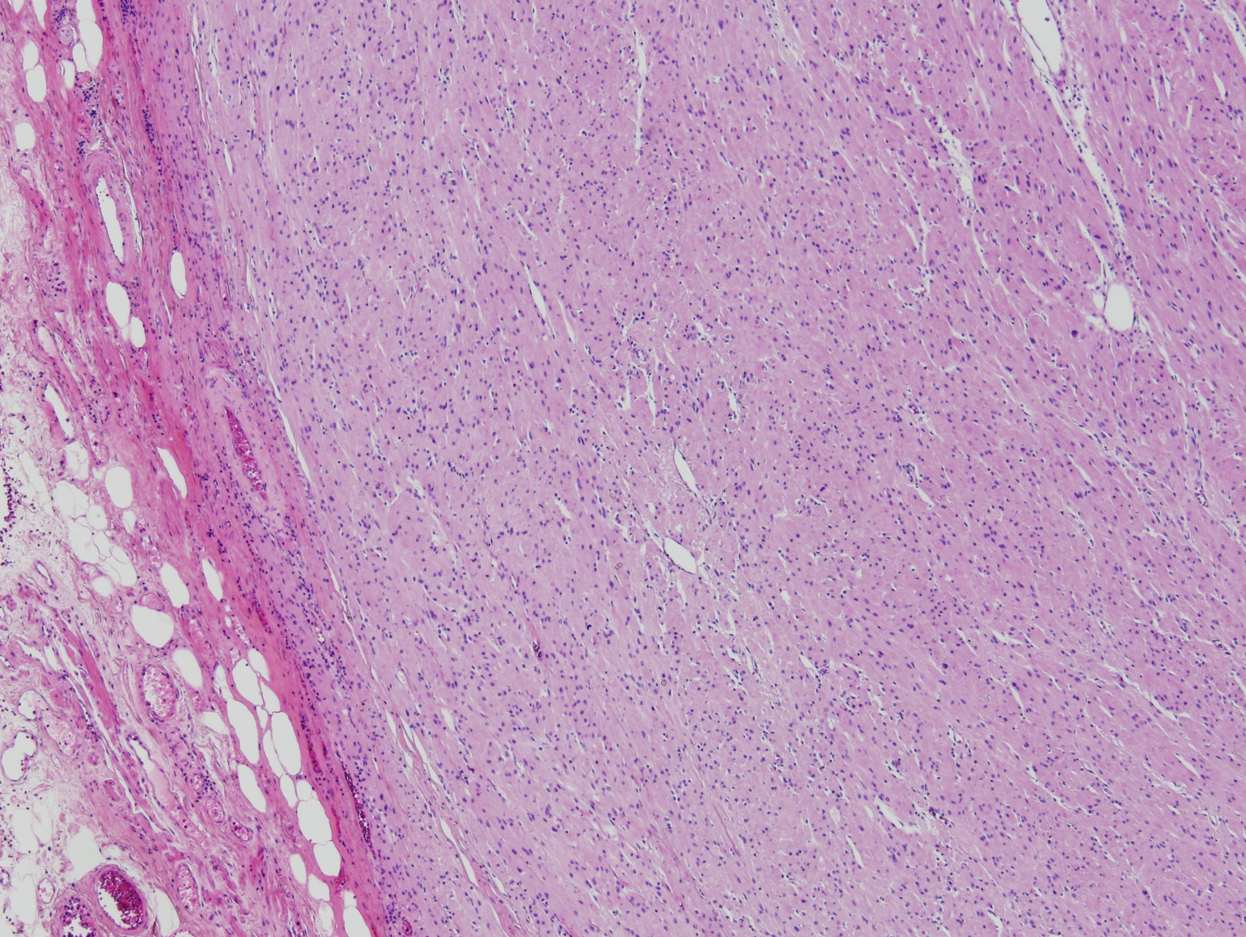

Slide 6
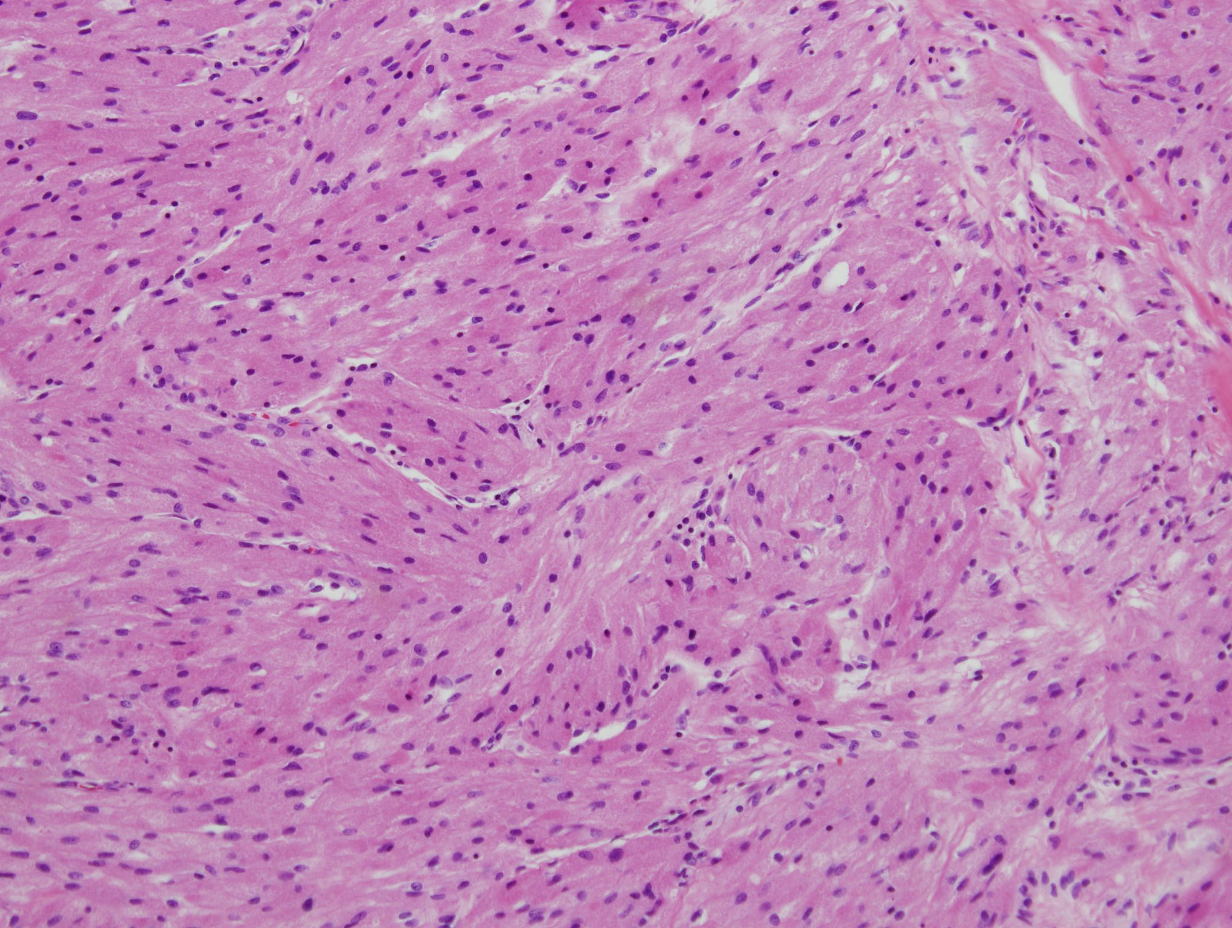

Slide 7
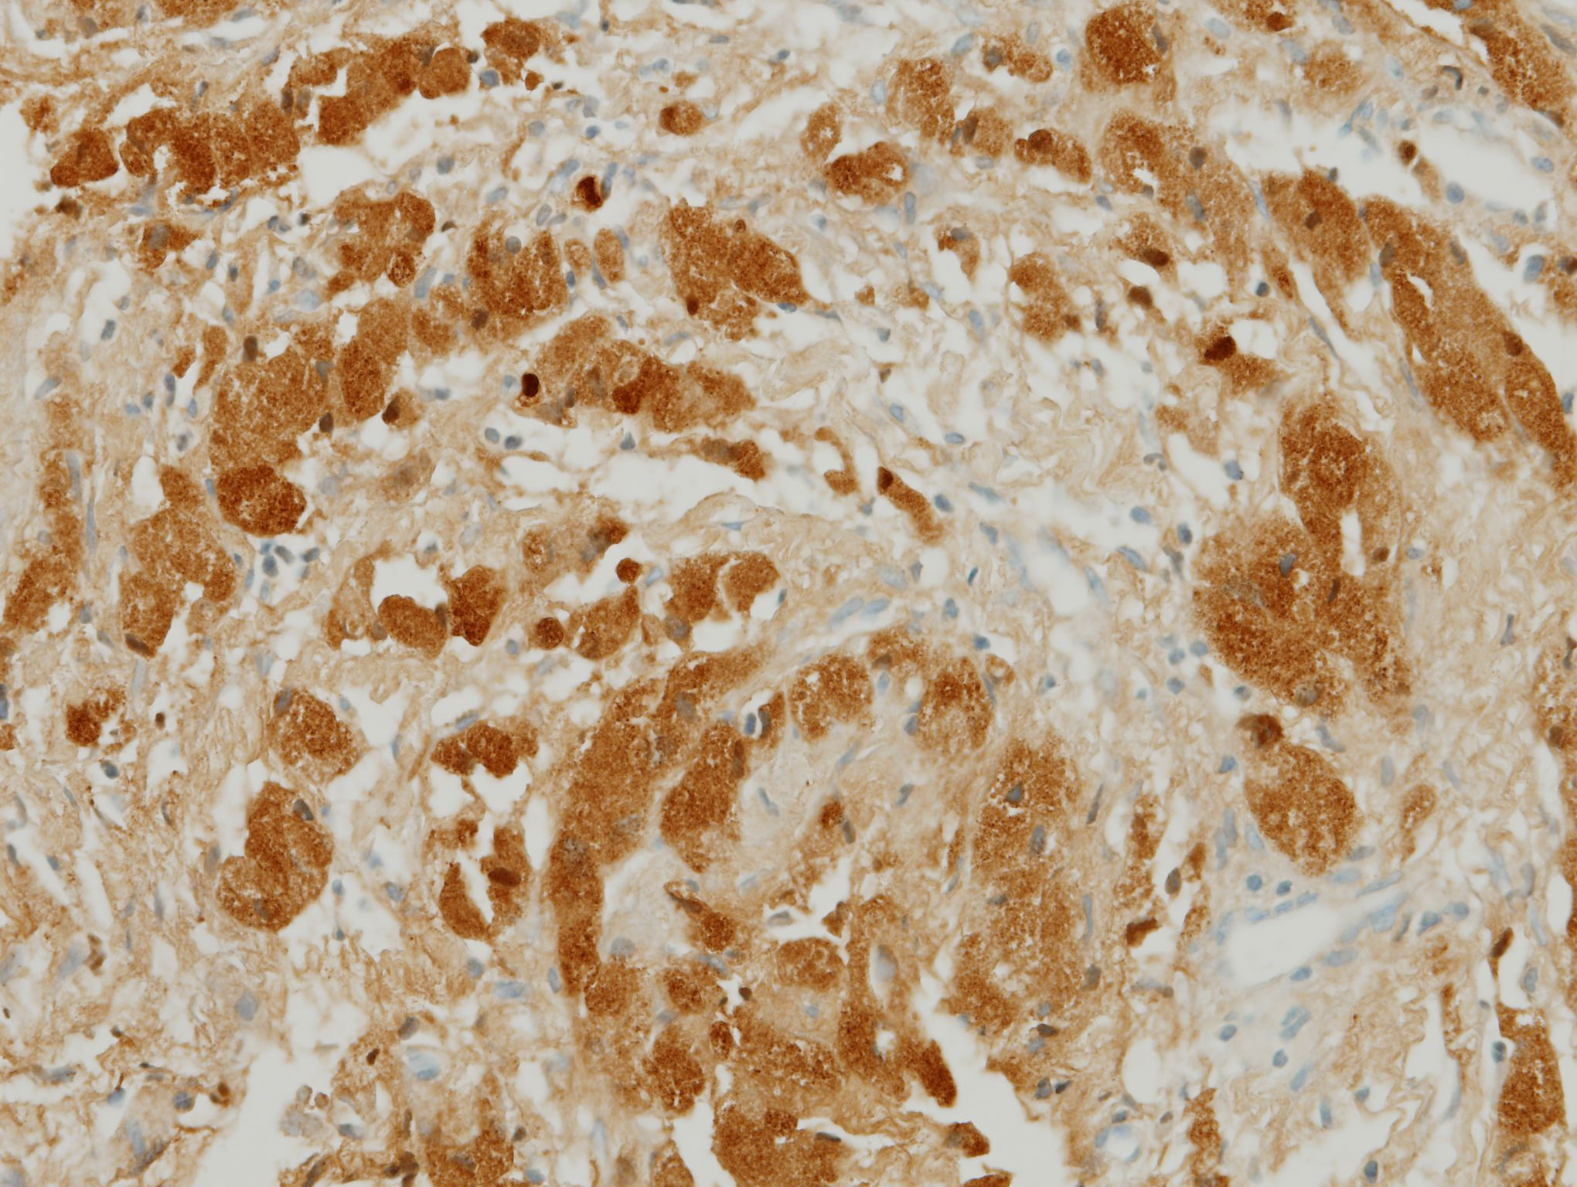
S100

Slide 8
CASE 2
M/32 5378706 강 O 규

Slide 9
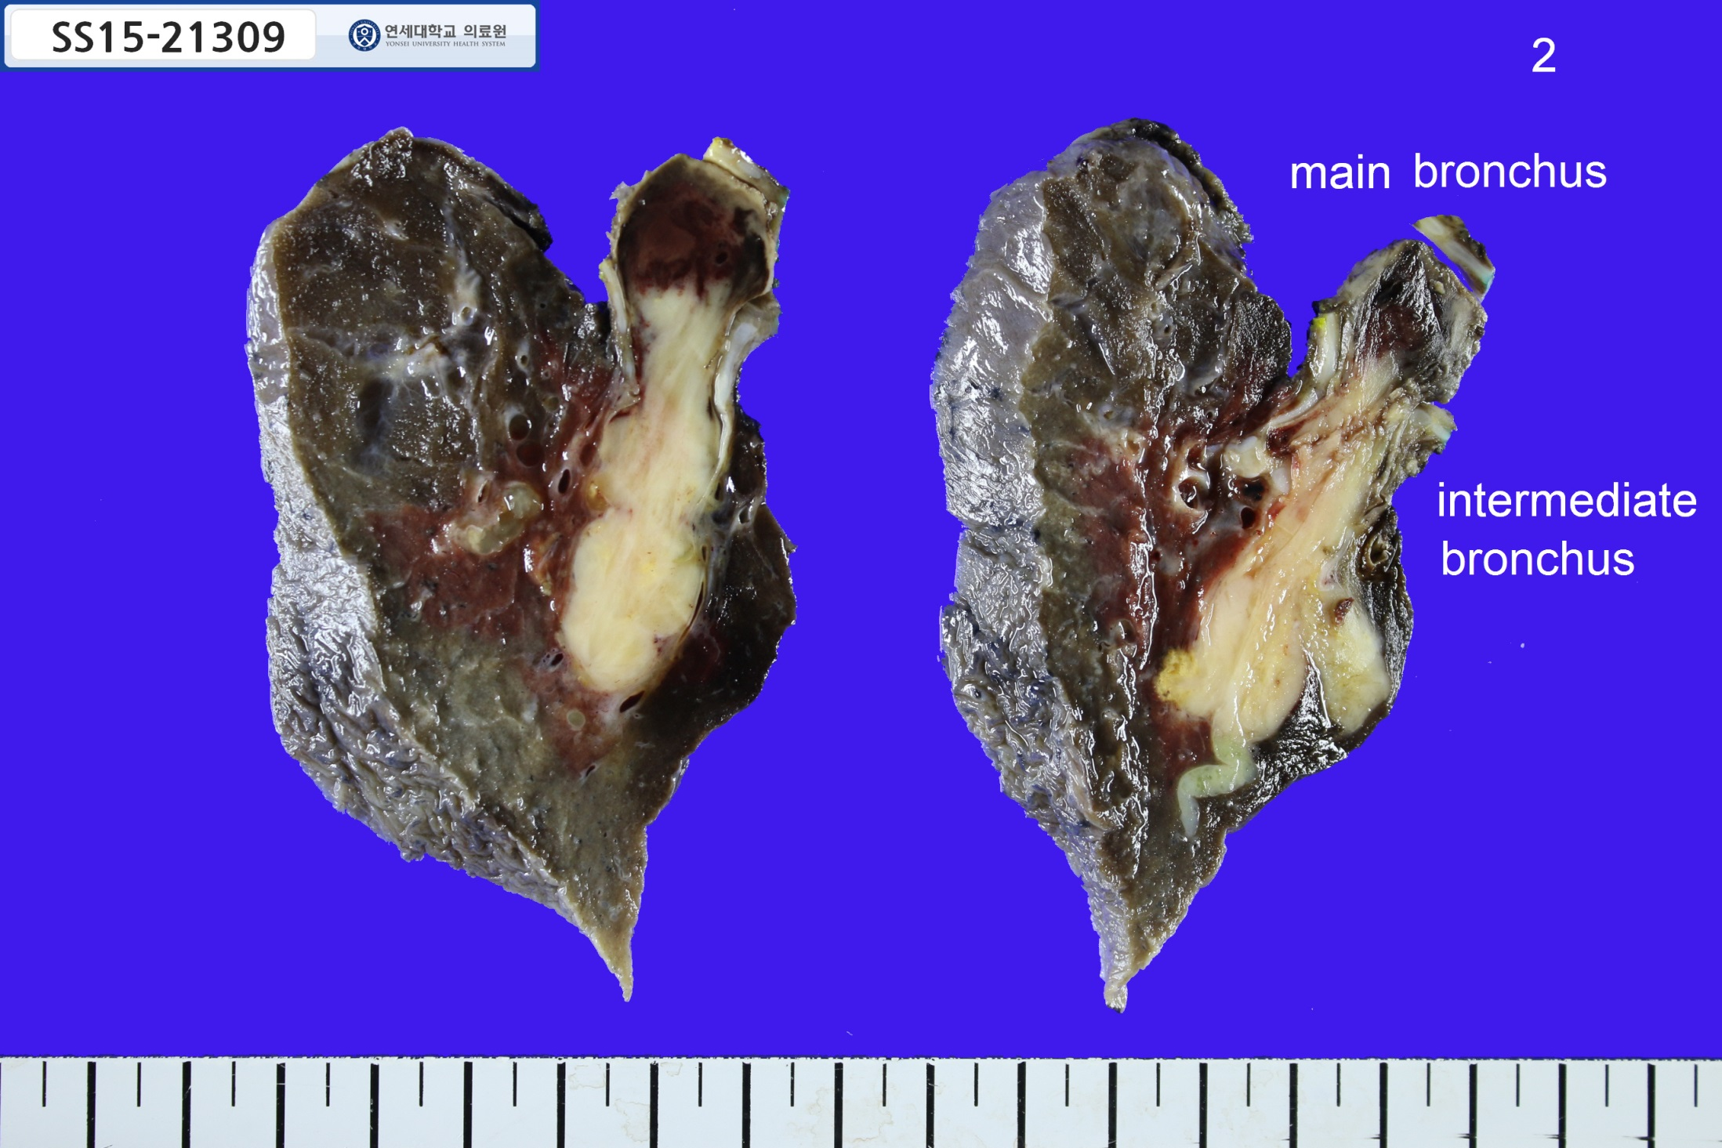
RUL, sleeve lobectomy
SS15-21309
6.0x3.0cm
Notes:
FNCLCC grade 3/3
◇ Tumor differentiation: score 3
◇ Necrosis: Present (10%), score 1
◇ Mitoses: 12/10 HPFs, score 2

Slide 10
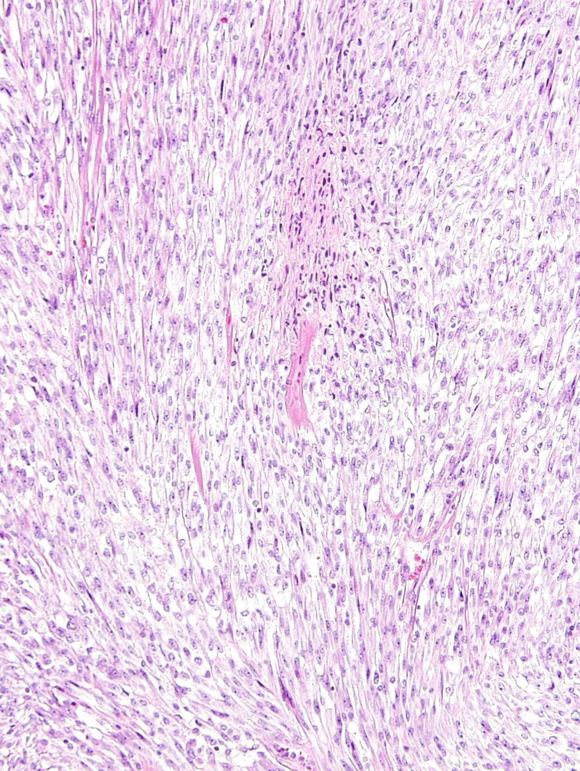
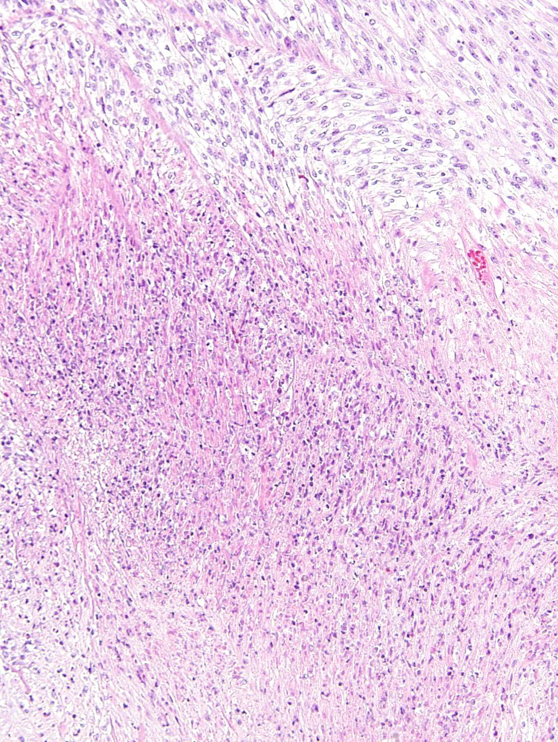

Slide 11
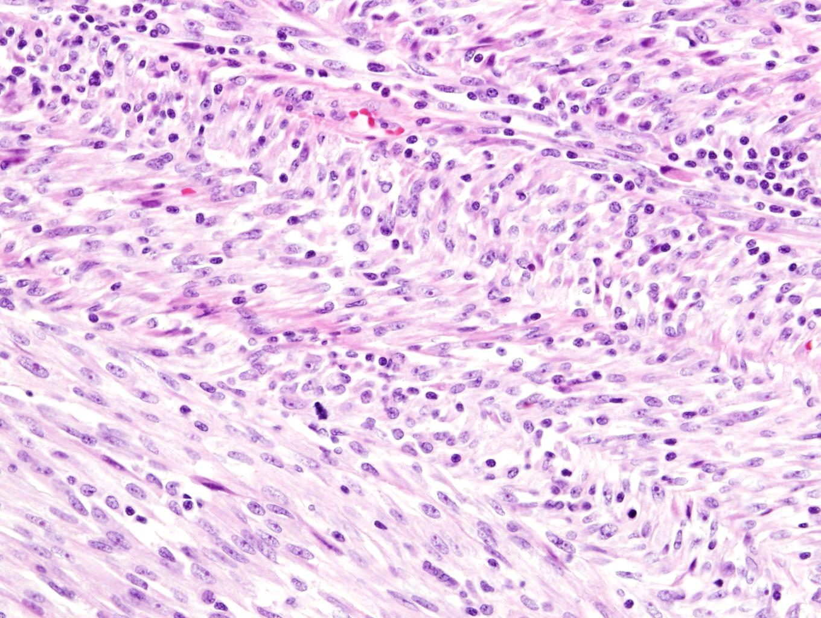

Slide 12
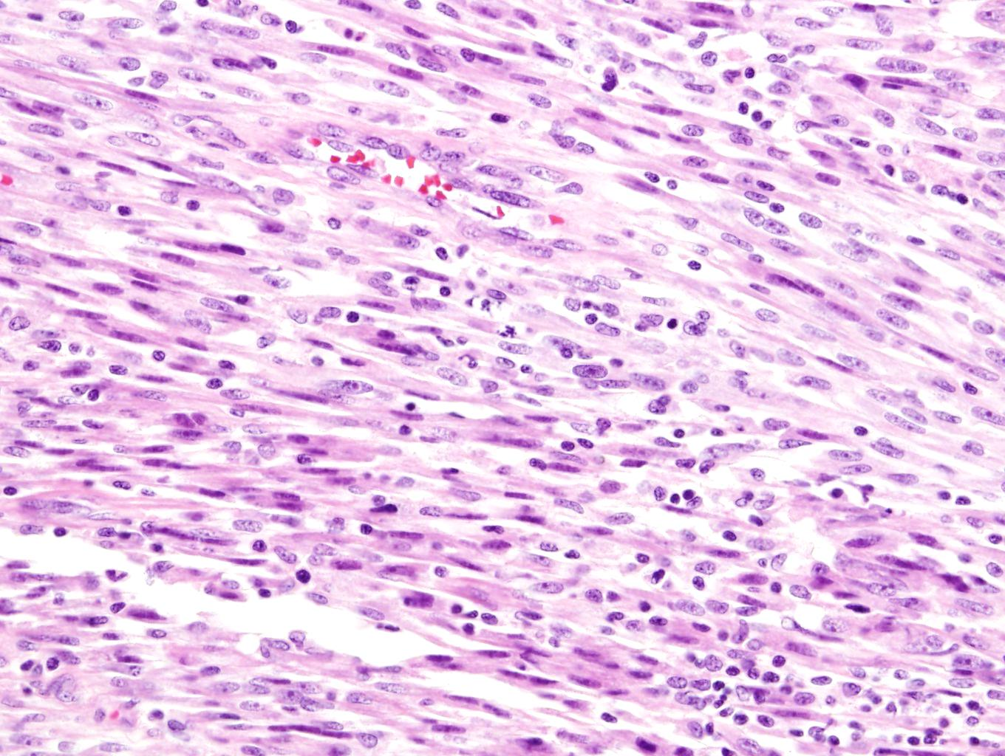

Slide 13
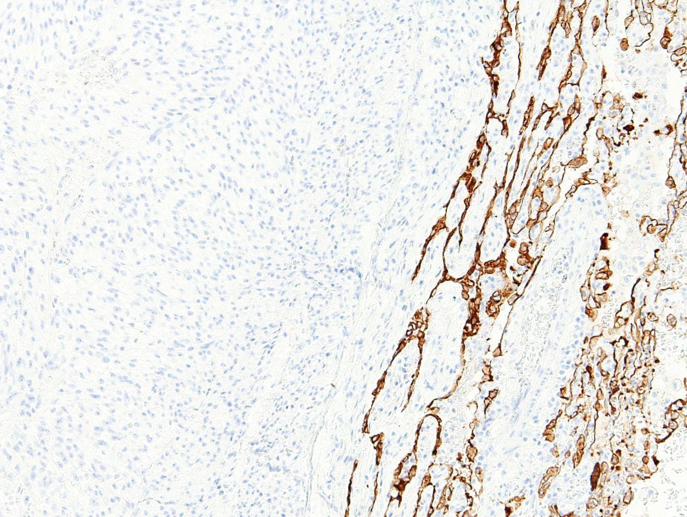
CK (AE1/AE3)
Notes:
CK(AE1/AE3): negative in tumor cells
C-Kit, CD34: negative in tumor cells
S-100, HMB45: negative in tumor cells
Caldesmon, actin (SMA), desmin, SMMHC: negative in tumor cells
TLE1: negative in tumor cells

Slide 14
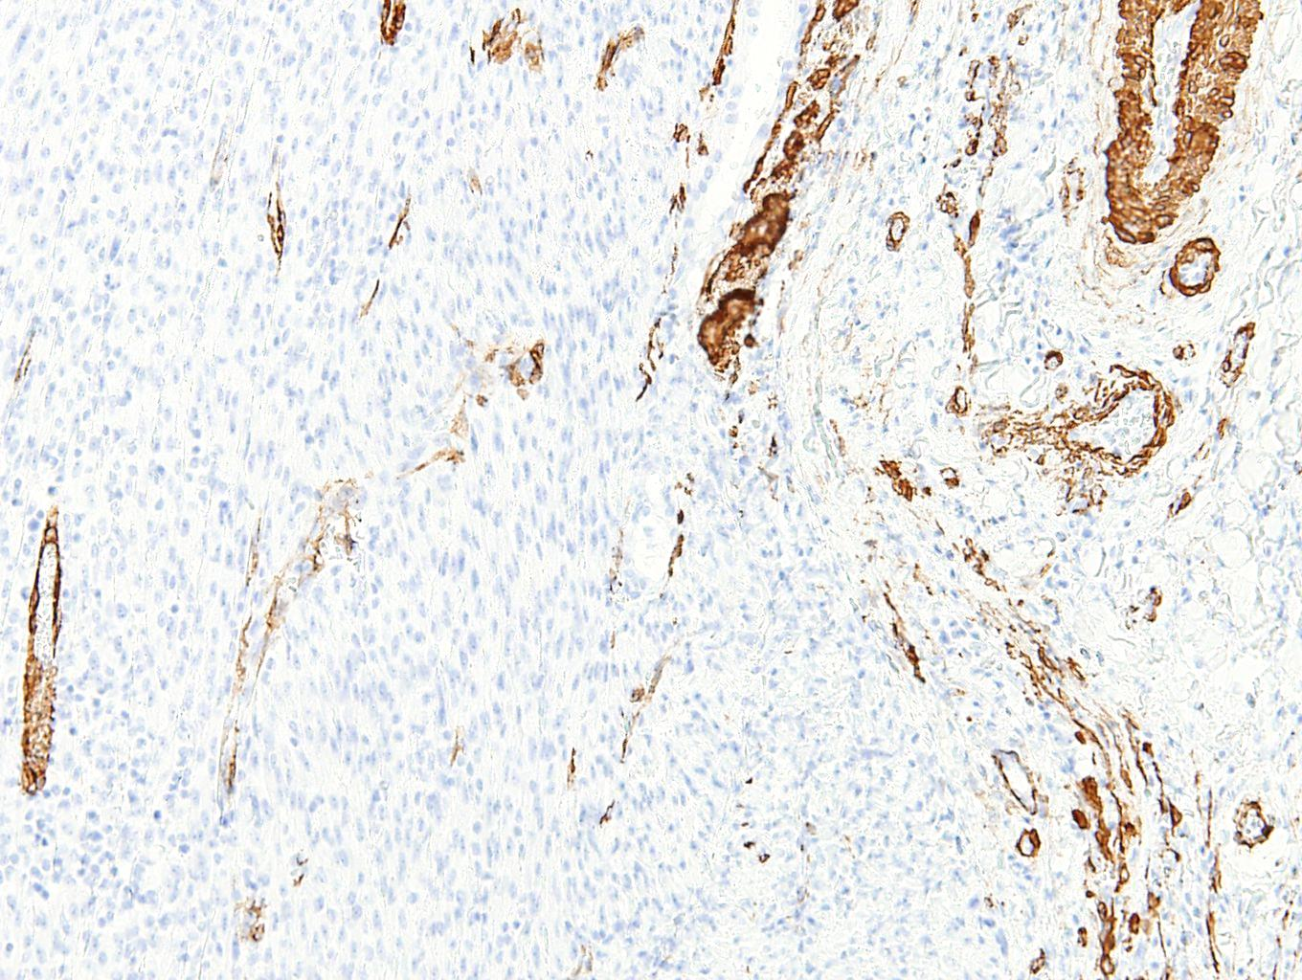
Actin (SMA), Caldesmon, Desmin, SMMHC

Slide 15
CASE3
F/50 5495001 박 O 숙

Slide 16
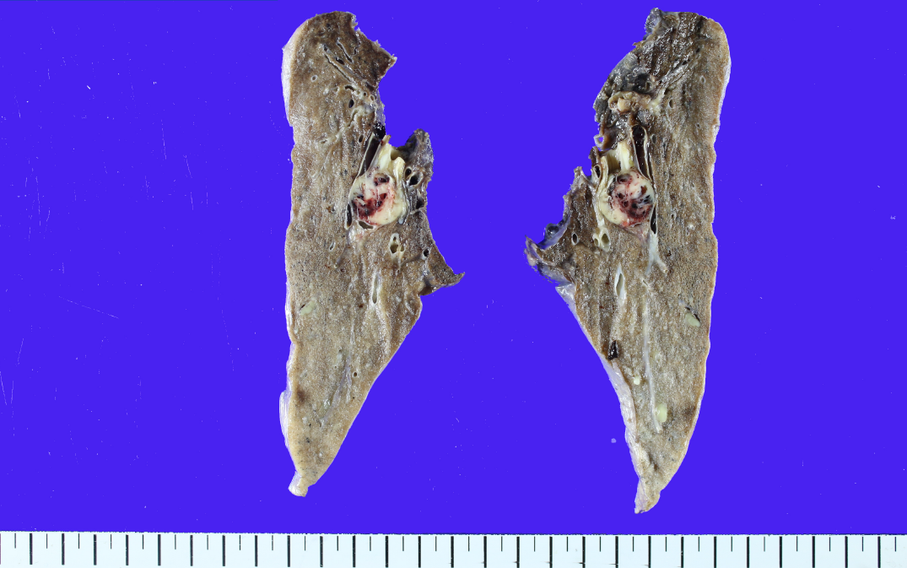
LLL, lobectomy
SS15-34041
1.8x1.7cm

Slide 17
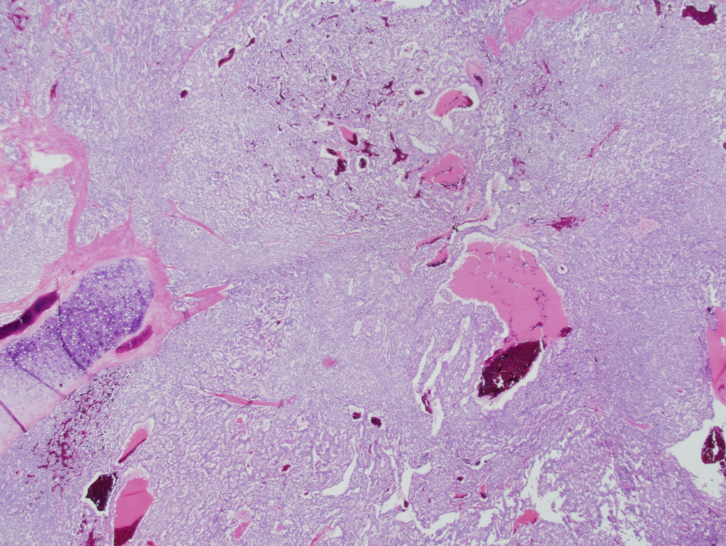

Slide 18
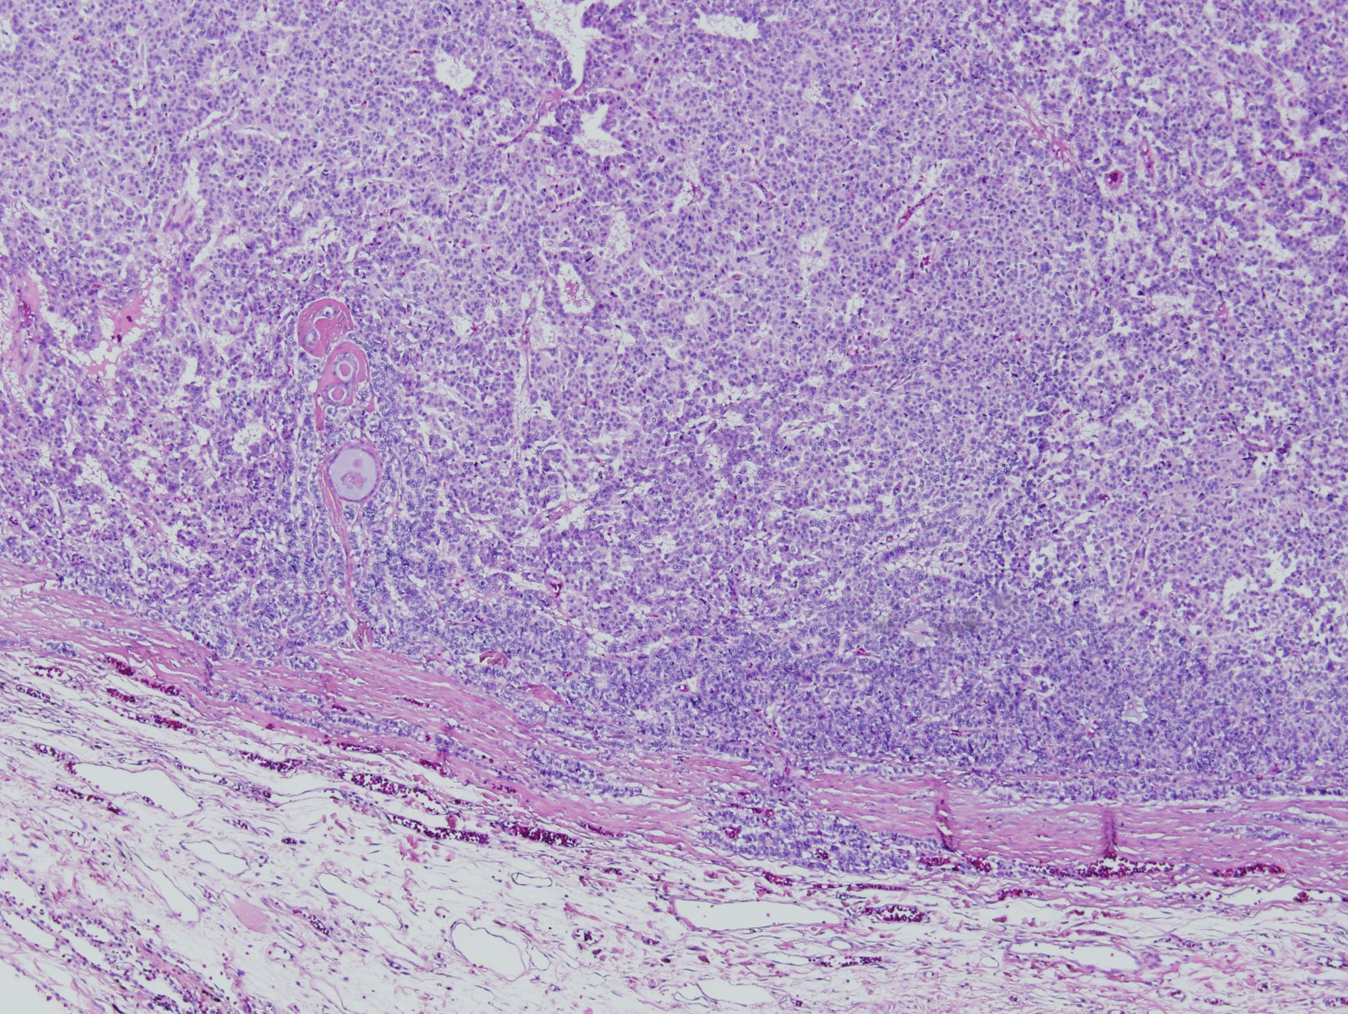

Slide 19
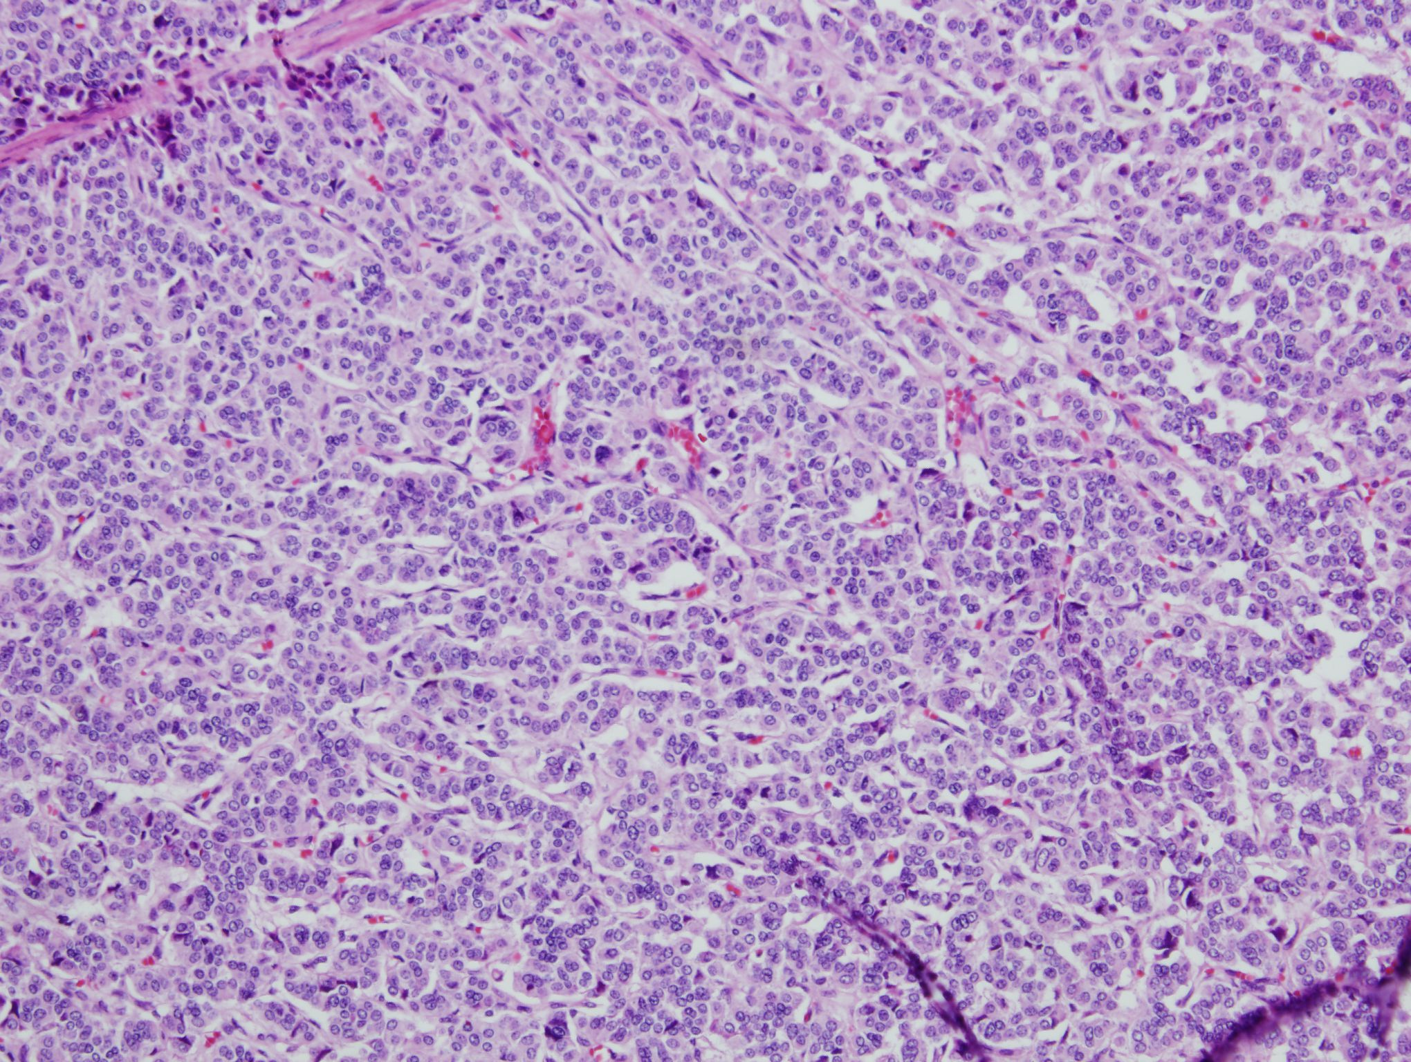

Slide 20
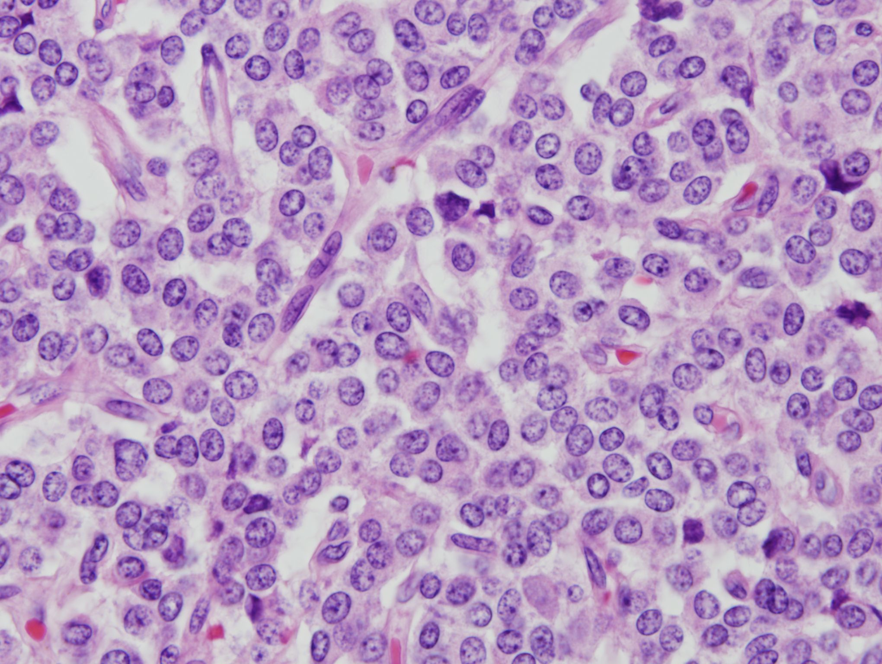

Slide 21
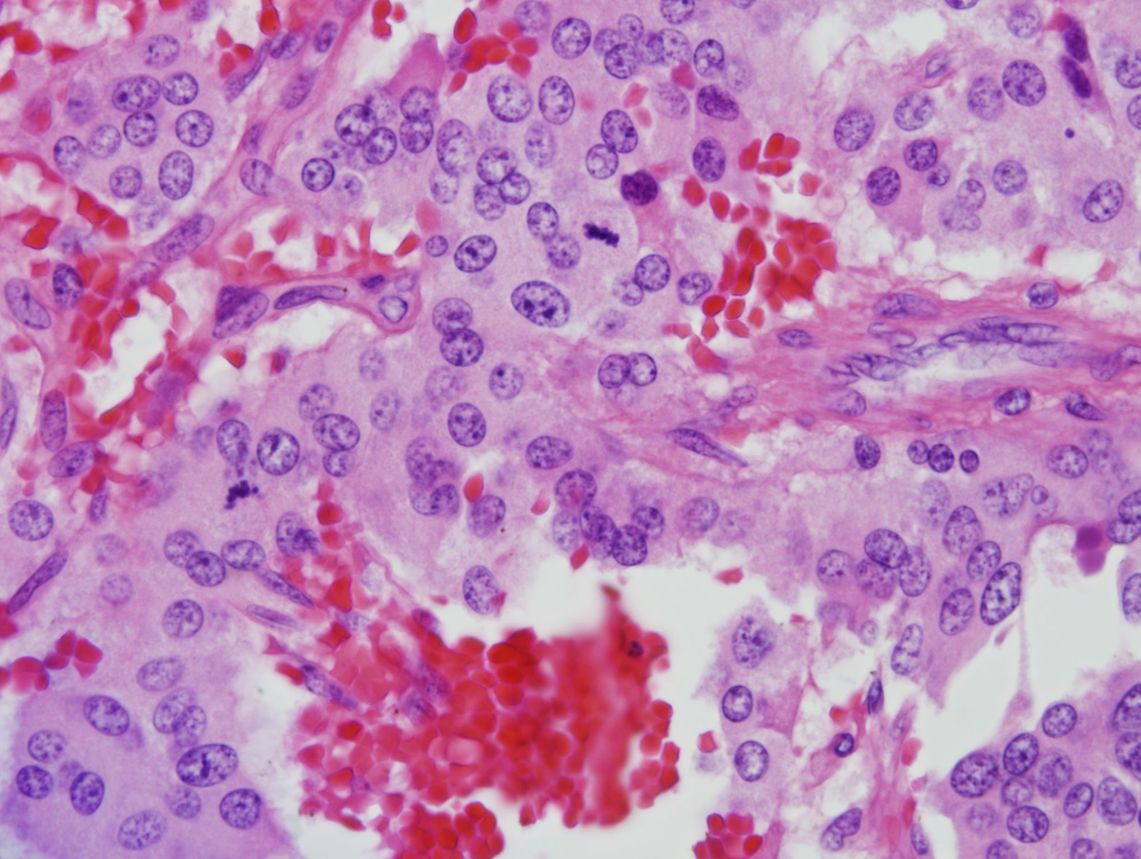
Mitosis 4/10HPF

Slide 22
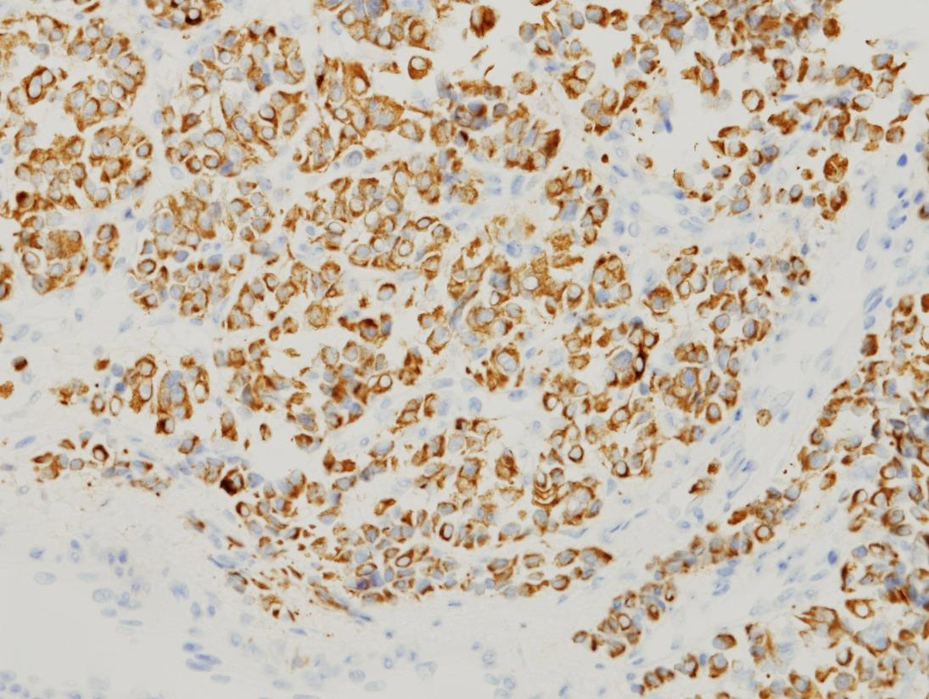
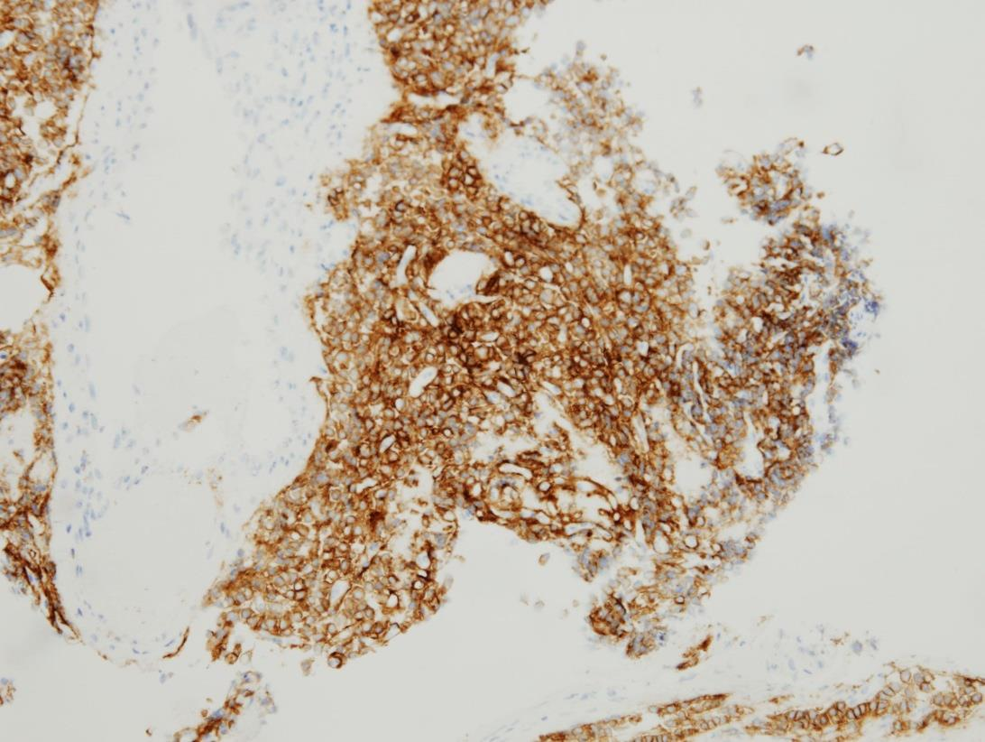
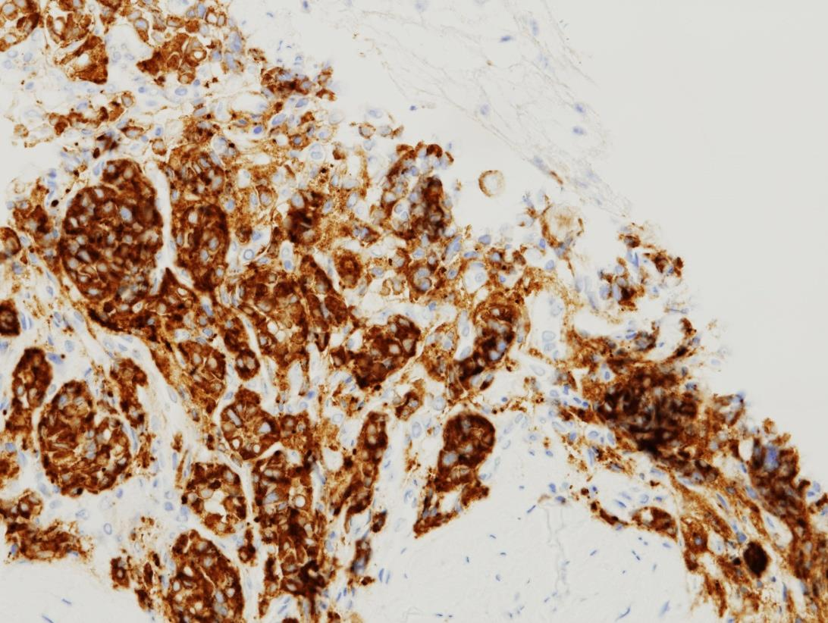
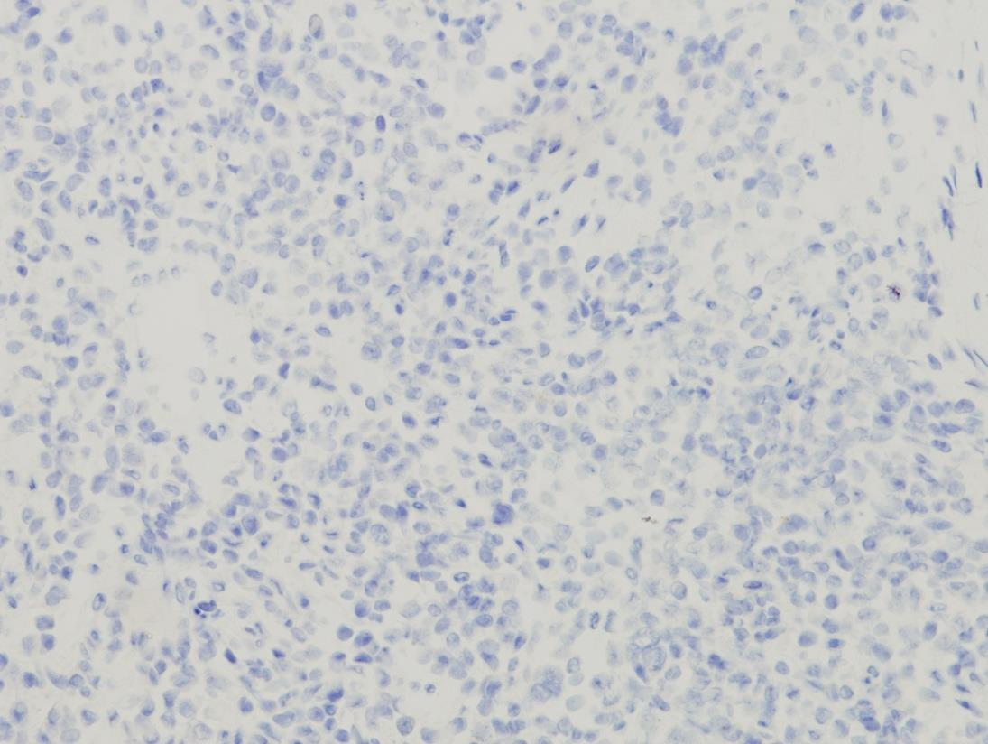
CK (AE1/AE3)
CD56
Shynaptophysin
Chromogranin A

