Slide 1
VATS conference
2015. 01. 29

Slide 2
7261070 정OO F/53

Slide 3
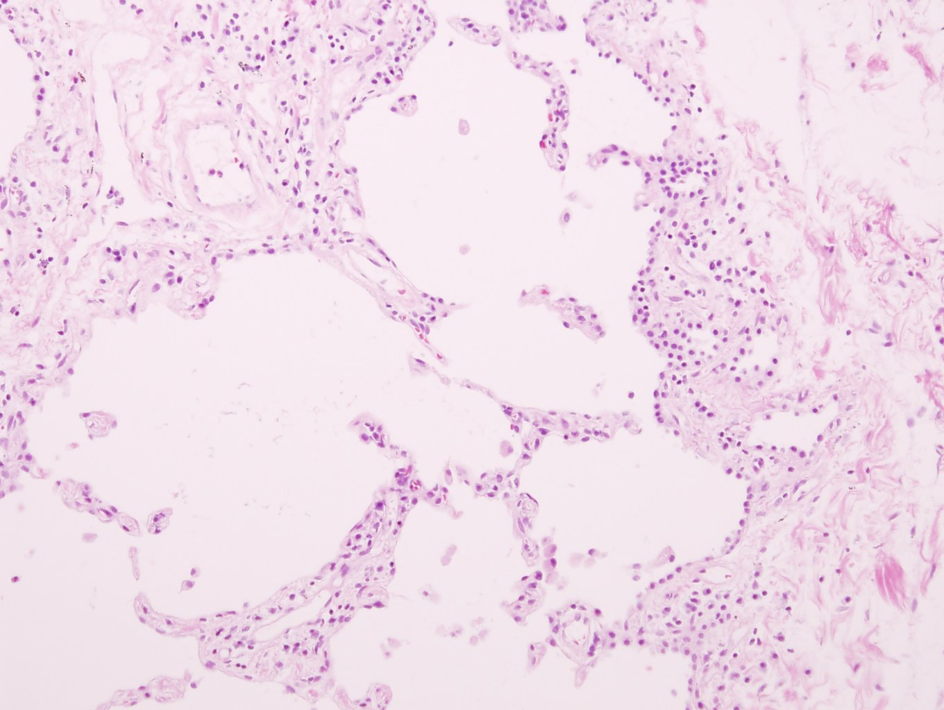

Slide 4
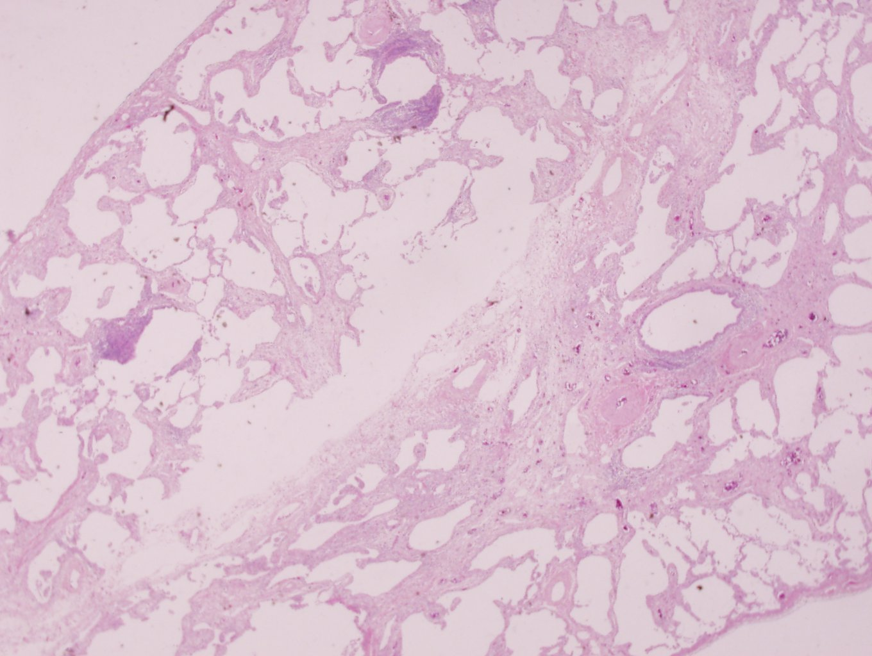

Slide 5
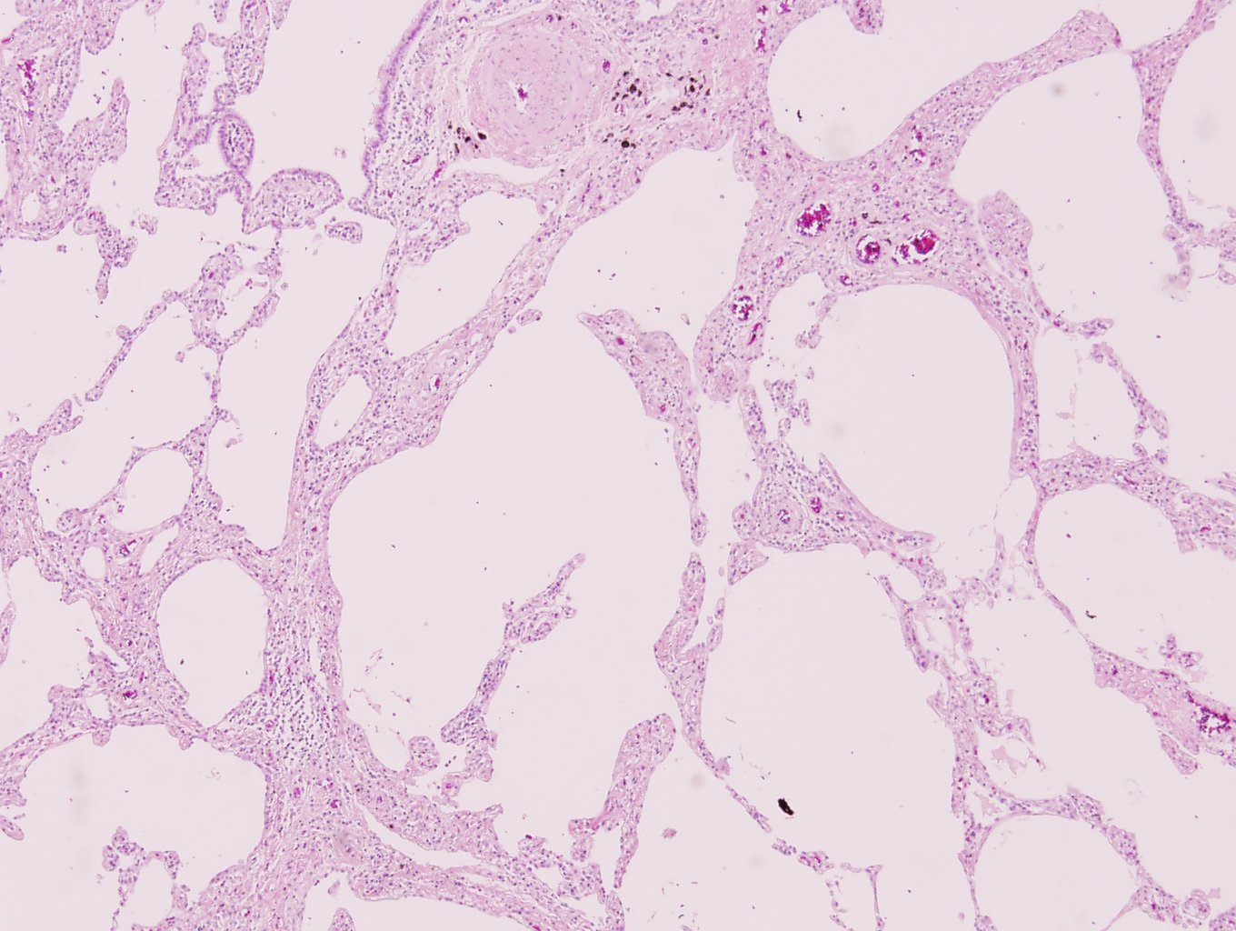

Slide 6
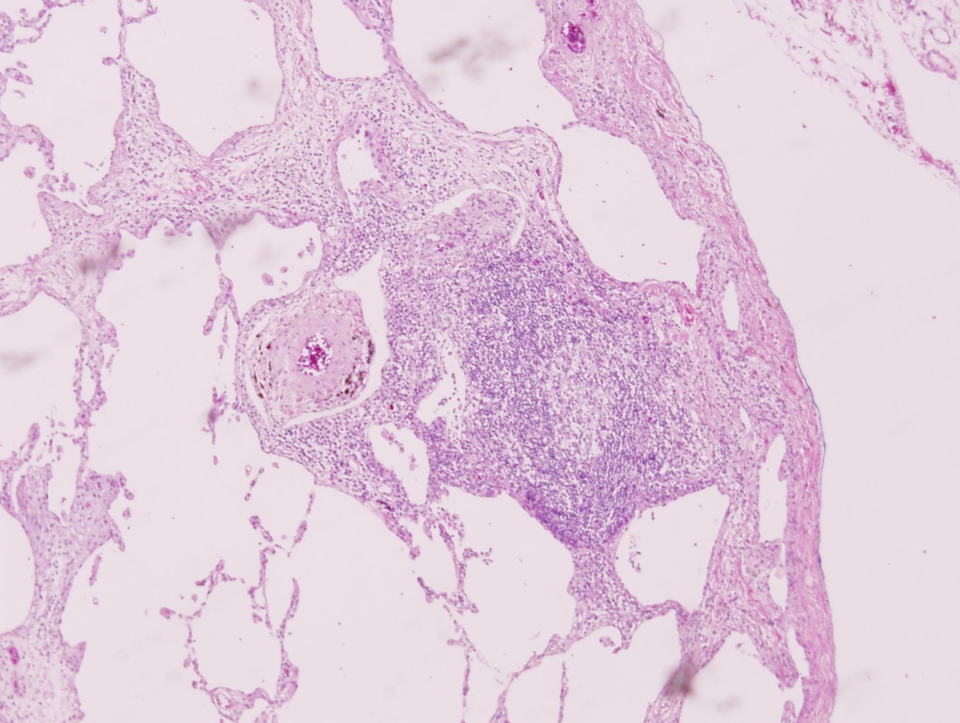

Slide 7
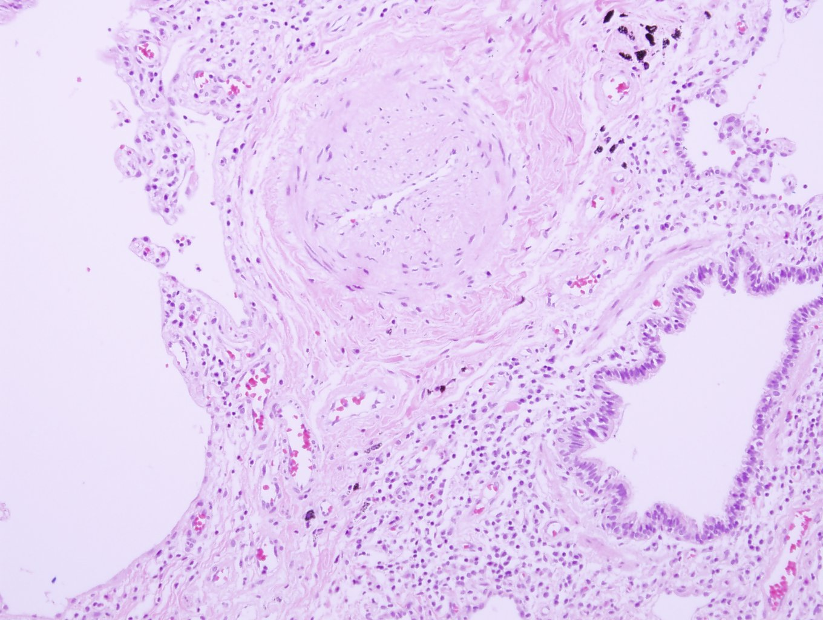

Slide 8
A. Lung, left upper lobe lingular and B. Lung, left lower lobe basal:
Lung, right and left lobe (recipient): Fibrosing interstitial pneumonia, probable UIP pattern, see note.
1) marked fibrosis and honeycombing change: not prominent
2) subpleural and paraseptal predominancy: absent
3) patchy involvement of lung parenchyma by fibrosis: not prominent
4) fibroblastic foci: present, focal
5) airspace enlargement: present
6) mild to moderate inflammation: present
7) type II pneumocyte hyperplasia: present
Note) 생검된 조직의 현미경 소견으로는 usual interstitial pneumonia와 nonspecific interstitial pneumonia, fibrosing variant의 감별이 필요합니다.

Slide 9
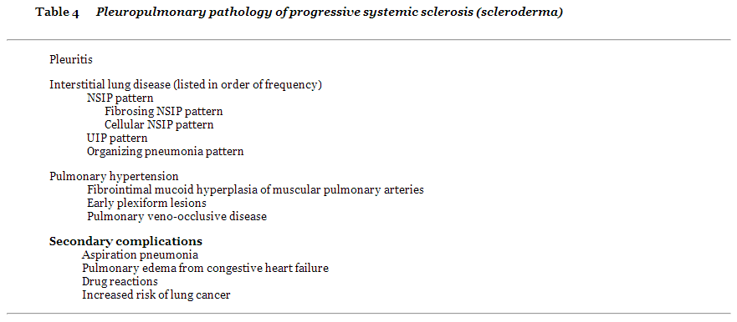

Slide 10
7965447 김 OO F/61

Slide 11
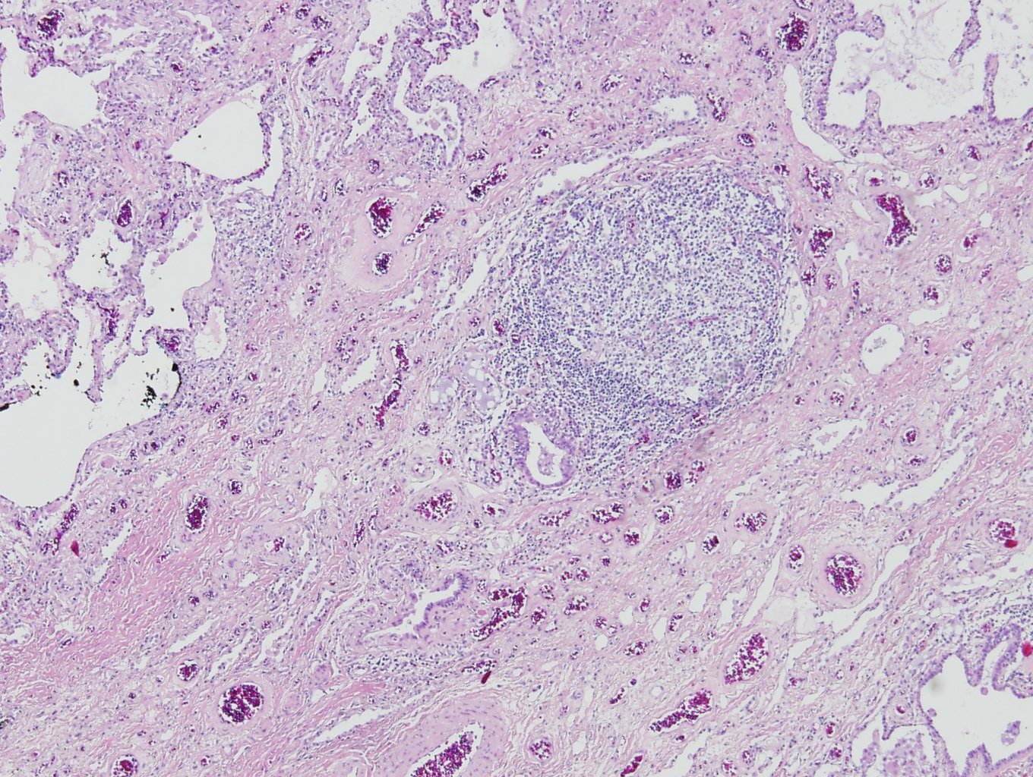

Slide 12
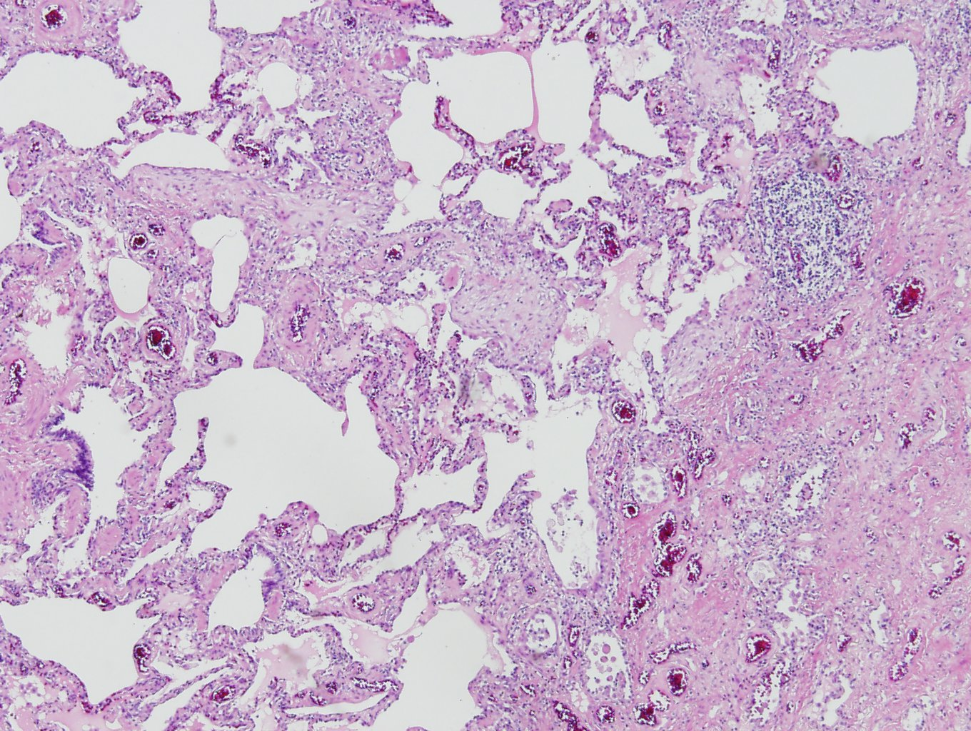

Slide 13
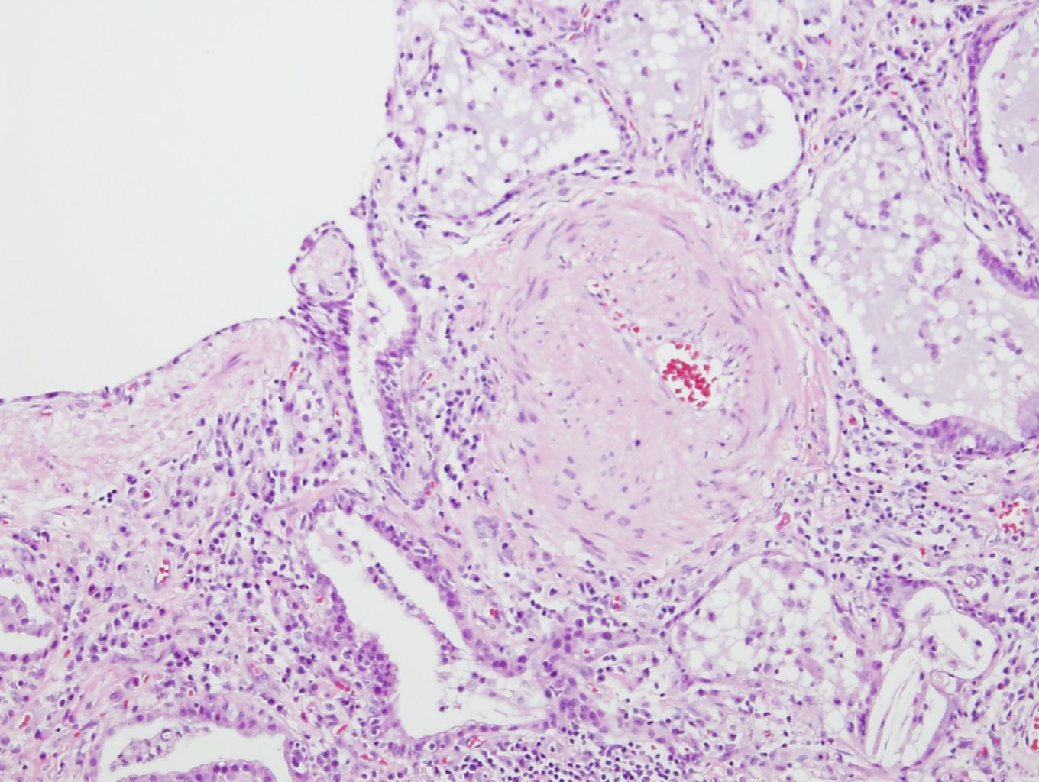

Slide 14
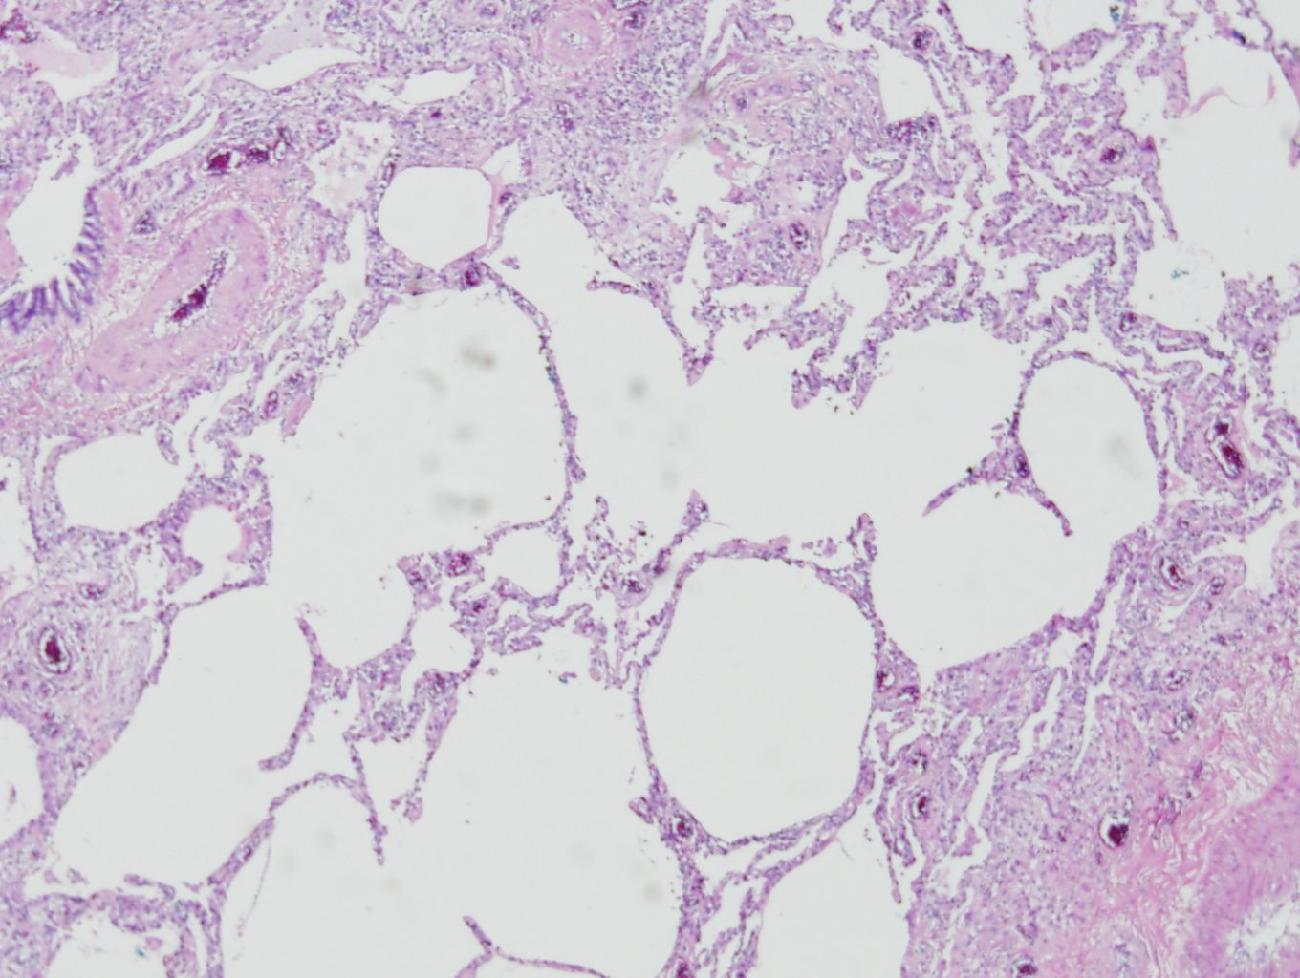

Slide 15
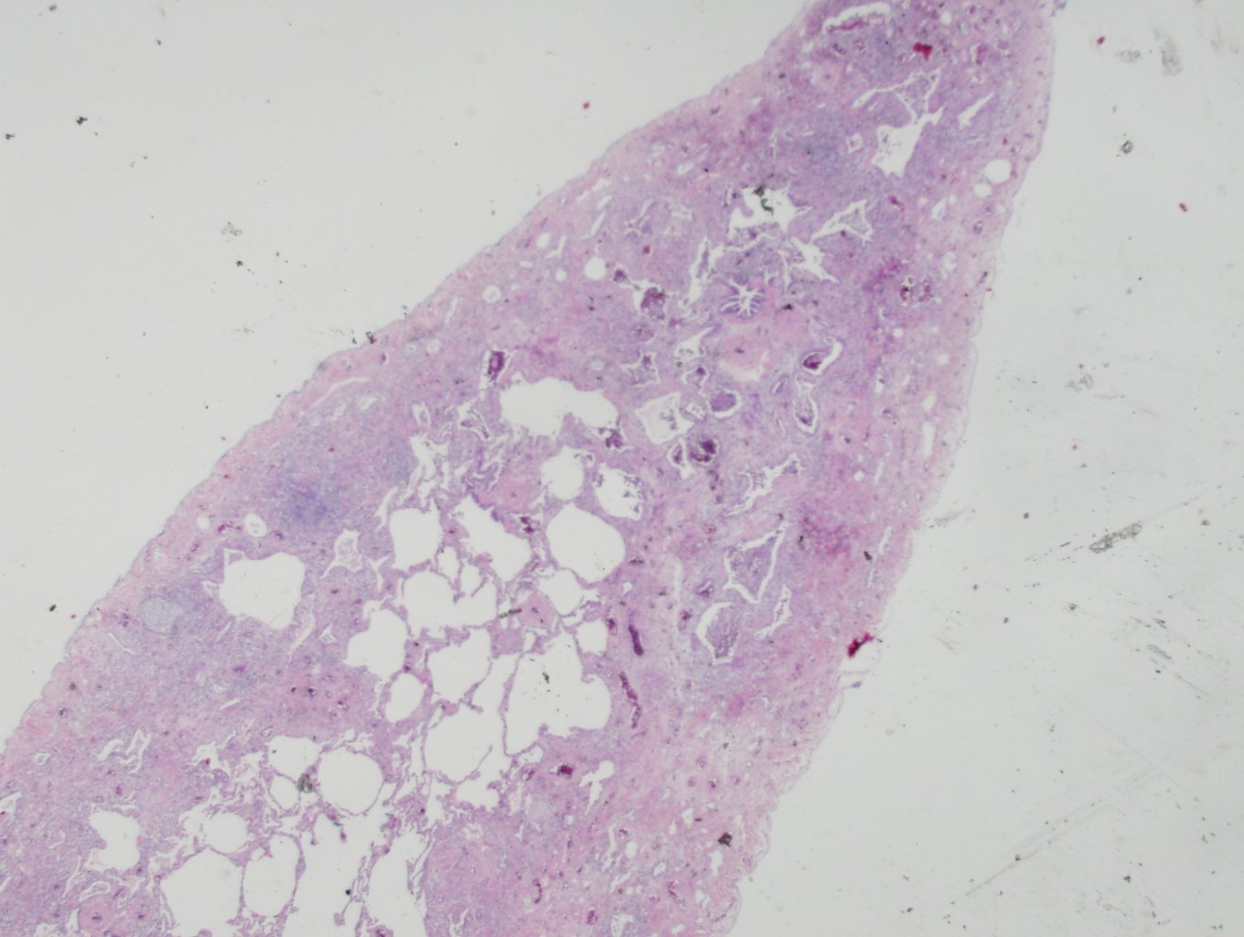

Slide 16
A. Lung, right middle lobe and B. Lung, right upper lobe:
Fibrosing interstitial pneumonia with
1) fibrosis and honeycombing change: mild honeycombing change
2) subpleural and paraseptal predominancy: not prominent
3) patchy involvement of lung parenchyma by fibrosis: not prominent
4) fibroblastic foci: present
5) airspace enlargement: present
6) mild to moderate inflammation: present
7) type II pneumocyte hyperplasia: present
Note) 생검된 조직의 현미경 소견으로는 nonspecific interstitial pneumonia, fibrosing variant의 가능성이 있습니다. 그러나 일부 fibroblastic foci와 airspace enlargement 소견이 관찰되므로 early phase 의 usual interstitial pneumonia의 가능성에 대하여 clinical follow-up 이 필요할 것으로 사료됩니다.

Slide 17
7920849 남 OO F/48

Slide 18
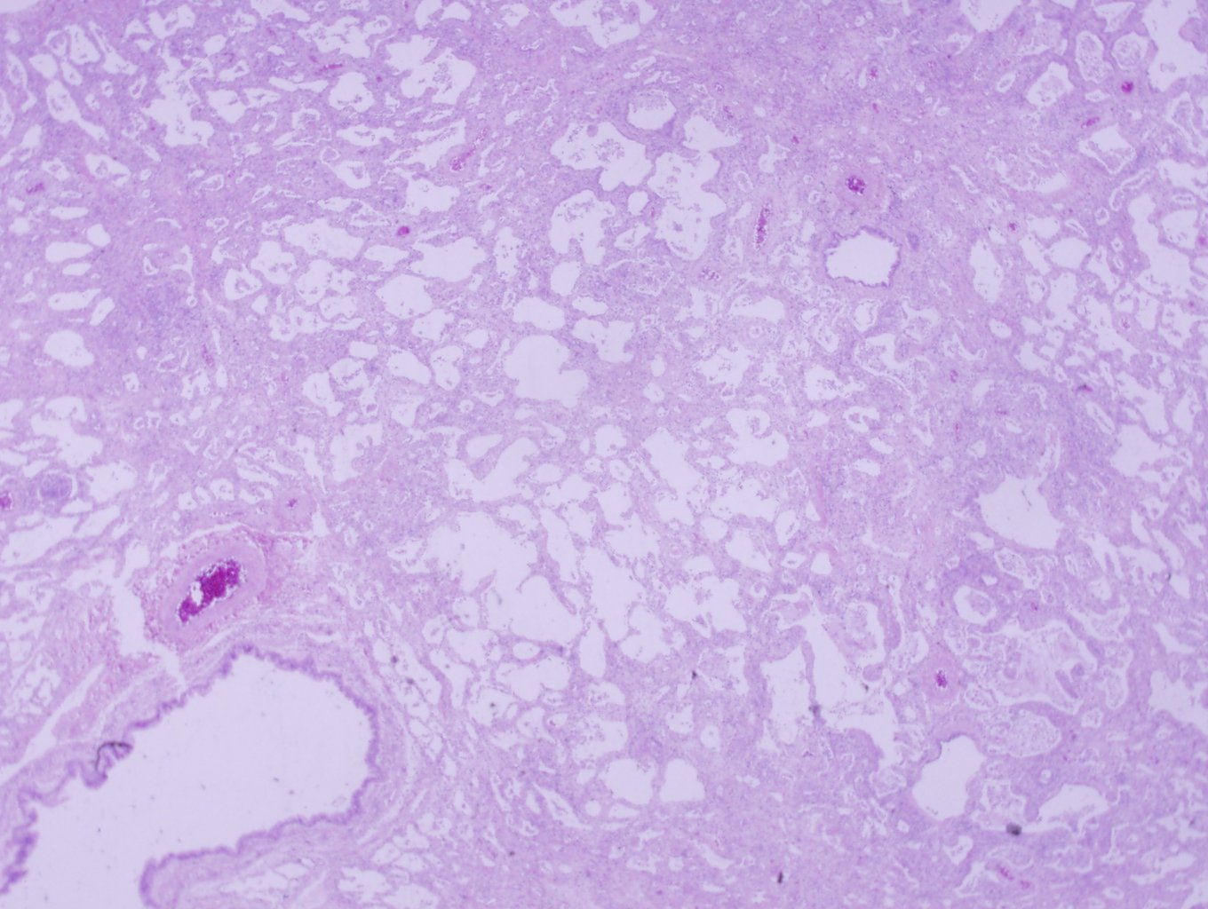

Slide 19
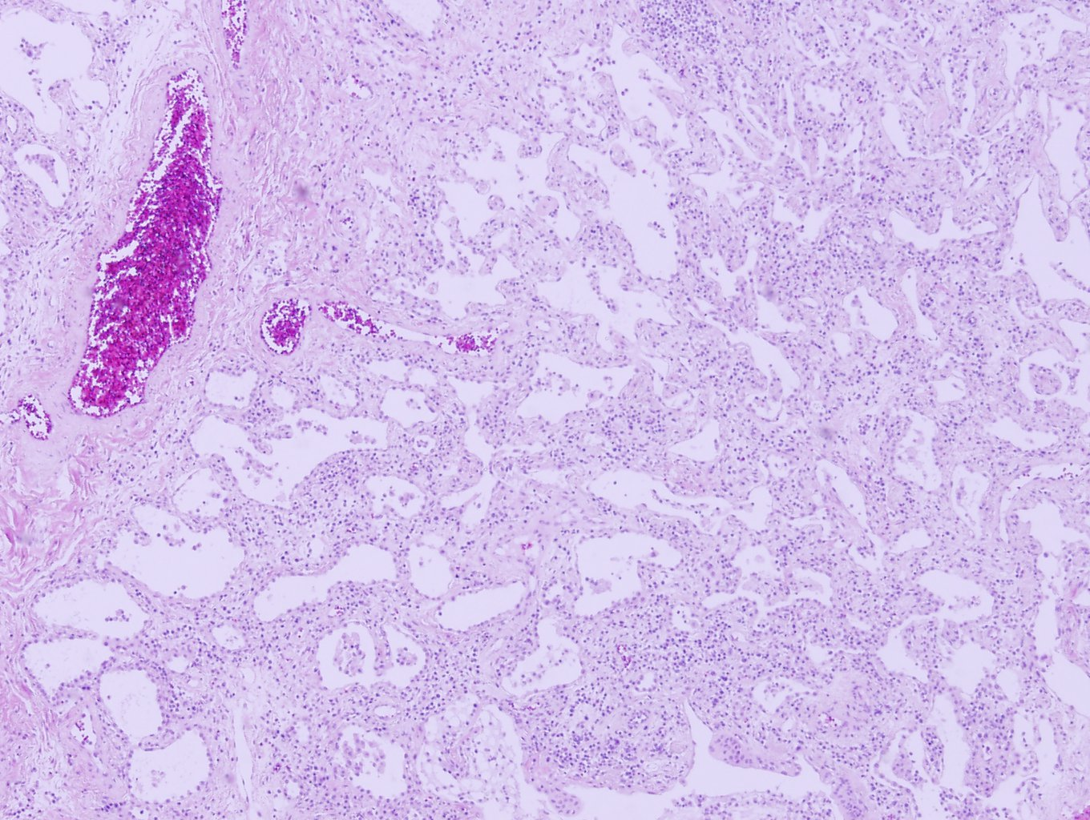

Slide 20
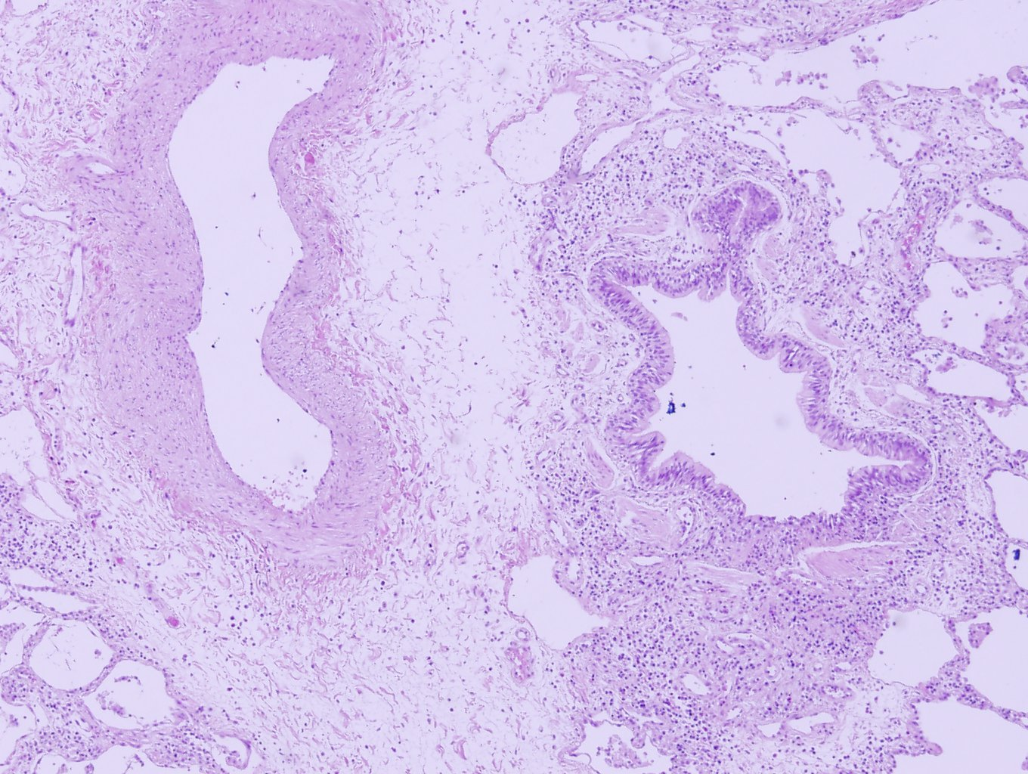

Slide 21
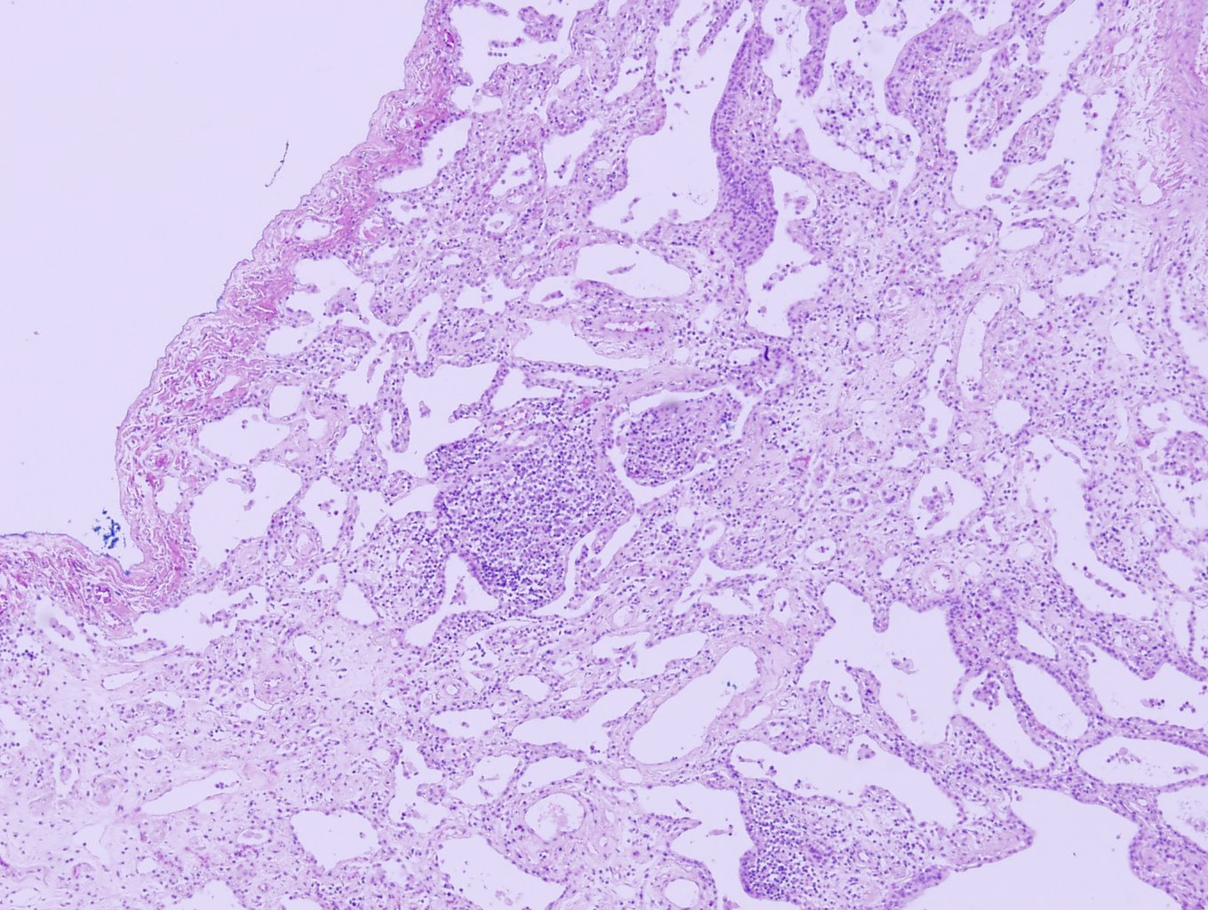

Slide 22
A. Lung, left upper lobe and B. Lung, left lower lobe:
Fibrosing interstitial pneumonia, see note
1) mild fibrosis and honeycombing change: Present
2) subpleural and paraseptal predominancy: Not predominent
3) patchy involvement of lung parenchyma by fibrosis: Not predominent
4) fibroblastic foci: Absent
5) airspace enlargement: Present
6) mild to moderate inflammation: Present
C. Chest wall mass: Consistent with lipoma
Note) Non-specific interstitial pneumonia pattern의 가능성이 있습니다. 임상적인 고려가 필요합니다.

Slide 23
