Slide 1
Acute eosinophilic pneumonia
S. H. Lee,
Division of Pulmonology
Department Of internal medicine
Yonsei University College of Medicine

Slide 2
Eosinophilic lung disease
Prominent infiltration by polymorphonuclear eosinophils of the lung interstitium and the alveolar spaces
Pulmonary Sx ,
Abnormal chest radiography,
Elevated levels of eosinophils in the sputum
and lung tissue
Notes:
1. Eosinophils are normally found in the lung in small numbers, generally comprising less than 2% of cells seen on bronchoalveolar lavage
2. Increased lung eosinophils can be defined by the finding of greater than 5% eosinophils on BAL.

Slide 3
Primary and secondary causes of eosinophilic lung disease
Primary causes
Acute eosinophilic pneumonia
Chronic eosinophilic pneumonia
Systemic disorders of eosinophilia affecting the lungs
Churg-Strauss vasculitis
Hypereosinophilic syndrome
Secondary causes
Allergic bronchopulmonary aspergillosis
Asthma
Autoimmune diseases
Bronchiolitis obliterans organizing pneumonia
Connective tissue diseases
Drug/toxin reaction
Eosinophilic bronchitis
Hypersensitivity pneumonitis
Infections
Neoplastic diseases
Allergy Asthma Proc 34:19 –25, 2013

Slide 4
Acute eosinphilic pneumonia
Most dramatic of eosinophilic pneumonias
Mimics infectious pneumonia OR
acute respiratory distress syndrome

Slide 5
Etiology
Remains unknown
IL-5 , IL 18 elevated in the BAL fluid
under the control of lymphocyte
starts with antigenic stimulation of T lymphocyte and more specifically of Th2
Eosinophil granules damage to interstitium and alveoli.
Notes:
Several such conditions and exposures have been proposed in the literature; however, many of these exposures are in the form of single case reports, and so definite causality cannot be fully verified.
Drugs that have been reported to be associated with an AEP syndrome include BCG vaccination,8 minocycline,9–13 fludarabine,14 intramuscular progesterone, 15 and sertraline.
Inhalational exposures that have been associated with AEP include World Trade Center demolition dust,17 firework smoke,18 tear gas bomb explosion,19 gasoline tank cleaning, 19 cave exploration,20 woodpile moving,20 smokehouse cleaning,19 and plant repotting.

Slide 6
Clinical features
Most patients: between 20 and 40 years of age
Male predominance
Two thirds of patients are smokers,
recent initiation, recent change, restarting
Environmental exposures to various inhaled contaminants
A minority have a history of allergic disease

Slide 7
Clinical features
Patients present with an acute illness of less than four weeks duration
Nonproductive cough (95%), dyspnea (92%), and fever (88%)
Malaise, myalgias, night sweats, chills, and pleuritic chest pain

Slide 8
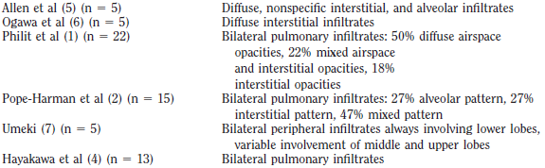
Imaging

Slide 9
Imaging
Initial : show only subtle reticular or ground glass opacities
Progression: bilateral diffuse mixed ground glass and reticular opacities develop
CT: bilateral, random, and patchy ground-glass or reticular opacities , Centrilobular nodules and air-space consolidation

Slide 10
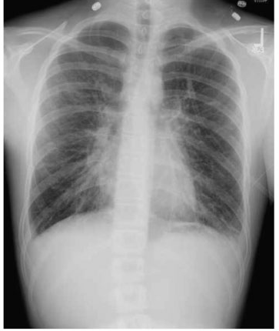
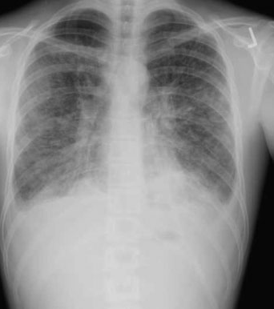
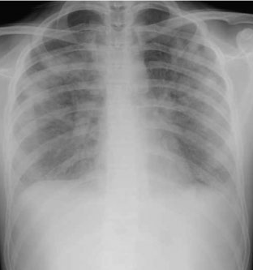
Notes:
Chest X-rays from a 17-year-old patient with acute eosinophilic pneumonia resulting from minocycline. (A) Initial presentation
showing diffuse interstitial infiltrates. (B) One day after admission, showing mixed alveolar and interstitial infiltrates with small pleural
effusions. (C) Two days after admission, showing diffuse alveolar infiltrates.

Slide 11
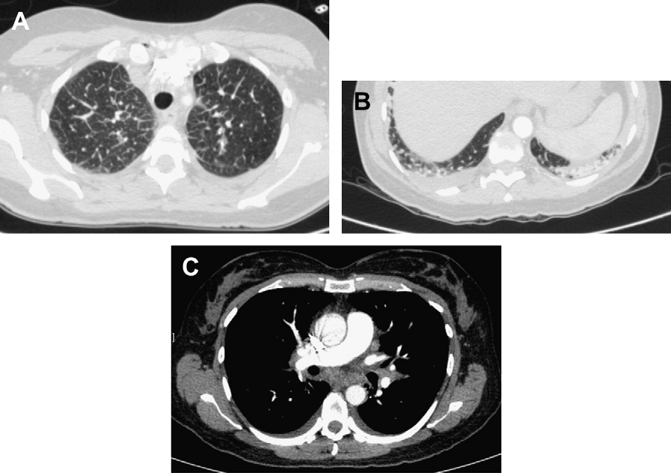
Notes:
Chest CT scan of a patient with acute eosinophilic pneumonia due to nitrofurantoin
intake, showing (A) interlobular thickening in the upper areas of the lungs, (B) mild airspace
consolidation in the lung bases, and (C) nonabundant bilateral pleural effusion and mediastinal
lymphadenopathy

Slide 12
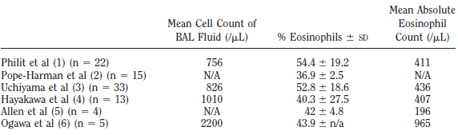
Lab finding
Blood eoshinphil count : at normal in most case → may rise to high values within days after presentation
BAL: 37% to 54% of eosinophils on average
Pleural effusion: nonspecific pleural eosinophilia

Slide 13
Lung function
Performed only in the less severe cases
Mild restrictive ventilatory defect,
Reduced carbon monoxide transfer capacity,
Increased alveolar-arterial oxygen gradient of PO2.

Slide 14
Pathology
Marked infiltration of eosinophils in the interstitium and in the alveolar spaces
Acute and organizing diffuse alveolar damage together with interstitial alveolar
Features of diffuse alveolar damage with hyaline membranes, fibroblast proliferation,
and inflammatory cells are common

Slide 15
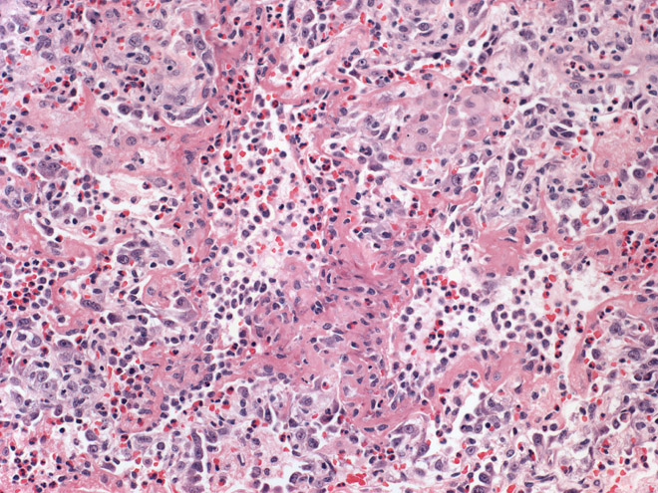
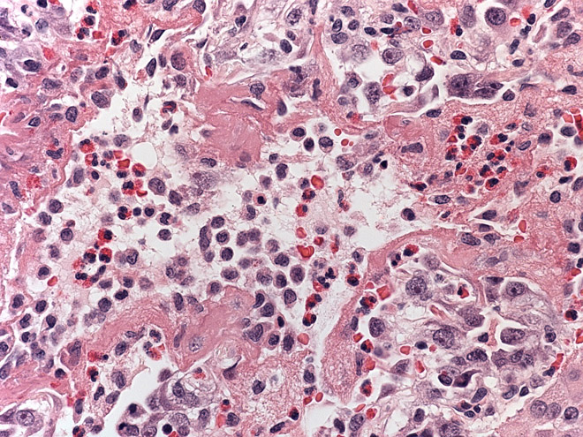
Notes:
1> There is an interstitial and intraalveolar infiltrate of eosinophils.
2> the hyaline membranes are composed of fibrin. Eosinophils are present within the alveolar airspace and thickened interstitium.

Slide 16
Diagnosis
A febrile illness of short duration (<1 month )
Hypoxemic respiratory failure ( [SpO₂] <90 percent on room air or [PaO₂] <60 mmHg)
Bilateral diffuse pulmonary opacities on CXR
BAL differential cell count showing eosinophilia >25 %
Absence of known causes of eosinophilic pneumonia, including drugs, infections, asthma, or atopic

Slide 17
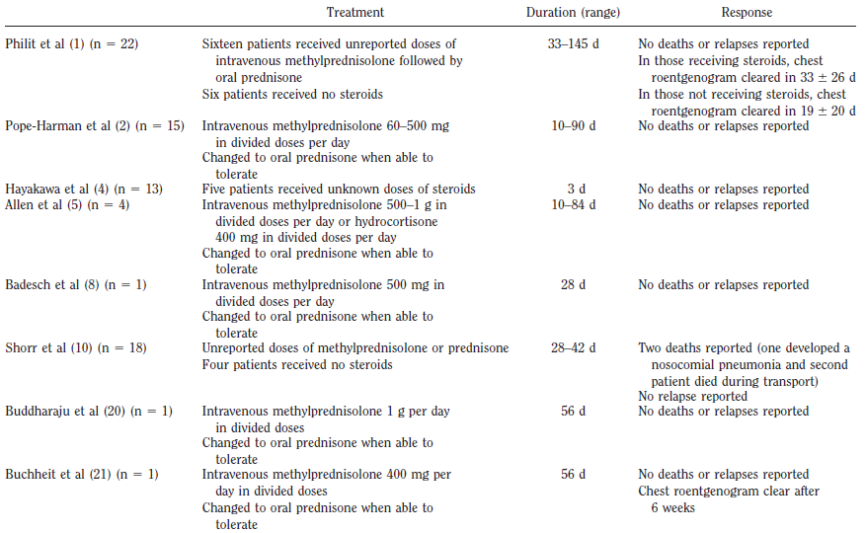
Treatment

Slide 18
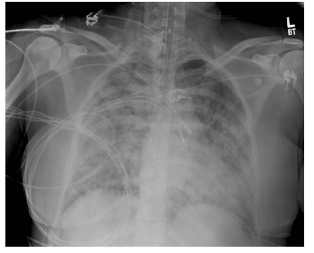
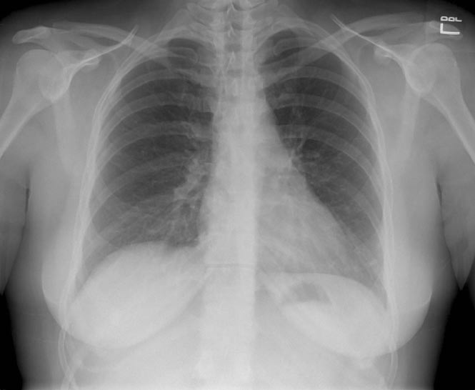
Treatment
supportive care
systemic glucocorticoid therapy for 2 to 4 weeks
Notes:
day 1 of intensive care unit admission while intubated and receiving mechanical ventilation showing diffuse air space disease with air bronchograms consistent with noncardiogenic pulmonary edema
Discharge chest roentgenogram with patient now having received 10 days of steroid therapy for acute eosinophilic pneumonia

Slide 19
Prognosis
symptomatic and radiographic improvement is usually rapid and progressive with complete radiographic clearing over one to two months after initiation of systemic glucocorticoids
pulmonary function tests return to normal after recovery from the illness
Relapse is uncommon

Slide 20

Notes:
경청해주셔서 감사합니다.

