Slide 1

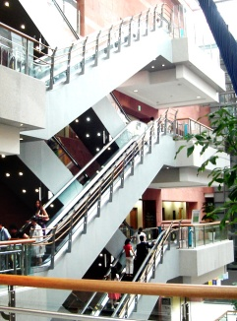


Benefits and Harms of CT screening for lung cancer
Bach PB et al. JAMA. 2012 Jun 13;307(22):2418-29
문찬수
Division of Pulmonology
Department of Internal Medicine
Yonsei University College of Medicine

Slide 2
CONTENTS
INTRODUCTION
  : Lung cancer incidence, mortality
2. EARLIER STUDIES FOR LUNG CANCER SCREENING
  : screening with chest X ray and sputum cytology
3. NEW GUIDELINE AND RECENT STUDIES
  : NCCN, DANTE, NLST, DLCST
4. BENEFITS AND HARMS OF CT SCREENING
  : Benefits, limitations

Slide 3
1. INTRODUCTION
#CONTENTS

Slide 4
Lung cancer is..
Lung cancer is the leading cause of cancer death in worldwide!
Most patients is diagnosed already advanced disease
  Stage III 30%
  Stage IV 40%
Current five year survival rate is 16%

Slide 5
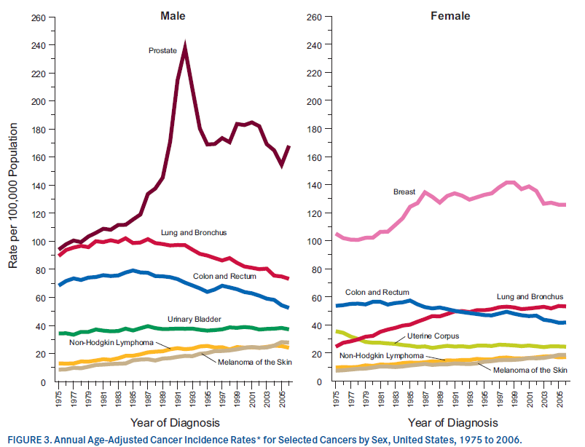
Lung cancer incidence, USA
Jemal A et al, Cancer statistics, 2010. CA cancer J Clin. 2010;60(5):277-300

Slide 6
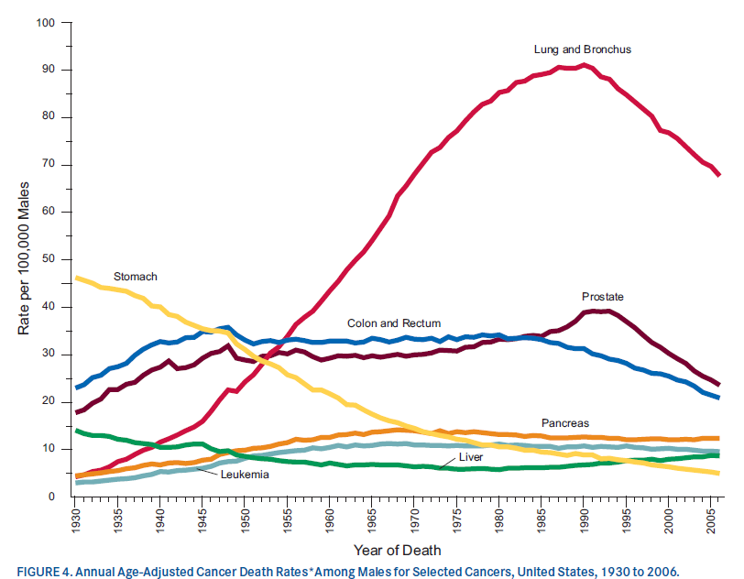
Lung caner mortality of male, USA
Jemal A et al, Cancer statistics, 2010. CA cancer J Clin. 2010;60(5):277-300

Slide 7
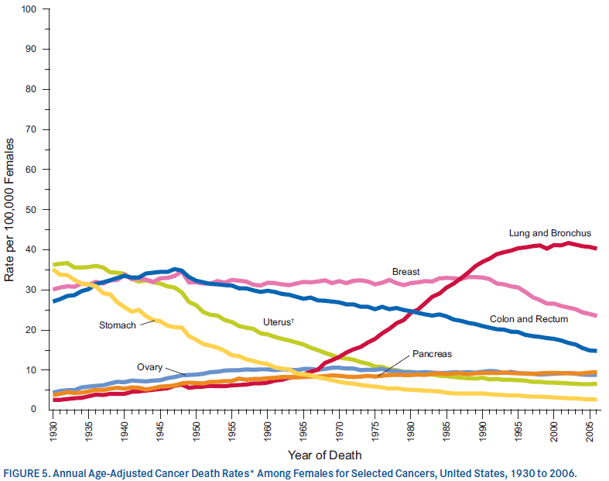
Lung caner mortality of female, USA
Jemal A et al, Cancer statistics, 2010. CA cancer J Clin. 2010;60(5):277-300

Slide 8
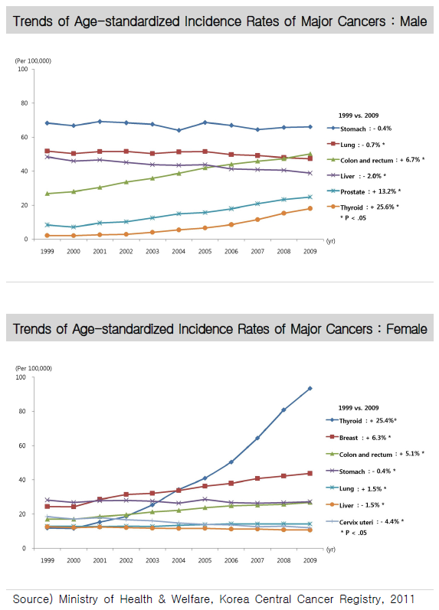
Lung cancer incidence, Korea
From Cancer facts & figures 2012, www.ncc.re.kr

Slide 9
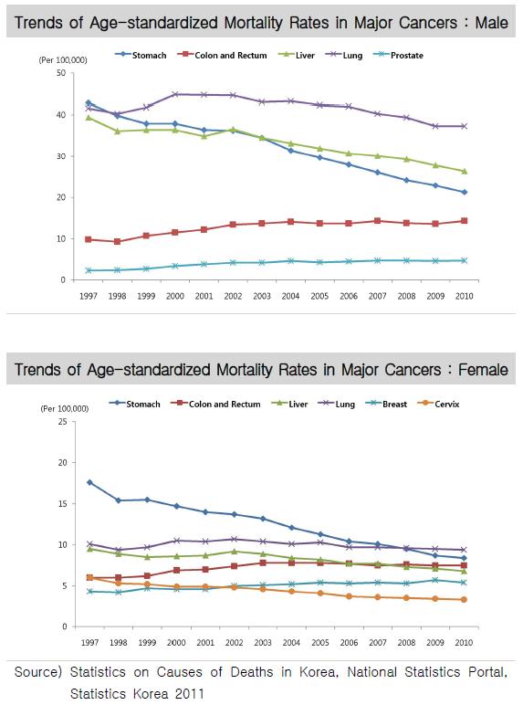
Lung cancer mortality, Korea
From Cancer facts & figures 2012, www.ncc.re.kr

Slide 10
2. EARLIER STUDIES FOR LUNG CANCER SCREENING
#CONTENTS

Slide 11
Caner screening
Object of cancer screening is to detect a early disease and reduce mortality
Good screening?
  Sensitivity and specificity
  Cost benefits
  Low associated morbidity
  Possible effective treatment when diagnosed at early disease

Slide 12
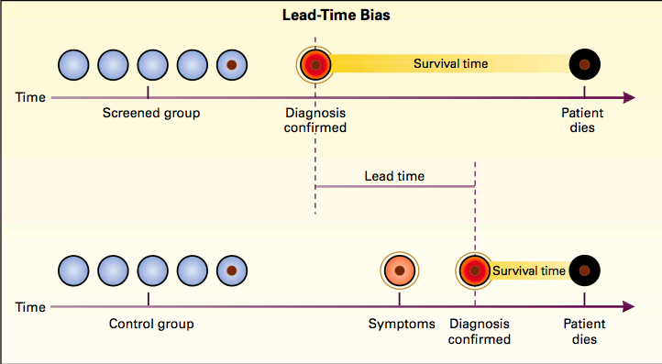
Screening bias
Early detection of slow growing tumor
apparently increases in the survival time.

Slide 13
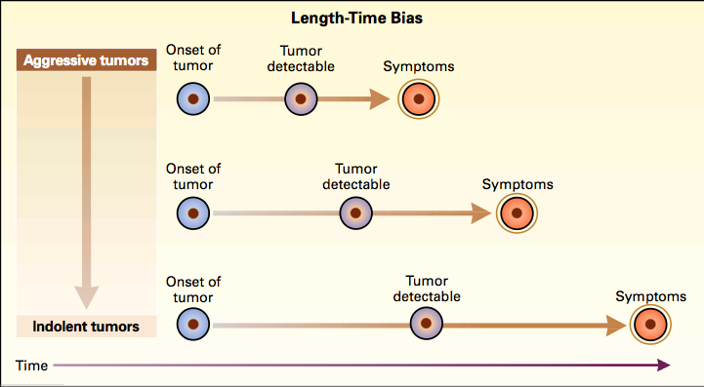
Only slowing growing tumor detected by screening, whereas aggressive is not detected.

Slide 14
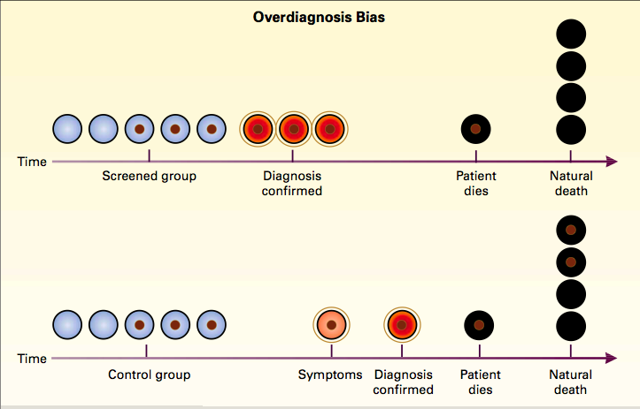
Detection of indolent tumors that have no impact on the patients life expectancy even if undiagnosed.

Slide 15
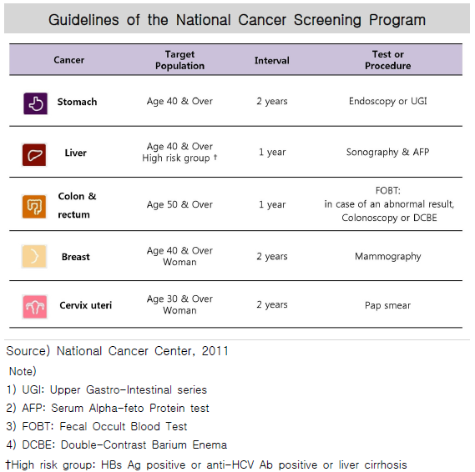
Screening programs of cancer, Korea
From Cancer facts & figures 2012, wwwncc.re.kr

Slide 16
Screening study for lung cancer?
Earlier randomized controlled trials(RCTs) with chest radiography and sputum cytology
  Mayo lung project
  Czech Trial
Marcus PM et al. J Natl Cancer Inst 2000;92:1308-1316.
Kubik A et al. Cancer 2000;89(11, Suppl)2363-2368.

Slide 17
Earlier studies ..
  increased detection of early stage tumor, survival time from diagnosis..
  However fail to reduce lung cancer mortality

Slide 18
New screening?
Lung cancer screening with low-dose computed tomography(LDCT) can..
  detect many tumor at early stage?
  reduce lung cancer mortality?

Slide 19
3. NEW GUIDELINE AND RECENT STUDIES
#CONTENTS

Slide 20
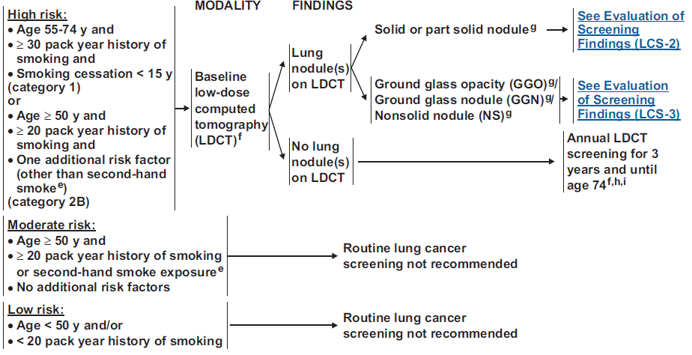
NCCN guideline recommend LDCT screening.
From NCCN Clinical Practice Guideline in Oncology(NCCN Guideline), www.nccn.org
Recommend LDCT screening only high risk..

Slide 21
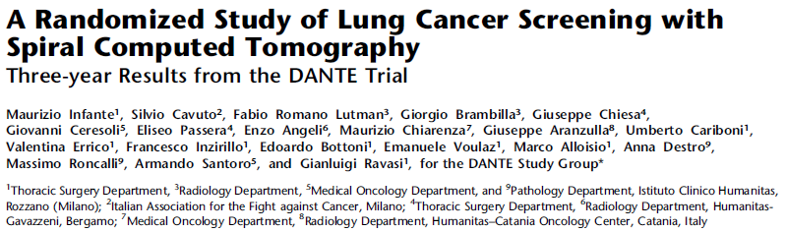
#1 DANTE, 2009
Infante M. et al. Am J Respir Crit Care Med. 2009 Sep 1;180(5):445-53. Epub 2009 Jun 11

Slide 22
Total 2,472, LDCT(n=1,276) vs. control(n=1,196), Italy
  Male, age 60~75 years, smoking(>20 pack-years), Mar 2001~Feb 2006
Method
  Baseline CXR and sputum cytology
  LDCT(baseline,1,2,3 years) vs. annual medical visit
  Median 33 month follow up

Slide 23
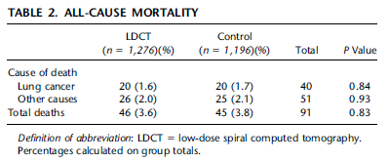
Lung cancer incidence (LDCT vs. control)
  60(4.7%) vs. 34(2.8%)
  Operability 39/60(65%) vs. 18/34(52%) (p=0.25)
  Complete resection 36/60(60%) vs. 17/34(50%) (p= 0.347)
No significant difference of lung cancer mortality and overall mortality

Slide 24
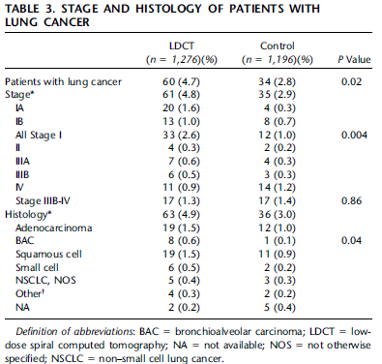
More stag I disease detected by LDCT
  33/60(54%) vs. 12/34(34%) (p=0.06)
However, number of advanced lung cancer(stage IIIB-IV) was same in both group

Slide 25
Conclusion :
  The mortality benefit from lung cancer screening by LDCT is far smaller than anticipated..

Slide 26
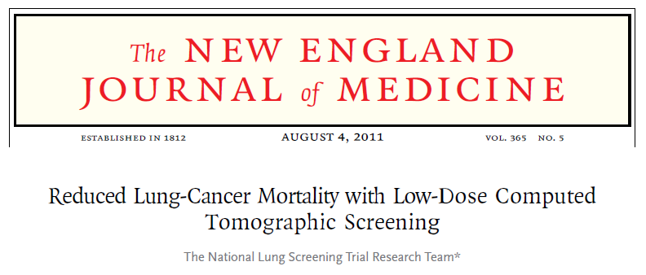
#2 NLST, 2011
N Engl J Med. 2011 Aug 4;365(5):395-409. Epub 2011 Jun 29

Slide 27
Total 53,454, LDCT(n=26,722) vs. control(n=26,732), USA
  Age 55~74 years, smoking(>30 pack-years or quit <15 years), Aug 2002~ Apr 2004
Method
  LDCT vs. CXR at baseline,1,2 years
  Median 6.5 years follow-up

Slide 28
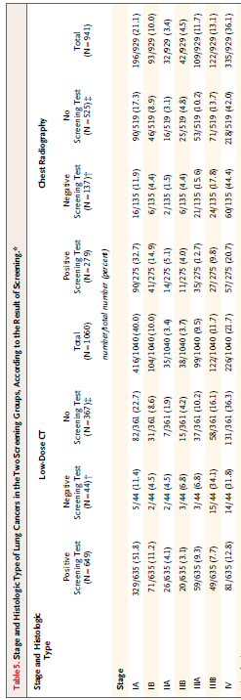
Incidence of lung cancer
  LDCT(n=1,060) vs. CXR(n=941)
early stage disease more detected by LDCT (LDCT vs. CXR)
  stage IA 416(40.0%) vs. 196(21.1%)
  stage IV 226(21.7%) vs. 335(36.1%)

Slide 29
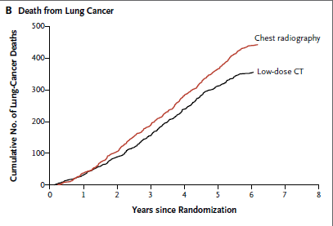
Relative reduction in lung cancer mortality of 20.0% with LDCT(356 deaths vs. 443, p=0.004)
  320 was number of needed to screen with LDCT to prevent one lung cancer death
  All cause of death reduced by 6.7% with LDCT(p=0.02)

Slide 30
Conclusion :
  Screening with the use of low-dose CT reduces mortality from lung cancer..

Slide 31
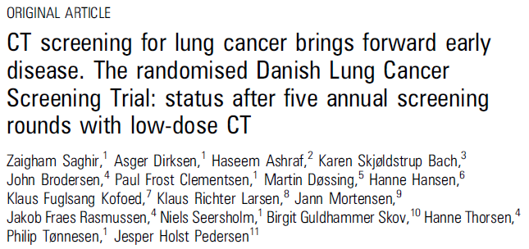
#3 DLCST, 2012
Saghir Z et al. Thorax 2012 Apr;67(4):296-301. Epub 2012 Jan 27

Slide 32
Total 4,104, LDCT(n=2,052) vs. control(2,052), Denmark
  Age 50 ~ 70 years, smoking(>20 pack-years, quit < 10 years), Oct 2004~Mar 2006
Method
  LDCT(baseline, 1,2,3,4 ) vs. annual medical visit
  Median 4.81 years follow-up

Slide 33
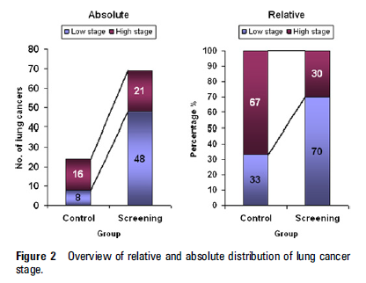
More lung cancer were diagnosed in LDCT
  69 vs. 24 (p<0.001)
low stage was six times higher in LDCT
  48(70%) vs. 8(33%)
However, no significant difference in absolute numbers of late stage..
  21(30%) vs. 16(67%)
  Overdiagnosis bias?
  No absolute stage shift..

Slide 34
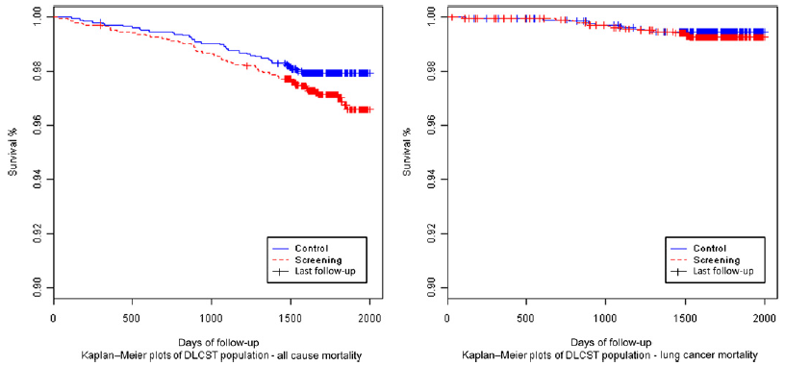
Death events of LDCT vs. control
  All cause : 61(2.97%) vs. 42(2.05%)
  Lung cancer :15(0.73%) vs. 11(0.54%)
No differences in Lung cancer or all-cause mortality..
But small size and short follow up?

Slide 35
Conclusion :
  CT screening for lung cancer brings forward early disease, at this point no stage shift or reduction in mortality..

Slide 36
4. BENEFITS AND HARMS OF CT SCREENING
#CONTENTS

Slide 37
Object
LDCT screening of lung cancer is now recommended. However..
  Potential benefits?
  Potential harms?
  Which groups are most benefit or not benefit?
  What screening setting is effective?

Slide 38
Method
Panel of experts :the ACS, ACCP, NCCN
MEDLINE(Jan,1996~Apr 8,2012), EMBASE(Jan,1996~Apr 8,2012), Cochrane Library(Apr 20, 2012)
Keyword : lung cancer, population screening, LDCT

Slide 39
RCTs and cohorts study using LDCT screening for lung cancer
591 citations reviewed, 8 RCTs and 13 cohorts

Slide 40
Primary outcome(Only RCTs) :
  Lung cancer mortality and all cause mortality
Secondary outcome :
  Nodule detection, invasive procedures, follow-up tests, smoking cessation

Slide 41
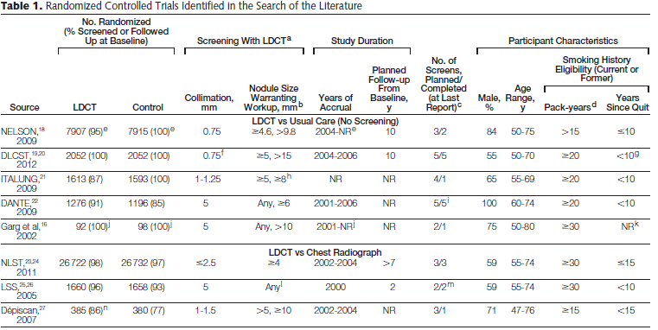
RCTs..
NR : not reported

Slide 42
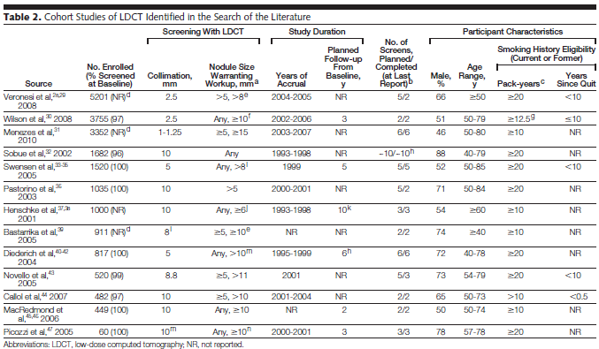
Cohort studies..

Slide 43
Results
Low risk of bias : only NLST, DLCST
  Other RCTs showed variable risks of bias
The risk of bias of cohort studies was variable and often high
  Lacked of justification for the sample size
  No definition of primary endpoint
  No description of funding source

Slide 44
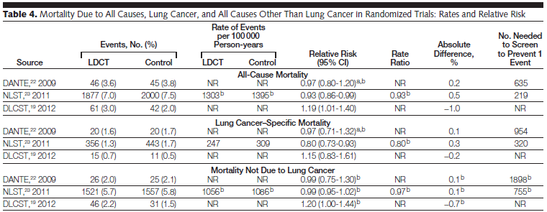
Only NLST, 3 rounds of screening, 20% relative reduction of lung cancer death (relative risk 0.80, p=.004)
Other two?
  No statistically significant difference..

Slide 45
Benefits about smoking behavior
  Undergoing LDCT screening may result in justification of continue smoking or opportunity for smoking cessation..
Not found evidence that altering smoking habits

Slide 46
Nodule detection rate per round was 20%
  Variable 3~30% in RCTs, 5~51% in cohorts, most are benign(≥90%)
  No statistically significant relation between smoking history and nodule detection rates.
Further evaluation
  CT 1~44.6%, PET 2.5~5.5%
  Invasive procedures generally low but varied considerably

Slide 47
NLST only reported complications
 | All nodule |  | Benign nodule
 | LDCT | CXR | LDCT | CXR
Major complication | 33* | 10 | 4.5 | 1.5
Image study alone | 1.1 | 1.5
BF or Needle biopsy | 1.5 | 0.7
Surgery | 14%
Death within 2 months | 8 | 5 | 4.1 | 1.1
Image study alone | 1.9 | 1.5
BF or Needle biopsy | 3.4 | 2.2
Surgery | 1% | 0.20%
BF : bronchoscopy, * : events per 10,000

Slide 48
Overdiagnosis
  CXR screening have roughly 25%..
  LDCT screening not yet be estimated
Kubik AK et al. 2000 Dec 1;89(11 Suppl):2363-8.
Marcus PM et al. J Nal Cancer Inst. 2000;92(16):1308-1316

Slide 49
Radiation exposure
  LDCT 1.5 mSv, chest CT(~8 mSv), PET-CT(~14 mSv)
    NLST participants : 8 mSv over 3 years
  Approximately 1 cancer death may be caused by radiation from imaging per 2,500 persons screened (Benefits > radiation risk)
  However, Young and low risk?
    No benefits in nonsmokers or age ≤ 42 years
Berrington de Bonzalez A et al. J Med Screen. 2008;15(3):153-158

Slide 50
Quality of life
  In 351 participants, NELSON trial
  87~99%, no discomfort related to CT scan
  46%, psychological distress while awaiting result
Van den Bergh KA et al. Cancer. 2008 Jul 15;113(2):396-404

Slide 51
Discussion
NLST, annual LDCT screening reduced relative risk of death from lung cancer by 20% !
However, two smaller RCTs(DANTE, DLCST) found no benefit..

Slide 52
Limitation..
Potential harms to patient
  High percentage of benign nodule
  radiation exposure
  procedure related complication

Slide 53
Uncertainty exists about the generalizability of results
  Heterogeneous structural setting
  Quality control
Others..
  Patients can experience fear and anxiety?
  Small negative effect on smoking?
  Cost-effectiveness?

Slide 54
Take home message..
LDCT screening may be benefit individuals at an increased risk for lung cancer
However there are potential harms of screening
and uncertainties regarding how to translate that conclusion into clinical practice

Slide 55
Thank you for your attention!

