Slide 1
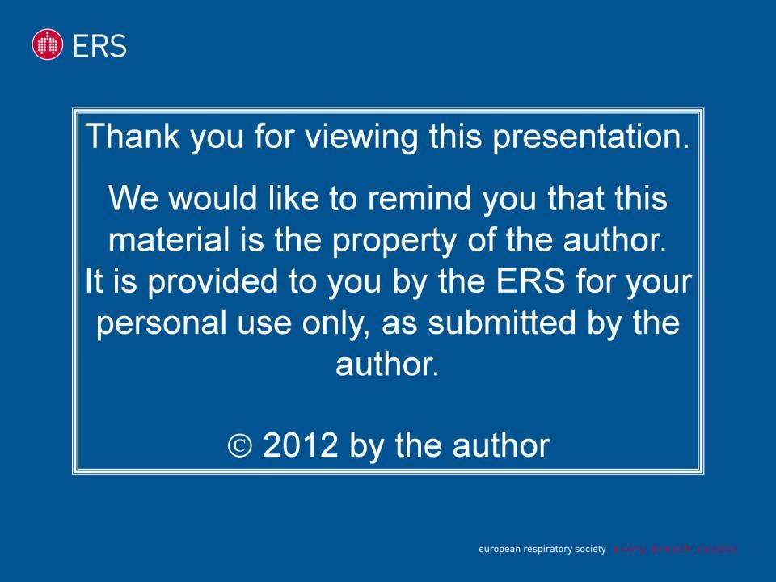

Slide 2



TB: an old and evergreen disease
G. B. Migliori
WHO Collaborating Centre for TB and Lung Disease,
Fondazione S. Maugeri, Care and Research Institute
Tradate, Italy

Slide 3
Outline
TB: evergreen disease?
Why evergreen?
The role of social determinants
The interventions
Challenges: TB/HIV and M/XDR-TB
Challenges in diagnosis and treatment
Elimination: dream or reality?

Slide 4
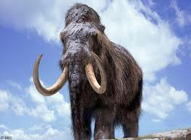
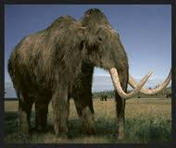
TB, an old disease 1
Rothschild BM, Laub R. Hyperdisease in the late Pleistocene: validation of an early 20th century hypothesis. Naturwissenschaften 2006;93:557-64.

Slide 5
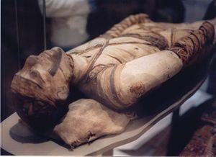
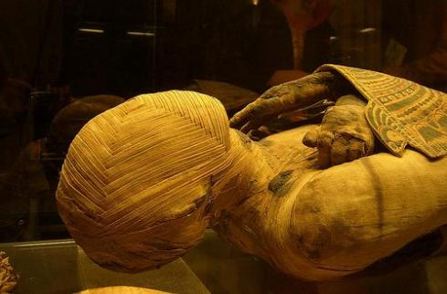
TB, an old disease 1
Nerlich AG, Haas CJ, Zink A, Szeimies U, Hagedorn HG.
Molecular evidence for tuberculosis in an ancient Egyptian mummy. Lancet. 1997;350:1404

Slide 6
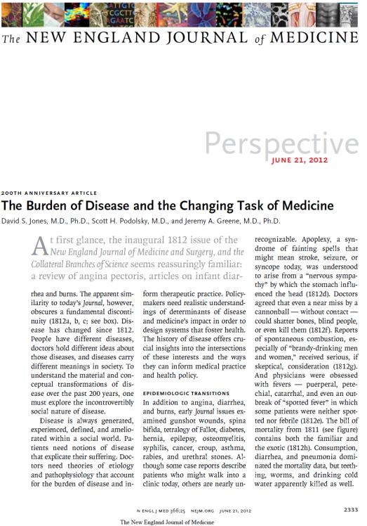

Slide 7
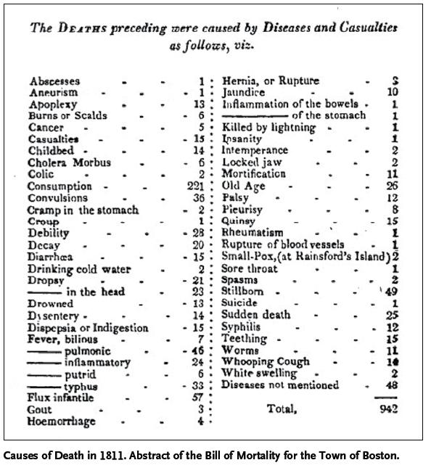

Slide 8
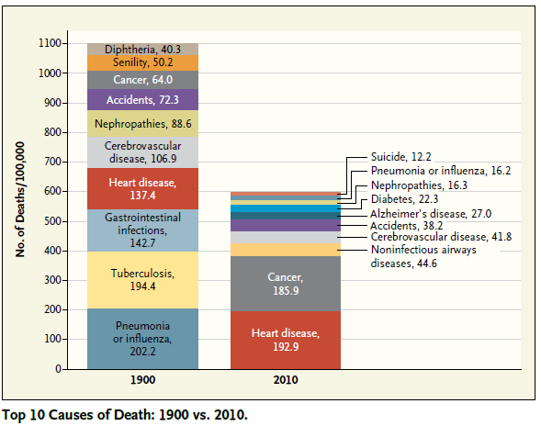

Slide 9
TB TRANSMISSION MODEL
IN ABSENCE OF INTERVENTIONS
1 SOURCE
50% SMEAR
POSITIVE
10 INFECTIONS
X 2 YRS = 20
10% LIFETIME
BREAKDOWN
20 INFECTED

Slide 10
TB TRANSMISSION MODEL
WITH TREATMENT
1 SOURCE
50% SMEAR
POSITIVE
0.5 SOURCE
10 INFECTIONS
X 1 YR = 10
10% LIFETIME
BREAKDOWN
10 INFECTED

Slide 11
TB TRANSMISSION MODEL
WITH EARLY DIAGNOSIS & TREATMENT
1 SOURCE
50% SMEAR
POSITIVE
0.25 SOURCE
10 INFECTIONS
X 0.5 YR = 5
10% LIFETIME
BREAKDOWN
5 INFECTED

Slide 12
TB TRANSMISSION MODEL
WITH IRREGULAR TREATMENT
1.5 SOURCES
1 SOURCE
50% SMEAR
POSITIVE
10 INFECTIONS
X 3 YRS = 30
10% LIFETIME
BREAKDOWN
30 INFECTED

Slide 13
Interventions over time: old weapons might be useful again? Sanatoria
First sanatorium Germany, 1857
First Dispensary, Scotland, 1897
BCG vaccination
Pneumotorax, Italy, 1907
Drugs, 1945-1962
Koch, Mtb,
1882
MMR,1950-1980
Fox:Ambulatory treatment, 1968
Styblo model, 1978
DOTS, 1991
sanatoria
Stop TB Strategy
screening
New Post-2015 Strategy
drug therapy
Socio-economic improvement

Slide 14
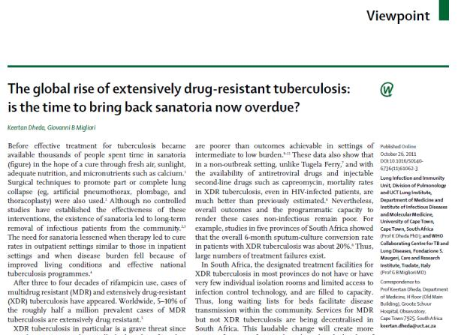
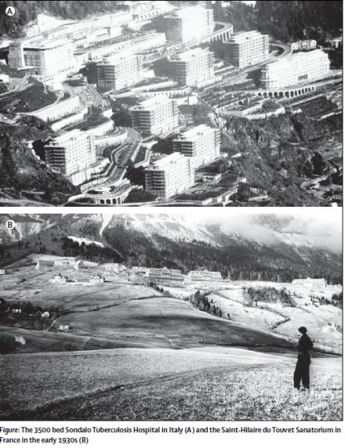
Improve Infection Control
Implement Palliative Care
Promote patient centered, comprehensive support to the individual

Slide 15
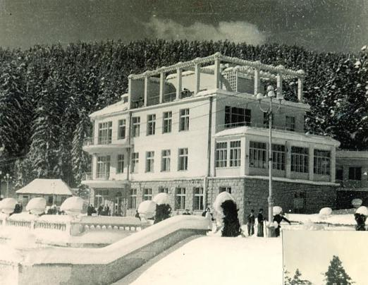
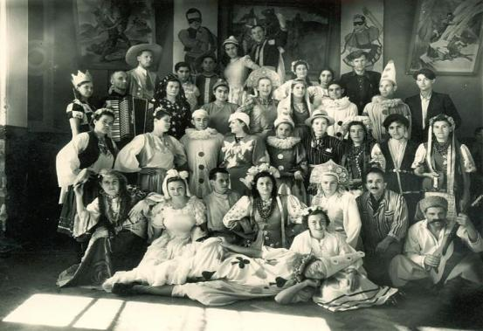

Slide 16
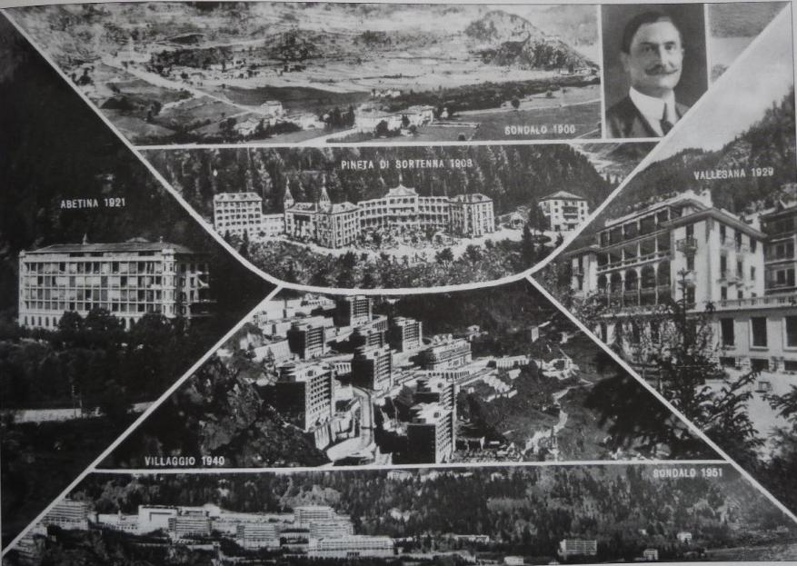

Slide 17
Interventions over time: old weapons might be useful again? Socio-economical improvement
First sanatorium Germany, 1857
First Dispensary, Scotland, 1897
BCG vaccination
Pneumotorax, Italy, 1907
Drugs, 1945-1962
Koch, Mtb,
1882
MMR,1950-1980
Fox:Ambulatory treatment, 1968
Styblo model, 1978
DOTS, 1991
sanatoria
Stop TB Strategy
screening
New Post-2015 Strategy
drug therapy
Socio-economic improvement

Slide 18
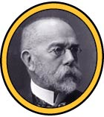
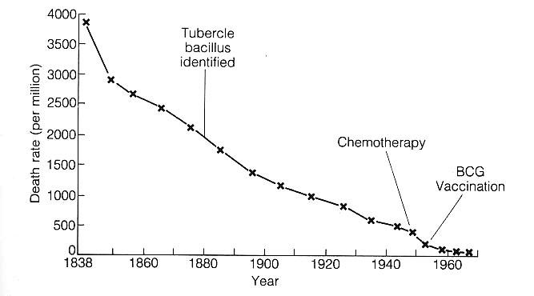
Decrease in Mortality, Germany, 1838-1970
First drugs: contributed <5% of reduction in TB deaths 1840-1970
M. tuberculosis discovered in 1882

Slide 19
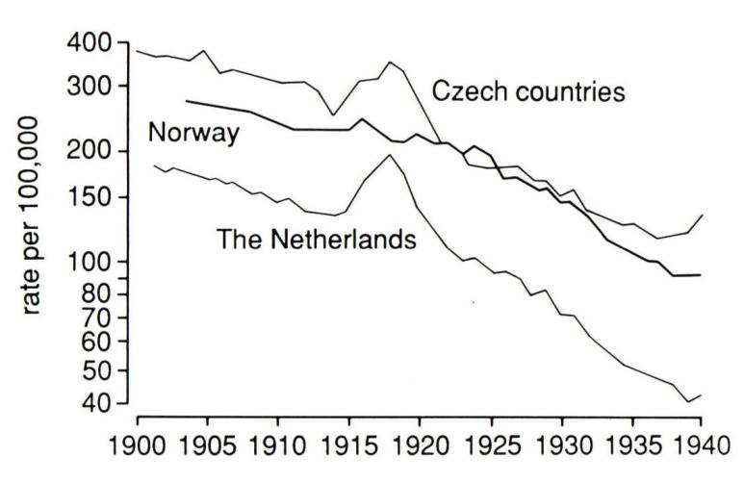
TB mortality in Europe
Notes:
EFFECT OF WW1 AND AT THE RIGHT THE START OF WW2

Slide 20
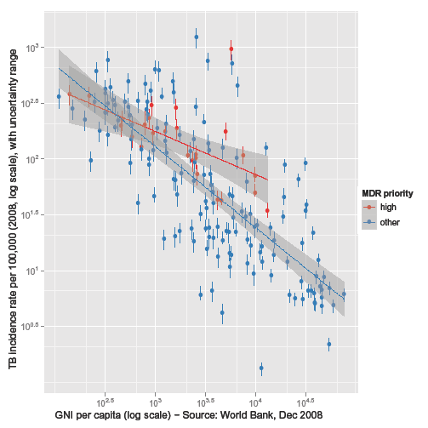
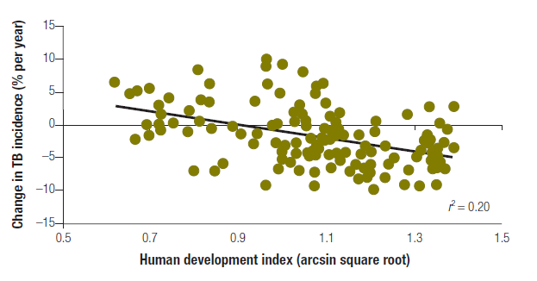
The lower the GNI and HDI, the higher the incidence of TB
Relationship Gross National Income/capita and HDI and TB incidence

Slide 21
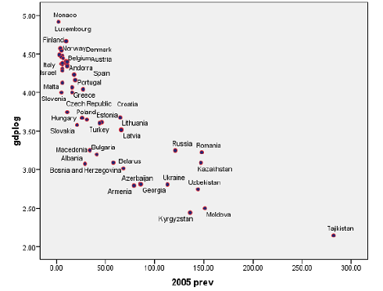
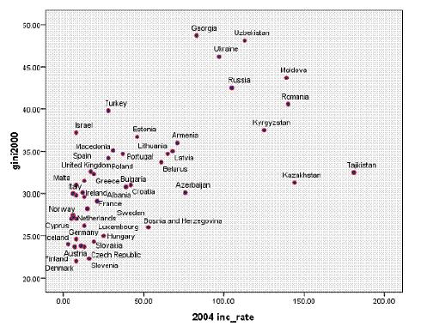
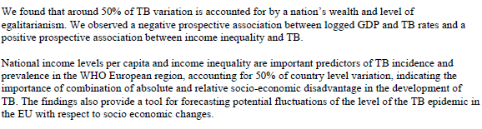
Ploubidis G et al. Social determinants of TB in Europe: A prospective ecological study. ERJ 2012, in press

Slide 22
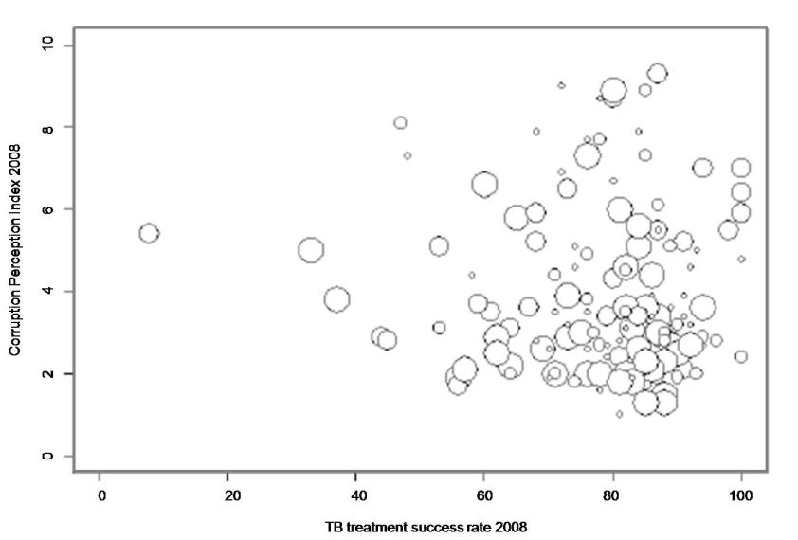
5% of inter-country variability of MDR % in new TB cases is related to corruption. It largely exceeds the effect of health related factors (e.g. TB management strategies)
MDR % among new TB cases according to CPI score and TB treatment success rate in 2008.
> the bubble size, > the % of MDR among new TB cases. ERJ 20012, in press
Notes:
Corruption Perception Index (CPI) compiled by Transparency International which orders the countries of the world according to "the degree to which corruption is perceived to exist among public officials and politicians" (8). This index ranges from 0 to 10 with a higher score meaning less (perceived) corruption.
around 5% of the inter-country variability of the percentage of MDR among new TB cases could be related to corruption, a total that largely exceeds the effect of health related factors significantly associated with the outcome in the analysis (TB management strategies). But still, because the equation corruption=death is seldom explicit, corruption only seems like a nuisance. In practice, governments still treat health and corruption as separate rather than integral components of the same strategy
5% of inter-country variability of the % of MDR among new TB cases is related to corruption. Itlargely exceeds the effect of health related factors (e.g. TB management strategies)

Slide 23
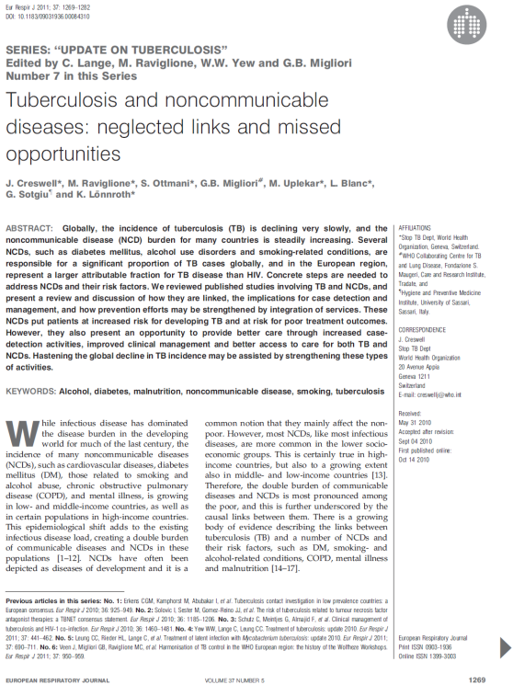
Alcohol
Smoking
Malnutrition
Silicosis
Mental illness

Slide 24
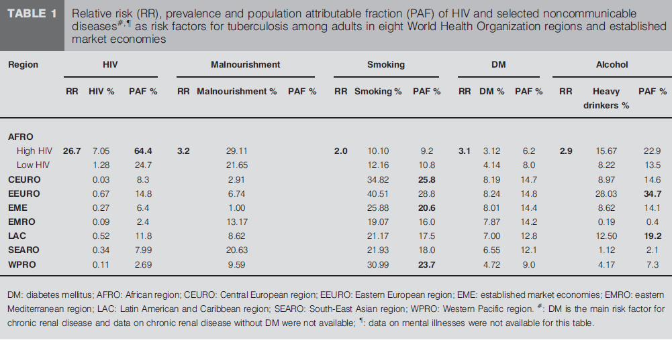

Slide 25
Evidence on social determinants
J. Creswell, M. Raviglione, S. Ottmani, et al. Tuberculosis and noncommunicable diseases: neglected links and missed opportunities. Eur Respir J. 2011; 37: 1269–1282.
Ploubidis GB, Palmer MJ, Blackmore C, et al. Social determinants of tuberculosis in Europe: A prospective ecological study. Eur Respir J. 2012 Jan 20. [Epub ahead of print]
Lönnroth K, Jaramillo E, Williams BG, Dye C, Raviglione M. Drivers of tuberculosis epidemics: The role of risk factors and social determinants. Social Science and Medicine 2009;8 :2240–2246
Lin H, Ezzati M, Murray M. Tobacco smoke, indoor air pollution and tuberculosis: a systematic review and meta-analysis.PLoS Medicine 2007;4:e142
Jeon CY, Murray MB. Diabetes mellitus increases the risk of active tuberculosis: a systematic review of 13 observational studies. PLoS Medicine 2008;5:e15
Lönnroth K, Williams BG, Cegielski P, Dye C. A homogeneous dose-response relationship between body-mass index and tuberculosis incidence. Int J Epidemiology 2010;9:149-55.
Lönnroth K, Williams BG, Stadlin S, Jaramillo E, Dye C. Alcohol use as a risk factor for tuberculosis – a systematic review. BMC Public Health 2008;8:289
Lönnroth K, Castro K, Chakaya JM, Chauhan LS, Floyd K, Glaziou P, Raviglione M. Tuberculosis control 2010 – 2050: cure, care and social change. Lancet 2010; 375:1814-29

Slide 26
Interventions over time: old and new public health strategies
First sanatorium Germany, 1857
First Dispensary, Scotland, 1897
BCG vaccination
Pneumotorax, Italy, 1907
Drugs, 1945-1962
Koch, Mtb,
1882
MMR,1950-1980
Fox:Ambulatory treatment, 1968
Styblo model, 1978
DOTS, 1991
sanatoria
Stop TB Strategy
screening
New Post-2015 Strategy
drug therapy
Socio-economic improvement

Slide 27
DOTS
Government commitment to ensuring sustained, comprehensive TB control activities
Case detection by sputum smear microscopy among symptomatic patients self-reporting to health services
Standardised short-course chemotherapy using regimens of six to eight months, for at least all confirmed smear positive cases. Good case management includes directly observed therapy (DOT) during the intensive phase for all new sputum positive cases, the continuation phase of rifampicin-containing regimens and the whole re-treatment regimen.
A regular, uninterrupted supply of all essential anti-TB drugs
A standardised recording and reporting system that allows assessment of case-finding and treatment results for each patient and of the TB control programme performance overall
Int J Tuberc Lung Dis 2001; 5(3):213-215

Slide 28
WHO-recommended Stop TB Strategy to Reach the 2015 MDGs (2006)
Pursue high-quality DOTS expansion and enhancement
  Political commitment with increased and sustained financing
  Case detection through quality-assured bacteriology
  Standardised treatment, with supervision and patient support
  An effective drug supply and management system
  Monitoring & evaluation system, and impact measurement
2 Address TB/HIV, MDR-TB and other challenges
3. Contribute to health system strengthening
4. Engage all care providers
5. Empower people with TB and communities
6. Enable and promote research
World Health Organization
Notes:
14
The STOP TB strategy is summarised as published in a special issue of Lancet in 2006. This is considered, today, as the WHO-recommended strategy of TB control

Slide 29
The STOP TB Strategy – 2010
Pursue high-quality DOTS expansion and enhancement
  Secure political commitment, with adequate and sustained financing
  Ensure early case detection, and diagnosis through quality-assured bacteriology
  Provide standardised treatment with supervision, and patient support
  Ensure effective drug supply and management
  Monitor and evaluate performance and impact
Address TB-HIV, MDR-TB, and the needs of poor and vulnerable populations
  Scale–up collaborative TB/HIV activities
  Scale-up prevention and management of multidrug-resistant TB (MDR-TB)
  Address the needs of TB contacts, and poor and vulnerable populations
Contribute to health system strengthening based on primary health care
  Help improve health policies, human resources development, financing, supplies, service delivery and information
  Strengthen infection control in health services, other congregate settings and households
  Upgrade laboratory networks, and implement the Practical Approach to Lung Health (PAL)
  Adapt approaches from other fields and sectors, and foster action on the social determinants of health
Engage all care providers
  Involve all public, voluntary, corporate and private providers through Public-Private Mix (PPM) approaches
  Promote use of the International Standards for Tuberculosis Care (ISTC)
Empower people with TB, and communities through partnership
  Pursue advocacy, communication and social mobilization
  Foster community participation in TB care, prevention and health promotion
  Promote use of the Patients' Charter for Tuberculosis Care
Enable and promote research
  Conduct programme-based operational research, and introduce new tools into practice
  Advocate for and participate in research to develop new diagnostics, drugs and vaccines

Slide 30



Global TB Control Targets
2015: Goal 6: Combat HIV/AIDS, malaria and other diseases
Target 8: to have halted by 2015 and begun to reverse the incidence…
Indicator 23: incidence, prevalence and deaths associated with TB
Indicator 24: proportion of TB cases detected
and cured under DOTS
2015: 50% reduction in TB prevalence and deaths by 2015
2050: elimination (<1 case per million population)

Slide 31

The global TB situation (1)
Estimated number of cases, 2010
Estimated number of deaths, 2010
All forms of TB
8.8 million
(8.5–9.2 million)
1.1 million*
(0.9–1.2 million)
HIV-associated TB
1.1 million
(1.0–1.2 million)
350,000
(320,000–390,000)
Multidrug-resistant TB
~ 650,000
out of 12 million (11-14 million) prevalent TB cases
* Excluding deaths attributed to HIV/TB
Source: WHO Global Tuberculosis Control Report 2011 (www.who.int/tb/publications/global_report/2011/gtbr11_full.pdf)
Notes:
In 2010 it was estimated that 8.8 million incident TB cases occurred in the world. Out of the 12 million prevalent TB cases, around 650,000 were estimated to be multidrug-resistant.

Slide 32
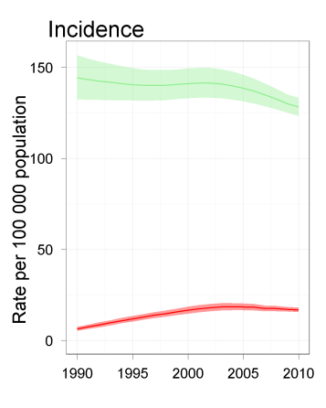
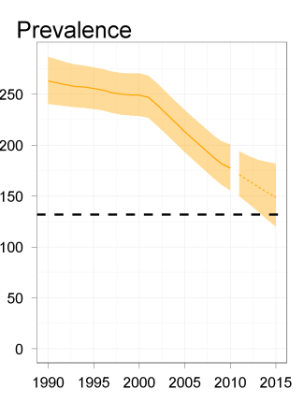
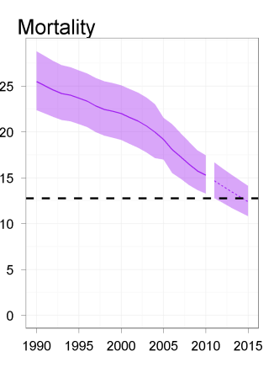
Incidence, prevalence and mortality rates: global estimates
Rate per 100,000 population
Incidence
Prevalence
Mortality
150
250
25
200
20
100
Peak in 2002
150
15
50
100
10
Target
Target
50
5
Falling 1.3% per year
40% decline since 1990
0
0
0
1990
2010
1990
2015
1990
2015

Slide 33
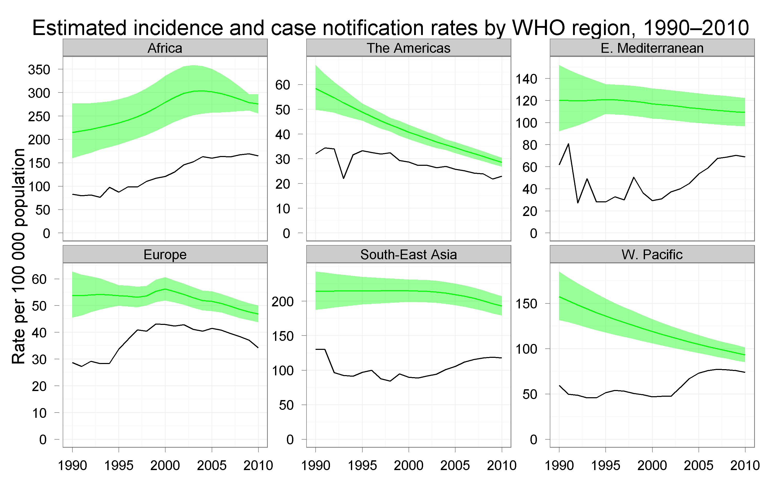
The global TB situation (2)
Notes:
Overall TB incidence (green lines) has been declining steadily in all the Regions of the world for several years.

Slide 34
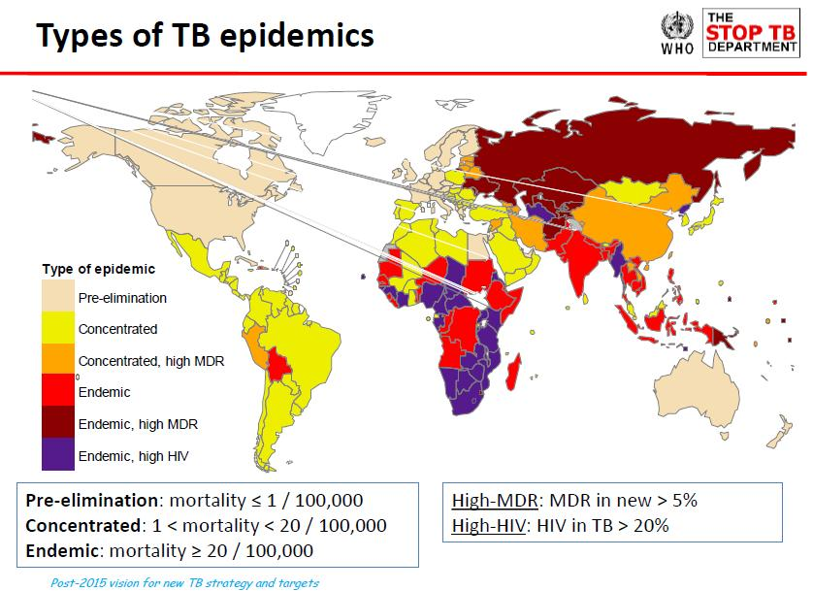

Slide 35
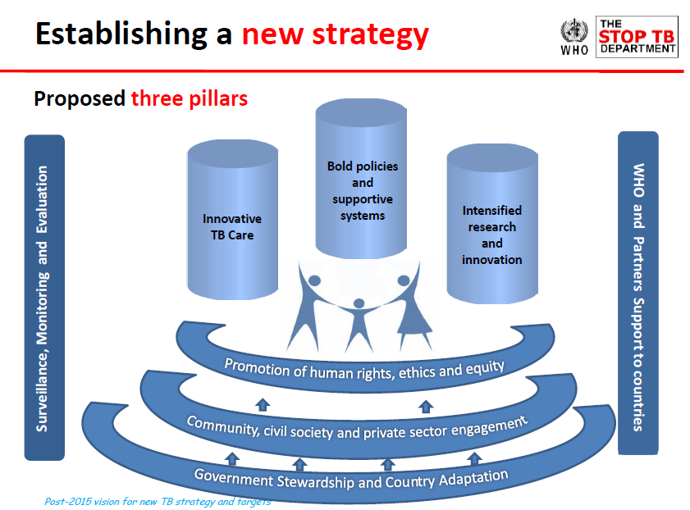

Slide 36

Definitions
MDR-TB = Strains resistant to at least INH and RIF (most important 1st-line drugs)
XDR-TB = MDR TB strains with additional resistance to any fluoroquinolone and any of the 3 injectable second-line drugs (amikacin, kanamycin, capreomycin)
TDR, XXDR = Resistance to all drugs (not standardised defin)
TDR/XXDR TB
TB with any
drug resistance
MDR TB
XDR TB

Slide 37


Range of % of MDR among new TB cases, 1994-2010
The boundaries and names shown and the designations used on this map do not imply the expression of any opinion whatsoever on the part of the World Health Organization concerning the legal status of any country, territory, city or area or of its authorities, or concerning the delimitation of its frontiers or boundaries.
Dotted lines on maps represent approximate border lines for which there may not yet be full agreement.  WHO 2010. All rights reserved

Slide 38
13 top settings with highest % of MDR-TB among new cases, 2001-2010
Minsk, Belarus (2010)
Preliminary results ERJ 2012
35.3

Slide 39
Distribution of proportion of MDR among previously treated TB cases, 1994-2010
The boundaries and names shown and the designations used on this map do not imply the expression of any opinion whatsoever on the part of the World Health Organization concerning the legal status of any country, territory, city or area or of its authorities, or concerning the delimitation of its frontiers or boundaries.
Dotted lines on maps represent approximate border lines for which there may not yet be full agreement.  WHO 2011. All rights reserved

Slide 40
MDR-TB notification and enrolment
MDR cases reported vs estimated among notified TB, 2010
WHO Region | 2010
 | Estimated | Reported | Ratio
African | 32,000 | 9,504 | 30%
American | 6,200 | 2,158 | 35%
East Med. | 14,000 | 829 | 6%
European | 53,000 | 32,616 | 62%
S-E Asian | 88,000 | 3,779 | 4%
West Pacific | 77,000 | 4,222 | 5%
Global | 290,000 | 53,108 | 18%
Notes:
When compared to the number of detectable MDR-TB cases if DST was accessible to all TB cases notified in the world, the 53 thousand cases reported by countries in 2010 represent less than a fifth of the estimated burden. Regional variations are large and coverage is lowest in the regions where the large majority of TB cases occur. 56 of the 135 countries (42%) with at least one case of MDR-TB in 2010 reported >50% of their estimated MDR-TB caseload. All countries are targeted to achieve this level of reporting completeness by 2015.

Slide 41
Countries that had reported at least one
XDR-TB case by Oct 2011
Notes:
By October 2011, 77 countries had reported at least one case of XDR. Coverage is low particularly in the African continent as a result of low capacity for testing for second-line medicines.

Slide 42
Outcomes of MDR-TB treatment
For MDR-TB patients started on treatment in 2008*
100%
80%
60%
40%
20%
0%
Kazakhstan
Turkey (263)
Uzbekistan
Ecuador (210)
Georgia (417)
Democratic
Philippines
Namibia (221)
Russian
Brazil (444)
Kyrgyzstan
Republic of
South Africa
Romania (816)
(2268)
(294)
Republic of the
(520)
Federation
(262)
Moldova (522)
(4383)
Congo (202)
(1537)
Success
Died
Failed
Defaulted
Not evaluated
* In countries reporting outcomes for >200 MDR-TB cases with <20% unevaluated (cohort size shown below country names)
Notes:
The proportion of MDR-TB patients with a successful outcome varied substantially between countries and averaged to about 53% globally. Of the 91 countries reporting outcomes, only 20 achieved or exceeded the Global Plan target of 75% success, three of them having cohorts of at least 50 patients. In 52/91 countries, the number of MDR-TB patients for whom outcomes were reported represented >90% of the number of MDR-TB patients notified by the country for 2008. Seventeen of the 27 high MDR-TB burden countries reported outcomes, eight of them with cohorts similar in size to the notified MDR-TB cases (>90%). By 2015, all countries are expected to report outcomes for all confirmed MDR-TB cases.

Slide 43
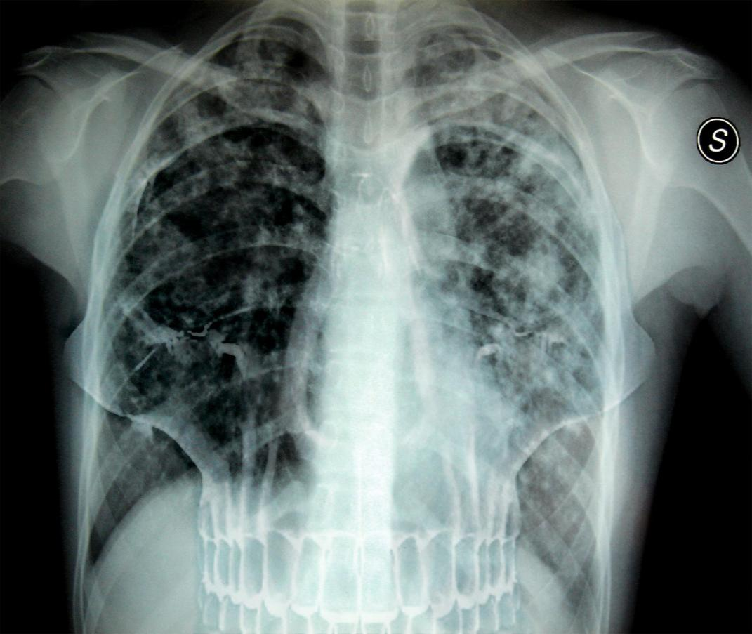

Slide 44

M/XDR-TB is becoming, in selected settings, a time-bomb

Slide 45
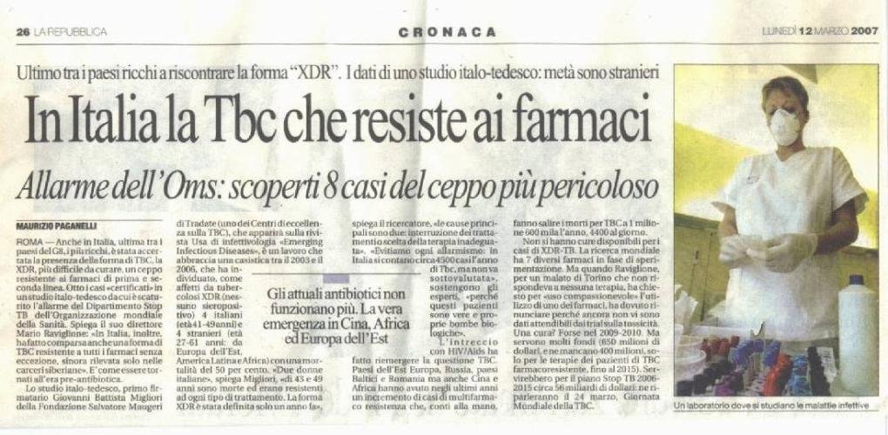
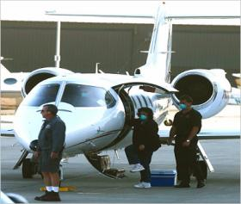
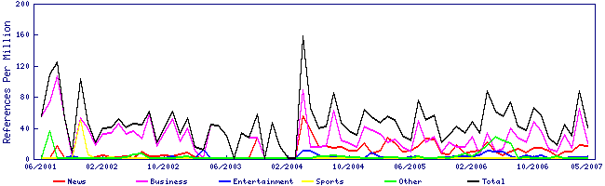
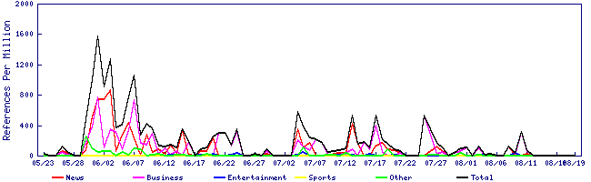
Andrew S
XDR-TB

Slide 46
Russian Federation
(new TB/HIV cases 1999-2009)
Frolova OP. AIDS 2010

Slide 47
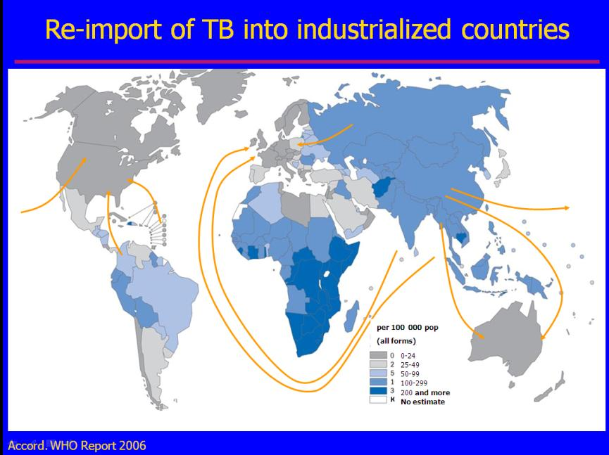
Notes:
Tuberculosis: Clinical symptoms, diagnosis, treatment and prevention
47

Slide 48
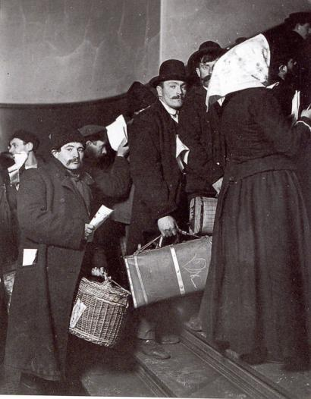
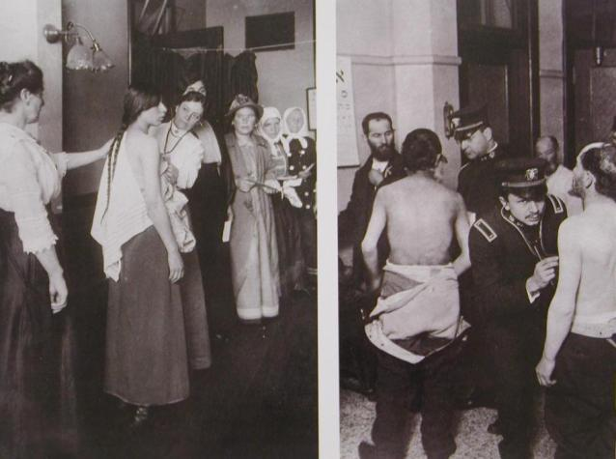
Notes:
Tuberculosis: Clinical symptoms, diagnosis, treatment and prevention
48

Slide 49
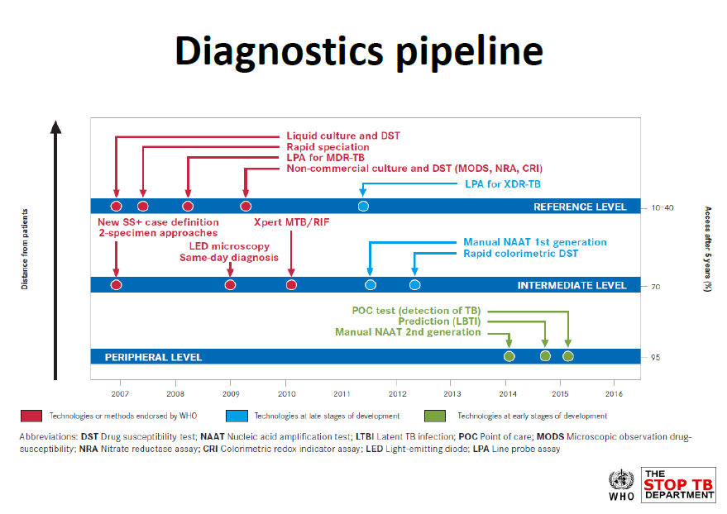

Slide 50
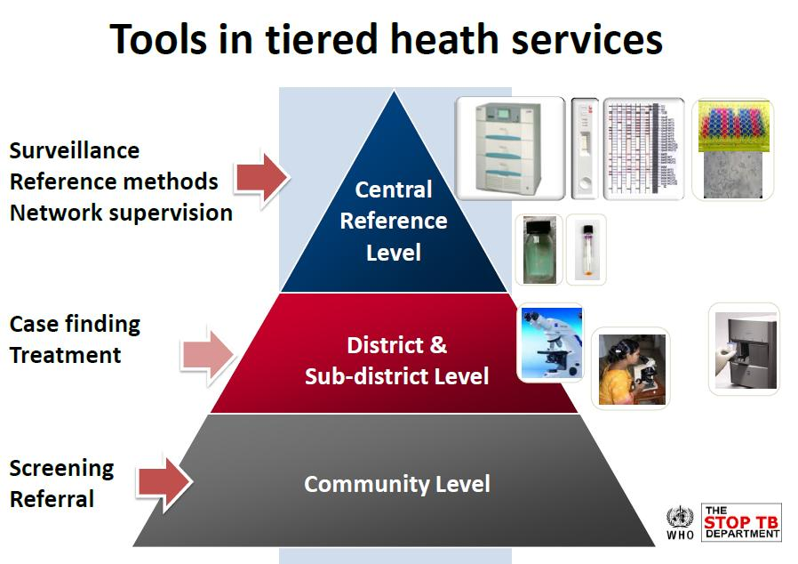

Slide 51
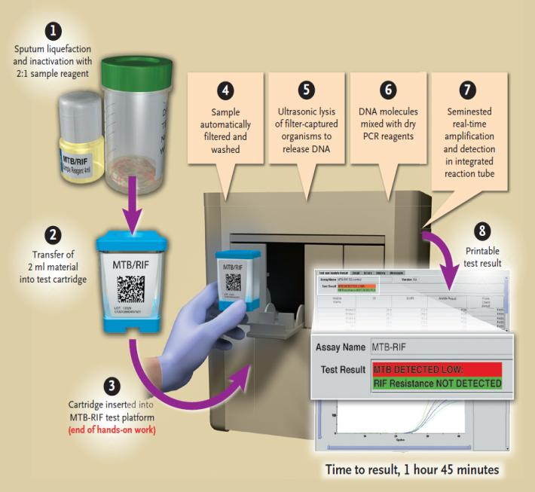
Gene Xpert

Slide 52
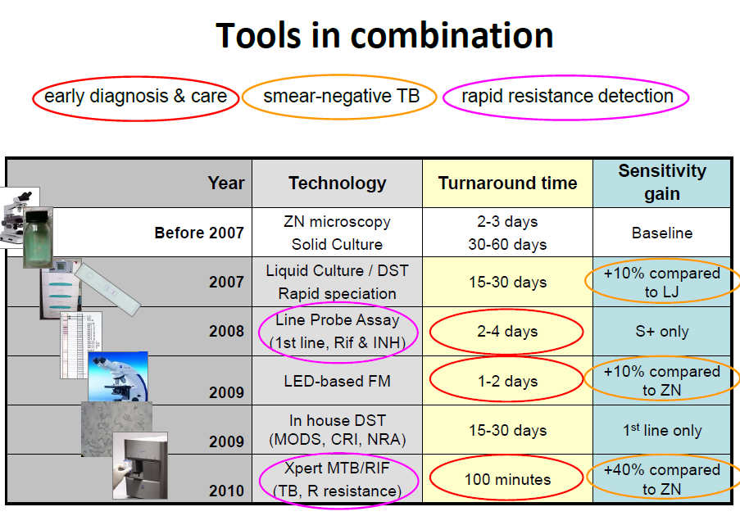

Slide 53
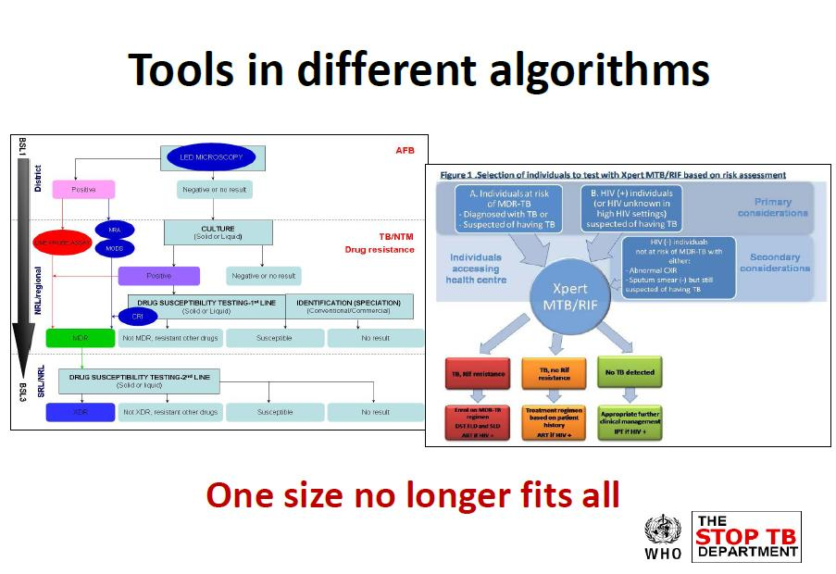

Slide 54
XDR= HR + 1 FQ + 1 Injectable (AMK, CM or KM)
XDR= extensively drug-resistant TB
1st-line oral
INH
RIF
PZA
EMB
(Rfb)
Injectables
Fluoroquinolones
SM
KM
AMK
CM
Cipro
Oflox
Levo
Moxi
(Gati)
Oral bacteriostatic 2nd line
ETA/PTA
PASA
CYS
Unclear efficacy
Not routinely recommended, efficacy unknown, e.g., amoxacillin/clavulanic acid, clarithromycin, clofazamine, linezolid, inmipenem/cilastatin, high dose isonizid

Slide 55

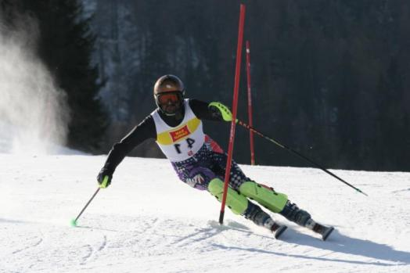
1966, the last anti-TB drug was discovered

Slide 56
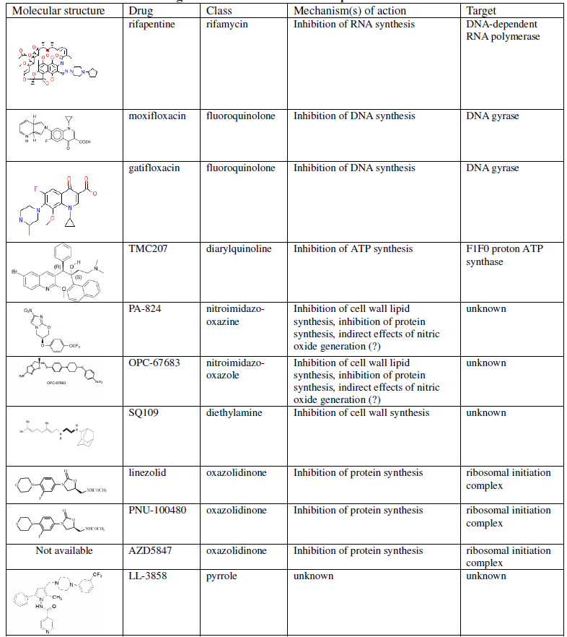
Bedaquiline
Delamanid

Slide 57
AE in Linezolid- containing regimens. Sotgiu et al, ERJ 2012

Slide 58
Meropenem
37 cases, 61 controls
Meropenem (3 g/day) added to optimised WHO-recommended, Linezolid-containing regimen significantitly increases % SS-C converters at 2 months in M/XDR-TB cases
Safe

Slide 59
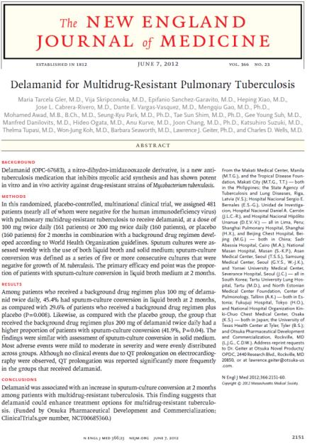
Delamanid
Delamanid added to a background MDR-TB regimen improves significantly SS-C conversion at month 2 (45.4 vs 29.6%)

Slide 60
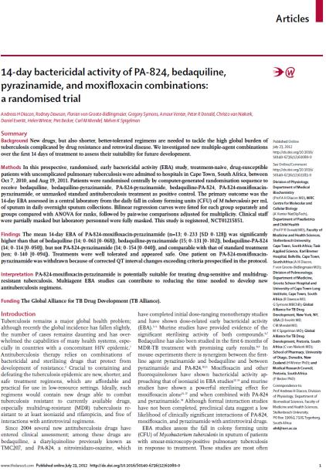
Bedaquiline (Bq) and PA-824
EBA at 2 w: PA-824+moxi+Z
better than: bq, bq+Z, bq+PA-824
Comparable to WHO Cat 1

Slide 61
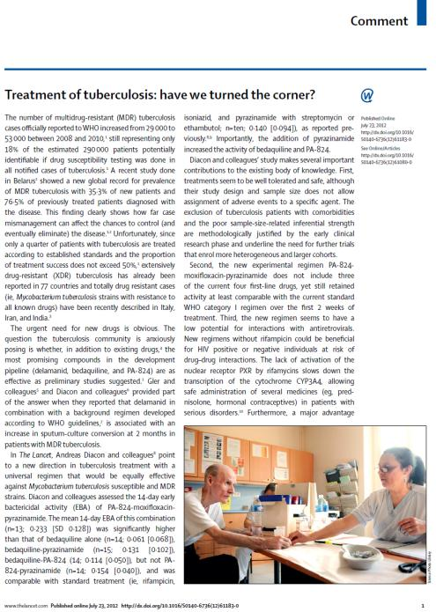
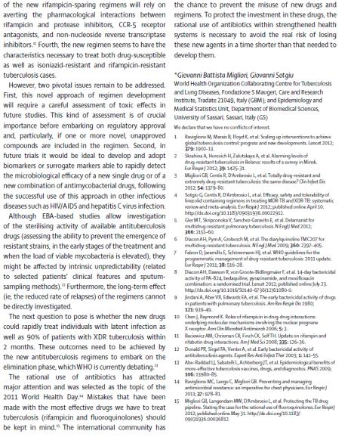

Slide 62
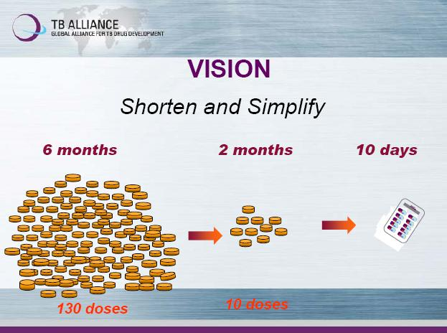

Slide 63


Slide 64

LTBI: it is the iceberg
Active TB disease
8,8 million new cases per year
- only “peak of iceberg”
Latent TB Infection (LTBI)
- the “hidden” epidemic
- ~2 billion people

Slide 65


Slide 66



Potential impact of new TB vaccines, diagnostics and drugs
Source: L. Abu Raddad et al, PNAS 2009
Add. Effects = effects also on latency
and infectiousness of cases in vaccinated
Led & NAAT at microscopy lab level
Dipstick at point of care
Regimen 1 = 4-month, no effect on DR
Regimen 2 = 2-month, 90% effective in M/XDR
Regimen 3 = 10-day, 90% effective in M/XDR

Slide 67

Prevention is Better than Cure: Vaccination

Slide 68


Eradication of tuberculosis: Will it be feasible?
" The possibility of eradicating tuberculosis in a country is essentially a function of its economic level…
…There are three major weapons which can be used in a policy of eradication: chemotherapy, vaccination, and chemoprophylaxis.
…In realising this objective, the developed countries can give developing ones considerable help"

Slide 69

Europe in 1990 committed for Elimination

Slide 70

21 EU-tailored Standards adapted from the International Standards (ISTC) document on diagnosis, treatment, HIV and co-morbidities management and public health /prevention to drive Europe towards Elimination

Slide 71

TB, for how long evergreen ?

