Slide 1
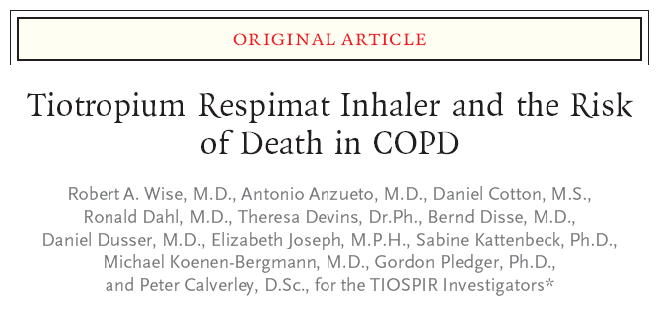
내과 3년차 고범석

Slide 2
Introduction
Tiotropium (Spiriva, Boehringer Ingelheim)
- long-acting inhaled anticholinergic bronchodilator
improves lung function
quality of life
exercise endurance
reduces exacerbations in patients with COPD
Handi-Haler inhalation device (at a dose of 18 μg)
- dry-powder formulation delivered
Respimat inhaler (at a dose of 5 μg)
- an aqueous solution delivered

Slide 3
Introduction
Crossover trials of tiotropium Respimat at a dose of 5 μg and HandiHaler at a dose of 18 μg for up to 4 weeks have shown similar efficacy, safety, and pharmacokinetic profiles
-van Noord JA, et al. Respir Med 2009;103:22-9.
Tiotropium Respimat at a dose of 5 μg was associated with excess mortality in the planned treatment period (rate ratio, 1.33; 95% confidence interval [CI], 0.93 to 1.92), particularly among patients with known cardiacrhythm disorders
- Tiotropium(Spiriva) Respimat: evaluation of fatal events. 2010
Understanding Potential Long-Term Impacts on Function with Tiotropium(UPLIFT) trial, in which fewer deaths were observed with HandiHaler treatment than with placebo in the planned treatment period

Slide 4
Introduction
Given the small amount of safety data for tiotropium Respimat at a dose of 5 μg (6448 patients, with 5487 patient-years at risk), as compared with HandiHaler at a dose of 18 μg (17,014 patients, with 23,934 patient-years at risk), a relationship between tiotropium Respimat and the risk of death could not be established
Tiotropium Safety and Performance in Respimat (TIOSPIR) trial
- the primary results of this large-scale, randomized, prospective evaluation of the safety and efficacy of tiotropium Respimat, as compared with tiotropium HandiHaler

Slide 5
Methods
Patients were randomly assigned to one of three groups
- once-daily tiotropium at a dose of 2.5 μg or 5 μg delivered by the Respimat soft-mist inhaler
a dose of 18 μg delivered by the HandiHaler inhalation device.
Continue until at least 1266 deaths had occurred
Enrolled patients
40 years of age or older and who had received a clinical diagnosis of COPD,
least 10 packyears of smoking history
Postbronchodilator ratio of the FEV1/FVC of 0.70 or less, and had an FEV1 of 70% or less of the predicted value
All COPD medications except other inhaled anticholinergic agents were allowed.

Slide 6
Methods
Excluded patients
A myocardial infarction within the previous 6 months
hospitalized for class III or IV heart failure
unstable or life-threatening arrhythmia requiring new treatment within the previous 12 months.
clinically significant lung diseases or a COPD exacerbation within the previous 4 weeks
moderate or severe renal impairment
cancer requiring therapy within the previous 5years
drug or alcohol abuse within the previous 12 months

Slide 7
Methods
Each patient received one of two possible Respimat inhalers: either 1.25 μg or 2.5 μg per inhalation, and a HandiHaler device; in each case, one of the inhalers held active medication and the other one contained placebo.
Patients were seen at local clinical centers every 12 weeks with a final visit 30 days after the end of treatment.
The primary safety outcome was the time to death from any cause
The primary efficacy outcome was the risk of the first COPD exacerbation
Secondary outcome
the number of COPD exacerbations
the time to the first moderate or severe exacerbation
the number of severe exacerbations
the time to major adverse cardiovascular events.

Slide 8
Results
Study Patients
Patients were recruited from May 2010 through April 2011; the study ended in May 2013.
20,313 patients who were screened, 17,183 underwent randomization, and 17,135 received at least one dose of the assigned treatment
13,199 (77.1%) continued treatment
The median duration of treatment was 835 days in all three study groups with a mean follow-up of 2.3 years

Slide 9
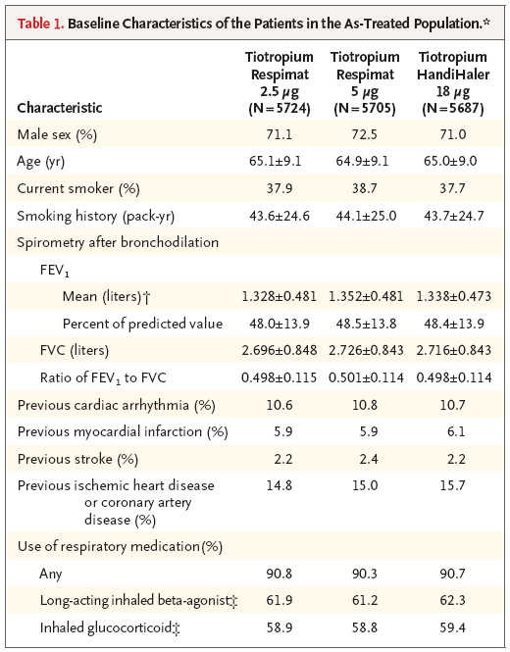

Slide 10
Results
Death
- the primary end point of the risk of death from any cause, the hazard ratio for Respimat 5 μg versus HandiHaler was 0.96 (95% CI, 0.84 to 1.09); for Respimat 2.5 μg versus HandiHaler, the hazard ratio was 1.00 (95% CI, 0.87 to 1.14)

Slide 11
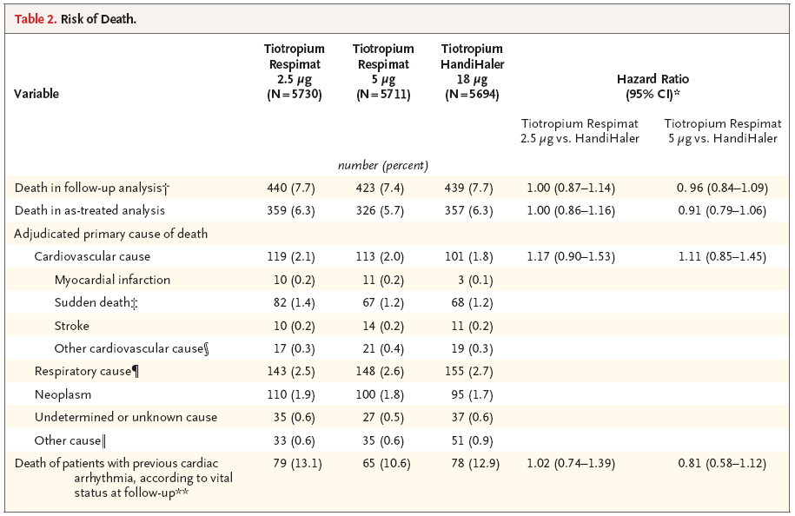
Results

Slide 12
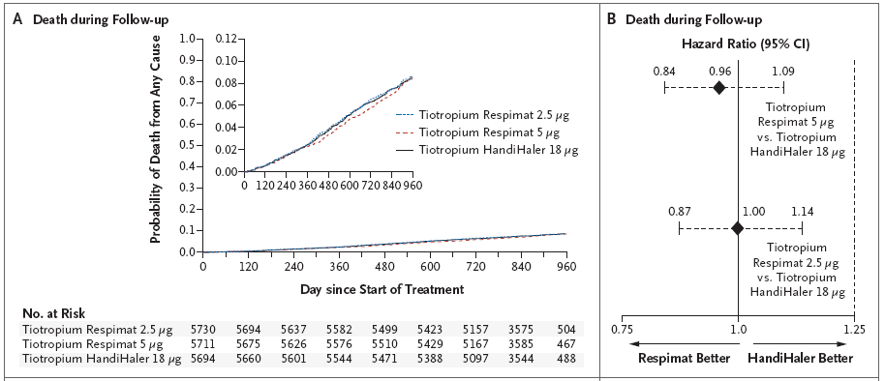
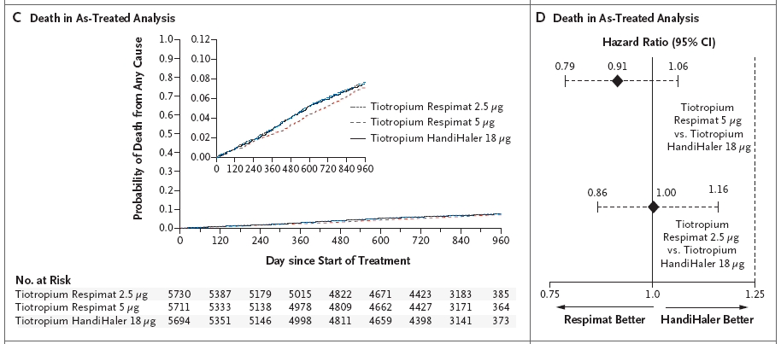

Slide 13
Results
COPD exacerbations
the second primary end point of the risk of the first exacerbation, the hazard ratio for Respimat 5 μg versus HandiHaler was 0.98 (95% CI,0.93 to 1.03). a difference that was not significant (P = 0.42).
The proportions of patients with a COPD exacerbation were 47.9% for the Respimat 5-μg group and 48.9% for the HandiHaler group
Rates of exacerbations, moderate or severe exacerbations, and severe exacerbations were similar in the three study groups

Slide 14
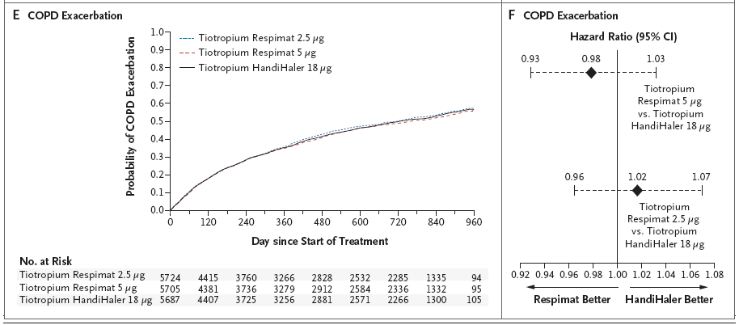
Results

Slide 15
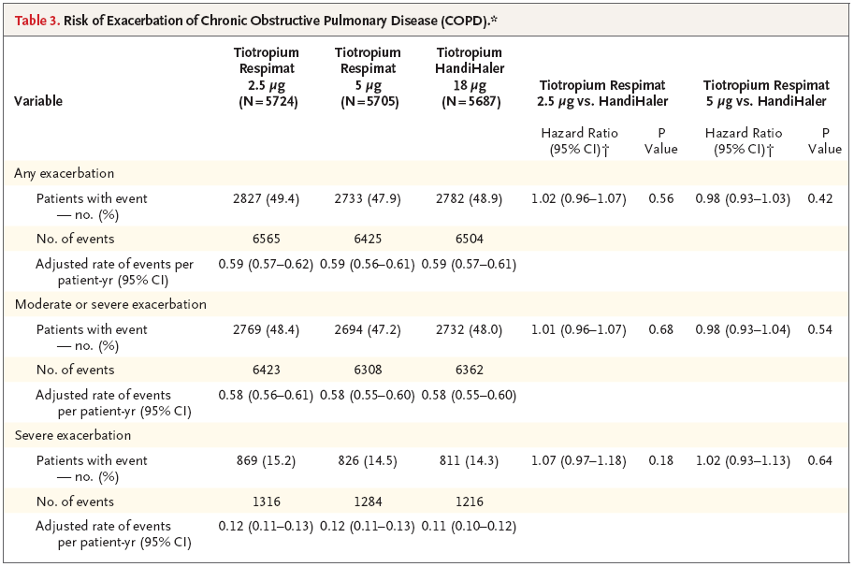

Slide 16
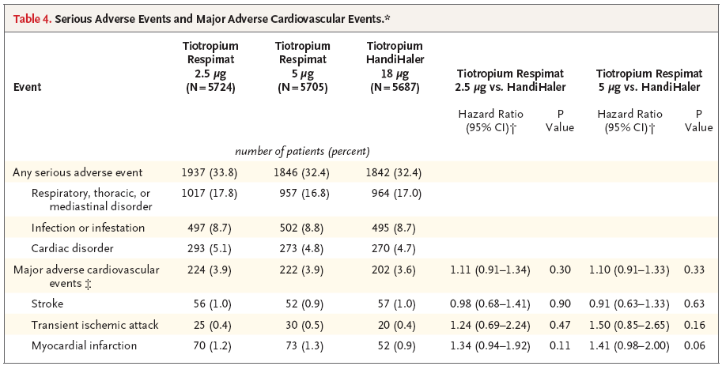
Results

Slide 17
Discussion
The UPLIFT trial
- tiotropium HandiHaler was associated with lower mortality than was placebo
The Respimat trials
- mortality with tiotropium Respimat was reported to be higher than with placebo
The TIOSPIR trial to have sufficient power to estimate the difference in mortality between tiotropium delivered by the Respimat and tiotropium delivered by an active control (the HandiHaler).
1302 patients died, as compared with 137 patients who died in the initial meta-analysis

Slide 18
Discussion
Rates of death per 100 patient-years
The pooled analysis of trials of Respimat 5 μg (with a rate of 2.64) and UPLIFT (with a rate of 3.94)
Tiotropium Respimat was not associated with higher mortality than tiotropium HandiHaler among patients with previous cardiac disease, including stable arrhythmias at baseline
Placebo-controlled trials of bronchodilators in COPD, early discontinuation in the placebo group may bias results
- lower overall than rates in the UPLIFT and TORCH studies

Slide 19
Discussion
Strengths
- a large study with more than 34,000 patient-years of exposure to tiotropium and was powered to precisely estimate rates of death and exacerbations
- enrolled a substantial number of patients with a history of cardiac disorders (1825 patients with cardiac arrhythmia and 3152 with ischemic heart disease, coronary artery disease, or heart failure).
Limitations
- the absence of a placebo group
- Excluded patients with unstable cardiovascular conditions(myocardial infarction within the previous 6 months, hospitalization for class III or IV heart failure, or unstable or life-threatening arrhythmia)

Slide 20
Discussion
The results from this large-scale trial support the need for caution when interpreting safety outcomes from meta-analyses of small data sets and observational studies
Tiotropium at a dose of 5 μg or 2.5 μg, delivered by the Respimat inhaler, had a safety profile and exacerbation efficacy similar to those of tiotropium at a dose of 18 μg delivered by the HandiHaler device.

