Slide 1
Association of diabetes and tuberculosis: impact on treatment and post-treatment outcomes
María Eugenia Jiménez-Corona, Luis Pablo Cruz-Hervert, Lourdes García-García,
Leticia Ferreyra-Reyes, Guadalupe Delgado-Sánchez, Miriam Bobadilla-del-Valle,
Sergio Canizales-Quintero,2 Elizabeth Ferreira-Guerrero, Renata Báez-Saldaña,
Norma Téllez-Vázquez, Rogelio Montero-Campos, Norma Mongua-Rodriguez,
Rosa Areli Martínez-Gamboa, José Sifuentes-Osornio, Alfredo Ponce-de-León
Thorax 2013;68:214–220
R3 주영수

Slide 2
Introduction
  Diabete mellitus is global endemic disease and Low- and middle-income countries where 80% of all deaths from DM occur
  The risk of TB among people whti DM is three times higher than in people without DM
  WHO and the International Union Against TB and Lung Disease (Union)
    Acknowledged the need for international guidelines on the joint management and control of TB and DM
    Published a provisional collaborative framework for the care and control of both diseases.
Notes:
WHO는 당뇨를 global endemic disease로 분류 하였으며 저,중산국가에서 전체 사망에서의 80%가 DM으로 부터 나타난다고 밝혔으며
TB는 전 세계적으로 유병은 감소추세이지만 지속적인 주요사망원인이 되고 있으며
당뇨가 없는 사람보다 당뇨를 가진사람이 3배정도 TB감염의 위험이 높음이 선행연구에서 밝혀진 바 있습니다.
최근 WHO와 international union against TB and lung disease에서는 TB와 DM을 함께 manage하는 국제적인 가이드라인이 필요함을 공표하였고
이에대한 개괄적 협조체계를 발표한 바 있습니다.

Slide 3
Introduction
In this study
  Describe the clinical manifestations and treatment and post-treatment outcomes in patients with DM and bacteriologically confirmed pulmonary TB compared with TB patients without this diagnosis.
Notes:
본 연구에서는 DM이 없는 환자와 비교하여 DM이 있고 폐결핵이 확인된 환자에서의 임상양상및 치료및 치료이후의 결과에 대하여
서술한 연구입니다.

Slide 4
Methods-Population and enrolment
  Between March 1995 and April 2010
  12 municipalities in the Orizaba Health Jurisdiction in Veracruz State, Mexico
  Aged > 15 years, coughing for >15 days
  Consenting pts with AFB or M. tubercuosis in sputum samples recruited over 15 years and underwent epidermiological, clinical, microbiological and molecular evaluation
Notes:
1995년 3월부터 2010년 4월사이에 12개의 멕시코 베라크루즈주의 오리자바 보건관할구역의 12개 자치구를 대상으로 하였고
15세 이상의 15일 이상의 기침을 하는환자에서 AFB양성혹은 배양양성인 환자를 enroll하여 인구학적, 임상적, 미생물학적, 분자생물학적인
연구를 시행했습니다.

Slide 5
Methods (2)
 | Microbiological evaluation methods
1995-2000 | Cultured on smear positive sputum samples
2000-2005 | Cultured on all sputum samples, both smear(-) and (+)
2005-2010 | Culture on sputum samples from all previously treated TB pts and any new patients with TB considered at high risk of having drug-resistant TB
DM Patient
  Who received a previous diagnosis from a physician
  On oral hypoglycaemic medication or Insulin administration
Notes:
미생물학적인 연구는 95년부터 2000년까지는 객담검사에서 도말양성인 경우 배양하였고 2000년부터 2005년까지는 도말에 상관없이 모두 배양하였으며
2005년부터는 이전에 치료하였던 모든 객담을 배양하였고, 약제저항성결핵의 위험이 높은 환자를 모두 배양하였습니다.
당뇨환자는 이전에 의사에게 당뇨를 진단을 받았거나, 경구혈당강하제 또는 인슐린 치료를 받는 환자라고 정의하였습니다.

Slide 6
Methods- Therapeutic regimens
 | Regimen
1995-1998 | New case : 2HRZ/4HR Retreated case : 2HRZ/4HR plus ethambutol(E) or streptomycin(S)
After 1998 | New case : 2HRZE/4HR Retreated case : 2HRZES/1HRZE/5HRE
After 2000 with MDR | Second-line standardised regime using at least four drugs highly likely to be effective for 18–24 months after culture conversion
Notes:
2000년이후 다제내성결핵에서는 효과가 있으리라 판단되는 적어도 4가지이상의 약제를 조합하여 18-24개월동안 배양음전될때까지 치료하였습니다

Slide 7
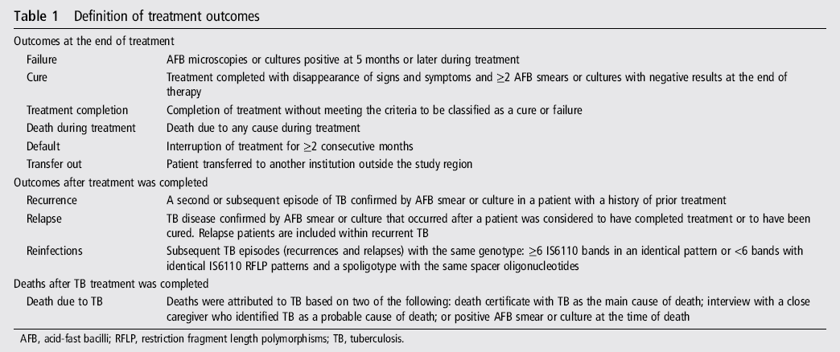
Methods
Notes:
다음은 치료 결과에대한 정의입니다
Treatment failure는 5개월이상 치료함에도 AFB or Cx positive로 정의하였고 Cure는 치료가 증상과 징후가 없으면서 2번이상 배양또는 AFB음전 으로 정의하였고 treatment completion은 cure또는 failure를 만족하지 못하였을때로 정의하였습니다.
Recurrence는 이전에 치료를 하였던적이 있는 환자에서 다시 AFB or Cx에서 TB가 확인되는경우를 말하며
Relapse는 이전에 완치판정을 받았거나 치료를 완료하였던 환자에서 AFB smear 또는 Cx에서 TB가 확인되는경우
Reinfection은 같은 genotype을 가질때 즉, 6개이상의 is6110 band가 동일한 패턴이거나 <6밴드 이하의 동일한 IS6110 RFLP패턴을가지지만 spoliotype이 같은 spacer oligonucleotide를 가질때로 정의하였습니다.
TB에의한 죽음은 다음의 2가지 이상을 만족할때인데, 사망진단서에서 사망원인이 결핵으로 되있을때, 가까운 caregiver가 사망의 원인일것이라고 말할때,
사망당시 AFB 또는 Cx에서 positibe일때라고 정의하였습니다.

Slide 8
Methods
HIV testing
  Voluntary HIV testing and coundselling offered to all participants
  All positive results were confirmed by western blot analysis
Measurement of glucose concentration
  1166 of the 1262 Pts(92.39%) in whom a serum sample obtained after the diagnosis of TB
  Diagnostic results:
    ≥126 mg/dl in fasting or ≥200 mg/dl for random samples

Slide 9
Methods – Mycobacteriology and genotyping
Isolates were genotyped and compared
using IS6110-based RFLP and spoligotyping
  if the IS6110 RFLP patterns of the isolate had <6 bands

Slide 10
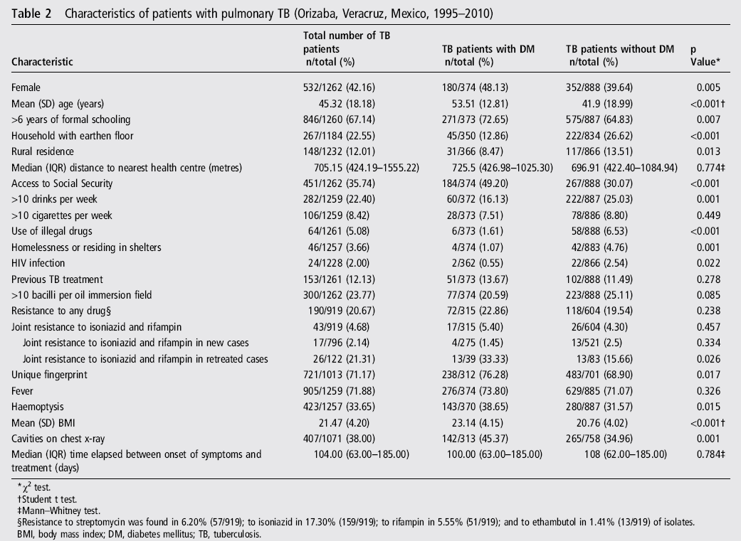
Results
Characteristics of patients with TB according to DM
Notes:
1262명의 pul tbc환자가 enrol 되었고, 29.63%(374/1262)가 TB진단받기전에 DM을 진단받았습니다.
DM환자중 female이 많고, older, higher socioeconomic level이 많았습니다.
DM이 아닌환자들이 illegal drug, alcohol use, homelessness, HIV infection이 많았다.
재치료군에서 DM환자들이 H, R모두 내성인 경우가 더 많았다.
DM 의 환자에서 reactivation이 더 많았다.
성별, 이전 치료 Hx, bacilli의 개수, drug resitance, HIV infection은 두군에서 차이 없었다

Slide 11
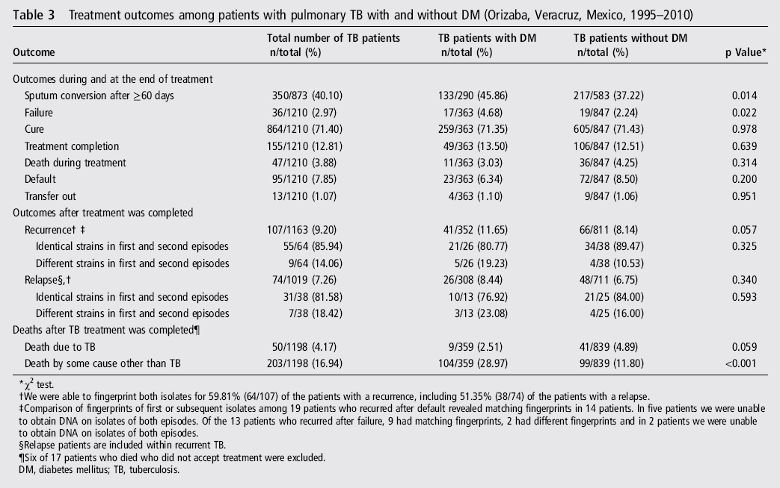
Results
Treatment outcomes
Notes:
17명은 치료 거부함
1056명의 치료를 마친 환자중 761(72.06%)의 환자가 진단 10일내에 치료 시작함
DM이 있는 환자가 delayed sputum conversion, treatment failure비율이 높음
107명의 recurrence환자중 64명의 검체를 finger printing할수 있었고 그 중 74명의 replapce환자중 38명이 포함되어 있었다
대부분의 환자는 같은 gentype을 가졌지만 5/26(19.23%)에서는 다른 strain의 재감염을 보였다.
치료종결후 12개월이내의 재발의 비율 및 다른strain의 재감염비율은 차이가 없었다.

Slide 12
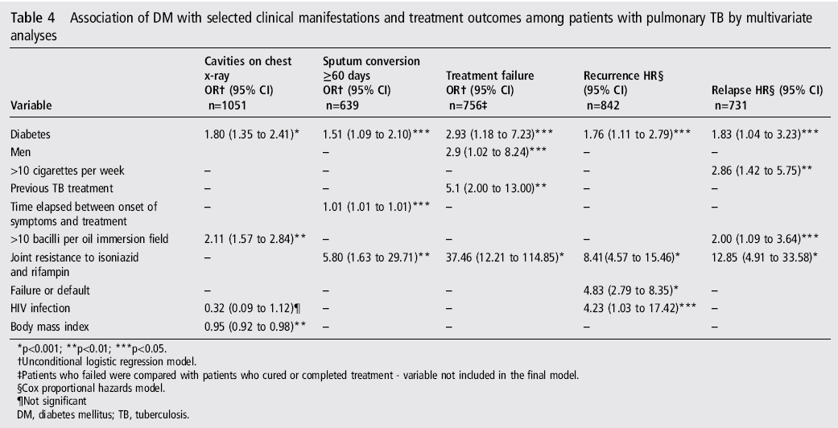
Results
Characteristics of patients with TB according to DM
Notes:
평균 f/u기간은 평균 f/u 기간은 61.7months
Recurrence및 replase의 probablity가 높다
CXR에서의 cavity, 60일 이후의 sputum conversion, treatment failure, recurrence and relapse 가 높았다.

Slide 13
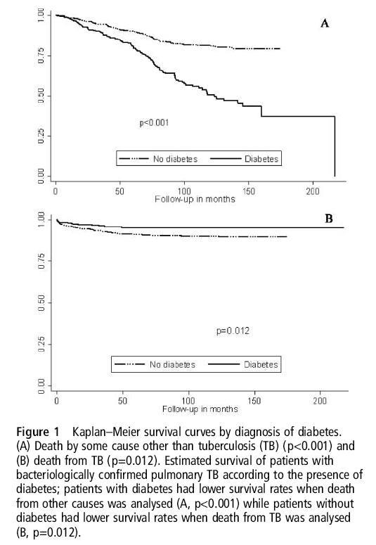
Results
Notes:
치료기간중의 TB에 의한 사망률은 비슷하였고 치료 종결후 TB 이외의 다른 원인에 의한 사망률은 DM환자군에서 높았다
DM이 없는 환자가 TB에 의한 사망률이 높았다

Slide 14
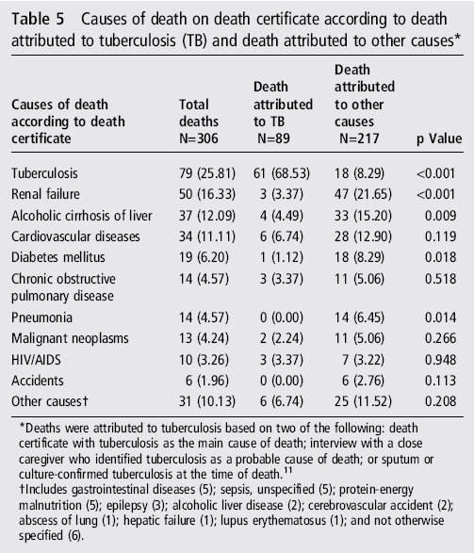
Results
Notes:
Renal failure, alcoholic cirrhosis of the liver, cardiovascular diseases and DM
main causes of death on the death certificate in those patients whose death was attributed to a cause other than TB

Slide 15
Discussion
  Patients with DM and TB have more severe clinical manifestations, delayed sputum conversion and a higher probability of treatment failure, recurrence and relapse.
  Subsequent episodes among pts with DM are due to bacteria with the same genotype or are caused by refection with bacteria a different genotype

Slide 16
Discussion
  The frequency of DM among patients with pulmonary TB observed in this study was high (29.63%) and similar to that reported among Mexican Americans18 and in other regions
  Clinical and radiological manifestations are more severe among patients with DM and TB
  Independent risk of failure as a sole outcome associated with DM in our study was 2.93 (95% CI 1.18 to 7.23), which is higher than the previously reported pooled risk associated with the combined outcome of failure and death of 1.69 (95% CI 1.36 to 2.12)

Slide 17
Discussion
  Higher independent risks of recurrence and relapse among patients with DM
  Pts with DM are more likely to have infections caused by the same bacteria as the previous episode
  Exogenous TB reinfection in patients with DM
  might be due to nosocomial TB transmission occurring as a result of attending clinics where there is a high prevalence of diagnosed and undiagnosed TB, as has been described for HIV-infected patients

Slide 18
Discussion
  Higher rates of mortality from causes other
  than TB among patients with DM
  Earlier and higher rates of non-TB-related mortality in pts with DM explains lower rates of TB-related deaths despite poor TB treatment outcomes among them

Slide 19
Discussion
Strengths
  Recruitment of patients previously diagnosed with DM
  Large sample size
  Survival analyses that controlled for relevant confounders, permitted detection of negative outcomes including replase and recurrence
  Use of molecular tools allowed to compare strains betweewn subsequent episodes in the same patient

Slide 20
Discussion
Limitations
  Significant socioeconomic differeences between with and without DM
  Does not reflect the long term evolution of DM control
    Unable to determine wheter metabolic control had any impact on clinical outcomes
  May have underestimated the real frequency of DM
    Based on self-reporting of DM diagnosis by a physician

