Slide 1


Respiratory management
of patients with brain injury
Bo Ra Yoon
Division of Pulmonology,
Department of Internal Medicine,
Yonsei University College of Medicine

Slide 2
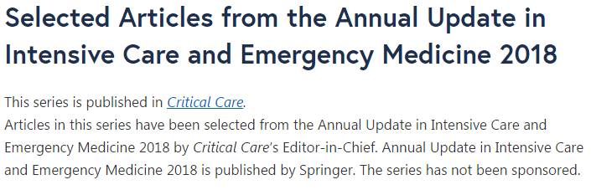
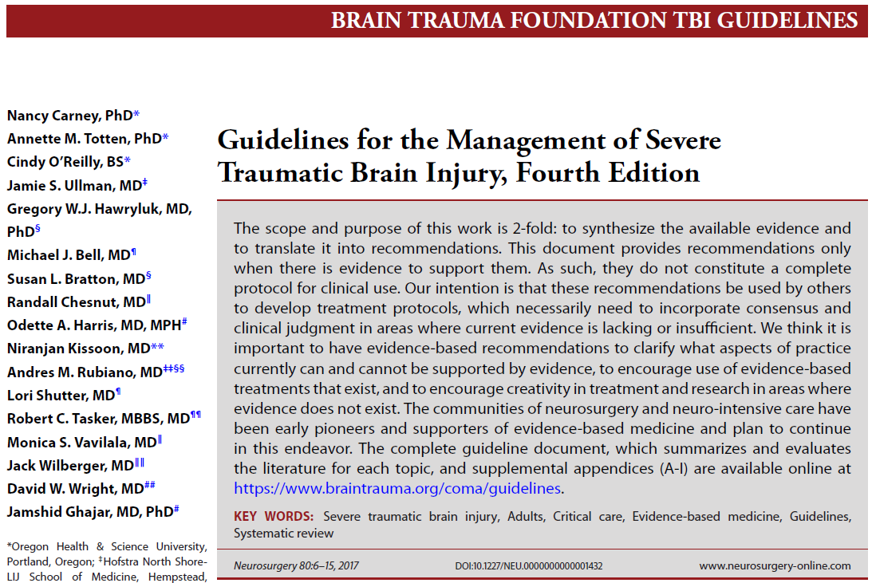
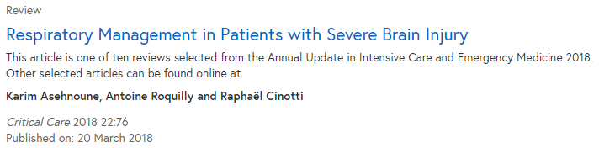

Slide 3
Introduction
Severe brain injuries, such as traumatic brain injury (TBI), ICH or stroke are a
common cause of ICU admission and mechanical ventilation initiation.
The respiratory management is further complex
because weaning these patients from mechanical ventilation and
the decision to extubate remain two challenging issues.
Recent guidelines recommend that prolonged prophylactic hyperventilation
with PCO₂ ≤25mmHg should be avoided, but the ventilator settings,
including those to set tidal volume or positive end-expiratory pressure (PEEP),
remain undetailed.

Slide 4
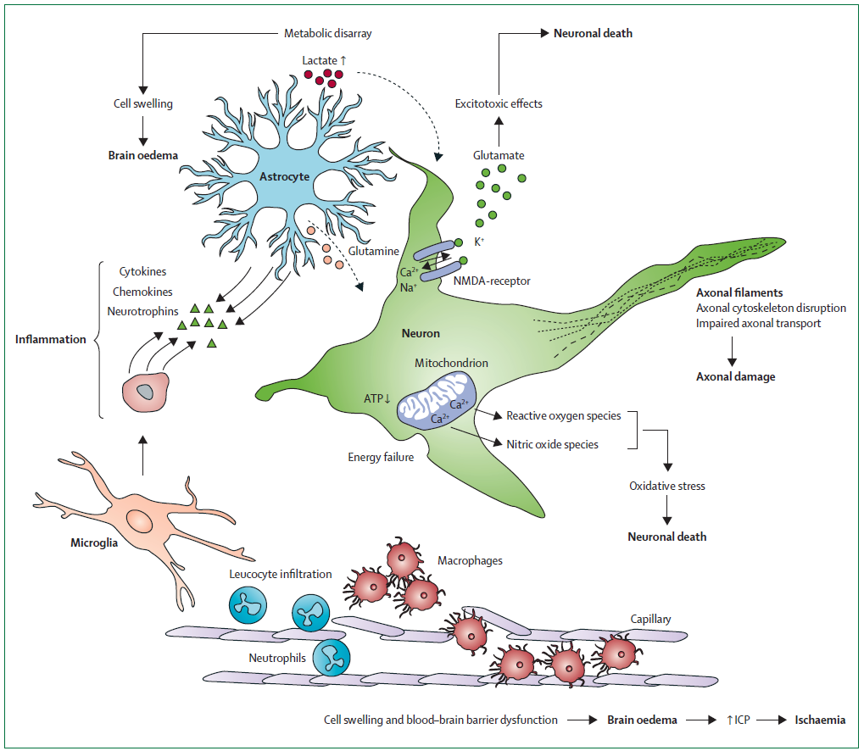
[Lancet 2012; 380: 1088–98]
Early management of severe traumatic brain injury
cell swelling + BBB dysfunction
→ brain edema, increased ICP, brain ischemia
neuron death
→ Glutamate produced excessively
→ astrocytes cannot remove glutamate
→ Glutamate binding to NMDA receptors
→ ion imbalance
→ depolarisation of the cell membrane
→ damages membrane lipids, proteins, and DNA
Hypoxemia and Hyper/Hypocapnia lead to secondary brain insults, which alter the outcome

Slide 5
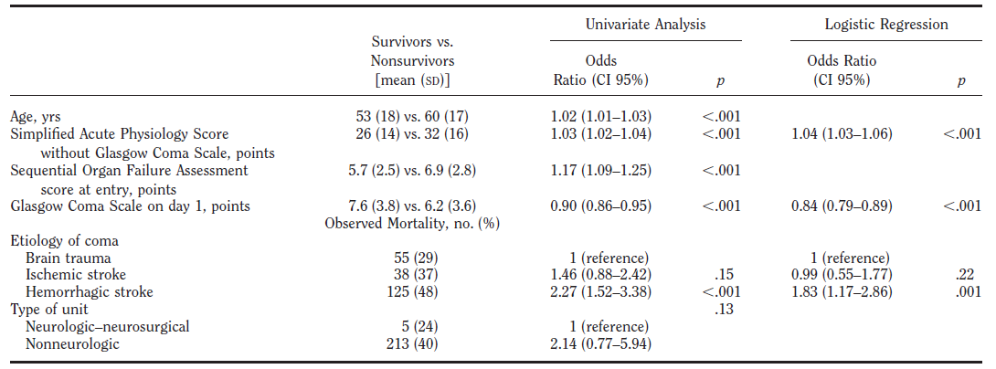
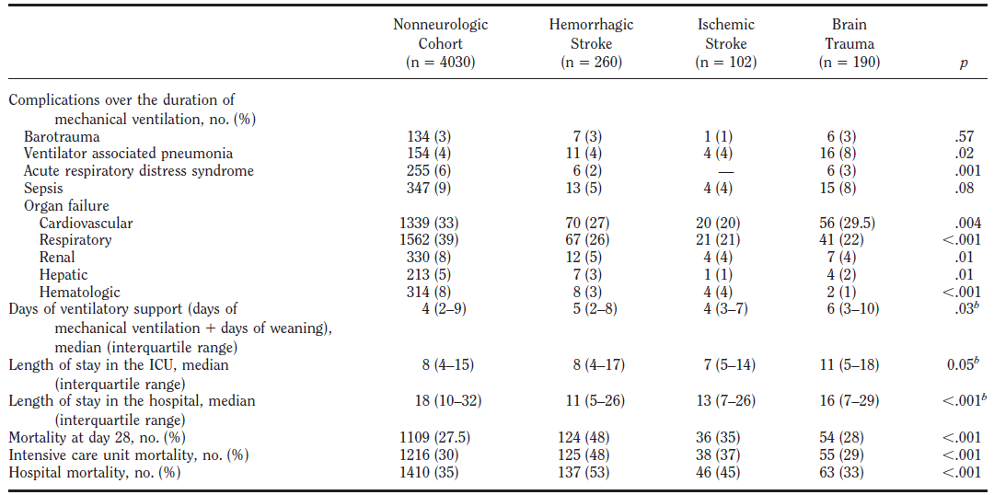
[Crit Care Med 2011 Vol. 39, No. 6]
Management and outcome of mechanically ventilated neurologic patients
Prospective, observational, and multicenter study, 349 ICUs
552 neurologic patients vs. 4,030 Non-neurologic patients
Higher mortality rate in neurologic patients despite a lower incidence of
extracerebral organ dysfunction.

Slide 6
[NEUROSURGERY Vol. 80. 1]
Guidelines for the management of severe traumatic brain
injury, 4th Edition
Mechanical ventilation is frequently applied
to protect the airway from the risk of aspiration and
to prevent both hypoxemia and hypercapnia.
Endotracheal intubation should be performed systematically
when the Glasgow Coma Score (GCS) is ≤8.
Increasing the inspired oxygen fraction (FiO2) delivery
with a target of PaO₂>60 mmHg.
An adequate control of PaCO₂ within a 32–45 mmHg range,
even at the very early Phase.

Slide 7
Tidal Volume

Slide 8
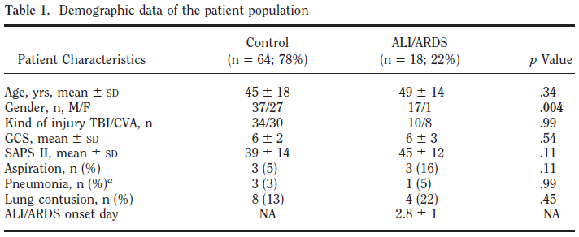
[Crit Care Med 2007 Vol. 35, No. 5]
High tidal volume is associated with the development of acute lung
injury after severe brain injury: An international observational study
Prospective multicenter observational study, 4 ICUs
86 brain injured patients, GCS score <9, studied for 8 days
** PaO₂/FIO₂ < 300 for ALI, PaO₂/FIO₂ < 200 for ARDS

Slide 9
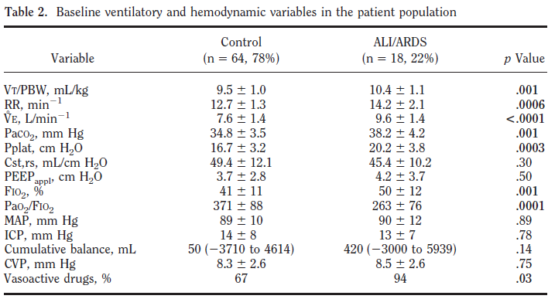
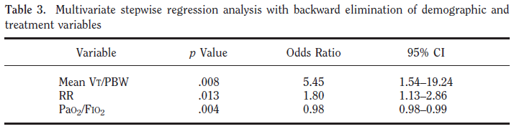
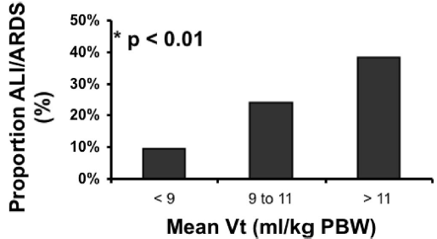
High TV and high RR are independent predictors of acute lung injury

Slide 10
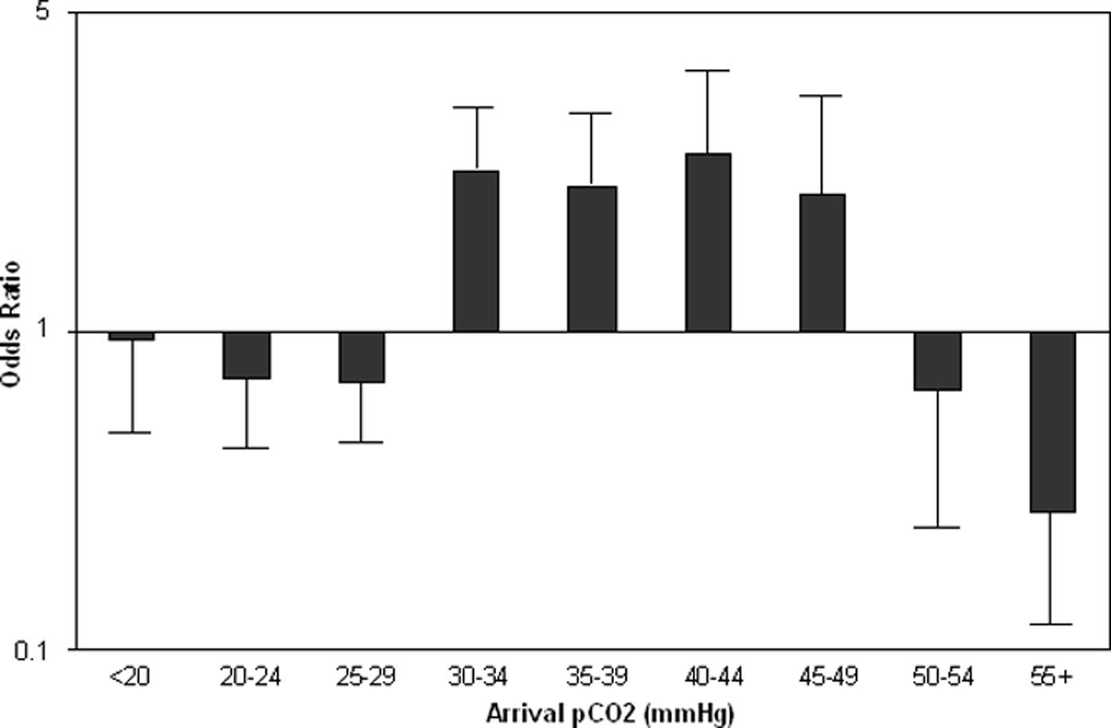
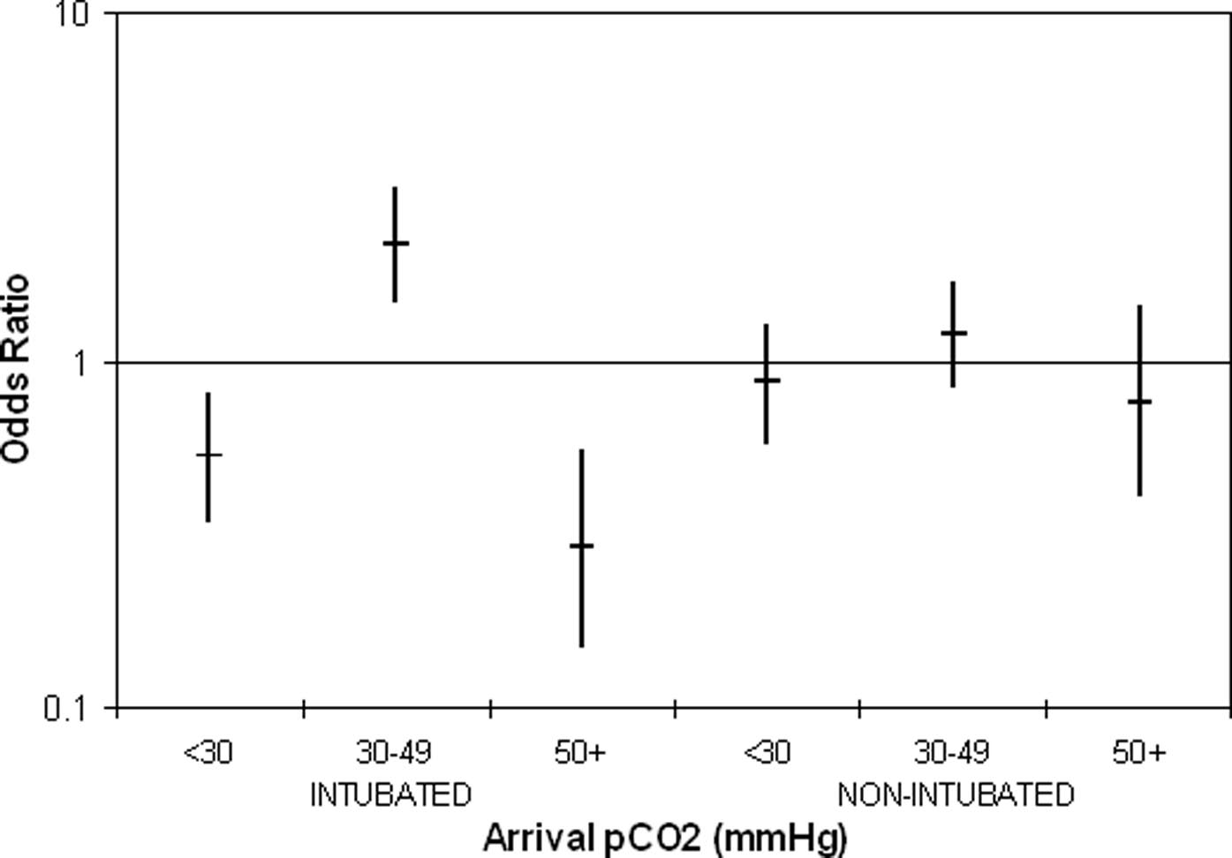
[Crit Care Med 2006 Vol. 34, No. 4]
Early ventilation and outcome in patients with moderate to severe
traumatic brain injury
Patients with arrival PCO₂ values 30–49 mmHg had improved survival and
more good outcomes

Slide 11
Positive End-expiratory Pressure

Slide 12
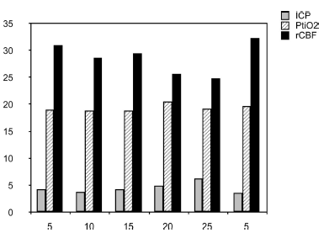
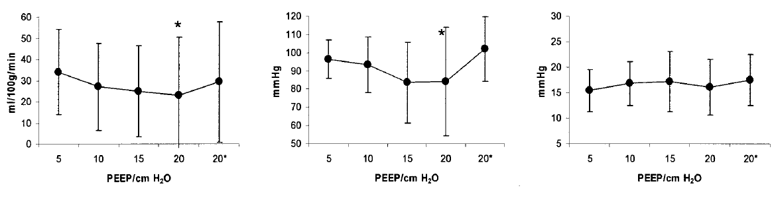
[Crit Care Med 2005 Vol. 33, No. 10]
Effects of positive end-expiratory pressure on regional cerebral blood flow, intracranial pressure, and brain tissue oxygenation
Five healthy female pigs
Through a frontal burr hole for ICP measure
high PEEP does not impair ICP or regional CBF
ICP : intracranial pressure (ICP)
PtiO₂ : brain tissue oxygen tension
rCBF : regional cerebral blood flow
CBF
MAP
ICP

Slide 13
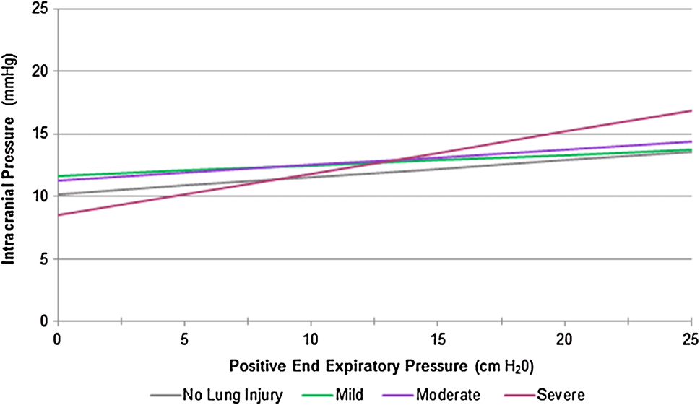
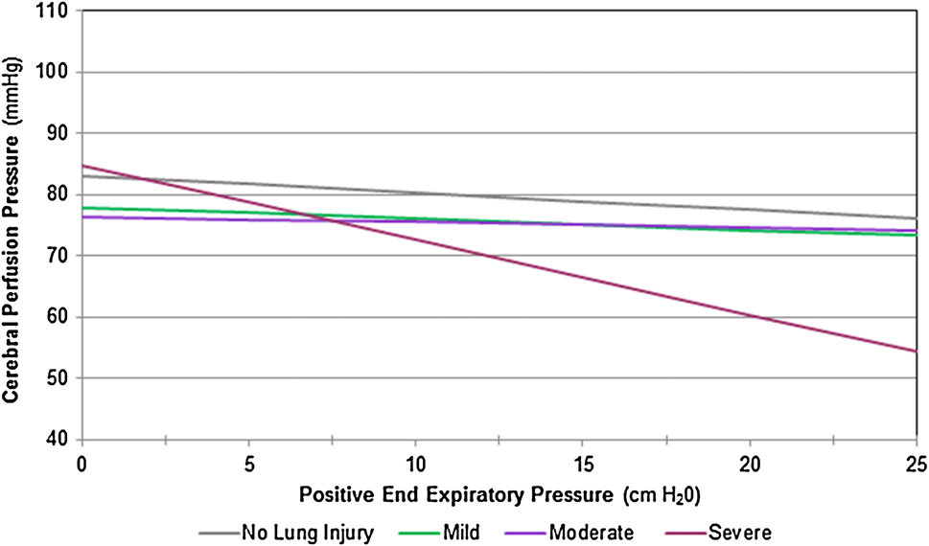
[Neurocrit Care (2017) 26:174–181]
The effect of positive end-expiratory pressure on intracranial
Pressure and Cerebral Hemodynamics
Retrospective study, between 2008 and 2015, 341 patients
The application of PEEP had no effect on either ICP or CPP
for those without severe lung injury
Mild : PaO₂/FiO₂ = 201-300 mmHg
Moderate : PaO₂/FiO₂ = 101-200 mmHg
Severe : PaO₂/FiO₂ <100 mmHg
Intracranial pressure
Cerebral perfusion pressure

Slide 14
Weaning & Extubation

Slide 15
[Am J Respir Crit Care Med Vol 161. pp 1530–1536, 2000]
Implications of extubation delay in brain-injured patients meeting
standard weaning criteria
Prospective observational cohort study
Of 136 patients,
timely (99 patients, 73%) vs. delayed (37 patients 27%)
Extubation delay was defined as the number of days
that elapsed between extubation readiness day and extubation day
minus 48 hr.

Slide 16
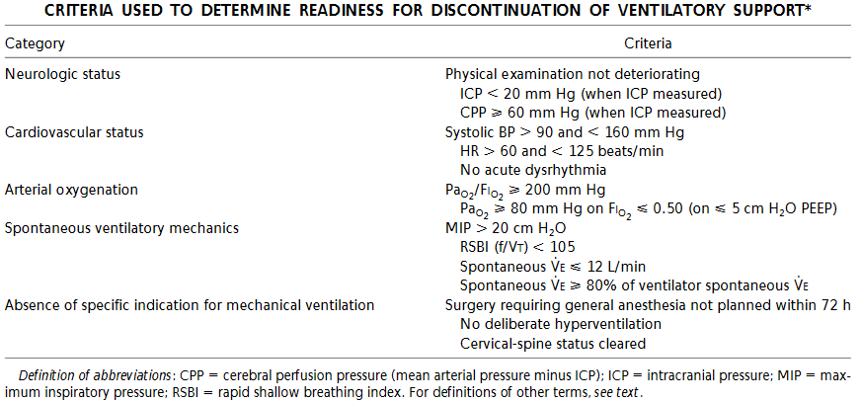
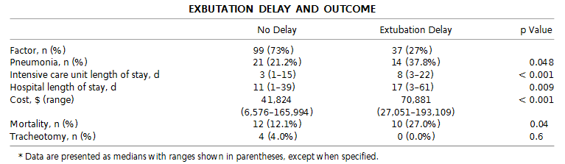
Patients with delayed extubation developed more pneumonias and had longer
ICU and hospital stays. Hospital charges were higher for extubation delay.
There was a similar reintubation rate.

Slide 17
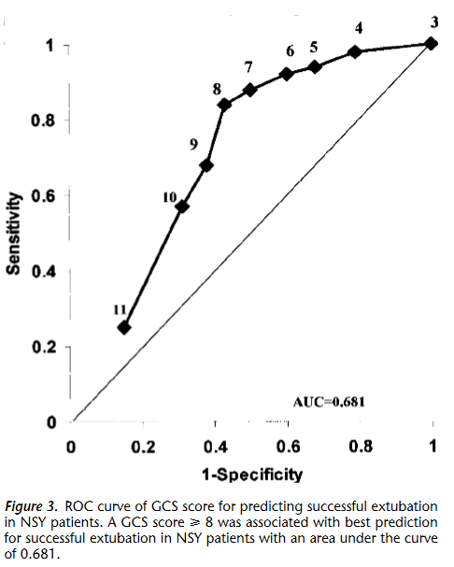
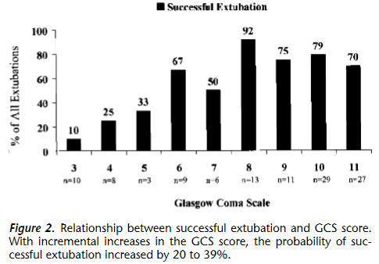
[Am J Respir Crit Care Med Vol 163. pp 658–664, 2001]
Predictors of successful extubation in neurosurgical patients
Randomized controlled trial, 100 patients
Daily screens of weaning parameters

Slide 18
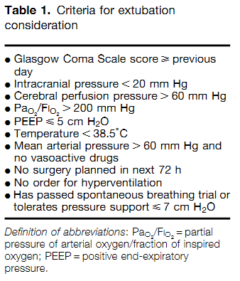
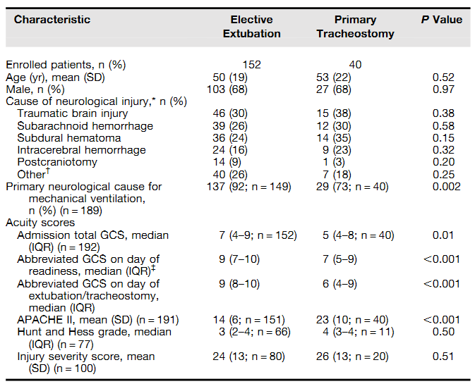
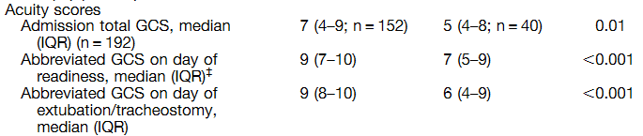
[AnnalsATS Volume 14 Number 1]
Airway management strategies for brain-injured patients meeting
standard criteria to consider extubation
Prospective multicenter observational cohort study
Of 192 patients included, 152 (79%) were extubated and 40 (21%) received
a tracheostomy without an extubation attempt

Slide 19
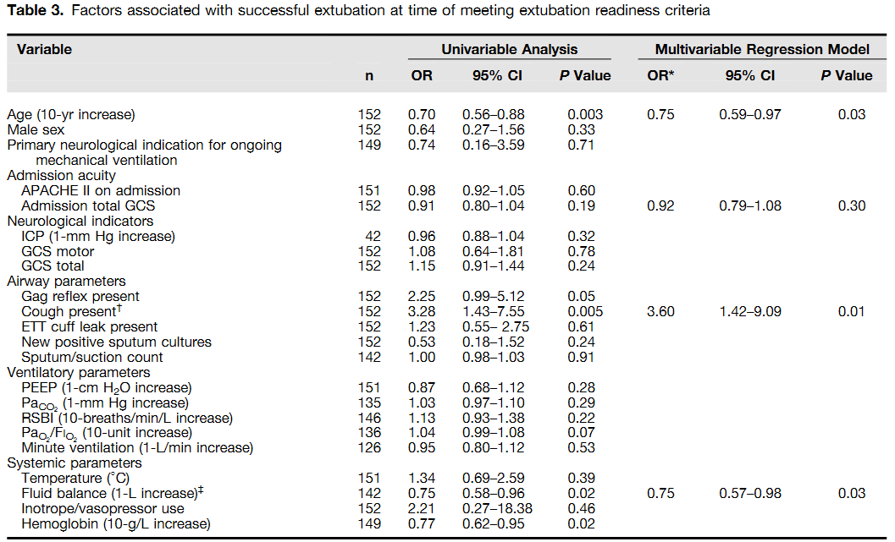
Factors associated with successful extubation were presence of cough,
fluid balance in prior 24 hours, and age.
A higher GCS score was not associated with successful extubation.

Slide 20
[Anesthesiology 2017; 127:338-46]
Extubation success prediction in a multicentric cohort of patients with severe brain injury
Prospective observational cohort study in 4 ICUs
Of the 437 patients, 338 patients (77.3%) displayed successful extubation.
The aim of the study was to create a score that could predict
extubation success.

Slide 21
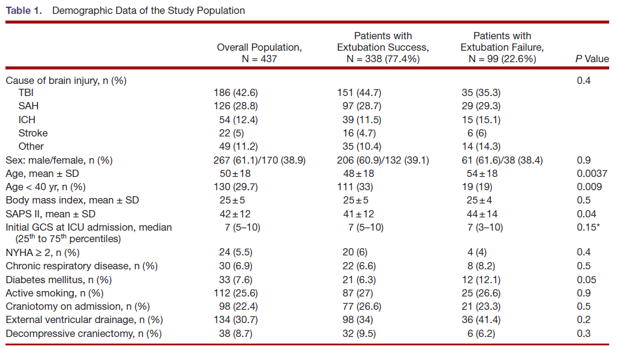
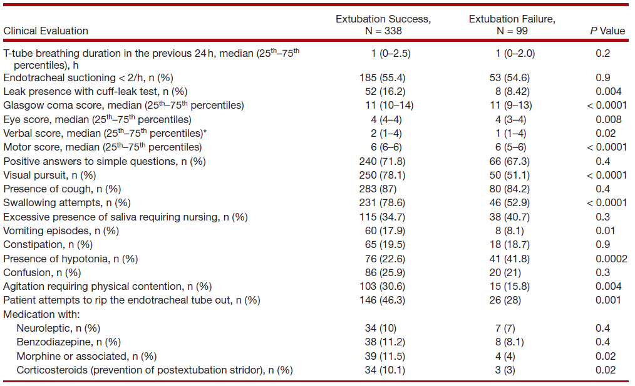

Slide 22
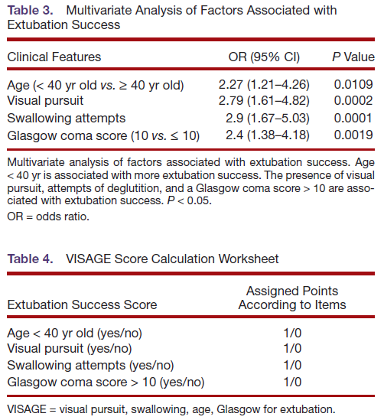
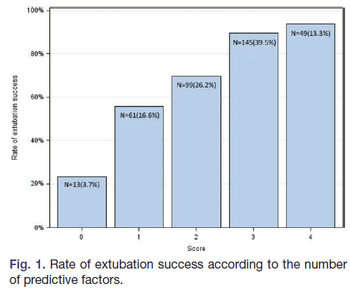
A score of 3 or greater was associated with 90% extubation success
AUC 0.75 (95% CI, 0.69 to 0.81)

Slide 23
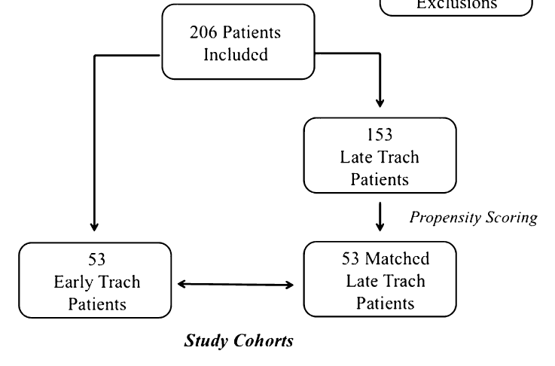
[Injury, Int. J. Care Injured 46 (2015) 110–114]
Early tracheostomy in trauma patients saves time and money
Early tracheostomy (ET) was a tracheostomy performed by the fifth hospital
day. ET patients were matched to late tracheostomy patients (LT, tracheostomy
after day 5) using propensity scoring and compared for multiple outcomes.

Slide 24
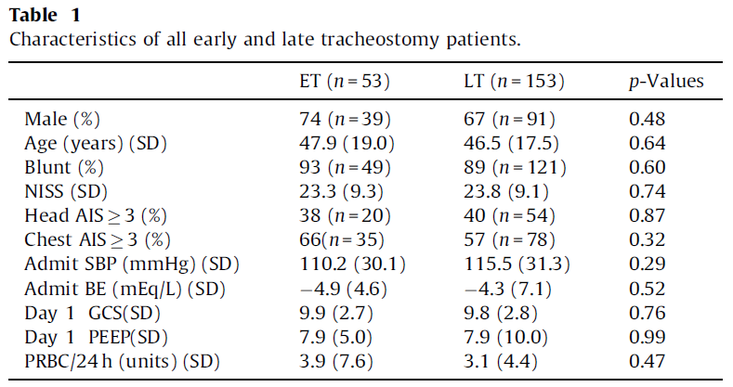
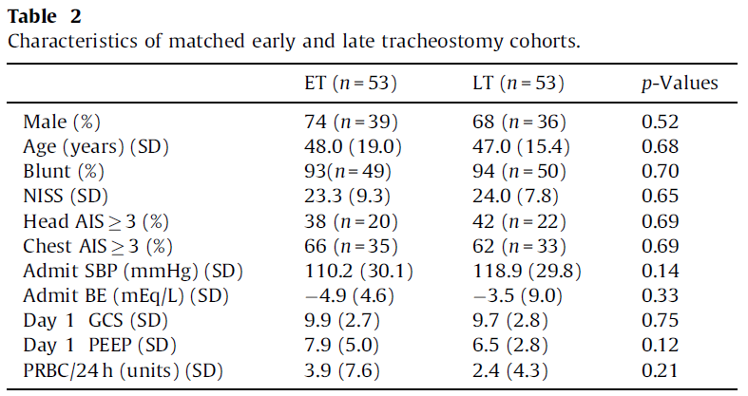

Slide 25
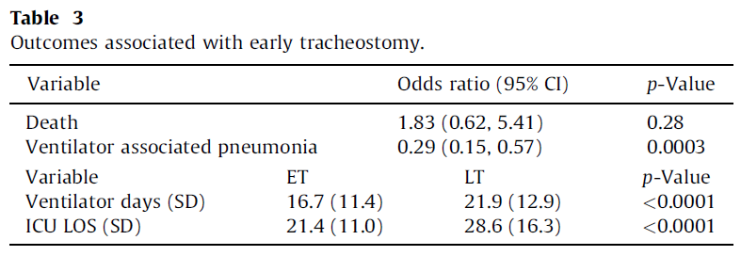
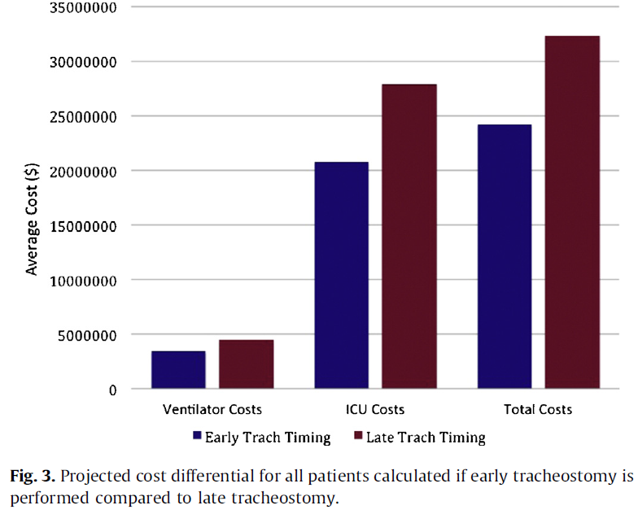
Early tracheostomy may be associated with an increase in the number of ventilator-free days,
less pneumonia, lower MV duration and ICU LOS.

Slide 26
[Lancet 2012; 380: 1088–98]
Guidelines for the management of severe traumatic brain
injury, 4th Edition
Respiratory care bundle in patients with brain injury
(1) It is now clear that PEEP has minor effects on CPP in euvolemic patients and could even
have positive consequences on brain tissue oxygenation.
(2) Protective ventilation, with low TV (6–8 ml/kg), can be safely performed.
(3) Waiting for a patient’s full neurological recovery is not mandatory and some specific
features, such as visual pursuit, cough, and deglutition, may help the attending
physician to perform extubation.
(4) Tracheostomy can be considered, but the best timing and the selection of patients who
might benefit from this strategy remain unknown.

Slide 27
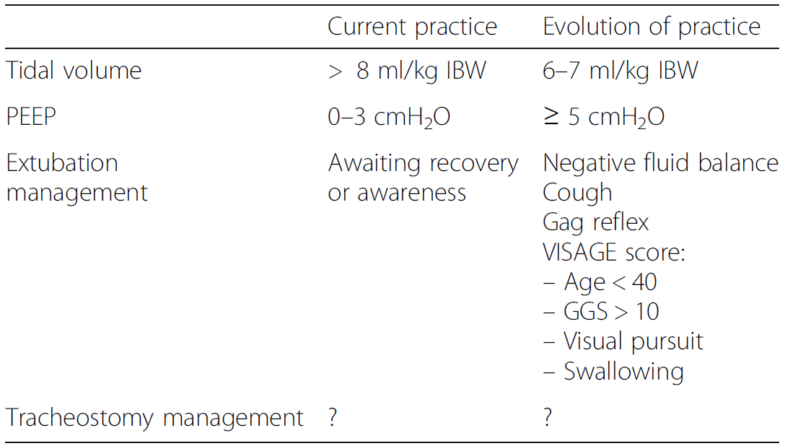
Respiratory care bundle in patients with brain injury

Slide 28

With the Love of God, Free Humankind from Disease and Suffering

