Slide 1
[Research meeting]
lung function evaluation after lung transplantation
Yoon Bora
Division of Pulmonology,
Department of Internal Medicine,
Severance Hospital,
Yonsei University College of Medicine

Slide 2
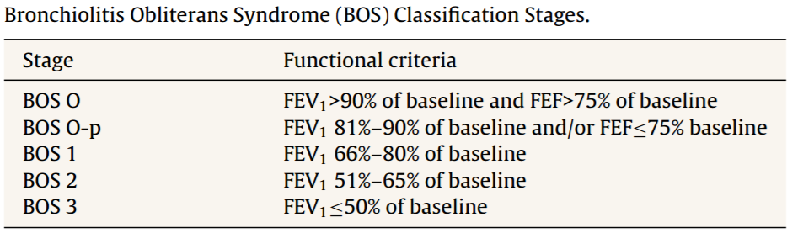
[Arch Bronconeumol. 2014;50(2):67–72]
Long-Term Follow-Up of the Lung Transplant Patient - Review
Rosalía Laporta Hernández, M. Teresa Lázaro Carrasco, Andrés Varela de Ugarte, Piedad Ussetti Gil
FEV1 figures falling by more than 20% from baseline in 2 consecutive measurements obtained in a 3–6-week interval are considered a criterion for bronchiolitis obliterans syndrome (BOS).
Small airway obstruction parameters, such FEF25%–75%, may precede a reduction of FEV1 and can be useful in the early detection of BOS.
Chronic lung allograft dysfunction (CLAD) is probably a better way of defining a chronic decline in FEV1 than BOS.

Slide 3
[Arch Bronconeumol. 2014;50(2):67–72]
Long-Term Follow-Up of the Lung Transplant Patient - Review
Rosalía Laporta Hernández, M. Teresa Lázaro Carrasco, Andrés Varela de Ugarte, Piedad Ussetti Gil
In bilateral transplant recipients, maximum post-operative pulmonary function is not affected by the underlying disease, but it is influenced by the characteristics of the graft, the recipient’s chest cavity and post-operative complications.
Between 6 and 9 months after surgery, FEV1 figures of between 75% and 85% and FVC from 66% to 92% may be achieved.
In the first months after surgery, mild restriction is observed which normalises after
the sixth month.
DLCO and gas exchange usually normalise after the third month, and exercise
tolerance increases progressively as time goes by.
Notes:
Caused by thoracotomy and disparity in volume between the graft and the thoracic capacity of the recipient.)

Slide 4
[Arch Bronconeumol. 2014;50(2):67–72]
Long-Term Follow-Up of the Lung Transplant Patient - Review
Rosalía Laporta Hernández, M. Teresa Lázaro Carrasco, Andrés Varela de Ugarte, Piedad Ussetti Gil
In unilateral transplant recipients, pulmonary function stabilises earlier, around the third month, because there is less trauma from the surgery.
In these patients, maximum pulmonary function is lower than in bilateral transplant recipients and is also affected by the characteristics of the residual native lung.
  In recipients with interstitial disease, there is a tendency for the native lung to collapse, so the graft lung expands freely into the corresponding hemithorax.
When the underlying disease is emphysema, the residual native lung tends to distend and herniate into the contralateral hemithorax, causing partial collapse of the graft

Slide 5
[Chest. 2007;132(4_MeetingAbstracts):596]
Using post-lung transplant FEV1 to predict survival in COPD patients undergoing single lung transplantation (SLT)
Luis F. Angel, MD*; Deborah J. Levine, MD; Juan F. Sanchez, MD; Scott Johnson, MD; Joel E. Michalek; Lee A. Zarzabal; Edward Sako, MD PhD; Andres Pelaez, MD; Atul Mehta, MD; John Calhoon, MD; Stephanie M. Levine, MD; Dennis Lyu, MD
Method
Multicenter data (4 transplant centers)
COPD or alpha-1-ATD patients who underwent SLT
2000.01.01 ~ 2000.12.
Primary outcome : best percentage predicted FEV1 within the first year
its effect on survival
Result
A total of 190 patients were studied (mean age 59.5±5.5 years, 50% female, mean pre-
transplant FEV1 0.6L ± 0.3L). Survival was significantly improved among those with best
predicted post-transplant FEV1 ≥ 65% at 5 years (65.1% vs 56.7%, p=0.03) and at 3
years (75.8% vs 65.3%, p=0.008).
Conclusion
Single lung transplants for COPD achieving a best FEV1 ≥ 65% within the first year post-transplant
have better long term survival rates as compared to those patients with FEV1 < 65% and comparable
to those undergoing BLT.

Slide 6
[J Thorac Dis 2016;8(11):3275-3282]
Risk factors and outcome of primary graft dysfunction after lung transplantation in Korea
Sungwoo Moon, Moo Suk Park, Jin Gu Lee, Ji Ye Jung, Young Ae Kang, Young Sam Kim, Se Kyu Kim, Joon Chang, Hyo Chae Paik, Song Yee Kim
The incidence of PGD (Primary Graft Dysfunction) is known to be 10–30% and it is the major cause of mortality within the first post-transplant year. PGD grade 3 is associated with worse clinical outcomes than other PGD grades regardless of time point. Therefore, the identification of risk factors for PGD, especially PGD grade 3, is very important for improving the outcomes of lung transplantation patients.
** 2006 ISHLT criteria (The International Society for Heart and Lung Transplantation)
Grade | PaO₂/FiO₂ | Radiographic infiltrates consistent with pulmonary edema
0 | >300 | Absent
1 | >300 | Present
2 | 200-300 | Present
3 | <200 | Present

Slide 7
[J Thorac Dis 2016;8(11):3275-3282]
Risk factors and outcome of primary graft dysfunction after lung transplantation in Korea
Sungwoo Moon, Moo Suk Park, Jin Gu Lee, Ji Ye Jung, Young Ae Kang, Young Sam Kim, Se Kyu Kim, Joon Chang, Hyo Chae Paik, Song Yee Kim
Method
retrospective study
January 2010 and March 2014
aged ≥18 years, 61 patients
underwent single or bilateral lung transplantation
Exclusion criteria
infection such as pneumonia
vascular anatomic complication
The primary outcome was the development of grade 3 PGD (PaO2/FiO2 ratio <200) at 48 or 72 hours after transplantation, and the clinical outcome after grade 3 PGD.

Slide 8
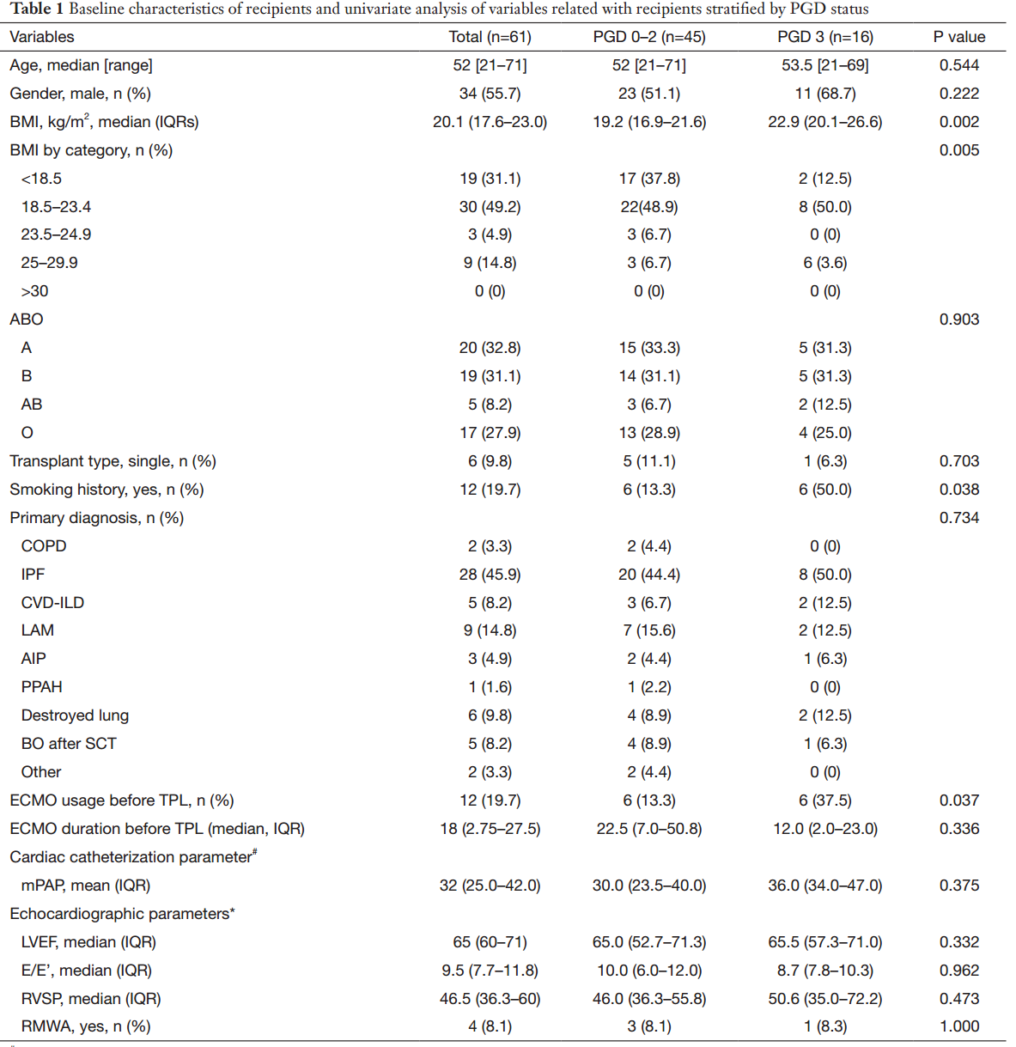
[J Thorac Dis 2016;8(11):3275-3282]
Risk factors and outcome of primary graft dysfunction after lung transplantation in Korea
Sungwoo Moon, Moo Suk Park, Jin Gu Lee, Ji Ye Jung, Young Ae Kang, Young Sam Kim, Se Kyu Kim, Joon Chang, Hyo Chae Paik, Song Yee Kim
Result
A higher BMI (median: 19.2, IQR 16.9–21.6 vs. median: 22.9, IQR 20.1–26.6, P=0.002),
any history of smoking (13.3% vs. 50.0%, P=0.038), and
ECMO use before transplantation (13.3% vs. 37.5%, P=0.037) were significantly more common in the grade 3 than in the grade 0–2 PGD group.

Slide 9
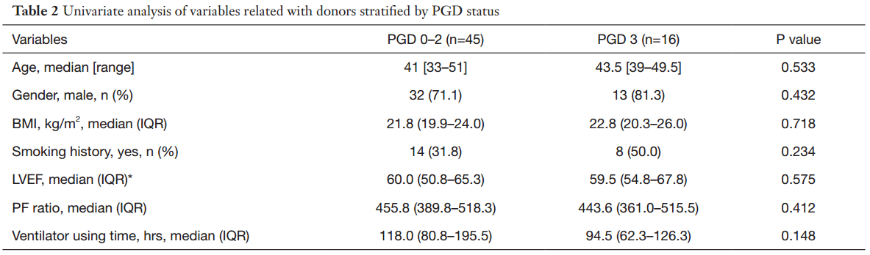
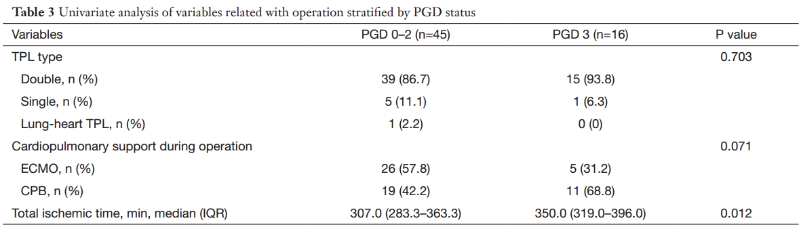
[J Thorac Dis 2016;8(11):3275-3282]
Risk factors and outcome of primary graft dysfunction after lung transplantation in Korea
Sungwoo Moon, Moo Suk Park, Jin Gu Lee, Ji Ye Jung, Young Ae Kang, Young Sam Kim, Se Kyu Kim, Joon Chang, Hyo Chae Paik, Song Yee Kim
Result

Slide 10
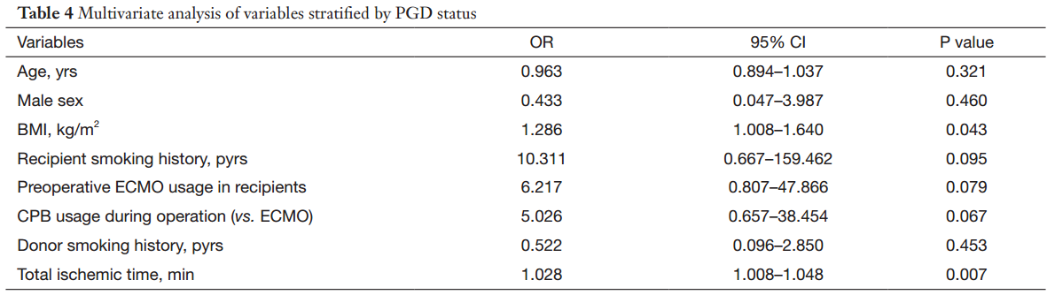
[J Thorac Dis 2016;8(11):3275-3282]
Risk factors and outcome of primary graft dysfunction after lung transplantation in Korea
Sungwoo Moon, Moo Suk Park, Jin Gu Lee, Ji Ye Jung, Young Ae Kang, Young Sam Kim, Se Kyu Kim, Joon Chang, Hyo Chae Paik, Song Yee Kim
Result

Slide 11
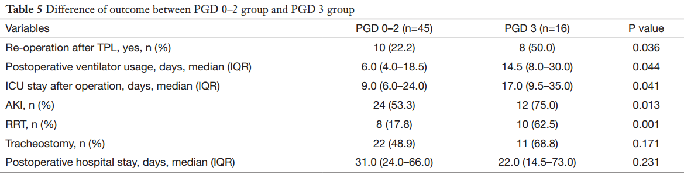
[J Thorac Dis 2016;8(11):3275-3282]
Risk factors and outcome of primary graft dysfunction after lung transplantation in Korea
Sungwoo Moon, Moo Suk Park, Jin Gu Lee, Ji Ye Jung, Young Ae Kang, Young Sam Kim, Se Kyu Kim, Joon Chang, Hyo Chae Paik, Song Yee Kim
Result

Slide 12
[CLINICS 2009;64(6):519-25]
Spirometric assessment of lung transplant patients: one year follow-up
Paulo M. Pêgo-Fernandes, Fernando Conrado Abrão, Frederico Leon Arrabal Fernandes, Marlova L. Caramori,
Marcos Naoyuki Samano, Fabio B. Jatene
Method
Retrospective review
2003.08 ~ 2006.08
39 patients (exclude 10 pts. who died within the first post op. year) 29 pts.
11pts. : Single-lung group
18pts. : Double-lung group
Sub-group analysis : Emphysema patients
5pts. : Single-lung group
4pts. : Double-lung group
The FVC and FEV1 values were analyzed as the percent of predicted value from the last test performed before transplantation. These tests were performed at 1 month, 3 months, 6 months, 9 months and one year following transplantation.

Slide 13
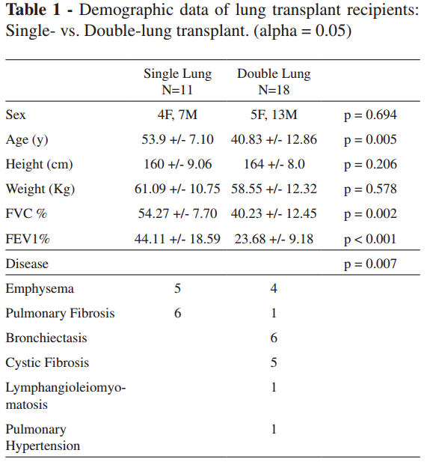
[CLINICS 2009;64(6):519-25]
Spirometric assessment of lung transplant patients: one year follow-up
Paulo M. Pêgo-Fernandes, Fernando Conrado Abrão, Frederico Leon Arrabal Fernandes, Marlova L. Caramori,
Marcos Naoyuki Samano, Fabio B. Jatene
Result
The patients who underwent double-lung transplantation had worse lung function pre-transplantation.
The single-lung transplant group contained a higher number of pulmonary fibrosis pts.

Slide 14
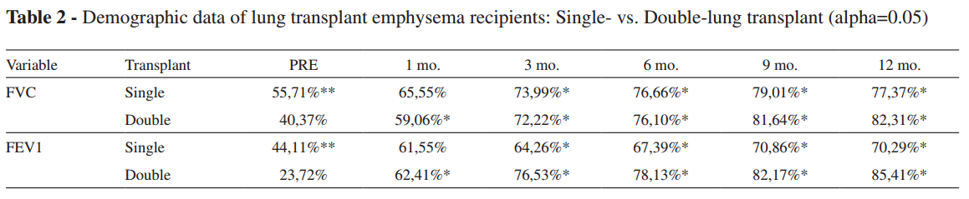
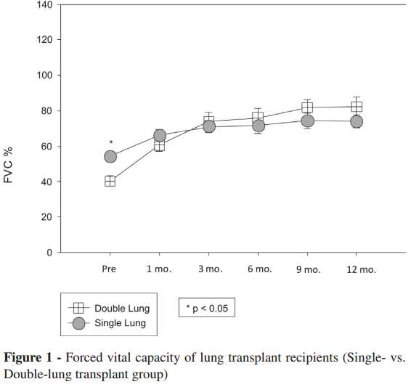
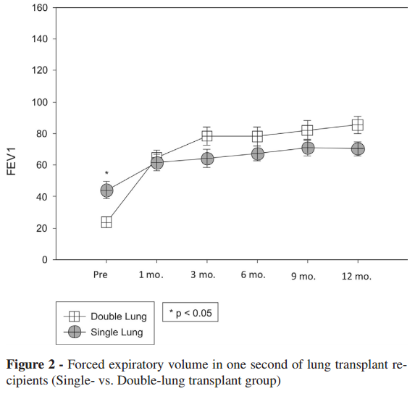
[CLINICS 2009;64(6):519-25]
Spirometric assessment of lung transplant patients: one year follow-up
Paulo M. Pêgo-Fernandes, Fernando Conrado Abrão, Frederico Leon Arrabal Fernandes, Marlova L. Caramori,
Marcos Naoyuki Samano, Fabio B. Jatene
Result
** Statistically significant difference between single and double transplant groups.
* Statistically significant difference compared to pre-transplant values.
- Single-lung group
After 3 and 6 months,
did not vary significant.
- Double-lung group
Continued to increase during
the first post-op year.

Slide 15
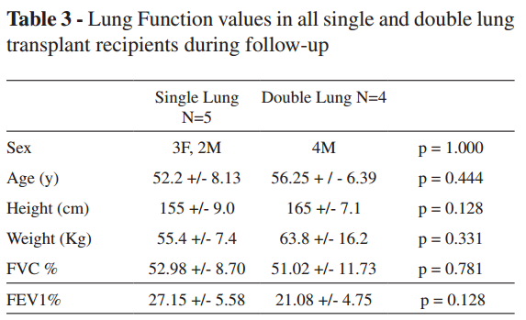
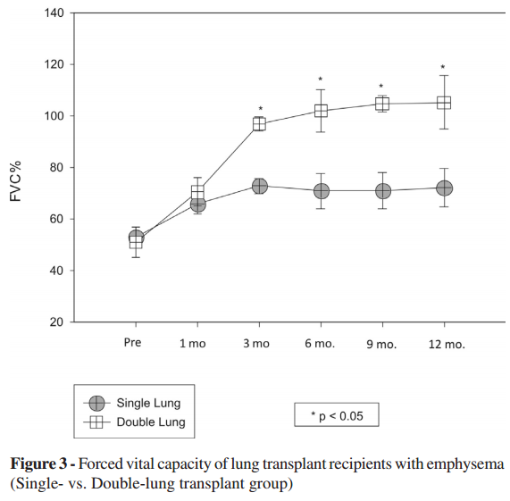
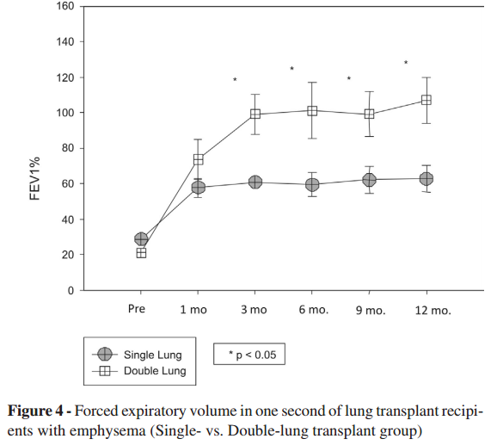
[CLINICS 2009;64(6):519-25]
Spirometric assessment of lung transplant patients: one year follow-up
Paulo M. Pêgo-Fernandes, Fernando Conrado Abrão, Frederico Leon Arrabal Fernandes, Marlova L. Caramori,
Marcos Naoyuki Samano, Fabio B. Jatene
Result
- Single-lung group
No significant variation in the FVC during the post-
transplant month (p=0.861)
FEV1 values increased from the sixth month post-
transplantation onwards (p=0.002)
- Double-lung group
Significant increases in FVC and FEV1 from the
third month post-transplantation onwards
(p<0.001 and p=0.002)

Slide 16
[CLINICS 2009;64(6):519-25]
Spirometric assessment of lung transplant patients: one year follow-up
Paulo M. Pêgo-Fernandes, Fernando Conrado Abrão, Frederico Leon Arrabal Fernandes, Marlova L. Caramori,
Marcos Naoyuki Samano, Fabio B. Jatene
Discussion
Although the pre-transplant lung function values were worse in the double-lung transplantation group, after one year of follow-up, we observed a greater improvement in FVC and FEV1 in the bilateral transplant group.
Double-lung group
FVC : 2.14 - fold increase
FEV1 : 3.75 - fold increase
Single-lung group
FVC : 1.37 - fold increase (P=0.004)
FEV1 : 1.66 - fold increase (P=0.001)

Slide 17
In Serverance …
1996.07.07 ~ 2017.05.11, 210 patients
2012.01.01 ~ 2013.12.31, 32 patients
32 patients
Post op PFT
No
11 patients
Yes
21 patients
 | Single lung T (N. 4) | Double lung T (N. 17) | P value
Age, median (range, yrs) | 58 (52, 71) | 48 (32, 66) | 0.059
Gender, man (n, %) | 2 (50) | 9 (53) | 0.921
BMI, median (IQR, kg/m²) | 22.3 (17.5, 24.3) | 18.3 (14.9, 20.3) | 0.089
MV apply, mean (SD, days) | 15.5 (±12.9) | 16.8 (±18.2) | 0.888
ECMO apply, mean (SD, days) | 2.3 (±1.7) | 6.1 (±8.8) | 0.407

Slide 18
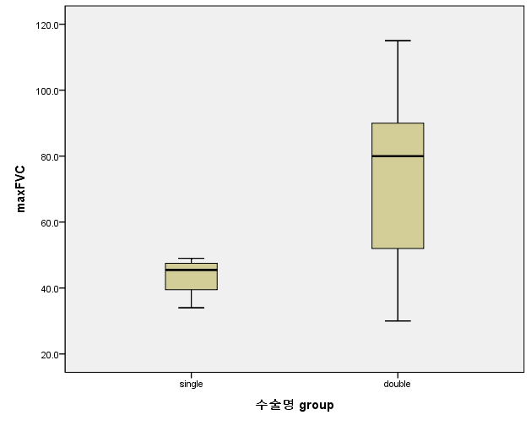
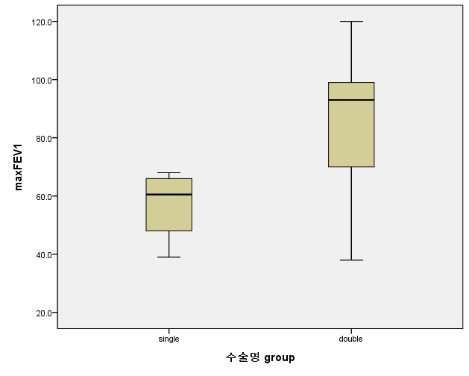
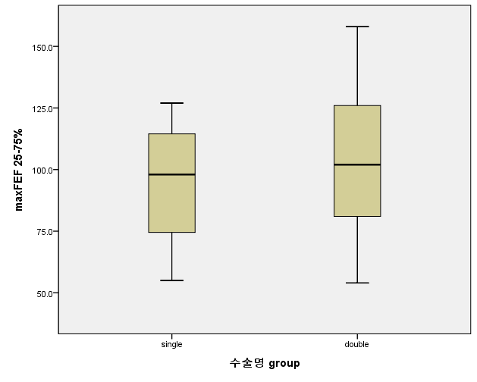
In Serverance …
Single lung T vs. Double lung T
 |  | Single lung T | Double lung T | P value
FVC | Median (IQR, %) | 45.50 (36.75, 48.25) | 80.00 (50.50, 90.00) | 0.022
FEV1 | Median (IQR, %) | 60.50 (43.50, 67.00) | 93.00 (69.00, 105.00) | 0.024
FEF 25~75% | Median (IQR, %) | 98.00 (64.75, 120.75) | 102.00 (78.50, 130.50) | 0.622
Max PFT 까지의 날짜수 | Median (range, days) | 200 (66, 722) | 486 (71, 981) | 0.152

Slide 19
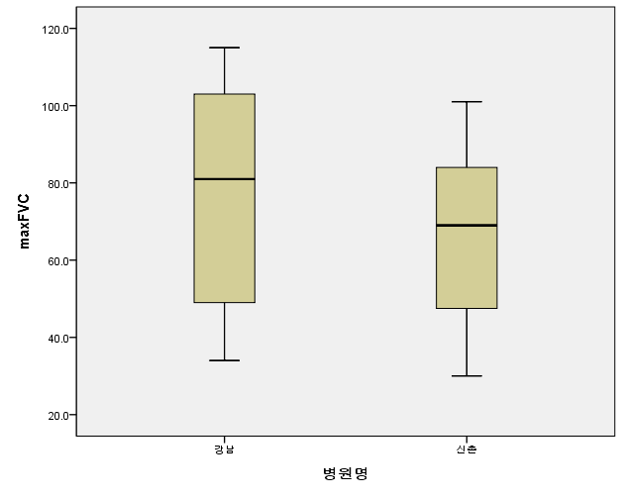
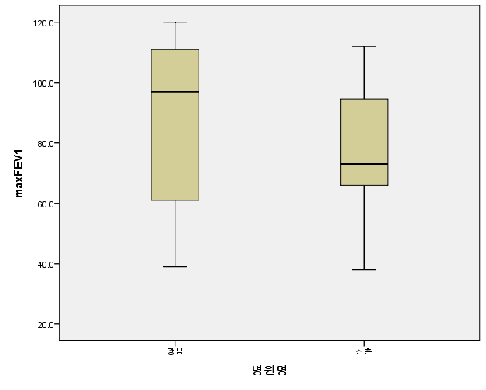
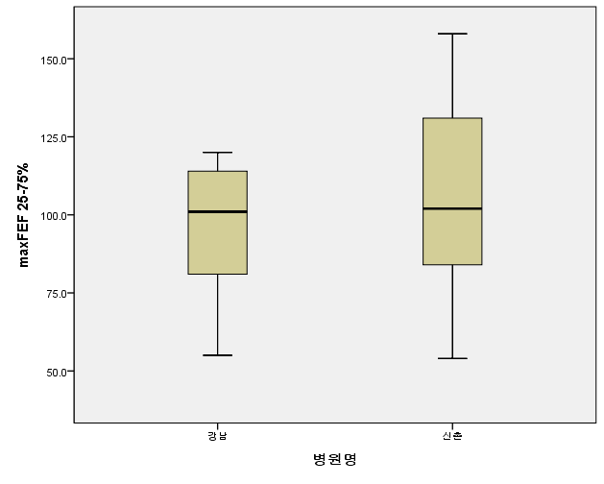
In Serverance …
강남 vs. 신촌 ??
 |  | Single lung T | Double lung T | P value
FVC | Median (IQR) | 81.00 (45.25, 106.00) | 69.00 (46.00, 86.00) | 0.370
FEV1 | Median (IQR) | 97.00 (55.5, 113.25) | 73.00 (64.00, 96.00) | 0.370
FEF 25~75% | Median (IQR) | 101.00 (74.50, 115.50) | 102.00 (76.00, 135.00) | 0.459
Max PFT 까지의 날짜수 | Median (range) | 761 (367, 981) | 321 (66, 815) | 0.008

Slide 20
In Serverance …
Further evaluation..
Donor : Sex, Ht., Wt., BMI, smoking, diagnosis, Ass. Disease (DM, CTD..) O2 supply,
TTE (RV function, systolic PAP, mean PAP, CI, CVP..)
Recipient factor : underlying disease
Operation : Cardiopulmonary bypass time, re-op, type of transplantation (S, D, H/L)
Post op : Rehabilitation, ICU stay, MV, ECMO, CRRT, infection
FOB c BAL, TBLB biopsy > rejection, infection..
6MWT, pre op LAS score (?)
Immune suppressant…
** Plan
Abstract : 6월 1일 !!!
Submission ...

Slide 21
Thank you ..

