Slide 1
Clinical outcome of difficult-to-wean patients with ventilator dependency at ICU discharge
Lee Jung Mo
Division of Pulmonology,
Department of Internal Medicine,
Institute of Chest Diseases,
Severance hospital, Yonsei University College of Medicine

Slide 2
Chronically critically ill pateints
Chronically critically ill pateints
  The patients who neither die nor recover in the ICU
Advances in intensive care medicine
  Increasing number of patients to survive an episode of Acute respiratory failure or Acute on chronic respiratory failure
  large and growing population of patients with partial or complete dependence on MV and other intensive care therapies

Slide 3
The difficult-to-wean patients
Up to 40% of patients admitted to ICUs may require mechanical ventilation
Up to 20% of patients will need a prolonged ICU length of stay due to difficult weaning
In USA
  more than 100,000 patients
  exceeding US $20 billion each year for the US health care system
  US $50 billion in 2020
Patients with prolonged weaning
  consume 37% of ICU resources

Slide 4
The difficult-to-wean patients
Definition
  ERS Task Force
    requiring more than 7 days of weaning after the first spontaneous breathing trial (SBT)
  The National Association for Medical Direction of Respiratory Care Consensus Conference
    need for more than 21 consecutive days of MV for more than 6 h / day
  Nelson et al.
    placement of a tracheotomy after at least 10 days of MV
    not expected to die or to wean from the ventilator in the immediate future

Slide 5
Causes of prolonged MV
severe acute condition over a severe chronic disease
The pathophysiologic mechanisms
  complex and multifactorial
    potentially reversible etiologies and irreversible factors
    nutrition and dietary intake-related problems and so on..
  comprehensive approach is needed.

Slide 6
Tracheostomy
Elective tracheostomy
  a point of demarcation between acute and chronic critical illness
  seems to increase in patients requiring prolonged MV
  unfavorably influence ICU survival in some studies
  association with lower ICU and in-hospital mortality rates
  Early tracheostomy ? Late tracheostomy ?
Decision to perform tracheostomy is more of an experience- than an evidence-based decision

Slide 7
Weaning success of difficult-to-wean patient
Definitions
  48 h, 7 days or 14 days without need of MV
  liberation from ventilator at the time of hospital discharge
  liberation from ventilator at 6 months–1 year after the onset of MV
Success rate : 30~53%
Average time to liberation : 16 to 37 days
  Failure to wean within 60 days persistent failure

Slide 8
Management of prolonged weaning beyond ICU
Ready for ICU discharge, in general
  acute disorder is reversed and clinical stability is achieved
Prolonged weaning patients
  dependent on the ventilator and/or tracheostomy
  need NIV for several hours a day

Slide 9
Where to treat the difficult-to-wean patient
ICUs are expensive resources and probably lacking to care for severe, acute patients.
ICU is inappropriate for prolonged weaning patients
  Quick patient turnover, high workloads for the staff, need for continuous monitoring and treatment, paucity of ICU beds
  Detrimental effect on psychological and cognitive function

Slide 10
Specialized weaning unit
Respiratory intermediate care units (RICUs) within acute care hospitals
  less costly than in a ICU
  provide multidisciplinary rehabilitation
  serve as a bridge to home care programs or long-term care facilities
Specialized regional weaning centers (WCs) within rehabilitation hospitals
  treat difficult-to-wean patients transferred from several acute care hospitals
  specialized teams (e.g., nurses, respiratory therapists, nutritionists, psychologists and speech therapists)
  lower costs
RICU and WC
  weaning success rate up to 80% (34~80%)

Slide 13
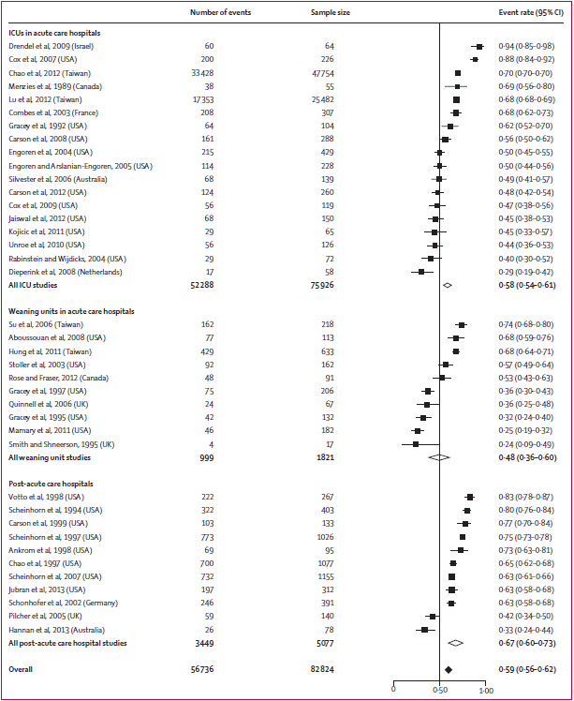
Mortality at 1 year

Slide 14
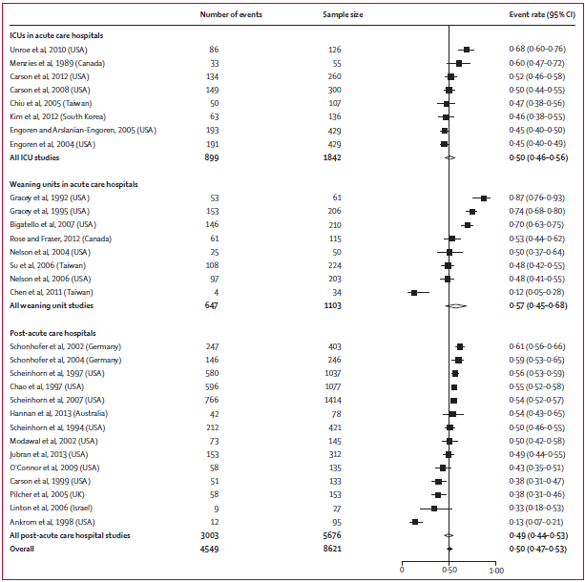
Proportion of patients successfully liberated from ventilatior

Slide 15
Clinical outcome of difficult-to-wean patients with ventilator dependency at ICU discharge
Lee Jung Mo
Division of Pulmonology,
Department of Internal Medicine,
Institute of Chest Diseases,
Severance hospital, Yonsei University College of Medicine

Slide 16
Flow chart of the enrollment of patients
Patient starting HMV in medical ICU
N = 84
Mortality in medical ICU
N = 12
Patient starting HMV, survived and discharge from ICU
N = 72
Weaning success
N = 33
Weaning failure
N = 39
Notes:
Flow chart

Slide 17
Baseline characteristics | Total | Weaning success | Weaning failure
 | (n = 72) | (n = 33) | (n = 39) | P-value
Age (years) | 64.0 (50.3-72.8) | 64.0(43.0-75.0) | 64.0(52.0-68.0) | P = 0.799
Men, n (%) | 47 (65.3) | 21(63.6) | 26(66.7) | P = 0.789
APACHE II score (ICU admission) | 22.0(16.0-27.0) | 20.0(15.5-24.5) | 24.0(17.0-29.0) | P = 0.022
Charlson comorbidity index | 1.0(0.0-3.8) | 2.0(0.0-4.0) | 1.0(0.0-3.0) | P = 0.520
Albumin level at HMV (g/dL) | 2.6(2.3-2.8) | 2.7(2.4-2.9) | 2.6(2.2-2.8) | P = 0.250
Hemoglobin level at HMV (g/dL) | 9.3(8.7-10.4) | 9.7(8.9-10.5) | 9.1(8.3-10.2) | P = 0.099
Duration to HMV initiation (days) | 22.5(12.0-38.8) | 23.0(13.5-36.0) | 21.0(10.0-41.0) | P = 0.941
Length of stay in ICU (days) | 26.0(14.0-54.8) | 26.0(16.5-39.0) | 26.0(13.0-58.0) | P = 0.747
Length of stay in hospital (days) | 105.5(60.8-165.0) | 116(78.5-170.5) | 80.0(34.0-165.0) | P = 0.094
In-hospital mortality rate (%) | 9(12.5) | 0(0.0) | 9(23.1) | P = 0.003
3 months survival rate (%) | 57 (82.5) | 27(96.4) | 20(69.0) | P = 0.012
6 months survival rate (%) | 54 (72.2) | 21(84.0) | 18(62.1) | P = 0.073

Slide 18
Further evaluations..
Comorbid conditions, causes of ICU admission ..
The predictive factors for weaning success
ROC curve of variables for predicting weaning success

