Slide 1
Nutritional Assessment - Mortality and Morbidity in Lung Transplantation Patients
Chi-Young Kim
Division of Pulmonology, Department of Internal Medicine,
Institute of Chest Diseases, Severance Hospital,
Yonsei University College of Medicine

Slide 2
Introduction
Selection of patients for nutritional support
-To decrease mortality and morbidity related to
Malnutrition
-To provide nutrition support only to those
Patients in whom the benefits will exceed risks.

Slide 3
Traditional Indicators Of Nutritional Status
Body Composition
  Body weight
  Anthropometry
  Urinary cratenine excretion
Plasma Proteins
  Albumin
  Prealbumin
  Retinol-binding protein
  Tranferrin

Slide 4
Traditional Indicators Of Nutritional Status
Immune System Function
  Total lymphocyte count
  Delayed cutaneous hypersensitivity
Multivariate Analyses
-Malnutrition Universal Screening Tool (MUST)
-Nutritional Risk Screening (NRS 2002)
-Mini Nutritional Assessment (MNA)
-Short Nutritional Assessment Questionnaire (SNAQ)
-Malnutrition Screening Tool (MST)
-Subjective Global Assessment (SGA)

Slide 5
Body Composition
Body weight:
- 10% or greater unintentional loss in body weight
- <70% of Ideal body weight (IBW)
Anthropometry:
- Triceps and subscapular skin fold thicknesses
- provides an index of body fat and muscle mass
urinary creatinine excretion:
- Assessment of body muscle mass
Notes:
Anthropometry - markedly abnormal values (below the fifth percentile) usually predict a poor clinical outcome.

Slide 6
Plasma Proteins
Albumin (< 2.1g/dl )
-correlate with clinical outcome
-increased incidence of medical complications
-Other causes of Hypoalbuminemia
Inflammation and injury
Losses through the gut or kidney
Losses from surface tissues.
Transferrin ( < 100 mg/dl )

Slide 7
Immune system function
- total lymphocyte count (< 800/mm³ )
  - delayed cutaneous hypersensitivity
Quantify Lean Muscle Mass: CT Scan
- common research tool
- measures tissue mass and changes
Notes:
Associated with a poor clinical outcome.

Slide 8
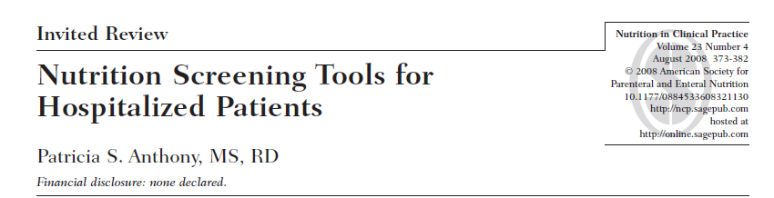
Malnutrition Universal Screening Tool (MUST)
Nutritional Risk Screening (NRS 2002)
Mini Nutritional Assessment (MNA)
Short Nutritional Assessment Questionnaire (SNAQ)
Malnutrition Screening Tool (MST)
Subjective Global Assessment (SGA)
Anthony NCP 2008
Notes:
IF 2.4 Nutrition in Clinical Practice에 2008

Slide 9
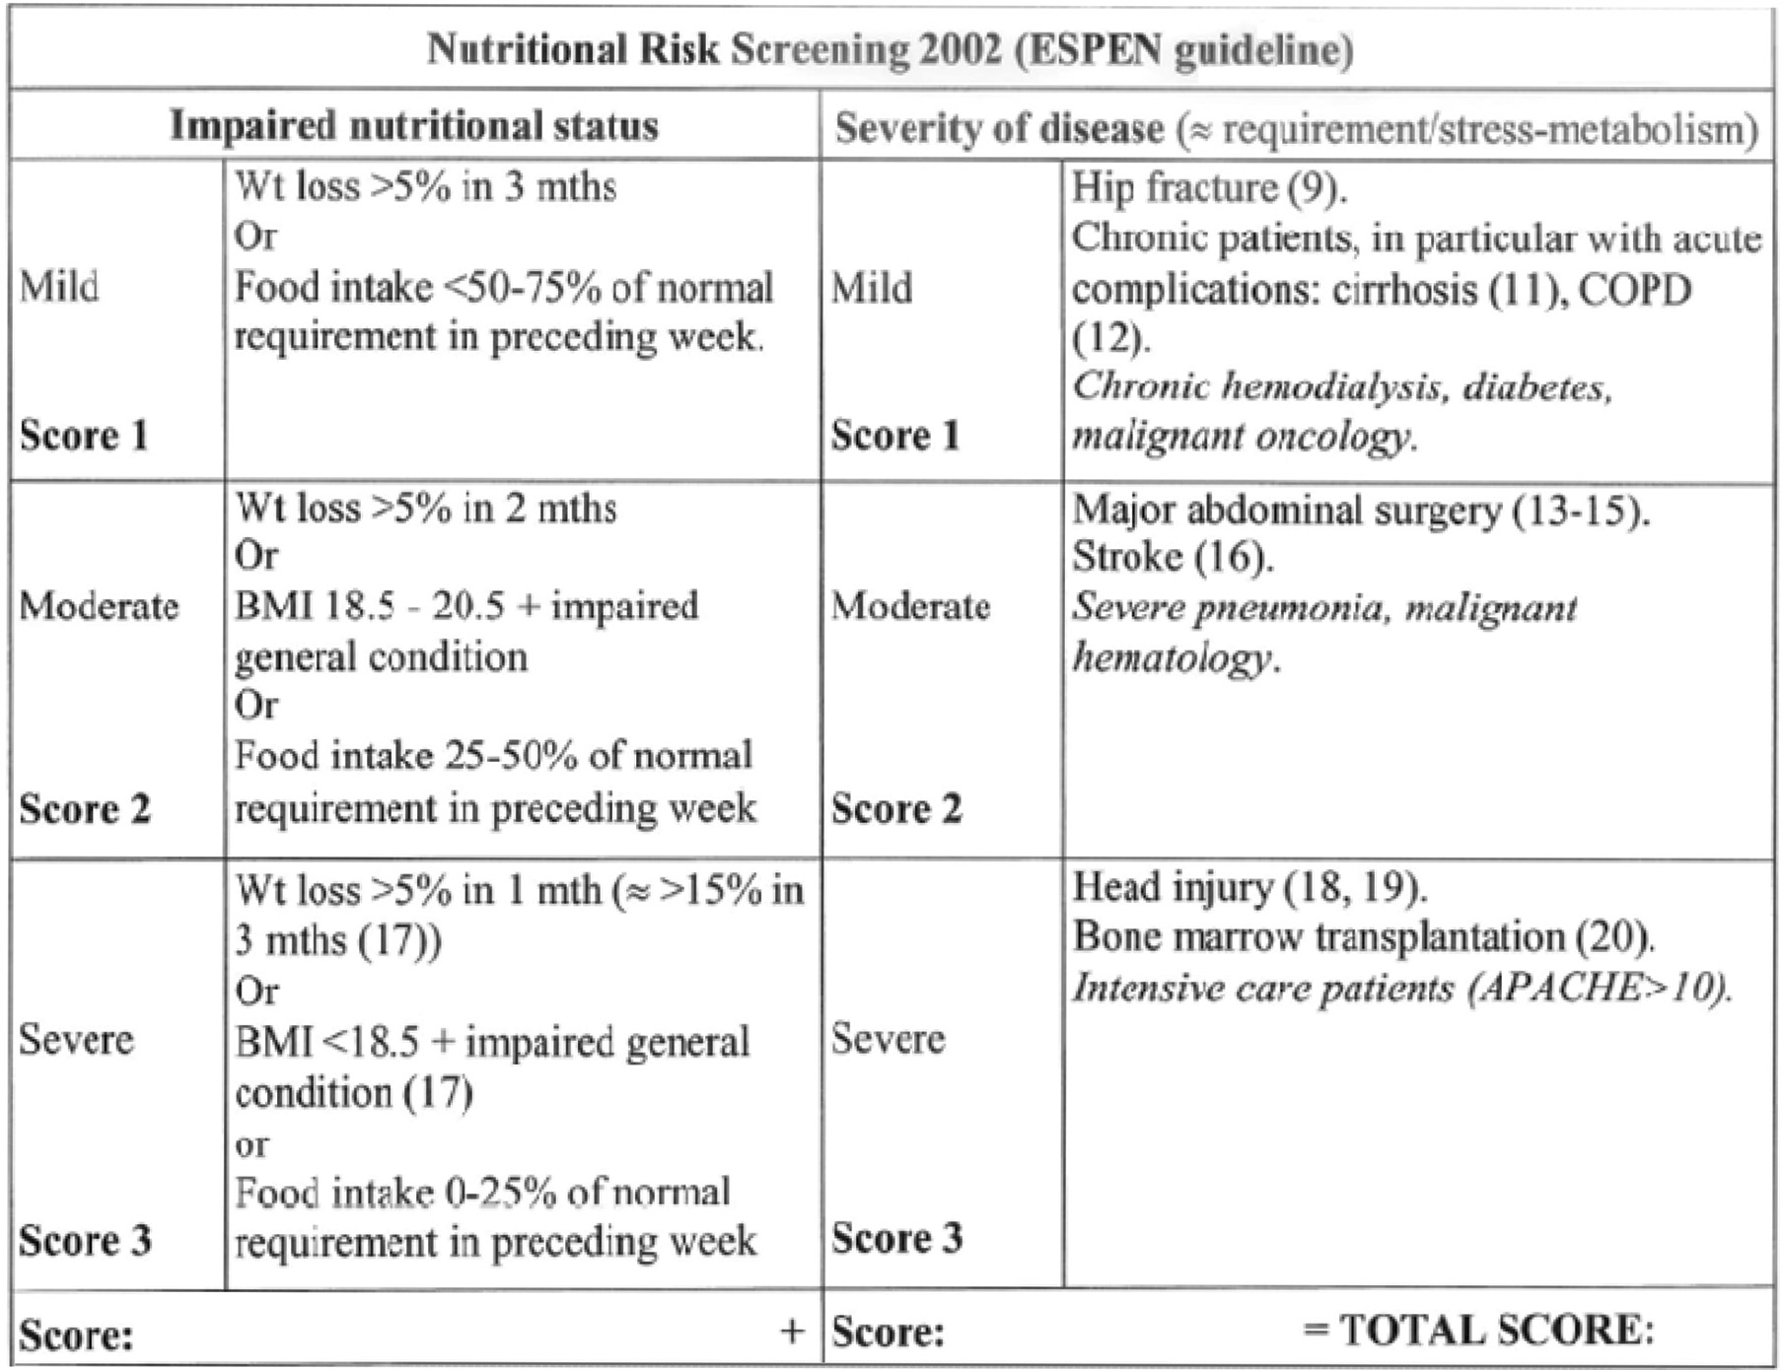
Notes:
ESPEN guideline

Slide 10
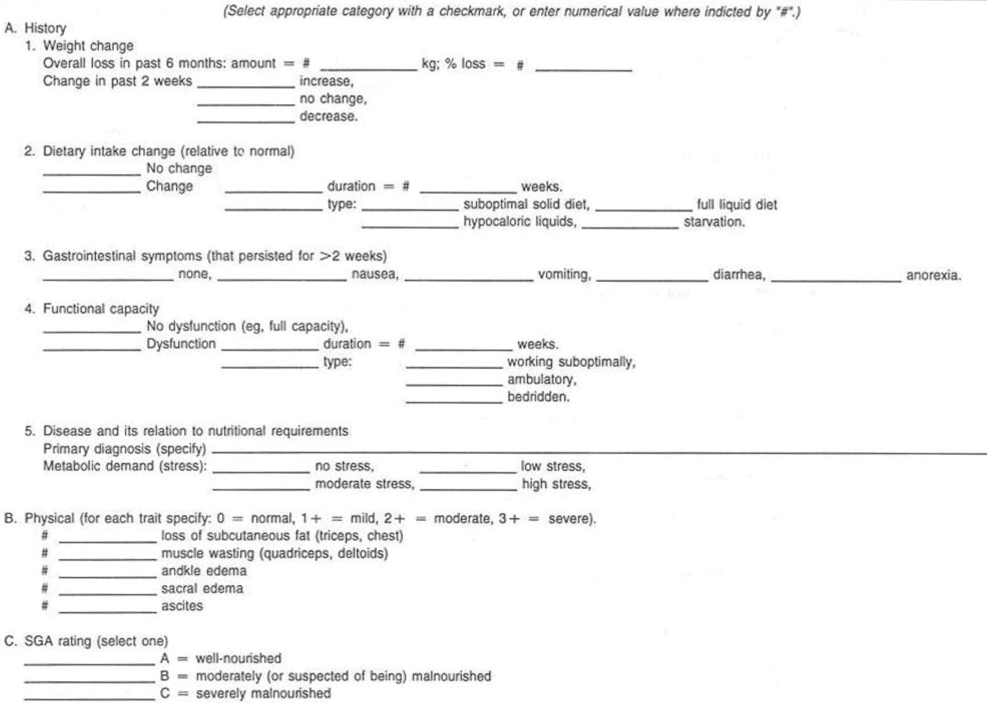
Subjective Global Assessment

Slide 11
Other multivariate Analyses
Prognostic nutritional index
  - 2 variable : serum albumin (g/dl), lymphocyte
  - PNI= 10 × albumin + 0.005 × lymphocyte
Nutritional risk index
  - 3 variable : serum albumin (g/dl), weight(Kg), ideal body weight(Kg)
  - (1.519 × albumin) + 41.7 × (weight/ideal body weight)
Geriatric nutritional risk index
  -2 variable : serum albumin (g/dl), BMI(Kg/M2)
  -GNRI = 14.89 × albumin + 41.7 × (BMI/22)
Notes:
When > 50% ----→ increased risk
Correlated with postoperative mortality and complications

Slide 12
In Cancer

Slide 13
Preoperative albumin-to-globulin ratio and prognostic nutrition index predict prognosis for glioblastoma
Liu et al. OncoTargets and Therapy 2017:10 725–733
Preoperative AGR and the PNI may be easy-to-perform and inexpensive indices for predicting OS with glioblastoma.
AGR and the PNI could also help in developing good adjuvant-therapy schedules
Notes:
IF 2.235
N=166

Slide 14
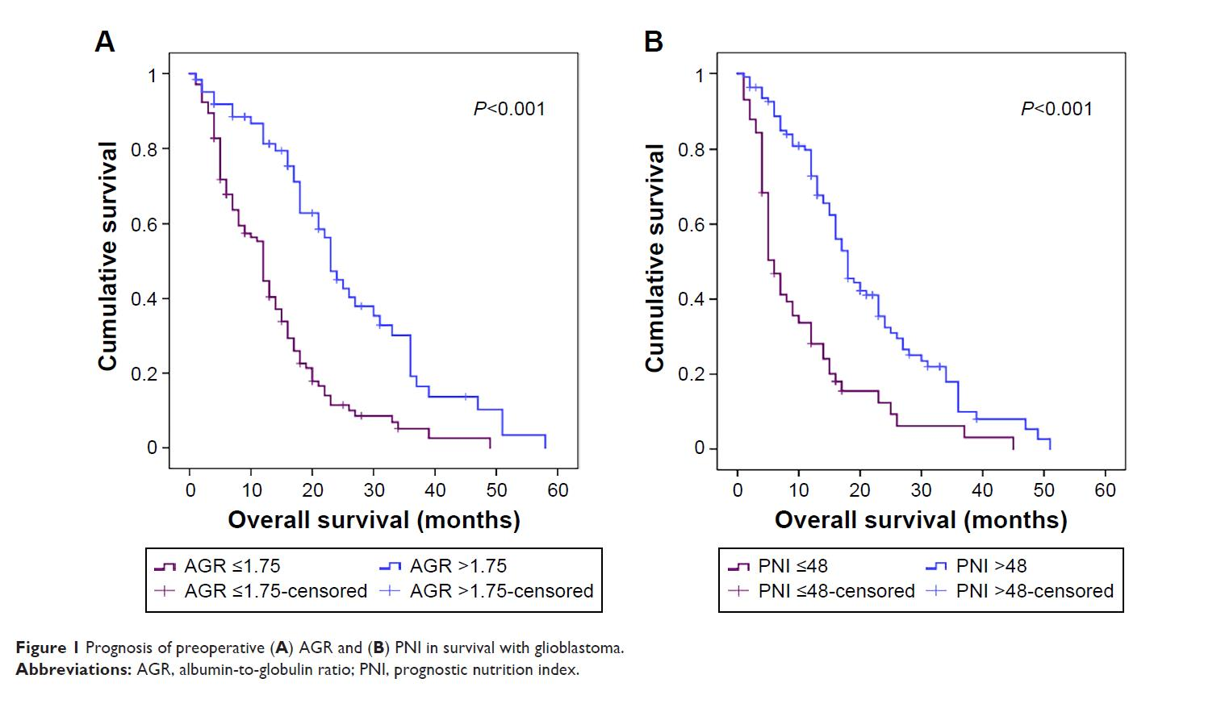
Notes:
PNI 48 기준

Slide 15
Value of the prognostic nutritional index and weight loss in predicting metastasis and long‑term mortality in nasopharyngeal carcinoma
Pre-therapy PNI and weight loss have significant predictive value for metastasis and mortality in patients with NPC
Du et al. J Transl Med (2015) 13:364
Notes:
Journal of Translational Medicine
IF 4.116
PNI < 55.0
N=694

Slide 16
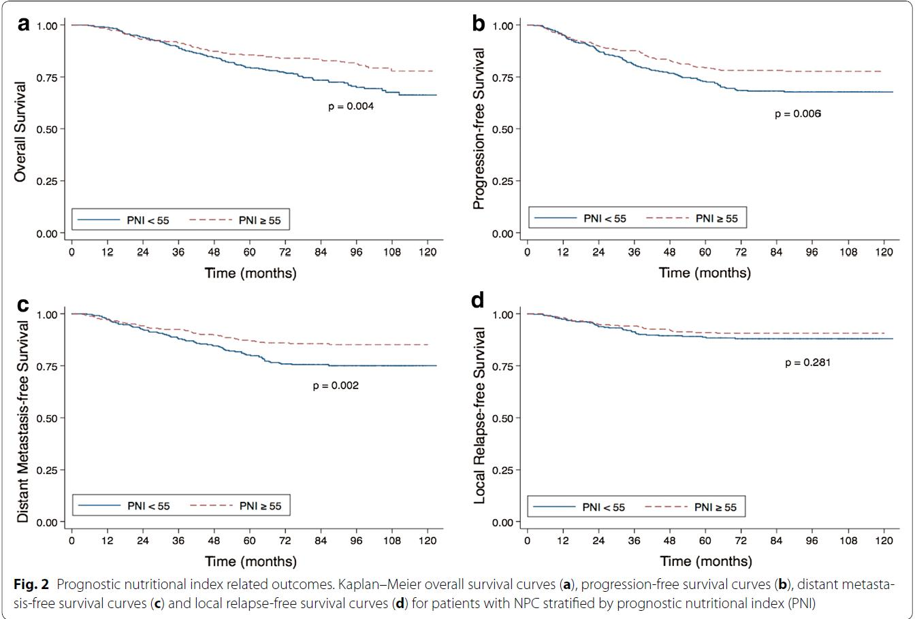

Slide 17
A Preoperative Nutritional Index for Predicting Cancer Specific and Overall Survival in Chinese
Patients With Laryngeal Cancer
The PNI is an inexpensive and readily available score that predicted survival in patients with LSCC after curative laryngectomy
Zhang at el. Medicine Volume 95, Number 11, March 2016
Notes:
N=975

Slide 18
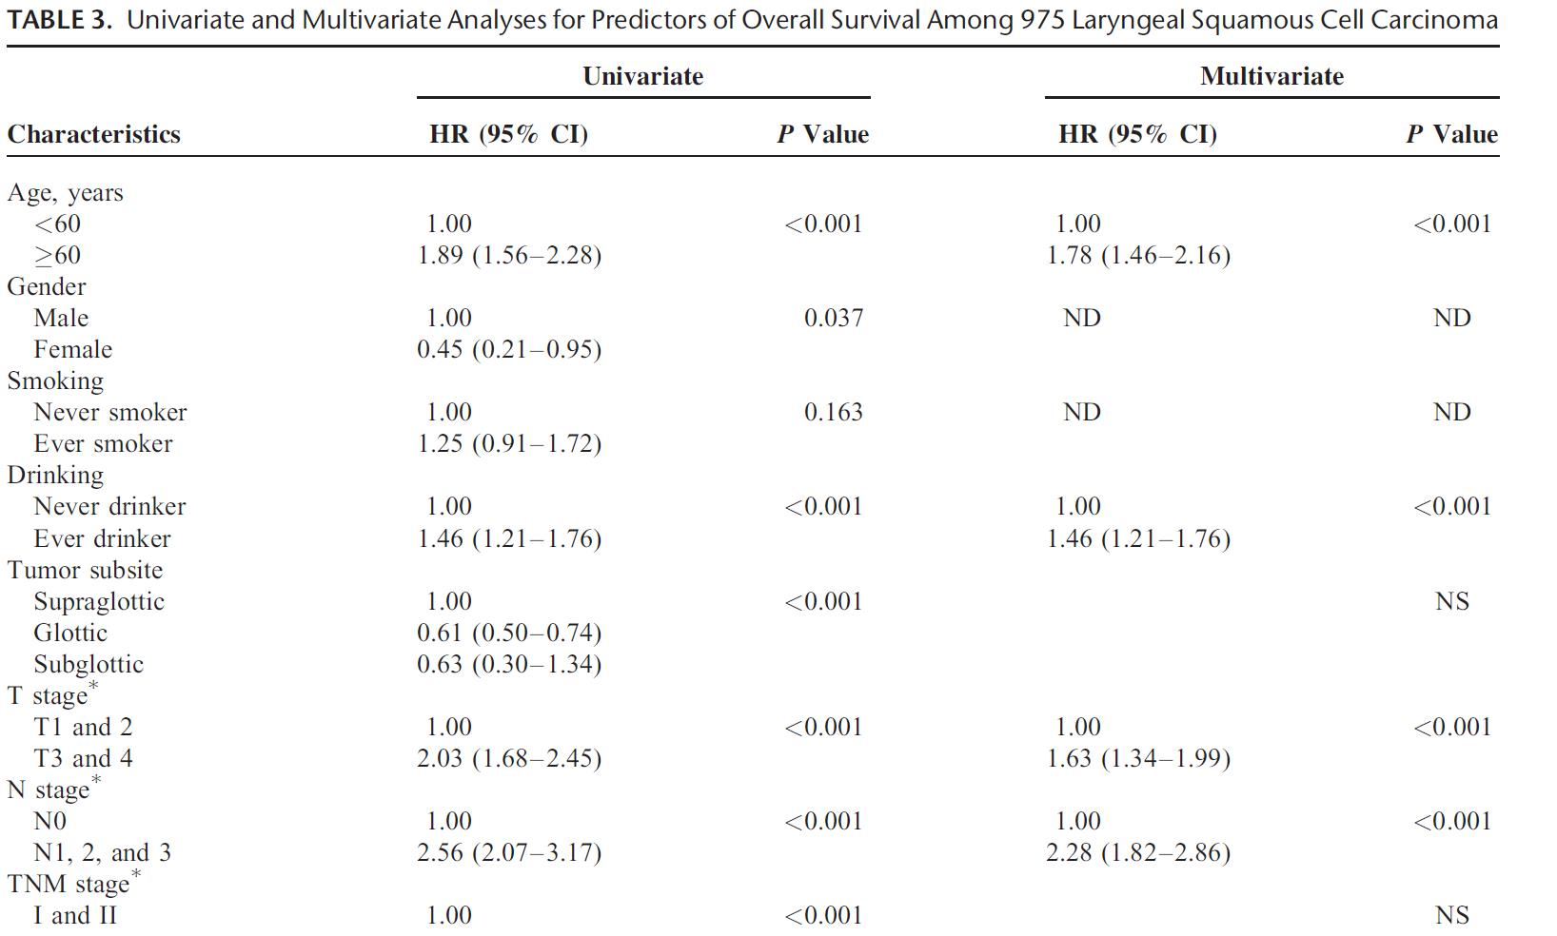
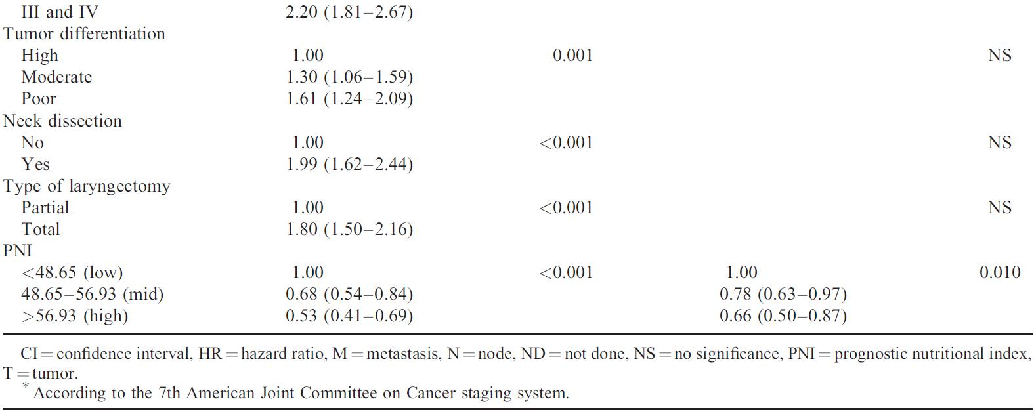
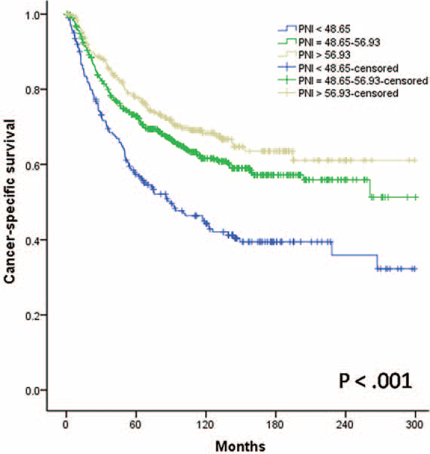

Slide 19
Low Prognostic Nutritional Index Correlates with Worse Survival in
Patients with Advanced NSCLC following EGFR-TKIs
low prognostic nutritional index correlates with worse survival for patients with advanced NSCLC and taking EGFR-TKIs
Zhang et al. Plos One 2016 Jan 19;11
Notes:
N=144

Slide 20
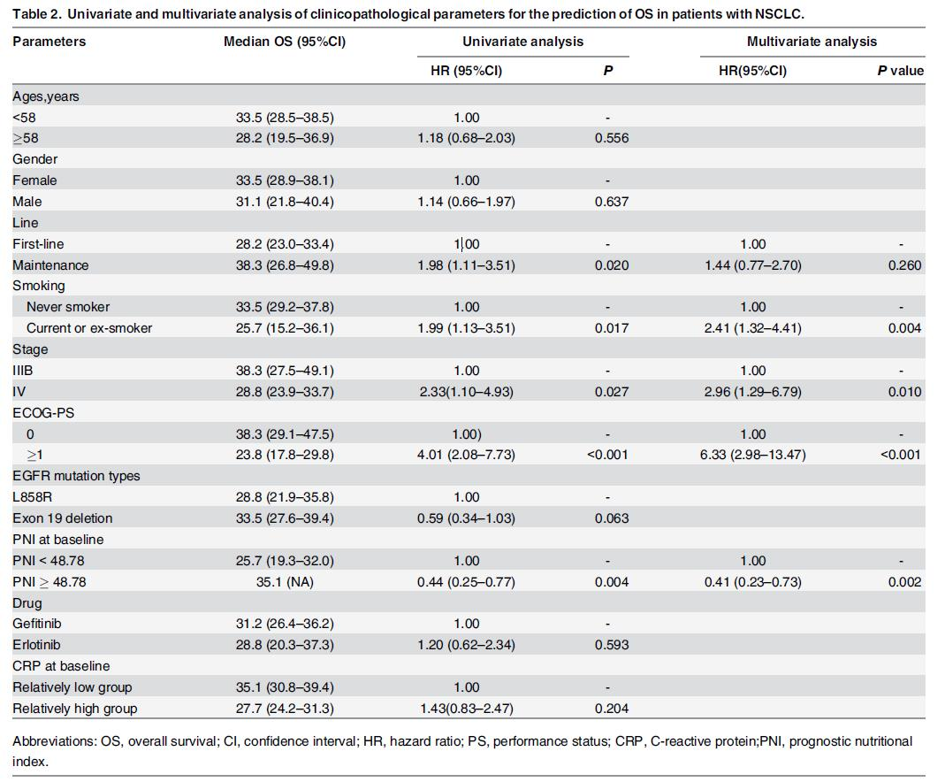

Slide 21
The Significance of the Prognostic Nutritional Index in Patients with Completely Resected Non-Small Cell Lung Cancer
The prognostic nutritional index is an independent prognostic factor for survival of patients with completely resected non-small cell lung cancer
Zhang et al. PLOS ONE 2015 Sep 10;10(9)
Notes:
N=409

Slide 22
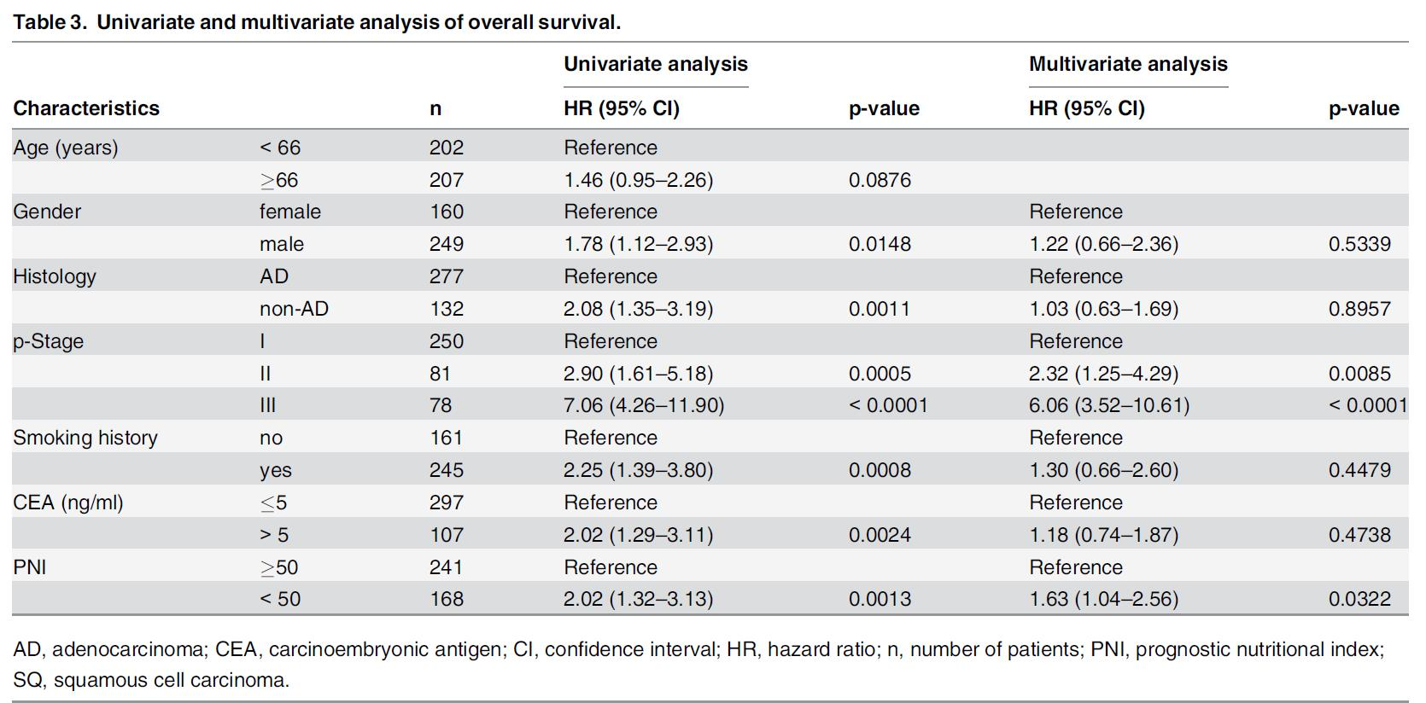

Slide 23
Prognostic nutritional index predicts postoperative complications and long-term outcomes of gastric cancer
The PNI is a simple and useful marker not only to identify patients at increased risk for postoperative
complications and longterm survival
The PNI should be included in the routine assessment
of advanced gastric cancer patients
Jiang N et al . World J Gastroenterol 2014 August 14; 20(30): 10537-10544
Notes:
N=386

Slide 24
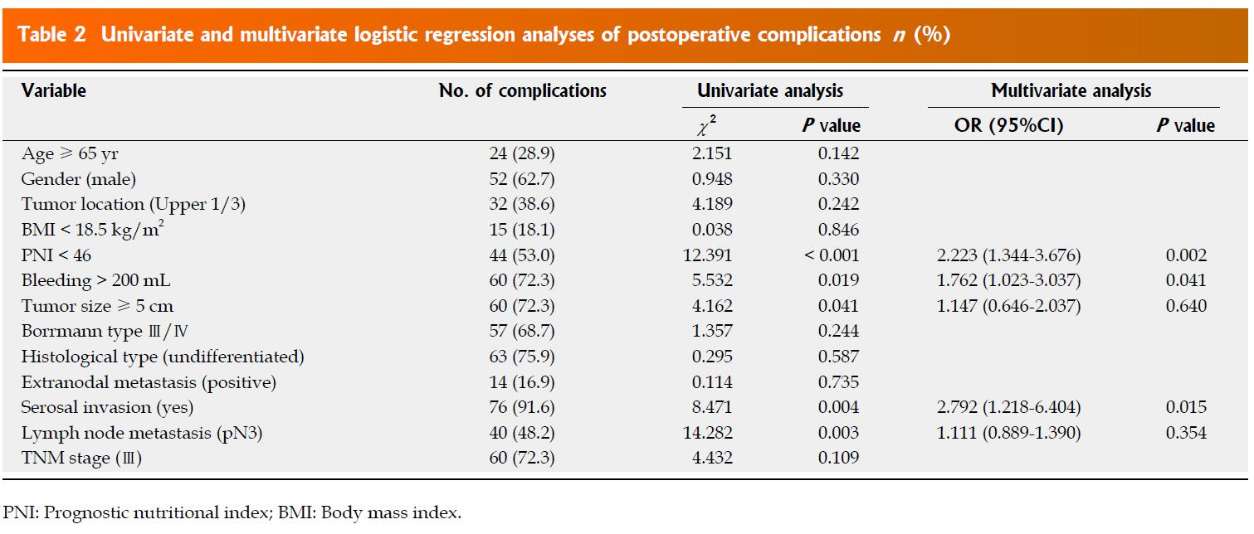
Notes:
N=195

Slide 25
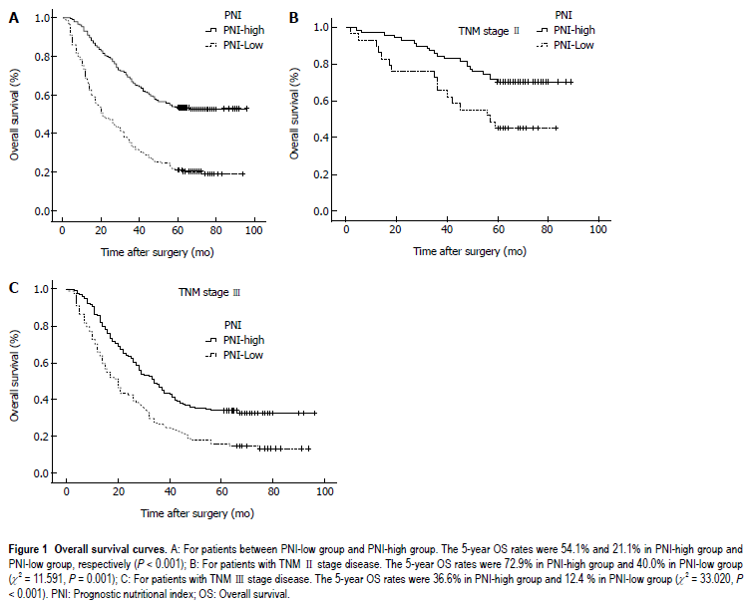

Slide 26
Prognostic Nutritional Index (PNI) Predicts Tumor Recurrence of Very Early/Early Stage Hepatocellular Carcinoma After Surgical Resection
The PNI is a significant prognostic factor for OS and DFS of patients with very early/early stage HCC
receiving curative surgery.
Chan et al. Ann Surg Oncol (2015) 22:4138–4148
Notes:
N=324
IF 4.239

Slide 27
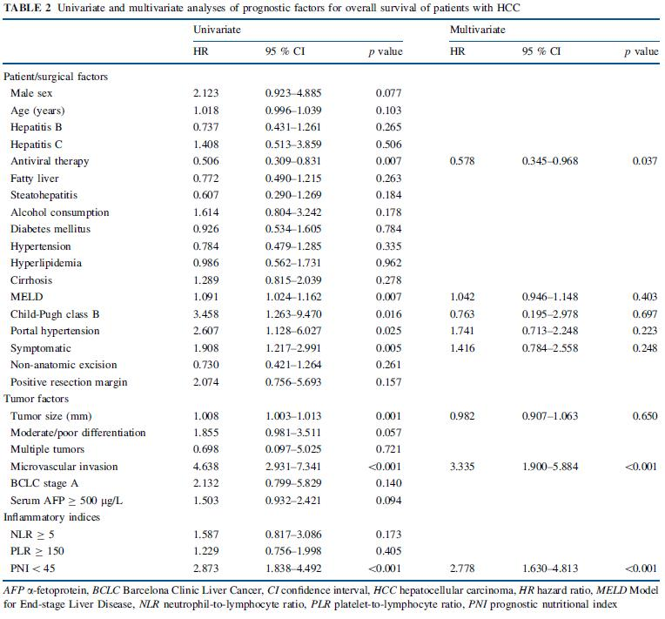

Slide 28
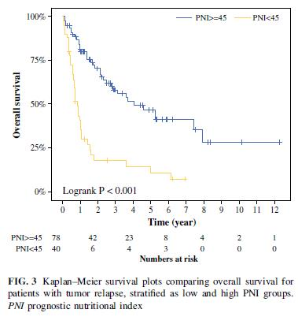

Slide 29
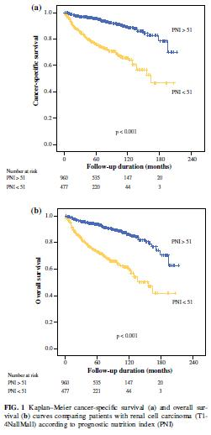
Preoperative Prognostic Nutritional Index is a Significant Predictor of Survival in Renal Cell Carcinoma PatientsUndergoing Nephrectomy
Jeon et al. Ann Surg Oncol (2016) 23:321–327
PNI is an independent prognostic factor for predicting survival after nephrectomy in patients with RCC.
Notes:
IF 4.239

Slide 30
Other disease

Slide 31
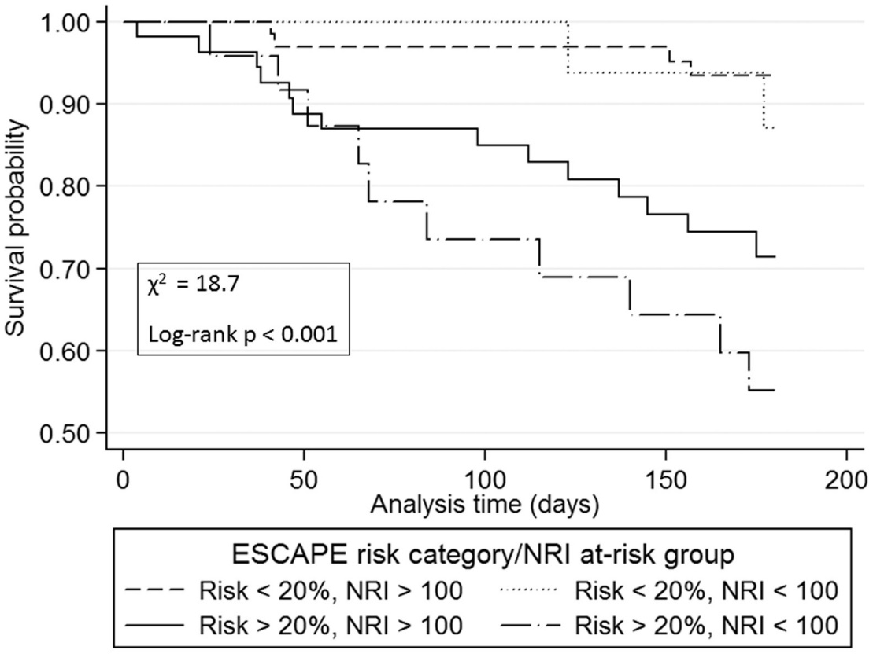
Nutritional Risk Index predicts mortality in hospitalized advanced heart failure patients
Hummel et al. J Heart Lung transplant 2015 Nov;34(11):
The NRI is a simple tool that can improve mortality risk stratification at hospital discharge in hospitalized patients with advanced HF
Notes:
N=160

Slide 32
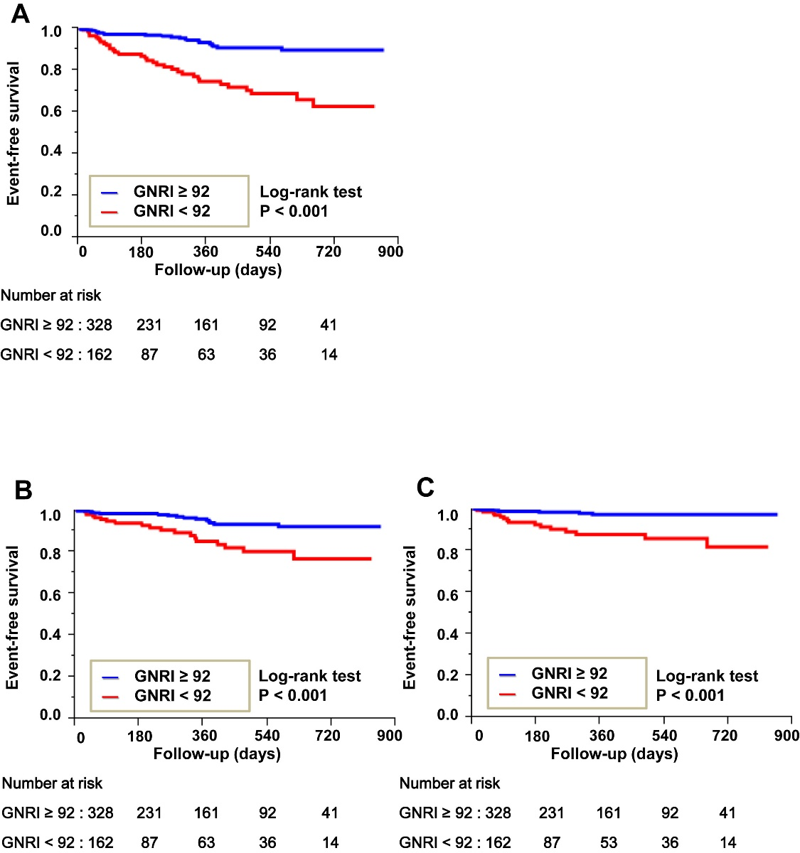
Usefulness of Geriatric Nutritional Risk Index for Assessing Nutritional Status and Its Prognostic Impact in Patients Aged ≥65 Years With Acute Heart Failure
Nagai et al. Am J Cardiol 2016 15;118(4)
The lower GNRI on admission was independently
associated with worse clinical outcomes in patients aged ≥65 years with AHF
Notes:
N=490
IF=3.356

Slide 33
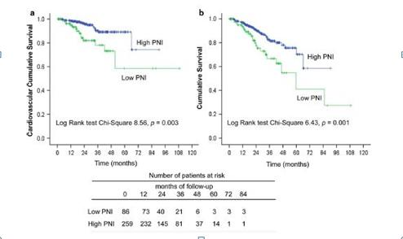
Low prognostic nutritional index associated with cardiovascular disease mortality in incident peritoneal dialysis patients
Low PNI at initiation of PD was independently
associated with an increased CVD mortality
Peng et al. Int Urol Nephrol 2017 Feb 10
Notes:
N=345

Slide 34
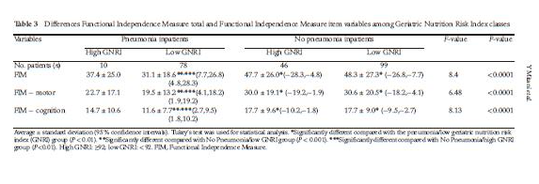
Relationship between functional independence measure and geriatric nutritional risk index in pneumonia patients in longterm nursing care facilities
GNRI are useful predictor tools that could help to prevent pneumonia in Japanese patients in long-term care facilities.
Mitani et al. Geriatr Gerontol Int 2016

Slide 35
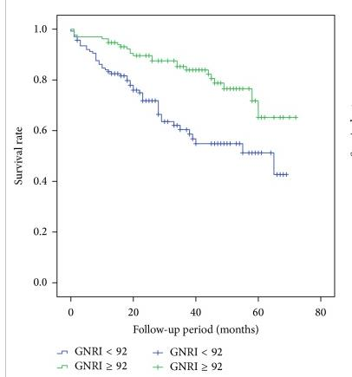
The Geriatric Nutritional Risk Index Independently Predicts Mortality in Diabetic Foot Ulcers Patients Undergoing Amputations
Hong et al. Journal of Diabetes Research Volume 2017
GNRI on admission might be a novel clinical predictor for the incidence of death in patients with diabetic foot ulcers who were undergoing amputations
Notes:
IF=2.435

Slide 36
In Transplantation

Slide 37
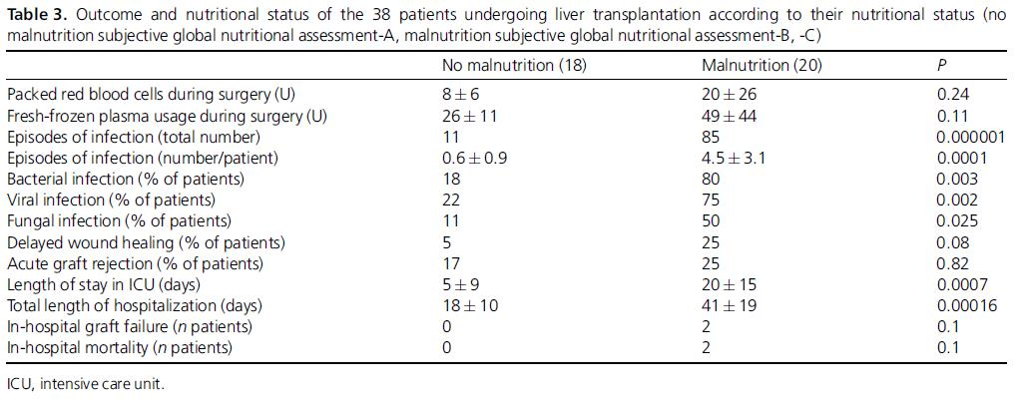
Nutritional status: its influence on the outcome of patients undergoing liver transplantation
John et al. Liver International 2010 Feb;30(2):208-14.
Notes:
IF=4.255
N=

Slide 38
Comparison of baseline characteristics
Variable | Patients with low PNI (n=31) | Patients with high PNI(n=50) | P-value
Age, years | 55.2(12.6) | 49.2 (14.6) | 0.064
Male gender, N (%) | 18 (58.0) | 30 (58.2) | 0.863
Smoking, N (%) | 14 (45.2) | 26 (52%) | 0.550
BMI, kg/m² | 20.1(3.7) | 20.3 (3.4) | 0.832
Weight, Kg | 54.2(2.3) | 54.8(1.3) | 0.838
WBC | 11020.3 (4150.0-17990.0) | 9469.0 (3920.0-19750.0) | 0.082
CRP | 47.8 (0.6-251.5) | 21.3 (0.6-278.8) | 0.054

Slide 39
ROC curve
AUROC 0.791, 95% CI 0.687-0.894
p < 0.001
Sensitivity 68.8%, Specificity 81.6%
Cut-off value >39.25

Slide 40
Univariate and Multivariate Analysis for PNI score
 | Univariate analysis |  |  |  | Multivariate analysis
variable | HR | CI | P value |  | HR | CI | P value
Age, years | 1.044 | 1.011-1.078 | 0.009 |  | 1.027 | 0.996-1.058 | 0.086
Male gender, N (%) | 0.545 | 0.258-1.153 | 0.112
Smoking, N (%) | 1.028 | 0.514-2.056 | 0.938
BMI, kg/m² | 1.101 | 0.992-1.221 | 0.070
WBC | 1.000 | 1.000-1.000 | 0.056
CRP | 1.006 | 1.001-1.011 | 0.015 |  | 1.000 | 0.996-1.058 | 0.922
PNI | 5.169 | 2.427-11.007 | <0.001 |  | 4.443 | 1.998-9.927 | <0.001

Slide 41
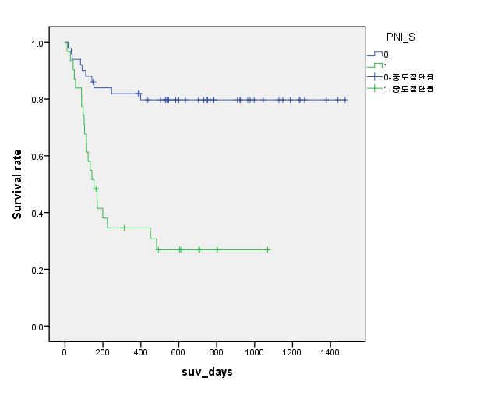
Kaplan-Meier survival curve
(log rank P<0.001)

Slide 42
추가 분석항목
추가 인원 및 항목 data collection
Abumin – TLC variation
NRI 추가 분석
Complication
risk factor
Notes:
Sepsis, Re-OP, Bleeding...
PGD, rejection….

Slide 43

Notes:
경청해주셔서 감사합니다.

