Slide 1
2016.09.20 Research meeting
SCMP in ICU patient
R4 송명진

Slide 2
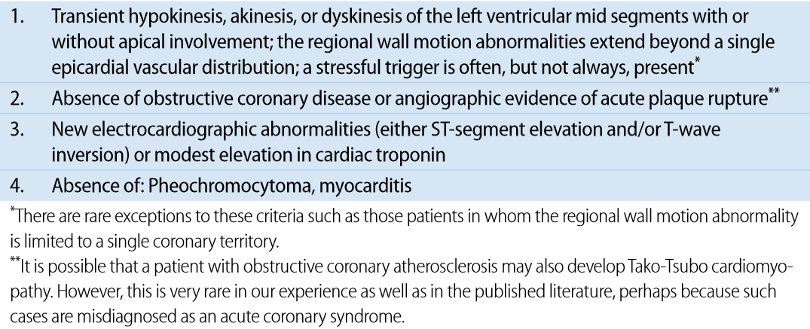
SCMP 정의
Mayo Clinic diagnostic criteria for Takotsubo cardiomyopathy
환자의 내과적 condition 으로 인해 coronary work up 을 진행할 수 없는 경우, SCMP 전형적인 심초음파 소견을 보이는 경우 혹은 EKG 소견 (prominent ST-segment elevations , deep T-wave inversions)과 심초음파 상 wall motion abnormalities 위치가 일치하지 않는 경우 coronary artery disease 를 배제할 수 있다고 판단하여 SCMP 로 진단.
f/u TTE상 WMA 에 호전이 있는 경우
M. Madhavan et al, Herz 2010, 35:240–244

Slide 3
 | JH Park, et al. CHEST (2005 ) | D. Haghi et al. Intensive Care Med (2006) | YY Jo, et al. Journal of Critical Care (2013)
 | Prospective study | Prospective study | Retrospective study
Popul-ation | 92 pts who admitted Asan Medical Center ICU, March to May 2003. TTE on D0, D3, D7 | 6 pts who diagnosed SCMP during admission to ICU, in Germany, January 2004 and May 2005 | 71 pts who diagnosed SCMP during admission to the ICU of Yonsei University Heath System, January 2008 to May 2011
Objective | to assess the frequency and clinical implications of LVAB in ICU patients | to assess clinical features of SCMP occurring in the ICU | to define predictors of in-hospital mortality and to explore the implication of APACHE II score in pts with SCMP
Result | -26(28%) pts diagnosed SCMP -LVAB had a higher frequency of sepsis, hypotension, using inotropic agents, cardiomegaly, pulmonary edema. -Sepsis was the only variable associated with the development of LVAB. | Sudden hemodynamic deterioration requiring vasopressor support, EKG abnormalities consisting of ST elevation, ST depression or T-wave inversion may be the presenting symptom of SCMP | malignancies, male sex, age less than 65 years, and APACHE II score higher than 15 remained independent risk factors for in-hospital mortality of SCM.

Slide 4
 | Tsutomu Murakami, et al. Journal of Cardiology (2014) | Sebastien et al,. EHJ(2015)
 | Retrospective study | Retrospective study
Popul-ation | 107 pts with SCMP from the Tokyo CCU Network database, January to December 2010. | 1314 pts who admitted Centre Hospitalier Universitaire de la Réunion(France) ICU, 2012-2013.
Objective | to determine features characterizing pts with adverse clinical outcome by comparing those with cardiac complication and without cardiac complication during hospitalization | to evaluate the mechanisms, incidence, treatment and prognosis of SCMP.
Result | - Cardiac complications : cardiac death, pump failure (Killip grade ≥ II), SVT/VF, AVB - Cardiac complications were observed in 41 patients (37 pump failure complicated by 3 cardiac deaths and 2 SVT/VF and 2 AVB with-out pump failure) - There was no difference in age, peak CK, CRP and ST elevation on EKG. -WBC count and BNP were independent predictors of in-hospital adverse cardiac complications. | - 20 pts (1.5%) were diagnosed with SCMP - SCMP was suspected because of hemodynamic impairment (80%), ECG modifications (15%) and/or dyspnea (15%) - apical (typical Takotsubo) in 90%, atypical in 10%. - mechanisms or conditions associated with occurrence of SCMP : catecholamine toxicity (45%), psychological stress, seizures or neurological impairment (35%), nonepicardial coronary ischemia (20%), left ventricular outflow track (LVOT) obstruction (10%) - SAPS2(simplified acute physiologic score), renal impairment, malnutrition, norepinephrine infusion and thrombocytopenia were associated with death in the univariate analysis

Slide 5
연구 목표
연구 배경
In critically ill patient, it is considered that cardiac dysfunction may have a significant impact on prognosis. The aims of this study were to assess frequency of Stress induced cardiomyopathy(SCMP) and predictors for incidence of SCMP in patients who admitted to medical ICU. We also explored the predictors of in-hospital mortality in patients with SCMP.
연구 목표
  2015년 ICU 환자 375 명 중,
  SCMP가 동반된 환자의 Mortality 에 영향을 미치는 predictor

Slide 6
2015년 ICU 입실환자 375명 중
ICU입실 기간 중 TTE를 시행한 338명
SCMP 42명(12.4%)

Slide 7
전체 환자의 baseline characteristics
Variables | SCMP ( n=42) | Non-SCMP ( n = 296) | P value
Age (y) | 63.6±18.0 | 67.3±14.7 | 0.15
BMI | 21.4±2.9 | 22.7±4.5 | 0.08
Female sex, n (%) | 45.2 (19) | 37.8(112) | 0.36
Hypertension | 45.2 (19) | 56.9(168) | 0.16
Diabetes mellitus | 19.0(8) | 39.2(116) | 0.01
End-stage renal disease | 14.3(6) | 13.9(41) | 0.94
History of malignancy | 38.1(16) | 30.1(89) | 0.29
Sepsis | 85.7(36) | 85.1(252) | 0.92
COPD | 4.8(2) | 16.9(50) | 0.04
LC | 4.8(2) | 11.1(33) | 0.20
CAOD | 11.9(5) | 15.2(45) | 0.57
CHF | 16.7(7) | 12.2(36) | 0.41
CVD | 16.7(7) | 21.3(63) | 0.49
Smoking | 33.3(14) | 33.8(100) | 0.95
APACHE II SCORE > 20 | 76.2(32) | 69.3(205) | 0.36
AKI | 57.1(24) | 45.6(135) | 0.16
Shock | 88.1(37) | 74.7(221) | 0.06
MV | 90.5(28) | 71.9(213) | 0.03
CRRT | 35.7(15) | 31.1(92) | 0.55
QTc | 466.3±48.0 | 457.7±47.4 | 0.27
AF | 14.3(6) | 13.9(41) | 0.94
LV thrombus | 2.4(1) | 0.0(0) | 0.01
EF (%) | 38.0±15.6 | 61.7±11.8 | <0.001

Slide 8
SCMP의 발생의 위험인자
Variables | OR | 95% CI | P value
Age | 0.98 | 0.95-1.01 | 0.07
BMI | 0.88 | 0.78-0.99 | 0.04
HTN | 1.17 | 0.40-3.41 | 0.78
DM | 0.38 | 0.12-1.09 | 0.11
Malignancy | 0.94 | 0.35-2.56 | 0.91
COPD | 0.36 | 0.07-1.87 | 0.22
Shock | 3.28 | 0.70-12.54 | 0.14
AKI | 1.49 | 0.58-3.87 | 0.41
MV | 0.32 | 0.52-7.52 | 0.32
EF | 0.89 | 0.87-0.92 | < 0.01

Slide 9
SCMP 환자들 중 survivor vs non-survivor 의 위험인자
(In-hospital mortality)
 | OR | 95% CI | P value
Age | 1.04 | 0.95-1.13 | 0.40
BMI | 0.73 | 0.52-1.01 | 0.06
Malignancy | 0.65 | 0.04-10.08 | 0.76
EF | 1.06 | 0.97-1.17 | 0.20
AKI | 8.19 | 1.35-49.75 | 0.02

