Slide 1
Clinical Significance of Nutrition in MAC patients
Research meeting
문성우

Slide 2

Clinical Significance of Nutrition in MAC patients
Impact of PNI on the prognosis of MAC patients
Comparing various nutritional indexes in predicting survival
  Studies using 1 data

Slide 3
Clinical Significance of Nutrition in MAC patients
Malnutrition (Malnourishment)
  Condition that results from eating a diet in which nutrients are either not enough or are too much such that the diet causes health problems
Malnutrition in NTM patients
  Slender, Older Women Appear to Be More Susceptible to Nontuberculous Mycobacterial Lung Disease
                Chan et al. Gender Medicine Volume 7, Issue 1, February 2010, Pages 5-18
  BMI is an excellent marker for nutritional assessment and for predicting disease spread in patients with pulmonary MAC infection.
                Ikegame et al. Nutritional Assessment in Patients with Pulmonary Nontuberculous Mycobacteriosis, Internal Medicine, 2011

Slide 4
Clinical Significance of Nutrition in MAC patients
Consequences of malnutrition
  Muscle function
    body draws on functional reserves in tissues such as muscle, adipose tissue and bone leading to changes in body composition
  Cardio-respiratory function
    Poor respiratory muscle function; reduces cough pressure and expectoration of secretions, delaying recovery from respiratory tract infections.
  Gastrointestinal function
    pancreatic exocrine function, intestinal blood flow, villous architecture and intestinal permeability
  Immunity and wound healing
  Psychosocial effects
    Saunders et al. Malnutrition: causes and consequences, Clinical Medicine 2010, Vol 10, No 6: 624–7

Slide 5
Immune defect with malnutrition
Defects of innate immunity
  Impaired epithelial barrier function of the skin and gut
  Reduced granulocyte microbicidal activity
  Fewer circulating dendritic cells
  Reduced complement proteins
Defects of adaptive immunity
  Reduced levels of soluble immunoglobulin A (IgA) in saliva and tears
  Lymphoid organ atrophy
  Reduced delayed-type hypersensitivity (DTH) responses
  Fewer circulating cells
  A shift from Th1-associated to Th2-associated cytokines
  Lymphocyte hypo-responsiveness to mitogens
  Reduced vaccine responsiveness

Slide 6
Nutritional markers in several diseases
No | Author | Study design | No. of patients | Target disease | Index | Results
1 | D J Pinato | Pro | 112 | HCC | PNI | PNI is an independent and externally validated predictor of poor OS in patients with HCC.
2 | Satoru Okada | Retro | 46 | Colorectal cancer | PNI | PNI could be a prognostic factor and a very useful objective screening tool for assessing the nutritional condition of unresectable or recurrent colorectal cancer
3 | Marc Schiesser | Pro | 200 | Pts. under GI surgery | NRS, NRI, bioimpedance analysis | The nutrition risk score, nutrition risk index, and bioimpedance analysis correlate with the incidence and severity of perioperative complications in GI surgery
4 | Ikue Kobayashi | Pro | 490 | H/D patients | GNRI | GNRI is considered to be a clinically useful marker for the assessment of nutritional status in haemodialysis patients.
5 | Bryce Montané | Retro | 287 | Hetero- (Robot ass. pneumo-) | BMI | Obese patients have increased risk of pneumonia, compared with “normal weight” and “overweight” patients.
6 | Satoru Kobayashi | Retro | 135 | IIP | GPS | GPS is an independent prognostic factor of OS and RFS in lung cancer patients with IP who underwent a lung resection.
7 | Hideki Kawai | Retro | 40 | NSCLC | prealbumin | preoperative serum prealbumin level is an independent long-term prognostic factor
8 | Gouji Toyoakwa | Retro | 108 | NSCLC (Sq. cell ca.) | CONUT score | CONUT score was an independent prognostic factor for the DFS and OS in patients with resected lung SCC
9 | Satoru Okada | Retro | 248 | NSLC | PNI | PNI could represent a useful biomarker to predict postoperative complications and survival in patients with completely resected NSCLC
10 | Shunsuke Mori | Retro | 542 | NSCLC | PNI | PNI is an independent prognostic factor for survival of patients with completely resected NSCLC
Notes:
각 index별 유용성을 확인한 연구들을 간단히 정리해 본 표입니다. 굉장히 다양한 질환에서 연구가 이루어졌고,
lung cancer 환자에서는 prealbumin, CONUT score, PNI에 대한 연구들이 진행된 바 있었습니다.
이중 두 논문에 대해 간단히 말씀을 드리면,

Slide 7
Traditional indicators of nutritional status
Prognostic nutritional index (PNI)
albumin (g/dl), lymphocyte
PNI= 10 × albumin + 0.005 × lymphocyte
Nutritional risk index (NRI)
albumin (g/㎗), weight (㎏), ideal body weight(㎏)
(1.519 × alb) + 41.7 × (Bwt./ideal Bwt.)
Geriatric nutritional risk index (GNRI)
albumin (g/㎗), BMI (㎏/㎡)
GNRI = 14.89 × albumin + 41.7 × (BMI/22)
Glasgow prognostic score (GPS)
albumin (g/L), CRP (mg/L)
CONUT score
albumin (g/mL), Total lymphycyte count, Total cholesterol (㎎/㎗)
Body composition
  Body weight
  Anthropometry
  Urinary cratenine excretion
Plasma proteins
  Albumin
  Prealbumin
  Retinol-binding protein
  Tranferrin
Immune system function
  Total lymphocyte count
  Delayed cutaneous hypersensitivity
Notes:
일반적으로, 알려진 영양학적인 인자로는 체성분과 관련된 인자, albumin 등의 혈액학적인 인자, total lymphocyte count와 같은 면역체계와 관련한 인자 등이 있고, 이들을 combine해서 만든 PNI, NRI, GNRI, GPS, 그리고 본 주제에서 언급하는 CONUT score와 같은 지표들이 있습니다.

Slide 8
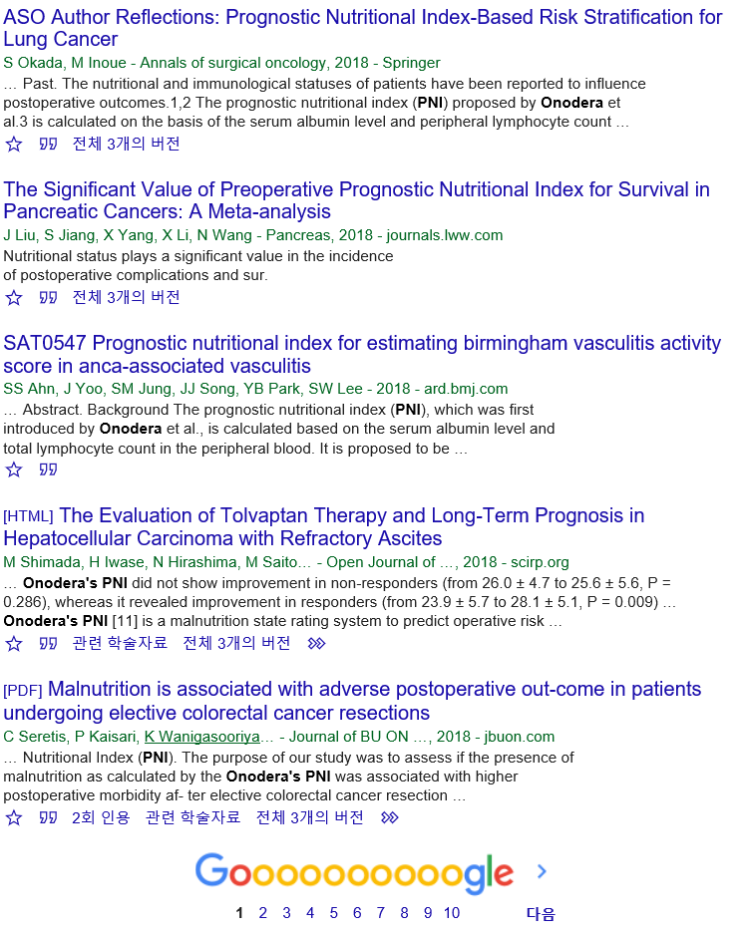
Prognostic Nutritional Index score
200 malnourished cancer patients of digestive organs, a multiparameter index of nutritional status was defined to relating the risk of postoperative complications to base line nutritional status
10 × serum albumin (g/dL) + 0.005 × total lymphocyte count (/mm3).
Onodera T, Goseki N, Nosaki G. Prognostic nutritional index in gastrointestinal
surgery of malnourished cancer patients. Nihon Geka Gakkai
Zasshi 1984; 85: 1001-5.

Slide 9
Nutritional Risk Index (NRI)
1.519 × alb) + 41.7 × (Bwt./ideal Bwt.)
Perioperative total parenteral nutrition in surgical patients. The Veterans Affairs Total Parenteral Nutrition Cooperative Study Group. N Engl J Med. 1991;325:525–32.

Slide 10
Geriatric nutritional risk index
GNRI = 14.89 × albumin + 41.7 × (BMI/22)
Bouillanne, O., Morineau, G., Dupont, C., Coulombel, I., Vincent, J.P., Nicolis, I. et al, Geriatric nutritional risk index: a new index for evaluating at-risk elderly medical patients. Am J Clin Nutr. 2005;82:777–783.
diffuse large B cell lymphoma
Esophageal cancer
Hemodialysis
TAVI
RA
And So on...

Slide 11
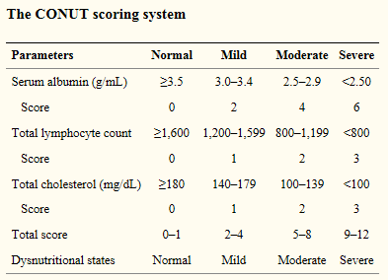
CONUT score & OS
(Shoji, Fumihiro, et al. Anticancer research 37.2 (2017): 741-747.)
CONUT score
108 patients with resected lung SCC
CONUT : efficient tool for early detection and continuous control of hospital undernutrition. (n=53)
(K. Ignacio de Libarri et al. Nutr. Hosp. 2003)
Independent prognostic factor for the DFS and OS in patients with resected lung SCC
Notes:
그리고 CONUT score는 albumin, total lymphocyte count, cholesterol 수치로 계산을 하며, 각 점수에 따라 normal, mild, moderate, severe로 구분을 하게됩니다.
이 연구에서는 108명의 sq. cell ca. lung cancer 환자에서 CONUT score를 이용하여 비교하였을 때, CONUT score가 2점 이상이었던 경우 disease-free survival 및 overall survival 모두 감소하는 경향을 보임을 확인하였습니다.

Slide 12
Study Population
No. of total Pts. Diagnosed as NTM
From March, 2005 to Sept, 2017
n= 906
Diagnosed As MAC
n=731
Insufficient data
No Data on Ht., Wt., or Smoking Hx (n=61)
No Albumin or Lymphocyte data (n=136)
No AFB data (n=21)
Not 1` Treatment (n=2)
s/p Lung transplantation (n=3)
Included in the study population
n=508

Slide 13
Collected Variables
Ht, Wt, Smoking & baseline data
Treatment
  Regimen, Conversion failure, Treatment failure, Tx start, end, f/u culture result
Hx : HTN, DM, CKD, Liver disease, Malignancy, Immunosuppress status,
Sx : Cough, Sputum, Dyspnea, Hemoptysis, Fever, Weakness, Wt. loss
Lab : Including WBC, Lympho, Cholesterol, Alb / Prot
NTM : NTM Type (on CT), ID result, date, multiple species, FOB result, Smear data, culture data, IGRA
PFT

Slide 14
1st Study Design
Main predictors : PNI Score
Primary outcome
  Survival according to PNI
2ndary outcome
  Culture conversion on Sub-group (Pts. Whom were treated, n=240)
  2ndary outcome was analyzable on 194 Pts
Hypothesis
:Lower PNI score resulted in worse survival & non-culture conversion

Slide 15
Cutoff for malnutrition
(varies according to Dz, Papers)
Figure 1. Receiver operating characteristic curve to determine the cut-off value of the Prognostic Nutritional Index (PNI) score for the prediction of overall survival in MAC patients
The optimal cut-off value is 45.55 (area under the curve = 0.728)

Slide 16
Table 1. Baseline characteristics
Variables | All (n=508) | normal (353) | malnutrition (155) | P-value
Age, mean years ± SD (range) | 64.02 ± 11.676 | 62.28 ± 10.968 (21-86) | 67.97 ± 12.30 (23-97) | <0.001
sex,male | 238 (46.9%) | 145 (41.1%) | 93 (60%) | <0.001
BMI, mean, ± SD (range) | 20.25 ± 3.64 (12.11-48.12) | 20.56 ± 3.51 (13.22 - 48.12) | 19.55 ± 3.84 (12.11-32.76) | 0.004
ever smoker | 174 (34.3%) | 111 (31.4%) | 63 (40.6%) | 0.054
Smoking, PYRs | 31.64 ± 27.31 (0 - 220) | 29.68 ± 29.68 (0-150) | 35.21 ± 31.76 (0.25-220) | 0.232
Comorbidities
Diabetes | 83 (16.3%) | 57 (16.1%) | 26 (16.8%) | 0.896
HTN | 188 (37%) | 129 (36.5%) | 59 (38.1%) | 0.765
Chronic liver diseases | 40 (7.9%) | 26 (7.4%) | 14 (9%) | 0.592
Chronic renal failure | 31 (6.1%) | 16 (4.5%) | 15 (9.7%) | 0.042
Malignancy | 150 (29.5%) | 92 (26.1%) | 58 (37.4%) | 0.011
Laboratory test, mean value SD
WBC | 7.27 ± 3.32 (0.6-37.24) | 6.91 ± 3.03 (0.75 -37.24) | 8.09 ± 3.79 (0.60-22.49) | <0.001
Lymphocyte | 1.68 ± 0.74 (0.09-7.17) | 1.93 ± 0.70 (0.20-7.17) | 1.12 ± 0.47 (0.09-2.49) | <0.001
Protein, g/dL | 6.93 ± 0.96 (1.8-17.2) | 7.12 ± 0.70 (2.8-8.6) | 6.48 ± 1.27 (1.8-17.2) | <0.001
Albumin, g/dL | 4.00 ± 0.66 (1.8-7.5) | 4.29 ± 0.45 (2.7-7.5) | 3.33 ± 0.55 (1.8-4.5) | <0.001
PNI | 48.37 ± 8.23 (21.85-79.65) | 52.56 ± 4.98 (45.55-79.65) | 38.84 ± 5.89 (21.85-45.50) | <0.001
Radiographic finding & AFB |  |  |  | 0.013
Fibrocavitary | 92 (18.1%) | 61(17.3%) | 31 (20%)
Nodularbronchiectatic | 345 (68%) | 252 (71.6%) | 93 (60%)
Others | 70 (13.8%) | 39 (11.1%) | 31 (20%)
Positive AFB smear** | 79 (15.6%) | 49 (13.9%) | 30 (19.4%) | 0.143
*combined NTM other than NTM | 132 (26.0%) | 97 (27.5%) | 35 (22.6%) | 0.273
Sx
Cough | 200 (39.4%) | 132 (37.4%) | 68 (34%) | 0.2
Sputum | 214 (42.1%) | 142 (40.2%) | 72 (46.5%) | 0.205
Dyspnea | 73 (14.4%) | 34 (9.6%) | 39 (25.2%) | <0.001
Hemoptysis | 87 (17.1%) | 68 (19.3%) | 19 (12.3%) | 0.056
fever | 38 (7.5%) | 13 (3.7%) | 25 (16.1%) | <0.001
weakness | 32 (6.3%) | 11(3.1%) | 21 (13.5%) | <0.001
Treatment
Treatment done | 240 (47.3%) | 173 (49.0%) | 67 (43.2%) | 0.247

Slide 17
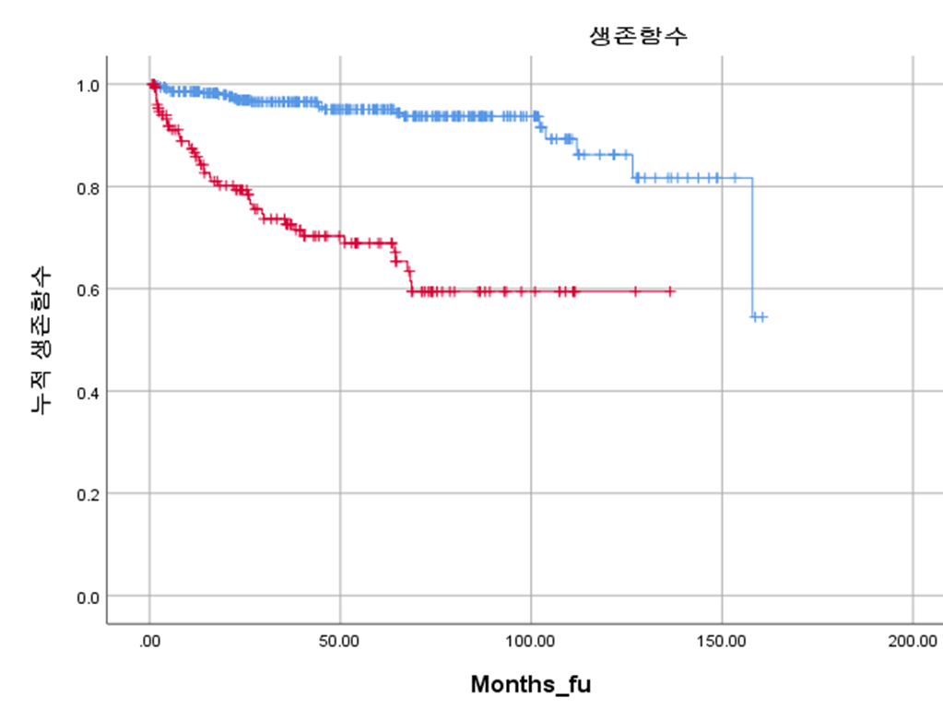
K-M Survival curve according to Malnutrition / Normal
Total death
64
In nl group
20
Malnutrition group
44

Slide 18
Table 2. Treatment modalities for initial Tx (n=240)
Drug used | all n= 240
Macrolide | 231 (96.3%)
RFP | 223(92.9%)
EMB | 216 (90%)
INAH | 9 (3.8%)
FQ | 11 (4.6%)
Aminoglycoside (AMK, SM or KM) | 38 (15.8%)
cephalosporins | 7 (2.9%)
Other | 10 (4.2%)
# of medication (Initial)
≤2 | 14 (5.8%)
3 | 187 (77.9%)
4 | 33 (13.8%)
≥5 | 6 (2.5%)
# Tx duration, months | 14.32 ± 10.54
Culture conversion** | 113/194 (58.2%)
**1년 outcome 결과 : 194명에서 가능
Data are presented as mean ± Standard deviation or as numbers (%).

Slide 19
Table 3. Basic characteristics of NTM patients who received Tx according to conversion failure (n=194)
 | all (n=194) | conversion + (n=113) | conversion - (n=81) | P-value
#Tx medi
Macrolide | 185 (95.4%) | 107 (94.7%) | 78 (96.3%) | 0.737
RFP | 177 (91.2%) | 103 (91.2%) | 74 (91.4%) | 1.000
EMB | 170 (87.6%) | 99 (87.6%) | 71 (87.7%) | 1.000
INAH | 8(4.1%) | 5 (4.4%) | 3 (3.7%) | 1.000
FQ | 10 (5.2%) | 4 (3.5%) | 6 (7.4%) | 0.325
Aminoglycoside | 34 (17.5%) | 15 (13.3%) | 19 (23.5%) | 0.085
cephalosporins | 6(3.1%) | 2 (1.8%) | 4 (4.9%) | 0.238
Other | 10 (5.2%) | 7 (6.2%) | 3 (3.7%) | 0.525
# of medication (Initial) |  |  |  | 0.579
2 이하 | 14 (7.2%) | 10 (8.8%) | 4 (4.9%)
3 | 148 (76.3%) | 85 (75.2%) | 63 (77.8%)
4+ | 32 (16.5%) | 18 (15.9%) | 14 (17.3%)
# Tx duration
Months |  | 14.5 ± 0.5 | 19.3 ± 14.2 | 0.001
age > 65 | 83 (42.8%) | 45 (39.8%) | 38 (46.9%) | 0.378
Male | 88 (45.4%) | 44 (38.9%) | 44 (54.3%) | 0.041
BMI |  | 19.82 ± 4.23 | 19.12 ± 3.09 | 0.205
Ever smoker, yes | 63 (32.5%) | 31 (27.4%) | 32 (39.5%) | 0.088
NTM type |  |  |  | 0.280
FC | 53 (27.3%) | 30(26.5%) | 23 (28.4%)
NB | 124 (63.9%) | 70 (61.9%) | 54 (66.7%)
other type | 17 (8.8%) | 13 (11.5%) | 4 (4.9%)
AFB smear + | 45 (23.2%) | 21 (18.6%) | 24 (29.6%) | 0.085
MAC 외 다른균 동정 | 65 (33.5%) | 34 (30.1%) | 31 (38.3%) | 0.281
PNI (<45.55) | 42 (21.6%) | 16 (14.2%) | 26 (32.1%) | 0.004
Serum Albumin | 4.135 ± 0.632 | 4.19 ± 0.55 | 4.06 ± 0.73 | 0.187
Lymphocyte | 1.747 ± 0.771 | 1.90 ± 0.84 | 1.53 ± 0.60 | 0.001
Cancer | 50 (25.8) | 30 (26.5%) | 20 (24.7%) | 0.868
HTN | 60 (30.9%) | 36 (31.9%) | 24 (29.6%) | 0.756
DM | 27 (13.9%) | 16 (14.2%) | 11 (13.6%) | 1.000
Liver disease | 20 (10.3%) | 9 (8%) | 11 (13.6%) | 0.236
CKD | 10 (5.2%) | 6 (5.3%) | 4 (4.9%) | 1.000
cough | 80 (41.2%) | 46 (40.7%) | 34 (42.0%) | 0.883
sputum | 91 (46.9%) | 48 (42.5%) | 43 (53.1%) | 0.149
dyspnea | 24 (12.4%) | 15 (13.3%) | 9 (11.1%) | 0.825
hemoptysis | 45 (23.2%) | 20 (17.7%) | 25 (30.9%) | 0.039
fever | 12 (6.2%) | 6 (5.3%) | 6 (7.4%) | 0.561
weakness | 11 (5.7)) | 7 (6.2%) | 4 (4.9%) | 0.765
weight loss | 12 (6.2%) | 5 (4.4%) | 7(8.6%) | 0.244

Slide 20
Table 4. Multivariate logistic regression analyses for the variables associated with conversion failure
Variables | OR (CI) | P value
age > 65 | 1.106 (0.529-2.309) | 0.789
male | 1.731 (0.943-3.178) | 0.077
NTM type
FC | 1
NB | 0.858 (0.427-1.723) | 0.667
other type | 0.322(0.087-3.233) | 0.122
AFB Smear + | 1.326 (0.627-2.803) | 0.460
combined NTM other than MAC | 1.645 (0.863-3.136) | 0.131
PNI (<45.55) | 2.439 (1.176-5.060) | 0.017
Tx medication 수
2- | 1
3 | 1.920 (0.543-6.795) | 0.312
4+ | 1.975 (0.926-4.213) | 0.078
Sx : hemoptysis | 2.086 (1.030-4.221) | 0.041

Slide 21
Table 5. Univariate and multivariate Cox's proportional hazard analysis of variables for mortality in NTM patients
n=456
Variables | Univariate |  | Multivariate
 | HR (CI) | P value | HR (CI) | P value
age, yrs | 1.054 (1.028-1.080) | <0.001
age > 65 | 3.267 (1.861-5.737) | <0.001 | 2.119 (1.148-3.911) | 0.016
male | 3.618 (2.076-6.306) | <0.001 | 3.232 (1.713-6.095) | <0.001
BMI | 0.888(0.820-0.962) | 0.003 | 0.868(0.796-0.948) | 0.002
Ever smoker, yes | 1.637 (1.001-2.679) | 0.05 | 0.498(0.276-0.898) | 0.02
Smoking, PYRs | 1.002(0.989-1.015) | 0.811
NTM type
FC | 1 |  | 1
NB | 0.506 (0.275-0.930) | 0.028 | 0.393(0.202-0.764) | 0.006
other type | 1.840 (0.924-3.662) | 0.083 | 1.242(0.566-2.725) | 0.588
*Combined NTM infection + | 0.352 (0.173-0.714) | 0.004 | 0.366 (0.174-0.771) | 0.008
PNI (<45.55) | 6.887 (4.028-11.776) | <0.001 | 4.909 (2.820-8.544) | <0.001
PNI | 0.900(0.876-0.925) | <0.001
Serum Albumin | 0.231 (0.164-0.326) | <0.001
Lymphocyte | 0.615 (0.411-0.921) | 0.018
Tx started | 0.577 (0.346-0.962) | 0.035 | 0.551 (0.303-0.999) | 0.049
Cancer | 3.066 (1.865-5.040) | <0.001 | 2.535 (1.509-4.257) | <0.001
HTN | 1.285 (0.782-2.112) | 0.322
DM | 1.876 (1.063-3.311) | 0.03 | 1.894 (1.021-3.516) | 0.043
Liver disease | 0.493 (0.155-1.575) | 0.233
CKD | 1.472 (0.589-3.678) | 0.408
cough | 0.938 (0.567-1.551) | 0.802
sputum | 1.146 (0.699-1.876) | 0.589
dyspnea | 2.491 (1.409-4.403) | 0.002 | 1.421 (0.756-2.672) | 0.275
hemoptysis | 0.422 (0.181-0.980) | 0.045 | 0.674 (0.692-3.433) | 0.289
fever | 1.507 (0.683-3.328) | 0.31
weakness | 2.744 (1.302-5.780) | 0.008 | 1.642(0.748-3.607) | 0.217
weight loss | 0.431 (0.060-3.111) | 0.404
Culture conversion | 1.082 (0.441-2.653) | 0.863

Slide 22
Low PNI (Malnutrition) was associated with Negative culture conversion and with Lower Survival
1st to review how nutrition affected the outcome in NTM Pts.

Slide 23
Limitation
(1) the retrospective study design, single center
(2) the presence of inflammation was not evaluated
(3) the degree of comorbidity was not accurately recorded
(4) other indexes were not included

Slide 24
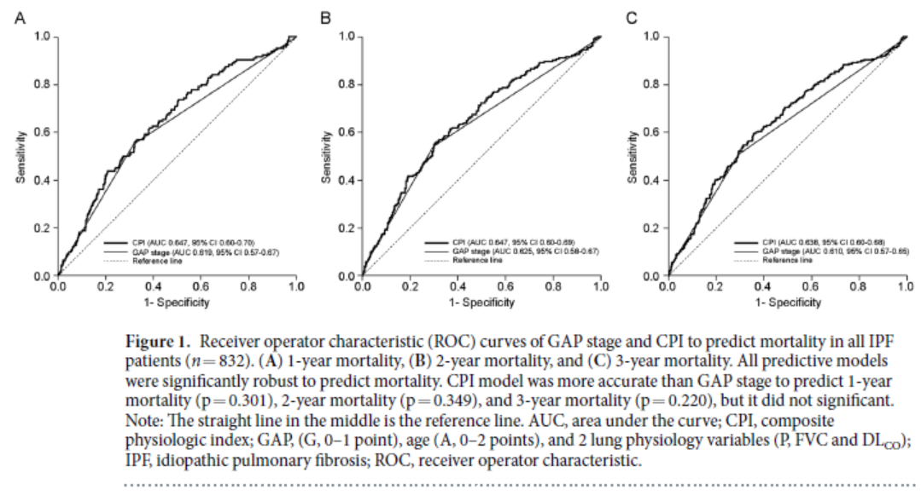
2nd study
Comparing various nutritional indexes in predicting survival
Comparing PNI, Nutritional risk index (NRI), Geriatric nutritional risk index (GNRI), CONUT score
Method
  Comparison b/w ROC curve using medcalc

Slide 25
환자 Review 를 추가로 진행하며 몇 명을 빼고 통계를 전체 다시돌려야 함.
NTM type 에 대한 추가 review 가 필요.
Score Qualification

