Slide 1

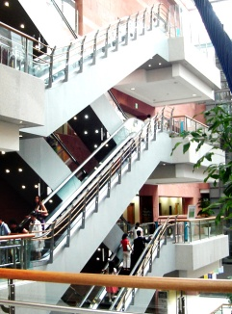


Pulmonary Manifestations of SLE
Kim Young
Division of Pulmonology
Department of Internal Medicine
Yonsei University College of Medicine

Slide 2
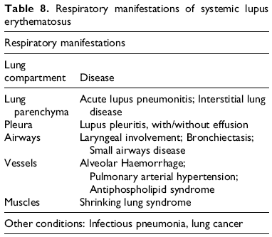
Pulmonary Manifestations of SLE
Notes:
사실 SLE 는 거의 대부분 다른 임상 증상들을 동반하고 있기 때문에 후에 말씀 드릴 다른 CTD 에 비해서는 CTD-ILD 라고 구별하기가 쉬운 편이기도 하고, SLE related ILD 가 다른 CTD-ILD 보다 드물다.
Pleural , lung 실질, 호흡근, vascular involvement 등 다양하게 involve 하는 것에 비해
치료를 요하는 환자는 SLE 환자의 3~8% 정도입니다. 하지만 증상이 없어도 PFT 와 HR-CT 상에 이상을 보이는 경우는 흔합니다.
나타나는 형태는 pul h, edema, DAD , chronic 하게는 IP 와 fibrosis 등으로 나타날수 있습니다.

Slide 3
Pulmonary Manifestations of SLE
1. Pleurisy is the most common form of pulmonary disease in SLE.
2. Both acute lupus pneumonitis and diffuse alveolar hemorrhage are fairly uncommon but have a high mortality.
3. Chronic lupus pneumonitis/lupus-associated ILD resembles IPF clinically.
4. Don’t forget to exclude infection.

Slide 4
Acute lupus pneumonitis
Acute lupus pneumonitis is an uncommon manifestation of SLE (1-12 %)
characterized by focal or diffuse pulmonary consolidation with an autoimmune rather than infectious origin.
Association with anti-dsDNA,
anti-Ro/SSA antibodies.

Slide 5
Clinical manifestations
Acute lupus pneumonitis is characterized by acute onset of fever, dyspnea, cough, (sometimes with hemoptysis),
late inspiratory crackles,
hypoxia, pleural effusion (in 50 %),
serum anti-DNA antibodies, and
no apparent infection (that is, a pathogen cannot be cultured or isolated).

Slide 6
Clinical manifestations
Arterial hypoxemia is common > 50% of patients will need mechanical ventilation.
Mortality 50% - Survivors have persistent pulmonary function abnormalities, including severe restrictive ventilatory defects.

Slide 7
Diagnosis
Chest PA- pulmonary infiltrates on x-ray (diffuse acinar infiltrates especially in the lower lung fields).
Chest CT – bilateral ground glass opacities and/or consolidation are observed. Small bilateral pleural effusions are also common and
fibrosis (a honeycomb appearance).
Gallium scintigraphy -Increased uptake.

Slide 8
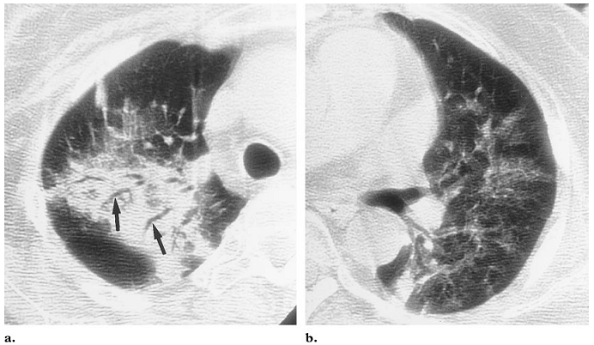
Acute Lupus pneumonitis
CT
  bilateral ground glass opacities and/or consolidation are observed.
  Small bilateral pleural effusions are also common.
Notes:
bilateral ground glass opacities and/or consolidation are observed.

Slide 9
Diagnosis
BAL fluid analysis was lymphocytosis or granulocytosists.
Open lung biopsy may be necessary if
CT scan and BAL are equivocal in a
symptomatic patient.
Biopsy may also be necessary to exclude an infectious etiology .(including PCP and other unusual pathogens in patients on high dose steroids).

Slide 10
Histopathology
Pathologic examination in lupus pneumonitis reveals acute alveolar wall injury, alveolar hemorrhage, alveolar edema, hyaline membrane formation, and immunoglobulin and complement deposition.
interstitial fibrosis, vasculitis, hematoxylin bodies, interstitial pneumonitis, alveolitis, or pleuritis.

Slide 11
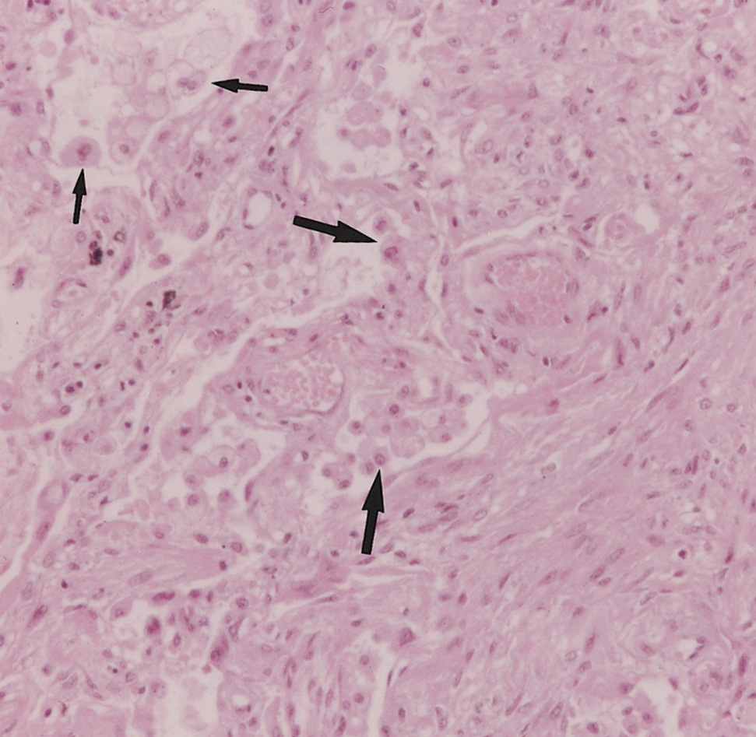
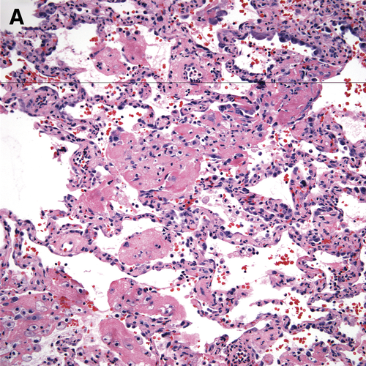
Histopathology
prominent interstitial fibroblastic proliferation and alveolar type 2 pneumocyte hyperplasia . These findings are compatible with the organizing stage of diffuse alveolar damage.
acute lung injury with or without hyaline membranes. Diffuse pulmonary hemorrhage also may occur, usually accompanied by vasculitis and capillaritis.

Slide 12
Treatment
There have been no controlled trials addressing treatment of lupus pneumonitis.
The following recommendations are based on personal experience and case reports.
Acute lupus pneumonitis needs prompt intervention if the outcome is to be improved.
Broad spectrum antibiotic coverage should be given pending culture results.

Slide 13
Treatment
The mainstay of therapy is systemic prednisone (1 to 1.5 mg/kg per day in divided doses).
If no response is seen within 72 hours,
the administration of IV pulse glucocorticoids (up to 1 gram of methylprednisolone per day for three days) and the addition of slower-acting immunosuppressive drugs such as cyclophosphamide should be considered .

Slide 14
Treatment
Patients with marked tachypnea or hypoxemia and those in whom diffuse alveolar hemorrhage is suspected may benefit from immediate use of IV high-dose methylprednisolone rather than a trial of oral glucocorticoids.
In refractory cases of DAH - plasmapheresis , IV IG, and success with rituximab has also been reported.

Slide 15
Prognosis
Survival may have improved in recent years, thanks to advances in ventilatory care and the prompt use of high dose corticosteroids.
  Prognosis is poor, with reported mortality rates of approximately 50%.

Slide 16
Diffuse alveolar hemorrhage
Diffuse alveolar hemorrhage: Fairly uncommon; in one series, 3.7% of patients
Pathology may demonstrate either capillaritis or “bland hemorrhage”

Slide 17
Chronic lupus pneumonitis
Chronic lupus pneumonitis: Sometimes follows an acute episode; prevalence < 5%
• Clinically similar to IPF with bibasilar crackles and infiltrates.
• PFTs with restrictive pattern.
• Chest CT may demonstrate a ground glass appearance (consistent with biopsy
showing cellular inflammation) or a reticulonodular appearance (consistent with
biopsy showing fibrotic pattern)

Slide 18
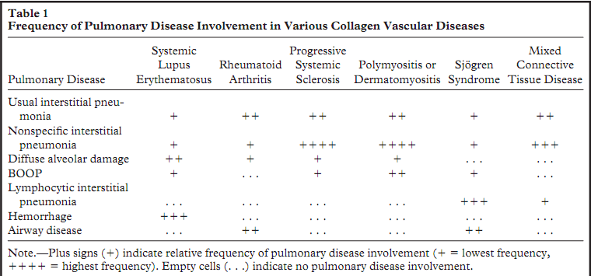
SLE related ILD
Interstitial lung diseases (ILD) are frequently seen in CTDs, particularly systemic sclerosis (SSc), polymyositis/dermatomyositis (PM/DM) rheumatoid arthritis (RA), accounting for a significant proportion of deaths.

Slide 19
SLE related ILD
Interstitial lung disease (ILD) has been noted in up to 9% of patients with SLE in some series.
Clinical and pathophysiologic characteristics — Patients with ILD present with insidious onset of chronic nonproductive cough, dyspnea, and decreased exercise tolerance.

Slide 20
Diagnosis
The clinical and pathological findings in ILD in SLE are similar to those in other rheumatic diseases with ILD and in idiopathic pulmonary fibrosis (IPF).
The presence of lupus is suggested by the characteristic extrapulmonary and serological manifestations.
PFT typically reveal a restrictive pattern with reduction in total lung capacity and also diminished DLCO.

Slide 21
Diagnosis
Although chest radiographs may reveal evidence of ILD.
HRCT scanning is the standard for defining the presence and type of pattern of ILD that may correlate with specific a pathologic diagnosis
A ground-glass appearance is associated with predominant cellular infiltration which, on lung biopsy, is most consistent with nonspecific pneumonia (NSIP).

Slide 22
Diagnosis
In comparison, a reticular pattern is associated with primarily fibrotic disease which, on lung biopsy, is most consistent with usual interstitial pneumonia (UIP).
Bronchoalveolar lavage — BAL can also be useful to exclude infection, hemorrhage, malignancy, and granulomatous disease.

Slide 23
Diagnosis
Lung biopsy — Lung biopsy may be required if the diagnosis is still in doubt despite the less invasive tests described above .
The most common pathologic patterns seen include nonspecific interstitial pneumonia (NSIP), UIP, lymphocytic interstitial pneumonia (LIP), and, on occasion, cryptogenic organizing pneumonia and amyloidosis .

Slide 24
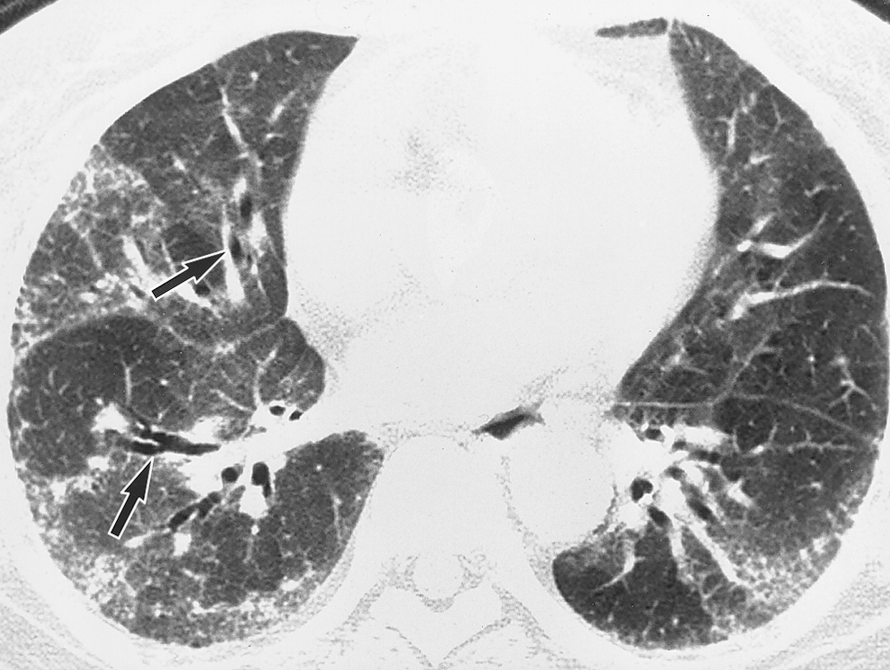
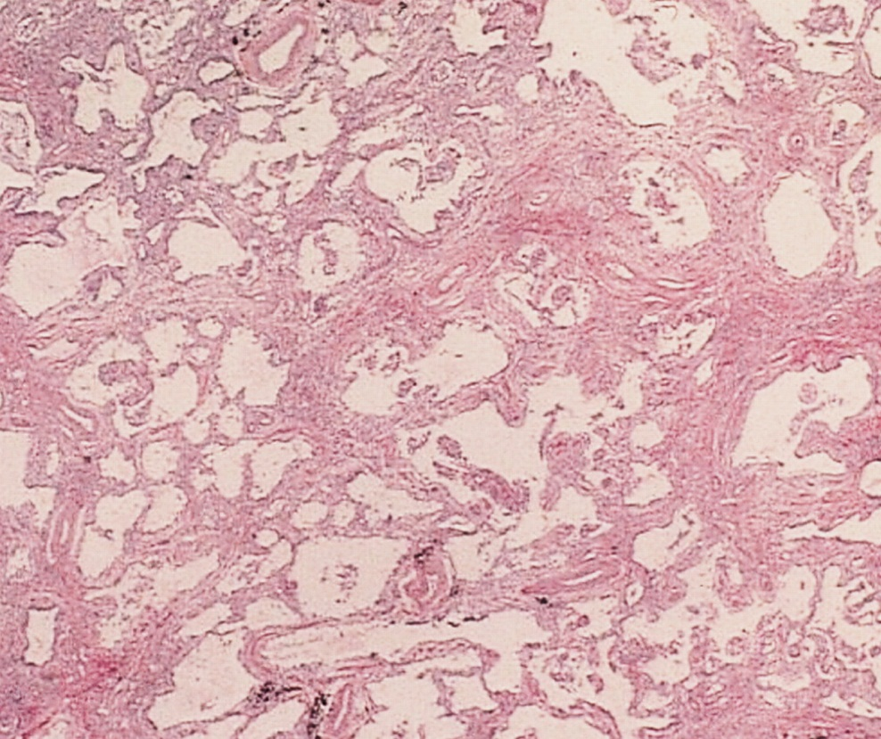
Diagnosis
SLE and NSIP (fibrosing pattern)
uniform interstitial fibrous thickening with infiltration of a few mononuclear cells.
SLE and NSIP (fibrosing pattern)

Slide 25
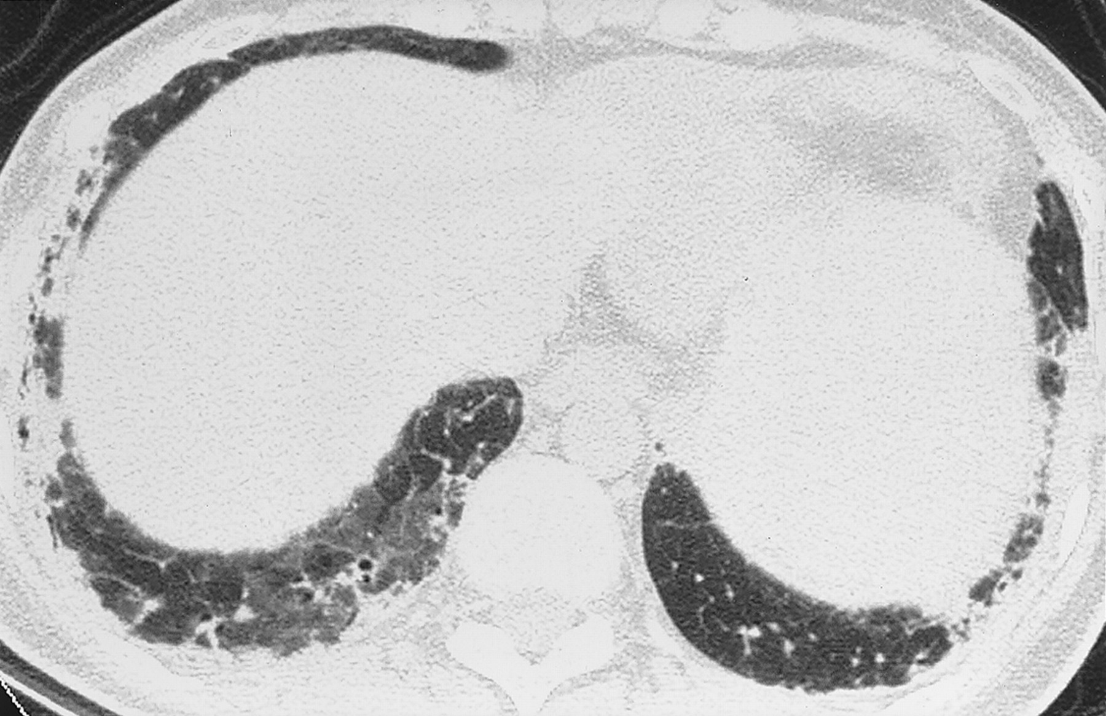
Diagnosis
SLE and and UIP

Slide 26
Treatment
As immunosuppressive therapy is unlikely to benefit those patients with established pulmonary fibrosis, it is important to determine, near the time of diagnosis, whether the primary process is inflammatory or fibrotic.
As with acute pneumonitis in SLE, there have been no controlled trials of treatment for ILD in SLE.

Slide 27
Treatment
Recommendations — Treatment involves the use of a glucocorticoid, either alone or, in combination with an immunomodulating agent. Therapy with glucocorticoids alone may be beneficial in some cases, but, typically, combination therapy is used with a gradual taper of glucocorticoids over a period of several months to low doses, 10 mg per day or below . However, it should be noted that others have noted no improvement in DLCO with glucocorticoid treatment .

Slide 28
Treatment
In patients with progressive and severe disease, therapy is initiated with high doses of glucocorticoids (eg, prednisone 1 to 2 mg/kg/day) and cyclophosphamide (usually intravenously) with transition to either azathioprine or mycophenolate mofetil after 6 to 12 months; for those who have less severe disease or in whom cyclophosphamide is not well-tolerated, azathioprine or mycophenolate may be used as initial treatment .

Slide 29
Treatment
There is no established treatment for fibrotic lung disease, though agents such as pirfenidone and agents that target tyrosine kinase inhibition and transforming growth factor beta are being actively investigated.

Slide 30
Treatment of CTD-related ILD; comparison with IPF
Corticosteroids, starting with a dose of 0.5-1 mg/kg often in combination with an oral immunosuppressant.
Over time prednisolone is gradually tapered over the space of 6~12 months down to a maintenance dose of 10 mg once daily.
Azathioprine is the most commonly
  50 mg once daily for a month → dose up to 150 mg once daily (or the equivalent 2 mg/kg, but not more than 200 mg daily)
Mycophenolate may be better tolerated.

Slide 31
Lung Transplantation recommend
In IPF, referral for lung transplant is suggested when the disease is extensive (DLCO <40%) and/or progressive (>10% decline in FVC and/or >15% decline in DLCO).
In CTD-ILD, it is only patients with
  extensive disease who continue to decline despite maximal immunosuppression, for whom lung transplant should be considered.

